Slide 1
3D Printing Techniques
Powder Bed Fusion

Slide 2
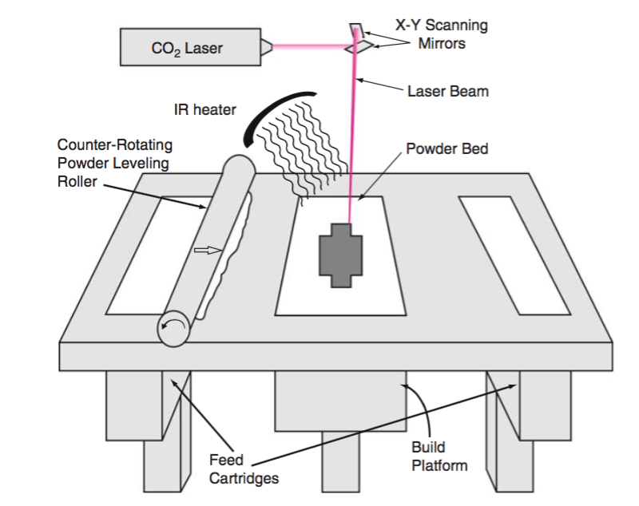
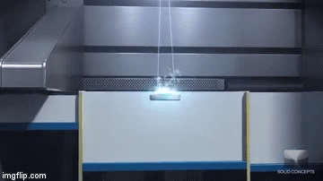
Selective Laser Sintering (SLS)
SLS fuses thin layers of powder (typically ~0.1 mm thick) which have been spread across the build area using a counter-rotating powder leveling roller. The process takes place inside an enclosed chamber filled with nitrogen gas.
The powder in the build platform is maintained at an elevated temperature just below the melting point and/or glass transition temperature of the powdered material.
Infrared heaters are placed above the build platform to maintain an elevated temperature just below the melting point and/or glass transition temperature.
A focused CO2 laser beam is directed onto the powder bed and is moved using galvanometers that it thermally fuses the material to form the slice cross-section.
After completing a layer, the build platform is lowered by one layer thickness and a new layer of powder is laid and leveled using the counter-rotating roller.
This process repeats until the complete part is built.
Finally, the parts are removed from the powder bed, loose powder is cleaned off the parts.

Slide 3
There are 4 different fusion mechanisms:

Slide 4
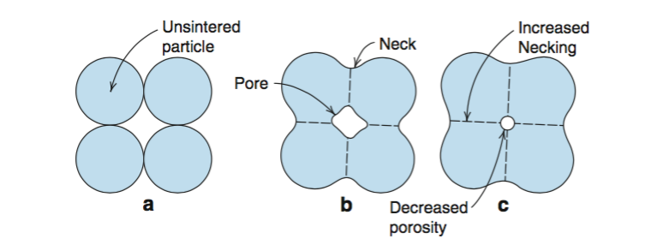
1-Solid-state Sintering
Solid-state Sintering is the fusion of powder particles without melting at temperatures between one half of the absolute melting temperature and the melting temperature.
The mechanism for sintering is primarily diffusion between powder particles.
Smaller particles sinter more rapidly and initiate sintering at lower temperature than larger particles.
Few AM processes use sintering as a fusion mechanism because it takes much longer time than melting mechanism .

Slide 5
2-Chemically-induced Sintering
Chemically-induced sintering involves the use of thermally-activated chemical reactions between two types of powders or between powders and atmospheric gases to form the product which binds the powders together.
Examples of reactions between powders and atmospheric gases include:
laser processing of SiC in the presence of oxygen, whereby SiO2 forms and binds together a composite of SiC and SiO2;
The resulted part of the chemically-induced sintering is a porous part.
As a result, post-process infiltration or high-temperature furnace sintering to higher densities is often needed to achieve properties that are useful for most applications.
The cost and time associated with post-processing have limited the adoption of chemically-induced sintering in commercial machines.

Slide 6
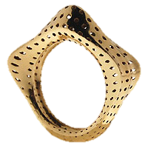
3-Liquid-phase Sintering and Partial Melting (LPS)
Liquid-phase sintering is the fusion of powder particles when a portion of components within a collection of powder particles become molten, while other portions remain solid.
In LPS, the molten components act as the glue which binds the solid particles together.
LPS can be classified to:
Distinct Binder and Structural Materials
Indistinct Binder and Structural Materials

Slide 7
3-Liquid-phase Sintering and Partial Melting Distinct Binder and Structural Materials
The binding and structural material can be combined in three different ways:
separate particles.
Composite particles
Coated particles.
(a) separate particles.
(b) composite particles.
(c) coated particles.
(d) indistinct mixtures.
Darker regions represent the lower-melting-temperature binder material.
Lighter regions represent the high- melting-temperature structural material.
For indistinct mixtures, microstructural alloying eliminates distinct binder and structural regions.

Slide 8
3-Liquid-phase Sintering and Partial Melting Distinct Binder and Structural Materials Separate particles
It is advantageous for the binder material to be smaller in particle size than the structural material to maintain the desired properties of the structural material in the final structure.
Fine particles size of the binder enables more efficient packing in the powder bed and less shrinkage and lower porosity after binding.
Composite structures formed from separate particles typically are quite porous, which are then post-processed in a furnace to achieve the final part properties.
Parts including the binder polymer before the post- processing are called “green” parts.

Slide 9
3-Liquid-phase Sintering and Partial Melting Distinct Binder and Structural Materials Composite Particles
Composite particles contain both the binder and structural material within each powder particle.
Mechanical alloying of binder and structural particles or grinding of cast results in powder particles that are made up of binder and structural materials agglomerated together.
The benefits of composite particles are that they typically form higher density green parts and typically have better surface finish after processing than separate particles.
Composite particles can consist of mixtures of polymer binders with higher melting point polymer, metal or ceramic structural materials; or metal binders with higher melting point metal or ceramic structural materials.
The binder and structural portions of each particle, if viewed under a microscope, are distinct from each other and clearly discernable.
An example of this composite is the glass-filled nylon, where the structural material (glass beads) is used to enhance the properties of the binding material (nylon).

Slide 10
3-Liquid-phase Sintering and Partial Melting Distinct Binder and Structural Materials Coated Particles
In this case, a composite formed by coating structural particles with the binder material
This situation is more effective than random agglomerations of binder and structural materials.
These coated particles can have several advantages including:
Better absorption of laser energy.
More effective binding of the structural particles.
Better flow properties.

Slide 11
3-Liquid-phase Sintering and Partial Melting Indistinct Binder and Structural Materials
We can describe this kind of fusion based on the sintered material as:
In polymers, due to their low thermal conductivity, it is possible to melt smaller powder particles and the outer regions of larger powder particles without melting the entire structure, so it is partial but not full melting.
In metals, LPS can occur between particles during partial melting of a single particle type.
In noneutectic alloys, melting occurs between the liquidus and solidus temperature of the alloy, where only a portion of the alloy will melt when the temperature is maintained in this range. Regions of the alloy with higher concentrations of the lower-melting-temperature constituent(s) will melt first.

Slide 12
4-Full Melting
Full melting is the mechanism associated with powder bed fusion processing of engineering metal alloys and semi-crystalline polymers.
In these materials, the entire region of material subjected to impinging heat energy is melted to a depth exceeding the layer thickness.
Thermal energy of subsequent scans of a laser or electron beam is typically sufficient to re-melt a portion of the previously solidified solid structure; and thus, this type of full melting is very effective at creating well-bonded, high-density structures from engineering metals and polymers.
For metal powder bed fusion processes, the engineering alloys that are utilized in these machines (Ti, Stainless Steel, CoCr, etc.) are typically fully melted.

