Slide 1
Introduction to Computer Science CHAPTER 2: Problem Solving Using Computers
College of Computer Science and Engineering
University of Jeddah
Jeddah, Saudi Arabia
Muhammad U. Ilyas (Asst. Prof) milyas@uj.edu.sa

Slide 2
Learning Outcomes
Learn the basic elements of a programmatic flowchart to express algorithms.
Learn about variables, values and basic data types.
Learn to break down programs into steps small enough to be expressible in flowchart form.
Learn to use Flowgorithm to build executable flowcharts.
Learn basic debugging features like setting breakpoints, variable watches and stepping through programs.

Slide 3
2.1.Computer Program Development:
Computer Program
A sequence of very precise instructions that a computer executes for an intended purpose.
Developing a program involves steps similar to any problem-solving task.
There are five main ingredients in the programming process:
Define the problem
Planning the solution.
Coding the program.
Testing the program.
Documenting the program.

Slide 4
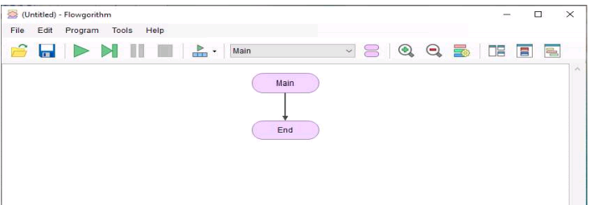
2.2.Flowgorithm:
In this section you will learn how you can use flowcharts to express a sequence of steps to perform a certain task.
Flowgorithm lets new programmers build flowcharts that can be executed step by step.

Slide 5
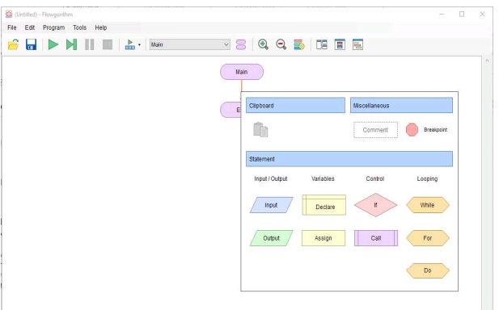
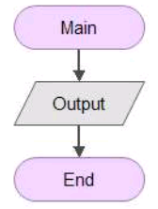
Example 2.1: Hello World!
We begin by creating what is traditionally the first program taught in any new language, called Hello World.

Slide 6
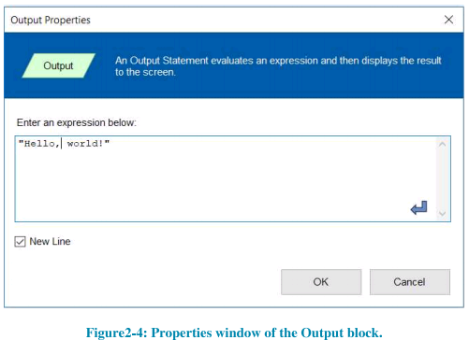
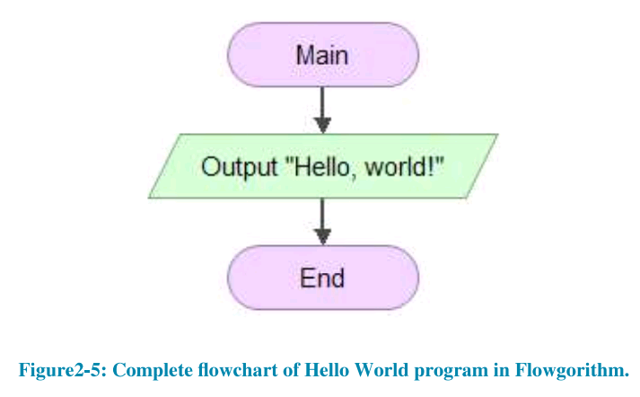
Example 2.1: Hello World!
Double-click or the right-click on the Output shape to edit it.
A window will appear titled ‘Output Properties’.
Using this window, you can specify what will be displayed on the screen.

Slide 7
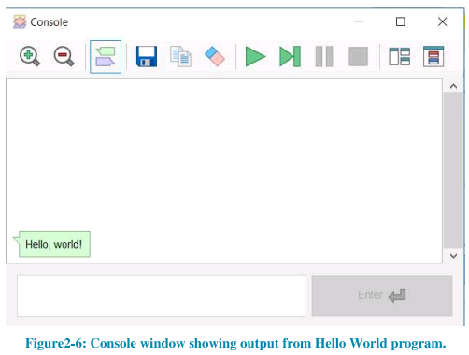
Example 2.1: Hello World!
On the main toolbar, you should see a green icon that looks like the Play Button you use when playing a DVD or watching a video on YouTube.
The Output shape will now appear in green.

Slide 8
2.4. More Flowchart Elements:

Slide 9
Flowchart elements
There are a number of elements, like the output element that you used, that can be added into a flowchart.
Using this approach, the program displays output on a text-only screen and the user inputs data using the keyboard.

Slide 10
2.4.1. Using Variables:

Slide 11
Common Variable Types
In order to perform any non-trivial task, computers need the ability to store or remember values. This is done using variables.
Variables in computer programs are containers that can store different kinds of numbers or text.
The values can be used by different mathematical, logical, or text editing operations.
Types of variables:
Integer.
Real.
String.
Boolean.

Slide 12
Table 2-1: Types of Variables in Flowgorithm
Type of variable |  | Sample Values
Integer | Positive or negative whole numbers. Can be used for mathematical calculations. | …, -3, -2, -1, 0, 1, 2, 3, …
Real | Can store real numbers, i.e., positive or negative numbers with or without fractions. Can be used for mathematical calculations. | -1.5, 0, 1000.34, 12986.354829, -205.32, …
String | Text data. String values are written in double quotes to indicate their start and end (“…”). | “Hello, world!”, “Omar Alzahrani”, “743.12”, “85”
Boolean | Stores only 1 bit of information, with only one of two possible options | (false) or 1 (true)

Slide 13
2.4.2 Simple Mathematics Operations for Numeric Variables:
The numeric variables (i.e., Integer and real type variables) can be operated upon using various operators.
Types of mainly used operations and it signs are:
Addition +
Subtraction -
Multiplication *
Division /

Slide 14
2.4.2 Simple Mathematics Operations for Numeric Variables:

Slide 15
Table 2-2: : Basic mathematical operations
Expression | Result | Notes
1 + 3 ^ 2 | 10 | $1+3^{2}$
10 * 2 + 5 * 6 | 50 | 10 * 2 and 5 * 6 have higher precedence than addition. The addition is done last.
7 * (4 - 1) | 21 | Parentheses are used for subexpressions, which are evaluated as a whole.
6 / 3 * 2 | 4 | In mathematics, multiplication and division have the same precedence levels. So, they are evaluated left-to-right.
10 mod 3 | 1 | Modulo math gives the remainder from division
10 % 3 | 1 | Same expression, but using the C-Family operator

Slide 16
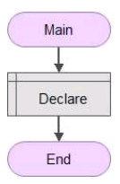
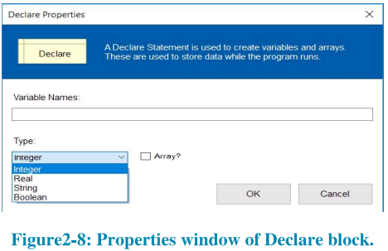
Example 2.2:
Start with a blank new Flowgorithm project.
Add a declare block between the Main & End blocks.

Slide 17
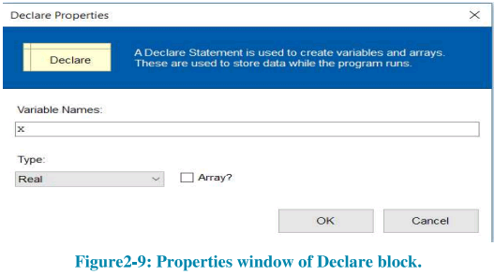
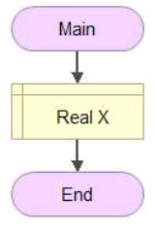
Example 2.2:
Double-click on the Declare block which will then display a property window for the Declare block.
We must give the variable a name and decide what type the variable is going to be.

Slide 18
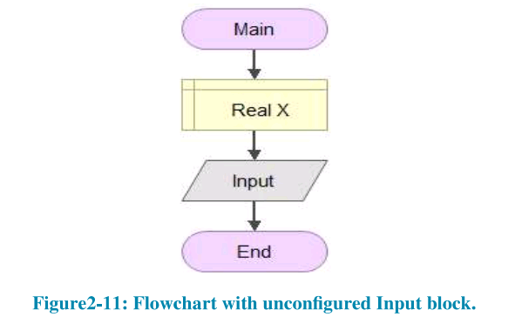
Example 2.2:
After the variable X is created, we need to get a number from the user as the input and share it in X.

Slide 19
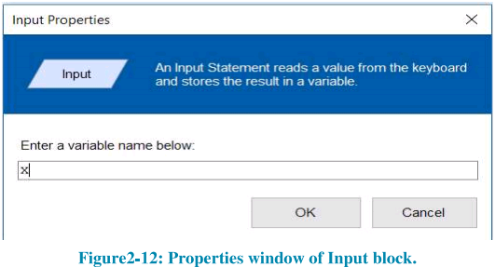
Example 2.2:
Now, double click on the Input block to open its property window.
It will require the name of the variable given by the user will be stored.

Slide 20
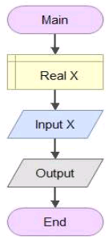
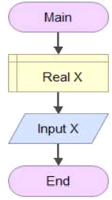
Example 2.2:
The flowchart creates a variable X, asks the user for a real number as input, & stores that it in variable X.
To display a value, we need an output block.

Slide 21
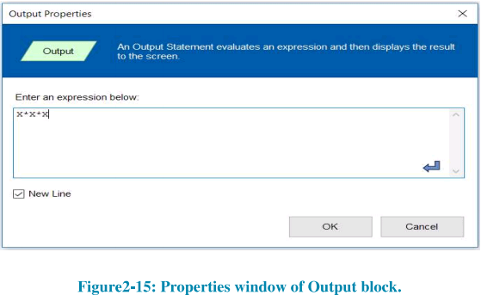
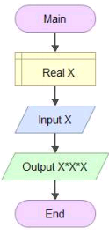
Example 2.2:
Double-click on the Output block to open its property windows.
Output block requires the name of a variable or an expression that produces a value that can displayed.

Slide 22
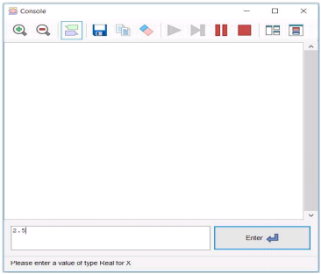
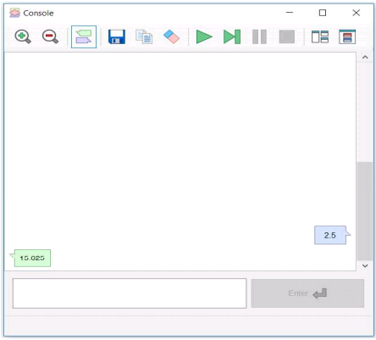
Example 2.2:
To execute the flowchart, click the green arrow on the Flowgorithm toolbar.
That will open the console window below.
We could enter any number at this point.

Slide 23
2.4.3 If Block & Assignment Block:
If Block is different from other blocks.
If blocks checks a condition is Boolean.
i.e. it can be true or false.
If its true, execution will continue on according to condition of developer want to execute.
If its false execution may be stop or continue in different steps from true condition.
Assignment are the conditions from the developer on true or false.

Slide 24
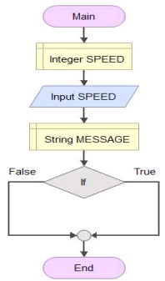
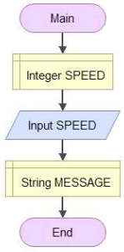
Example 2.3: Speed Check
Create the flowcharts below that create an integer variable called SPEED.
Assigns it a value provided by the user.
Creates a String variable called MESSAGE.
Add an IF block after the declaration of String Message.

Slide 25
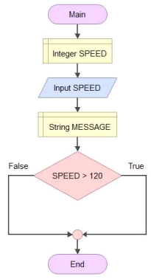
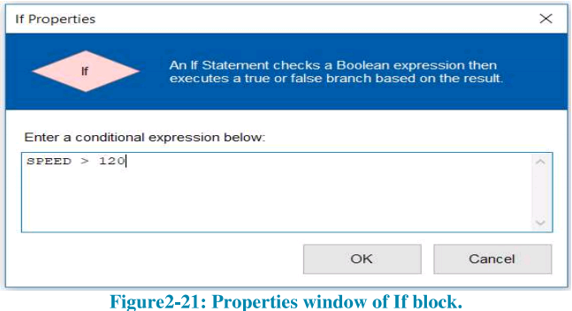
Example 2.3: Speed Check
Let’s add a condition to check.
We will check if the value of the SPEED variable exceeds 120.

Slide 26
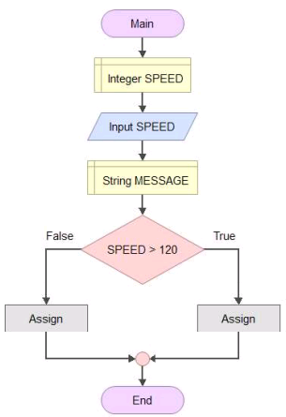
Example 2.3: Speed Check
Add two Assignment blocks to the flowchart, one to the True branch and one to the False branch of the If block.

Slide 27
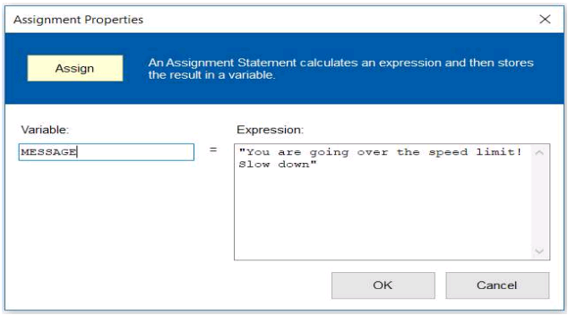
Example 2.3: Speed Check
Double-click the Assignment block of the True branch to open its property window.
When the value of the SPEED variable is greater than 120.
We assign the string “you are going over speed limit! Slow down” to the string variable MESSAGE.

Slide 28
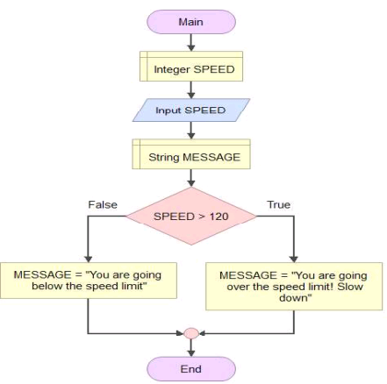
Example 2.3: Speed Check
Similarly, open the property windows of the Assignment block in the False branch & assign the string “You are going below the speed limit”. To string variable MESSAGE.

Slide 29
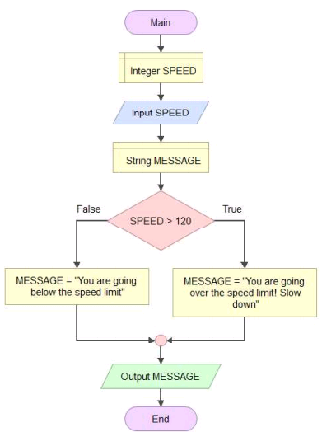
Example 2.3: Speed Check
Finally, add an output block before End block, as shown, to display the value of variable MESSAGE.

Slide 30
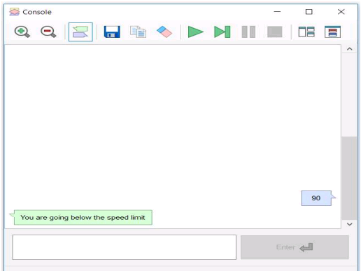
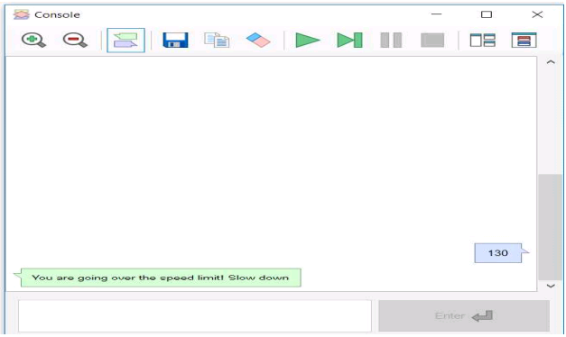
Example 2.3: Speed Check
Execute the completed flowchart.
The console window will request a value for SPEED.
And what happens if you enter a value greater than 120.

Slide 31
2.4.4 Task Repetition Using Loops:

Slide 32
Loops
The structure used to define repetition in computer programs is called a loop.
Computer code, or in the case of executable flowcharts like we are using, sequences of blocks, is put inside a loop and is run repeatedly and is called the body of the loop.
Each execution of the code inside a loop is called an iteration.
All loops are the same in some key aspect:
Before or after each iteration, it checks if a certain condition specified by the programmer is still true or not.
If the condition is still true, it executes another iteration.
If it is not, the loop is exited, and the program continues to execute beyond the loop.
As we will see in this section, loops are mainly three different types:
For loop.
While loop.
Do-while loop.

Slide 33
2.4.5 Arrays of Variables:

Slide 34
Storing a list of variables of the same Type
If a variable is a container that stores a value, you can think of an array as a list of variables, each of which is called an element of that array.
All elements of an array are of the same data type.
Each element of an array can be accessed by the name given to the array and a number indicating its location in the array.

Slide 35
2.5.6 For Loop:

Slide 36
2.5.6 For Loop:
For loop is usually used when it is known beforehand how many times the body of the loop is to be executed.
The sequence of execution in a For loop is:
“condition check – execute – condition check – execute – … – condition check – exit”

Slide 37
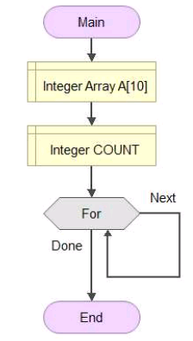
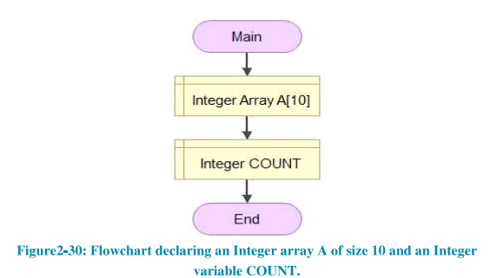
2.5.6 For Loop:
Begin by creating the flowchart.
Using a For loop to access & initialize the array elements.

Slide 38
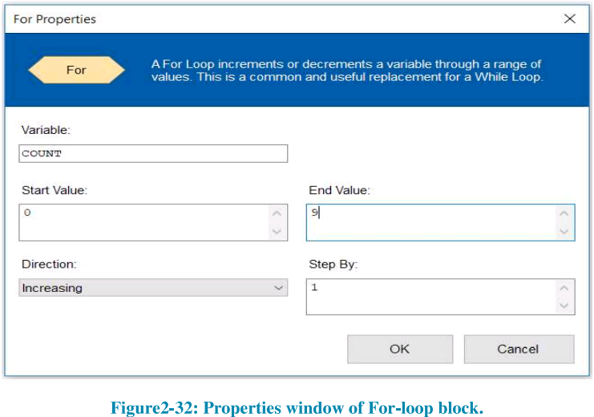
Example 2.4: Using a For Loop
Double-click on the For-loop block to open its property windows shown below.

Slide 39
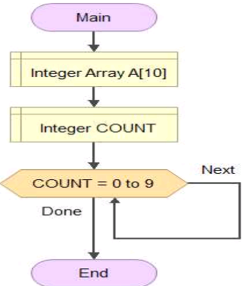
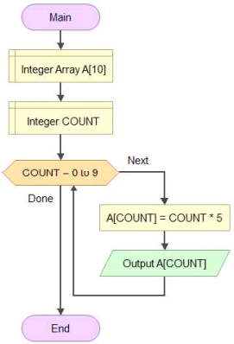
Example 2.4: Using a For Loop
We are going to configure the For-loop to run from 0 to 9, with the COUNT variable increased by 1 after each iteration.
Now, add an assignment block and an output block to the Next branch.

Slide 40
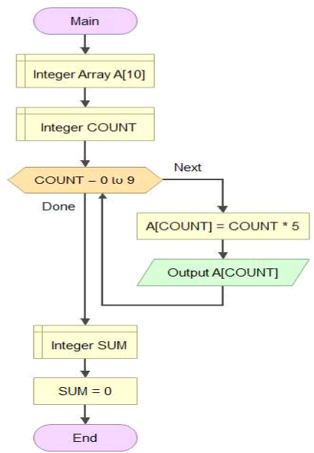
Example 2.4: Using a For Loop
We are going to extend the preceding.
To accumulate/add all values stored in array A.
& store the sum of all elements, which we name sum.
Initialize it to 0.

Slide 41
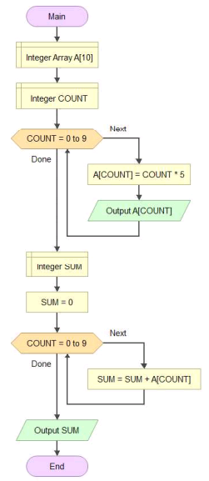
Example 2.4: Using a For Loop
Computing the sum can now be performed by adding another
For-loop that runs for 10 iterations over array A.
& adds each array element to SUM.
The value stored in the SUM variable is printed out using
an Output blocks.

Slide 42
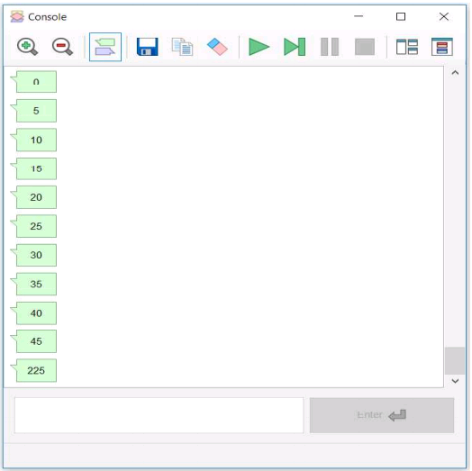
Example 2.4: Using a For Loop
The output of executing the flowchart is shown below.
The first 10 outputs were produced inside the first For-loop.
The 11th the & last Output is the value of the SUM variable.

Slide 43
2.4.7. While Loop:

Slide 44
2.4.7 While Loop:
A While loop is usually used when it is not known beforehand.
How many times the body of the loop is to be executed.
The condition that is checked becomes true after an unknown number of times.
The sequence of executive in While loop is the same as in a For loop:
“condition check – execute – condition check – execute – … – condition check – exit”

Slide 45
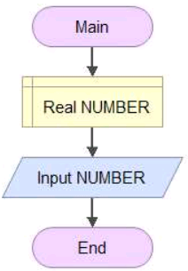
Example 2.6: Recursively divide user given number by 2
Create the flowchart.
It creates a variable of type real and called NUMBER and then initialize s it with a user provided value using an INPUT block.

Slide 46
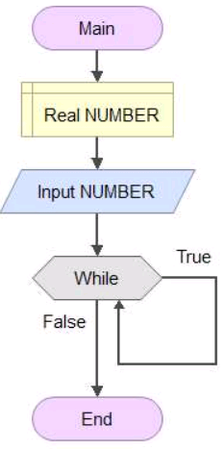
Example 2.6: Recursively divide user given number by 2
Add While-loop block.
The While-loop block has two branches exiting from it, one labeled True and one labeled False.

Slide 47
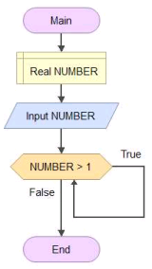
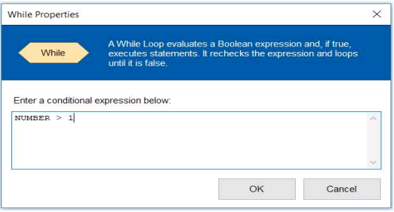
Example 2.6: Recursively divide user given number by 2
The property window required only single condition that will be checked.
We want to print out the value of NUMBER, then divide NUMBER by 2.
& repeat it until the value is still greater than 1.

Slide 48
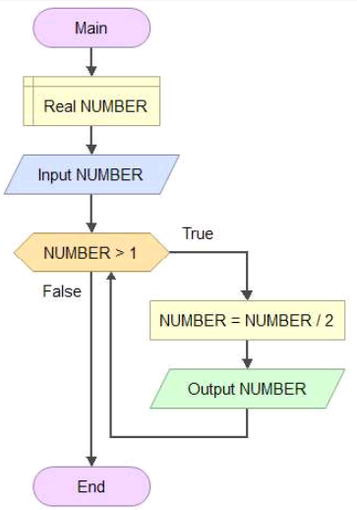
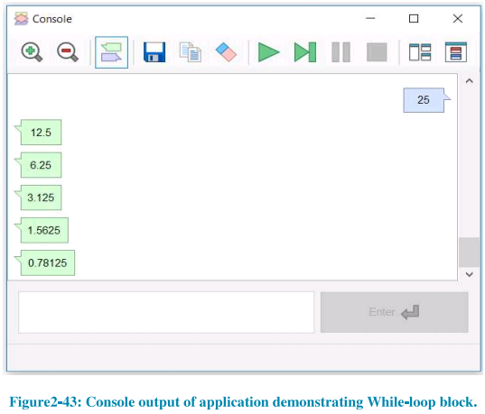
Example 2.6: Recursively divide user given number by 2
Finally, we have to add an Assignment and Output block to the True branch.
When you execute the flowchart, the console window will prompt you to enter the number.

Slide 49
2.4.8. Do-while Loop:

Slide 50
2.4.8 Do-while Loop:
Do-while loop, like the while loop, is used when it is not known beforehand.
How many times the body of the loop is to be executed.
The sequence of execution in a Do-while loop is:
“Execute – condition check – executive – … – condition check – exit”.
The sequences execution is different from a For loop or a While loop.

Slide 51
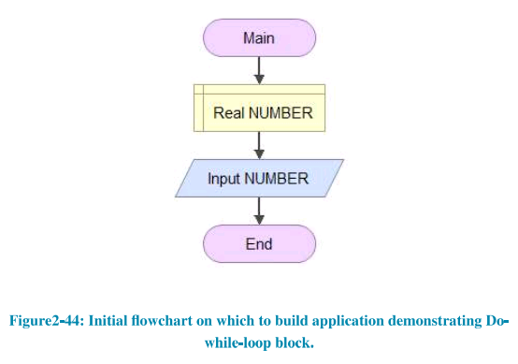
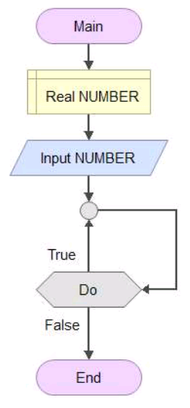
Example 2.7: Do-while-loop version of Example 2.6
We begin with the same two Declaration and Input blocks.
Add a Do-while loop block after the Input block.
The Do-while loop has two branches exiting, one labeled True and the other false.

Slide 52
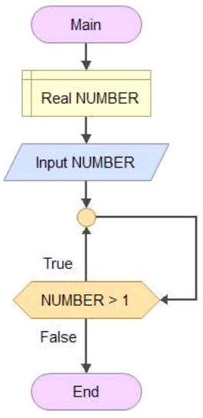
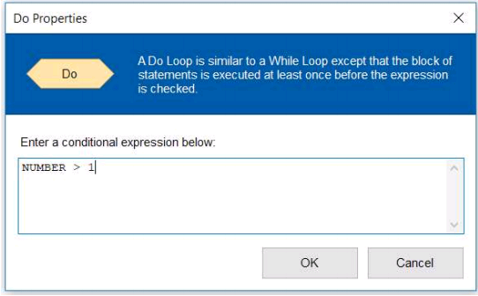
Example 2.7: Do-while-loop version of Example 2.6
Double-click on the Do-while block to open its property windows.
We are going to use the same condition we used in the previous example, i.e., NUMBER > 1, in order preserve similarly.

Slide 53
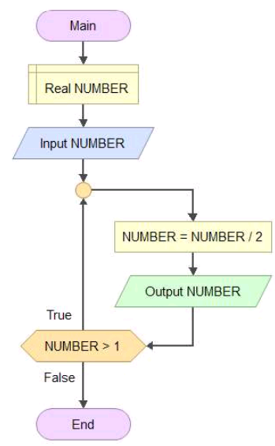
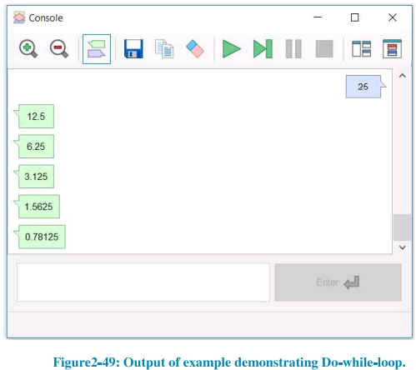
Example 2.7: Do-while-loop version of Example 2.6
Add the same Assignment & Output blocks to the loop body branch as in the previous example.
Executing the flowchart yields the following output in the console window:

Slide 54
2.4.9 Differences Between Different Loops:
For Loop | While Loop | Do-while Loop
Pre-test loop (checks condition to enter loop) | Pre-test loop | Post-test loop (checks condition to exit loop)
Loop condition is tested BEFORE executing the loop body | Loop condition is tested BEFORE executing the loop body | Loop condition is tested AFTER executing the loop body
Loop body may not be executed at all. | Loop body may not be executed at all. | Loop body is always executed at least once.

Slide 55
Example 2.8: While vs. Do-while Loop

Slide 56
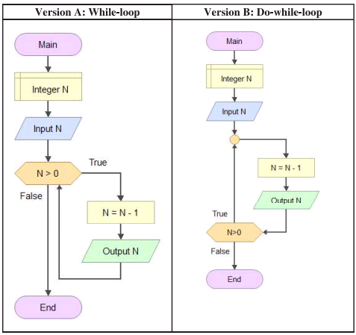
Example 2.8: While vs Do-while
We are going to build one more example using a While-loop and Do-while-loop.

Slide 57
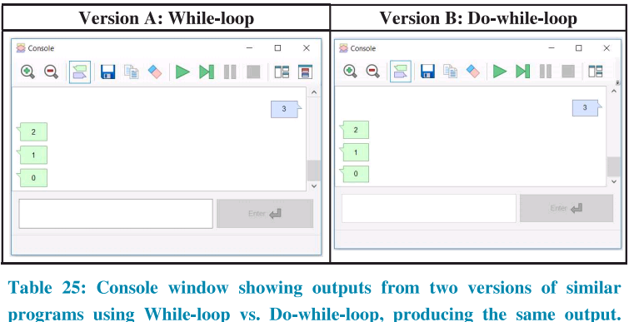
Example 2.8: While vs Do-while
Both programs take an integer as input from the console & store it in an integer variable “N”.
Let us see what happens what N is given the value 3.
Outputs of both versions are the same.

Slide 58
Example 2.8: While vs Do-while
Now, let us see what happens when N is given the value 0.
Now the Outputs produced by version A and version B differ.
The reason is that the given input 0 is not greater than 0.

Slide 59
While vs. Do-while
In conclusion, the difference between the While and Do-while loops is often explained in the form of a meme of the Roadrunner and Wily Coyote.

Slide 60
2.5 Function Calling

Slide 61
Example 2.9: Greeting function call
A call statement transfer control to a function.
Information (sets of values) being passed into the function is called argument.
Functions allows us to divide complex sequences of operations into multiple smaller flowcharts.
Create a flowchart, contain an Output block printing the string “Goodbye!”.

Slide 62
Example 2.9: Greeting function call
Now let us add a second function to our flowchart.
This will open the function Manager window below.

Slide 63
Example 2.9: Greeting function call
This will open the function properties window below. The name of our new function will be “Greeting”.
This will return you to the Function Manager window, with the name of the new Greeting function appearing in the list.

Slide 64
Example 2.9: Greeting function call
In the Flowgorithm window, you should now find yourself looking at a new, empty flowchart called “Greeting”.
Add another Output block to the Greeting function to make it more interesting.

Slide 65
Example 2.9: Greeting function call
Now, add a Call block to the Main function.
Double-click on the Call block to open its properties window. It requires the name of
function

Slide 66
Example 2.9: Greeting function call
That complete the flowchart.
Executing the flowchart produces the following Output.

Slide 67
Example 2.9: Greeting function call
The order in which blocks execute and control passes from Main, to the Greeting function and back to Main is shown below.

Slide 68
2.6 Comments:
Comments don’t affect how your program runs.
They are used to include documentation about the program for other programmers.
These can include: the logics of a loop, known issues. Changes made, future changes, etc.
As a rule, it is good programming practice to always comment on your code, not just for other’s sake, but for your own.

Slide 69
2.7. Debugging a Program in Flowgorithm

Slide 70
Debugging
One of the greatest skills a programmer can develop is debugging.
Which means locating and fixing errors in a program.
The term debugging refers to the process of removing any errors in a computer program.

Slide 71
2.7.1. Watching Variables

Slide 72
2.7.1 Watching Variables:
As a program executes, the values stored by the different variables.
Created in it may change from one step to the next.
In such situations, it is helpful for programmers to be able to observe the values of all variables at every step of the program.
This is called “watching variables”.

Slide 73
2.7.1 Watching Variables:
If you open the Variable Watch Window for either flowchart in the last example, you will see something like the one shown below.

Slide 74
2.7.2. Controlling Flowchart Executive Speed
Flowgorithm allows you to control the speed at which a flowchart executes.
By slowing it down enough for a human to follow its execution steps.
When you click the Run Speed button on the menu bar, a menu containing three execution speed:
Fast. (default).
Medium.
Slow.

Slide 75
2.7.3. Stepping Through a Flowchart:
To control the execution of each step of the flowchart.
i.e., the transition from each block to the next, Flowgorithm has another feature called Stepping.
Stepping is a very important feature that is typically available in code development environments for most programming languages.

Slide 76
2.7.4. Breakpoints:
The Breakpoint shape temporarily halts the execution of the programs.
This is useful both for debugging programs and for demonstrations.
Most professional software development applications have some form of the breakpoint.
In Flowgorithm, a Breakpoint is inserted in the same manner as any other block.

Slide 77
2.7.5. Code Generation:
Flowgorithm is an introductory learning tools for new programmers.
To helps them start thinking in terms of small chunks comparable to how most programming languages function.
Flowgorithm’s code generation function can produce the equivalent code in any of 21 programming languages.

Slide 78
2.7.5. Code Generation:
When you click the code generation button for Version “B” flowchart of the last example, it will open the Source Code Viewer window shown below.

Slide 79
2.7.5. Code Generation:
If you click the black Down arrow next to the name of the programming language, you will see menu that contains a list of programming languages.

Slide 80
END
That’s All

