Slide 1
Chapter 9 - part 1
The Nature of Light and the Laws of Geometric Optics

Slide 2
The Nature of Light
The quantization model assumes that the energy of a light wave is present in particles called photons.
the energy of a photon (E ) is proportional to the frequency( ƒ) of the electromagnetic wave
h is Planck’s Constant (h = 6.63 x 10⁻³⁴ J.s)
Is light a wave or a particle?
Sometimes light acts like a wave, and at other times it acts like a particle.
Section 35.1

Slide 3
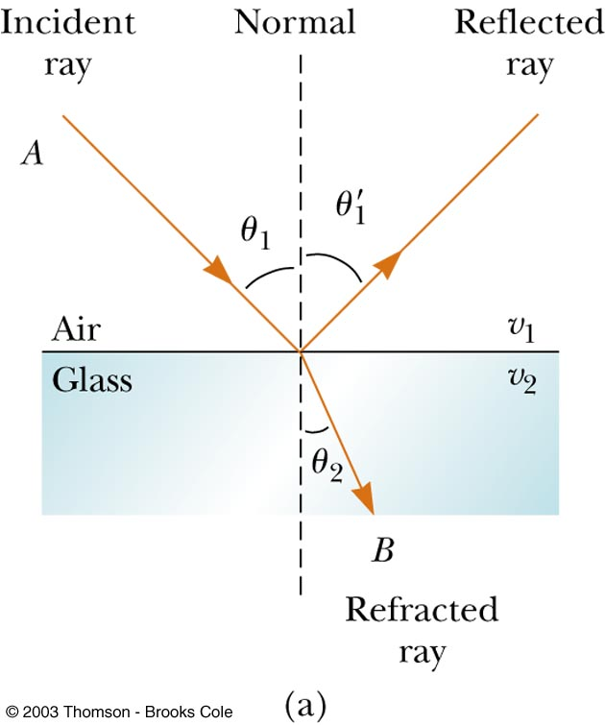
Reflection and Refraction of Light
When a ray of light traveling through a transparent medium into another transparent medium,
part of the energy is reflected
The incident ray is reflected back into the first medium.
The incident ray and the reflected ray in the same medium.
part enters the second medium, is said to be refracted
The incident ray in the first medium and the refracted ray in the second medium.
Section 35.4

Slide 4
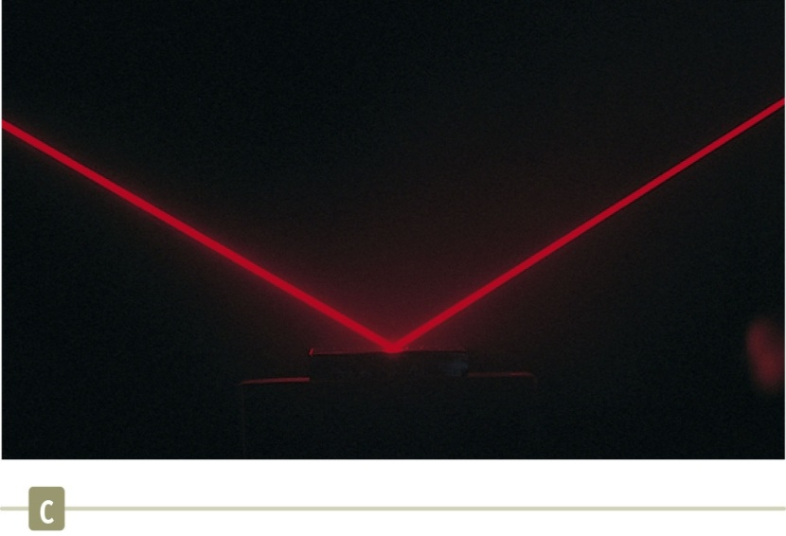
Specular Reflection
Specular reflection is reflection from a smooth surface.
The reflected rays are parallel to each other.
All reflection in this text is assumed to be specular.
Section 35.4

Slide 5
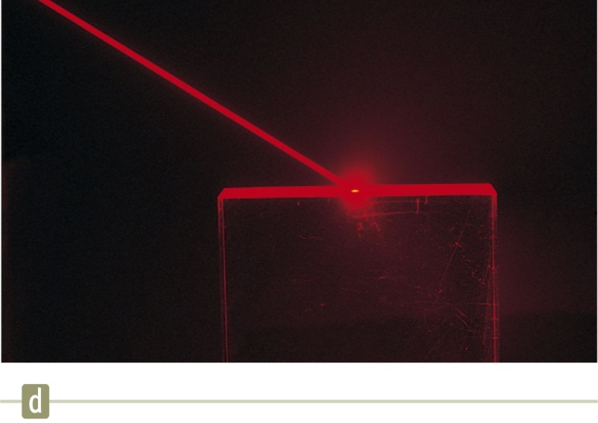
Diffuse Reflection
Diffuse reflection is reflection from a rough surface.
The reflected rays not as a parallel set but in various directions.
A surface behaves as a smooth surface as long as the surface variations are much smaller than the wavelength of the incident light.
Section 35.4

Slide 6
Law of Reflection
The incident ray is reflected back into the first medium.
The normal is a line drawn perpendicular to the surface at the point where the incident ray strikes the surface.
The incident ray makes an angle of θ₁ with the normal.
The reflected ray makes an angle of with the normal.
The Law of Reflection
The angle of reflection is equal to the angle of incidence.
The incident ray, the reflected ray and the normal are all in the same plane.
Section 35.4

Slide 7
Refraction of Light
The ray that enters the second medium changes its direction. This bending of the ray is called refraction.
The incident ray, the reflected ray, the refracted ray, and the normal all lie on the same plane.
The angle of refraction depends on the properties of the two media and on the angle of incidence θ₁.
v₁ is the speed of the light in the first medium
v₂ is the speed of the light in the second medium.
Section 35.5

Slide 8
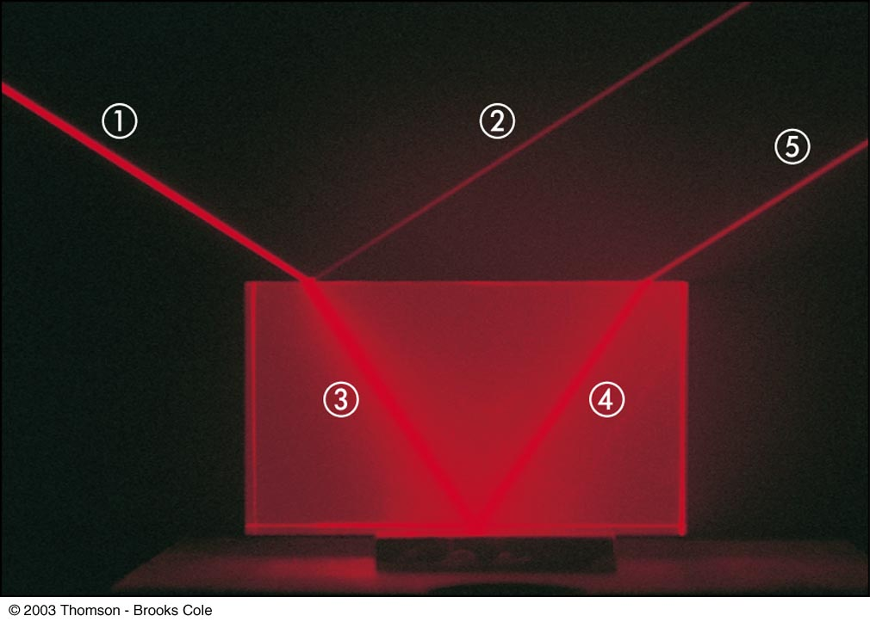
Quick Quiz 35.2 If beam is the incoming beam in Figure, which of the other four red lines are reflected beams and which are refracted beams?
Ray  is the incident ray
Ray  is the reflected ray
Ray  is refracted into the crystal
Ray  is internally reflected in the crystal
Ray  is refracted as it enters the air from the crystal

Slide 9
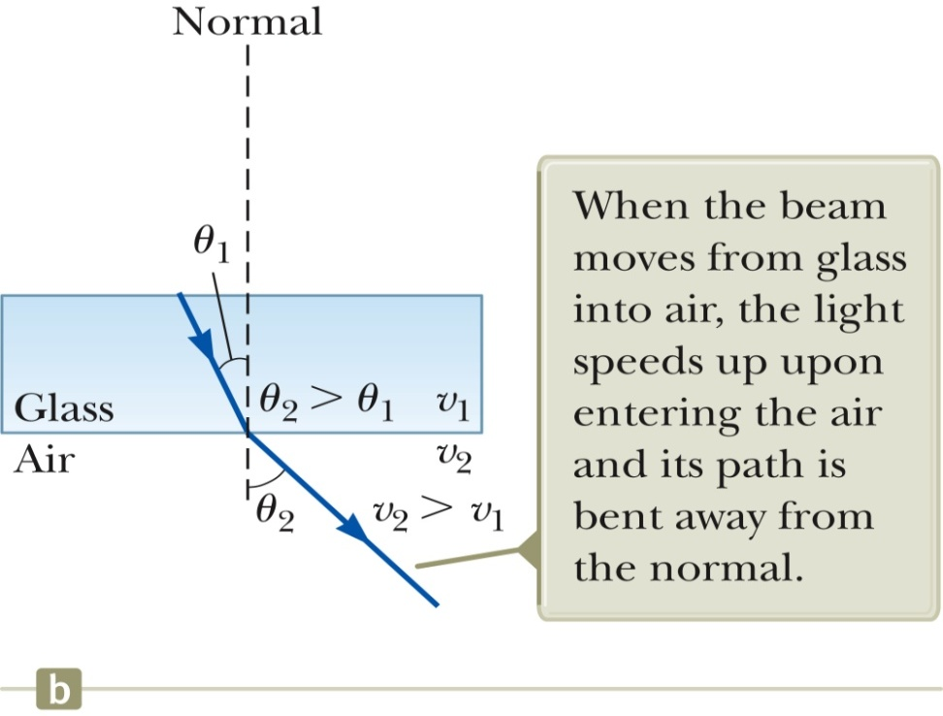
Refraction Details
When light moves from a material in which its speed is high to a material in which its speed is lower, Figure a,
the angle of refraction θ₂ is less than the angle of incidence θ₁,
the ray is bent toward the normal
If the ray moves from a material in which light moves slowly to a material in which it moves more rapidly, Figure b,
θ₂ is greater than θ₁,
The ray is bent away from the normal.
Section 35.5

Slide 10
Index of Refraction
The speed of light (v) in any material is less than its speed in vacuum (c).
The maximum speed of light in vacuum (air)
c = 3 x 10⁸ m/s
The index of refraction, n, of a medium can be defined as
For a vacuum (air), n = 1
For other media, n > 1
n is a unitless ratio
Section 35.5

Slide 11
Frequency Between Media
As light travels from one medium to another,
Its frequency (ƒ) does not change (constant).
ƒ = ƒ₁ = ƒ₂
Both the wave speed (v) and the wavelength (λ) do change.
medium 1: v₁ , λ₁ , n₁
medium 2: v₂ , λ₂ , n₂
Section 35.5

Slide 12
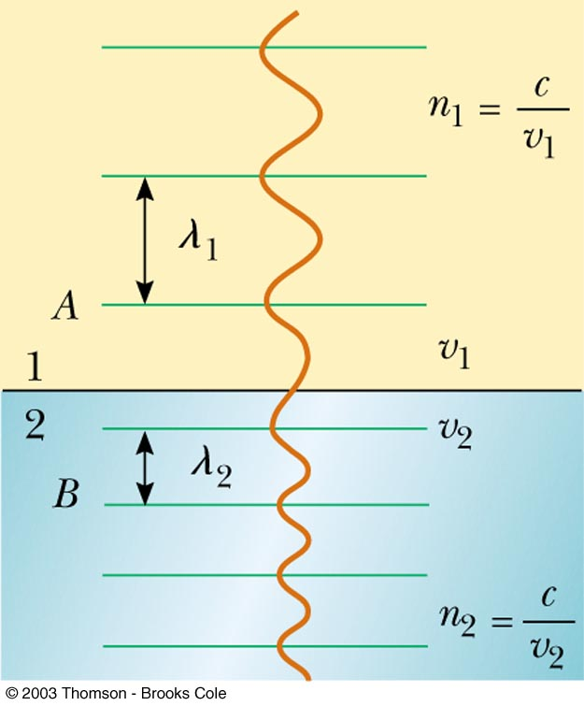
Index of Refraction Extended
v = ƒλ
The frequency stays the same as the wave travels from one medium to the other.
ƒ = ƒ₁ = ƒ₂
v₁ = ƒ λ₁ and v₂ = ƒ λ₂
The ratio of the indices of refraction of the two media can be expressed as various ratios
The index of refraction is inversely proportional to the wave speed.
As the wave speed decreases, the index of refraction increases.
The higher the index of refraction, the more it slows downs the light wave speed.
Section 35.5

Slide 13
The previous relationship can be simplified to compare wavelengths and indices:
λ₁n₁ = λ₂n₂
If medium 1 is vacuum (air), n₁ = 1 and the index of refraction of the material can be defined in terms of the wavelengths.
we see that because
Section 35.5

Slide 14
Example 35.5 Laser Light in a Compact Disc
A laser in a compact disc player generates light that has a
wavelength of 780 nm in air.
(A) Find the speed of this light once it enters the plastic of a compact disc (n =1.55).
(B) What is the wavelength of this light in the plastic?

Slide 15
Snell’s Law of Refraction
Snell’s Law
n₁ sin θ₁ = n₂ sin θ₂
θ₁ is the angle of incidence
θ₂ is the angle of refraction

Slide 16
Example 35.3 An Index of Refraction Measurement
A beam of light of wavelength 550 nm traveling in air is incident on a slab of transparent material. The incident beam makes an angle of 40.0⁰ with the normal, and the refracted beam makes an angle of 26.0⁰ with the normal. Find the index of refraction of the material.
Using Snell’s law of refraction and taking n₁ =1 for air,
n₁ sin θ₁ = n₂ sin θ₂

Slide 17
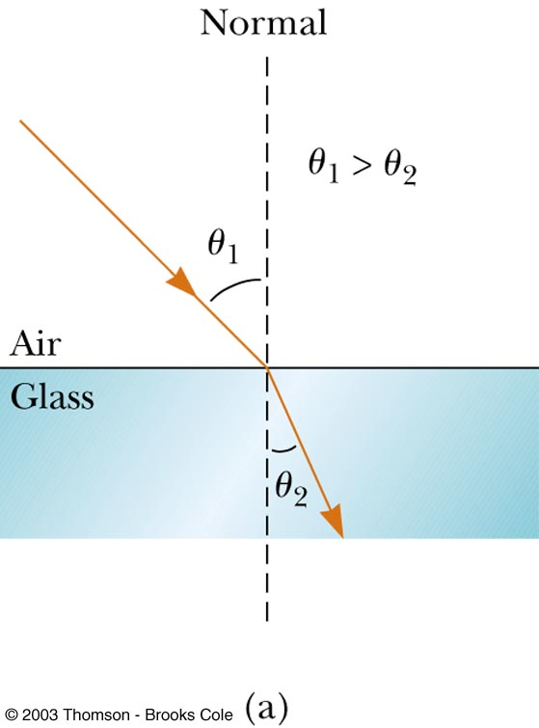
Example 35.4 Angle of Refraction for Glass
A light ray of wavelength 589 nm traveling through air is incident on a smooth, flat slab of crown glass at an angle of
30⁰ to the normal,. Find the angle of refraction.
n₁ sin θ₁ = n₂ sin θ₂
From Table 35.1, we find that n₁ = 1 for air and
n₂ =1.52 for crown glass. Therefore,
30⁰
Because this is less than the incident angle of 30⁰, the refracted ray is bent toward the normal,

Slide 18
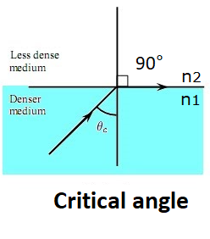
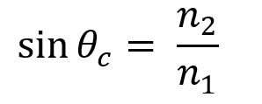
Critical angle
The critical angle (θ_{c} ): the angle of incidence producing an angle of refraction equal to 90º.
The refracted light ray moves parallel to the boundary so that θ₂ =90°
Using Snell’s law
n₁ sin θ₁ = n₂ sin θ₂
rare medium
for
the boundary
The refracted rays are bent away from the normal because the index of refraction n₁ (Denser medium) is greater than n₂ (rare medium)

Slide 19
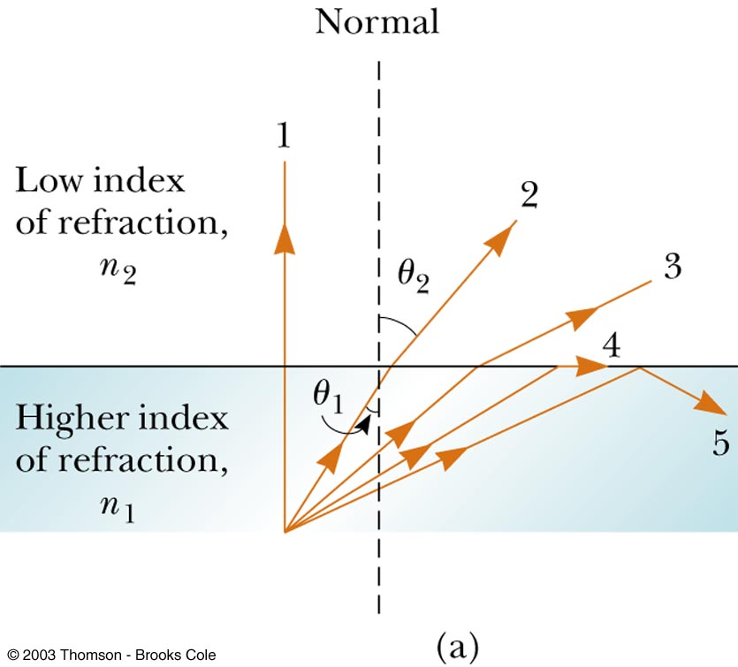
Total Internal Reflection
At this angle of incidence( the critical angle (θ_{c} )), all of the energy of the incident light is reflected.
For any angle of incidence greater than the critical angle, light will undergo total internal reflection.
Total internal reflection can occur when light attempts to move from a medium with a high index of refraction to one with a lower index of refraction
Ray 5 shows internal reflection

Slide 20
Q1 Refractive index of glass is 1.52 and refractive index of water is 1.33, then the critical angle will be

Slide 21
Note
Critical angle and total internal reflection of light are possible only when light enters from denser to rarer medium.
denser medium rarer medium
So it’s occur If:

Slide 22
