Slide 1
Chapter(10)
Correlation
and
Regression
Lecturer : FATEN AL-HUSSAIN
Note: This PowerPoint is only a summary and your main source should be the book.

Slide 2
Introduction
10-1 Scatter plots .
10-2 Correlation .
10-3 Correlation Coefficient .
10-4 Regression .
Note: This PowerPoint is only a summary and your main source should be the book.

Slide 3
Correlation and Regression inferential statistics involves determining whether a relationship between two or more numerical or quantitative variables exists.
Examples:
TV viewing and class grades—students who spend more time watching TV tend to have lower grades .
In the summer as the temperature increases people are thirstier.
Height and weight.
Ice cream causes drowning.
Note: This PowerPoint is only a summary and your main source should be the book.

Slide 4
Correlation is a statistical method used to determine whether a linear relationship between variables exists.
Regression is a statistical method used to describe the nature of the relationship between variables—that is, positive or negative, linear or nonlinear.
Note: This PowerPoint is only a summary and your main source should be the book.

Slide 5
There are two types of relationships
simple
multiple
In a simple relationship, there are two variables: an
independent variable (predictor variable)
dependent variable (response variable).
In a multiple relationship, there are two or more independent variables that are used to predict one dependent variable.
Note: This PowerPoint is only a summary and your main source should be the book.

Slide 6
Example1:
Is there a relationship between a person’s age and his or her blood pressure?
The type of relationship:
The independent variable(s):
The dependent variable:
Example 2:
Is there a relationship between a students final score in math and factors such as the number of hours a student studies, the number of absences, and the IQ score.
The type of relationship:
The independent variable(s):
The dependent variable:
Note: This PowerPoint is only a summary and your main source should be the book.

Slide 7
Simple relationship can also be positive or negative.
Positive relationship exists when both variables increase or decrease at the same time.
Example: a person’s height and perfect weight.
Negative relationship, as one variable increases, the other variable decreases and vice versa.
Example: the strength of people over 60 years of age.
Note: This PowerPoint is only a summary and your main source should be the book.

Slide 8
Scatter Plots
A scatter plot is a graph of the ordered pairs (x, y) of numbers consisting of the independent variable x and the dependent variable y.
Notation:
  X: Explanatory (independent, predictor) variable
  Y: Response (dependent, outcome) variable
Note: This PowerPoint is only a summary and your main source should be the book.

Slide 9
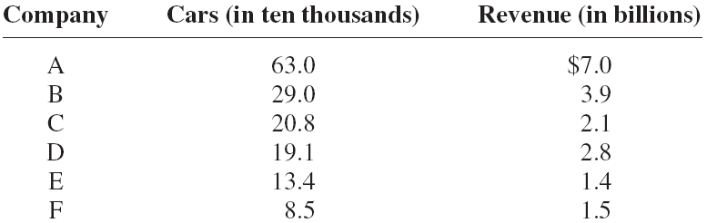
Example 10-1:
Construct a scatter plot for the data shown for car rental companies in the United States for a recent year.
Step 1: Draw and label the x and y axes.
Step 2: Plot each point on the graph.
Note: This PowerPoint is only a summary and your main source should be the book.

Slide 10
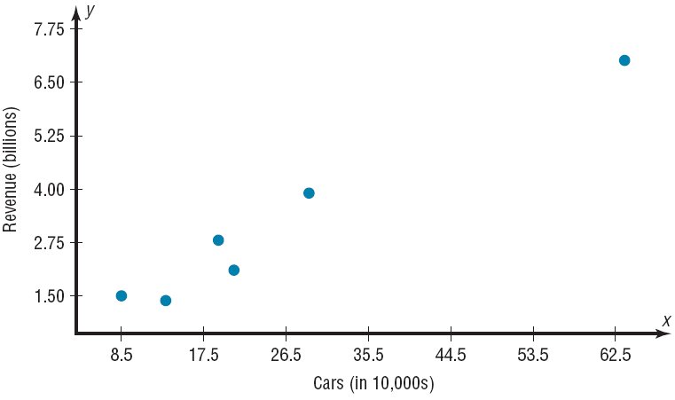
There is a positive relationship
increase
increase
Note: This PowerPoint is only a summary and your main source should be the book.

Slide 11
Example 10-2:
Construct a scatter plot for the data obtained in a study on the number of absences and the final grades of seven randomly selected students from a statistics class.
Student | Number of absences x | Final grade y
A | 6 | 82
B | 2 | 86
C | 15 | 43
D | 9 | 74
E | 12 | 58
F | 5 | 90
G | 8 | 78
Note: This PowerPoint is only a summary and your main source should be the book.

Slide 12
There is a negative relationship
Solution :
Step 1: Draw and label the x and y axes.
Step 2: Plot each point on the graph.
decreases
increase
Note: This PowerPoint is only a summary and your main source should be the book.

Slide 13
Example 10-3:
Construct a scatter plot for the data obtained in a study on the number of hours that nine people exercise each week and the amount of milk (in ounces) each person consumes per week.
Student | Hours x | Amount y
A | 3 | 48
B | 0 | 8
C | 2 | 32
D | 5 | 64
E | 8 | 10
F | 5 | 32
G | 10 | 56
H | 2 | 72
I | 1 | 48
Note: This PowerPoint is only a summary and your main source should be the book.

Slide 14
There is no specific type of relationship
Solution :
Step 1: Draw and label the x and y axes.
Step 2: Plot each point on the graph.
Note: This PowerPoint is only a summary and your main source should be the book.

Slide 15
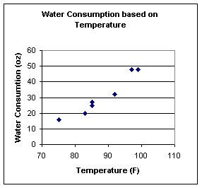
Questions ???
Determine the type of relationship shown in the figure below:
Positive
Negative
No relationship
Note: This PowerPoint is only a summary and your main source should be the book.

Slide 16
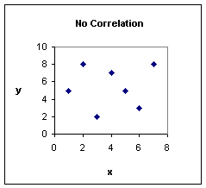
Positive
Negative
No relationship
Note: This PowerPoint is only a summary and your main source should be the book.

Slide 17
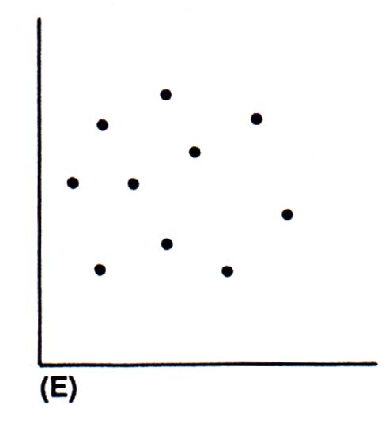
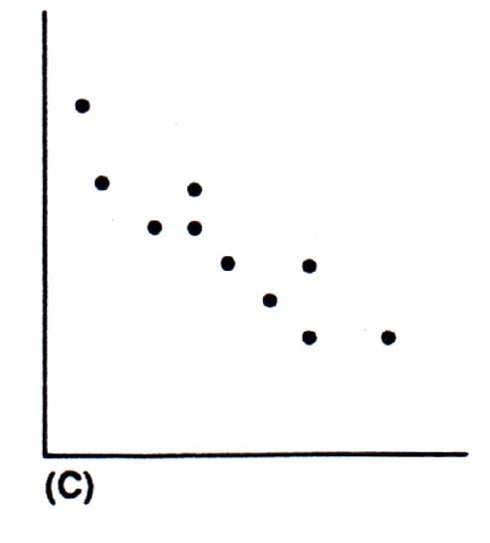
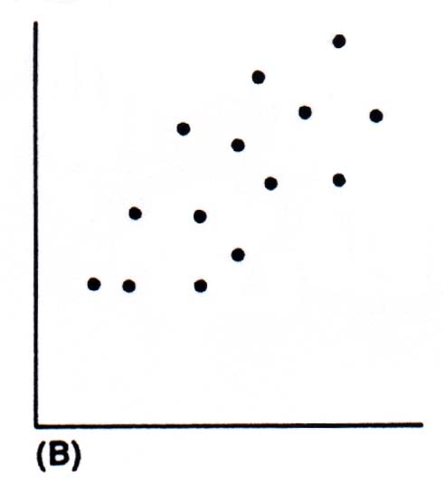
How would you describe the graph?
No relationship
Positive relationship
Negative relationship
both data sets increase together.
as one data set increases, the other decreases.
Note: This PowerPoint is only a summary and your main source should be the book.

Slide 18
Do the data sets have a positive, a negative, or no relationship?
A. the relationship between exercise and weight
Negative relationship
B. The speed of a runner and the number of races she wins.
Positive relationship
C. The size of a person and the number of fingers he has
No relationship
D. When we study the relationship between the Number of hours
of studying and the final score
Positive relationship
Note: This PowerPoint is only a summary and your main source should be the book.

Slide 19
Correlation
The correlation coefficient computed from the sample data measures the strength and direction of a linear relationship between two variables.
The symbol for the sample correlation coefficient is r. The symbol for the population correlation coefficient is ρ.
Note: This PowerPoint is only a summary and your main source should be the book.

Slide 20
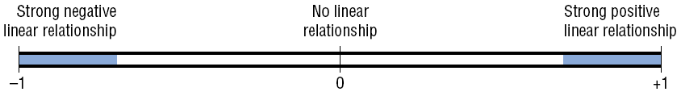
The range of the correlation coefficient is
from −1 to +1 .
If there is a strong positive linear relationship between the variables, the value of r will be close to +1.
If there is a strong negative linear relationship between the variables, the value of r will be close to −1.
-1 ≤ r ≤ 1
Note: This PowerPoint is only a summary and your main source should be the book.

Slide 21
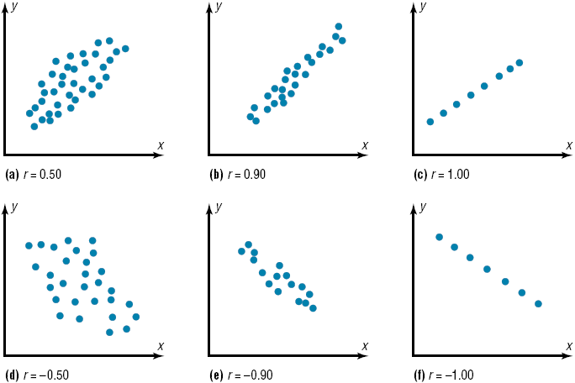
Note: This PowerPoint is only a summary and your main source should be the book.

Slide 22
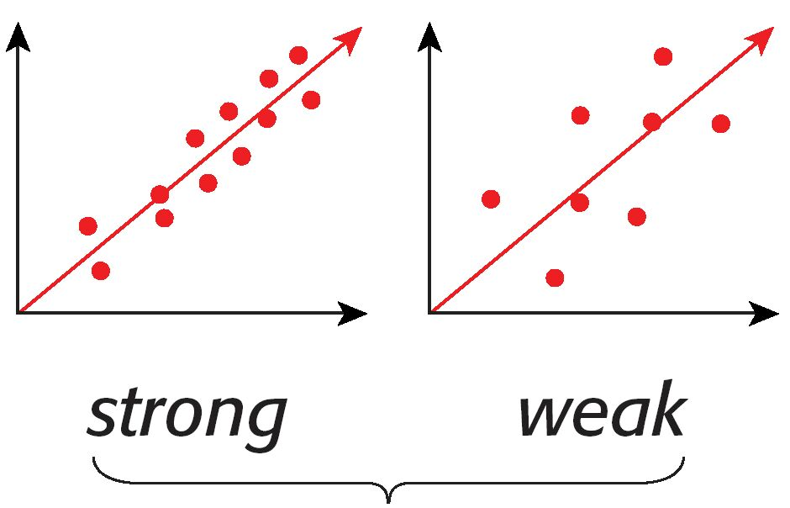
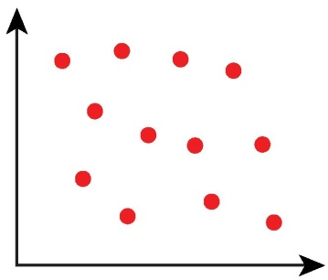
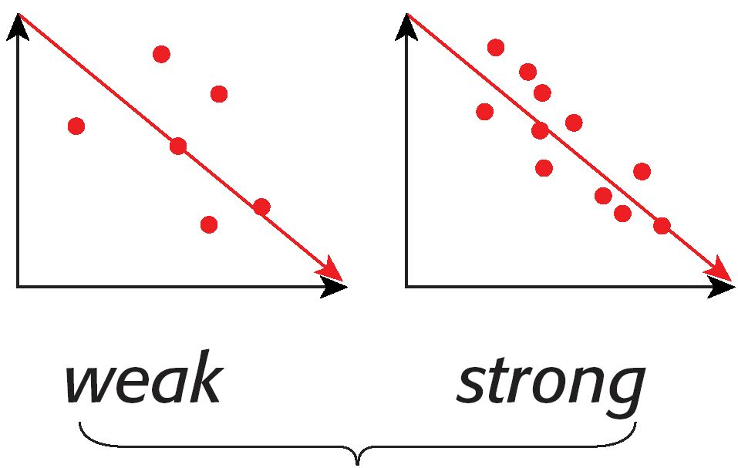
positive linear relationship
negative linear relationship
Note: This PowerPoint is only a summary and your main source should be the book.

Slide 23
correlation coefficient
Pearson
Ch(10)
Spearman Rank
Ch(13)
-Denoted by (r)
-Only Used when Two
variables are quantitative.
-Denoted by (r_{s})
- Used when Two
variables are Quantitative
or
Qualitative.
Note: This PowerPoint is only a summary and your main source should be the book.

Slide 24
Pearson Correlation
Coefficient
Note: This PowerPoint is only a summary and your main source should be the book.

Slide 25
The formula for the Pearson correlation coefficient is
where n is the number of data pairs.
Rounding Rule: Round to three decimal places.
Note: This PowerPoint is only a summary and your main source should be the book.

Slide 26
Example 10-4:
Compute the correlation coefficient for the data in Example 10–1.
company | Cars x | Income y | xy | x² | y²
A | 63.0 | 7.0 | 441 | 3969 | 49
B | 29.0 | 3.9 | 113.10 | 841 | 15.21
C | 20.8 | 2.1 | 43.68 | 432.64 | 4.41
D | 19.1 | 2.8 | 53.48 | 364.81 | 7.84
E | 13.4 | 1.4 | 18.76 | 179.56 | 1.96
F | 8.5 | 1.5 | 2.75 | 72.25 | 2.25
Σx =
153.8
Σy =
18.7
Σxy =
682.77
Σx2 =
5859.26
Σy2 =
80.67
Note: This PowerPoint is only a summary and your main source should be the book.

Slide 27
Solution :
r = 0.982 (strong positive relationship)
Note: This PowerPoint is only a summary and your main source should be the book.

Slide 28
Example 10-5:
Compute the correlation coefficient for the data in Example 10–2.
Student | Number of absences(x) | Final grade (y) | xy | x² | y²
A | 6 | 82 | 492 | 36 | 6.724
B | 2 | 86 | 172 | 4 | 7.396
C | 15 | 43 | 645 | 225 | 1.849
D | 9 | 74 | 666 | 81 | 5.476
E | 12 | 58 | 696 | 144 | 3.364
F | 5 | 90 | 450 | 25 | 8.100
G | 8 | 78 | 624 | 64 | 6.084
Σx = 57
Σy = 511
Σxy =
3745
Σx2 =
579
Σy2 =
38.993
Note: This PowerPoint is only a summary and your main source should be the book.

Slide 29

Solution :
r = -0.944 (strong negative relationship)
Note: This PowerPoint is only a summary and your main source should be the book.

Slide 30
When we study the relationship between the Number of hours
of studying and the final score, the correlation coefficient could be:
0.83
-0.75
0
0.3
Compute the value of the Pearson product moment correlation
coefficient for the data below:
r = +0.028
r = - 0.224
r = -0.789
r = -0.028
X values | -2 | -3 | 5
Y values | 7 | -1 | 2
Note: This PowerPoint is only a summary and your main source should be the book.

Slide 31
If the value of the correlation coefficient r = - 0.11, that means that the linear relationship between the variables is
positive strong.
negative strong.
positive weak.
negative weak.

Slide 32
Spearman Rank
Correlation Coefficient
If both sets of data have the same ranks ,r_{s} will be +1.
If the sets of data are ranked in exactly the opposite way , r_{s} will be
-1.
If there is no relationship between the ranking ,r_{s} will be near 0.
Note: This PowerPoint is only a summary and your main source should be the book.

Slide 33
The formula for the Spearman Rank correlation coefficient is
Where
d = difference in ranks.
n = number of data pairs.
Note: This PowerPoint is only a summary and your main source should be the book.

Slide 34
Example 13-7:
Two students were asked to rate eight different textbooks for a specific course on an ascending scale from 0 to 20 points. Compute the correlation coefficient for the data:
Textbook. | Student 1 | Student 2
A B C D E F G H | 4 10 18 20 12 2 5 9 | 4 6 20 14 16 8 11 7
Note: This PowerPoint is only a summary and your main source should be the book.

Slide 35
Student 1’s rating
4
10
18
20
12
2
5
9
Student 1’s rating
20
18
12
10
9
5
4
2
1
2
3
Rank
4
5
6
7
8
Note: This PowerPoint is only a summary and your main source should be the book.

Slide 36
Student 2’s rating
4
6
20
14
16
8
11
7
Student 2’s rating
20
16
14
11
8
7
6
4
1
2
3
Rank
4
5
6
7
8
Note: This PowerPoint is only a summary and your main source should be the book.

Slide 37
Solution:
Textbook. | Student 1 | Student 2 | X1 | X2 | d=X1 – X2 | d²
A B C D E F G H | 4 10 18 20 12 2 5 9 | 4 6 20 14 16 8 11 7 | 7 4 2 1 3 8 6 5 | 8 7 1 3 2 5 4 6 | -1 -3 1 -2 1 3 2 -1 | 1 9 1 4 1 9 4 1
Total |  |  |  |  | 0 | 30
Note: This PowerPoint is only a summary and your main source should be the book.

Slide 38
rs = 0.643 (strong positive relationship)
Note: This PowerPoint is only a summary and your main source should be the book.

Slide 39
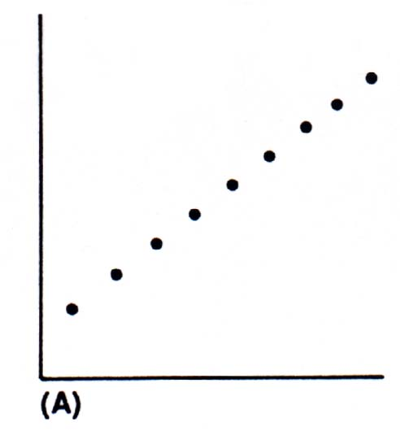
Questions ???
The correlation coefficient between two variables equals
(r = -0,8) this mean :
Weak negative
Strong negative
Strong positive
Which the graphic is perfect positive linear relationship:
Note: This PowerPoint is only a summary and your main source should be the book.

Slide 40
Two students were asked to rate six different television shows on a scale from 0 to 10 points. The data are shown in the following table:
What is the Spearman Rank Correlation Coefficient for this set of data?
A) 0.886
B) 0.114
C) 0.2
D) -0.886
Show | A | B | C | D | E | F
Student1 | 10 | 8 | 6 | 4 | 3 | 7
Student 2 | 7 | 9 | 3 | 4 | 0 | 5

Slide 41
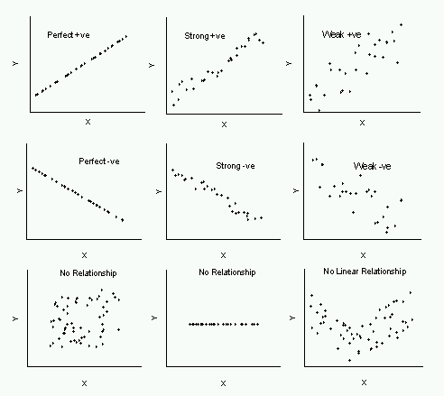
What does a scatter plot look like? Below are 9 scatter plots that show three examples of a positive relationship in the top row (perfect, strong, weak), three examples of a negative relationship in the middle row (perfect, strong weak), and three examples of no relationship.
Note: This PowerPoint is only a summary and your main source should be the book.

Slide 42
Regression
Note: This PowerPoint is only a summary and your main source should be the book.

Slide 43
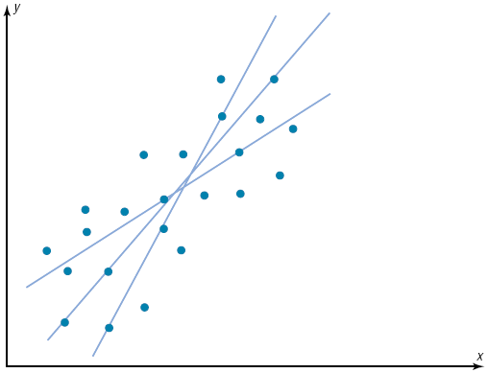
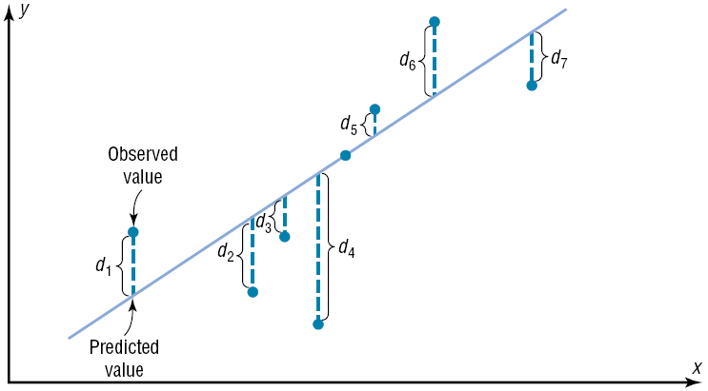
Best fit means that the sum of the squares of the vertical distance from each point to the line is at a minimum.
Note: This PowerPoint is only a summary and your main source should be the book.

Slide 44
Regression Line
y
x
Note: This PowerPoint is only a summary and your main source should be the book.

Slide 45
Note: This PowerPoint is only a summary and your main source should be the book.

Slide 46
Solution :
Example 10-9:
Find the equation of the regression line for the data in Example 10–4, and graph the line on the scatter plot.
Σx = 153.8, Σy = 18.7, Σxy = 682.77, Σx² = 5859.26,
Σy² = 80.67, n = 6
Note: This PowerPoint is only a summary and your main source should be the book.

Slide 47
Find two points to sketch the graph of the regression line.
Use any x values between 10 and 60. For example, let x equal 15 and 40. Substitute in the equation and find the corresponding y value.
Plot (15,1.986) and (40,4.636), and sketch the resulting line.
Note: This PowerPoint is only a summary and your main source should be the book.

Slide 48
Note: This PowerPoint is only a summary and your main source should be the book.

Slide 49



Solution :
Example 10-10:
Find the equation of the regression line for the data in Example 10–5, and graph the line on the scatter plot.
Σx = 57, Σy = 511, Σxy = 3745, Σx² = 579, n = 7
Note: This PowerPoint is only a summary and your main source should be the book.

Slide 50

Remark
The sign of the correlation coefficient and the sign of the slope of the regression line will always be the same.
r (positive) ↔ b (positive)
r (negative) ↔ b (negative)
Car Rental Companies: r =0.982 , b=0.106
Absences and Final Grade: r = -0.944 , b= -3.622
The regression line will always pass through the point
.
For Example:
Note: This PowerPoint is only a summary and your main source should be the book.

Slide 51
Example 10-11:
Use the equation of the regression line to predict the income of a car rental agency that has 200,000 automobiles.
x = 20 corresponds to 200,000 automobiles.
Hence, when a rental agency has 200,000 automobiles, its revenue will be approximately $2.516 billion.
Note: This PowerPoint is only a summary and your main source should be the book.

Slide 52
The magnitude of the change in one variable when the other variable changes exactly 1 unit is called a marginal change. the value of slope b of the regression line equation represent the marginal change.
For Example:
Car Rental Companies: b= 0.106, which means for each increase of 10,000 cars, the value of y changes 0.106 unit (the annual income increase $106 million) on average.
Note: This PowerPoint is only a summary and your main source should be the book.

Slide 53
The magnitude of the change in one variable when the other variable changes exactly 1 unit is called a marginal change. the value of slope b of the regression line equation represent the marginal change.
For Example:
Absences and Final Grade :b= -3.622, which means for each increase of 1 absences, the value of y changes -3.62 unit (the final grade decrease 3.622 scores) on average.
Note: This PowerPoint is only a summary and your main source should be the book.

Slide 54
Questions ???
If the regression line is given by y`= 7- 4x ,then the correlation coefficient (r) is -----.
Zero
Negative
Positive
-4
If the equation of the regression line is
, find y' when x = 2.
1.252
0.4
1.052
0.548
Note: This PowerPoint is only a summary and your main source should be the book.

Slide 55
The slop of the regression line is
1.02
1.3
-1.3
-1.02
The equation of the regression line between the age of a car in years(x) and its price (y); is given by: Y=65.3-9.25x. The correct statement to represent this equation is :
When the age of the car increases by one year the price of it decreases by (65.3) Riyals on average
When the price of the car increases by one Riyals the age of the car decreases by (9.25) years on average
When the age of the car increases by one year the price of it decreases by (9.25)
When the price of the car increases by one Riyals the age of the car decreases by (65.3) on average
Note: This PowerPoint is only a summary and your main source should be the book.

Slide 56
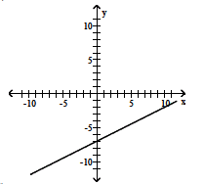
. Which of the following linear regression equations represents the graph below?
 | A) | y`= 13 + 2 x
 | B) | y`= 13 – 2 x
 | C) | y`= -7 + 2 x
 | D) | y`= -7 – 2 x
Note: This PowerPoint is only a summary and your main source should be the book.

Slide 57


