Slide 1
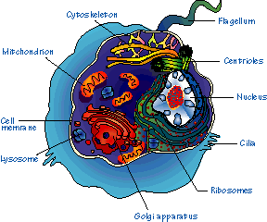
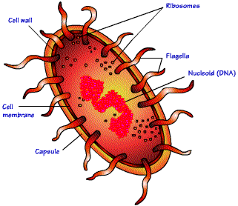
Lab Exercise # 2
Zoo- 145
Microscopic Study of the Structure and
Morphological Variations of the Cell

Slide 2
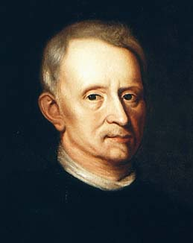
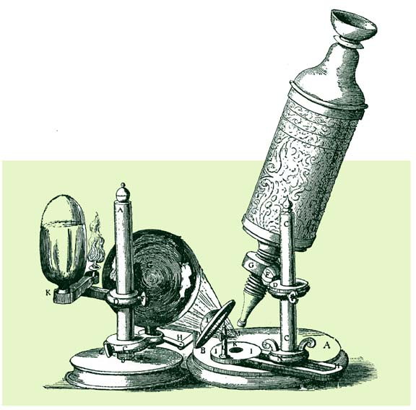
Lab Exercise # 2
Zoo- 145
Cells were discovered in
1665 by a British
scientist named
Robert Hooke.
He was able to observe the cell with the use of the microscope.

Slide 3
Lab Exercise # 2
Zoo- 145
Definition of Cell
A cell is the smallest unit that is capable of performing life functions.
Cells are the basic unit of life
All organisms are made up of cells
All cells come from pre-existing cells

Slide 4
Lab Exercise # 2
Zoo- 145
The Cells
Basic structural and functional unit of life
The Tissues
Cells group together to form tissues
The Organ
Different tissues combine together to form an organ
The System
Different organs combine together to form a system
The Body
Different systems combine together to form an animal or organism

Slide 5
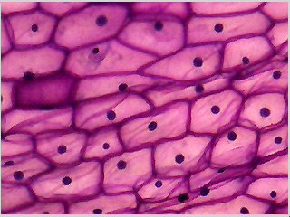
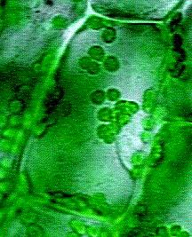
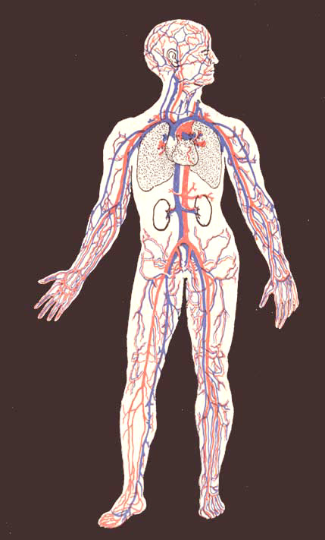


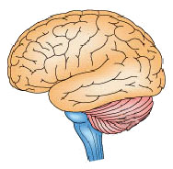
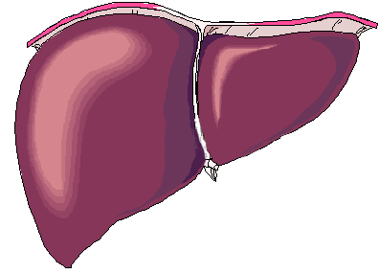
Lab Exercise # 2
Zoo- 145
Cells
Organisation of Life
Tissues
Animal
Organs
System

Slide 6
Lab Exercise # 2
Zoo- 145
Some cells are capable to live independent which are called single celled or unicellular organisms like the protozoa.
Classification of the cell
1- Prokaryotic cell: they are devoid of the true nucleus (does not surround by nuclear membrane).
2- Eukaryotic cell: they have true nucleus (surround by nuclear membrane).
Structure of the cell: the true cell consist of three parts
1- The Central part (nucleus).
2- The Peripheral part (cytoplasm).
3- The Cell membrane encases both of these parts.

Slide 7
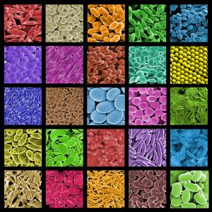
Lab Exercise # 2
Zoo- 145
Cells come in all shapes and sizes
Size: large, small etc
Shape: round, oval, polygonal etc

Slide 8
Lab Exercise # 2
Zoo- 145
Prokaryotic Cells
Do not have nucleus
Few internal structures
One-celled organisms, Example: Bacteria

Slide 9
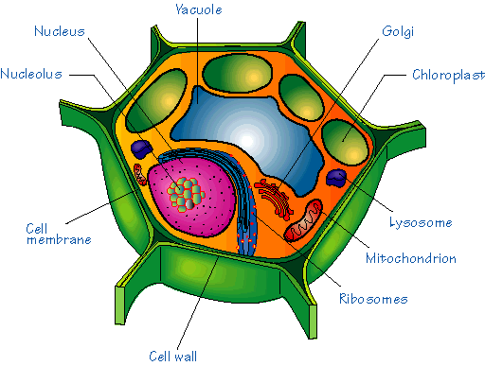
Eukaryotic Cells
Lab Exercise # 2
Zoo- 145
Contain nucleus and organelles surrounded by membranes
Most living organisms, example: humans
Usually larger than prokaryotic cells
Plant
Animal

Slide 10
Lab Exercise # 2
Zoo- 145
Paramecium
· Single-celled organism
· Shoe-shape
· The cilia are the locomotary organs
· It has two nuclei (macronucleus and micronucleus) and contractile, food vacuoles.
Macronucleus
Cilia

Slide 11
Lab Exercise # 2
Zoo- 145
Trypanosoma
· Single-celled organism
· Fusiform or sickle in the shape
· The flagellum is the locomotory organ
· It has one nucleus, parabasal granule and undulating membrane

Slide 12
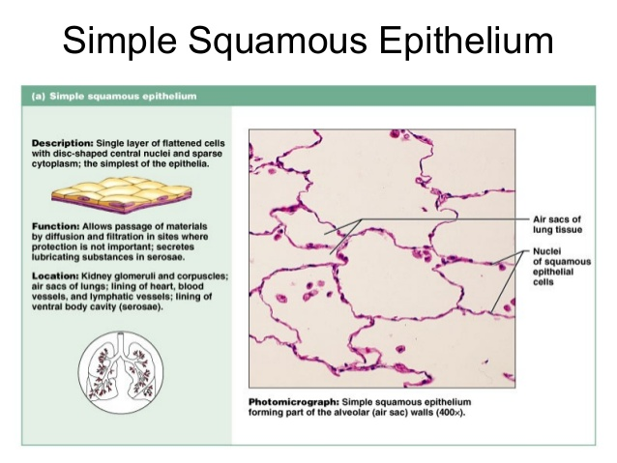

Slide 13
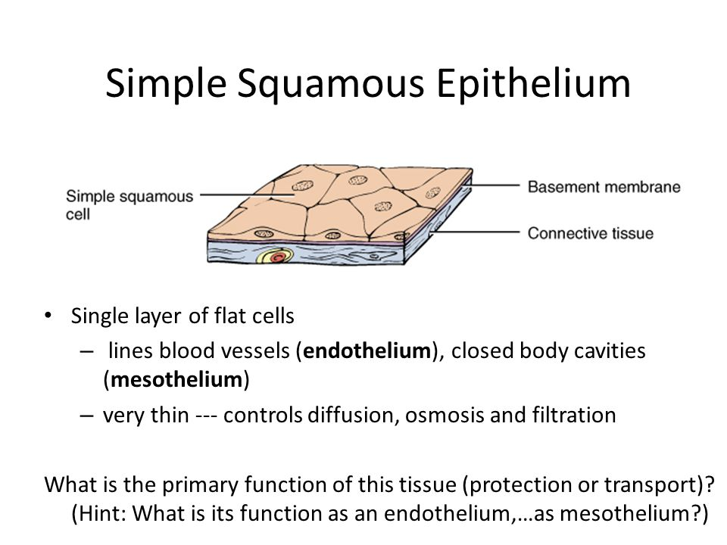
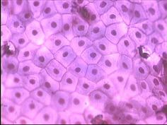

Slide 14
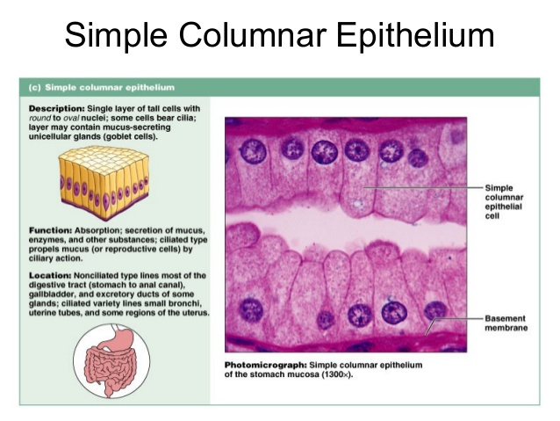

Slide 15
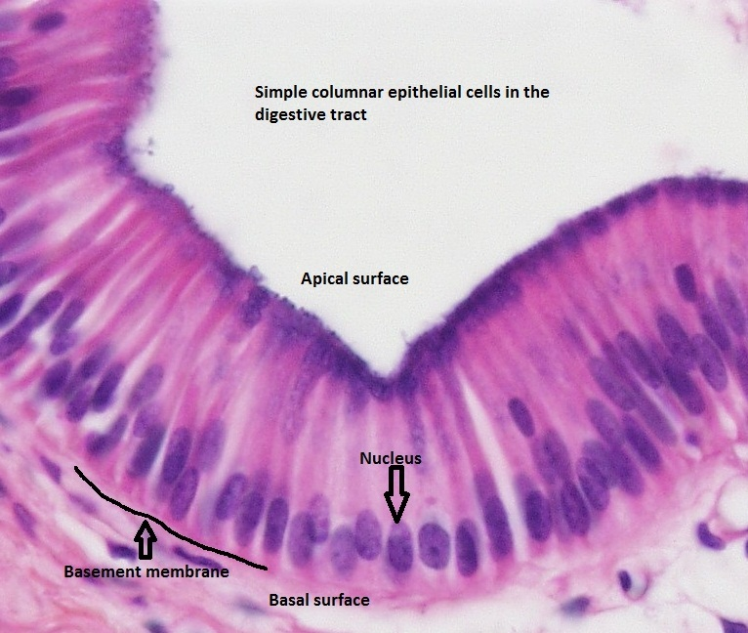
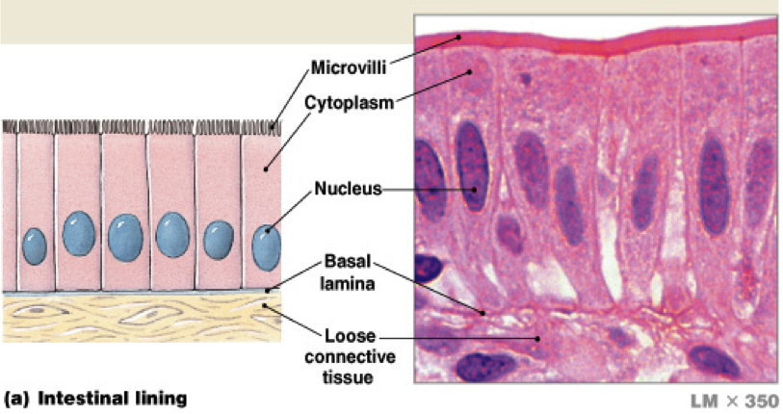

Slide 16
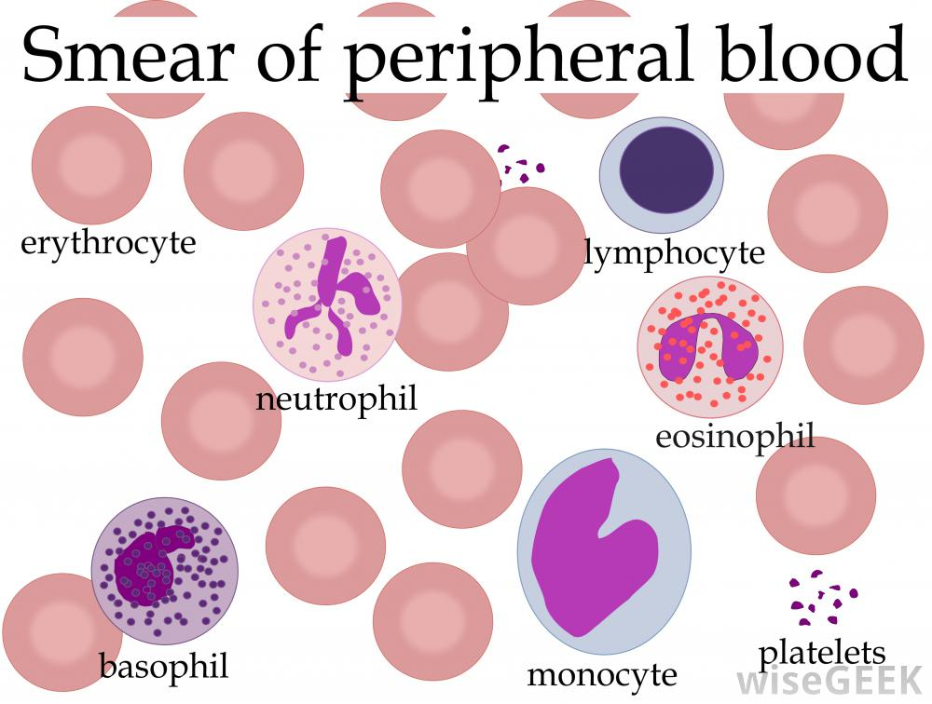
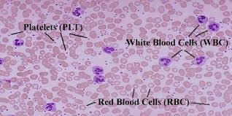
Peripheral blood cells
Are the cellular components of blood, consisting of red blood cells (erythrocytes),
white blood Cells (leucocytes), and platelets,

Slide 17
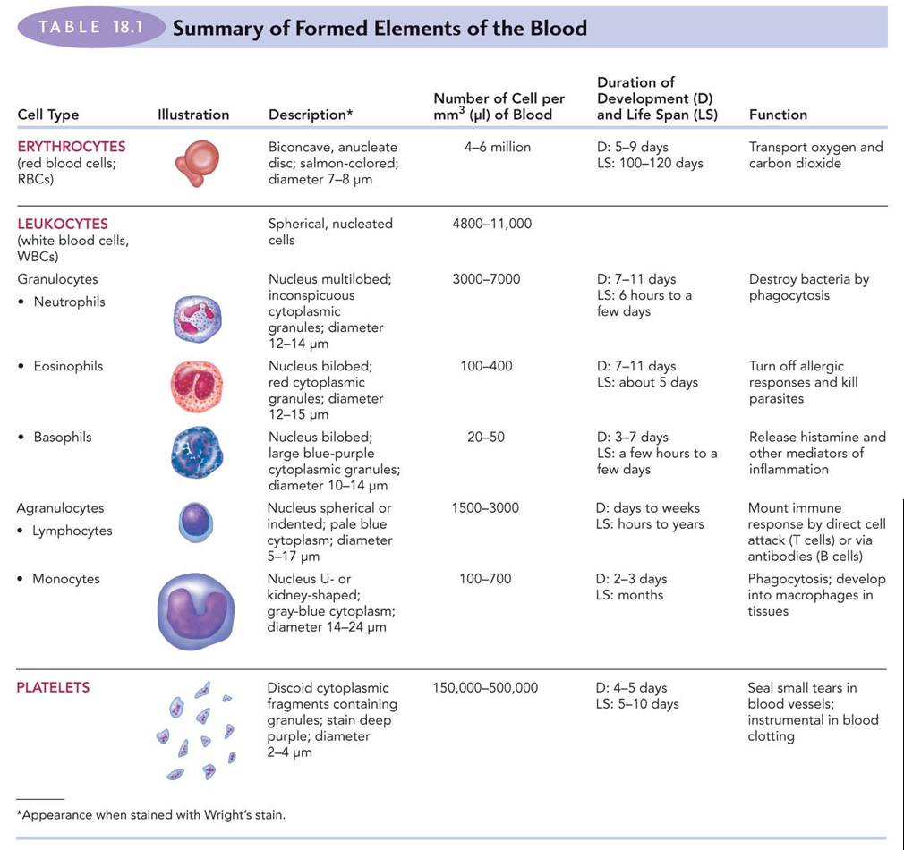

Slide 18
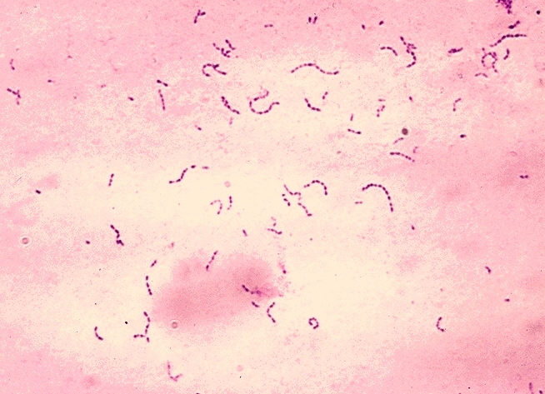
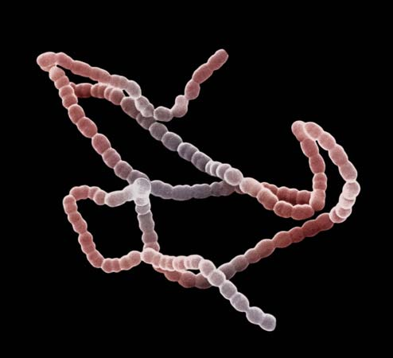
Streptococcus (Bacteria)
Streptococcus is a genus of coccus (spherical) gram-positive bacteria belonging to the phylum Firmicutes
and family Streptococcaceae. The term streptococcus (“twisted berry”) refers to the bacteria’s characteristic grouping in chains. Streptococci are microbiologically characterized as gram-positive and nonmotile.

Slide 19
Thank you !

