Slide 1

Chapter 6
Reaction Kinetics and Thermodynamics

Slide 2
Chapter 6: Reaction Kinetics and Thermodynamics
6.1.The First Law of Thermodynamics
Thermochemistry is the study of energy and its interconversion.
The First Law of Thermodynamics :
(The total energy of the universe is constant).
i.e. Energy can be converted from one form to another, but cannot be created or destroyed.
For example
if you climb a mountain, you do some work against the force of gravity as you carry yourself and your equipment up the mountain.
You can do this because you have the energy, or capacity to do so, the energy being supplied by the food that you have eaten. Food energy is chemical energy –energy stored in chemical compounds and released when the compounds undergo the chemical process of metabolism.

Slide 3
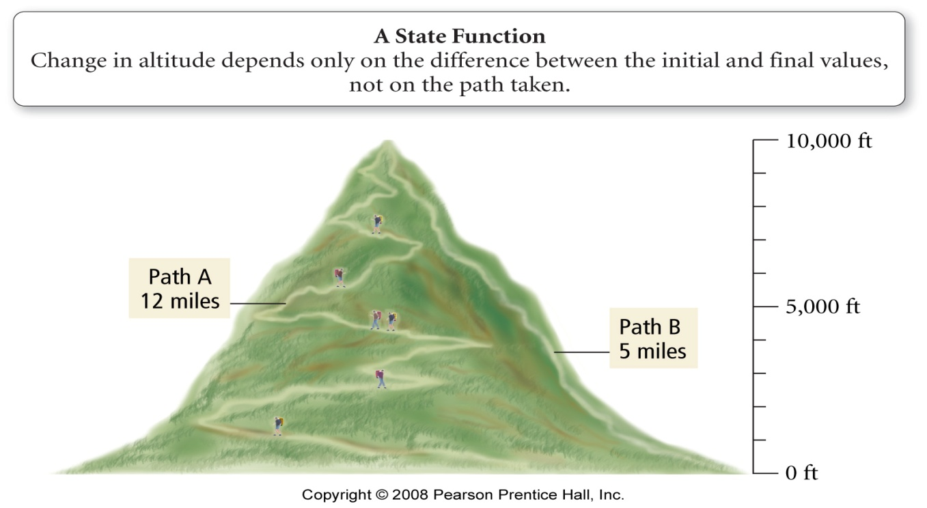
Chapter 6: Reaction Kinetics and Thermodynamics
6.1.The First Law of Thermodynamics
the internal energy is the total amount (sum) of kinetic and potential energies of all of the particles that compose the system.
the change in the internal energy of a system only depends on the amount of energy in the system at the beginning and end.
  a state function is a mathematical function whose result only depends on the initial and final conditions, not on the process used
  ΔE = E_{final} – E_{initial}
  ΔE_{reaction} = E_{products} - E_{reactants}

Slide 4
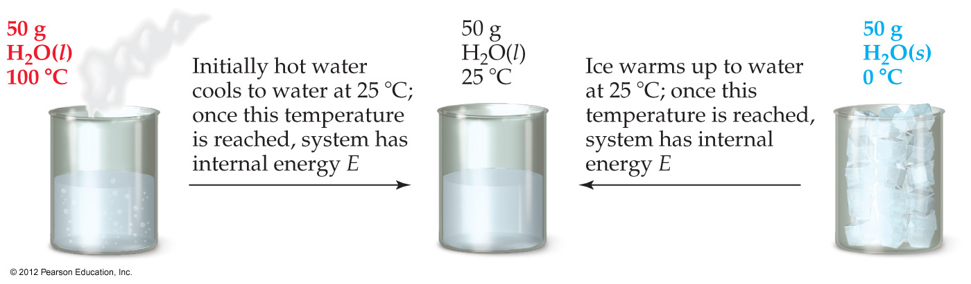
Chapter 6: Reaction Kinetics and Thermodynamics
6.1.The First Law of Thermodynamics
Therefore, internal energy is a state function.
It depends only on the present state of the system, not on the path by which the system arrived at that state.
And so, ΔE depends only on E_{initial} and E_{final}.

Slide 5
6.2 Quantifying heat and work
Heat is the exchange of thermal energy between a system and its surrounding caused by a temperature difference.
Thermal energy always transfer from hot matter to matter with lower temperature.
Thermal equilibrium is the condition in which energy stop transfer between the two bodies when reach the same temperatures.
Temperature is a measure of the thermal energy.
Temperature = Thermal Energy
40⁰C
90⁰C
greater thermal energy
6.2

Slide 6
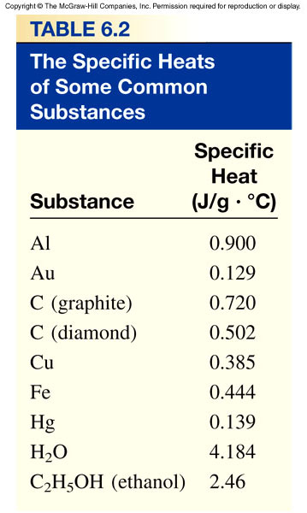
Temperature changes and heat capacity
When a system absorbs heat (q) its temperature changes by ∆T.
The specific heat (C_{s}) of a substance is the amount of heat (q) required to raise the temperature of one gram of the substance by one degree Celsius. Its unit is (J/g.°C).
The heat capacity (C) of a substance is the amount of heat (q) required to raise the temperature of a given quantity (m) of the substance by one degree Celsius.
Heat(q)
system
∆ T
C = q / ΔΤ
Heat (q) absorbed or released:
q = C x ΔΤ
q = m xC_{s} x ΔΤ
ΔT = T_{final} - T_{initial}

Slide 7
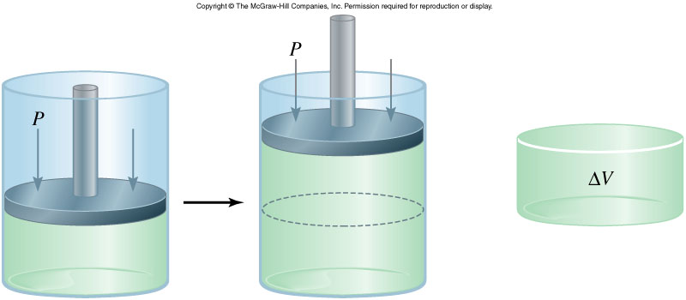
Work: Pressure–Volume (PV) Work
Chapter 6: Reaction Kinetics and Thermodynamics
PV work is work that is the result of a volume change against an external pressure.
When gases expand, ΔV is +, but the system is doing work on the surroundings, so w_{gas} is (–).
As long as the external pressure is kept constant,
  –work = external pressure × change in volume
  w = –PΔV
  Units of w is (atm.L) or J
  To convert the units to joules, use 101.3 J = 1 atm∙L.

Slide 8


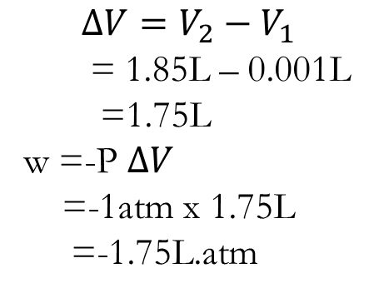

Chapter 6: Reaction Kinetics and Thermodynamics
Example: 6.1.p158
Inflating a balloon requires the inflator to do pressure-volume work on the surrounding. If a balloon is inflated from volume of 0.100 L to 1.85 L against external pressure of 1 atm. How much work is done (in joule)?
w=-P $∆V$
$$∆V=V_{2}−V_{1}$$
= 1.85L – 0.001L
=1.75L
w =-P $∆V$
=-1atm x 1.75L
=-1.75L.atm
لتحويل إلى جول نضرب في 101.3
To convert to J = x101.3
-1.75 L.atm x 101.3 J=-177J

Slide 9
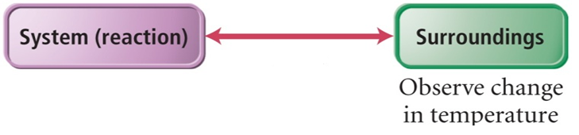
Chapter 6: Reaction Kinetics and Thermodynamics
6.3. Measuring ΔE for chemical reaction:
Constant-volume calorimetry
The First Law of Thermodynamics
A system exchange energy with its surrounding via heat and pressure-volume work:
Internal energy and the First Law of Thermodynamics
Heat (q) = m x C_{s} x ΔΤ
Work (w) = -PΔV
ΔE = q + w
ΔE is the change in internal energy of a system
q is the heat exchange between the system and the surroundings
w is the work done on (or by) the system
w = -PΔV when a gas expands against a constant external pressure

Slide 10
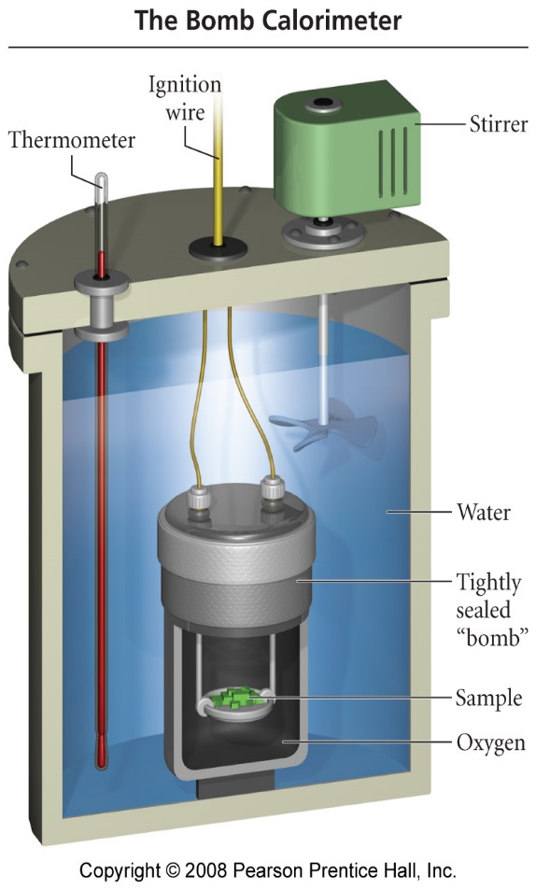
Bomb Calorimeter
A piece of equipment designed to measure ΔE for combustion reaction.
The temperature change is then related to the heat absorbed by the calorimeter (q_{cal}).
At constant volume
W = - PΔV
ΔV = 0
W = -P X0 = 0
ΔE = q_{v} – 0 = q_{v}
ΔΕ= q_{v}
q_{cal} = C_{cal} x ΔΤ
q_{cal} = - q_{rxn}
At constant volume
ΔΕ_{rxn} = q_{v} = q_{rxn}

Slide 11
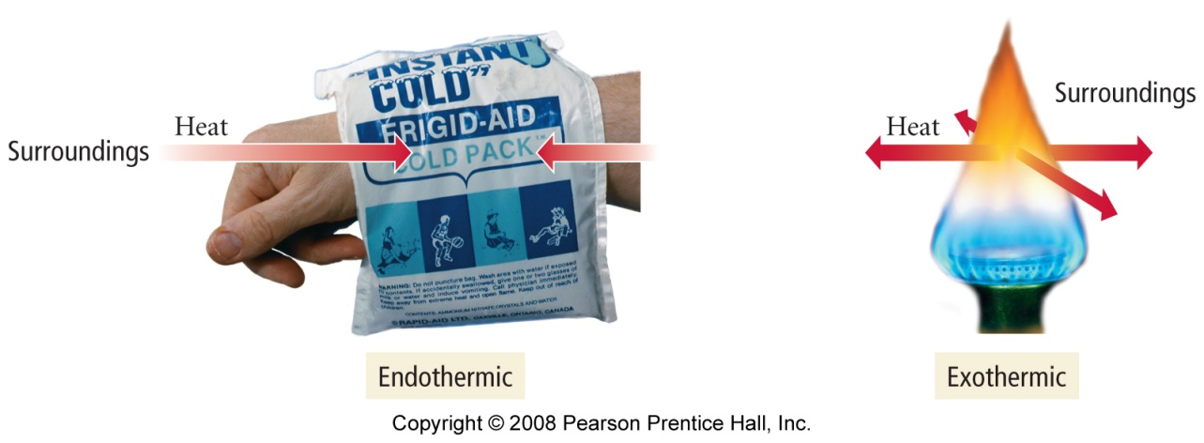
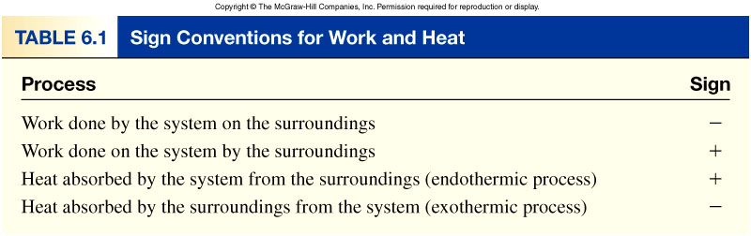
6.4 Enthalpy: The heat evolved in a chemical reaction at constant pressure
Enthalpy (H) of a system is defined as the sum of its internal energy and the product of its pressure and volume. It is the amount of heat absorbed or evolved in the reaction under condition of constant pressure.
At constant pressure:
ΔE = q + w
exothermic reactions has a negative (-) ΔH and gives off heat to the surroundings from the system.
An exothermic reaction feels warm to the touch.
endothermic reactions has a positive (+) ΔH and heat is being absorbed from the surroundings by the system.
An endothermic reaction feels cold to the touch.
qp = ΔH & w = -PΔV
ΔE = ΔH - PΔV
ΔH = ΔE + PΔV

Slide 12
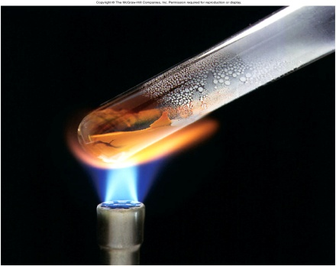
Exothermic process is any process that gives off heat – transfers thermal energy from the system to the surroundings.
2H₂ (g) + O₂ (g) 2H₂O (l) + energy
H₂O (g) H₂O (l) + energy
Endothermic process is any process in which heat has to be supplied to the system from the surroundings.
energy + 2HgO (s) 2Hg (l) + O₂ (g)
energy + H₂O (s) H₂O (l)
(Enthalpy is a state function. It doesn’t matter how you get there, only where you start and end.)
6.2

Slide 13
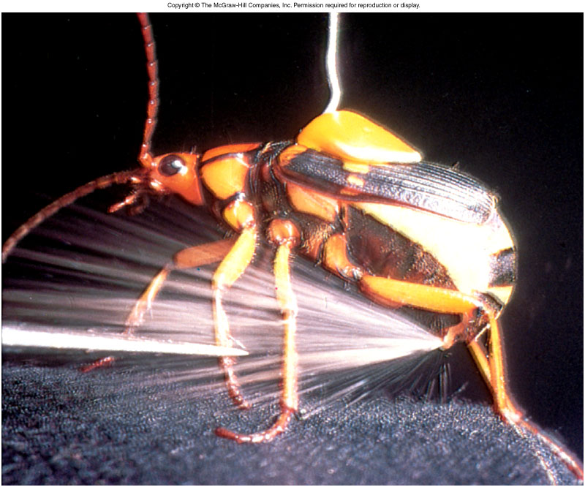
Chemistry in Action: Bombardier Beetle Defense (For read)
C₆H₄(OH)₂ (aq) + H₂O₂ (aq) C₆H₄O₂ (aq) + 2H₂O (l) ΔH⁰ = ?
C₆H₄(OH)₂ (aq) C₆H₄O₂ (aq) + H₂ (g) ΔH⁰ = 177 kJ/mol
H₂O₂ (aq) H₂O (l) + ½O₂ (g) ΔH⁰ = -94.6 kJ/mol
H₂ (g) + ½ O₂ (g) H₂O (l) ΔH⁰ = -286 kJ/mol
ΔH⁰ = 177 - 94.6 – 286 = -204 kJ/mol
Exothermic!

Slide 14
Stoichiometry involving ΔH: Thermochemical equations
The enthalpy change for a chemical reaction, ΔΗ_{rxn} , is also called the enthalpy of reaction or heat of reaction is an extensive property, one that depends on the amount of material.
Stoichiometry coefficients always refer to the number of moles of a substance
C₃H₈ (g) + 5 O₂ (g) 3 CO₂ (g) + 4H₂O (g) ΔH = -2044 kJ
One mole of C₃H₈ (g) ΔH = -2044 kJ
5 mole of O₂ (g) ΔH = -2044 kJ
There are three ways to determine ΔH for a chemical reaction:
Experimentally through Calorimetry.
Inferentially through Hess’s law.
Tabulated standard enthalpies of formation.

Slide 15
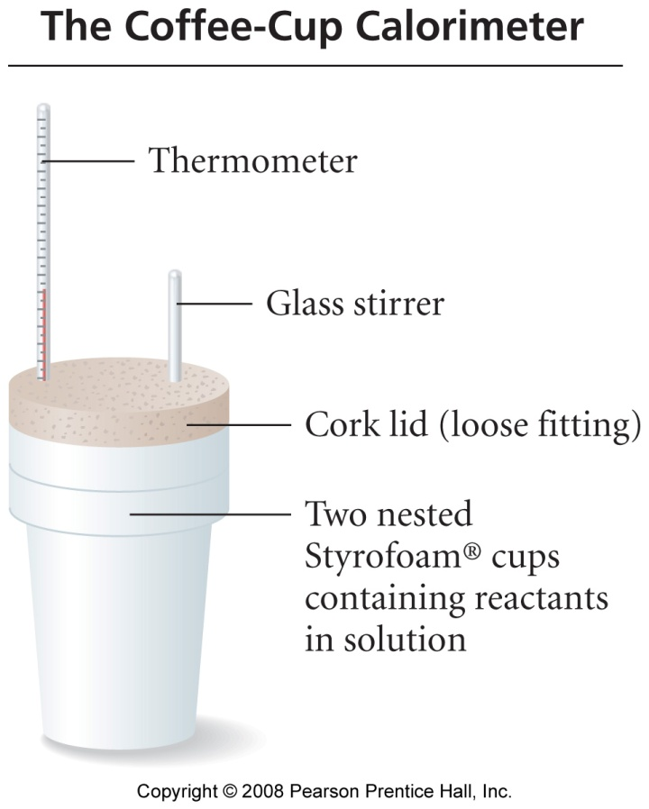
The coffee-cup calorimeter is used to measure enthalpy change ΔΗ_{rxn}, in solution.
Chapter 6: Reaction Kinetics and Thermodynamics
6.5. Constant – pressure Calorimetry: Mesuring ΔΗ_{rxn}
q _{soln} = m _{soln} xC_{s, soln} x ΔΤ
q _{rxn} = - q _{soln} = ΔΗ_{rxn}
The enthalpy, H, of a system is the sum of the internal energy of the system and the product of pressure and volume.
H = E + PV
حرارة التفاعل هو تغيّر المحتوى الحراري في التفاعل.
the enthalpy change, ΔH, of a reaction is the heat evolved in a reaction at constant pressure.

Slide 16
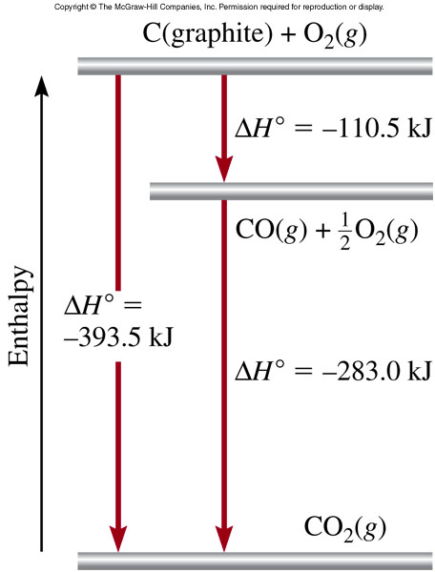
6.6 Relationships involving ΔΗ_{rxn ,} Thermochemical Equations
If you multiply both sides of the equation by a factor n, then ΔH must be multiplied by the same factor n.
H₂O (s) H₂O (l) ΔH = 6.01 kJ
2H₂O (s) 2H₂O (l) ΔH = 2 x 6.01 = 12.0 kJ
If you reverse a reaction, the sign of ΔH changes
H₂O (l) H₂O (s) ΔH = -6.01 kJ
If a chemical equation can be expressed as the sum of a series of steps, ΔΗ_{rxn} for the overall equation is the sum of the heats of reactions for each step. (Hess’s law)
C (graphite) + 1/2O₂ (g) CO (g)
CO (g) + 1/2O₂ (g) CO₂ (g)
C (graphite) + O₂ (g) CO₂ (g)
6.4

Slide 17
6-7 Enthalpies of reaction from Standard heat of formation
Standard States and Standard Enthalpy Changes, this standard has three parts:
1- Standard State
For a Gas: the pure gas at a pressure of exactly 1 atmosphere.
For a Liquid or Solid: the pure substance in its most stable form at a pressure of 1 atm and at the temperature of interest (often taken to be 25°C )
For a Substance in Solution: a concentration of exactly 1 M.
2- Standard Enthalpy Change (ΔH°)
The change in enthalpy for a process when all reactants and products are in their standard states. The degree sign indicates standard states.
3- Standard Enthalpy of Formation (ΔH_{f}°)
For a Pure Compound: The change in enthalpy when 1 mole of the compound forms from its constituent elements in their standard state.
For a Pure Element in Its Standard State: ΔH_{f}° = 0.
ΔH⁰ (O₃) = 142 kJ/mol
ΔH⁰ (C, diamond) = 1.90 kJ/mol
ΔH⁰ (C, graphite) = 0
f
ΔH⁰ (O₂) = 0
f
f
f

Slide 18
The standard enthalpy of reaction (ΔH⁰ ) is the enthalpy of a reaction carried out at 1 atm which can be determined by:
The direct method
rxn
aA + bB cC + dD
ΔH⁰
cΔH⁰ (C)
dΔH⁰ (D)
-
aΔH⁰ (A)
bΔH⁰ (B)
=
[
+
]
[
+
]
rxn
f
f
f
f
ΔH⁰
=
Σ
nΔH⁰ (products)
-
Σ
mΔH⁰ (reactants)
rxn
f
f
Calculate the standard enthalpy of the following reaction:
1 -The direct method by using the standard enthalpy of formation
C(s) + H₂O (g) CO (g) + H₂ (g) ΔH = ?????? kJ
ΔH⁰
ΔH⁰ (CO)
ΔH⁰ (H₂)
-
[
ΔH⁰ (C)
ΔH⁰ (H₂O)
=
[
+
]
+
]
rxn
f
f
f
f
ΔH⁰_{rxn} = [(- 110.5 + 0) – (0 + (-241.8)] = 131.3 kJ

Slide 19
Calculate the standard enthalpy of the following reaction:
2-The indirect method by using the Hess law
C(s) + H₂O (g) CO (g) + H₂ (g) ΔH = ?????? kJ
By using the following equations;
C(s) + O₂ (g) CO₂ (g) ΔH = - 393.5 kJ
2CO(g) + O₂ (g) 2 CO₂ (g) ΔH = - 566.0 kJ
2 H₂ (g) + O₂ (g) 2 H₂O (g) ΔH = - 483.6 kJ
Solution: by reversing and multiplying equations 2&3 by ½ and sum the three
equations we can get the following
C(s) + O₂ (g) CO₂ (g) ΔH = - 393.5 kJ
CO₂ (g) ½ O₂ (g) + CO (g) ΔH = + 283.0 kJ
H₂O (g) H₂ (g) + ½ O₂ (g) ΔH = + 241.8 kJ
C(s) + H₂O (g) CO (g) + H₂ (g) ΔH = +131.3 kJ

Slide 20
6.8 The rate of a chemical reaction
Chemical Kinetics is the area of chemistry concerned with speeds, or rates, at which a chemical reaction occurs.
Reaction rate is the change in the concentration (in the molarity) of a reactant or a product with time (M/s).
A B
Δ[A]
rate = -
Δ[A] = change in concentration of A over time period Δt
Δt
Δ[B]
Δ[B] = change in concentration of B over time period Δt
rate =
Δt
Because [A] decreases with time, Δ[A] is negative.
The rate for the general reaction can be defined as follows:
aA + bB cC + dD
1
Δ[A]
1
Δ[B]
1
Δ[C]
1
Δ[D]
rate = -
= -
=
=
a
Δt
b
Δt
c
Δt
d
Δt

Slide 21
Write the rate expression for the following reaction:
CH₄ (g) + 2O₂ (g) CO₂ (g) + 2H₂O (g)
Δ[CH₄]
1
Δ[O₂]
Δ[CO₂]
1
Δ[H₂O]
rate = -
= -
=
=
Δt
2
Δt
Δt
2
Δt
Example: 6.3.p167
Consider the balanced chemical equation:
In the first 10.0 seconds of the reaction, the concentration of I⁻ drops from 1.000 M to 0.868 M.
Calculate the average rate of this reaction in this time interval.
Predict the rate of change in the concentration of H⁺ (that is , Δ[H⁺]/Δt) during this time interval.
Solution:
H₂O₂ (aq) + 3I⁻ (aq) + 2 H⁺ (aq) I⁻₃ (aq) + 2H₂O (l)
Δ[I⁻ ]
1
(0.868 − 1.000)Μ
(a) rate = -
= -
= 4.40x10⁻³ M/s
Δt
3
10.0 s
1
Δ[H⁺]
Δ[H⁺]
(b) rate = -
= - rate = -2 x 4.40x10⁻³ = - 8.80x 10⁻³ M/s
2
Δt
Δt

