Slide 1
Schistosoma
Kingdom Animalia
Phylum Platehelminthes
Class Trematoda
Subclass Digenea
Order Strigeidida
Genus Schistosoma
Species mansoni, haemetobium

Slide 10
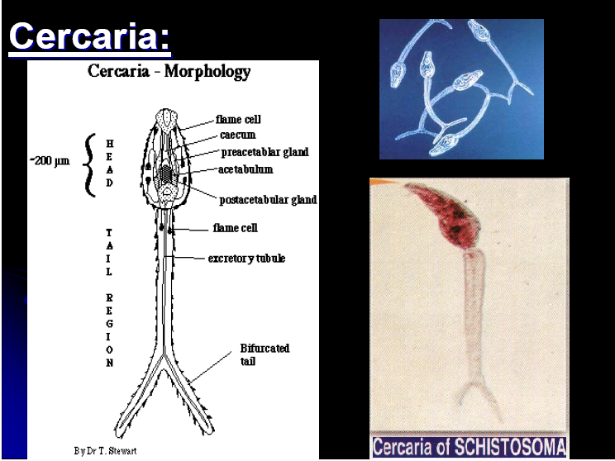

Slide 11
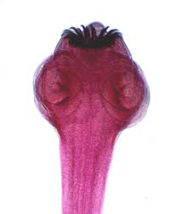
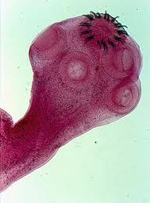
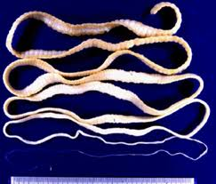
Taenia solium
Classification
Phylum Platyhelminthes
Class Cestoda
Subclass Eucestoda
Order Cyclophyllidea
Genus Taenia
Species solium
Found in the intestine of man
Commonly known as Beef Tape Worm
Intermediate host is Buffalo, pork and
dog
Man is the definitive host
Caused diseases Taeniasis

Slide 12
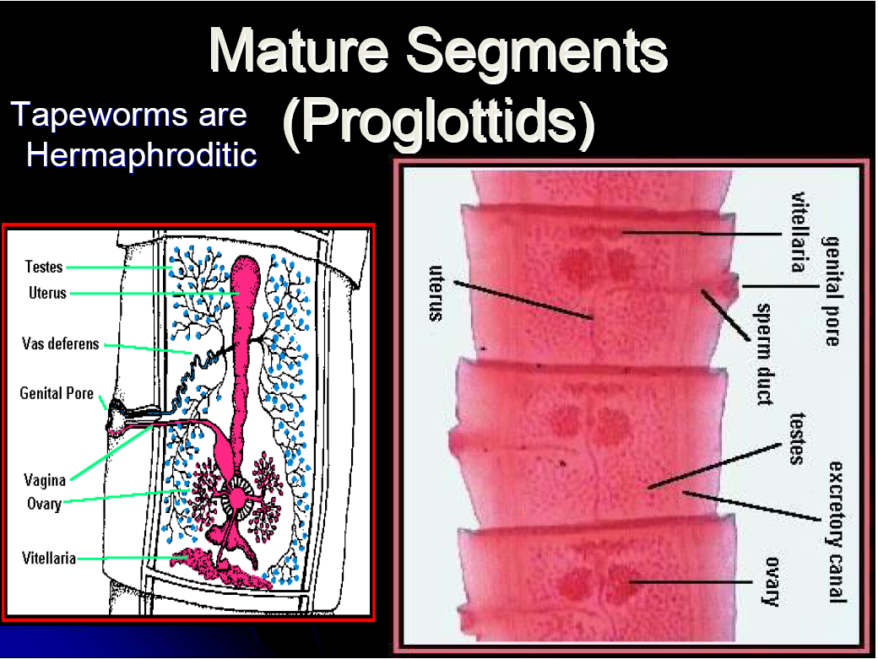

Slide 13
