Slide 1
Family and Friends 2-Grade 2
Unit 8
Tidy up!
Lesson 4 Phonics
P 75

Slide 2
Objectives
Recognise the sound /o/.
To write words with the phonic sound /o/.

Slide 3
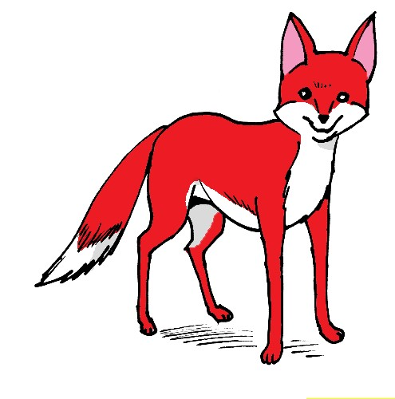
Listen, point and repeat
Log
Dog
Fox
Box

Slide 4
Read and circle the letter ‘o’ with your finger.
The fox is in a box.
The dog is looking at the fox in a box.
The dog took a log to the fox in a box.
The fox and the dog left the box and
played with the log.

Slide 5
Read and circle the sound ‘o’ with your finger.
The fox is in a box.
The dog is looking at the fox in a box.
The dog took a log to the fox in a box.
The fox and the dog left the box and
played with the log.

Slide 6
On your screen, match the words with the correct pictures using your finger!
Dog
Log
Fox
Box

Slide 7
On your screen, match the words with the correct pictures using your finger!
Dog
Log
Fox
Box

Slide 8
Write the missing letters to make a correct word.
_o_
B_x
D_ _
_ _ _

Slide 9
Write the missing letters to make a correct word.
Log
Box
Dog
Fox

Slide 10
Open your class book P75 and read.
Open your workbook P73 and answer the questions.

Slide 11
Open unit 8 practice PPT and answer L 4.

Slide 12
End of the lesson
Good job dear !

