Slide 1
Family and Friends 2 Grade 2 Unit 6 Lesson 6 P59

Slide 2
Objectives
1-Write sentences using (’s – hasn’t got).
2-Write sentences using (’ve got).
_________________________________________________________________________________________________________________________________________________
Ministry of Education-2020

Slide 3
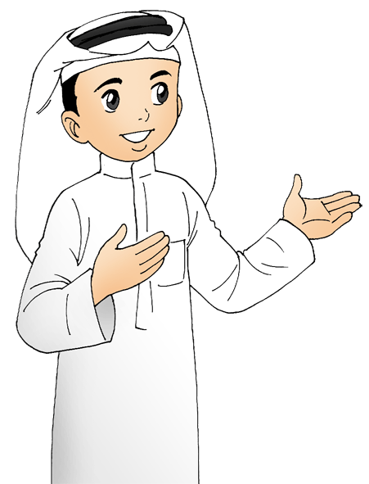
He
Let’s remember L2: we use …
Ali
dad
the boy
grandpa
brother
_________________________________________________________________________________________________________________________________________________
Ministry of Education-2020

Slide 4
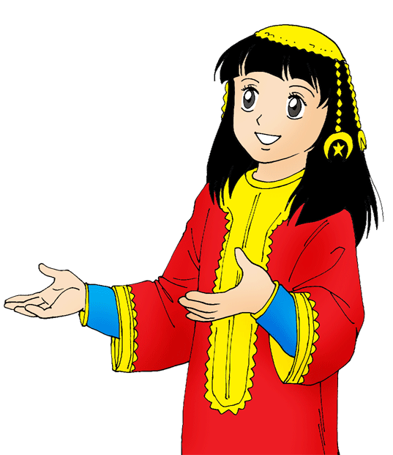
Let’s remember L2: we use …
She
Amal
the girl
mom
grandma
sister
_________________________________________________________________________________________________________________________________________________
Ministry of Education-2020

Slide 5
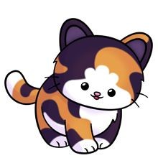
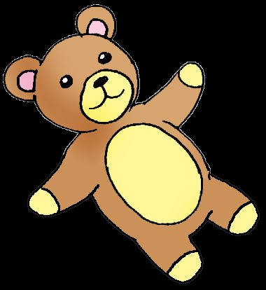
Let’s remember L2: we use …
it
Animals or objects
cat
pencil
teddy bear
_________________________________________________________________________________________________________________________________________________
Ministry of Education-2020

Slide 6
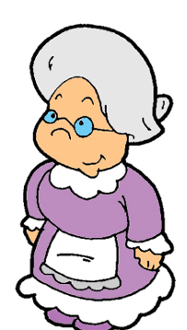
She
’s got
hasn’t got
1
2
She hasn’t got a blue dress.
She’s got glasses.
_________________________________________________________________________________________________________________________________________________
Ministry of Education-2020

Slide 7
He
’s got
hasn’t got
1
2
He hasn’t got a blue
T-shirt.
He’s got brown hair.
_________________________________________________________________________________________________________________________________________________
Ministry of Education-2020

Slide 8
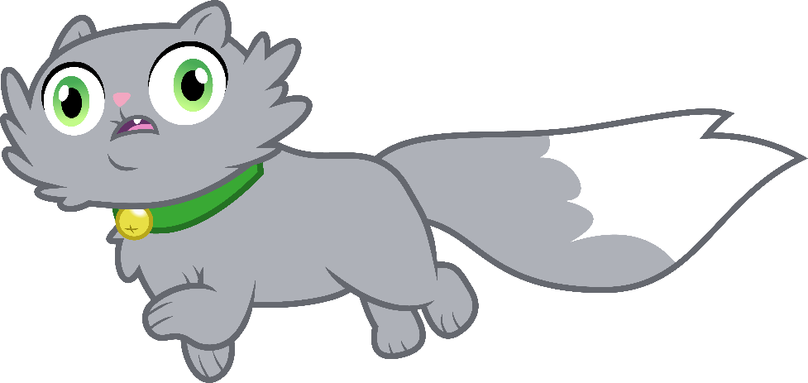
It
’s got
hasn’t got
1
2
It hasn’t got blue
eyes.
It’s got black eyes.
_________________________________________________________________________________________________________________________________________________
Ministry of Education-2020

Slide 9
I’ve
I’ve got a blue cap.
I’ve got a nice smile.
_________________________________________________________________________________________________________________________________________________
Ministry of Education-2020

Slide 10
Remember
He’s got = He has got
Hasn’t got = He has not got
I’ve got = I have got
_________________________________________________________________________________________________________________________________________________
Ministry of Education-2020

Slide 11
Let’s practice
Read and Circle 've – 's.
She’s got short hair.
He’s got blond hair.
I’ve got long hair.
It’s got eight legs.
_________________________________________________________________________________________________________________________________________________
Ministry of Education-2020

Slide 12
Let’s practice
Model answer!
Read and Circle 've – 's.
She’s got short hair.
He’s got blond hair.
I’ve got long hair.
It’s got eight legs.
_________________________________________________________________________________________________________________________________________________
Ministry of Education-2020

Slide 13
Let’s practice!
Read and rearrange to make a sentence.
.
She
short
’s
hair
got
Click and check your answer!
She
.
’s got short hair
eyebrows
got
He
.
’s
black
He’s got black eyebrows.
Click and check your answer!
_________________________________________________________________________________________________________________________________________________
Ministry of Education-2020

Slide 14
Let’s practice!
Read and rearrange to make a sentence.
.
She
short
’s
hair
got
Click and check your answer!
She
.
’s got short hair
eyebrows
got
He
.
’s
black
Click and check your answer!
He’s got black eyebrows.
_________________________________________________________________________________________________________________________________________________
Ministry of Education-2020

Slide 15
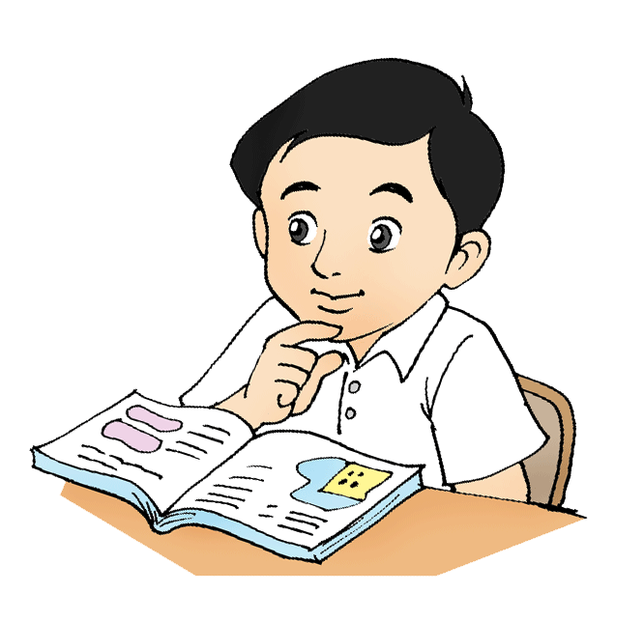
Let’s practice
Answer Activity 1, page 57 in your workbook.
Click and check your answer!
I’ve got short hair.
I’ve got long hair.
It’s got black eyes.
She’s got blue eyes.
He’s got curly hair.
_________________________________________________________________________________________________________________________________________________
Ministry of Education-2020

Slide 16
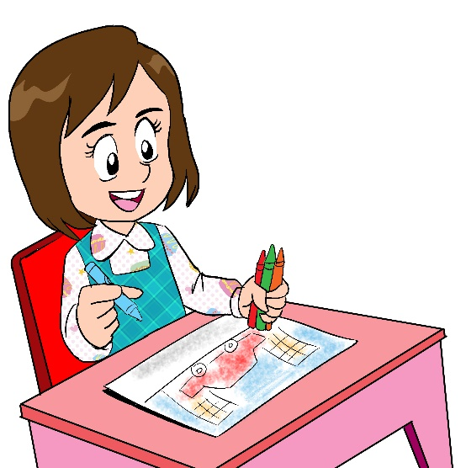
Don’t forget to answer the questions
in
Unit 6 worksheet L6
_________________________________________________________________________________________________________________________________________________
Ministry of Education-2020

Slide 17
End of lesson 6
Good job dear !
_________________________________________________________________________________________________________________________________________________
Ministry of Education-2020

