Slide 1
Lab Exercise # 13
Zoo- 145
Anatomy of Rat
The Nervous System in Rat

Slide 2
Nervous System
The nervous system in rats is divided into two parts:
The central nervous system (CNS)
The peripheral nervous system (PNS)
The central nervous system consist of Brain and Spinal Cord,
The peripheral nervous system is composed of all nerves outside the central system (Spinal nerves and cranial nerves)
The rat have 34 pairs of spinal nerves: 8 cervical, 13 thoracic, 6 lumber, 4 sacral and 3 caudal spinal nerve
There are 12 pairs of Cranial nerves emerging from various parts of the brain
The brain consist of three parts:
The fore brain
The mid brain
The hind brain

Slide 3
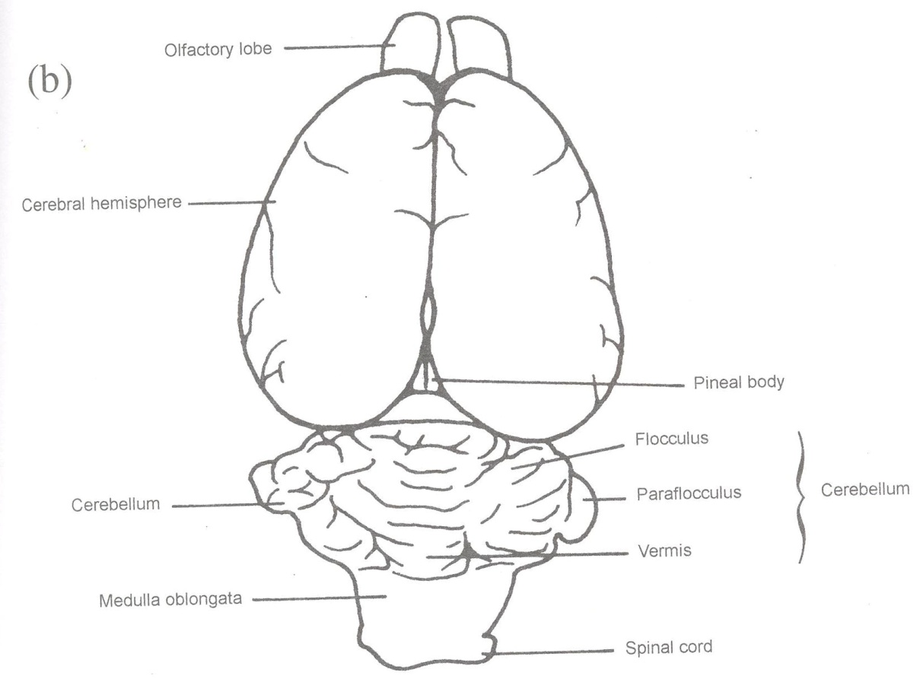
The dorsal view of the rat’s brain

Slide 4
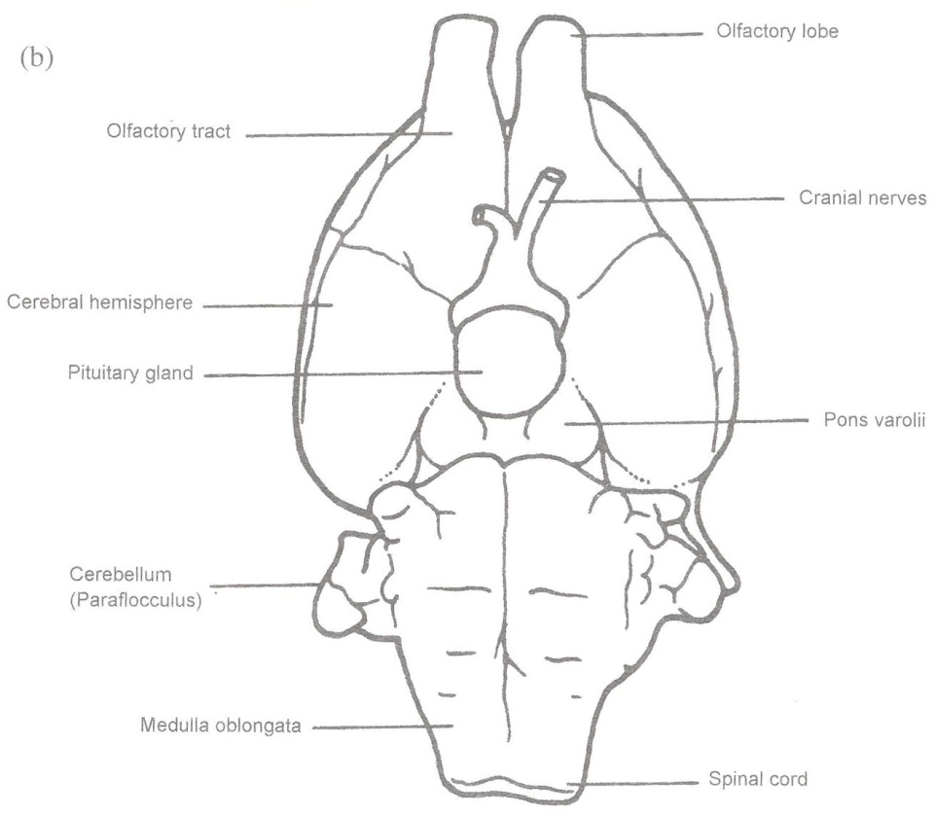
The ventral view of the rat’s brain

Slide 5
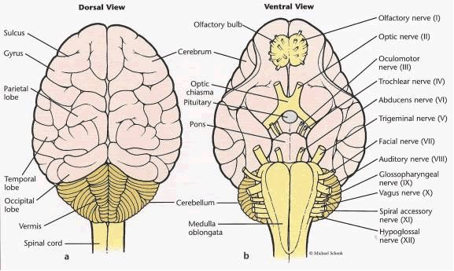

Slide 6
Two parts of nervous sytem
central and peripheral
Central nervous system CNS
consists of brain and spinal cord, serves as information input and output control center for the body, integrates regulates and controls bodys activities and relays impulses between brain and peripheral nerves
Peripheral nervous system PNS
composed of neurons arranged in nerves, contains sensory and motor neutrons that transport impulses to and from CNS
Autonomic nervous system
contains neutrons that parallel PNS neutrons with nerves, convey involuntary information such as breathing, heart rate, digestion, salivation, perspiration to and from CNS
Homeostasis
maintain body in stable condition, purpose of nervous system, accomplished by generation of nerve pulses that travel along nerve conduction pathaways
Receptors
impulses originate from these specialized sensory structures

Slide 7
Eendocrine system
releases signaling molecules called hormones into bloodstream
ex. pancreas secretes insulin
testes secretes testosterone
Cerebrum
anterior larger upper part of brain, associated with higher brain function such as thought and action, divided by longitutional fissure
Longitudional fissure
divides cerebrum into the right hemisphere controlling left body and vice versa
Frontal lobe
apart of cerebral cortex, associated with reasoning, planning, speech, movement, emotions, problem solving
Olfactory bulbs
recieve sensory neurons from nasal cavity and are responsible for smell
Cerebellum
posterior and slightly underneath cerebrum, primary reflex center for skeletal movements, coordination and balance
Medulla oblongata
brain stem leading to spinal cord, located at base of cerebellum, regulates heart beat breathing sweating vomiting and digestion

Slide 8
Thank you

