Slide 1
Chapter 7
Animal Form and Function
التركيب و الوظيفة فى الحيوان

Slide 2
Objectives
To illustrate how structure fits function at all levels of organization in the animal body
To define tissues as groups of cells with a common structure and function
To classify the animal tissues
To distinguish between the four basic types of animal tissues
Notes:
In this lesson, we discuss
We will use animals as examples of this. We also will.

Slide 3
Animals consist of a hierarchy of levels of organization
تتألف الحيوانات من منظومة مستويات التعضي
Animals are composed of groups of cells with a common structure and function
The structural hierarchy of the progression from cells to organisms is:
Groups of Cells make up Tissues
Different tissues make up Organs
Organs together make up Organ systems
Notes:
The structural hierarchy of the progression from cells to organisms is:

Slide 4
Form and function
Anatomy = Structure التشريح : التركيب
Physiology = Function الفسيولوجيا : الوظيفة
Examples:
Skin: thick cells closely attached to each other: forming a protective barrier.
- الجلد: يتكون من خلايا غليظة (تحمى)
Red Blood Cells: smooth & round cells: easy to flow through vessels
- خلايا الدم الحمراء: تتكون من خلايا دائرية ملساء (تسهل حركتها فى الأوعية الدموية)

Slide 5
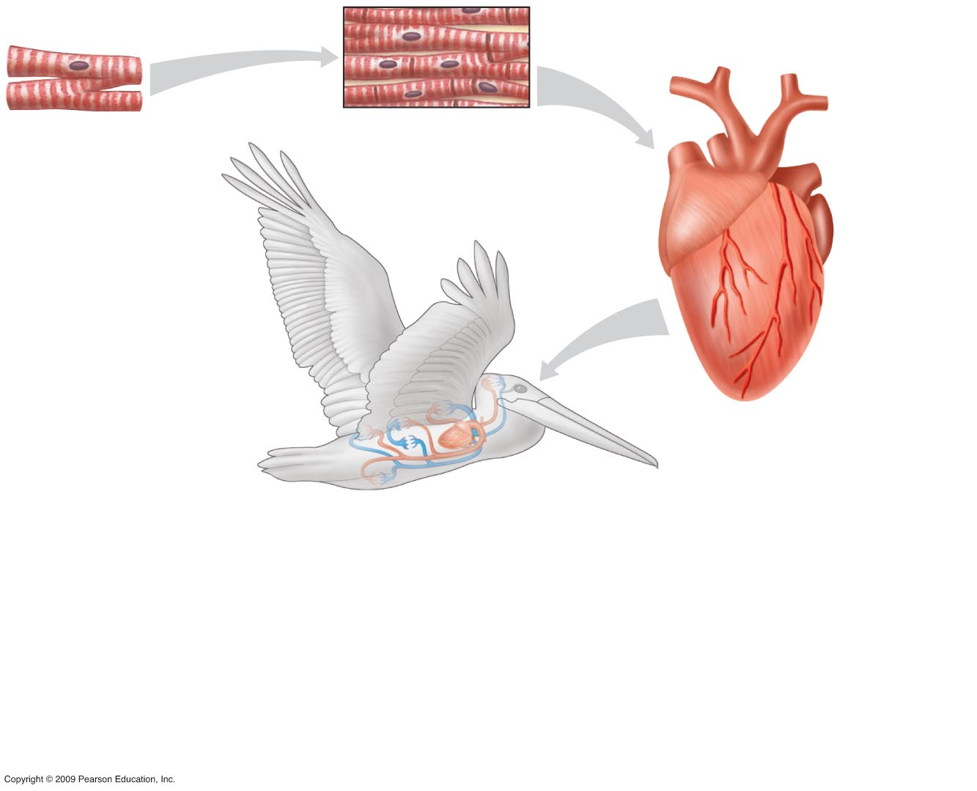
A
Cellular levelالمستوى الخلوي
Muscle cellخلية عضلية
B
Tissue levelمستوى النسيج
Muscle tissueنسيج عضلي
C
Organ levelمستوى العضو
Heartالقلب
D
Organ system levelمستوى الجهاز
Circulatory systemالجهاز الدوري
An example of structural hierarchy
مثال لمنظومة مراتب مستويات التعضية
Notes:
5
Figure 20.1 An example of structural hierarchy in a pelican.

Slide 6
Classification Of Animal Tissues

Slide 7
Tissues الأنسجة
There are four main types of tissues in animals:
الحيوانات لديها أربعة أنواع رئيسية من الأنسجة
Epithelial tissueالأنسجة الطلائية
Connective tissueالأنسجة الضامة
Muscle tissueالأنسجة العضلية
Nervous tissueالأنسجة العصبية

Slide 8
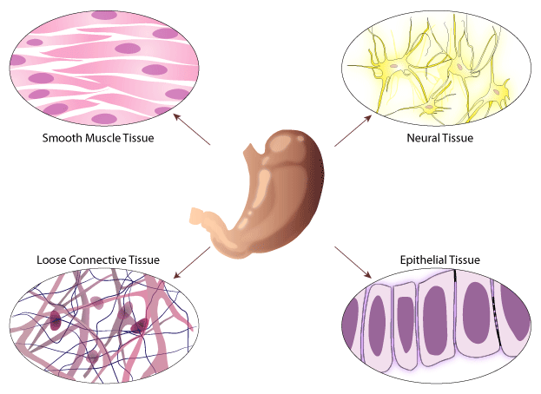

Slide 9
Epithelial Tissue الأنسجة الطلائية

Slide 10
Epithelial tissue الأنسجة الطلائية
Epithelial tissues are flat sheets of cells that cover the surfaces inside and outside the body.
They also line organs and support other tissues.
They may contain specialized cells that allow the tissue to perform multiple functions.
تغطي الأنسجة الطلائية الجسد وتبطن أعضاءه وتجاويفه
Function as barrier against mechanical injury, pathogens (microbes).
تعمل الأنسجة الطلائية على حماية الجسد من الجروح والميكروبات

Slide 11
Epithelial tissue الأنسجة الطلائية
Epithelial tissues are classified into 3 major shapes divided into subtypes, based on the number of layers of cells.
The cells shapes are:
توجد الخلايا الطلائية على ثلاث هيئات (أشكال)
Notes:
11
Student Misconceptions and Concerns
1. Students often find it challenging to gain a proper understanding of the evolution of form and function relationships. Such relationships appear to have been “constructed” to meet a purpose, a consequence of deliberate planning and design. Ask students to explain why we have lungs, and they will typically answer something along the line of “Because we need to breathe,” or “Because we need oxygen.” Need, however, does not cause evolution. Natural selection involves editing rather than creating diversity. A better answer might be “Because lung-like structures conveyed an advantage in gas exchange in our ancestors.”
2. Relationships between form and function are found all around us. For some of us, noticing the connections is easy. However, many students have spent little time considering why any particular structure has its characteristic shape. Practice with examples helps to build a better understanding of these important relationships.
Teaching Tips
1. Simple squamous cells have a shape that is generally similar to a fried egg: flattened, with a bump in the middle representing the nucleus or yolk.
2. Students might misunderstand how the cilia lining our respiratory passages work. Cilia do not “filter” the air like a comb. Instead, cilia are covered by a layer of mucus. Dust particles adhere to sticky mucus, which is then swept up the respiratory tract by the cilia. If students clear their throats, they will identify the fate of this mucus. We swallow after clearing our throats!

Slide 12
Epithelial tissue الأنسجة الطلائية
Squamous—like a fried egg
حرشفية – مثل البيض المقلي (بلا حدود)
Cuboidal—as tall as they are wide
مكعبانية – طولها مثل عرضها
Columnar—taller than they are wide
عمادية – طولها أكثر من عرضها
Notes:
12
Student Misconceptions and Concerns
1. Students often find it challenging to gain a proper understanding of the evolution of form and function relationships. Such relationships appear to have been “constructed” to meet a purpose, a consequence of deliberate planning and design. Ask students to explain why we have lungs, and they will typically answer something along the line of “Because we need to breathe,” or “Because we need oxygen.” Need, however, does not cause evolution. Natural selection involves editing rather than creating diversity. A better answer might be “Because lung-like structures conveyed an advantage in gas exchange in our ancestors.”
2. Relationships between form and function are found all around us. For some of us, noticing the connections is easy. However, many students have spent little time considering why any particular structure has its characteristic shape. Practice with examples helps to build a better understanding of these important relationships.
Teaching Tips
1. Simple squamous cells have a shape that is generally similar to a fried egg: flattened, with a bump in the middle representing the nucleus or yolk.
2. Students might misunderstand how the cilia lining our respiratory passages work. Cilia do not “filter” the air like a comb. Instead, cilia are covered by a layer of mucus. Dust particles adhere to sticky mucus, which is then swept up the respiratory tract by the cilia. If students clear their throats, they will identify the fate of this mucus. We swallow after clearing our throats!

Slide 13
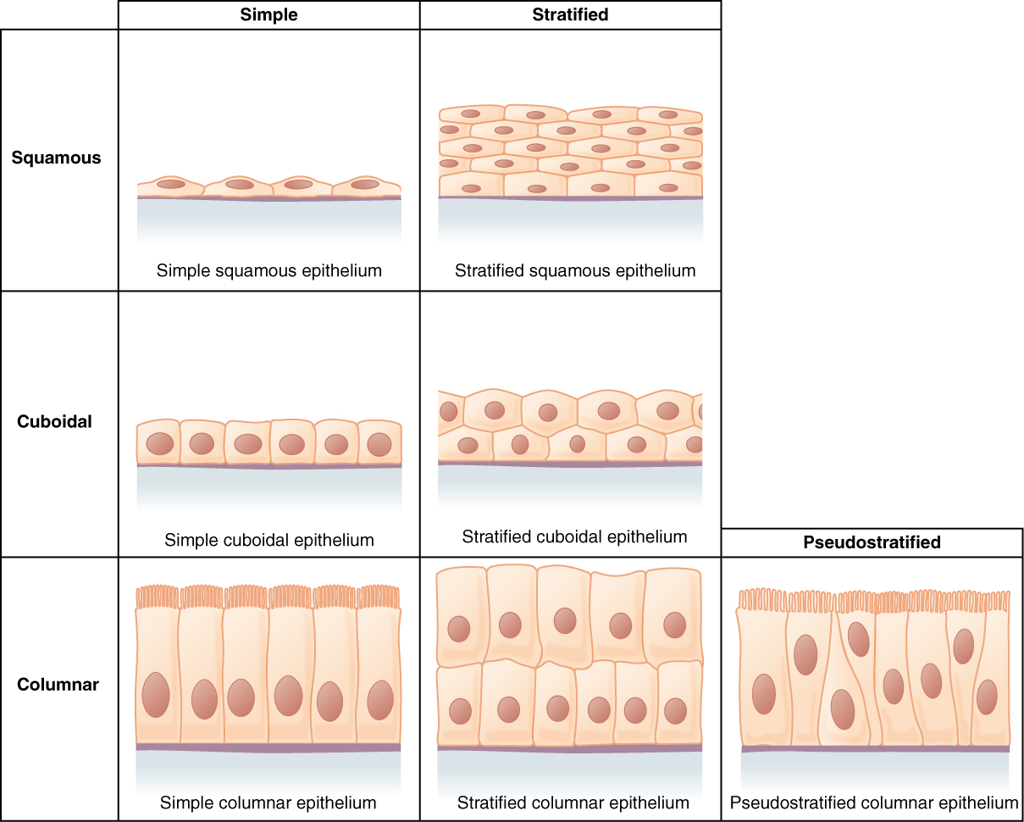
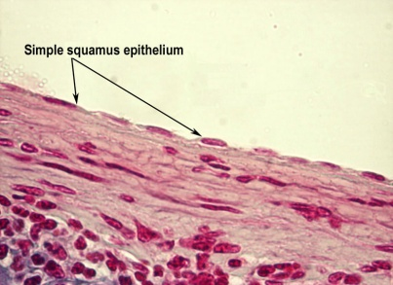
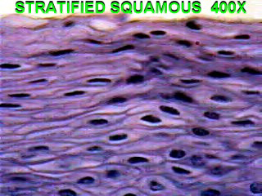
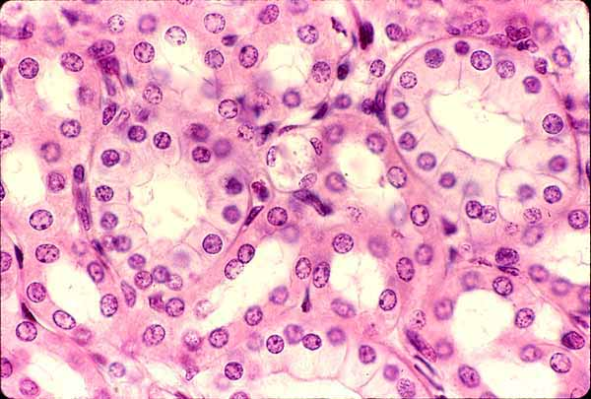
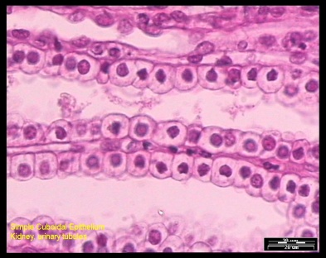
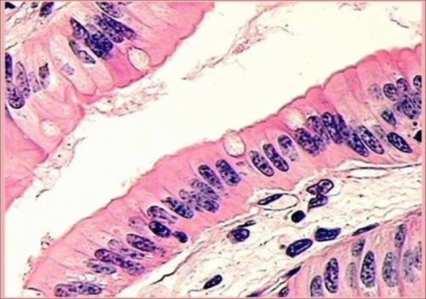
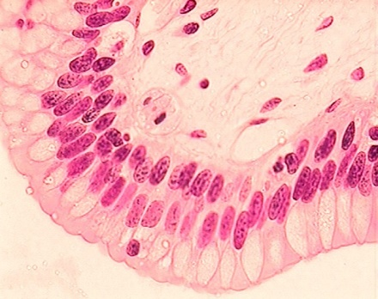
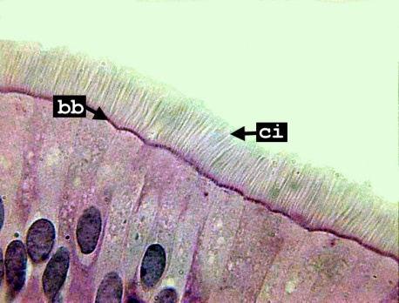
Epithelial tissues الأنسجة الطلائية

Slide 14
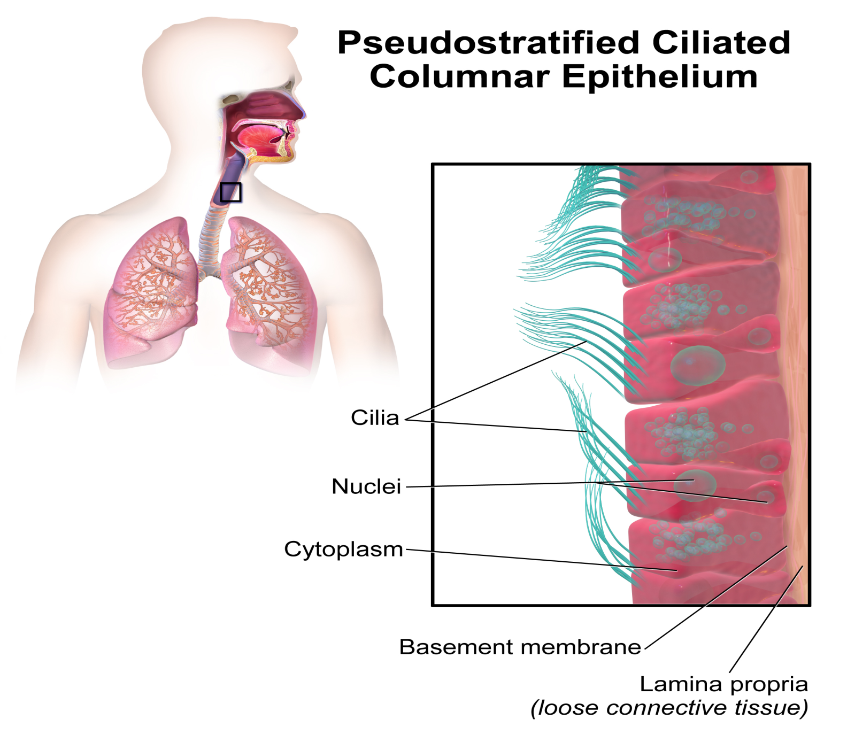
Epithelial tissue الأنسجة الطلائية
Notes:
14
Figure 20.4 Types of epithelial tissue; part E, Stratified squamus epithelium (lining the esophagus).

Slide 15
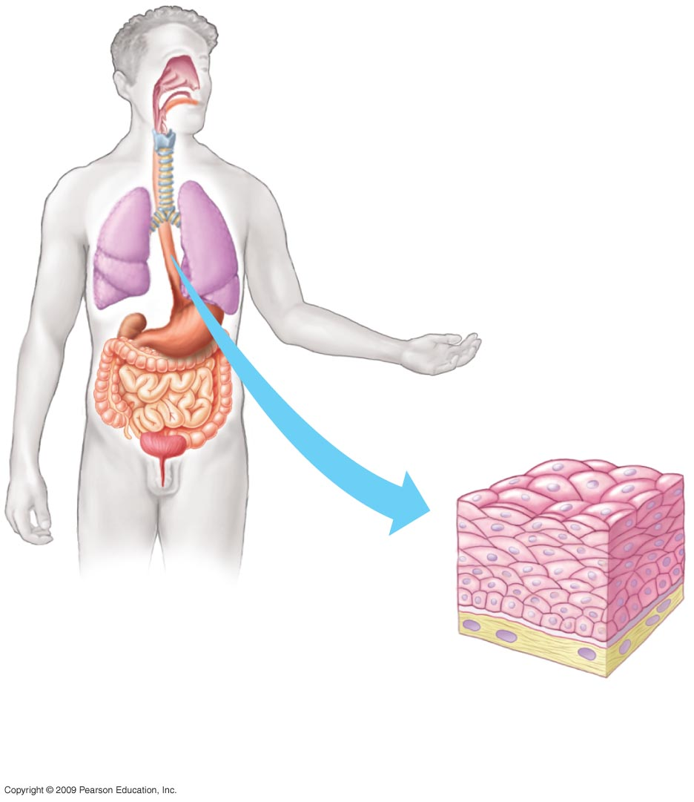
E
Stratified squamous epithelium
نسيج طلائي حرشفي طبقي
(esophagusالمرئ )
Notes:
15
Figure 20.4 Types of epithelial tissue; part E, Stratified squamus epithelium (lining the esophagus).

Slide 16
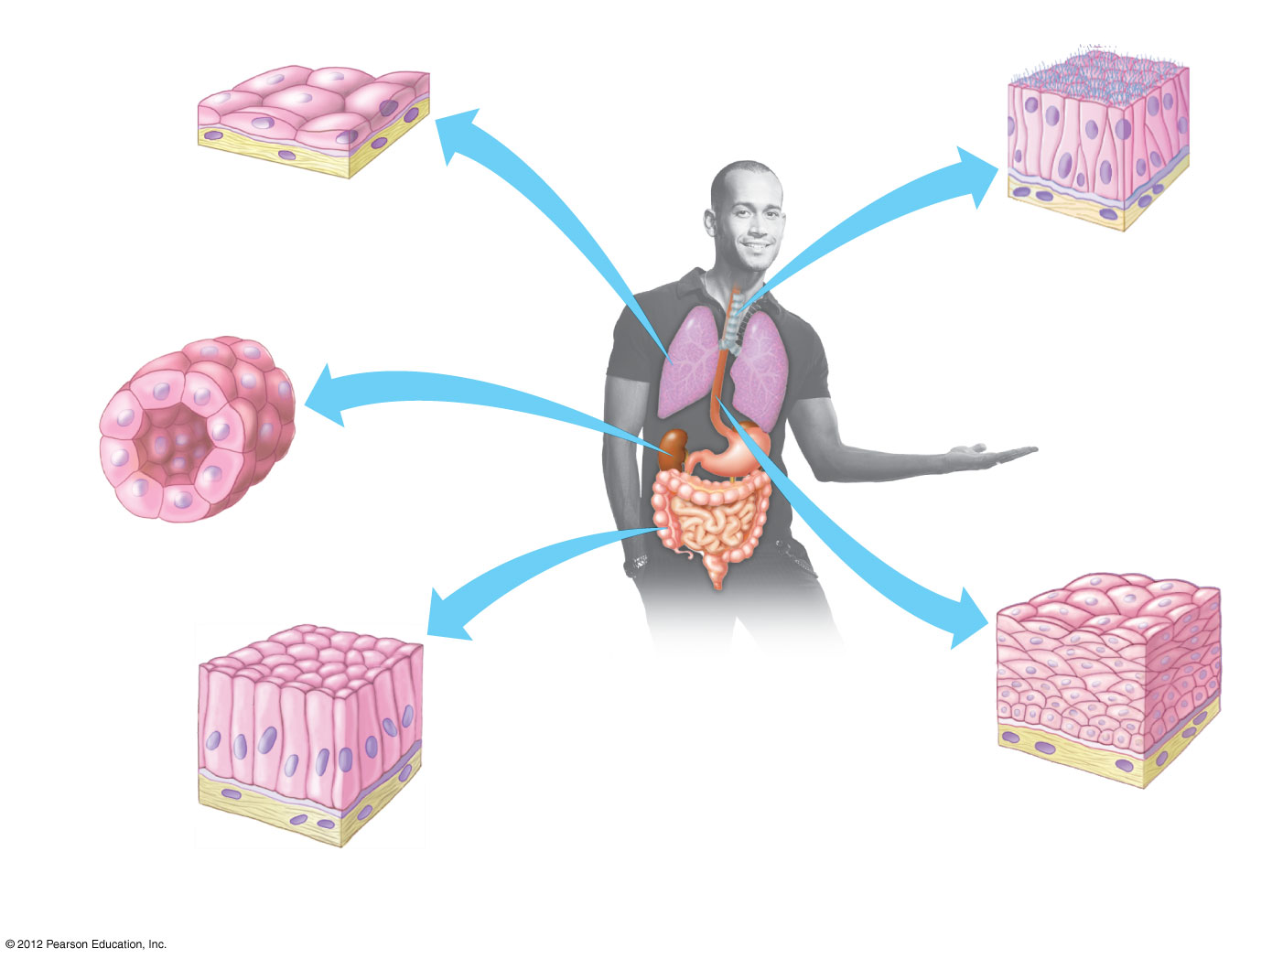
Apical surface of epithelium
Basal lamina
Underlying tissue
Cell nuclei
Simple squamous epithelium
Pseudostratified ciliated columnar epithelium
Simple cuboidal epithelium
Stratified squamous epithelium
Simple columnar epithelium

Slide 17
Muscle Tissue الأنسجة العضلية

Slide 18
Muscle Tissue الأنسجة العضلية
Muscle tissue compose of long cells called muscle fibers capable of contracting.
تقوم الأنسجة العضلية بالحركة استجابة للاشارات العصبية
The primary function (i) of muscle tissue is to provide movement.
This is achieved by contraction of muscle cells in response to nerve signals, which occurs when proteins inside the cells pull on each other.
Other functions such as (ii) to maintain the posture, (iii) stabilizing joints.

Slide 19
Muscle Tissue الأنسجة العضلية
Muscles are divided into (3) types:
Skeletal عضلات هيكلية (voluntary ارادية)
Cardiac عضلات قلبية ( Involuntary لارادية )
Smooth عضلات ملساء ( Involuntary لارادية )

Slide 20
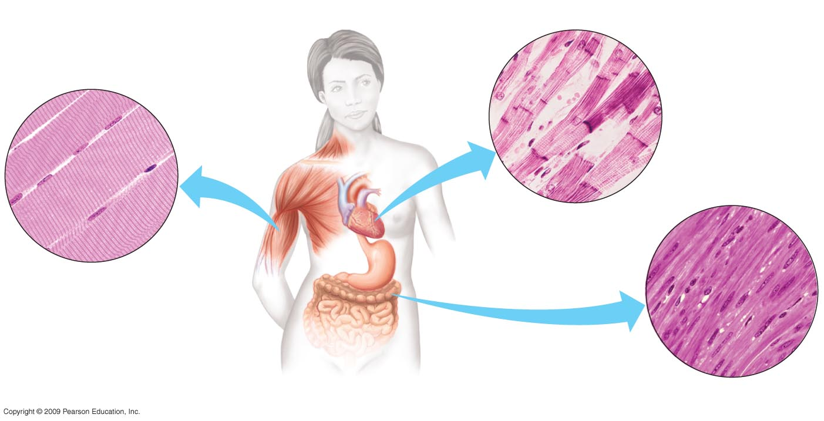
Muscle Tissue الأنسجة العضلية
Unit of muscle
contraction
وحدة الإنقباض العضلي
Muscle fiber
ليفة عضلية
Junction between
two cells
اتصال خلوي بين خليتين
Muscle fiber
ليفة عضلية
Nucleus
نواة
Nucleus
نواة
Muscle fiber
ليفة عضلية
Nucleusنواة
B
Cardiac muscle
عضلة قلبية
A
Skeletal muscle
عضلة هيكلية
C
Smooth muscle
عضلة ملساء
The three types of muscle
الأنواع الثلاث للعضلات
Notes:
20
Figure 20.6 The three types of muscle.

Slide 21
Connective Tissue النسيج الضام

Slide 22
Connective Tissue النسيج الضام
A type of tissue that connects, or separates different types of tissues and organs of the body.
The cells of connective tissue are embedded in a great amount of extracellular material.
This matrix is secreted by the cells.

Slide 23
Connective Tissue النسيج الضام
Functions mainly to bind and support other tissues.
يرتبط النسيج الضام بالأنسجة الأخرى ويدعمها
Connective tissue comes in various forms.
It may be liquid, solid, or anywhere in between.
can be grouped into six major types
يمكن تقسيم الأنسيجة الضامة إلى ستة أنواع

Slide 24
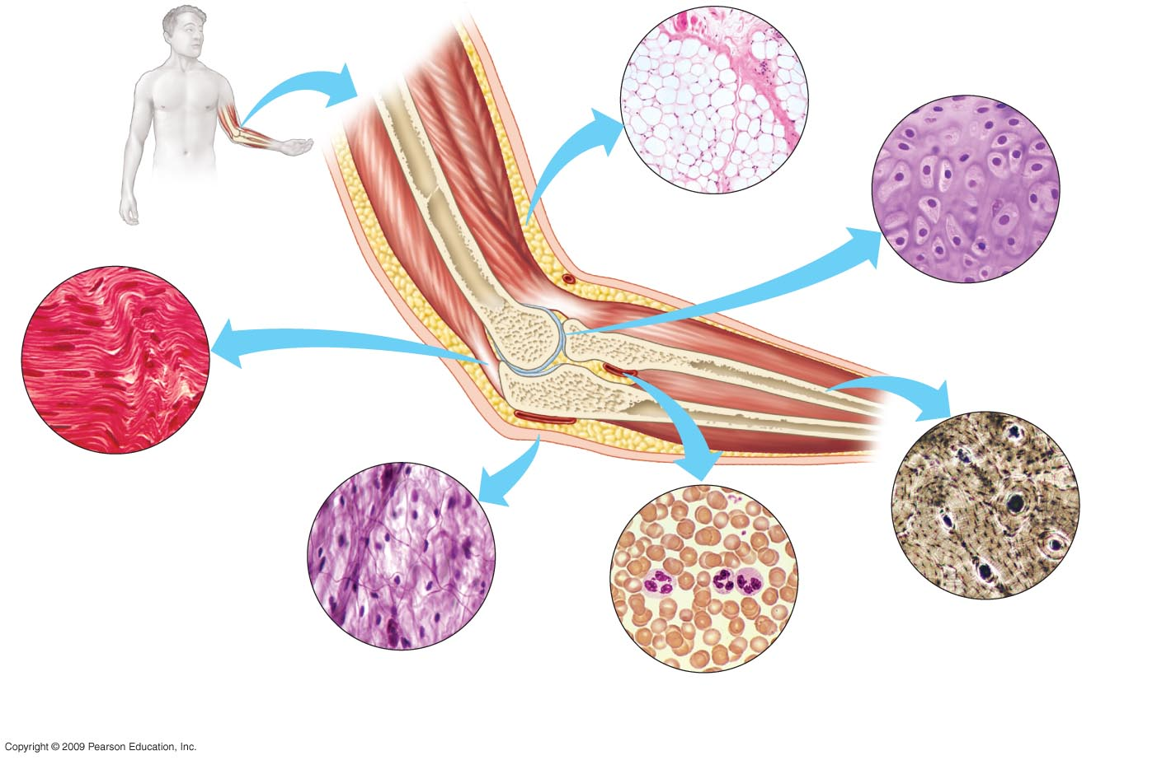
Connective Tissue النسيج الضام
Fat droplets
قطيرات
دهنية
Cartilage-
Forming cells
خلايا مكونة
للغضروف
storehouse for nutrients C
Matrix
المادة الحشوية
Adipose tissue which contains fat droplets
نسيج دهني
Cell nucleus
نواة خلية
D
Cartilageالغضروف
(at the end of a boneفي نهاية العظم يتكون من كولاجين )
Collagen fibers
ألياف كوللاجين
Central
Canal
قناة مركزية
B
Cellخلية
Matrix
المادة
الحشوية
Fibrous connective tissue
نسيج ضام ليفي
Forming tendons (muscles to bones)l
تكون الاوتارالتى تربط العضلات بالعظم
Forming ligaments (Bones to joints)
تكون الأربطة التى تربط الأوتار بالعظم
White blood
Cells
خلايا دم
بيضاء
Bone-
Forming Cells
خلايا مكونة
للعظم
Red blood
cell
خلايا دم حمراء
Collagen fiberألياف كوللاجين
Plasmaبلازما
E
A
Boneالعظم
Elastic fibersألياف مطاطة
provides framework and
strength for body
Loose connective tissue
النسيج الضام الفجوي
Under the skin distributed throughout the body
binding materials of organs
تحت الجلد
F
Bloodالدم
Types of connective tissue
أنواع الأنسجة الضامة
Notes:
24
Figure 20.5 Types of connective tissue.

Slide 25
Nervous Tissue الأنسجة العصبية

Slide 26
Nervous tissue الأنسجة العصبية
Cells with branching extensions that form a communication network all over the body.
Sense stimuli and transmit signals in the form of nerve impulses from one part of animal to another.
Nerve tissue can be found everywhere in the body.
The biggest masses of it are in the central nervous system: the brain and spinal cord.
The peripheral nervous system (the nerve and sensory cells).
تشعربالعوامل المحفزة وتنقل الاشارات على شكل ذبذبات عصبية فى جسم الحيوان. توجد الانسجة العصبية تقريبا فى كل الجسم الا أن الجزء الأكبر موجود بالمخ والحبل الشوكى.

Slide 27
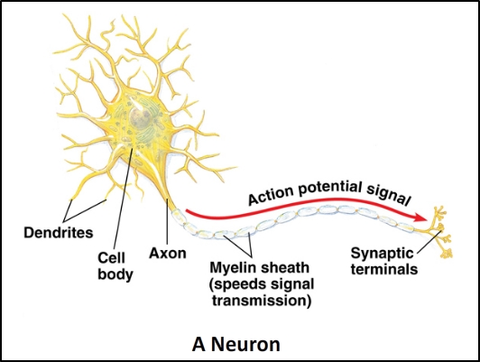
Nervous tissue الأنسجة العصبية
The cells that carry out this function are called neurons.
Neurons conduct nerve impulses.
Several other types of cells support and protect the neurons. Called supporting cells.

Slide 28
Summary

Slide 29
Tissue | Epithelial | Connective
Characteristics | Covers the outside of the body Lines organs and cavities within the body | Connects, separates different types of tissues and organs.
Structure | Sheets of close cells | Cells of connective tissue are embedded in a great amount of extracellular material (matrix)
Function | A protective barrier against mechanical injury, pathogens (microbes). | Bind and Support
Types | 1. Squamous Simple: only one layer (e.g. capillaries – air sacs) Stratified: more than one layer (e.g. esophagus) 2. Cuboidal : Cube shaped (e.g. Kidney – Salivary) 3. Columnar : Column shape (e.g. small intestine) | 1. Loose Distributed throughout the body. 2. Fibrous Bundles of fibres (Tendons :muscle to bone) (Ligaments: bone to joint) 3. Cartilage (at bone ends and consists of collagen fibers embedded in rubbery material) 4. Bones Matrix of collagen fibers embedded in a hard substance (Ca – Mg – P) 5. Blood Matrix: a liquid matrix (plasma) consists of water – salts – protein Contain RBCs&WBCs 6. Adipose Cells in a matrix of fibers Contain fat droplets

Slide 30
Tissue | Muscle | Nervous
Characteristics | Most abundant tissue in most animals | Found in brain – spinal cord - nerves
Structure | Long cells called muscle fibers | Nerve cells (neurons)
Function | Contracting in response to nerve signals | Sense stimuli Transport (conduct) nerve impulses
Types | 1. Skeletal Attached to bones by tendons (voluntary) 2. Cardiac contractile tissue of heart (involuntary) 3. Smooth Walls of digestive tract – arteries (involuntary)

Slide 31
SYSTEMS | ORGANS | FUNCTIONS
Respiratory | lungs, nasal passages, bronchi, pharynx, trachea, diaphragm, bronchial tubes | intake of oxygen and removal of carbon dioxide from body
Nervous | spinal cord, brain, nerves, skin, eyes, ears, tongue, nose | control of body activities and the reaction to stimuli
Digestive | stomach, liver, teeth, tongue, pancreas, intestine, esophagus | break down of food and absorption for use as energy
Excretory | kidneys, bladder ureters, skin | controls water and salt balance
Endocrine | pituitary gland, adrenal gland, thyroid gland, gonads | production of hormones and body regulation
Skeletal & Muscular | bones, muscles | protection and movement
Circulatory | blood, blood vessels, heart, lymph | transport of nutrients, metabolic wastes, water, salts, and disease fighting cells
Integumentary | skin | protection of body from injury and bacteria, maintenance of tissue moisture, holds receptors for stimuli response, body heat regulation

Slide 32
Connection

Slide 33
Tissues AND organs

Slide 34
Tissues AND organs
The heart is an organ that is mostly made up of cardiac muscle tissue. However, it also is made up of nervous, epithelial, and connective tissue.
These tissues work together to make the heart an efficient pump that circulates blood throughout the body.

Slide 35
Tissues AND organs
The muscle tissue does the work of pumping the blood for circulation throughout the body.
The nervous tissue coordinates the contraction of the muscle tissue for efficient pumping action.
The epithelial tissue lines the chambers of the heart.
The connective tissue binds the tissues together. It also gives the heart strength and elastic properties.

Slide 36
Heart is an organ which contains different types of tissues. Each tissue performs specific functions
يتكون القلب من عدة أنسجة - يؤدي كل نسيج وظائف محددة
The heart has: epithelial, connective, and nervous tissues
يحتوي القلب على أنسجة طلائية وضامة وعصبية
Epithelial tissues line the heart chambers
تبطن الطلائية غرف القلب
Connective tissues make the heart elastic
تجعل الأنسجة الضامة القلب مطاطاً
Nervous tissues regulate contractions
تنظم الخلايا العصبية انقباضات عضلة القلب
Copyright © 2009 Pearson Education, Inc.
Notes:
36
Student Misconceptions and Concerns
1. Students often find it challenging to gain a proper understanding of the evolution of form and function relationships. Such relationships appear to have been “constructed” to meet a purpose, a consequence of deliberate planning and design. Ask students to explain why we have lungs, and they will typically answer something along the line of “Because we need to breathe,” or “Because we need oxygen.” Need, however, does not cause evolution. Natural selection involves editing rather than creating diversity. A better answer might be “Because lung-like structures conveyed an advantage in gas exchange in our ancestors.”
2. Relationships between form and function are found all around us. For some of us, noticing the connections is easy. However, many students have spent little time considering why any particular structure has its characteristic shape. Practice with examples helps to build a better understanding of these important relationships.
Teaching Tips
1. Sponges are well-adapted to maximize surface area exposed to water. Like the small intestine with its many villi, the highly porous structure of sponges dramatically increases the area available for water filtering.

Slide 37
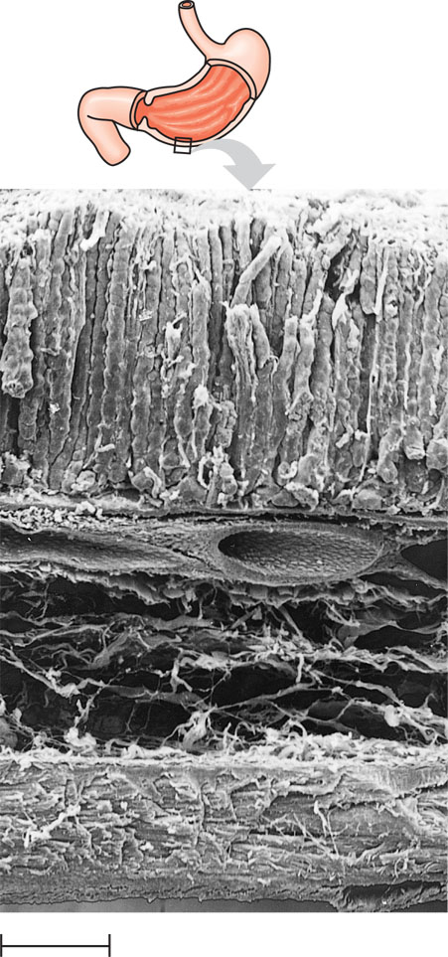
Tissue layers of the stomach and small intestine
والامعاء الدقيقة طبقات الأنسجة فى جدارالمعدة
Lumenالتجويف
Mucosa
(lines the lumen)
Epithelial tissue
نسيج طلائي
(columnar epithelium)
(طلائية عمادية)
Submucosa
Contains blood vessels
& nerves.
Connective tissue
نسيج ضام
Muscularis
Smooth muscle tissue
نسيج عضلي أملس
(2 layer)
(طبقتين)
0.2 mm

Slide 38
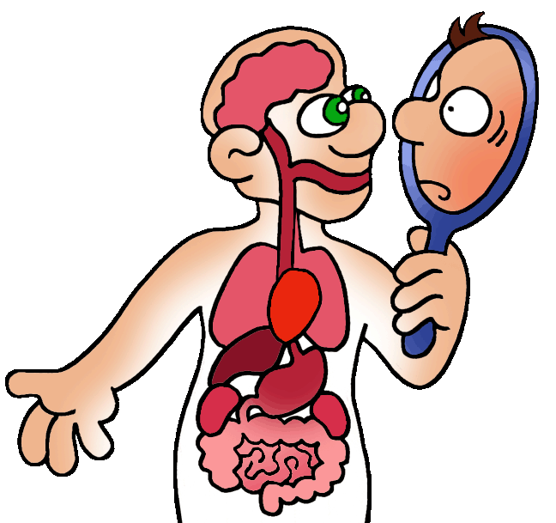
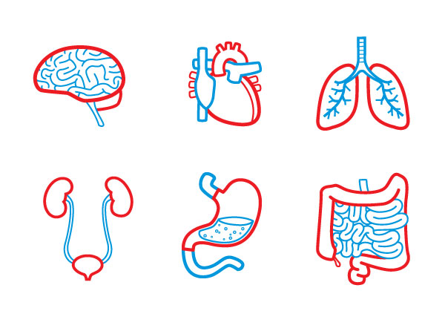
Organ systems الأجهزة العضوية

