Slide 1


Slide 2

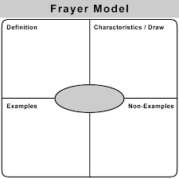
exercise:
: Time
apply:
□ :single
Group: □
active learning
Day:
Date:
Class:
Subject
Title:
FrAyer model strategy

Slide 3
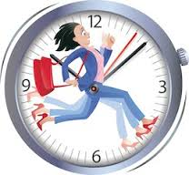
exercise:
: Time
apply:
□ :single
Group: □
active learning
Day:
Date:
Class:
Subject
Title:
ONE MINUTE STRATEGY

Slide 4
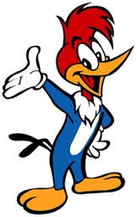
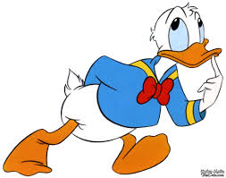
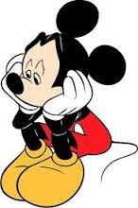
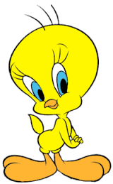
exercise:
: Time
apply:
□ :single
Group: □
active learning
Day:
Date:
Class:
Subject
Title:
Concepts cartoons strategy

Slide 5
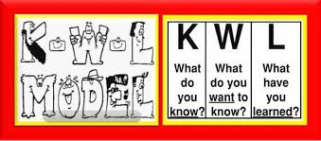
exercise:
: Time
apply:
□ :single
Group: □
active learning
Day:
Date:
Class:
Subject
Title:
K.w.l STRATEGY
Know
Want to know
Learned

Slide 6

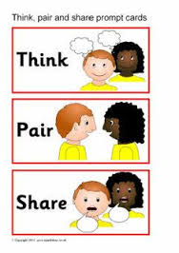
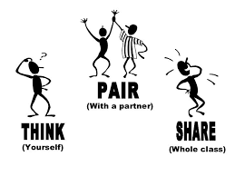
exercise:
: Time
apply:
□ :single
Group: □
active learning
Day:
Date:
Class:
Subject
Title:
................................
................................
................................
................................
................................
................................

Slide 7

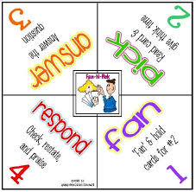
exercise:
: Time
apply:
□ :single
Group: □
active learning
Day:
Date:
Class:
Subject
Title:
fAN-N-Pick strategy
Cards no:
1) question of cards?
....................................................
2) question of cards?
....................................................
3) question of cards?
....................................................
4) question of cards?
....................................................

Slide 8


exercise:
: Time
apply:
□ :single
Group: □
active learning
Day:
Date:
Class:
Subject
Title:
ONE PEN,ONE BOOK STRATEGY
........................................................
.........................................................
........................................................
........................................................

Slide 9



exercise:
: Time
apply:
□ :single
Group: □
active learning
Day:
Date:
Class:
Subject
Title:
WHO AM I ? STRATEGEY

Slide 10
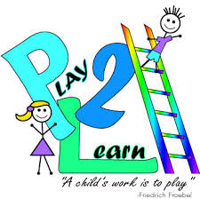
exercise:
: Time
apply:
□ :single
Group: □
active learning
Day:
Date:
Class:
Subject
Title:
Play to learn Strategy
Name playing
Required materials:
Examples:

Slide 11

exercise:
: Time
apply:
□ :single
Group: □
active learning
Day:
Date:
Class:
Subject
Title:
Role play strategy

Slide 12
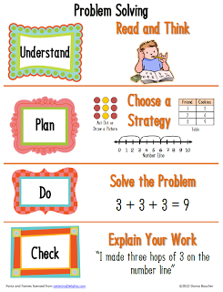
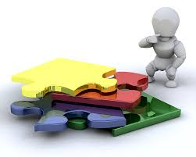
exercise:
: Time
apply:
□ :single
Group: □
active learning
Day:
Date:
Class:
Subject
Title:
problem solving strategy

Slide 13
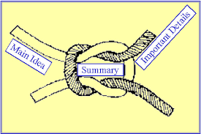
exercise:
: Time
apply:
□ :single
Group: □
active learning
Day:
Date:
Class:
Subject
Title:
collaborative summarizing strategy
Drafting ideas
Main idea

Slide 14
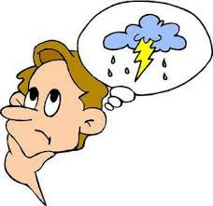
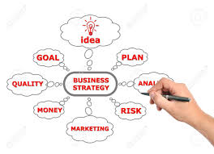

classify different jobs into three categories
exercise:
Time 5 minute s
apply:
□ :single
group Group: □
active learning
Day:
Date:
Class:
Subject
Title:
s
brainstorming strategy
........................................................
.........................................................
........................................................
........................................................
.........................................................

Slide 15


exercise:
: Time
apply:
□ :single
Group: □
active learning
Day:
Date:
Class:
Subject
Title:
critical thinking strategy
................................
................................
................................
................................
................................
................................
................................

Slide 16

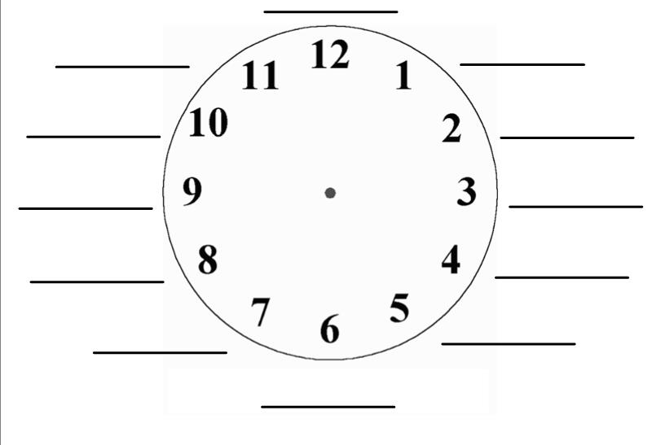
exercise:
: Time
apply:
□ :single
Group: □
active learning
Day:
Date:
Class:
Subject
Title:
clock buddies

Slide 17
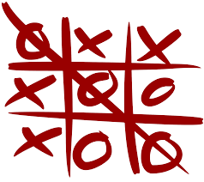
exercise:
: Time
apply:
□ :single
Group: □
active learning
Day:
Date:
Class:
Subject
Title:
TIC TAC TO STRATEGEY

Slide 18
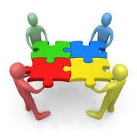
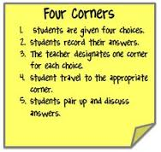
exercise:
: Time
apply:
□ :single
Group: □
active learning
Day:
Date:
Class:
Subject
Title:
FOUR CORNER STRATEGY
FOUR CORNER

Slide 19

exercise:
: Time
apply:
□ :single
Group: □
active learning
Day:
Date:
Class:
Subject
Title:
TRAIN STRATEGY

Slide 20
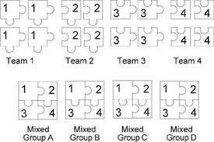
exercise:
: Time
apply:
□ :single
Group: □
active learning
Day:
Date:
Class:
Subject
Title:
JIGSAW STRATEGY

Slide 21
exercise:
: Time
apply:
□ :single
Group: □
active learning
Day:
Date:
Class:
Subject
Title:
JIGSAW STRATEGY

Slide 22
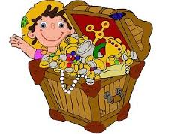
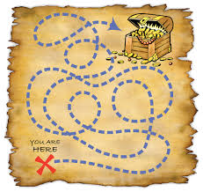
exercise:
: Time
apply:
□ :single
Group: □
active learning
Day:
Date:
Class:
Subject
Title:
STEPS TO TREASURE STRATEGY
Who
Find
treasure?

Slide 23
exercise:
: Time
apply:
□ :single
Group: □
active learning
Day:
Date:
Class:
Subject
Title:
STEPS TO TREASURE STRATEGY
Who
Find
treasure?

Slide 24
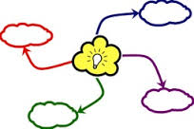

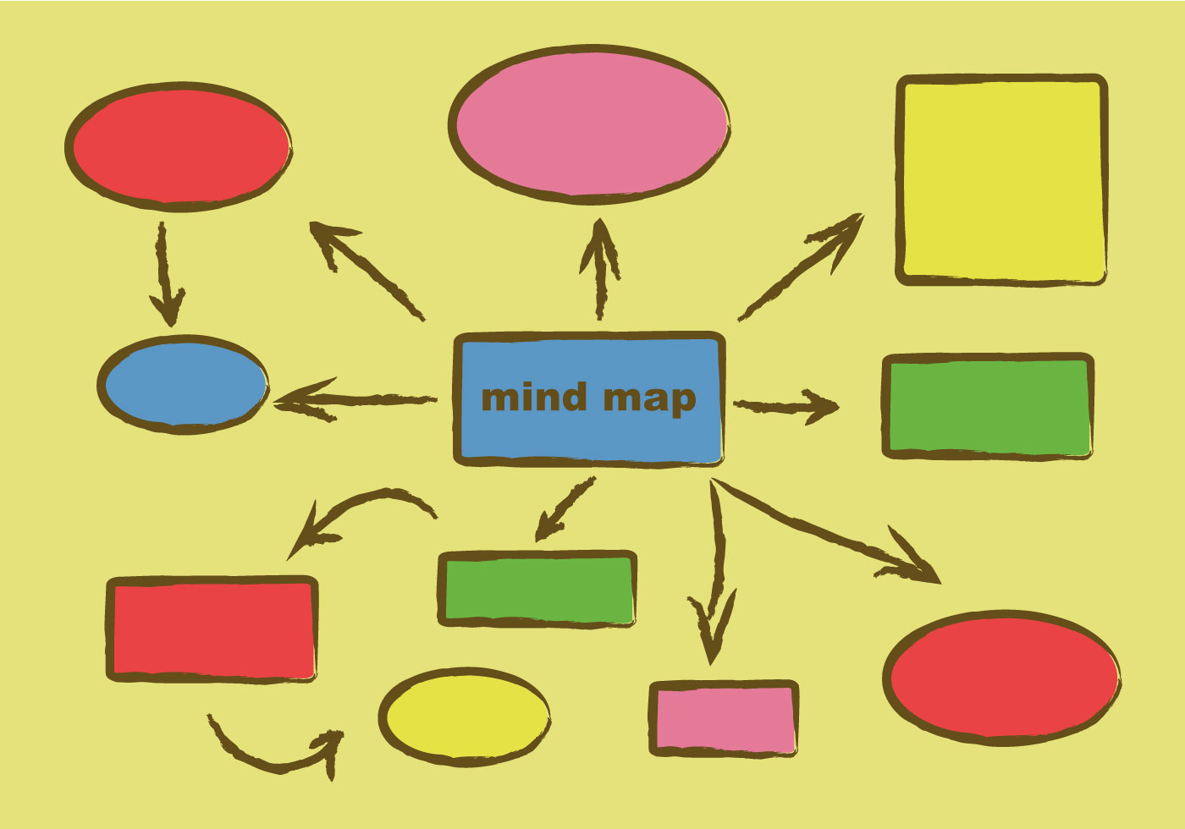
exercise:
: Time
apply:
□ :single
Group: □
active learning
Day:
Date:
Class:
Subject
Title:
MANDS MAP STRATEGY

Slide 25
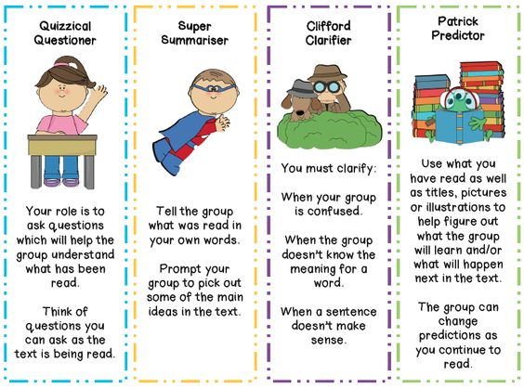
exercise:
: Time
apply:
□ :single
Group: □
active learning
Day:
Date:
Class:
Subject
Title:
Reciprocal Teaching STRATEGY

Slide 26
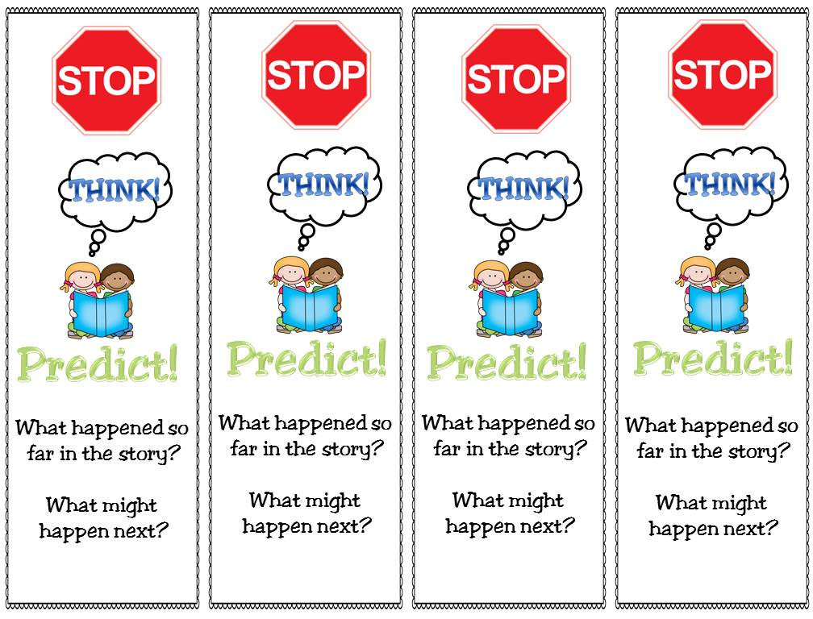
exercise:
: Time
apply:
□ :single
Group: □
active learning
Day:
Date:
Class:
Subject
Title:
Reciprocal Teaching STRATEGY

Slide 27
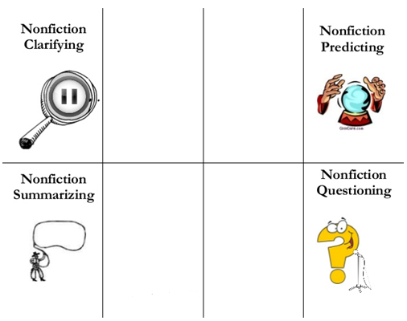
exercise:
: Time
apply:
□ :single
Group: □
active learning
Day:
Date:
Class:
Subject
Title:
Reciprocal Teaching STRATEGY

Slide 28
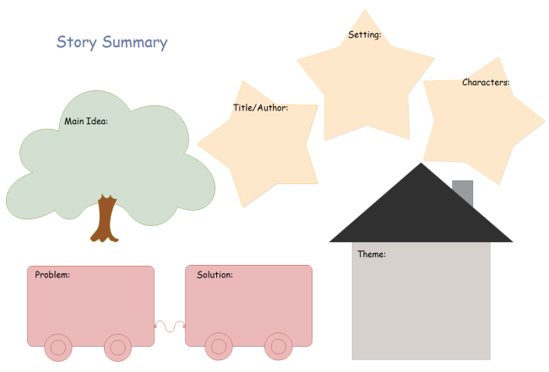
exercise:
: Time
apply:
□ :single
Group: □
active learning
Day:
Date:
Class:
Subject
Title:
STORY FACE STRATEGY

Slide 29
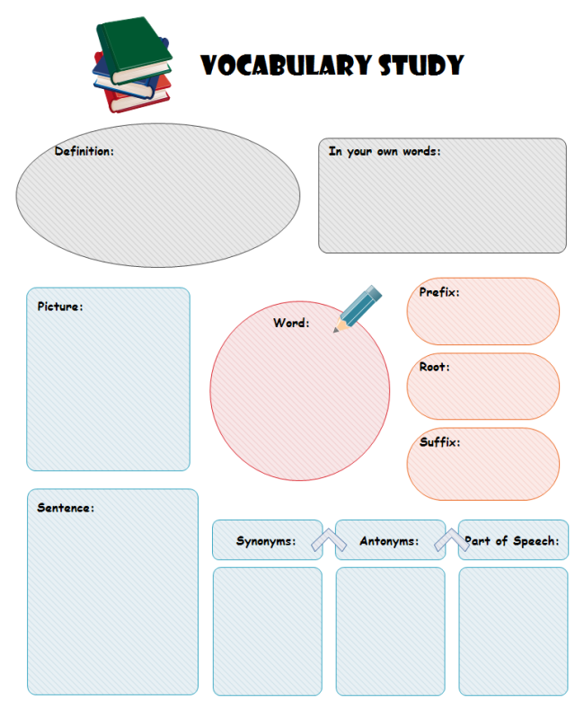
exercise:
: Time
apply:
□ :single
Group: □
active learning
Day:
Date:
Class:
Subject
Title:
STORY FACE STRATEGY

Slide 30
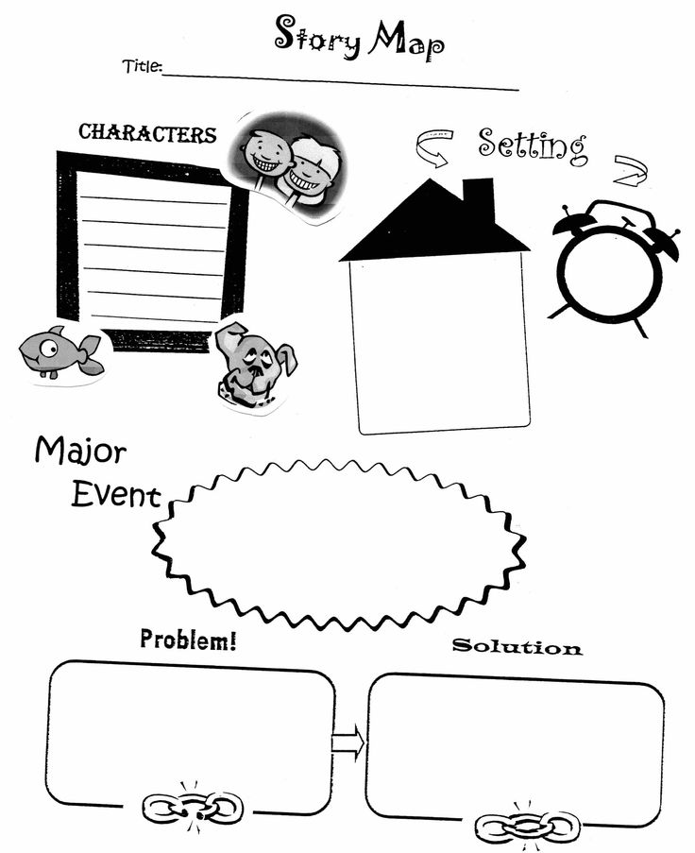
exercise:
: Time
apply:
□ :single
Group: □
active learning
Day:
Date:
Class:
Subject
Title:
STORY FACE STRATEGY

Slide 31
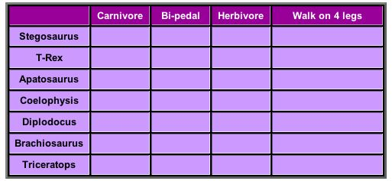
exercise:
: Time
apply:
□ :single
Group: □
active learning
Day:
Date:
Class:
Subject
Title:
SEMANTIC ANALYSIS STRATEGY

Slide 32
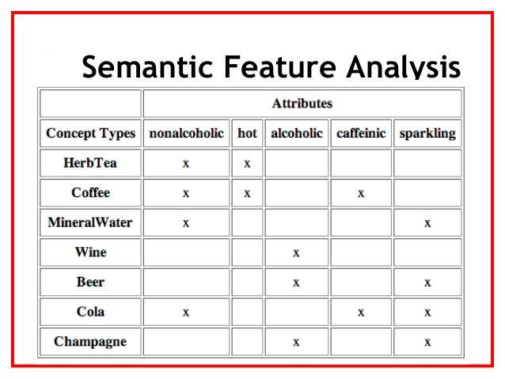
exercise:
: Time
apply:
□ :single
Group: □
active learning
Day:
Date:
Class:
Subject
Title:
SEMANTIC ANALYSIS STRATEGY

Slide 33
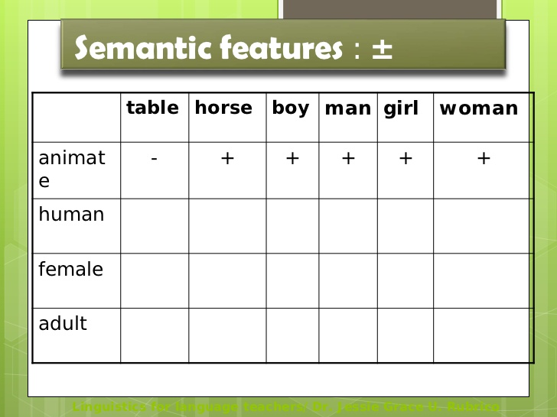
exercise:
: Time
apply:
□ :single
Group: □
active learning
Day:
Date:
Class:
Subject
Title:
SEMANTIC ANALYSIS STRATEGY

Slide 34
exercise:
: Time
apply:
□ :single
Group: □
active learning
Day:
Date:
Class:
Subject
Title:
SEMANTIC ANALYSIS STRATEGY

Slide 35
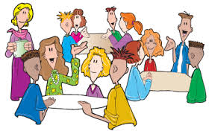

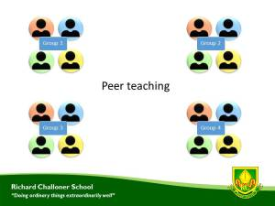
exercise:
: Time
apply:
□ :single
Group: □
active learning
Day:
Date:
Class:
Subject
Title:
Peer Teaching STRATEGY

Slide 36
exercise:
: Time
apply:
□ :single
Group: □
active learning
Day:
Date:
Class:
Subject
Title:
Peer Teaching STRATEGY
Ask Question
Answer Questions orally
Write answers
Sum up .........................................................................................................................................................................................................................................................................................................................................................................................

