Slide 1
Beam Deposition Processes
Direct Metal Deposition (DMD)
Laser Engineering Net Shaping
(LENS)
Neodymium–yttrium–aluminum–garnet (Nd:YAG) laser
CO₂ laser

Slide 2
Laser Engineering Net Shaping (LENS)
Nature of the raw material | Powder
Final Product | Metal, Metal mixture: Ti, Co, Stainless Steel, Ni, Al.
Advantages | Disadvantages
The variety of metals can be printed with this technology | No support material used in this technique, so complex structure fabrication is a challenge using this technique.
Rapid repair is possible using this technology especially for the Turbine blade. | This technique require a qualified technician to operate it.

Slide 3
Direct Metal Deposition (DMD)
Nature of the raw material | Powder
Final Product | Metal, Metal mixture: Ti, Co, Stainless Steel, Ni, Al.
Advantages | Disadvantages
The variety of metals can be printed with this technology | Manufacturing with this technology is costly.
Industrial parts repair is possible using this technology. | The not presence of support material limited its chance to manufacture a complex parts.

Slide 4
Direct Write Technology
Aerosol Jet Technology
Nature of the raw material | Liquid
Final Product | High conductive nano particle, Semi conductors.
Advantages | Disadvantages
Beneficial for printing of sensors. | Manufacturing with this technology is costly.
The variety of material can be printed with this technology | The not presence of support material limited its chance to manufacture a complex parts.

Slide 5
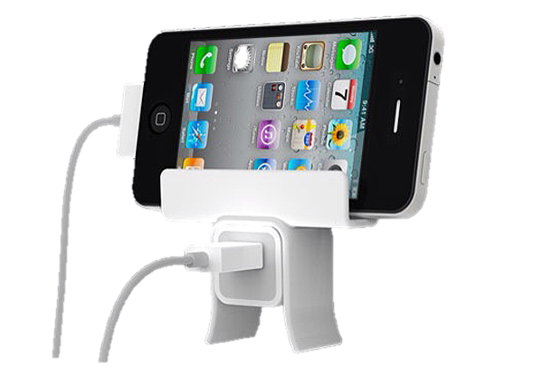
Guidelines for Process Selection
There are three key questions to choose the appropriate method for printing:
If you have an idea about the piece that you are going to manufacture, the next question will be; which printing technique going to be used and which material will be use!
Once I have the designs of the piece to be printed, what is the best printer I need to use for my purpose!
Once I have the printer and the piece to be printed, how the printer can be prepared to operate in an effective manner beside the operational processes and other tasks.

Slide 6
Decision-making in the selection process of the printing method
Utility theory approach: there are three elements of any decision:
Options – the items from which the decision maker is selecting.
Expectations – of possible outcomes for each option.
Preferences – how the decision maker values each outcome.
More specifically, in AM selection, an outcome might consist of the time, cost, and surface finish of a part built using a certain AM process, while the AM process itself is the option.

Slide 7
Selecting the appropriate printer for the manufacturing with 3D Printing
There are a software facilitate the 3D printing service providers to:
Identify feasible material/machine combinations,
Estimating manufacturing cost and time.
Determining optimal part orientations.
For individuals , they can visit the following online platform to select the appropriate printer.

Slide 8
Cost Estimation
Net Cost=P + O + M + L
P = Printer Cost
O=Cost of operation
M= Material Cost
L= Labor Cost
Cost per piece = p+o+m+l = 1/N x (P+O+M+L)
N= Number of pieces in one printing cycle.
Assuming the printer life will be 5 years and the printer will work 95% of the time during the year.
The cost of the printer for one printing cycle will be:
P= (Purchase price . T_{b})/(0.95 x 24 x365 x Y)
Tb=The time needed for printing per hour
24 . 365 = Representing the printing hours per year

Slide 9
Cost Estimation
O=T_{b} x C_{o}
C_{o} =Operational cost (cost of the printer maintenance, the cost of electricity, the cost of place rental and any other expenses)
M= K_{s} . K_{r} . N .v .C_{m} . ρ
K_{s}= Support Material Factor(1.1-1.5)
K_{r} =Consumed material cost and ranged between(1-7) in the Powder bed Technology.
v = Piece Volume
C_{m} = Material cost per mass unit
ρ =Density
L=T₁ .C₁
Labor cost is the cost of the time required for employees to set up the printing process, the removal of the printed parts, cleaning the printed parts, cleaning the printer, and processing to process the next printing.

Slide 10
Pre-Processing
Shrinkage often occurs during the printing process.
Shrinkage also occurs during the post-processing step that needed for the curing of the metal and ceramics in the powder bed processing technique.
This can be overcome by applying a scaling factor coefficient on the Cad model prior to the printing which can compensate for the shrinkage.

Slide 11
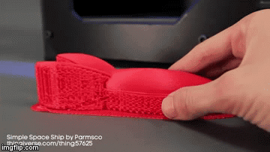
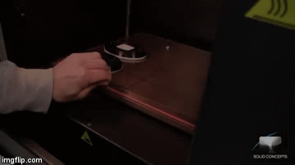
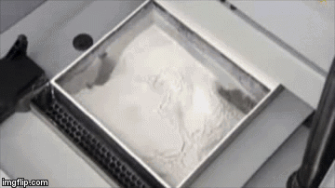
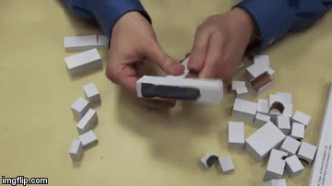
Post- Processing
Support Material
Synthetic Support
Natural Support
Powder-based processes
Sheet-based processes
Printing material
Another material

Slide 12
Post- Processing
Property Enhancements using Non-thermal Techniques
In many cases, that porosity can be infiltrated by a higher-strength material, such as cyanoacrylate (Super Glue1).
Property Enhancements using Thermal Techniques
In the case of beam deposition and PBF techniques for metals, this thermal processing is primarily heat treatment to form the desired microstructures and/or to relieve residual stresses.
Steps for heat treatment:
1-Green part brushed and air compressed gently.
2-Aluminum oxide placed on the crucible and the part immersed in it.
Control of shrinkage and dimensional accuracy during furnace processing is complicated by the number of process parameters that must be optimized and the multiple steps involved.
These parts are then post-processed to full density using hot isostatic pressing (HIP).
The SLS/HIP approach was successfully used to produce complex 3D parts in Inconel 625 and Ti–6Al–4V for aerospace applications.

Slide 13
Post- Processing
Surface Texture Improvements
Common surface textures are:
Stair-steps
Stair-stepping is a fundamental issue in layered manufacturing and is difficult to overcome, although one can choose a thin layer thickness to minimize error at the expense of build time.
Powder adhesion.
The amount of powder adhesion can be controlled, to some degree, by changing part orientation, powder morphology and thermal control technique.
Witness marks from support material removal
Painting the surface has the dual benefit of sealing porosity and, by viscous forces, smoothing the stair-step effect; thus making sanding and polishing easier and more effective.

