Slide 1
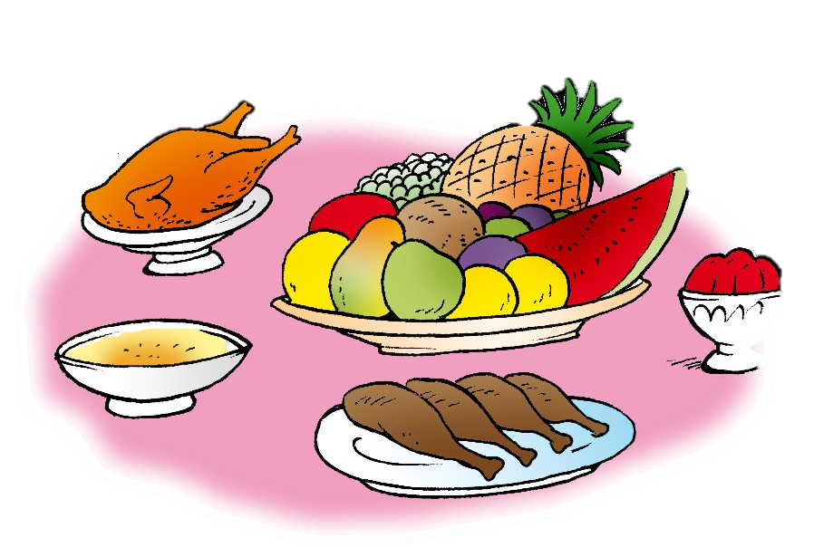
Unit 7- Lesson 2 P 65
Dinnertime!
Family and Friend 2
Grade 2

Slide 2
Objectives
1- Identify six different food items.
2- Answer questions with Yes, I do or No, I don’t.
_________________________________________________________________________________________________________________________________________________
Ministry of Education-2020

Slide 3
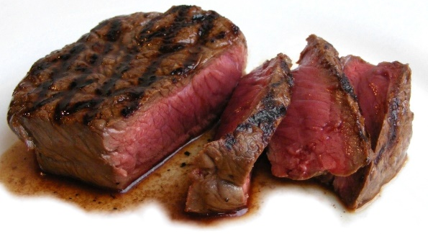
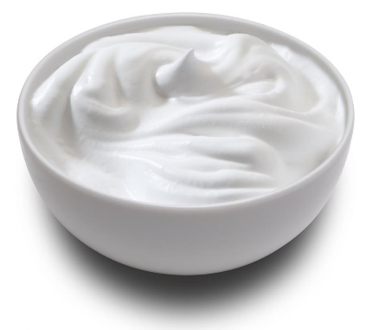
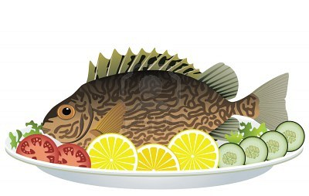
Let’s remember!
1
2
3
5
4
6
_________________________________________________________________________________________________________________________________________________
Ministry of Education-2020

Slide 4
Let’s remember!
1
2
3
rice
meat
carrots
6
5
4
yogurt
fish
bread
_________________________________________________________________________________________________________________________________________________
Ministry of Education-2020

Slide 5
If someone asks you
Do you like …?
Your answer should be …
or
Yes, I do.
No, I don’t.
_________________________________________________________________________________________________________________________________________________
Ministry of Education-2020

Slide 6
Listen and repeat
Do you like yogurt?
Yes, I do.
_________________________________________________________________________________________________________________________________________________
Ministry of Education-2020

Slide 7
Listen and repeat
Do you like rice?
No, I don’t.
_________________________________________________________________________________________________________________________________________________
Ministry of Education-2020

Slide 8
Answer the question on your mini-board and write (Yes, I do) OR (No, I don’t)
Do you like fish?
Yes, I do.
No, I don’t.
Yes, I do.
Click and check your answer!
_________________________________________________________________________________________________________________________________________________
Ministry of Education-2020

Slide 9
Answer the question on your mini-board and write (Yes, I do) OR (No, I don’t)
Do you like bread?
Yes, I do.
No, I don’t.
Click and check your answer!
No, I don’t.
_________________________________________________________________________________________________________________________________________________
Ministry of Education-2020

Slide 10
Answer the question on your mini-board and write (Yes, I do) OR (No, I don’t)
Do you like carrots?
Yes, I do.
No, I don’t.
Click and check your answer!
Yes, I do.
_________________________________________________________________________________________________________________________________________________
Ministry of Education-2020

Slide 11
Answer the question on your mini-board and write (Yes, I do) OR (No, I don’t)
Do you like meat?
Yes, I do.
No, I don’t.
Click and check your answer!
No, I don’t .
_________________________________________________________________________________________________________________________________________________
Ministry of Education-2020

Slide 12
Ask your family or friends
Do you like … ?
Yes, I do
No, I don’t
rice
yogurt
bread
_________________________________________________________________________________________________________________________________________________
Ministry of Education-2020

Slide 13
Open page 63 of your Workbook.
Answer questions 1 and 2.
1- Do you like bananas?
2- Yes, I do.
3- Do you like carrots?
4- No, I don’t.
5- Do you like bread?
6- Yes, I do.
Question 1
click and check your answer
Order
the words.
_________________________________________________________________________________________________________________________________________________
Ministry of Education-2020

Slide 14
Open page 63 of your Workbook.
Answer questions 1 and 2.
Question 2
Write.
click and check your answer
2- Do you like meat and rice?
Yes, I do.
3- Do you like carrots?
No, I don’t.
4- I like yogurt.
_________________________________________________________________________________________________________________________________________________
Ministry of Education-2020

Slide 15
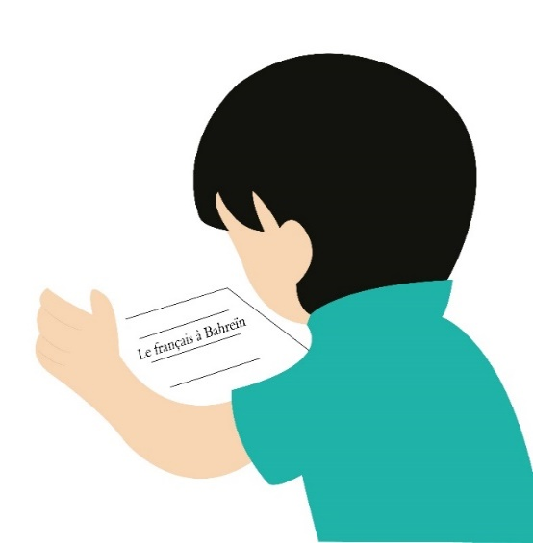
Don’t forget to answer
Unit 7 worksheet L2.
_________________________________________________________________________________________________________________________________________________
Ministry of Education-2020

Slide 16
Answer the questions
in the
practice PPT for L2.
_________________________________________________________________________________________________________________________________________________
Ministry of Education-2020

Slide 17
End of the
lesson!
_________________________________________________________________________________________________________________________________________________
Ministry of Education-2020

