Slide 1
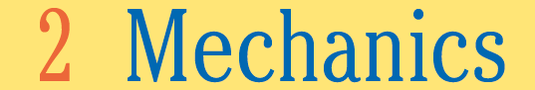

Slide 2
The major goals of this chapter are to enable you to:
1. Distinguish between a vector and a scalar quantity.
2. Find the components of a vector.
3. Distinguish between speed and velocity.
4. Use vectors to illustrate and solve velocity problems.
5. Distinguish between velocity and acceleration.
6. Utilize vectors to illustrate and solve acceleration problems.
7. Relate force and the law of inertia.
8. Apply the law of acceleration.
9. Identify components of friction.
10. Analyze forces in one dimension.
11. Distinguish among weight, mass, and gravity.
12. Analyze how the law of action and reaction is used.
13. Distinguish between the common and technical definitions of work.
14. Analyze how power is used and described in technical applications.
15. Relate kinetic and potential energy to the law of conservation of mechanical energy.

Slide 3
2.1 Mechanics: Vectors
Objectives
1. Distinguish between a vector and a scalar quantity.
2. Add vectors graphically.
3. Find the components of a vector.

Slide 4


Slide 5
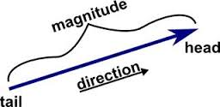
Scalar
Scalar ≡ a quantity that can be described by magnitude only
Examples: Speed, Mass, Temperature, Pressure
Vectors
Vector ≡ a quantity that requires both magnitude and direction
Examples: Velocity, Force, Acceleration

Slide 6
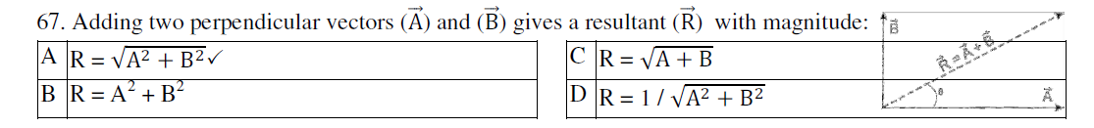
Vectors
Resultant
The sum of two or more vectors
  For vectors in the same direction, add arithmetically.
  For vectors in opposite directions, subtract arithmetically.
  Two vectors that don’t act in the same or opposite direction:
    use parallelogram rule.
  Two vectors at right angles to each other
    use Pythagorean Theorem: R² = V² + H².

Slide 7
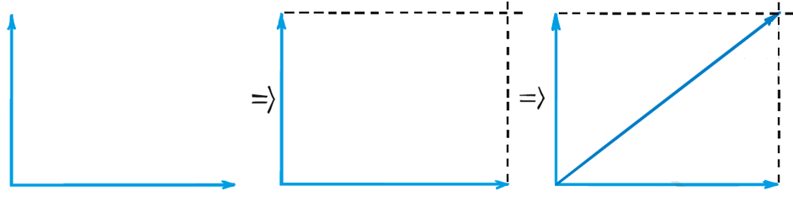
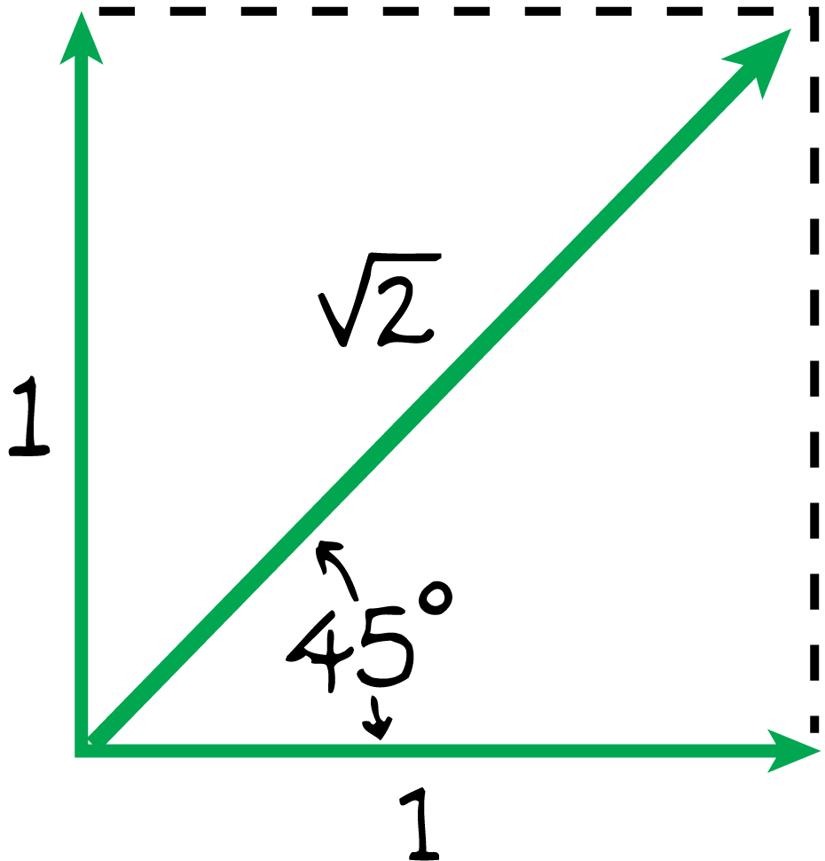
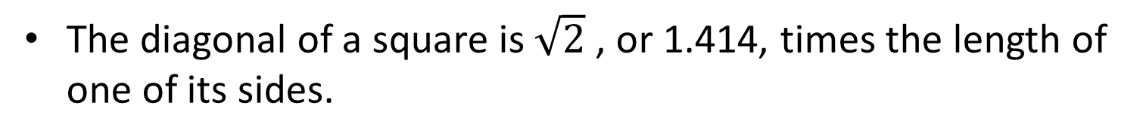
Parallelogram rule: Finding the resultant geometrically
Generally applies for rectangular and nonrectangular vectors
The diagonal of a square is$\sqrt{2}$ , or 1.414, times the length of one of its sides.

Slide 8
Vector Components
Often we will need to change a single vector into an equivalent set of two component vectors at right angles to each other:
  Any vector can be “resolved” into two component vectors at right angles to each other.
  Two vectors at right angles that add up to a given vector are known as the components of the given vector.
  The process of determining the components of a vector is called resolution.

Slide 9
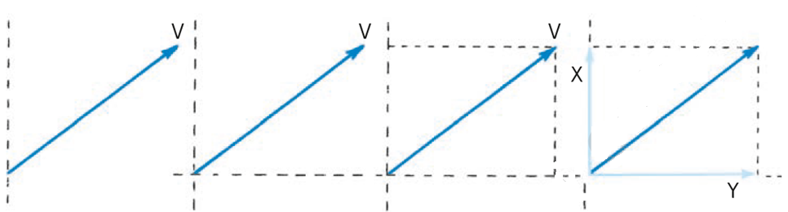
Finding vector components by resolution
Example:
http://www.physicsclassroom.com/Physics-Interactives/Vectors-and-Projectiles/Vector-Addition/Vector-Addition-Interactive

Slide 10
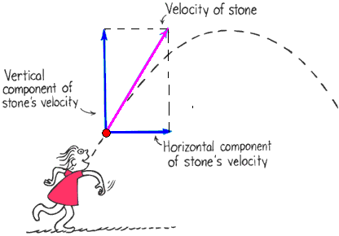
Vectors
Vector components
Vertical and horizontal components of a vector are perpendicular to each other
Determined by resolution.

Slide 11
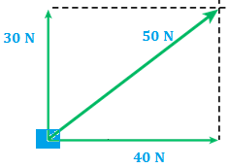
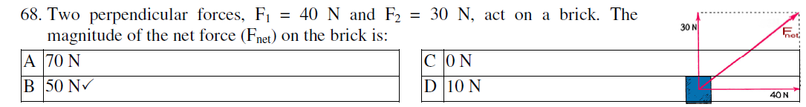
Force vectors
A pair of forces acting on a box.
The resultant of the 30-N and 40-N forces is 50-N

Slide 12
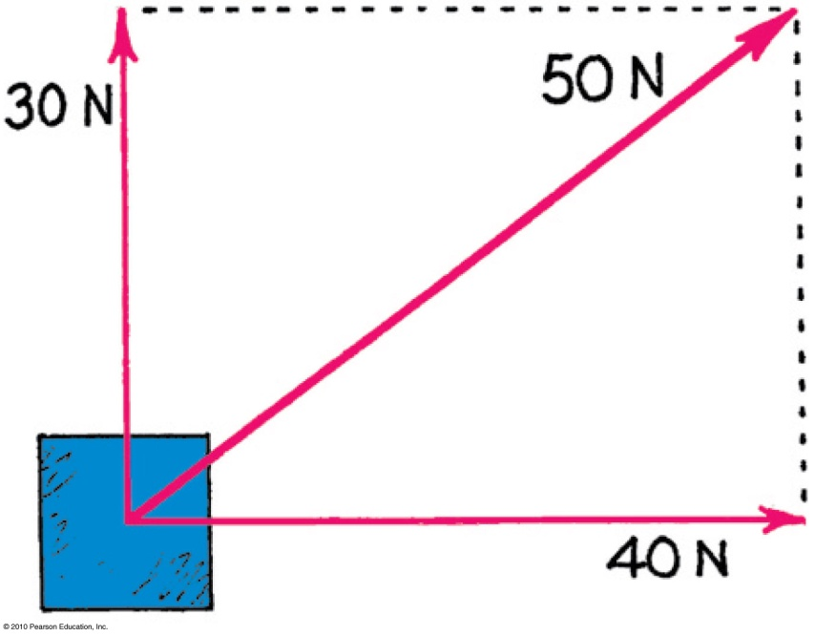
Vectors
CHECK YOUR UNDERSTANDING
Referring to the figure, which of the following are true statements?
A. 50 N is the resultant of the 30- and 40-N vectors.
The 30-N vector can be considered a component of the 50-N vector.
The 40-N vector can be considered a component of the 50-N vector.
All of the above are correct.

Slide 13
Vectors
CHECK YOUR ANSWER
Referring to the figure, which of the following are true statements?
A. 50 N is the resultant of the 30- and the 40-N vectors.
The 30-N vector can be considered a component of the 50-N vector.
The 40-N vector can be considered a component of the 50-N vector.
All of the above are correct.

Slide 14
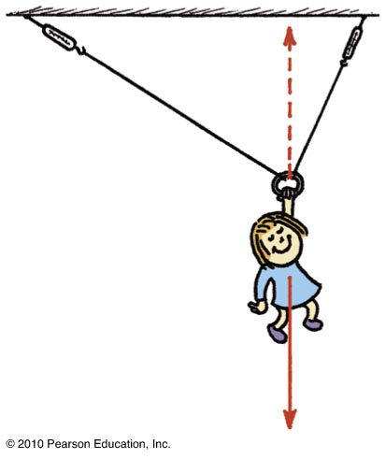
Force Vectors
Nellie Newton hangs from a rope as shown.
Which side has the greater tension?
There are three forces acting on Nellie:
  her weight,
  a tension in the left-hand side of the rope,
  and a tension in the right-hand side of the rope.

Slide 15
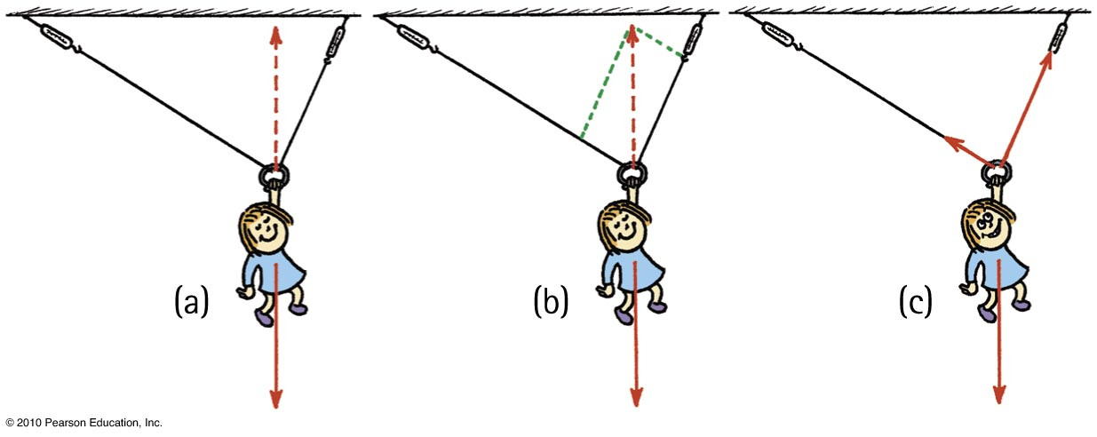
Force Vectors
Because of the different angles, different rope tensions will occur in each side.
Nellie hangs in equilibrium, so her weight is supported by two rope tensions, adding vectorially to be equal and opposite to her weight.
The parallelogram rule shows that the tension in the right-hand rope is greater than the tension in the left-hand rope.

Slide 16
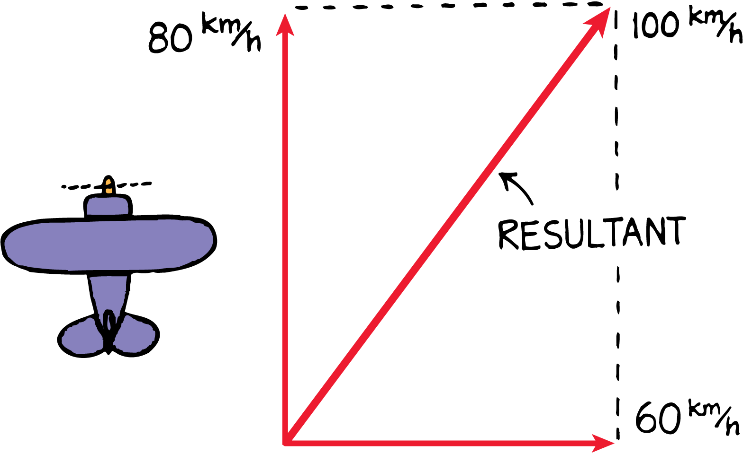
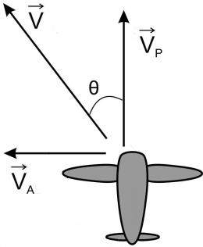
Velocity Vectors
An 80-km/h airplane flying in a 60-km/h crosswind has a resultant speed of 100 km/h relative to the ground.
A. 500 km/h, north-west ✓ B. 700 km/h, north-east
C. 500 km/h, north-east D. 700 km/h, north-west
Notes:
ˈkʌm.pəs

Slide 17
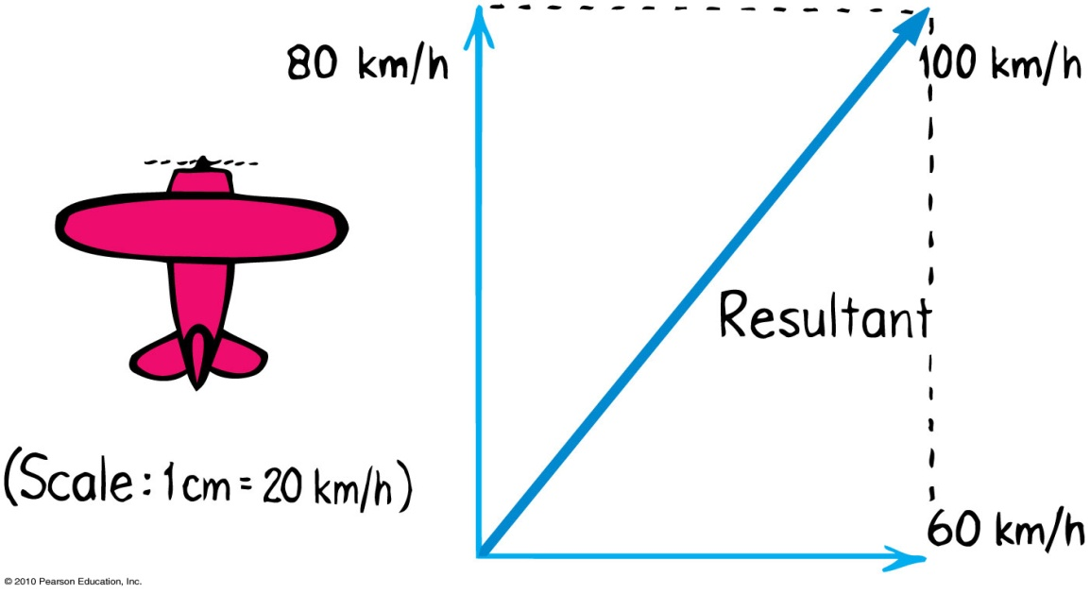
Referring to the figure, which of the following are true statements?
Vectors
CHECK YOUR UNDERSTANDING
A. 100 km/h is the resultant of the 80- and 60-km/h vectors.
The 80-km/h vector can be considered a component of the 100-km/h vector.
C. The 60-km/h vector can be considered a component of the 100-km/h vector.
All of the above are correct.
Notes:
D. All of the above are correct.

Slide 18
Referring to the figure, which of the following are true statements?
Vectors
CHECK YOUR ANSWER
A. 100 km/h is the resultant of the 80- and 60-km/h vectors.
The 80-km/h vector can be considered a component of the 100-km/h vector.
C. The 60-km/h vector can be considered a component of the 100-km/h vector.
All of the above are correct.
Notes:
D. All of the above are correct.

Slide 19
2.2. Linear motion
Objectives
Distinguish between speed and velocity
Describe motion in terms of changing velocity
Define and calculate acceleration
Distinguish between velocity and acceleration
Distinguish between Acceleration and deceleration

Slide 20
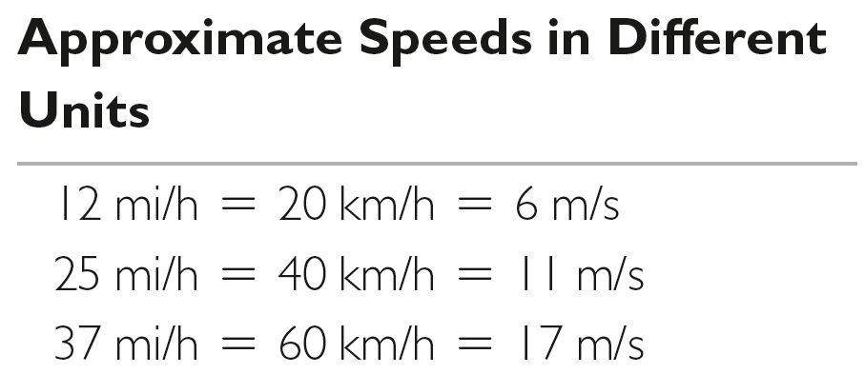
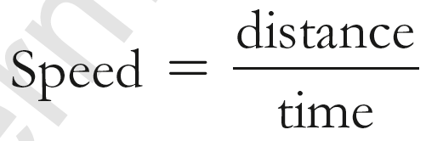
Linear Motion
Speed ≡ scalar quantity requiring magnitude only to describe how fast a body is.
Example: A girl runs 6 meters in 1 sec. Her speed is 6 m/s.
INSTANTANEOUS SPEED:
The speed at any instant of time

Slide 21
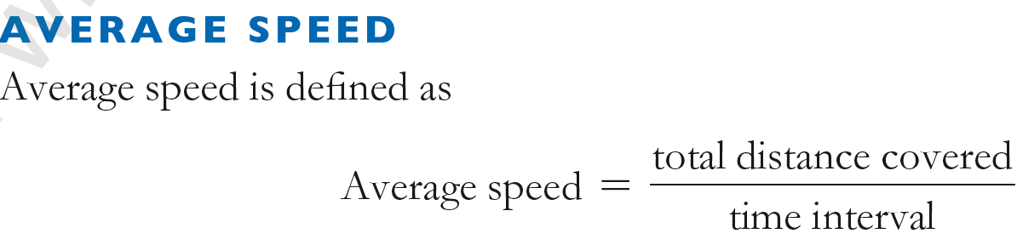
doesn’t indicate various instantaneous speeds along the way
Example: drive a distance of 80 km in 1 hour and your average speed is 80 km/h
If we know average speed and travel time, the distance traveled is easy to find.
total distance covered = average speed × travel time

Slide 22
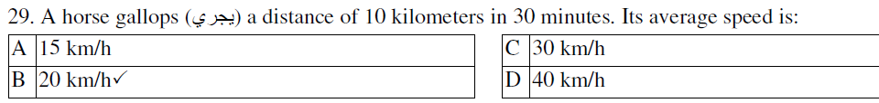
EXAMPLE:
Constant speed is steady speed, neither speeding up nor slowing down.
Notes:
ˈɡæl.əp - sted.i

Slide 23
Velocity
Velocity ≡ vector quantity requiring magnitude & direction.
It describes how fast and in what direction, i.e., Velocity is speed and direction of object’s motion.
Examples:
30 miles per hour, Up
25 meters per second, Down
300 miles per hour, Coming towards you

Slide 24
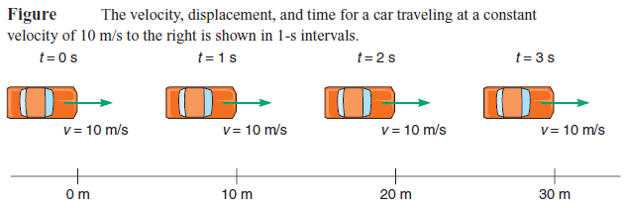
Velocity
CONSTANT VELOCITY:
is constant speed and constant direction (straight- line path with no acceleration).
Means motion in straight line at a constant speed.

Slide 25

Velocity
CHANGING VELOCITY:
If either the speed or the direction (or both) changes, then the velocity changes.
10 m/s,
downward
25 meters per second,
45 degrees upward
20 meters per second,
45 degrees downward
25 m/s,
downward
Velocity changes
in both these cases.

Slide 26
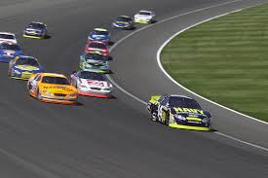
  Constant speed and constant velocity are not the same.
  A body may move at constant speed along a curved path but it does not move with constant velocity, because its direction is changing every instant.
25 m/s, upward
25 m/s,
downward
Same speeds
Different velocities

Slide 27
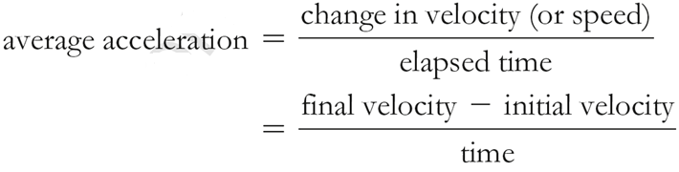
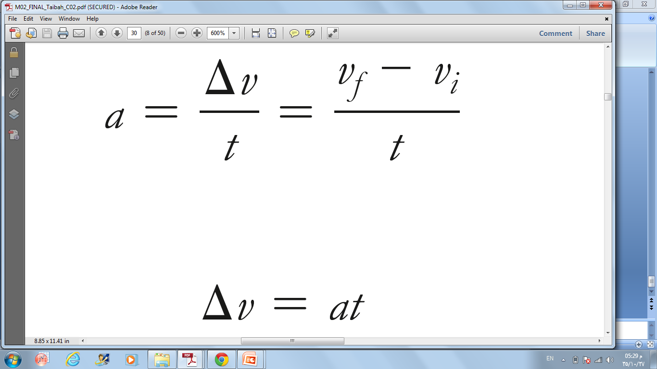
Acceleration
Acceleration ≡ Is the change in velocity per unit time.
Acceleration can mean speeding up, slowing down, or changing direction.
Dimensions: Length/Time² ([L]/[T²]) ; Units: m/s², km/h², ft/min², etc …

Slide 28
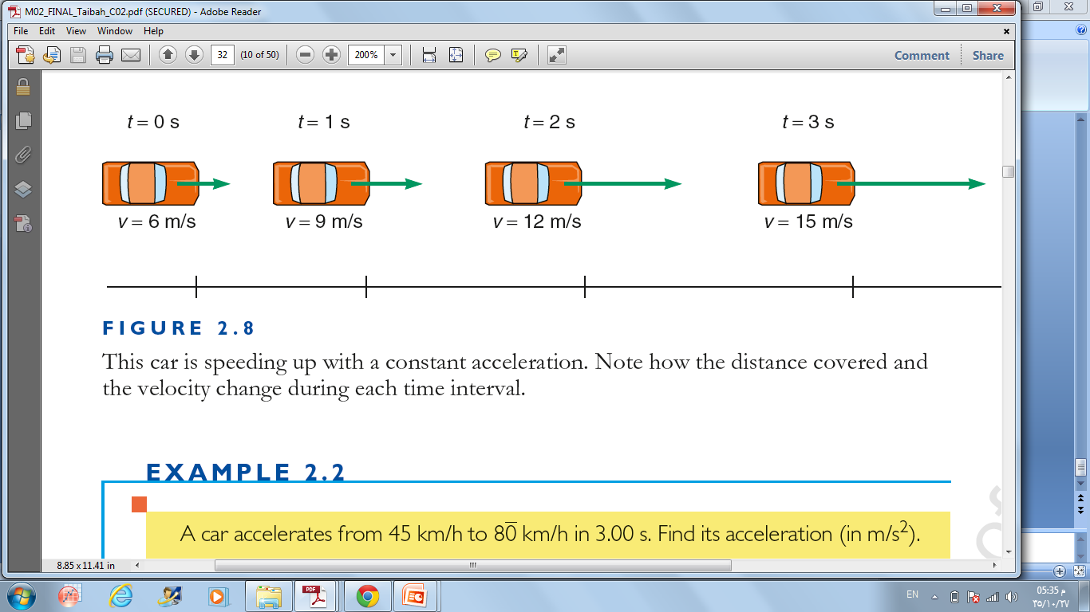
Acceleration
Acceleration
Acceleration
Acceleration

Slide 29
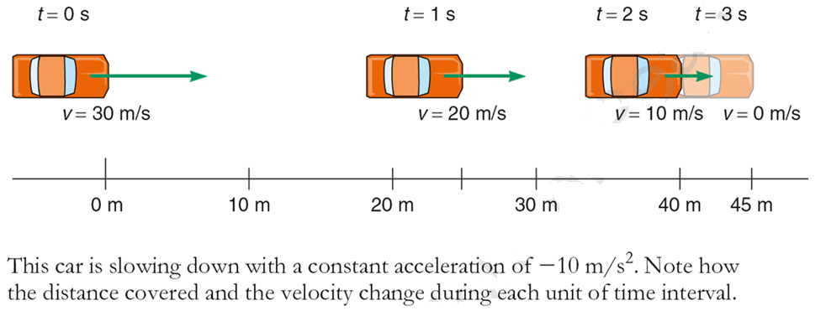
Deceleration
Deceleration
Deceleration
Deceleration is an acceleration that usually indicates that an object is slowing down.

Slide 30
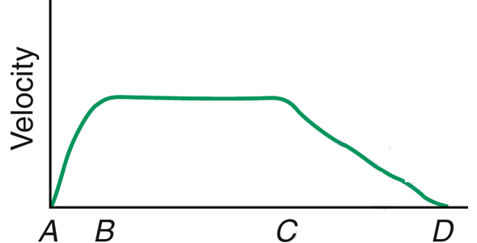
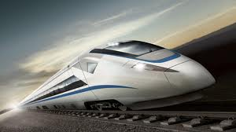

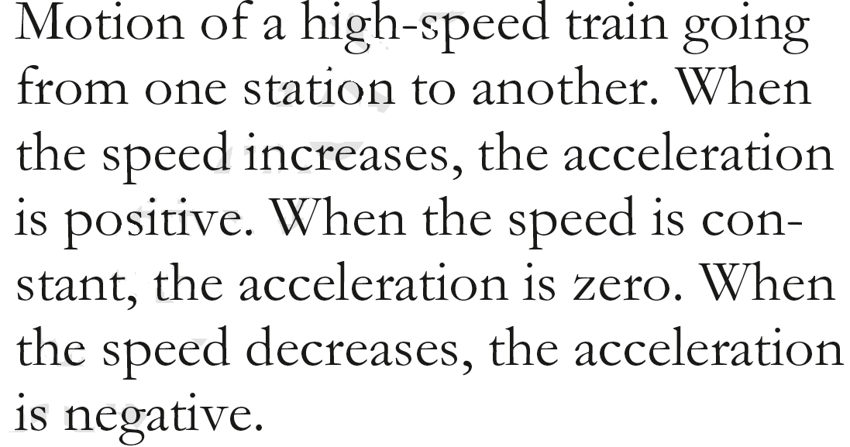

Acceleration as a vector: geometrical representation
+
Acceleration
–

Slide 31
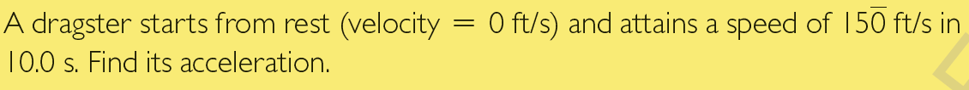
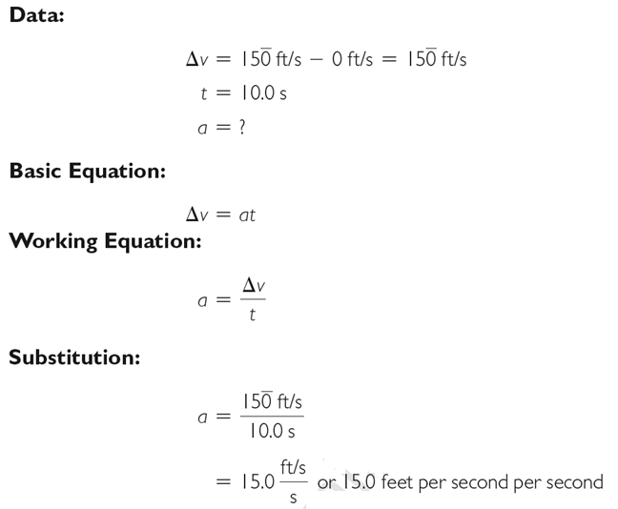
EXAMPLE:

Slide 32
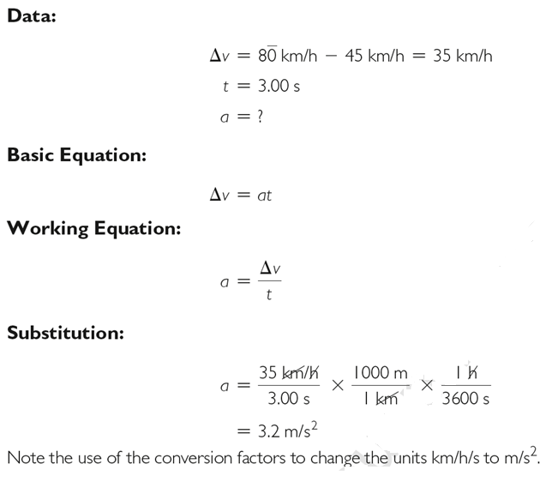
EXAMPLE:

Slide 33
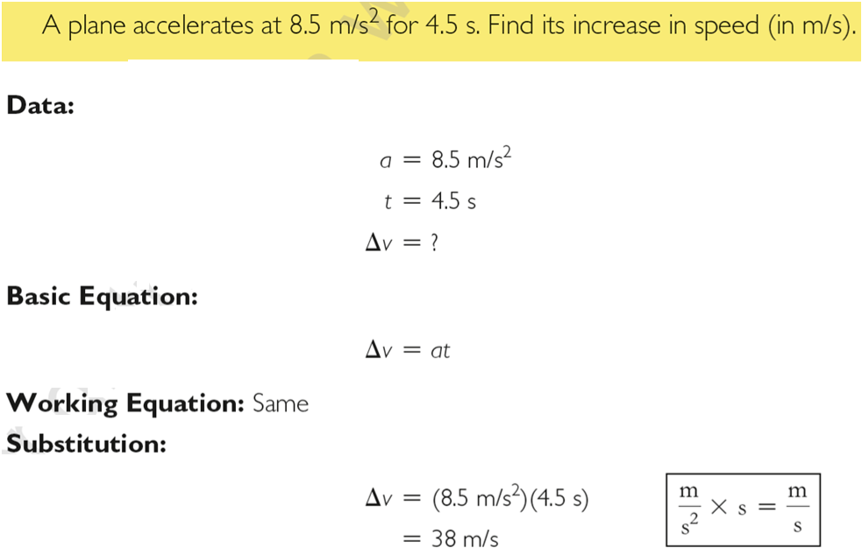
EXAMPLE:

Slide 34
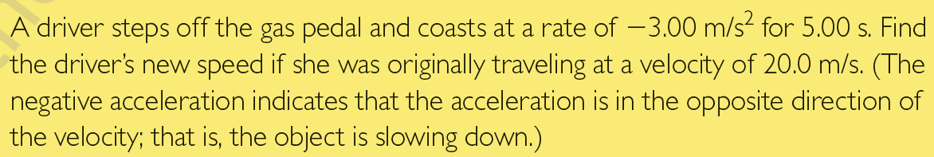
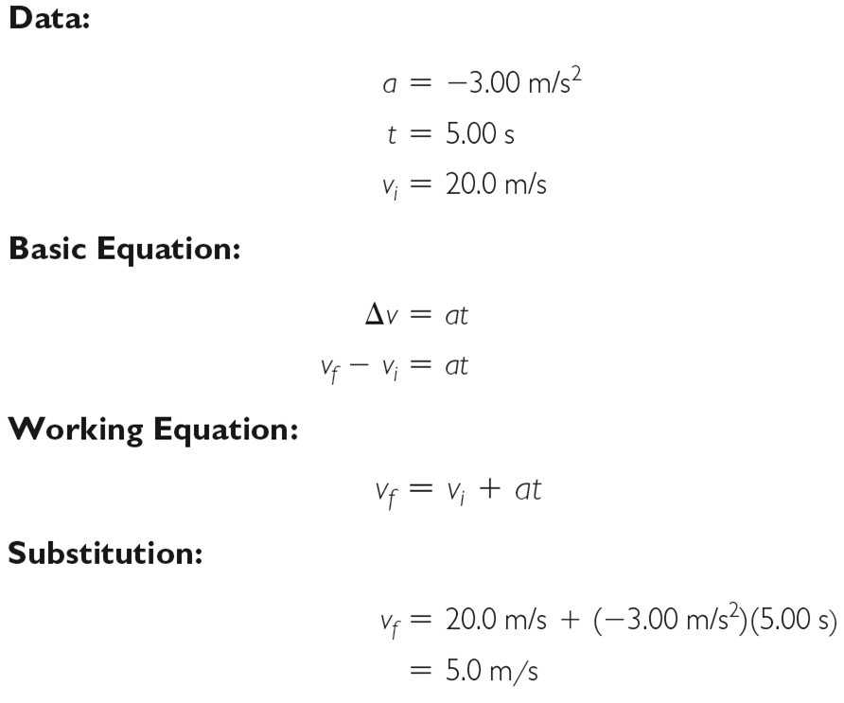
EXAMPLE:

Slide 35
2.3. Uniformly accelerated motion and free fall
Objectives
Apply kinematic equations to calculate distance, time, or velocity under condition of constant acceleration.
Describe the motion of an object in free fall.
Explain how air resistance affects the motion of objects.

Slide 36

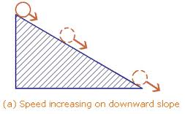
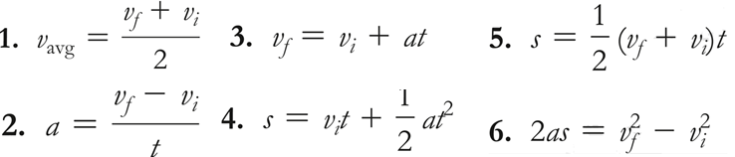

Uniformly accelerated motion and free fall
Characterized by the constant acceleration ⇒ its direction & magnitude are unchanging.
EXAMPLES:
ACCELERATED MOTION:
Equations for motion in straight line with constant acceleration:
Displacement is a vector pointing from the initial to the final position and with magnitude equals the shortest distance between the initial and final position

Slide 37
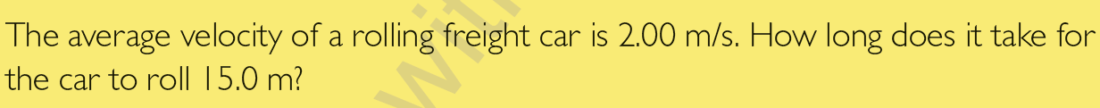
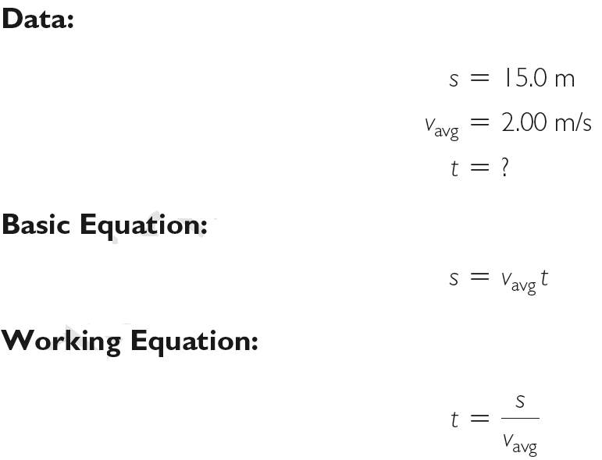
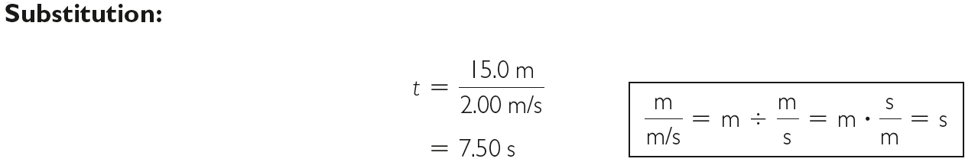
EXAMPLE:

Slide 38
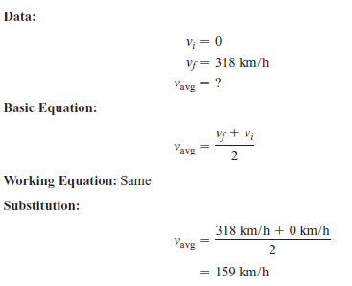
EXAMPLE:
A dragster starting from rest reaches a final velocity of 318 km/h. Find its average velocity.

Slide 39
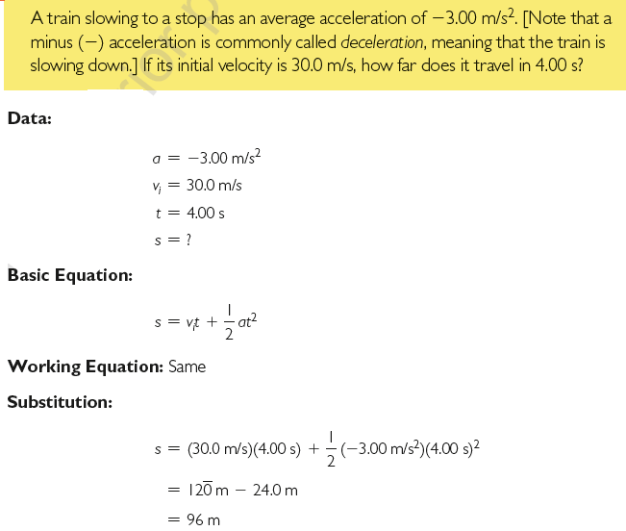
EXAMPLE:

Slide 40
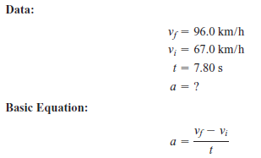
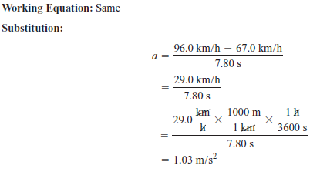
EXAMPLE:
An automobile accelerates from 67.0 km/h to 96.0 km/h in 7.80 s. What is its acceleration (in m/s2)?

Slide 41
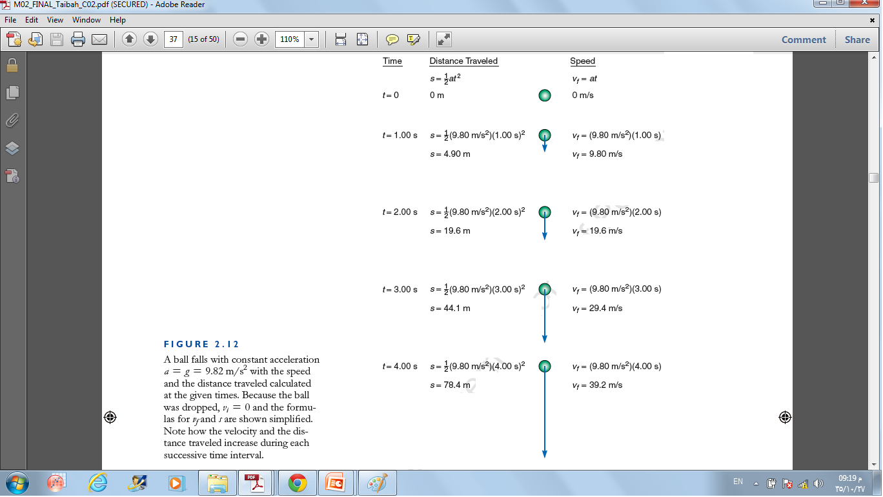
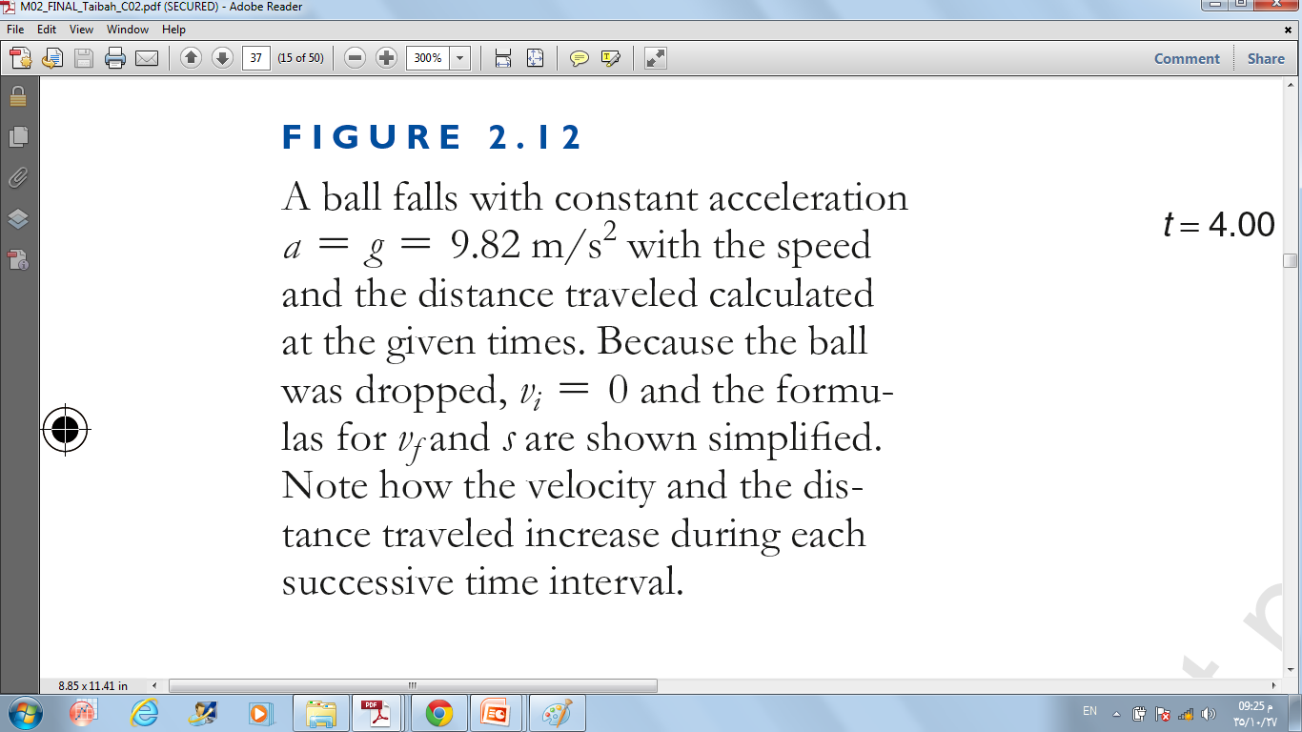
Free Fall
Freely falling bodies undergo constant acceleration
When acceleration a = g = 9.8 m/s² — free fall
Acceleration is g when air resistance is negligible.
Acceleration depends on force (weight) and inertia.

Slide 42
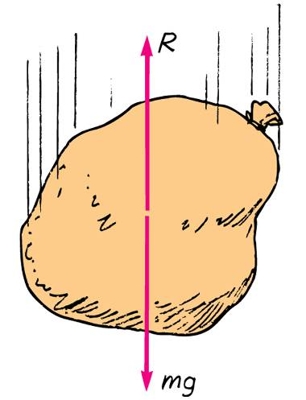
Non-Free Fall
When acceleration of fall is less than g, non-free fall
  occurs when air resistance is non-negligible.
  depends on two things:
    speed and
    frontal surface area.
Terminal speed
  occurs when acceleration terminates (when air resistance equals weight and net force is zero).
Terminal velocity
  same as terminal speed, with direction implied or specified.

Slide 43
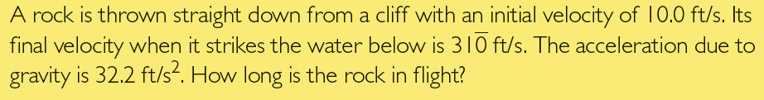
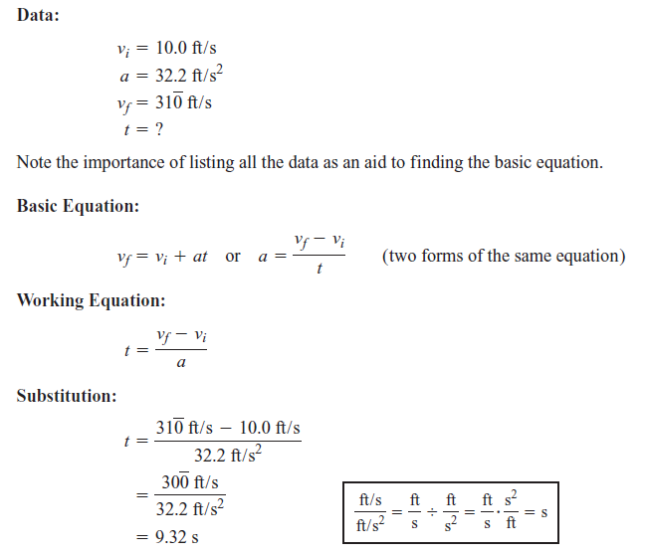
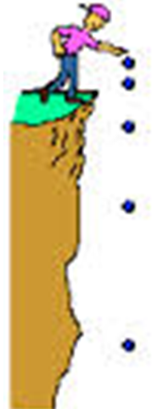

EXAMPLE:

Slide 44


When an object is thrown vertically upward, its speed is uniformly decreased by the force of gravity until it stops for an instant at its peak before falling back to the ground.
EXAMPLE:
A ball is thrown vertically upward with initial speed 1 m/s, determine the time for it to reach the highest altitude.
Upward
Downward

Slide 45
2.4. Force and Law of Inertia
Objectives
Define the force
Relate force and the law of inertia and recognize that force is needed to change an object’s motion.
Explain the meaning of Law of Inertia (Newton’s first law).
Describe how inertia and mass are related.

Slide 46

Force and Law of Inertia
The force:
  Is a vector (has magnitude and direction).
  Is any push or pull.
  Tends to change the state of motion of an object.
  Tends to produce acceleration in the direction of its application.
    But, for instance, opposite and equal forces cancel each other, resulting in zero acceleration
  SI unit of force is Newton (N)
    Conversion factor SI ↔ British system:
    4.45 N = 1 lb

Slide 47



Inertia:
  is related to the Newton first law of motion which is also called the law of inertia: a body at state of rest (speed = 0) or motion with constant velocity (constant speed in straight line) tends to remain at this state unless acted upon by an unbalanced force. ⇒ Inertia is a property of matter to resist changes in motion.
  depends on the amount of matter in an object (its mass).
The coin tends to remain at rest.
The car tends to continue moving.

Slide 48

Mass:
  is a measure of the inertia:
    The greater the mass of a body the greater is its resistance to motion
  SI unit is: Kilogram (kg):
    1 kg = 0.0685 slug

Slide 49
The Equilibrium Rule
Mechanical equilibrium is a state of no change with no net force acting
When the net force on an object is zero, the object is in mechanical equilibrium-this is known as the equilibrium rule.
The equilibrium rule
the vector sum of forces acting on a non-accelerating object equals zero
in equation form: ΣF = 0
Objects at rest are said to be in static equilibrium;
objects moving at constant speed in a straight-line path are said to be in dynamic equilibrium.

Slide 50
2.5. Force and the Law of acceleration
Objectives
Explain the relationship between force, mass, and acceleration
Apply the law of acceleration to solve motion problems

Slide 51
Force and the Law of acceleration
  Newton second law (the law of acceleration):
  F = m a
  F = the total force.
  m = mass.
  a = acceleration.
The force is directly proportional to the acceleration
The stronger the force, the larger is the acceleration. The weaker the force, the smaller is the acceleration
The mass is inversely proportional to the acceleration
when pushed with the same force, a more massive object will accelerate less and a less massive object will accelerate more.
  SI unit of force = Newton (N)
  From Newton 2nd law: 1 N = 1 kg m/s²
  or in British system: 1 lb = 1 slug ft/s².
  In other metric system: 1 dyne = 1 g cm/s².

Slide 52

EXAMPLE:

Slide 53

EXAMPLE:

Slide 54



Slide 55
2.6. Gravity and weight
Objectives
Distinguish among weight, mass, and gravity.
Describe how the weight and the mass of an object are related
Define the normal force and find its direction and magnitude
Distinguish between mass and volume

Slide 56


Gravity and weight
Weight:
The force on an object due to gravity
Scientific unit of force is the newton (N)
Free fall ⇒ acceleration due to gravity
= g = 9.8 m/s². (g = 32.2 ft/s², British
system).
Newton second law: F = m a ,
for free fall, a = g, F = F_{w} ⇒
The weight of an object is the amount of gravitational pull exerted on an object by earth.
If this force is not balanced by other forces , an acceleration is produced.
Notes:
The weight of an object is the amount of gravitational pull exerted on an object by earth. If this force is not balanced by other forces, an acceleration
is produced.
The weight of an object is the force exerted by the earth

Slide 57


EXAMPLE:

Slide 58

EXAMPLE:
Find the weight of 12.0 slugs.

Slide 59


When an object is in contact with a surface, a force is exerted on that object by the surface. This force, called a normal force (or Support Force), is perpendicular to the contact surface.
Magnitude of F_{N} = magnitude of F_{w}
EXAMPLE:
The normal force on a 70-kg student sitting on a level stool is:
A. 7 kg B. 70 kg C. 700 N D. 7 N

Slide 60



EXAMPLE: Astronaut mass = m = 75.0 kg
Near the earth’s surface:
The acceleration due to gravity = g = 9.80 m/s²
The weight =
F_{w} = m g = (75.0 kg) (9.80 m/s²) = 735 N.
Near the moon’s surface:
The acceleration due to gravity = g = 1.63 m/s²
The weight =
F_{w} = m g = (75.0 kg) (1.63 m/s²) = 122 N .
So mass remains the same, but the weight varies according to the gravitational pull ⇒ mass is a fundamental quantity.
Weight and mass are directly proportional in a given place

Slide 61


Mass:
The amount of inertia or material in an object.
Units: kg
Volume:
Measures the space occupied by an object.
Units: [Length]³ ≡ m³, cm³, Liter (L), ft³, …
Air
Lead
Same volumes but different masses
The more mass contained in an object, the greater its inertia and the more force it takes to move it or change its motion.

Slide 62
2.7. Friction and total forces in one dimension
Objectives
Define the friction force
Explain the cause of friction.
Distinguish between kinetic and static friction
Discuss how to decrease friction
Analyze forces in one dimension and calculate the net force for two or more forces acting along the same line

Slide 63


is a force that resists the relative motion of two objects in contact
depends on the kinds of material and how much they are pressed together.
is due to tiny surface bumps and to “stickiness” of the atoms on a material’s surface.
Example: Friction between a crate on a smooth wooden floor is less than that on a rough floor.

Slide 64

If there is no motion, friction acts in the direction opposite any force that tends to produce motion. The resistance to motion is the frictional force

Slide 65


The area of contact is not relevant. Friction depends only on the nature of the materials in contact and the force pressing them together.

Slide 66

Higher µ ⇒ two rough surfaces; lower µ ⇒ two smooth surfaces (not too smooth)
Note that μ does not have a unit because the force units always cancel.

Slide 67

Static friction:
The two surfaces are at rest relative to each other
kinetic friction:
The two surfaces are in relative motion
(sliding friction)
(starting friction)
⇒ Static friction > Kinetic friction
This is due to inertia.

Slide 68
In general, to reduce kinetic friction:
1. Use smoother surfaces.
2. Use lubrication to provide a thin film between surfaces.
3. Use Teflon to greatly reduce friction between surfaces when an oil
lubricant is not desirable, such as in electric motors.
4. Substitute rolling friction for sliding friction.

Slide 69



Note that μ does not have a unit because the force units always cancel.

Slide 70


The total, or net, force acting on an object is the resultant of the separate forces.
Example: If you pull on a box with 10 N and a friend pulls oppositely with 5 N, the net force is 5 N in the direction you are pulling.

Slide 71



Slide 72


EXAMPLE:

Slide 73



EXAMPLE:

Slide 74


Slide 75

When Josh pushes a crate across a kitchen floor at a constant speed, the force of friction between the crate and the floor is
The Force of Friction
CHECK YOUR NEIGHBOR
A. less than Josh’s push.
equal to Josh’s push.
equal and opposite to Josh’s push.
more than Josh’s push.
Notes:
C. equal and opposite to Josh’s push.

Slide 76
When Josh pushes a crate across a kitchen floor at a constant speed, the force of friction between the crate and the floor is
The Force of Friction
CHECK YOUR ANSWER
A. less than Josh’s push.
equal to Josh’s push.
equal and opposite to Josh’s push.
more than Josh’s push.
Notes:
C. equal and opposite to Josh’s push.

Slide 77
When Josh pushes a crate across a kitchen floor at an increasing speed, the amount of friction between the crate and the floor is
The Force of Friction
CHECK YOUR NEIGHBOR
A. less than Josh’s push.
equal to Josh’s push.
equal and opposite to Josh’s push.
more than Josh’s push.
Notes:
A. less than Josh’s push.

Slide 78
When Josh pushes a crate across a kitchen floor at an increasing speed, the amount of friction between the crate and the floor is
The Force of Friction
CHECK YOUR ANSWER
A. less than Josh’s push.
equal to Josh’s push.
equal and opposite to Josh’s push.
more than Josh’s push.
Explanation:
The increasing speed indicates a net force greater than zero. The crate is not in equilibrium.
Notes:
A. less than Josh’s push.

Slide 79
2.8. Law of Action and Reaction
Objectives
Explain the meaning of interaction pairs of forces
Analyze how the law of action and reaction is used
Determine the reaction force when given an action force

Slide 80
Law of Action and Reaction
Action and reaction forces
one force is called the action force; the other force is called the reaction force.
are co-pairs of a single interaction.
neither force exists without the other.
are equal in strength and opposite in direction.
always act on different objects, i.e., never act on the same object

Slide 81

Law of Action and Reaction
The third law of motion, the law of action and reaction, can be stated as follows: To every action there is always an opposed equal reaction.
For every force applied by object A to object B (action), there is an equal but opposite force exerted by object B to object A (reaction).
Examples:
Tires of car push back against the road while the road pushes the tires forward.
When a bullet is fired from a handgun (action), the recoil felt is the reaction.
The magnitude of the reaction force always equals the magnitude of the action force
The ground supplies
the force to accelerate the car.

Slide 82

Law of Action and Reaction
Simple rule to identify action and reaction
Identify the interaction—one thing interacts with another
  Action: Object A exerts a force on object B.
  Reaction: Object B exerts a force on object A.
  Example: Action—rocket (object A) exerts force on gas (object B).
  Reaction—gas (object B) exerts force on rocket (object A).

Slide 83
2.9. Work
Objectives
Distinguish between the common and technical definitions of work
Define work by relating it to force and displacement
Calculate the amount of work done.

Slide 84

Work
Work is a transferred energy during the motion (displacement).
Two things occur whenever work is done:
  application of force
  movement of something by that force
Work is done when a force acts through a distance

Slide 85

If you push against a stationary brick wall for several minutes, you do no work
Work
CHECK YOUR NEIGHBOR
A. on the wall.
at all.
Both of the above.
None of the above.
Notes:
A. on the wall.

Slide 86
If you push against a stationary brick wall for several minutes, you do no work
Work
CHECK YOUR ANSWER
A. on the wall.
at all.
Both of the above.
None of the above.
Explanation:
You may do work on your muscles, but not on the wall.
Notes:
A. on the wall.

Slide 87

Work

Slide 88


Work
Examples:
Twice as much work is done in lifting 2 loads 1 story high versus lifting 1 load the same vertical distance.
  Reason: force needed to lift twice the load is twice as much.
Twice as much work is done in lifting a load 2 stories instead of 1 story.
  Reason: distance is twice as great.

Slide 89



Work
Example:
  a weightlifter raising a barbell from the floor does work on the barbell.
SI system:
British system (or U.S. system)

Slide 90


Slide 91



Slide 92



Work done by a force not in the direction of motion
Note: Work by force perpendicular (θ =90º) to the direction of motion is zero. E.g. work by the weight = 0 J in previous example

Slide 93



Slide 94



They do the same amount of work. However, Junaid must exert more energy because he pushes into the ground more than Sami, who pushes more in the direction of the motion.

Slide 95

Find the amount of work done in vertically lifting a steel beam (دعامة فولاذية) with mass 750 kg at uniform speed a distance of 45 m.
Here the force is the weight of the beam

Slide 96
2.10. Power
Objectives
Define the concept of power
Explain the relationship between work and power
Apply the concept of power along with the appropriate units
Analyze how power is used and described in technical applications

Slide 97



Slide 98

1hp = ¾ kW = 750 W

Slide 99

EXAMPLE:

Slide 100


The power expended in lifting an 825-lb girder (عارضة) to the top of a building 100ft high is 10.0 hp. How much time is required to raise the girder?

Slide 101



Slide 102

A machine is designed to perform a given amount of work in a given amount of time. A second machine does the same amount of work in half the time. Find the power of the second machine compared with the first.

Slide 103



A motor is capable of developing 10.0 kW of power. How large a mass can it lift 75.0 m in 20.0 s?

Slide 104


EXAMPLE:

Slide 105
2.11. Energy
Objectives
Identify several forms of energy
Classify different types of potential energy
Use the concept of gravitational potential energy in problems that involve vertical motion
Calculate kinetic energy of an object
Distinguish between the kinetic energy and the potential energy
Understand how the total work done on a body changes the body’s kinetic energy, and how to use this principle to solve problems in mechanics

Slide 106

Energy
Energy is defined as the ability to do work.
Forms of energy:
Units:
SI system: Joule (J)
U.S. system: ft Ib

Slide 107


Renewable energies
Solar
Wind

Slide 108
Mechanical Energy
The mechanical energy of a body or a system is due to its position, its motion, or its internal structure.
There are two forms of mechanical energy:
  Potential energy
  Kinetic energy

Slide 109


Potential Energy
Potential energy is the stored energy of a body due to its internal characteristics or its position.
Internal potential energy is determined by the nature or condition of the substance;
Example:
  A stretched bow has stored energy that can do work on an arrow.
  A stretched rubber band of a slingshot has stored energy and is capable of doing work.

Slide 110
Potential Energy
Gravitational potential energy is determined by the position of an object relative to a particular reference level.
Example:
  water in an elevated reservoir
  raised ram of a pile driver
Notes:
Work done against a conservative force is somehow “stored,” in the sense that we can get
it back again in the form of kinetic energy.

Slide 111



Gravitational potential energy
Equal to the work done (force required to move it upward × the vertical distance moved against gravity) in lifting it
In equation form:
$E_{p}=m g h$

Slide 112

Does a car hoisted for repairs in a service station have increased potential energy relative to the floor?
Potential Energy
CHECK YOUR NEIGHBOR
A. Yes
No
Sometimes
Not enough information
Notes:
A. Yes.

Slide 113
Does a car hoisted for repairs in a service station have increased potential energy relative to the floor?
Potential Energy
CHECK YOUR ANSWER
A. Yes
No
Sometimes
Not enough information
Comment:
If the car were twice as heavy, its increase in potential energy would be twice as great.
Notes:
A. Yes.

Slide 114

Potential Energy
Example: Potential energy of 10-N ball is the same in all 3 cases because work done in elevating it is the same.

Slide 115



Slide 116


Kinetic Energy
Energy of motion
Kinetic energy is due to the mass and the velocity of a moving object
is given by the formula:
$$E_{k}= \frac{1}{2} m v^{2}$$
If object speed is doubled ⇒ kinetic energy is quadrupled.

Slide 117

Kinetic Energy
Kinetic energy and work of a moving object
Equal to the work required to bring it from rest to that speed, or the work the object can do while being brought to rest.
In other words, if all the work is transferred into kinetic energy then:
Total work = net force × displacement = kinetic energy,
or $F×s = \frac{1}{2} m v^{2}$

Slide 118








Slide 119


Slide 120
2.12. Conservation of Mechanical Energy
Objectives
Relate kinetic and potential energy to the law of conservation of mechanical energy.
Apply the law of conservation of energy to explain the motion of an object acted on by gravity.
Solve problems using conservation of mechanical energy

Slide 121
Conservation of Energy
Law of conservation of energy
Energy cannot be created or destroyed; it may be transformed from one form into another, but the total amount of energy never changes.

Slide 122
Conservation of Energy
A situation to ponder…
Consider the system of a bow and arrow. In drawing the bow, we do work on the system and give it potential energy. When the bowstring is released, most of the potential energy is transferred to the arrow as kinetic energy and some as heat to the bow.

Slide 123

Mechanical Energy = Potential Energy + Kinetic Energy

Slide 124



Example: Energy transforms without net loss or net gain in the operation of a pile driver.
conservation of mechanical energy
Solving for the velocity $v=\sqrt{2 g h}$

Slide 125


Slide 126


Kinetic and potential energy changes in a pendulum
Assuming no resistant forces, such as friction or air resistance,
The sum of the kinetic energy and the potential energy of the bob at any instant is a constant
The bob would swing uniformly “forever.

