Slide 1
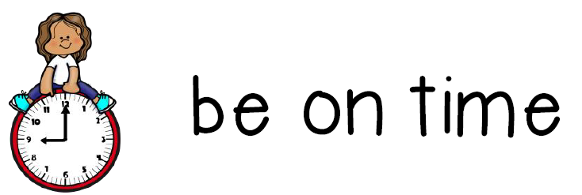
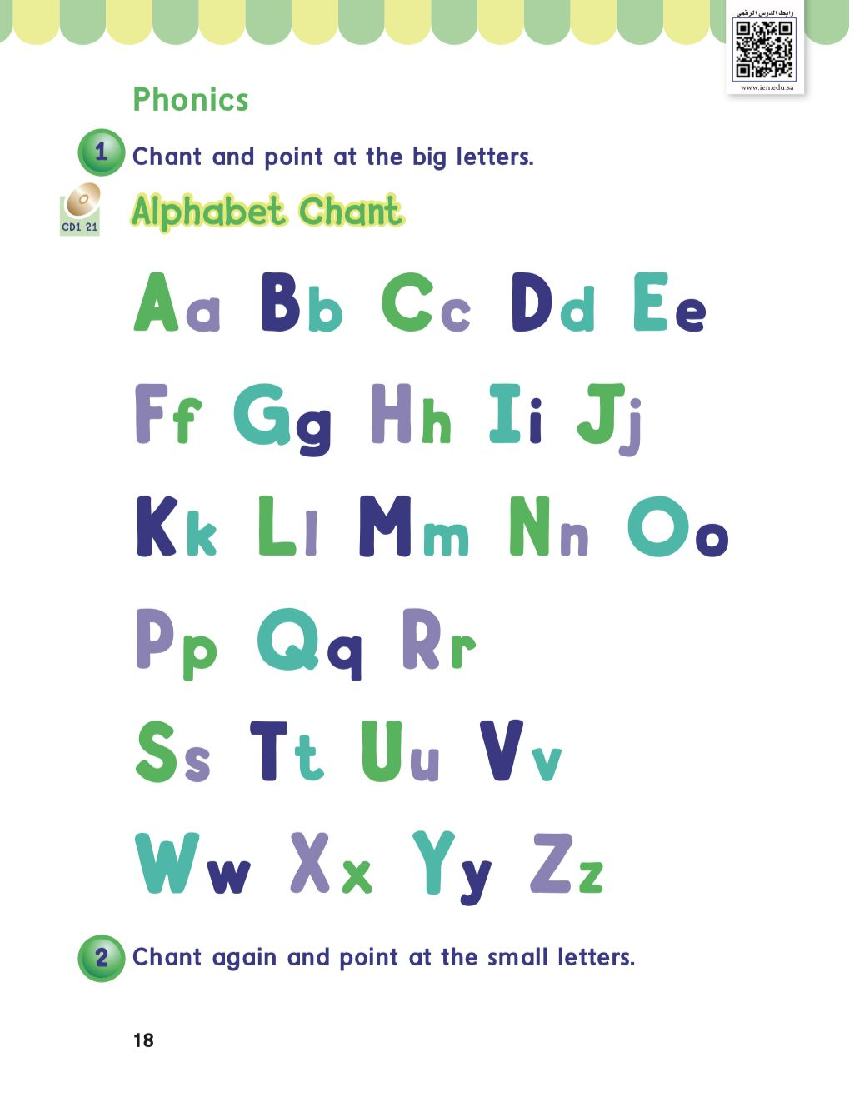
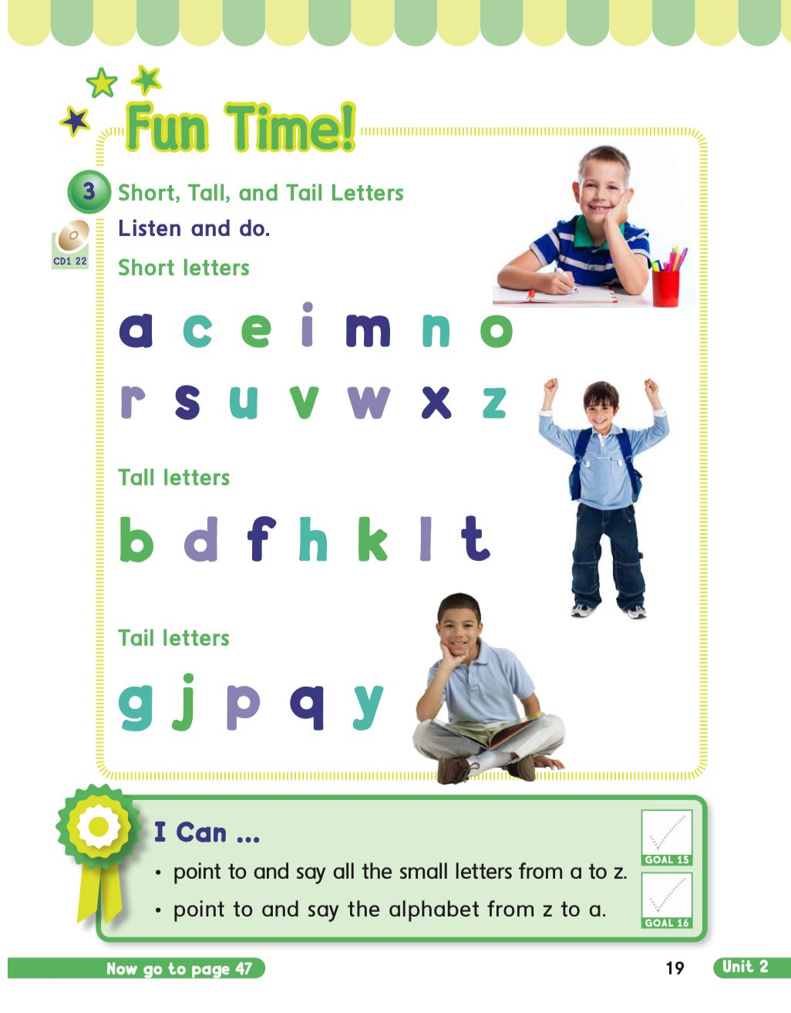
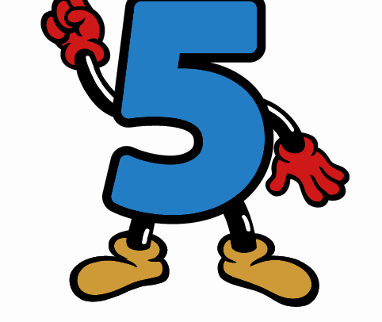
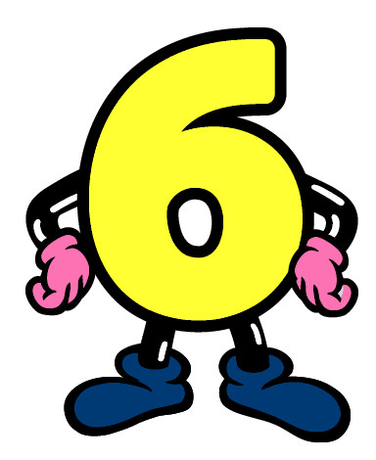
KSA National Anthem
Classroom Rules
Unit 2 : My body
Monday
Warm up
Lesson 4: Phonics
Main lesson
Fun Time
work book
Moral Goal
P: 18 / 19

Slide 2
KSA National Anthem
Classroom Rules
Warm Up
Main lesson
Fun Time
work book
Moral Goal

Slide 3
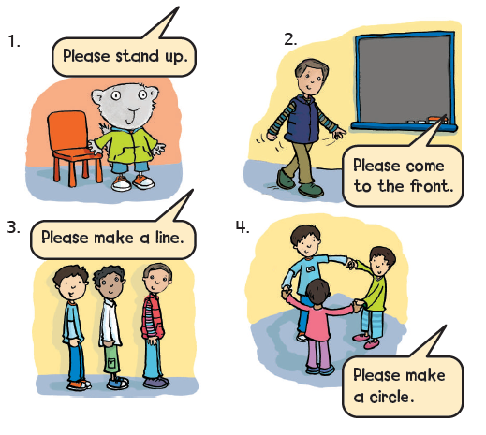
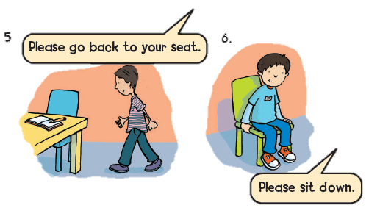
KSA National Anthem
Classroom Rules
Warm up
Main lesson
Fun Time
work book
Moral Goal

Slide 4
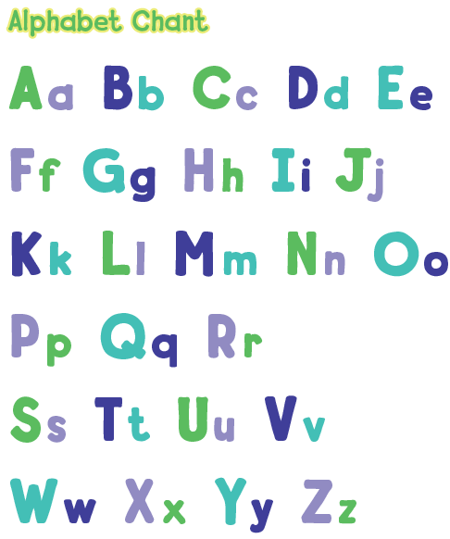
KSA National Anthem
Classroom Rules
1
Chant and point at the big letters
Warm up
Main lesson
Fun Time
work book
Moral Goal

Slide 5
KSA National Anthem
Classroom Rules
Moral Goal
Warm up
Main lesson
Fun Time
Work book
Moral Goal

Slide 6
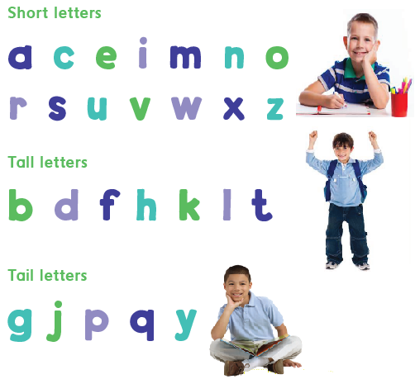
KSA National Anthem
3
Classroom Rules
Short , Tall , and Tail letters. Listen and do .
Warm up
Main lesson
Fun Time
work book
Moral Goal

Slide 7
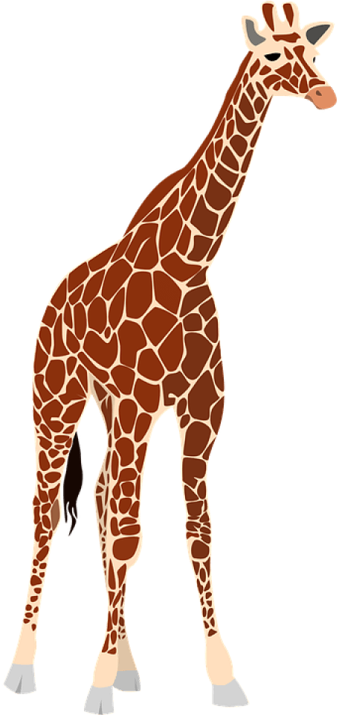
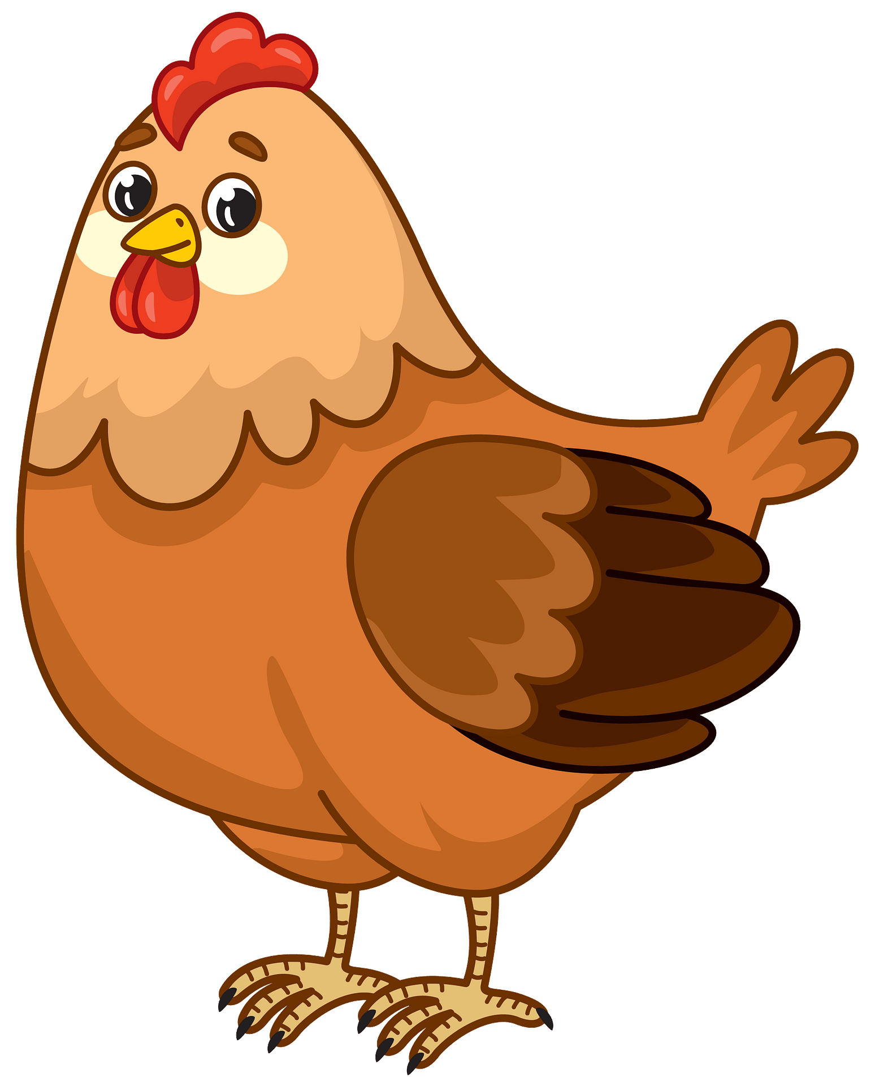
KSA National Anthem
Classroom Rules
Warm up
Main lesson
Fun Time
work book
Moral Goal

Slide 8
KSA National Anthem
Classroom Rules
a c e i m n o
Warm up
Main lesson
Fun Time
work book
r s u v w x z
Moral Goal
Small

Slide 9
KSA National Anthem
Classroom Rules
Warm up
Main lesson
b d f h k l t
Fun Time
work book
Moral Goal
Tall

Slide 10
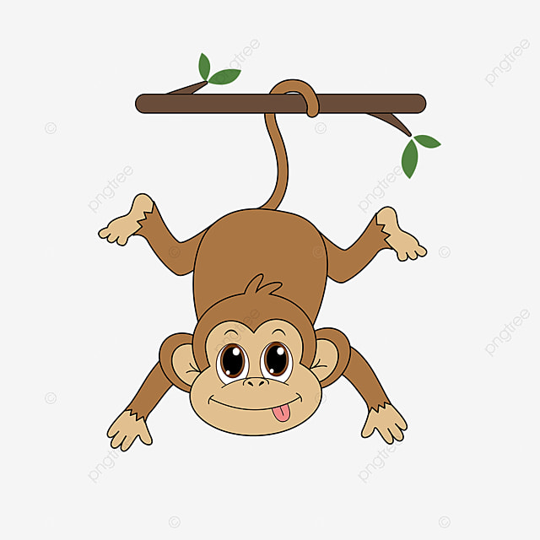
KSA National Anthem
Classroom Rules
Warm up
g j p q y
Main lesson
Fun Time
work book
Moral Goal
Tail

Slide 11
KSA National Anthem
Classroom Rules
Warm up
Main lesson
Fun Time
work book
Moral Goal

Slide 12
KSA National Anthem
Classroom Rules
Warm up
Main lesson
Fun Time
work book
Moral Goal

Slide 13
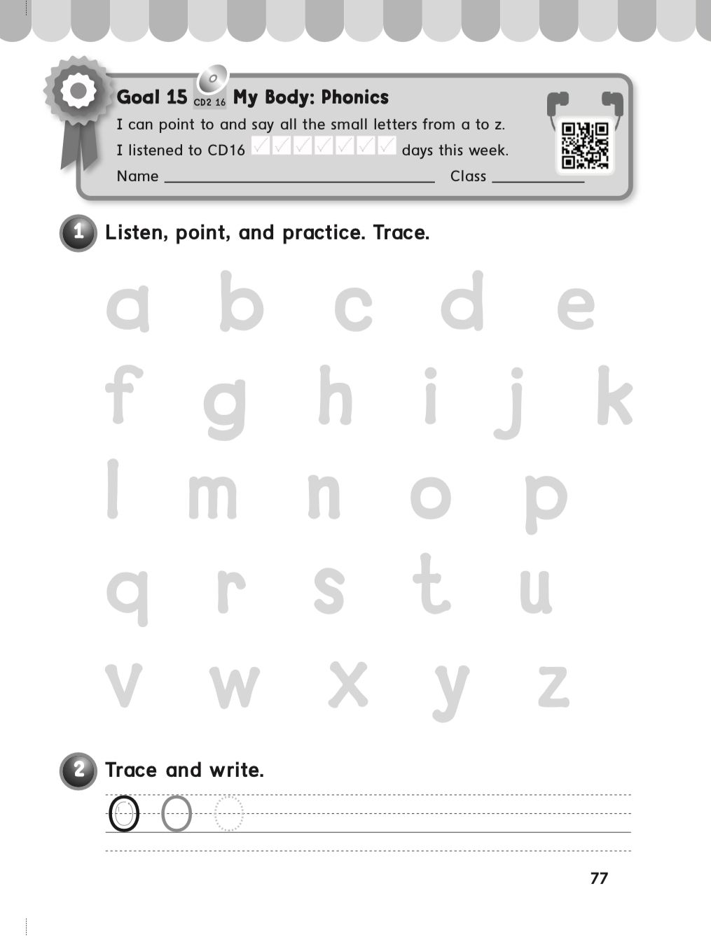
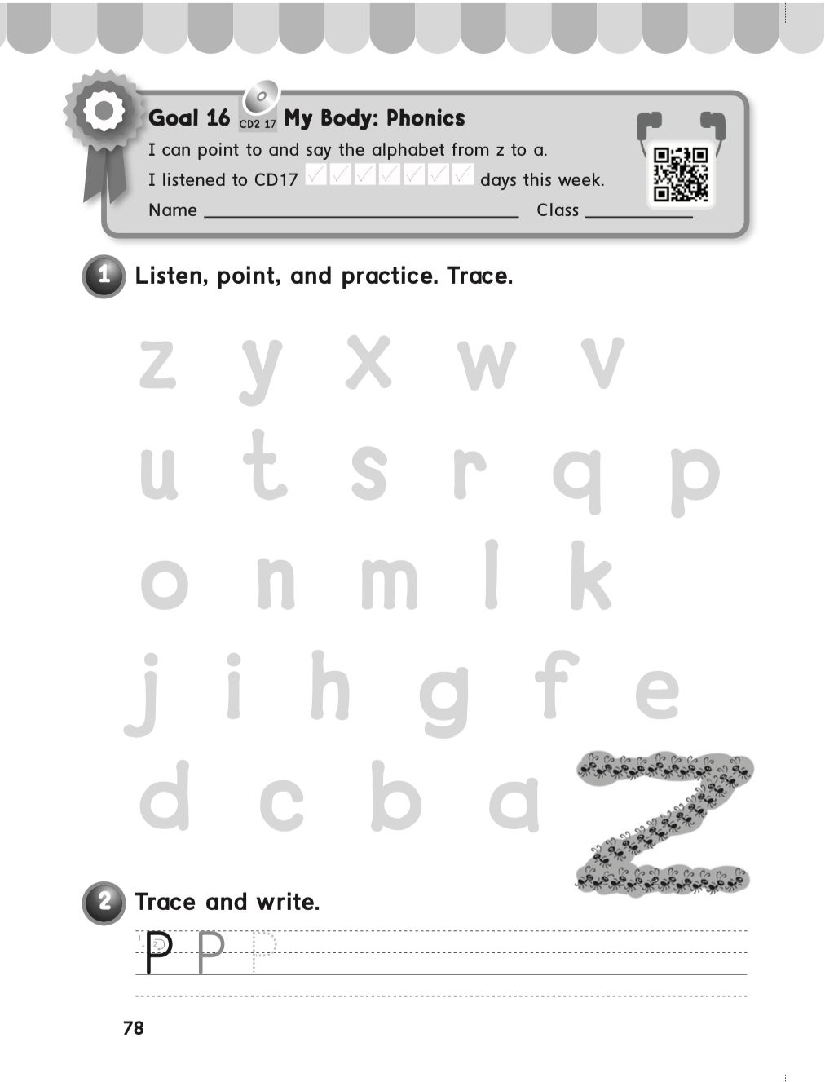
KSA National Anthem
Classroom Rules
Warm up
Main lesson
Fun Time
work book
Moral Goal
P: 77 / 78

Slide 14
