Slide 1
Chapter 7
Lecture 21
The Nervous System

Slide 2
The Nervous System (NS)
Every conscious and unconscious actions that occurs in your body is controlled by the nervous system (NS)
Functions include:
Communication from one end of the body to another
Collection and integration of internal and external stimuli
Formulation of appropriate responses

Slide 3
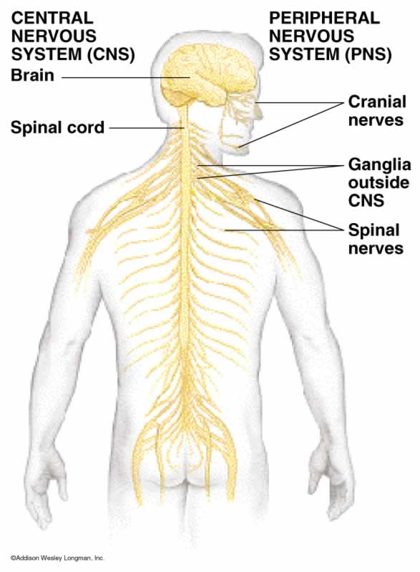
The NS Has Two Components
Central Nervous System (CNS)
Composed of the brain and spinal cord
Integration and command center
Peripheral Nervous System (PNS)
Paired spinal and cranial nerves
Carries messages to and from the spinal
cord and brain
Nervous system
CNS
Brain
Spinal cord
PNS
Somatic Nervous system
Autonomic Nervous system

Slide 4
CNS vs. PNS
Sensory (afferent) information
From special senses, general sensory receptors in blood vessels, viscera and tissues
CNS : Brain and spinal cord
- Integration
Motor (efferent) response
To muscules or glandular tissue

Slide 5
CNS: The Brain and Spinal Cord
The human brain weighs about 1,400 grams
The cerebrospinal fluid and meninges protect and nourish the CNS
The meninges are a series of three consecutive tissue coverings between the nervous tissue and the bone

Slide 6
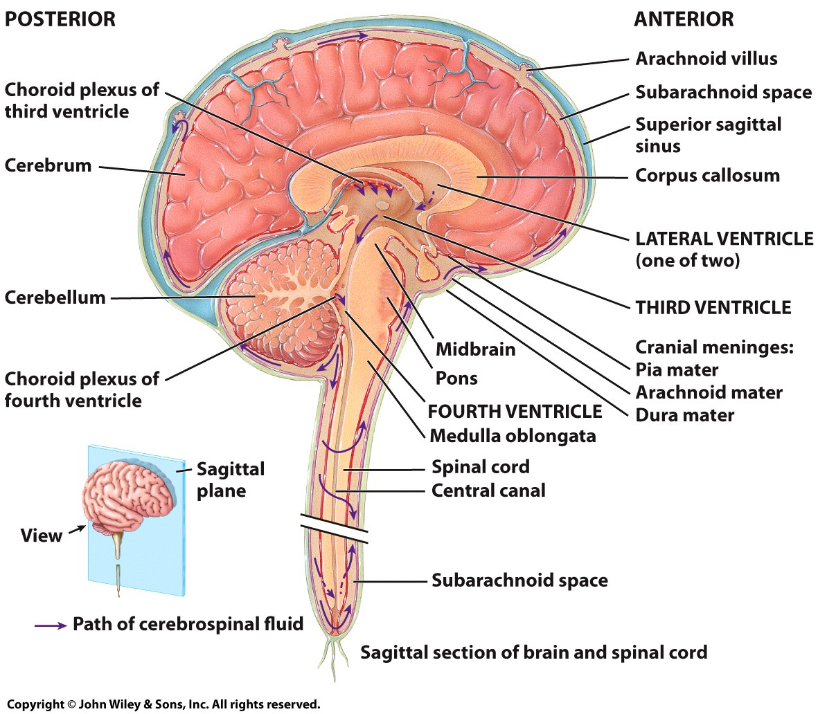
Cerebrospinal Fluid (CSF)
Provides a constant environment for the CNS
Its is continuously produced and absorbed, creating a constant flow
Ventricles make CSF
CSF helps maintain the blood-brain barrier
Permits passage of only certain ions and nutrients

Slide 7
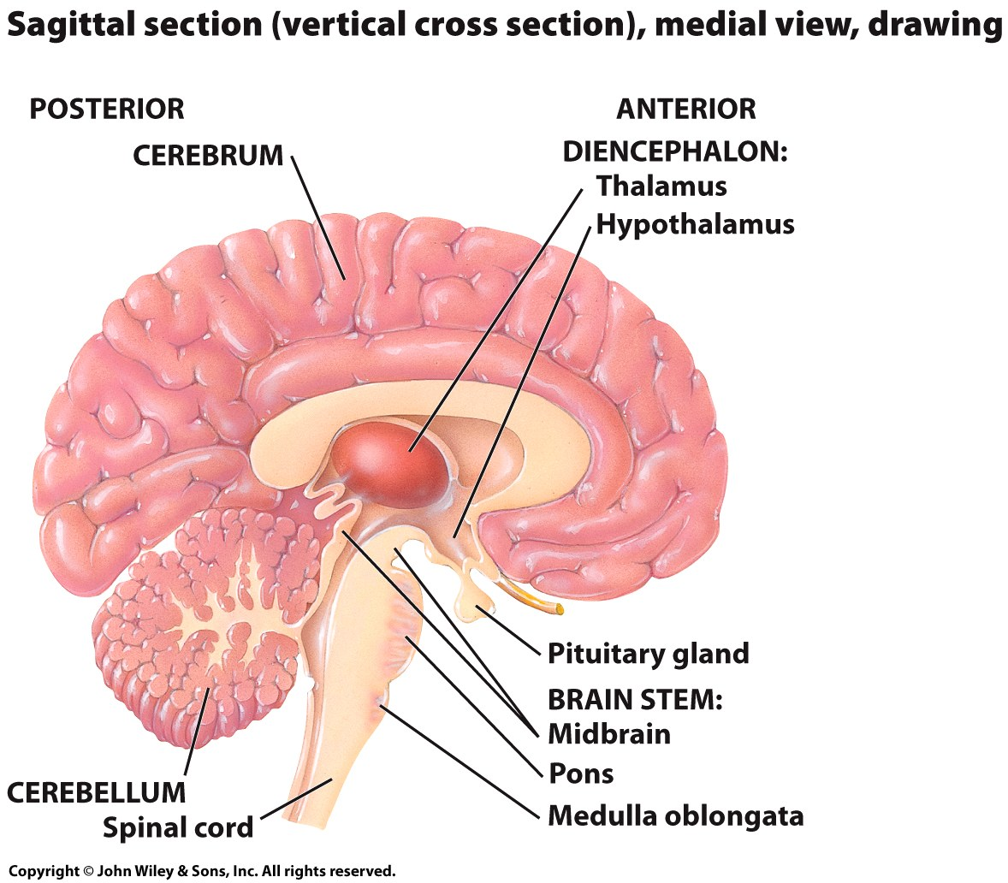
The Brain
The brain has 4 main parts
The brain stem((جذع
The cerebellumالمخيخ
The diencephalonالبيني
The cerebrumالمخ

Slide 8
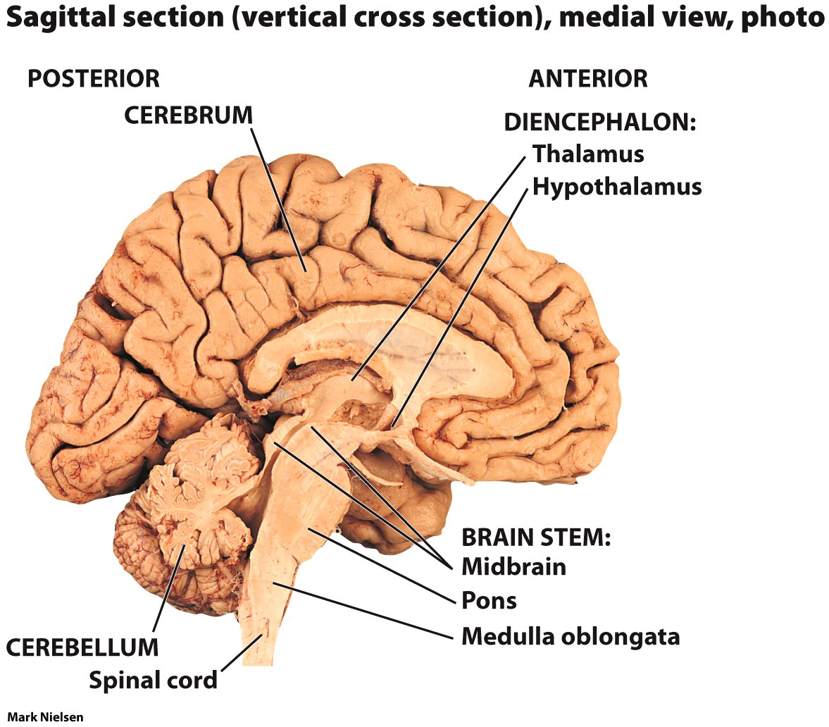
The Brain Stem
Made up of the
mid brain(الدماغ المتوسط), medulla oblongata(النخاع المستطيل),
and pons
Regulates
heart rate, breathing, and blood pressure

Slide 9
The Cerebellum(المخيخ)
Focuses on muscles and movement
Maintains muscle tone, posture and balance
Important in learning motor skills
Riding a bike
Taking notes in class

Slide 10
The Diencephalon(الدماغ البيني)
A relay center for sensory information and motor responses
The thalamus and hypothalamus are also located here
The hypothalamus
Secretes hormones that control the pituitary gland
Also regulates circadian rhythm, body temperature, heart rate, blood pressure and controls smooth muscle contraction

Slide 11
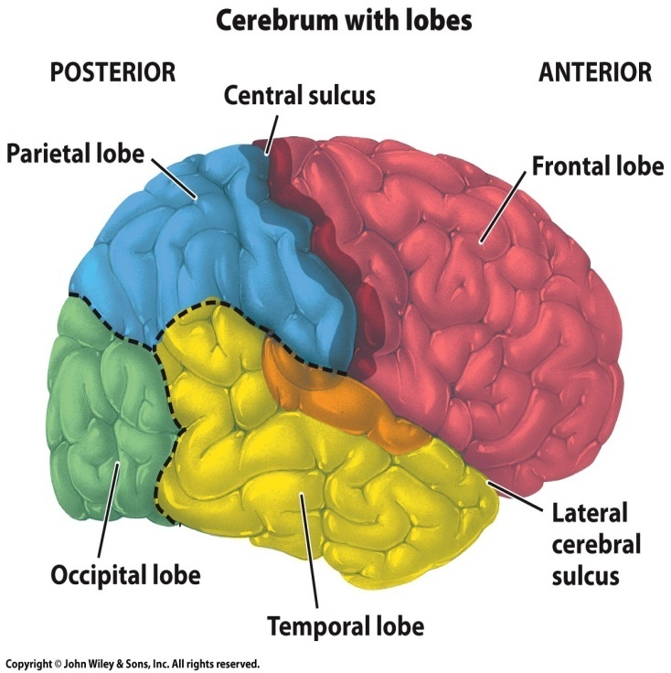
The Cerebrum(المخ)
Largest portion of the brain
Central processing center where learning, remembering, and activity planning takes place
-Organized into four lobes
Frontal, parietal, occipital, temporal
The outer layer of cerebrum, called the cerebral cortex, (قشرة الدماغ)is composed of gray matter
- Contains neuronal cell bodies, dendrites, and non-myelinated axons
The inner layer of the cerebrum consists of white matter that is composed of myelinated axons
- covered in lipids which allows for faster impulse transmission

Slide 12
PNS: Two Divisions
PNS
Somatic NS:
(voluntary, conscious movement)
It regulates skeletal muscles
Autonomic NS:
(involuntary, unconscious reactions)
It regulates homeostasis, smooth muscles, functions
Sympathetic NS
control the body when it is actively moving and consuming energy
Fight and flight responses
Parasympathetic NS
Control the body at energy storage and relaxation
Rest and digest responses
Most body organs are innervated by both the Sympathetic and Parasympathetic NS
- To maintain homeostasis

Slide 13
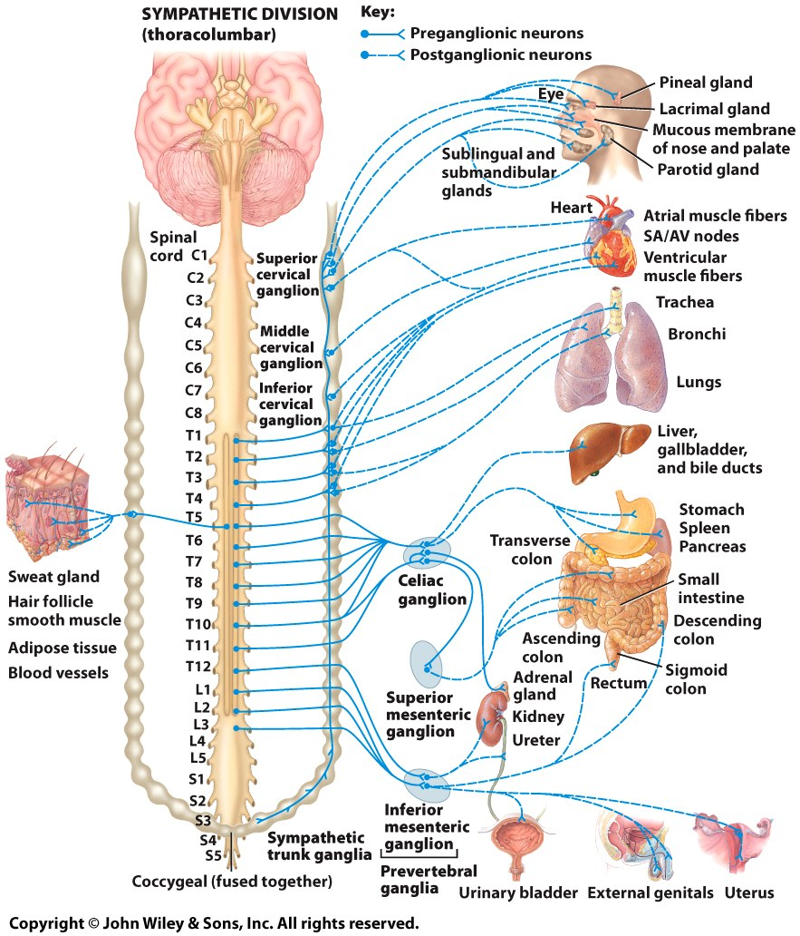
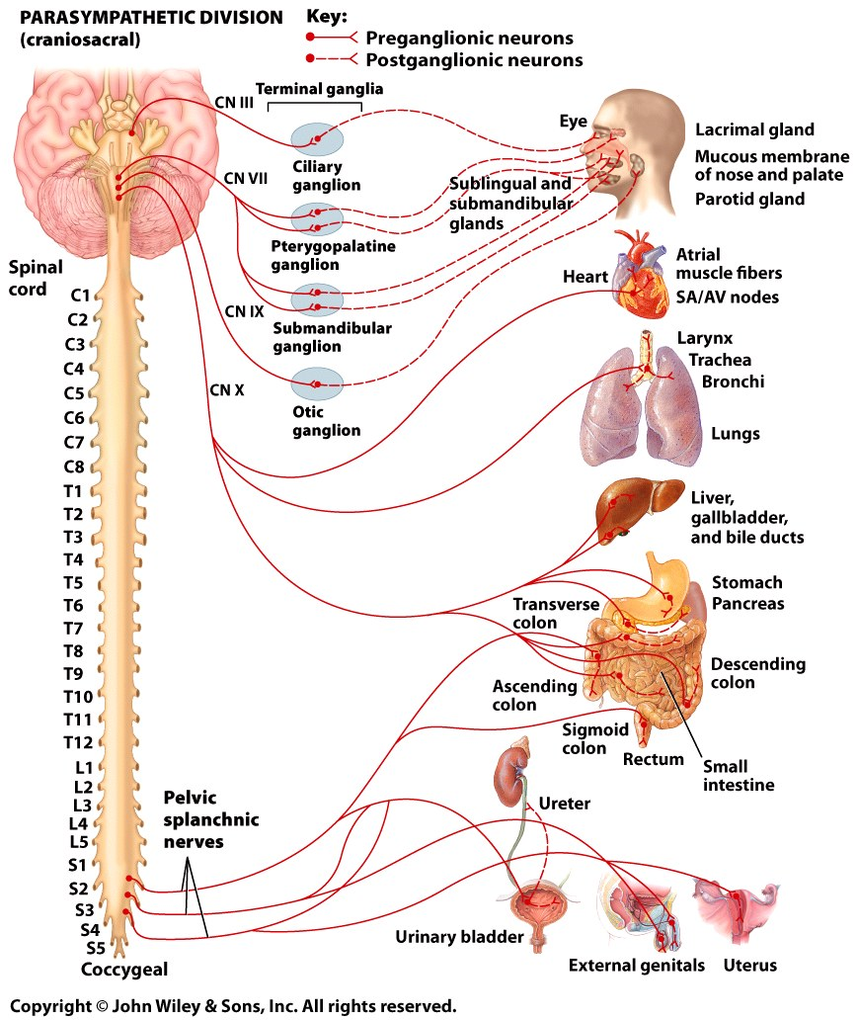
Autonomic NS
SYMPATHETIC NS
PARASYMPATHETIC NS

Slide 14
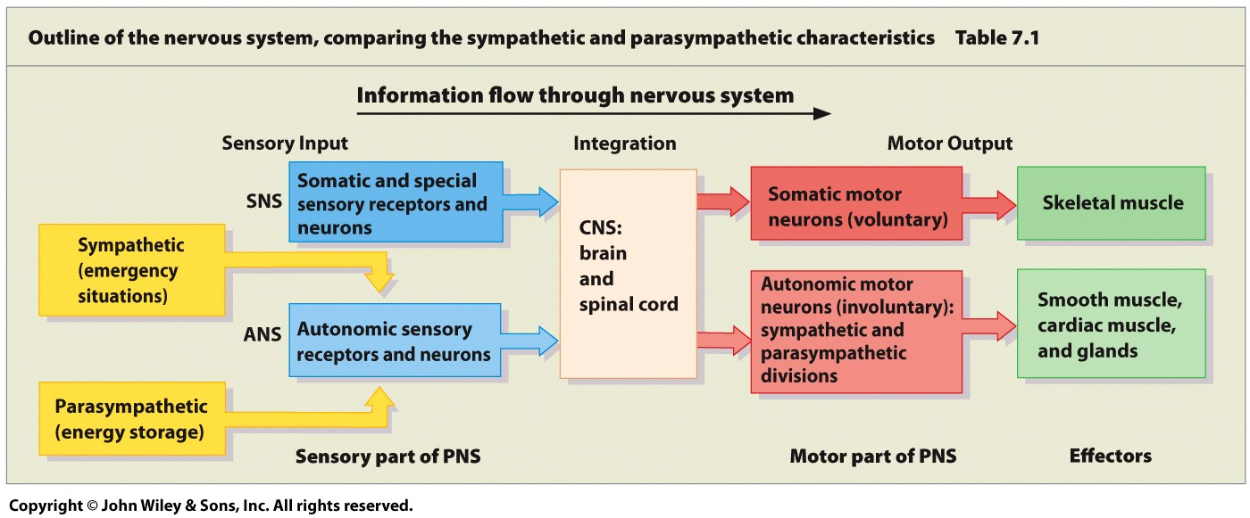
Sympathetic vs. Parasympathetic

Slide 15
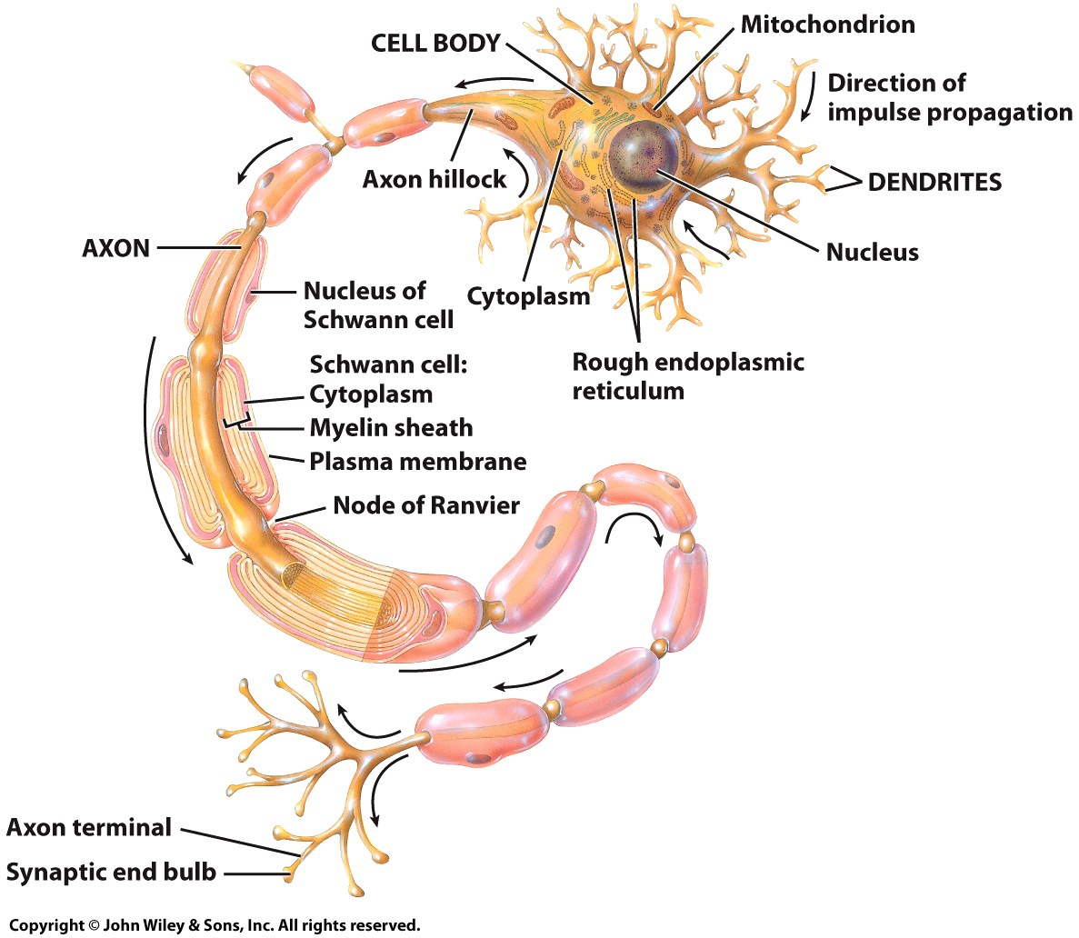
Neurons
The NS contains neurons and neuroglial cells
The neuron is the functional unit of the NS
Functions include:
Carrying sensory information to the brain
Sending responses to organs
Neurons arrange into bundles called nerves
Neuroglia are the supporting cells of nervous tissue

Slide 16
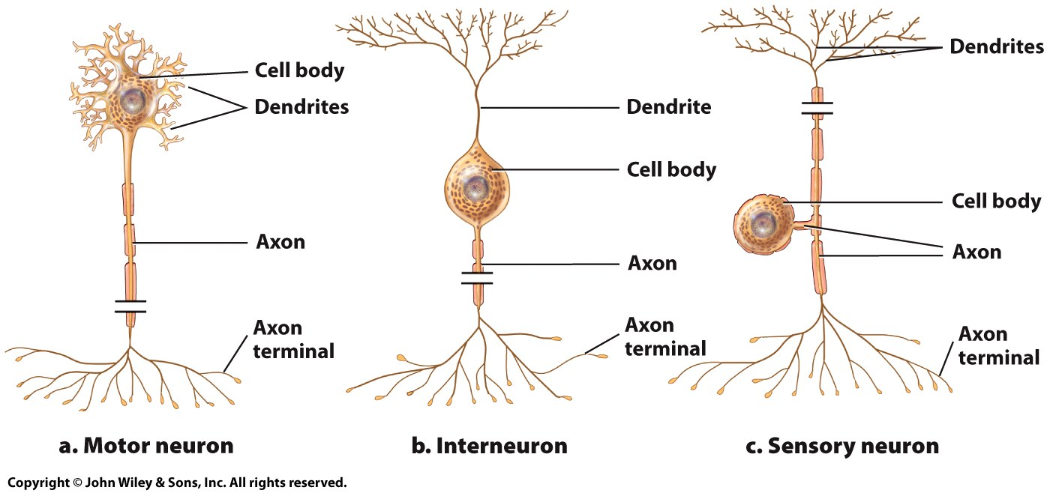
Neurons
The three classes of neurons are based on function
Sensory neurons: detect conditions in the environment or body
Motor neurons: carry instruction to the body
Interneurons: connect sensory and motor neurons

Slide 17
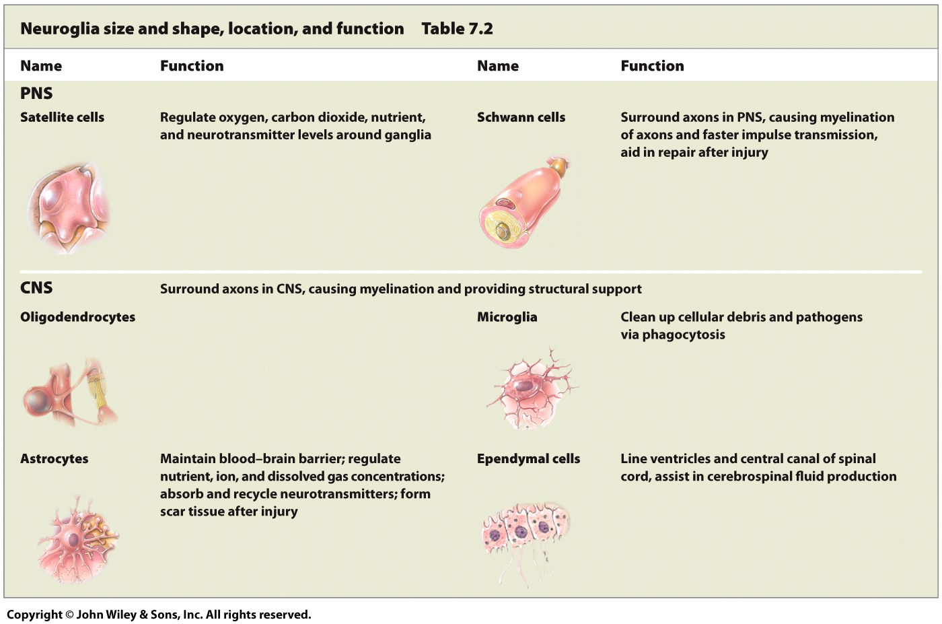
Neuroglia

Slide 18
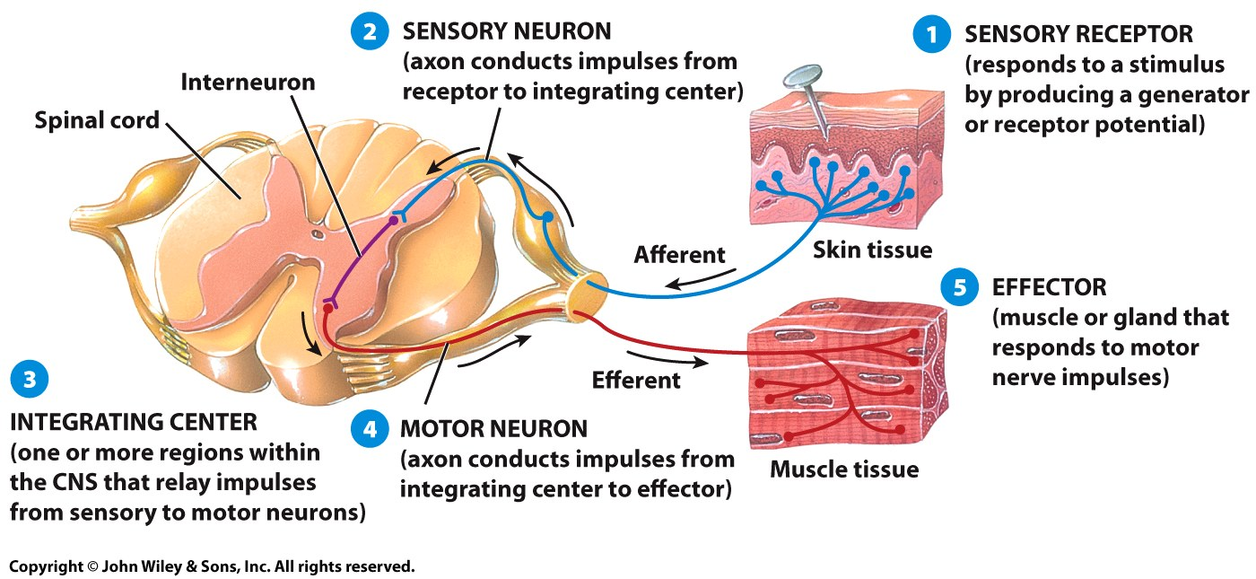
The Reflex Arc
Reflexes are rapid responses to sensory stimuli

Slide 19
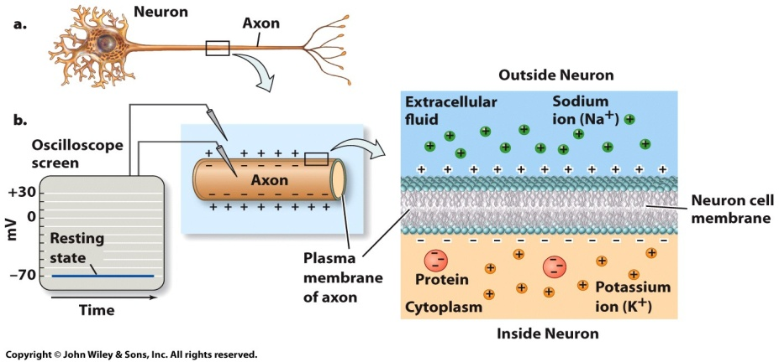
Membrane Potential
The membrane potential results from the difference in ion concentrations between the two sides of a cell membrane

Slide 20
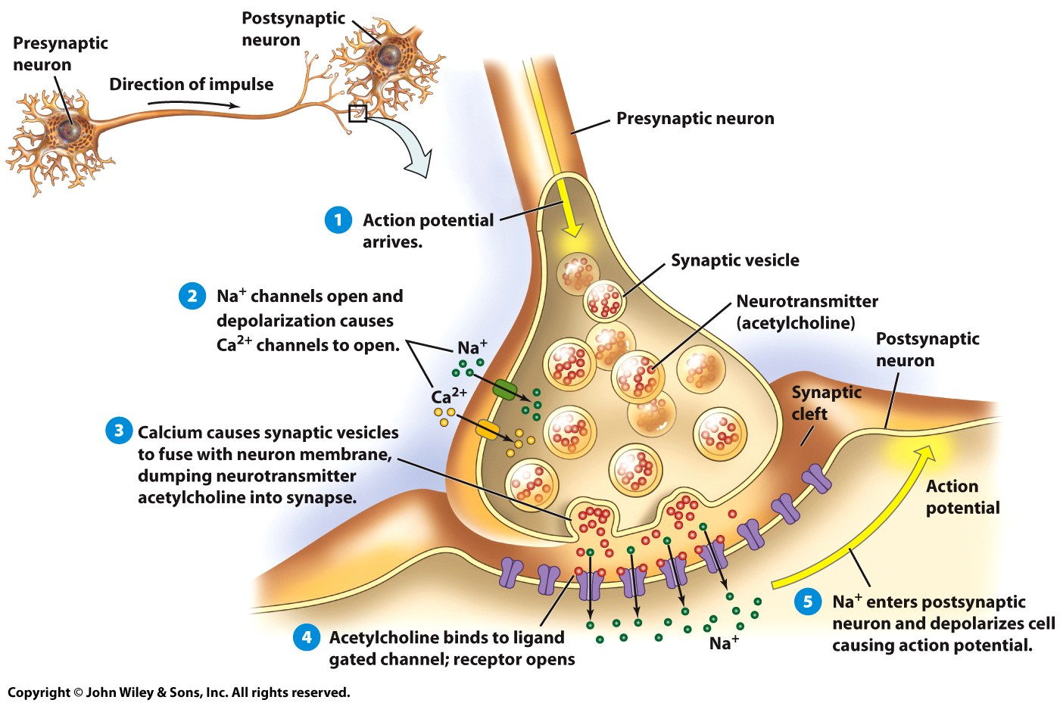
Neurotransmitters
Synapses separate one neuron from another
Neurotransmitters are chemicals used to transmit the nerve impulse from one cell to the next
Diffuse across the synaptic cleft

