Slide 1
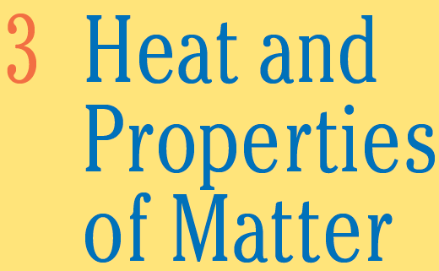

Slide 2
Objectives
The major goals of this chapter are to enable you to:
Distinguish between temperature and heat.
Express temperature using different scales.
Find the heat required for change of phase of solids, liquids, and gases.
Define elasticity
Apply Hooke’s law
Calculate the amount of stress on objects.
Define and Solve density problems.

Slide 3

Temperature:
Basically temperature is a measure of hotness or coldness of an object
Properly measured with instrumental thermometer. (not by hand which is not sensitive enough nor precise)
Thermometer example:
A property of matter that we use to find temperature is the change in volume of a liquid or a solid as its temperature changes.
The liquid in glass thermometers
When the liquid is heated, it expands and rises up the glass tube.
The height to which the liquid rises indicates the temperature

Slide 4

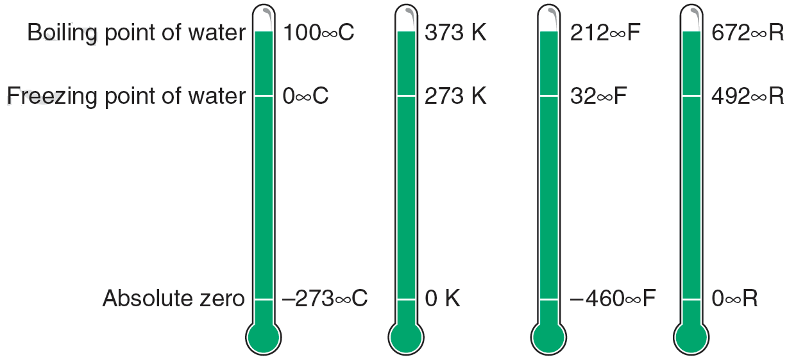

The relationship between Fahrenheit temperatures (T_{F}) and Celsius temperatures (T_{C}) is given by
T_{C} = 5/9 (T_{F} - 32°)
T_{F} = 9/5 T_{C} + 32°

Slide 5
Learning Check
A. What is the temperature of freezing water?
1) 0 °F 2) 0 °C 3) 0 K
B. What is the temperature of boiling water?
1) 100 °F 2) 32 °F 3) 373 K
C. How many Celsius units are between the boiling and freezing points of water?
1) 100 2) 180 3) 273
Determine the temperature at which both scales agree (T_{c} =T_{F}.).

Slide 6
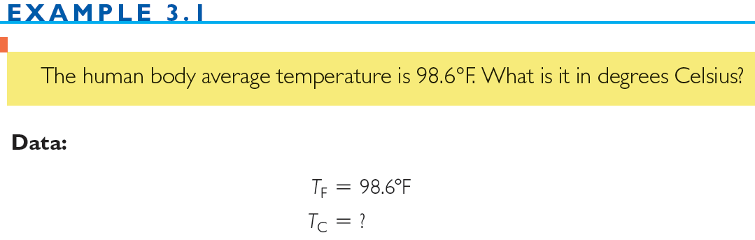
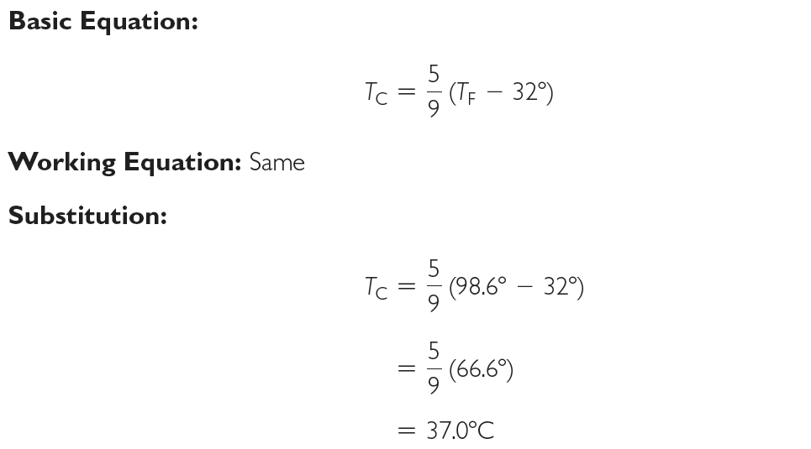
To solve for Kelvin:
T_{K} = T_{C} +273
T_{K} = 37.0 + 273
T_{K} = 310 K

Slide 7
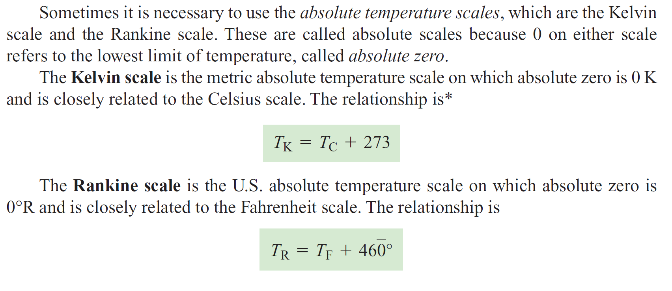
The normal temperature of a chickadee is 105.8 °F. What is that temperature on the Celsius scale?
1) 73.8 °C
2) 58.8 °C
3) 41.0 °C

Slide 8

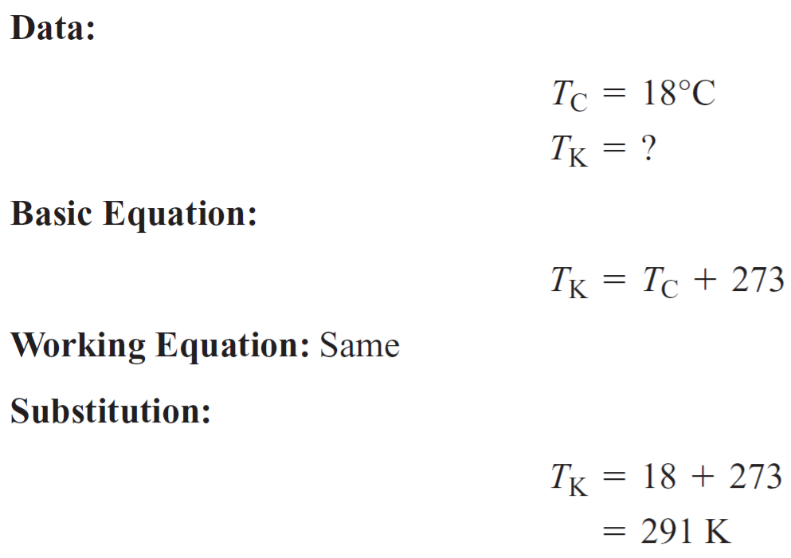
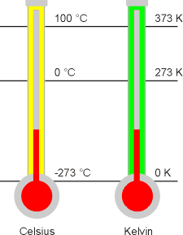
1 K = 1 °C
0 K = –273 °C
0 K (absolute zero) is the lowest possible temperature.
Kelvin temperature scale, is more commonly used for scientific measurements.

Slide 9
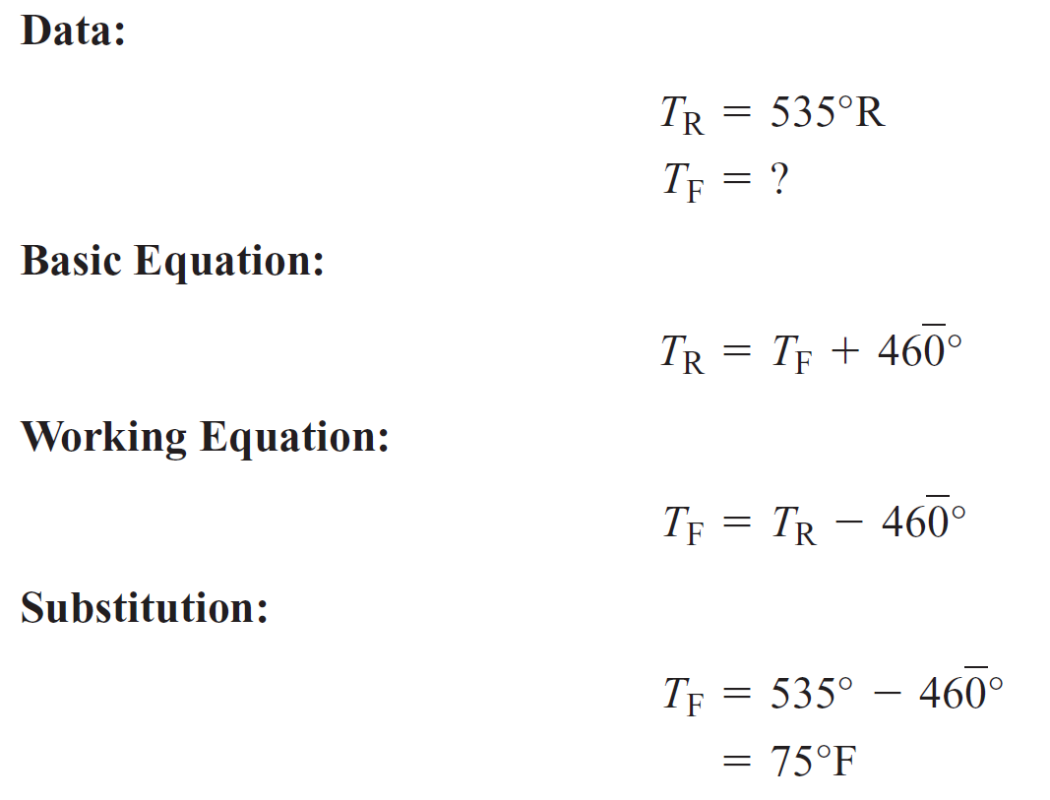

Slide 10
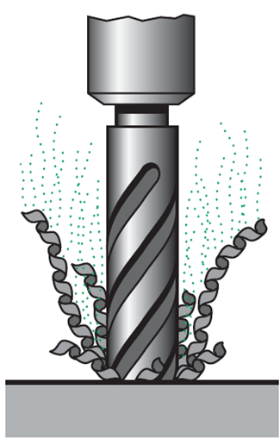
Heat
When a hole is drilled in a metal block, it becomes very hot.
As the drill does mechanical work on the metal, the temperature of the metal increases
At high temperatures, the atoms in the metal vibrate more rapidly than at low temperatures. Their velocity is higher at high temperatures, and thus their kinetic energy is greater.
Friction causes a rise in temperature of the drill and plate.

Slide 11
Heat
is a form of internal kinetic and potential energy contained in an object associated with the motion of its atoms or molecules and may be transferred from an object at a higher temperature to one at a lower temperature.
Heat cannot be stored. Heat is a transformed energy (example: work by friction force transforms into heat)
Units:
  SI system → Joule (J)
  U.S. system → ft lb
Other units:
  Metric/SI system → kilocalorie (kcal)
  U.S. system → Btu (British thermal unit)
Conversion factors:
  1 kcal = 4190 J ; 1 Btu = 778 ft lb

Slide 12
The kilocalorie (kcal) is the amount of heat necessary to raise the temperature of 1 kg of water 1°C (from 14.5°C to 15.5°C).
The calorie (cal) is the amount of heat (energy) necessary to raise the temperature of 1 g of water 1°C.
Note: One food calorie is the same as 1 kcal.
what is the difference between temperature and heat?
Temperature is a measure of the hotness or coldness of an object.
Heat is the total thermal energy (kinetic and potential) that can be transferred from an object at a higher temperature to one at a lower temperature.
Two basic ways of changing the temperature of an object:
1. By doing work on the object, such as the work done by the drill on the metal block 2. By supplying energy to the object, such as mechanical, chemical, or electrical
energy.

Slide 13
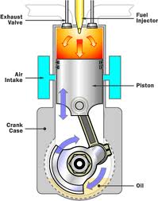
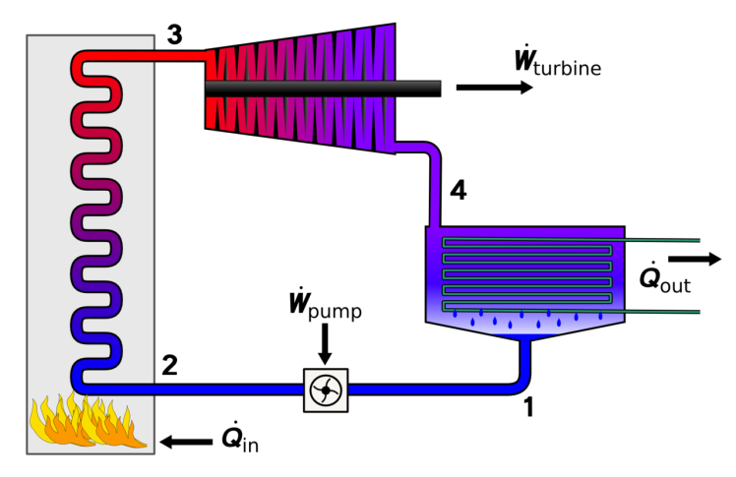
Conversion of heat into useful work
EXAMPLES:
In our bodies:
Food → Heat → muscular energy (~ 25 % of the heat) → work
By burning gases:
Heat → gas expansion → work (example: internal combustion engine in cars)
By steam.:
Heat → energetic steam → work (example: steam turbine)
Internal combustion engine
Steam generator & turbine

Slide 14

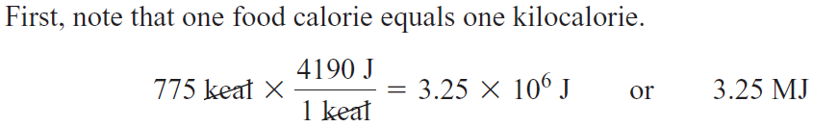

EXAMPLES
Find the amount of work (in J) that is equivalent to 4850 cal of heat.
How much work must a person do to offset eating a 775-calorie breakfast?
A given coal gives off 7150 kcal/kg of heat when burned. How many joules of work result
from burning one metric ton, assuming that 35.0% of the heat is lost?
First, note that one metric ton equals 1000 kg.

Slide 15


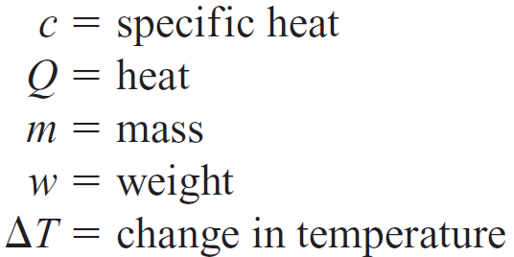
The specific heat of a substance is a measure of its capacity to absorb or give off heat per degree change in temperature

Slide 17
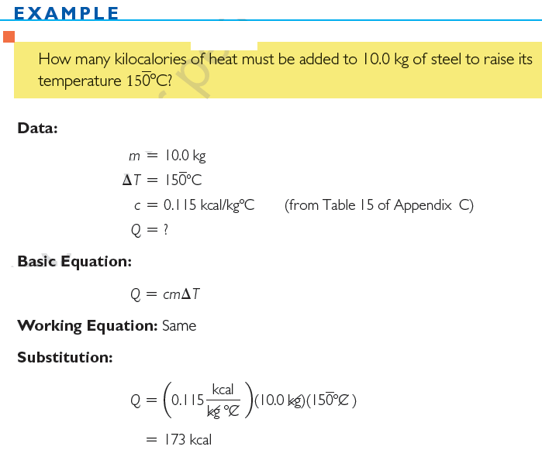

Slide 18
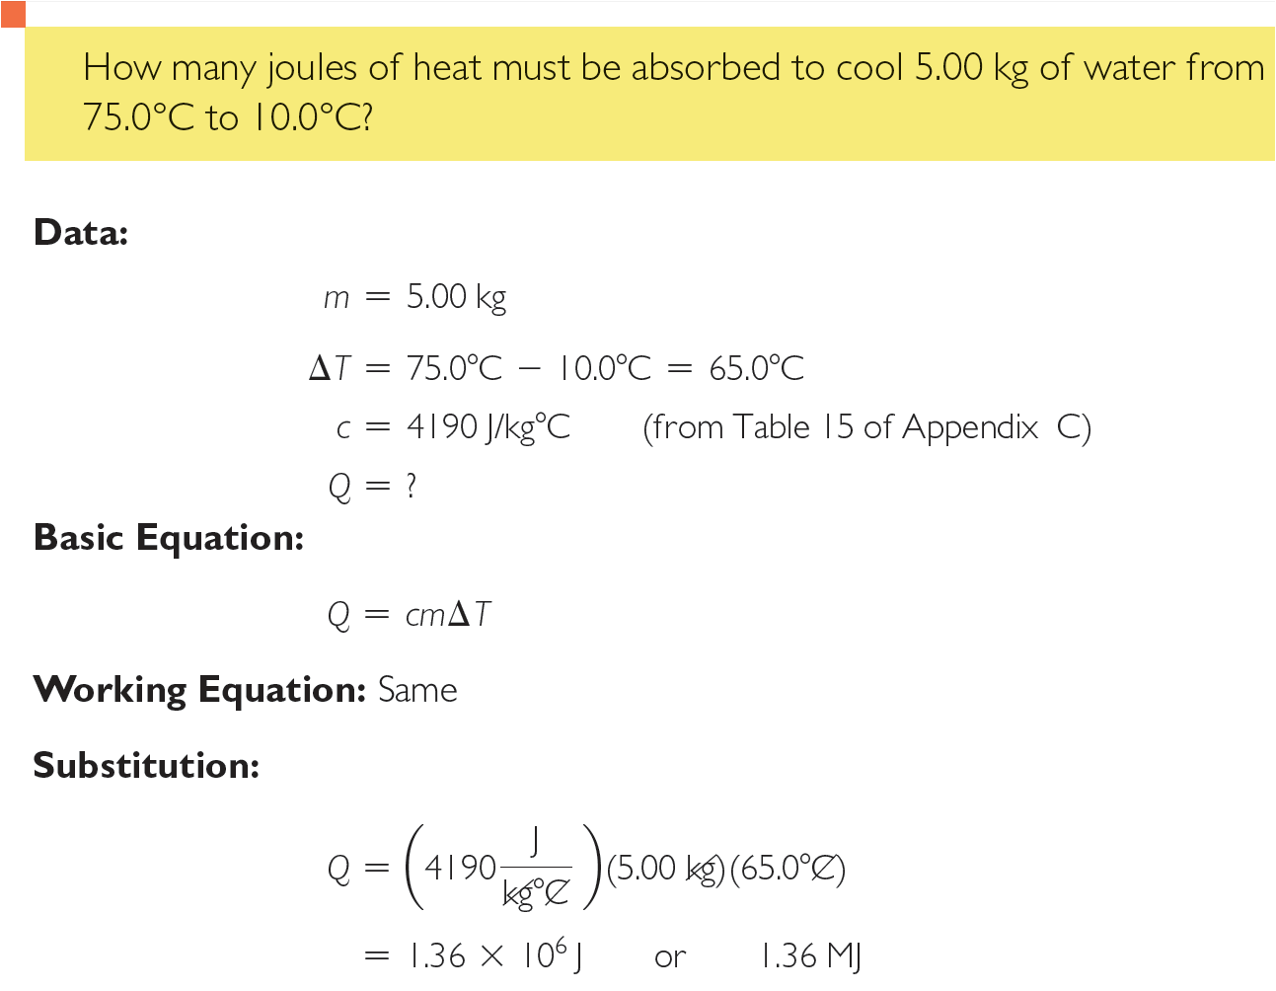

Slide 19

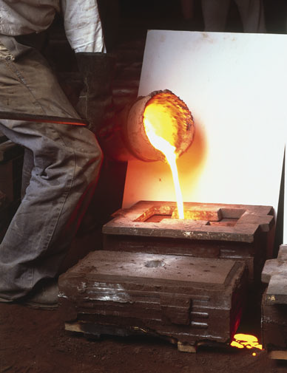
Change of phase (sometimes called change of state) is a change in a substance from one form of matter (solid, liquid, or gas) to another.
Molten iron at about 2900F is poured from a bucket into an open mold by a person in protective clothes and gloves.

Slide 20

The change of phase from solid to liquid is called melting or fusion.
The change from liquid to solid is called freezing or solidification.
Melting and solidification of these substances occur at the same temperature
There is no temperature change during change of phase. Ice at 0°C changes to water at 0°C.
Although there is no temperature change during a change of phase, there is a transfer of heat.
* A melting solid absorbs heat and a solidifying liquid gives off heat.

Slide 21
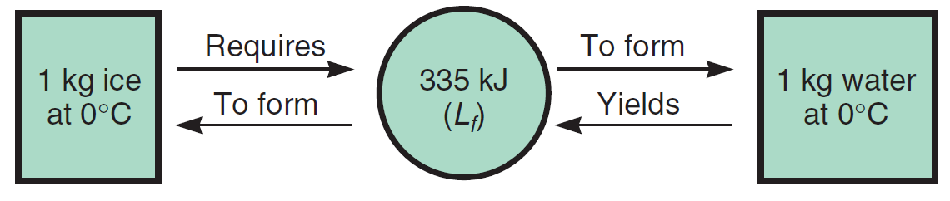
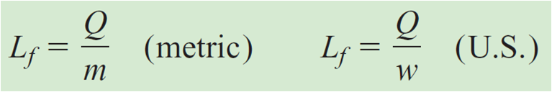
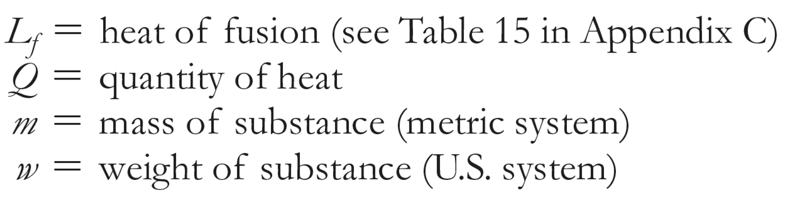
EXAMPLE
When 1 g of ice at 0°C melts, it absorbs 80 cal of heat.
Similarly, when 1 g of water freezes at 0°C, ice
at 0°C is produced, and 80 cal of heat is released.
No temperature change during change of phase

Slide 22
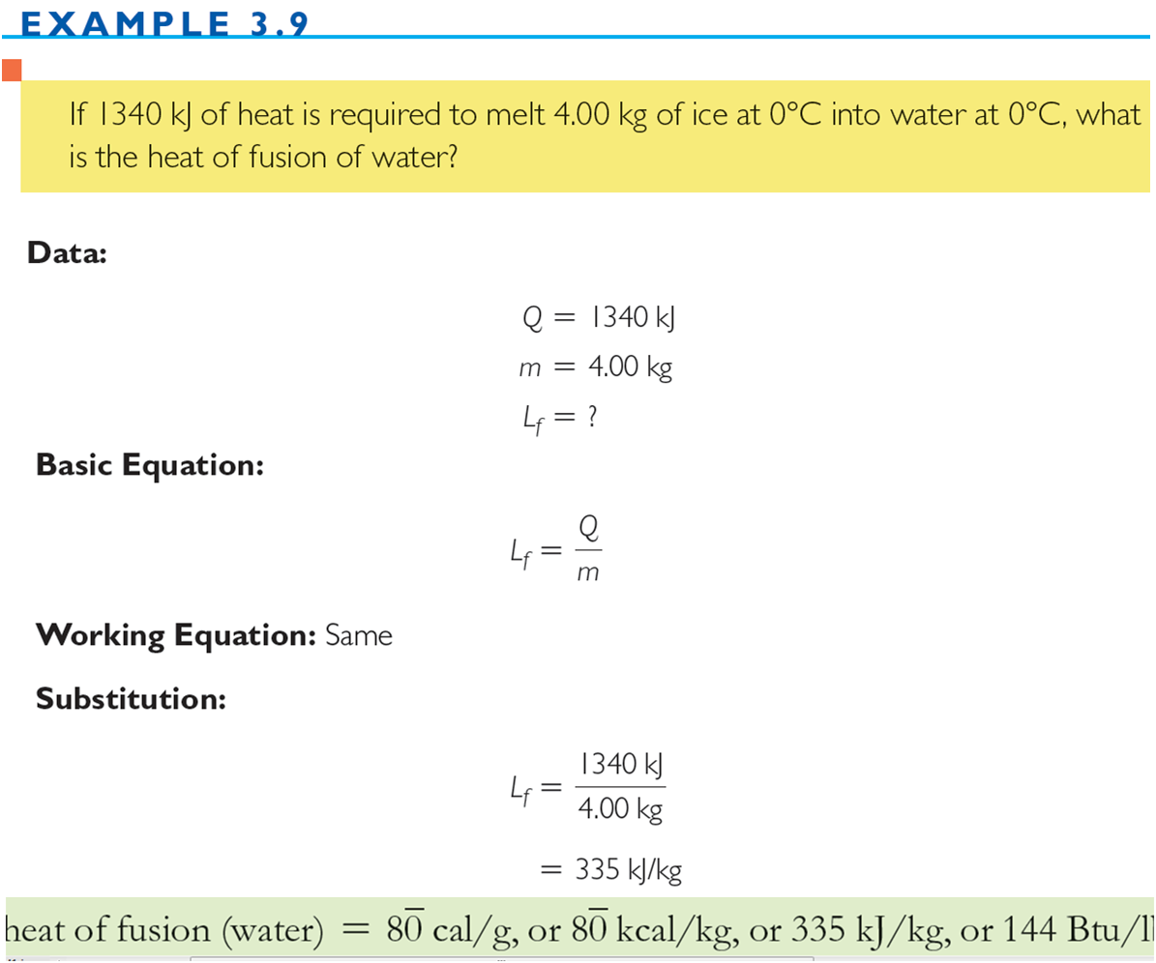

Slide 23


The change of phase from liquid to a gas or vapor is called vaporization.
The reverse process (gas → liquid) is called condensation
While a liquid is boiling, the temperature of the liquid does not change. However, there is a transfer of heat.
A liquid being vaporized (boiled) absorbs heat. As a vapor condenses, heat is given off.

Slide 24
Heat supplied to boiling water
changes liquid water into steam—the gas form of water.
A large amount of heat is released by condensation of steam in a radiator.

Slide 25
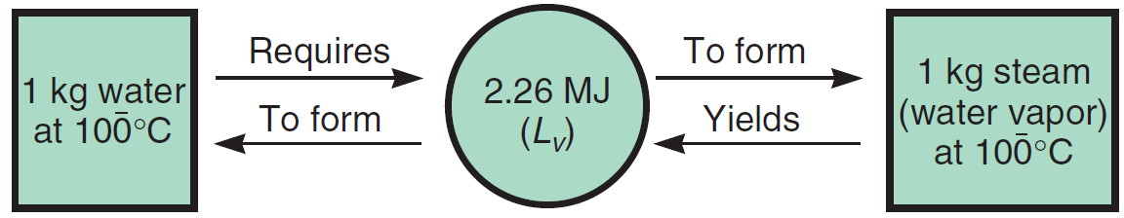
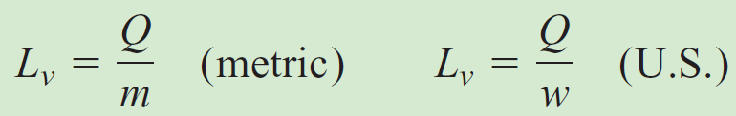
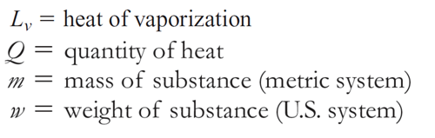

EXAMPLE
No temperature change during change of phase

Slide 26
At the point of condensation, the vapor becomes saturated; that is, the vapor cannot hold any more moisture
Relative humidity is the ratio of the actual amount of vapor in the atmosphere to the amount of vapor required to reach 100% of saturation at the existing temperature.
As the air temperature decreases without change in pressure or vapor content, the relative humidity increases until it reaches 100% at saturation.
The temperature at which saturation is reached is called the dew point
Once saturation is reached and the temperature continues to decrease, condensation occurs in the form of dew, fog, mist, clouds, and rain or other forms of precipitation.

Slide 27
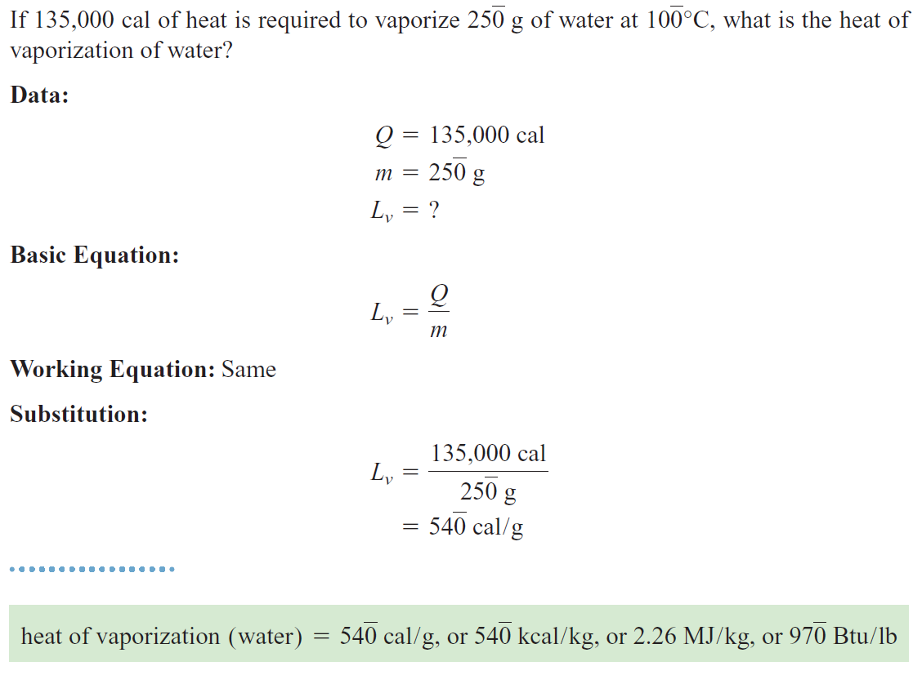
EXAMPLE

Slide 28
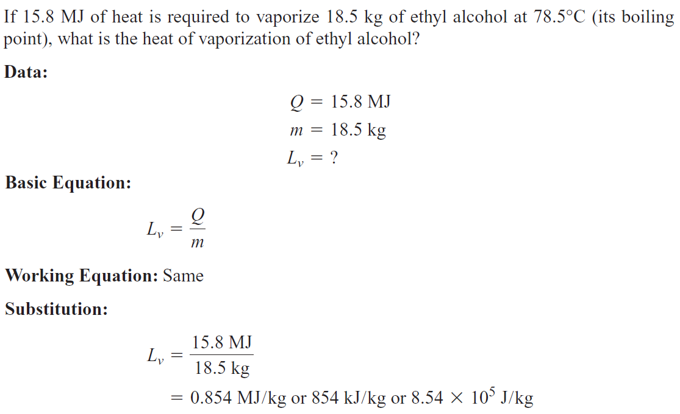
EXAMPLE

Slide 29
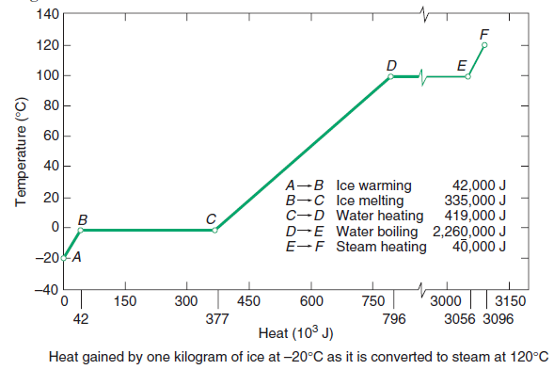


EXAMPLE

Slide 30
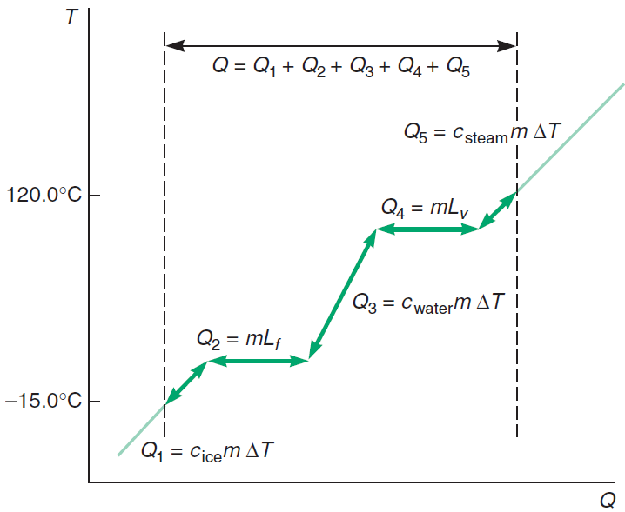

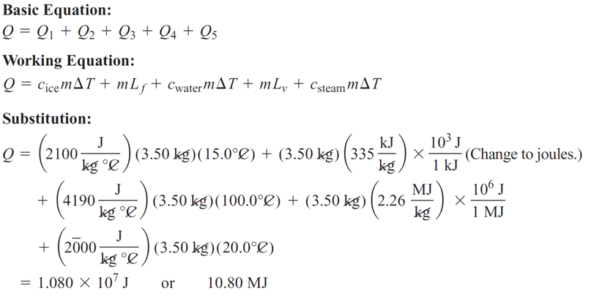
EXAMPLE

Slide 31


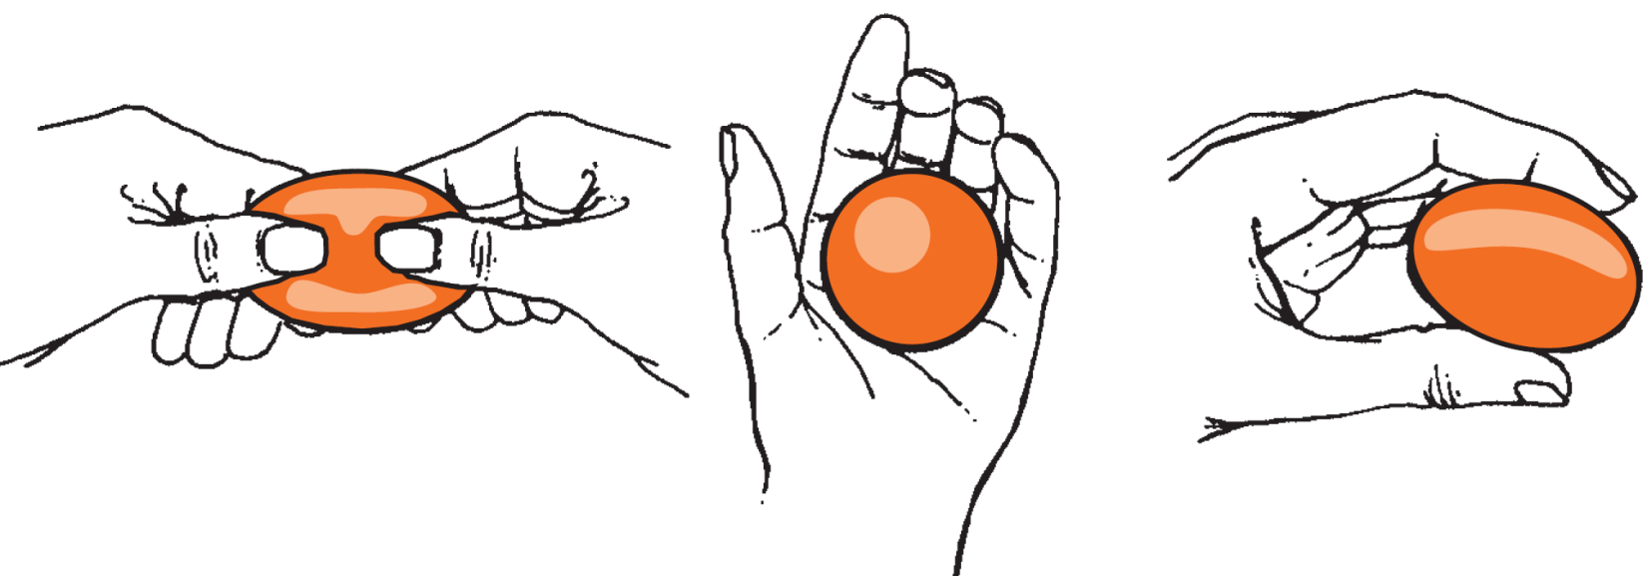
is a measure of a deformed object’s ability to return to its original size and shape once the outside forces are removed.
EXAMPLE:
Stretch
squeeze
Release
Release
When molecules are slightly pulled out of position (being farther apart than normal), they attract each other after releasing the pressure .
When they are pressed too close together, they repel each other after releasing the pressure.

Slide 32
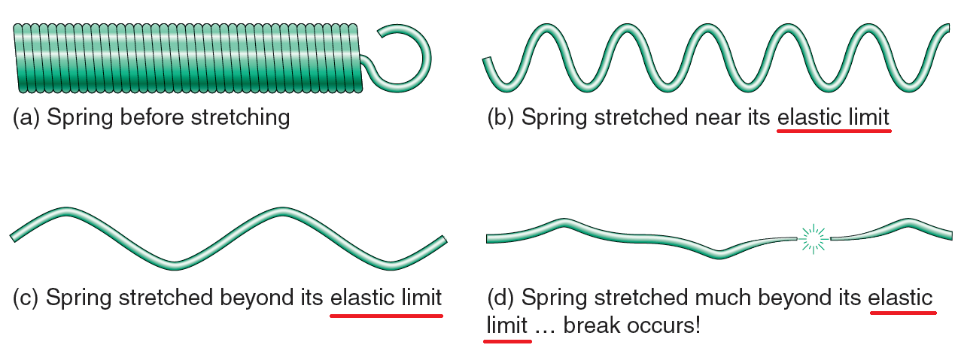
The elastic limit
If too large a deforming force is applied, an object may become deformed permanently.
The elastic limit of a solid is the point beyond which a deformed object cannot return to its original shape.

Slide 33
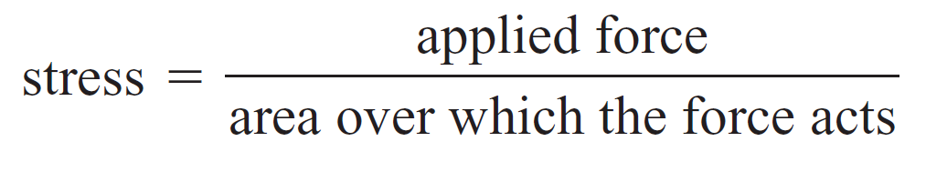
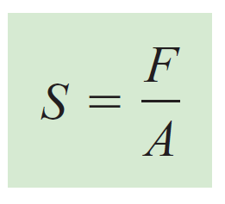
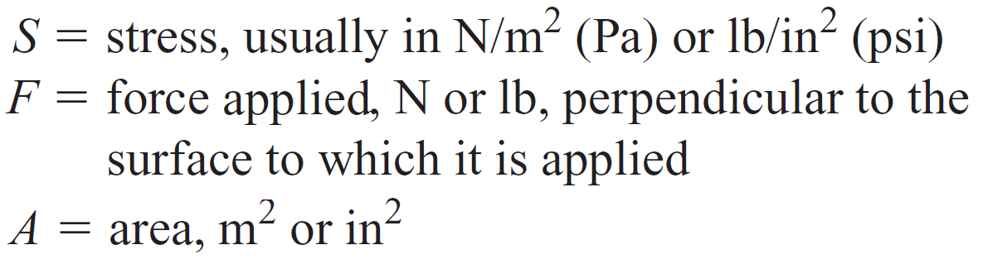
Stress
Or
⇒ Pa ≡ Pascal (SI pressure unit) ⇒ 1 Pa = 1 N/m²

Slide 34
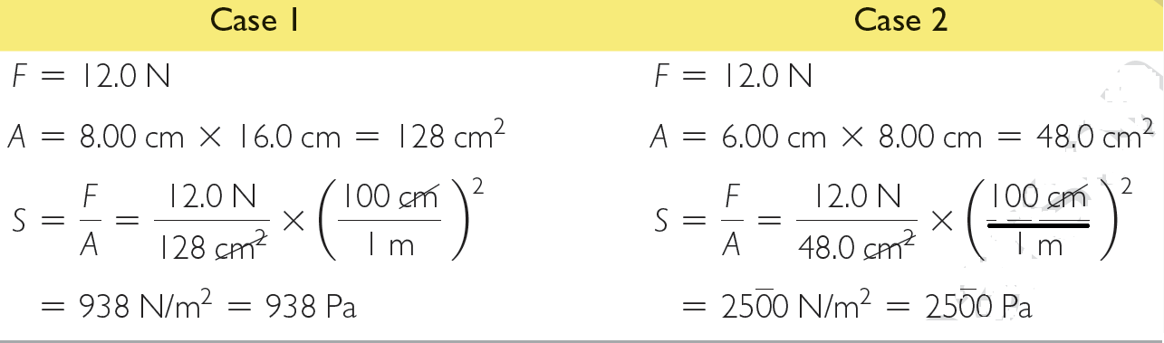
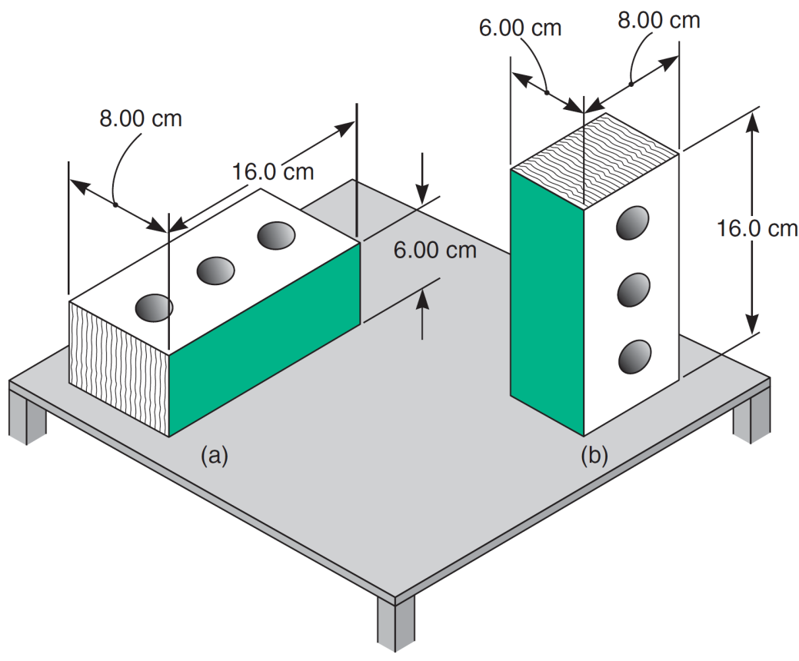
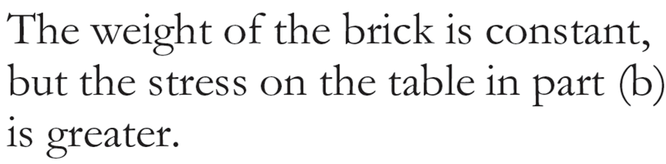
EXAMPLE:
This shows that when the same force is applied to a smaller area, the stress is greater.

Slide 35
Stress, basic types:
Tension
Compression
Shear
Torsion
bending

Slide 36
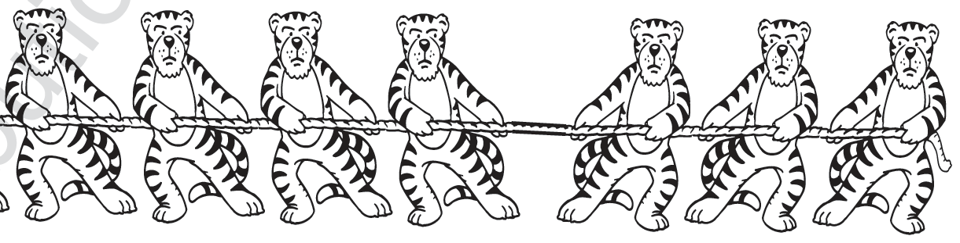
1. Tension
Tension is a stress caused by two forces acting directly opposite each other.
This stress tends to cause objects to become longer and thinner.
The rope in a tug-of-war competition is in constant tension.
F
F
A
Tension

Slide 37
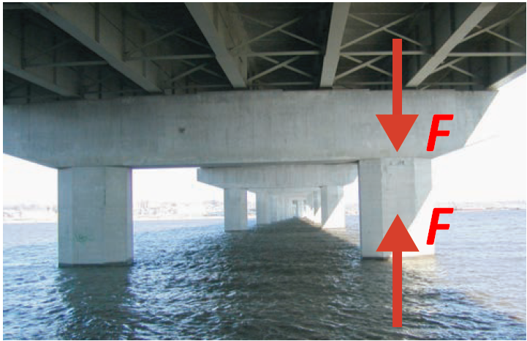
2. Compression
Compression is a stress caused by two forces acting directly toward each other.
This stress tends to cause objects to become shorter and thicker
The stress present in a supporting column is compression
A load is pushing down on the column, while the ground is applying a force pushing up on the column.
As a result, the pillar compresses.
A column under the New Clark Bridge crossing the Mississippi River is in compression.

Slide 38
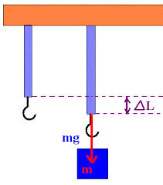

Stress causes strain
Strain:
is the deformation of an object due to an applied force.
change in length
Strain ≡
(i.e., change in length per unit length)
Original length
Or
change in volume
Strain ≡
Original volume

Slide 39

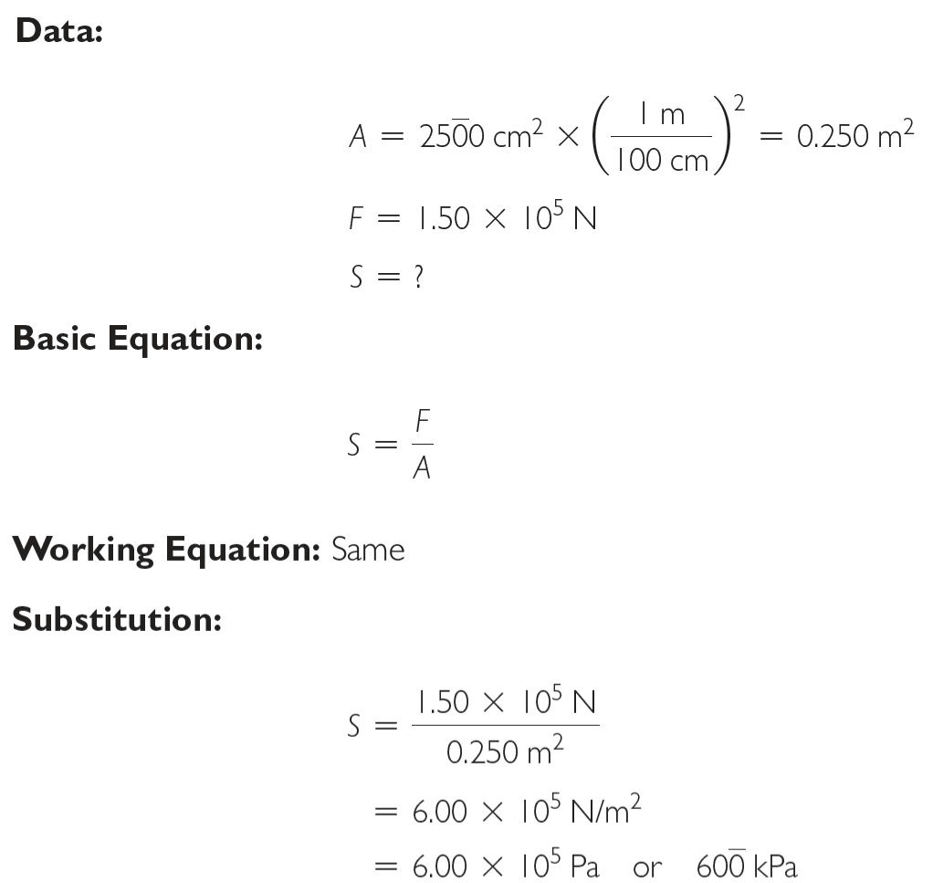
EXAMPLE:

Slide 40
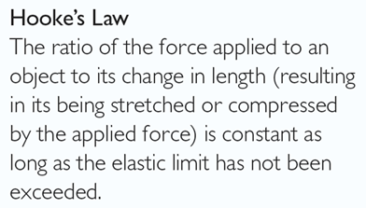
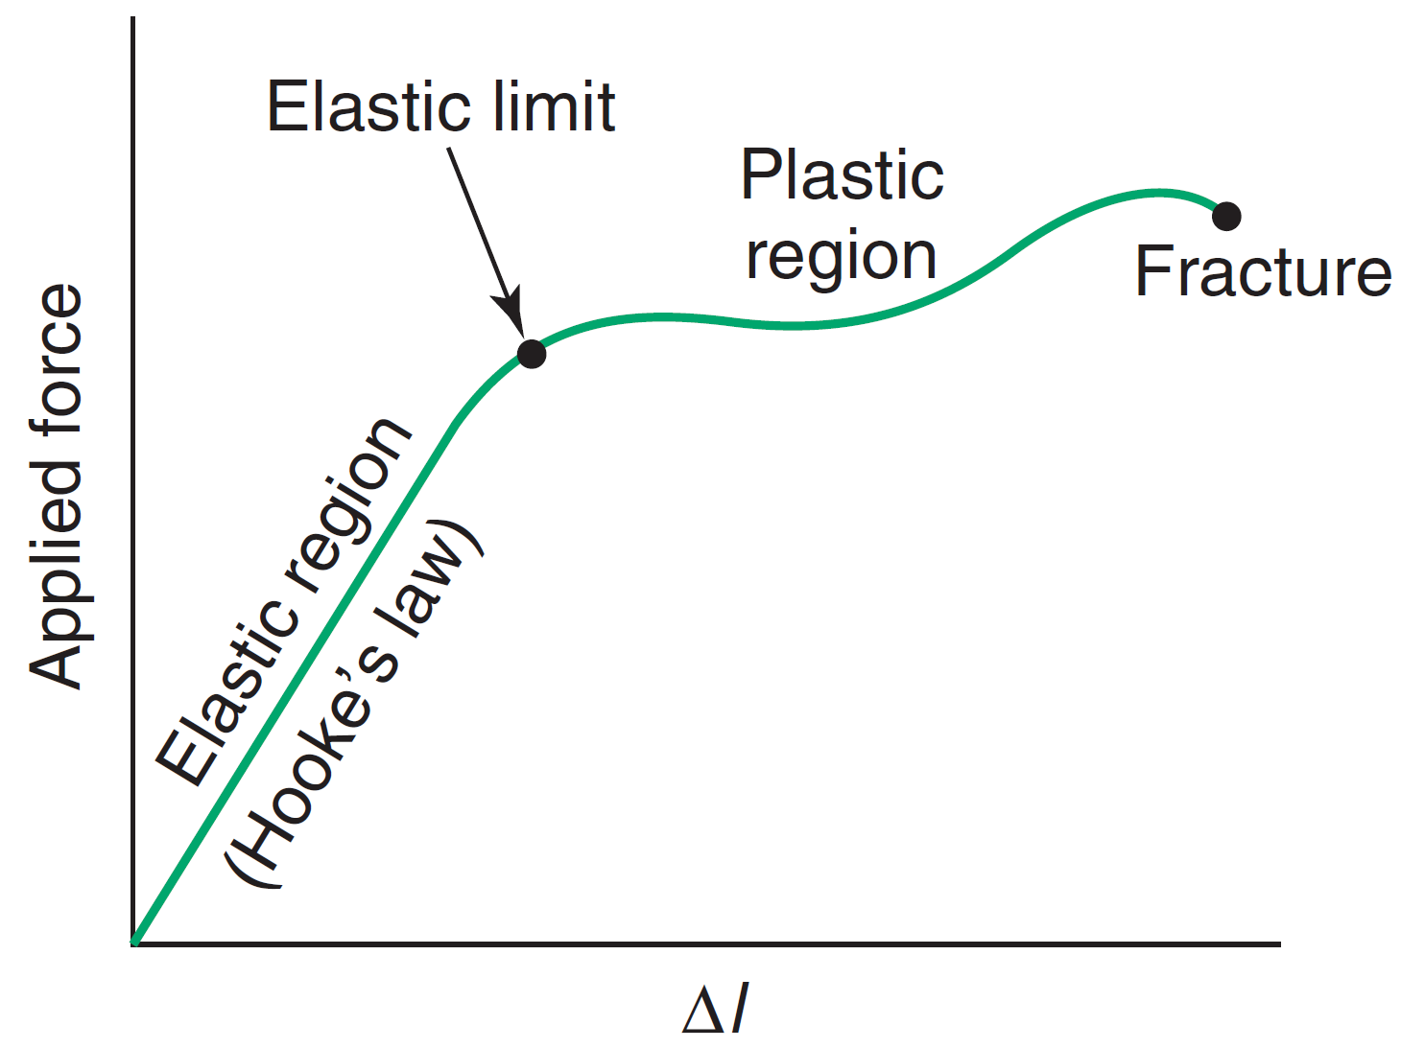
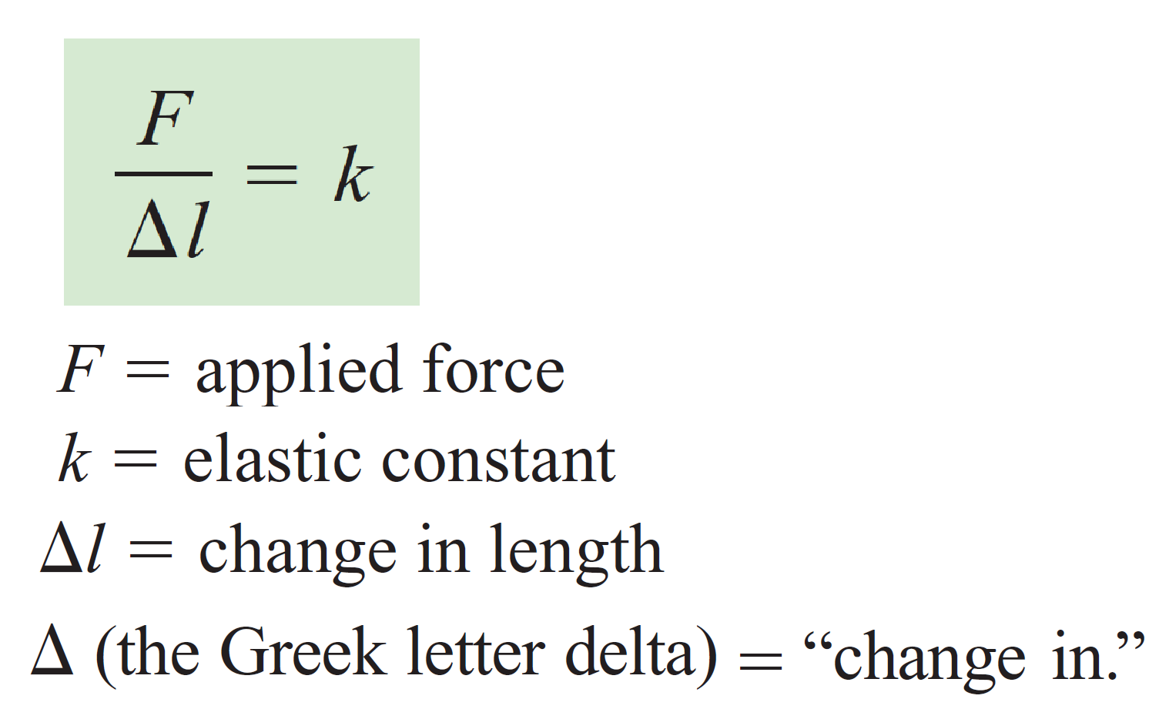
Hook’s Law
Stress is directly proportional to strain as long as the elastic limit has not been exceeded.

Slide 41
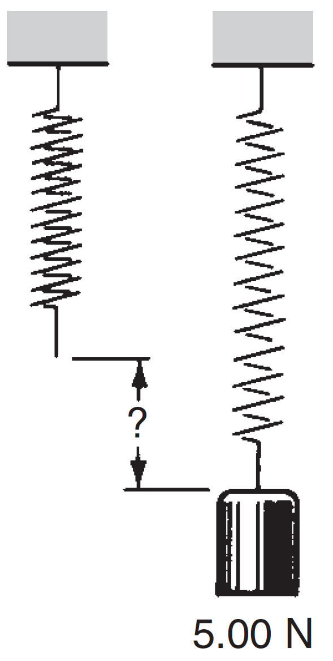
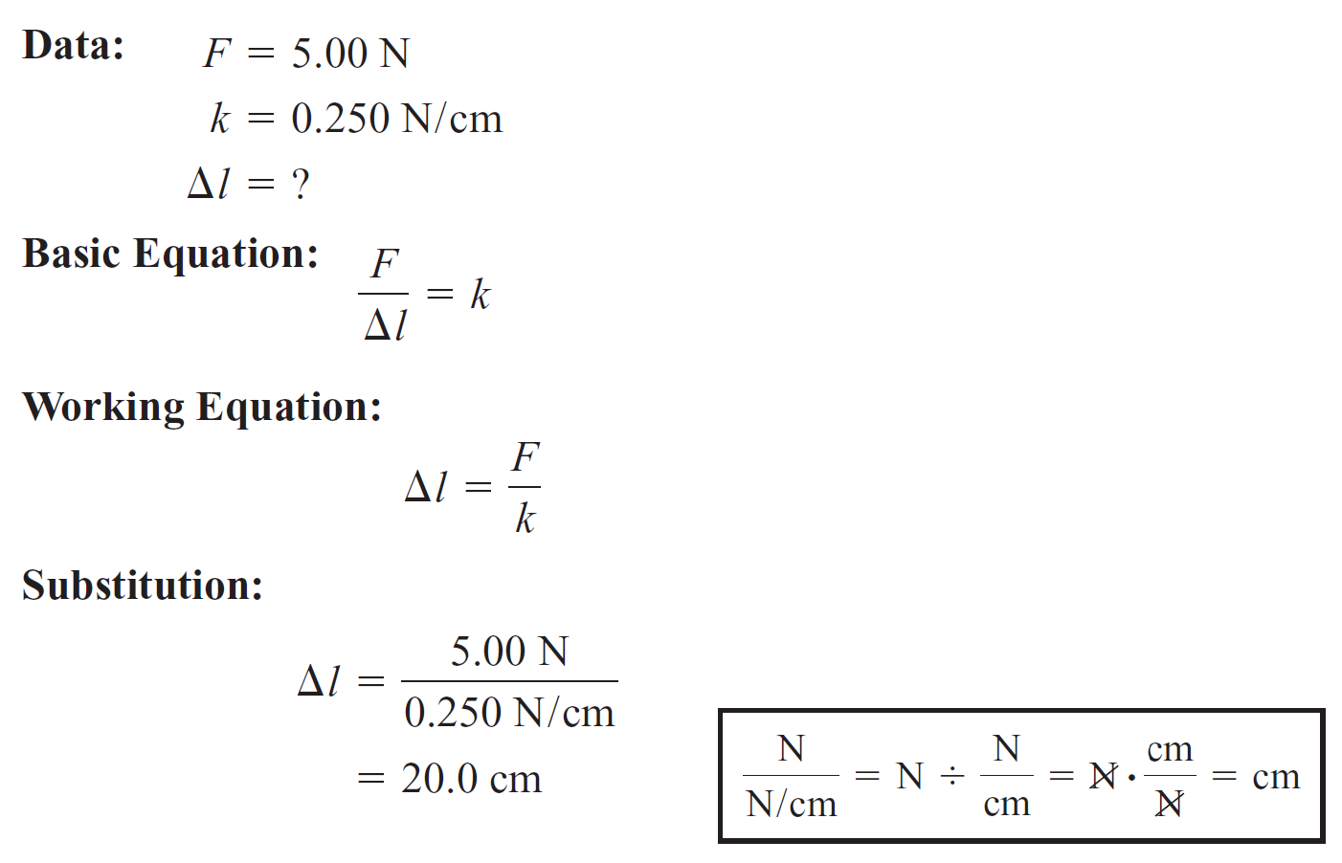

Slide 42
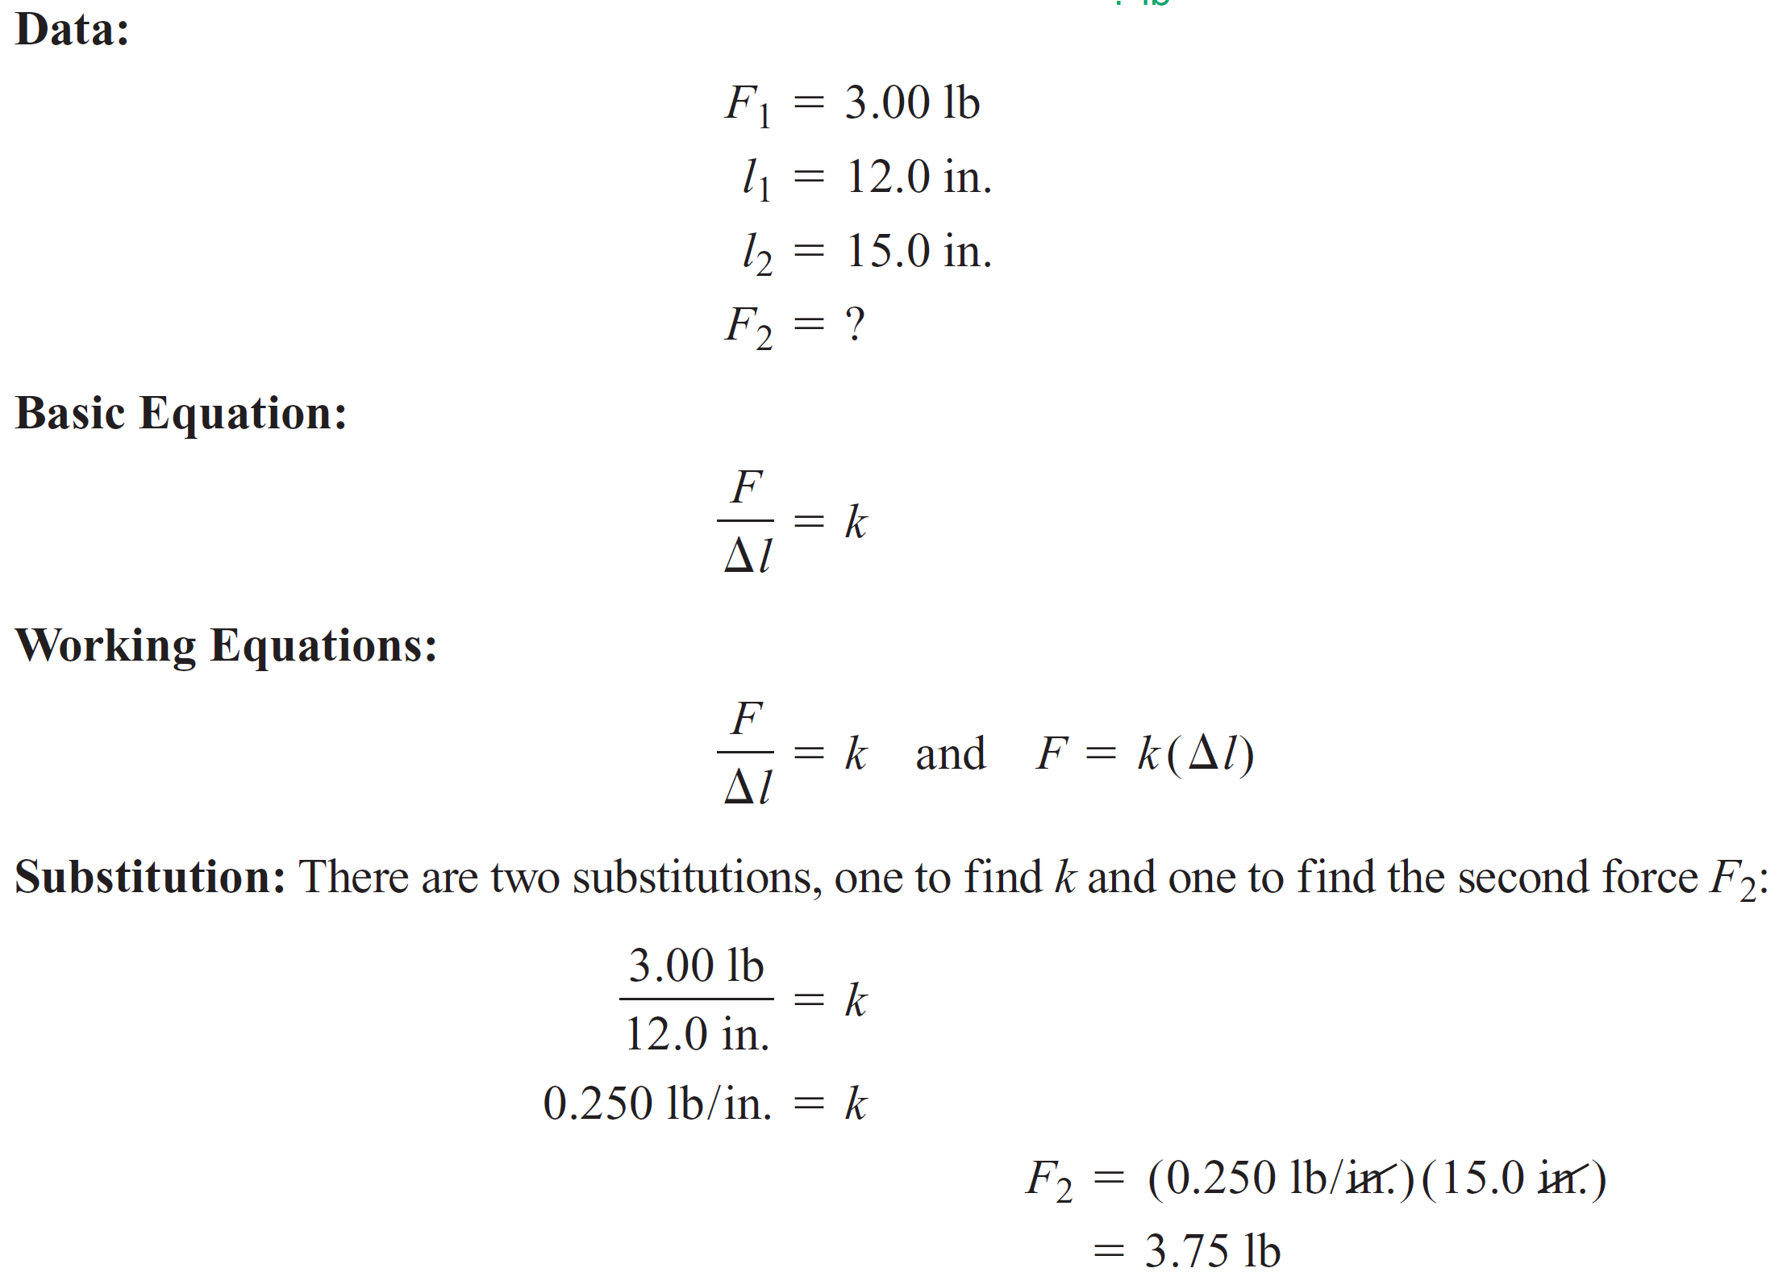
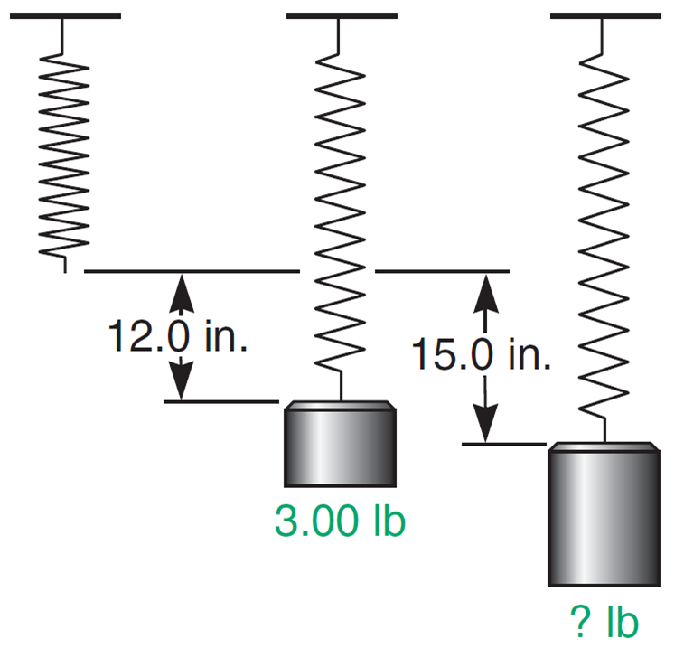

Slide 43
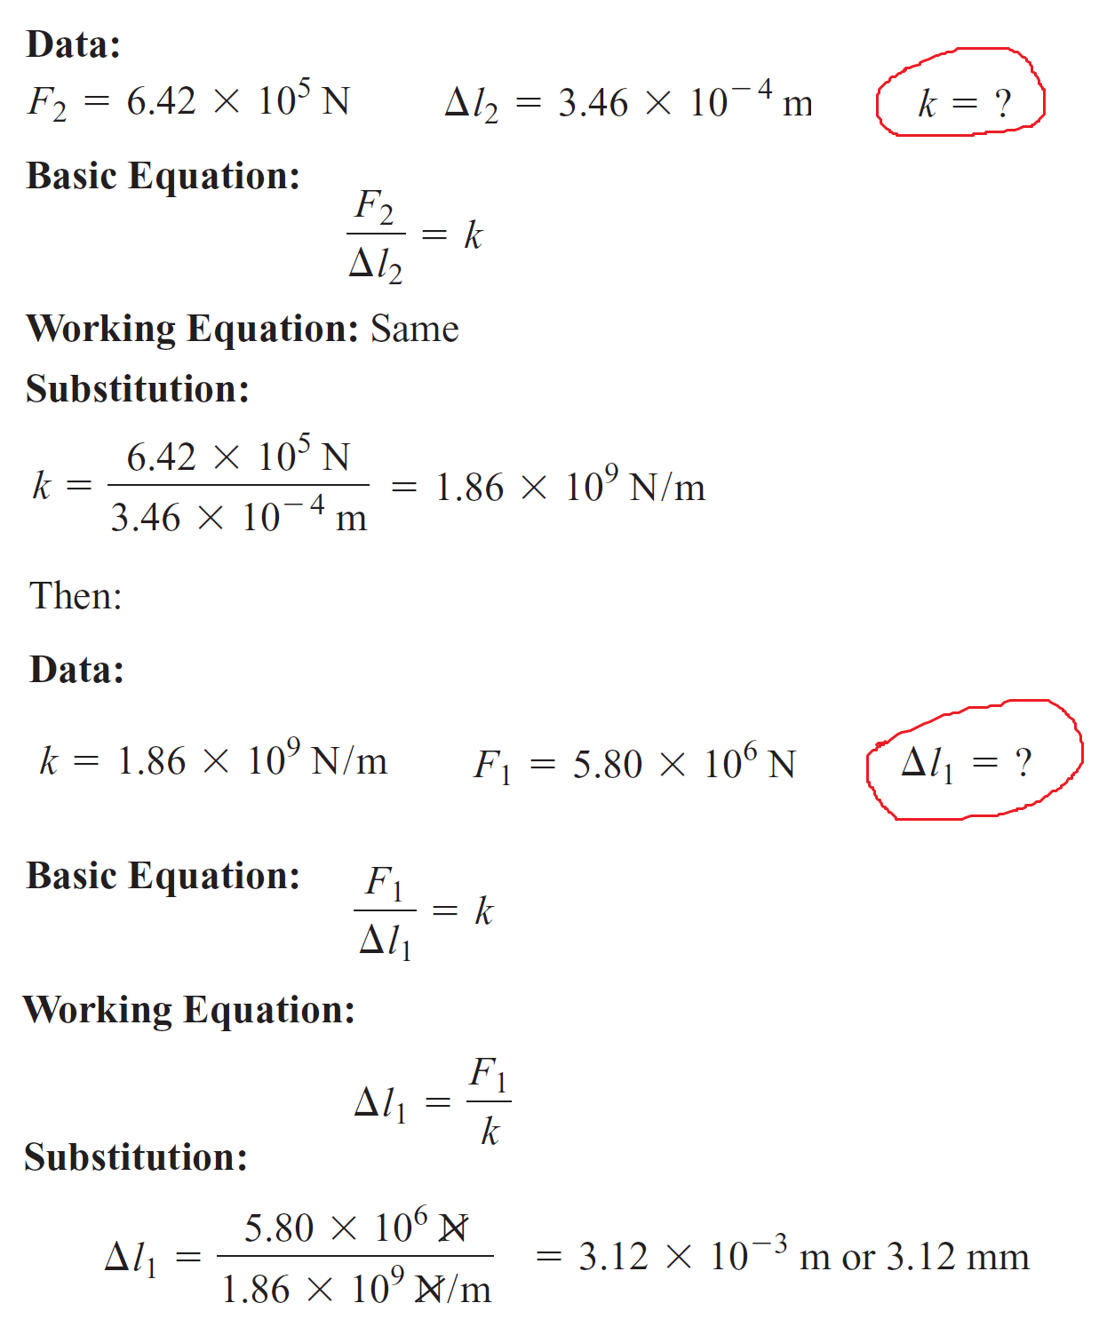
EXAMPLE
A support column is compressed 3.46 ×10^{–4} m under a weight of 6.42 × 10⁵ N. How much is the column compressed under a weight of 5.80 × 10⁶ N?
First find k:

Slide 44

Basic properties:
  Has definite volume (takes shape of its container)
  Molecules are close together and move in a flowing motion
  Difficult to compress

Slide 45
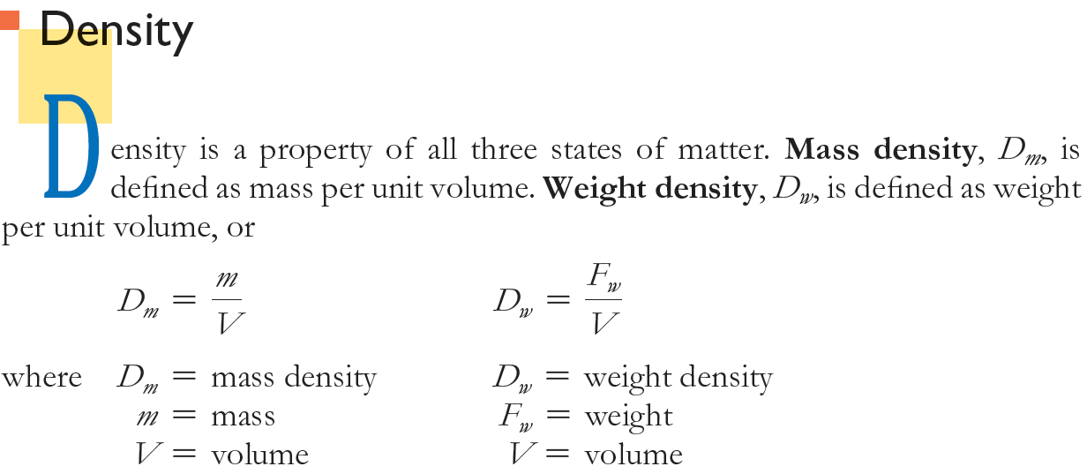

Slide 46
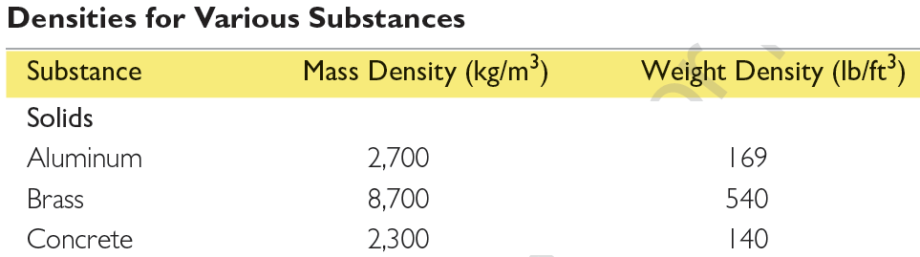


(1 atm ~ 10⁵ Pa)
Note:
Generally, density increases with decreasing temperature. Exception is water for which ice is less dense than liquid water ⇒ Fish swim peacefully beneath floating ice in frozen Antarctica lakes (وسبحان الخالق)

Slide 47




Slide 48



Slide 49




Slide 51
Pages:
84 ، 85 ، 87 ، 91 ، 92 ، 96 ، 97 و 98.

