Slide 1
Around the World
Unit 4

Slide 2
Objectives At the of this lesson, the students will be able to:
01
List the countries and nationalities
02
03
Differentiate between countries and nationalities
Pronounce the countries and nationalities correctly
04
Ask and answer about countries and nationalities

Slide 3
Guess the Country by Clues

Slide 4
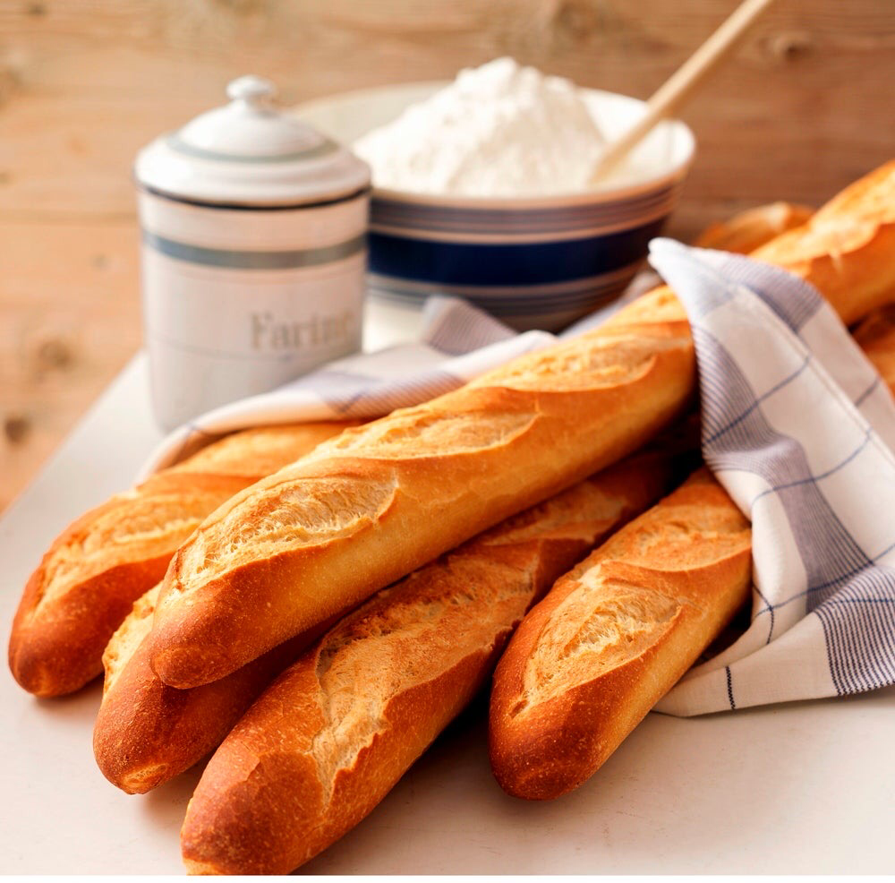
Which country do these 3 clues describe?
cheese
France
French beard
Eiffel Tower

Slide 5
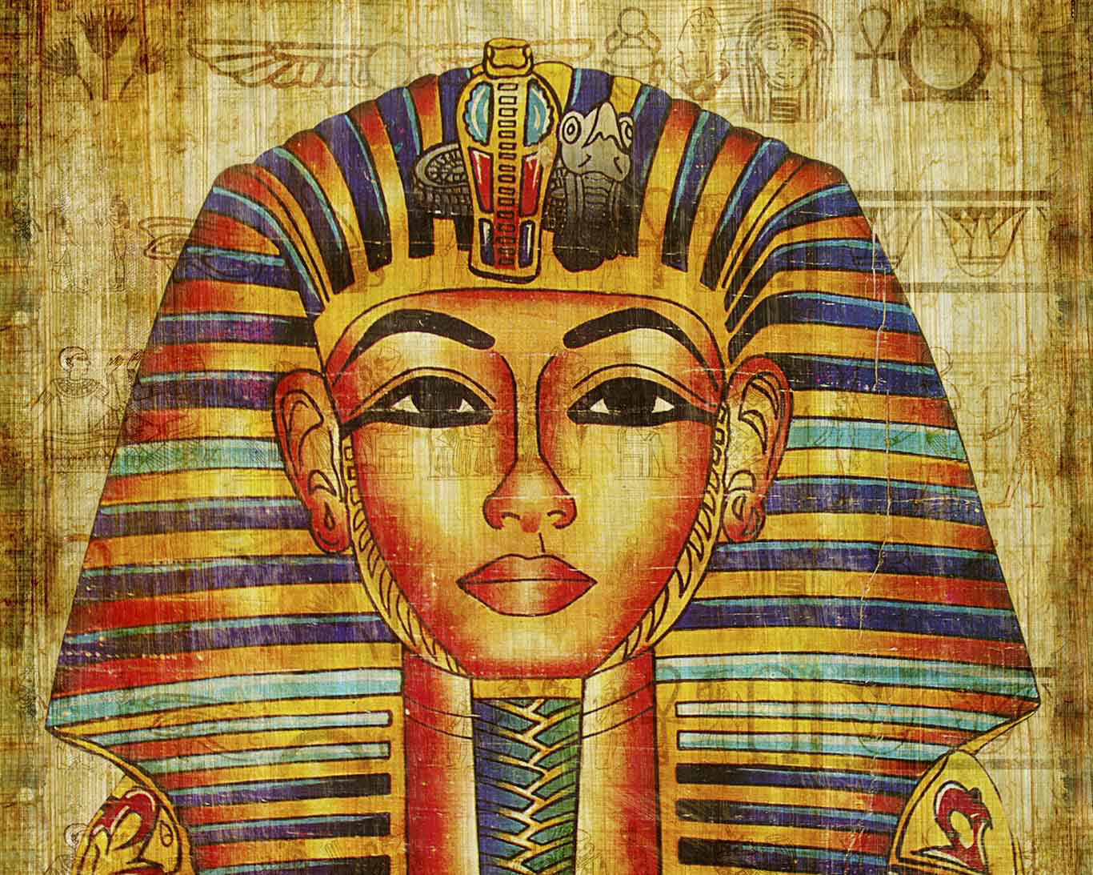
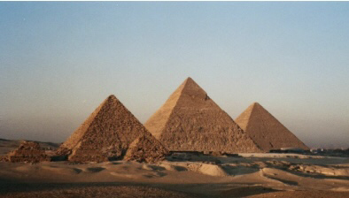
Which country do these 2 clues describe?
Cleopatra
Pyramids
Egypt

Slide 6
Which country do these 3 clues describe?
Pasta
Italy
Pizza
Pisa Tower

Slide 7
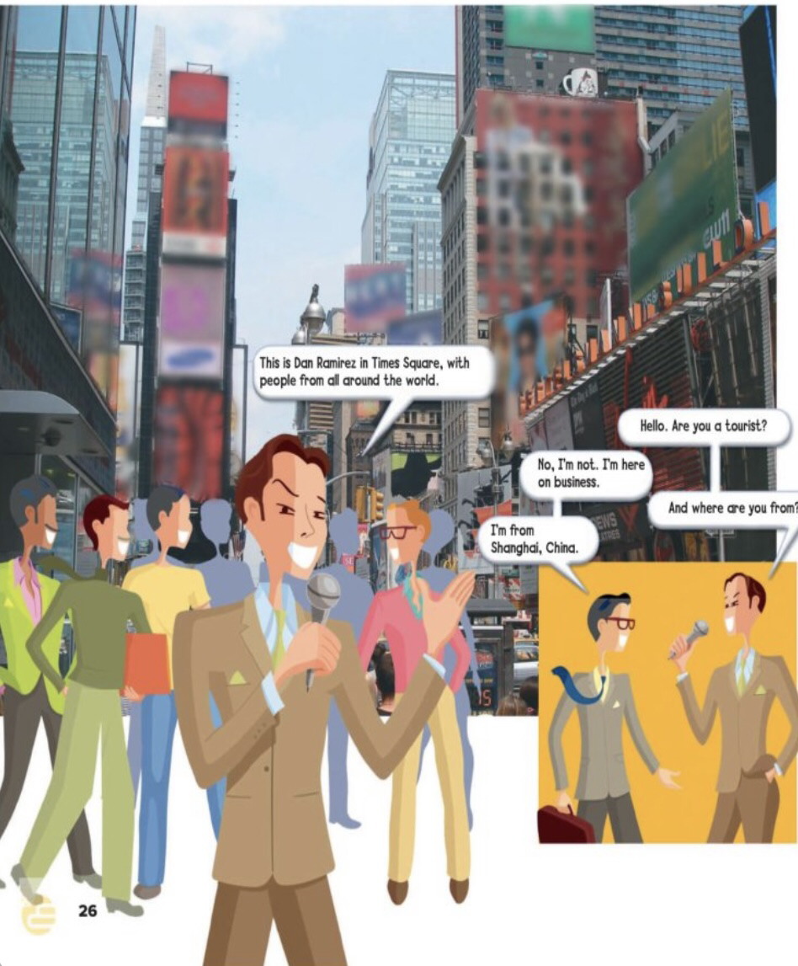
Listen and discuss

Slide 8
Who’s Dan Ramirez? What is Times Square?
He’s a reporter from a television station
It is a popular tourist destination

Slide 9
What are their names? Where are they from? What is their nationality?
John and Paul
They’re from England
English

Slide 10
Where is Tom from? What’s his nationality?
Tom is from Australia
Australian

Slide 11
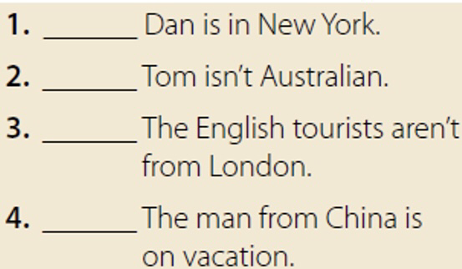
Quick Check Answer Yes or No

Slide 12
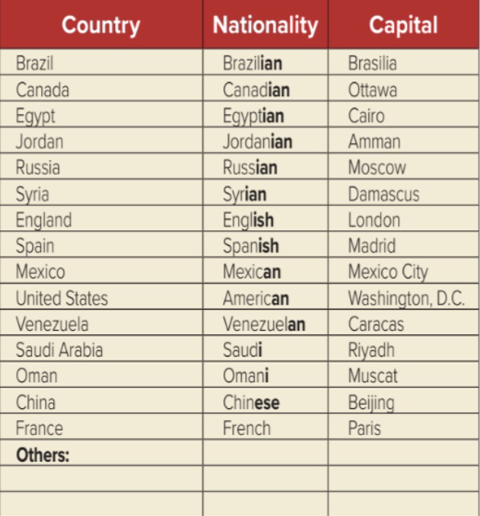
Listen and Repeat

Slide 13
Worksheet

Slide 14
–Page101 Exercise B
Homework

Slide 15
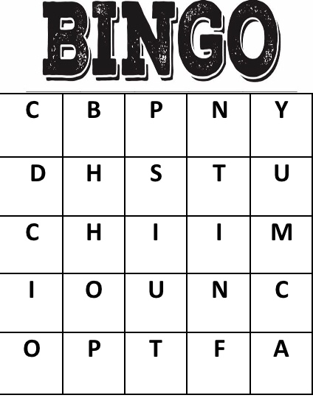
One minute Activity It’s time to play !
This is my flag.
China

Slide 16
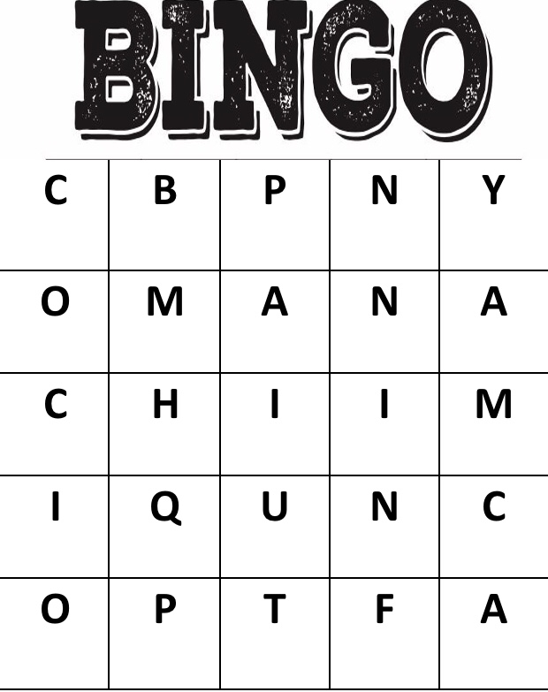
One minute Activity It’s time to play !
This is my flag.
Oman

Slide 17
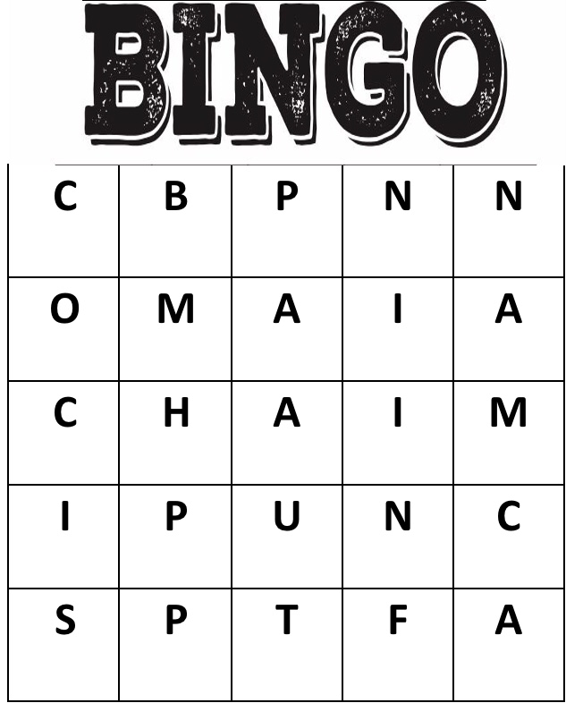
One minute Activity It’s time to play !
This is my flag.
Spain

Slide 18
Thanks!
Tr.Bushra Alnouh

