Slide 1
Diving Deep
for
Synonyms
and
Antonyms
© 2010 Teachers Unleashed.
Notes:
Thank you so much for downloading this PowerPoint presentation. For additional licenses, go to https://www.teacherspayteachers.com/Store/Teachers-Unleashed Note to Buyers: The slides will appear to have overlapping text when you open the presentation. This is due to animation formatting. When viewed in slideshow, the presentation will work normally. It is a good idea to preview the presentation before showing your students, so that you are familiar with the formatting and feel of the piece. © 2010 Teachers Unleashed. All rights reserved. Purchase entitles the right to use this product for personal classroom use only. Sharing or duplication for colleagues, schools, websites, or for commercial purposes is forbidden without permission from the publisher.

Slide 2
How to use this PowerPoint
• Preview slides first to see how much time you’ll need.
• Engage your students with a fun character voice.
• Ask for volunteer readers to mix it up.
• Look for places to add your own teachable moments.
• Break it up into sections:
Direct teaching/notes
Guided practice
Independent/partner/group practice
Use slides 19 – 22 as an informal assessment
© 2010 Teachers Unleashed.

Slide 3
Before we can dive in
you need to understand what
synonyms and antonyms are!
Antonyms
Are words that mean the opposite
Synonyms
Are words that mean the same
Let’s take a
closer look….
© 2010 Teachers Unleashed.

Slide 4
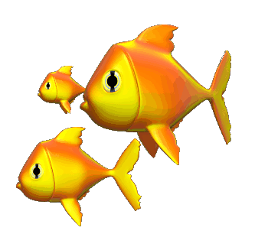
A Closer Look….
For example:
take the word ‘happy’
Synonyms
content
pleased
joyful
glad
cheerful
Antonyms
sad
miserable
gloomy
unhappy
depressed
© 2010 Teachers Unleashed.

Slide 5
Okay….Practice Time!
On your whiteboard or piece of paper, make a T-chart, and decide which words are synonyms and which are antonyms.
When you’ve finished…Check your work!
Synonyms will turn red, and
Antonyms will turn yellow!
© 2010 Teachers Unleashed.

Slide 6
Example
big
SYNONYMS
This is what it should look like!
ANTONYMS
Let’s get to it!
large
huge
gigantic
immense
tiny
small
little
puny
© 2010 Teachers Unleashed.

Slide 7
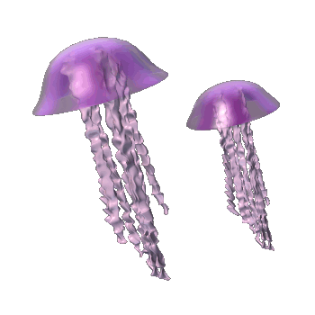
The jellyfish are very graceful and
beautiful.
attractive
ugly
gorgeous
revolting
lovely
stunning
hideous
horrible
© 2010 Teachers Unleashed.

Slide 8
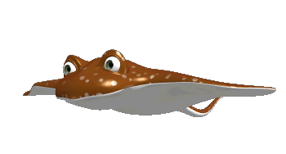
Stingrays can be extremely
dangerous.
treacherous
harmless
risky
safe
secure
protected
unsafe
hazardous
© 2010 Teachers Unleashed.

Slide 9
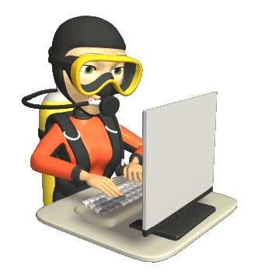
It is important that scuba divers are
smart.
sharp
unwise
intelligent
bright
clever
foolish
brainless
© 2010 Teachers Unleashed.

Slide 10
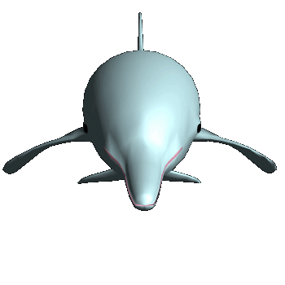
Many dolphins swim up to boats because they are
friendly.
mean
welcoming
offensive
pleasant
nasty
sociable
rude
gracious
© 2010 Teachers Unleashed.

Slide 11
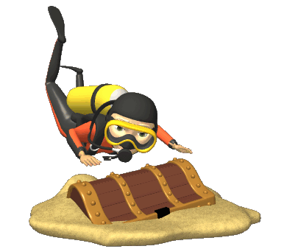
Buried treasure hidden by pirates is
mysterious.
strange
recognizable
familiar
identifiable
mystifying
odd
common
puzzling
© 2010 Teachers Unleashed.

Slide 12
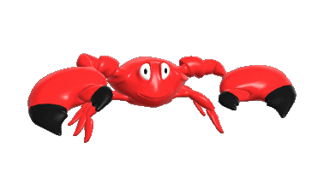
Crabs are very cautious of their surroundings and move
slowly.
sluggishly
swiftly
quickly
lethargically
unhurriedly
speedily
© 2010 Teachers Unleashed.

Slide 13
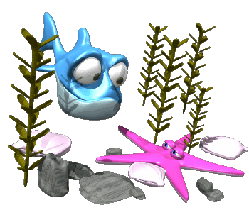
When fish find new places, they become very
curious.
bored
interested
nosy
unconcerned
inquisitive
© 2010 Teachers Unleashed.

Slide 14
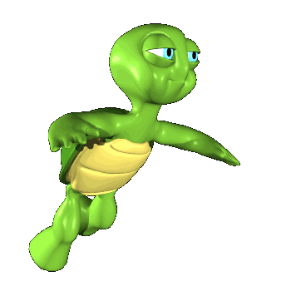
When sea turtles are swimming they look
silly.
levelheaded
goofy
sensible
serious
absurd
ridiculous
© 2010 Teachers Unleashed.

Slide 15
When sharks are hunting for prey, they can seem
scary.
pleasant
kind
frightening
chilling
terrifying
nice
© 2010 Teachers Unleashed.

Slide 16
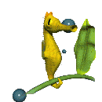
Seahorses can hold on to seaweed because their tails are
strong.
sturdy
tough
powerful
weak
scrawny
frail
© 2010 Teachers Unleashed.

Slide 17
You’re doing great!
Now let’s see if you can handle some test questions!!
© 2010 Teachers Unleashed.
© 2010 Teachers Unleashed.

Slide 18
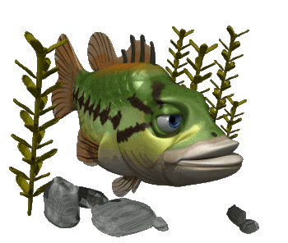
Pat and Diana reached the giant coral reef, and searched for fish.
What is an antonym for the underlined word?
huge
massive
tiny
enormous
© 2010 Teachers Unleashed.

Slide 19
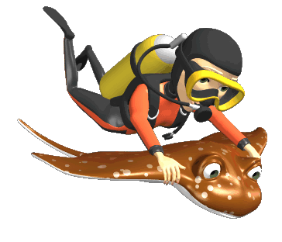
A beautiful manta ray gave Wendy a smooth ride through the ocean.
What is a synonym for the underlined word?
easy
rough
bumpy
violent
© 2010 Teachers Unleashed.

Slide 20
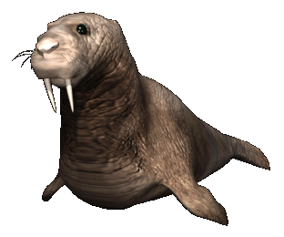
While diving deep, Wendy observed a cute, chubby seal just swimming by.
What is an antonym for the underlined word?
overweight
slender
plump
heavy
© 2010 Teachers Unleashed.

Slide 21
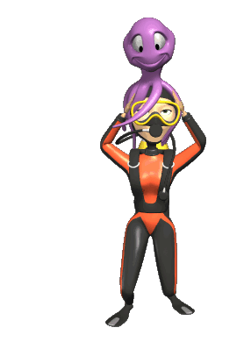
When Wendy got on the boat, an eight-legged friend came with her.
What is a synonym for the underlined word?
enemy
rival
adversary
buddy
© 2010 Teachers Unleashed.

