Slide 1
Super Goal 5

Slide 2
UNIT 4

Slide 3
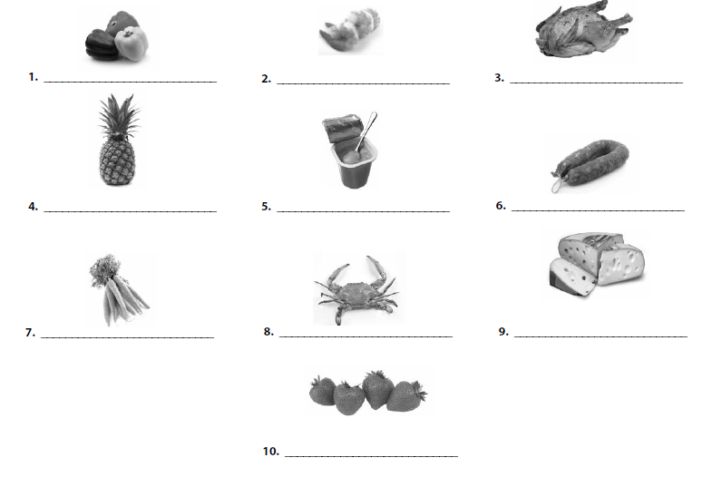
Peppers
Shrimp
Chicken
Pineapple
Yoghurt
Sausage
Carrots
Crab
Cheese
Strawberries
Chicken
Shrimp
Yoghurt
Pineapple
Peppers
Sausage
Crab
Cheese
Strawberries
Carrots

Slide 4
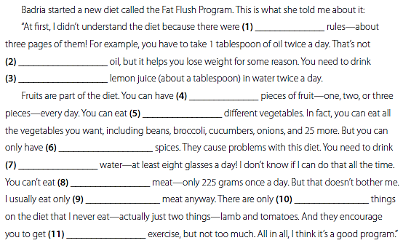
a lot of
a lot of
a little
a few
a lot of
a few
a lot of
a lot of
a little
a few
a little

Slide 5
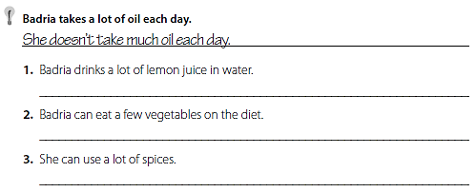
Badria doesn’t drink much lemon juice in water .
Badria can eat many vegetables on the diet .
She can’t use a lot of spices .
I eat a lot of meat , but I don’t eat enough vegetables .
I eat a lot of cookies , but I don’t eat enough fruit .
I drink a lot of soda , but I don’t drink enough water .

Slide 6
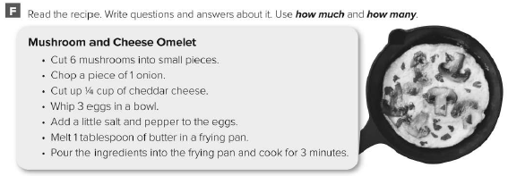
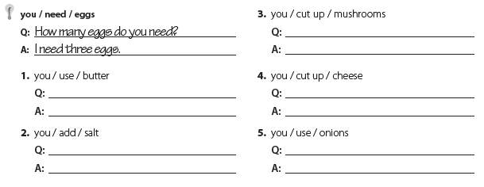
How many mushrooms do you cut up ?
You cut up 6 mushrooms .
How much butter do you use ?
You use 1 tablespoon of butter .
How much cheese do you cut up ?
You cut up ¼ cup of cheese .
How much salt do you add ?
You add a little salt .
How many onions do you use ?
You use a piece of 1 onion .

Slide 7
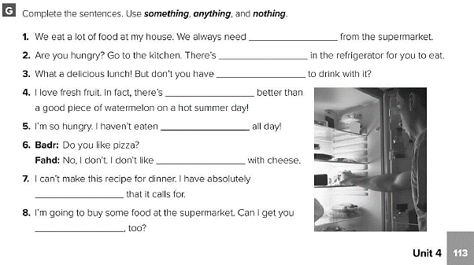
something
something
anything
nothing
anything
anything
nothing
something

Slide 8
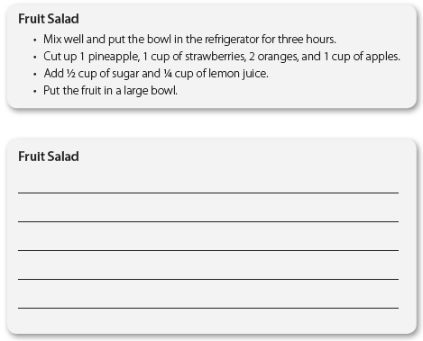
Cut up 1 pineapple , 1 cup of strawberries , 2 oranges , and 1 cup of apples
Add ½ cup of sugar and ¼ cup of lemon juice
Put the fruits in a large bowl .
Mix well and put the bowl in the refrigerator for three hours

Slide 9
First , cut up 1 pineapple , 1 cup of strawberries , 2 oranges , and 1 cup of apples
Then , add ½ cup of sugar and ¼ cup of lemon juice
After that , put the fruits in a large bowl .
Finally , mix well and put the bowl in the refrigerator for three hours

Slide 10
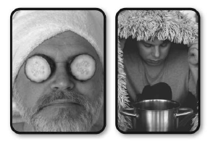
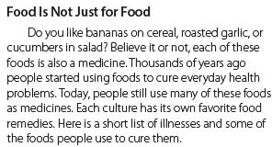
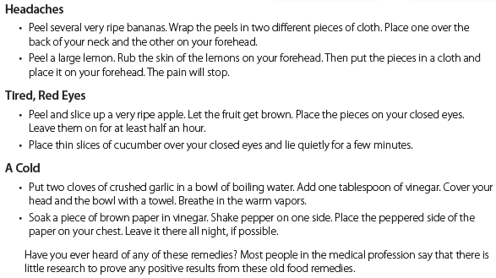

Slide 11
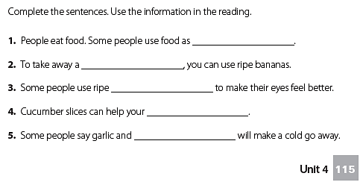
medicines
headache
apples
eyes
vinegar

Slide 12
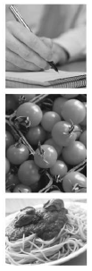
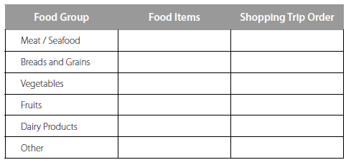
Roasted chicken with salad and fries
1 chicken
4 breads
1 lettuce
3 tomatoes
4 potatoes
--
1 yoghurt
1 mayonnaise
1 barbecue sauce

Slide 13
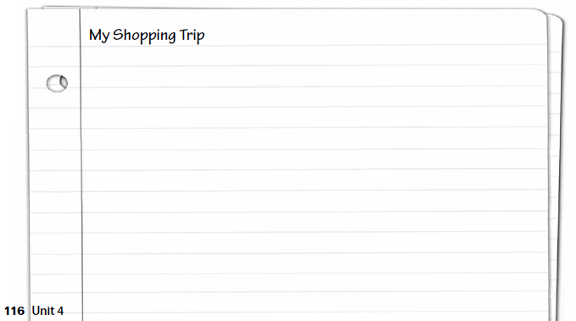
قم بكتابة مقال عن قائمة التسوق من خلال الجدول السابق

Slide 14
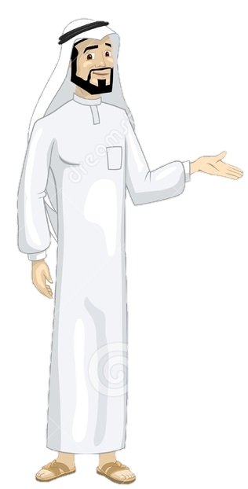
See you later
Take care
Teacher :
Badr Sayid Al-Shehri

