Slide 2
Unit 3
Work and leisure

Slide 4
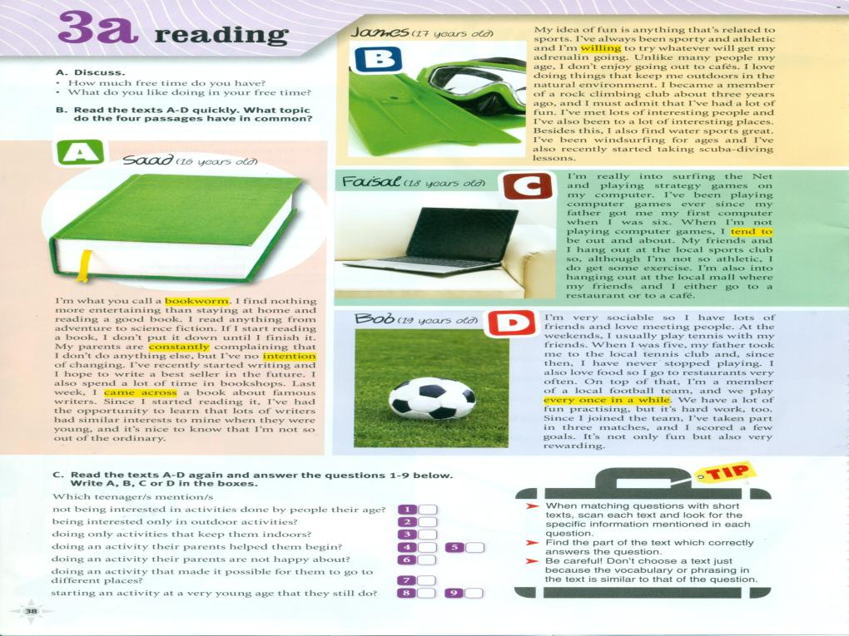
B
B
A
C
D
A
B
D
D

Slide 5
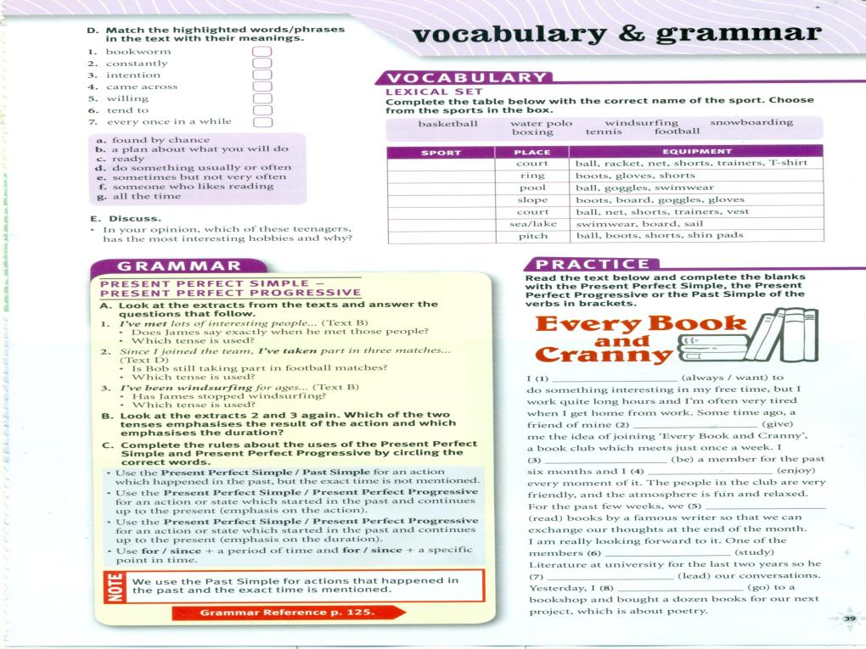
f
g
b
a
c
d
e
tennis
boxing
Water polo
Snowboarding
basketball
windsurfing
football
Have always wanted
gave
Have been
Have enjoyed
Have been reading
Has been studying
Has been leading
went

Slide 6
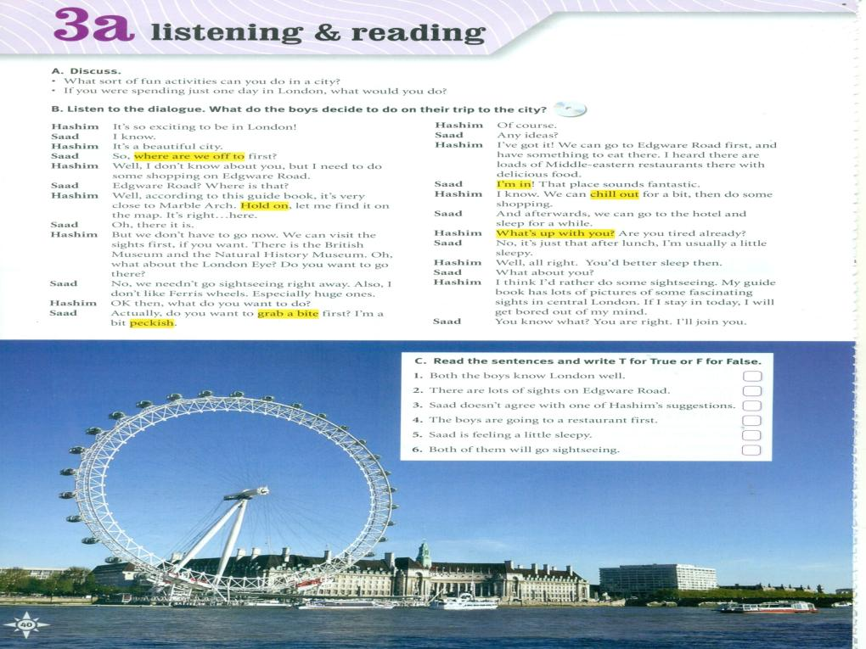

Slide 7
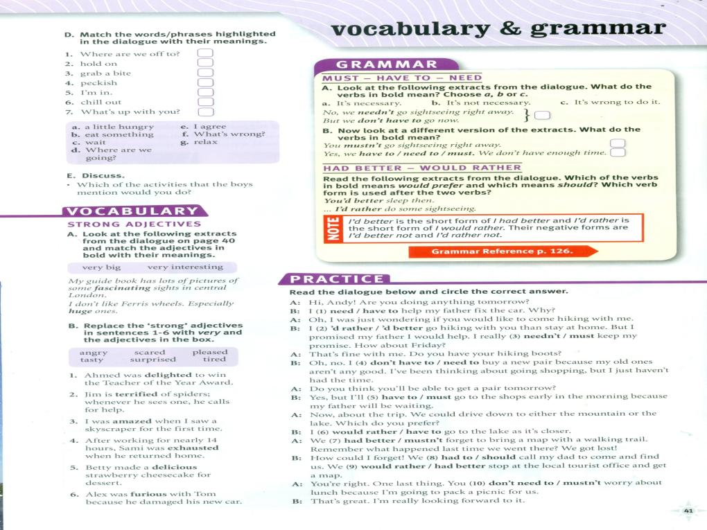
d
c
b
a
e
g
f

Slide 9
3
4
3
2
2
1
2

Slide 10
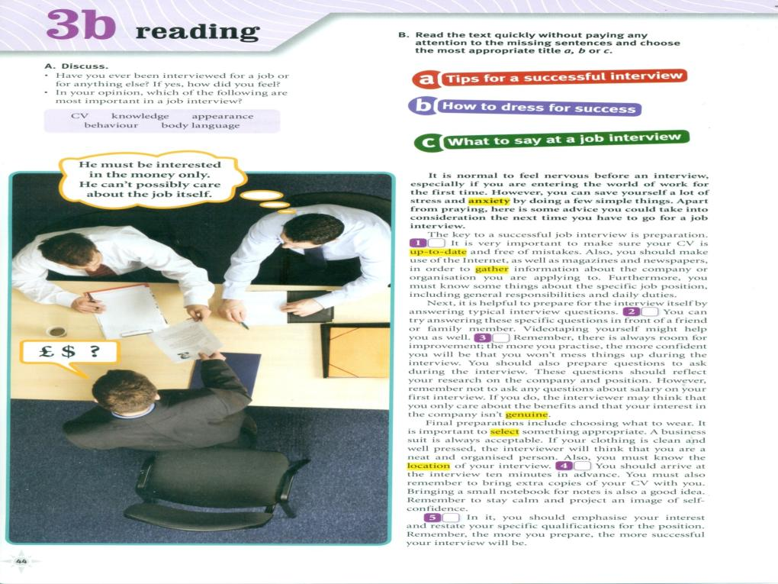

Slide 11
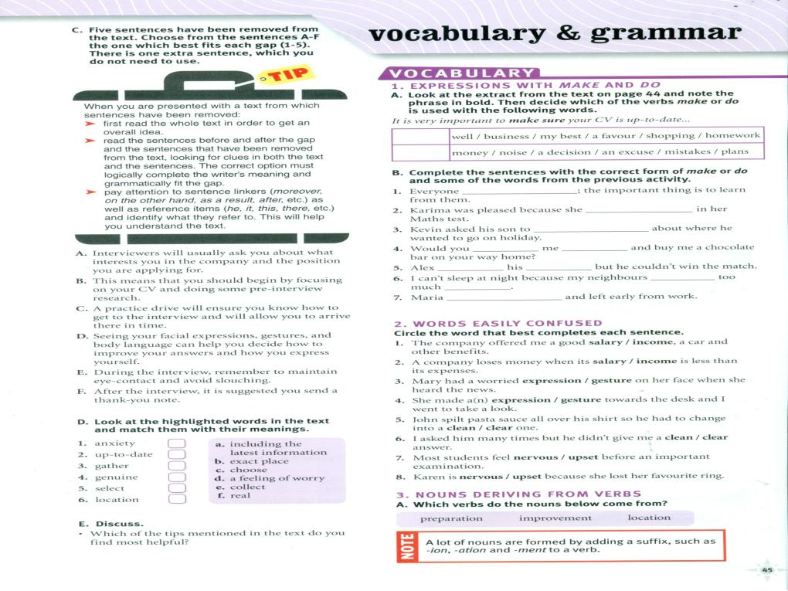
Make mistakes
did well
Make a decision
do
a favour
did best
make
noise
d
a
e
f
c
b

Slide 12
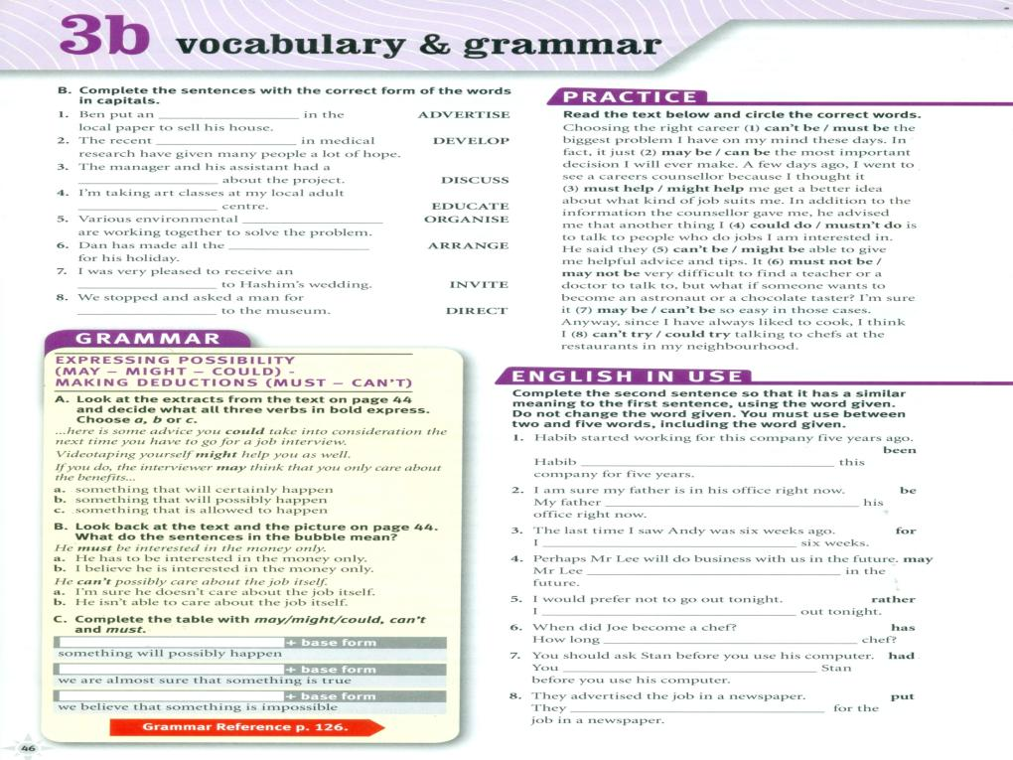
advertisement
development
discussion
education
organisations
arrangements
invitation
directions
has been working for
must be in
haven’t seen Andy for
may do business with us
‘d rather not go
has Joe been a
Had better ask
Put an advertisement

Slide 14
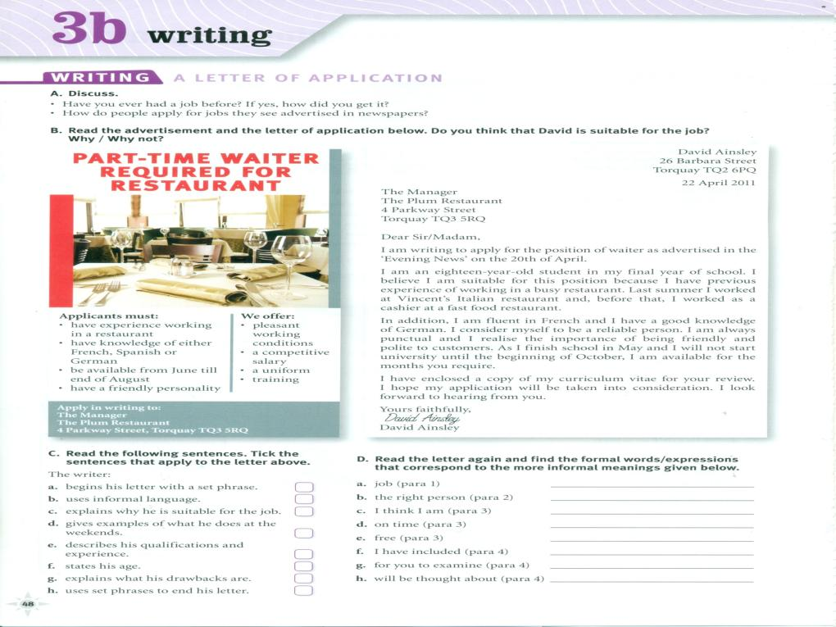
position
suitable
Consider my self
punctual
available
I have enclosed
For your review
Will be taken into consideration

Slide 15
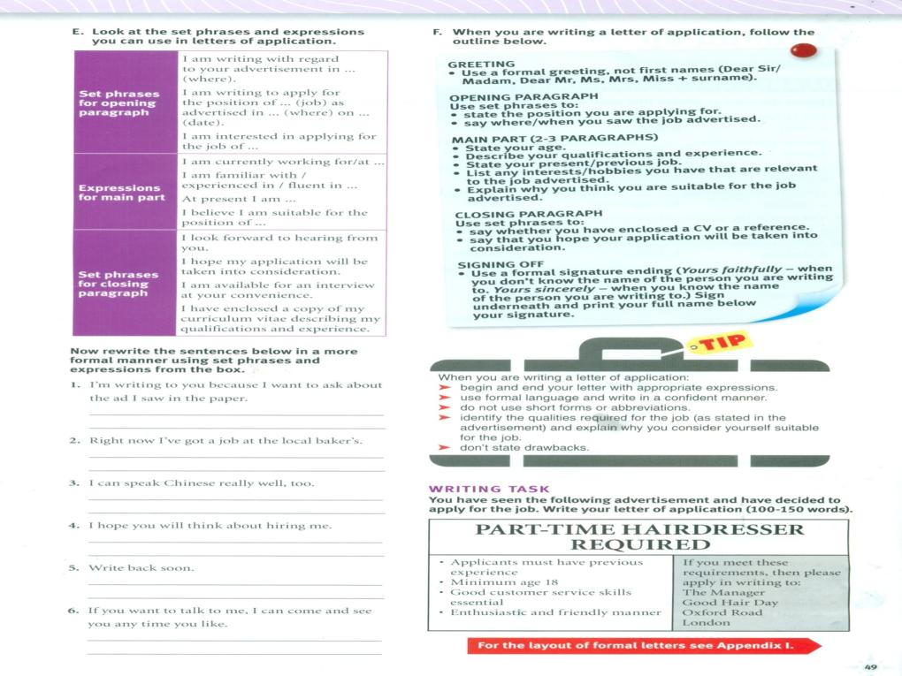

Slide 17
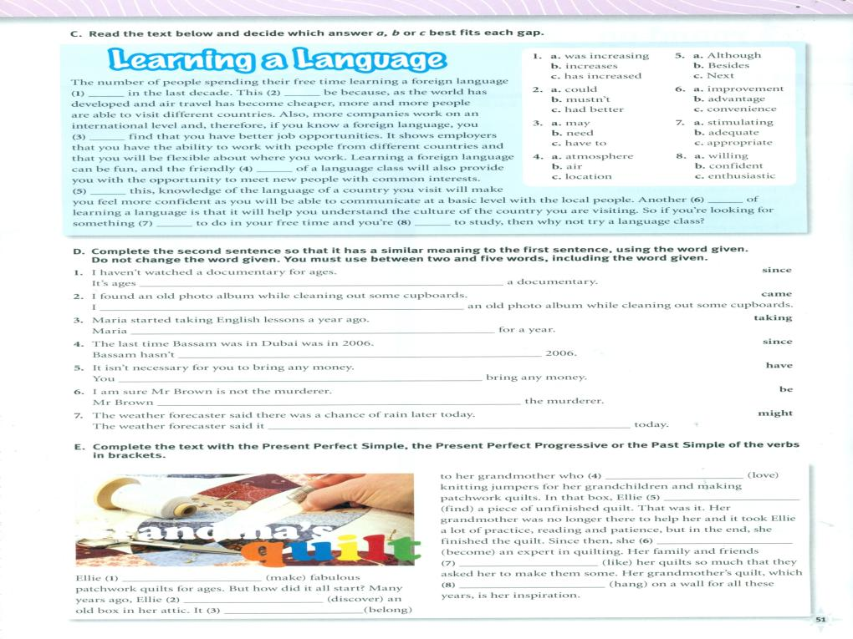
since I have watched
came across
Has been taking English lessons
been to Dubai since
don’t have to
can’t be
might rain later

