Slide 1
Chapter(3)
Data Description
Lecturer : FATEN AL-HUSSAIN
Lecture (8)
Note: This PowerPoint is only a summary and your main source should be the book.

Slide 2
3-1 Measures of Central Tendency
A statistic is a characteristic or measure obtained by using the data values from a sample .
A parameter is a characteristic or measure obtained by using all the data values for a specific population.
Note: This PowerPoint is only a summary and your main source should be the book.

Slide 3
Measures of Central Tendency
The Mean
The Mode
The Median
The Midrange
Note: This PowerPoint is only a summary and your main source should be the book.

Slide 4
The Mean
The mean is the sum of the values divided by the total number of values .
The symbol represent the sample mean .
The Greek letter µ (mu) is used to represent the population mean .
n represent the total number of values in the sample.
N represent the total number of values in the population .
Note: This PowerPoint is only a summary and your main source should be the book.

Slide 5
Example 3-1: The data represent the number of days off per year for a sample of individuals selected from nine different countries . Find the mean. 20 , 26 , 40 , 36 , 23 , 42 , 32 , 24 , 30
Solution :
Note: This PowerPoint is only a summary and your main source should be the book.

Slide 6
Example 3-1: The data shown represent the number of boat registrations for six counties in southwestern Pennsylvania . Find the mean. 3782 , 6367 , 9002 , 4208 , 6843 , 11.008
Solution :
Note: This PowerPoint is only a summary and your main source should be the book.

Slide 7
The Median
The median is the midpoint of the data array . The symbol for the median is MD.
When the data set is ordered it is called a data array.
The median is the halfway point in a data set
Step 1: Arrange the data in order.
Step 2: Select the middle point .
Note: This PowerPoint is only a summary and your main source should be the book.

Slide 8
Example 3-4 :
The number of rooms in the seven hotels in downtown Pittsburgh is
713 , 300 , 618 , 595 , 311 , 401 , 292 .
Find the median?
Solution :
Odd number of values in data set
Step 1: Arrange the data in order.
292 , 300 , 311 , 401 , 595 , 618 , 713
Step 2: Select the middle point .
292 , 300 , 311 , 401 , 595 , 618 , 713
Median
Note: This PowerPoint is only a summary and your main source should be the book.

Slide 9
Example 3-6 :
The number of tornadoes that have occurred in the United States over an 8-year period follows
684, 764, 656, 702, 856, 1133 , 1132 , 1303.
Find the median?
Solution :
Even number of values in data set
Step 1: Arrange the data in order.
656 , 684 , 702 , 764 , 856 , 1132 , 1133 , 1303
Median
Note: This PowerPoint is only a summary and your main source should be the book.

Slide 10
Example 3-8 :
Six customers purchased these numbers of magazines :
1 , 7 , 3 , 2 , 3 , 4
Find the median ?
Even number of values in data set
Solution :
Step 1: Arrange the data in order.
1 , 2 , 3 , 3 , 4 , 7
Median
Note: This PowerPoint is only a summary and your main source should be the book.

Slide 11
The Mode
The mode is the value that occurs most often in a data set.
unimodal | A data set that has only one value that occurs with the greatest frequency .
bimodal | A data set has two values that occur with the same greatest frequency ,both values are considered to be the mode and the data set.
multimodal | A data set has more than two values that occur with the same greatest frequency ,each value is used as the mode, and the data set.
No mode | Each value occurs only once .
Note: This PowerPoint is only a summary and your main source should be the book.

Slide 12
Example 3-9 :
Find the mode of the signing bonuses of eight NFL players for a specific year. The bonuses in millions of dollars are
18.0 , 14.0 , 34.5 , 10 , 11.3 , 10 , 12.4 , 10
Solution :
10 , 10 , 10 , 11.3 , 12.4 , 14.0 , 18.0 , 34.5
Since $10 million occurred 3 times
The mode is $10 million .
Then the data set is said
to be unimodal.
Example 3-10 :
110 , 731 , 1031 , 84 , 20 , 118 , 1162 , 1977 , 103 , 752
Each value occurs only once so there is no mode
Note: This PowerPoint is only a summary and your main source should be the book.

Slide 13
Example 3-11 :
104 | 104 | 104 | 104 | 104
107 | 109 | 109 | 109 | 110
109 | 111 | 112 | 111 | 109
The values 104 and 109 both occur 5 time
The modes are 104 and 109 .
Then the data set is said
to be bimodal .
Note: This PowerPoint is only a summary and your main source should be the book.

Slide 14
The Midrange
The midrange is defined as the sum of the lowest and highest values in the data set, divided by 2 . The symbol MR is used for the midrange.
Note: This PowerPoint is only a summary and your main source should be the book.

Slide 15
For example 3-15:
2 , 3 , 6 , 8 , 4 , 1 . Find the midrange ?
For example 3-16:
18.0 , 14.0 , 34.5 ,10 , 11.3 , 10 , 12.4 10
. Find the midrange ?
Note: This PowerPoint is only a summary and your main source should be the book.

Slide 16
The Weighted Mean
The weighted mean of a variable x by multiplying each value by its corresponding weight and dividing the sum of the products by the sum of the weights.
(not all values are equally represented)
Where are the weights and
are the values.
Note: This PowerPoint is only a summary and your main source should be the book.

Slide 17
Example 3-17:
A student received an A in English Composition I (3 credits), a C in Introduction to Psychology (3 credits), a B in Biology I (4 credits),and a D in physical Education (2credits).Assuming A= 4 grade points , B= 3 grade points , C = 2 grade points , D= 1 grade points and F = 0 grade points , find the student’s grade points average.
Course | Credits (w) | Grade (x)
English Composition I Introduction to Psychology Biology I physical Education | 3 3 4 2 | A(4 point) B(2 point) C(3 point) D(1 point)
Note: This PowerPoint is only a summary and your main source should be the book.

Slide 18
Summary of Measures of Central Tendency
Have a look to page no. 116
Properties and Uses of Central Tendency
Have a look to page no. 116
Note: This PowerPoint is only a summary and your main source should be the book.

Slide 19
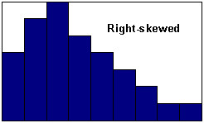
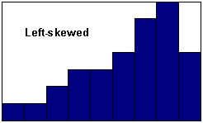
Distribution Shapes
Positively skewed
Negatively skewed
y
y
Mode
Median
Mean
x
Mean
Median
Mode
x
> MD> D
< MD< D
Note: This PowerPoint is only a summary and your main source should be the book.

Slide 20
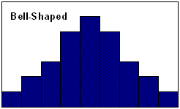
Symmetric distribution
Mode
Median
Mean
= MD = D
Note: This PowerPoint is only a summary and your main source should be the book.

Slide 21
In a positively skewed or right skewed distribution : the data values fall to the left of the mean ;the tail is to the right . Also the mean is to the right of the median and the mode is to the left of the median.
In a negatively skewed or left skewed distribution : the data values fall to the right of the mean ;the tail is to the left . Also the mean is to the left of the median and the mode is to the right of the median.
In a symmetric distribution: the data values are evenly distribution on both sides of the mean ,when the distribution is unimodal .T he mean ,median and mode are the same .
Note: This PowerPoint is only a summary and your main source should be the book.

Slide 22
Summary
Mean
Median | Arrange the data and Select the middle point .
Mode
Midrange
Weighted Mean
,
unimodal
, bimodal
multimodal
, No mode
Note: This PowerPoint is only a summary and your main source should be the book.

Slide 23
Measures of Variation
Lecturer : FATEN AL-HUSSAIN
Lecture (9)
Note: This PowerPoint is only a summary and your main source should be the book.

Slide 24
3-2 Measures of Variation
Example 3-18:
A testing lab wishes to test two experimental brands of outdoor paint to see how long each will last before fading. The testing lab makes 6 gallons of each paint to test. Since different chemical agents are added to each group and only six cans are involved, these two groups constitute two small populations . The results (in months)are shown. Find the mean of each group.
Brand A | Brand B
10 | 35
60 | 45
50 | 30
30 | 35
40 | 40
20 | 25
Note: This PowerPoint is only a summary and your main source should be the book.

Slide 25
Solution :
The mean for brand A is
The mean for brand B is
Note: This PowerPoint is only a summary and your main source should be the book.

Slide 26
The range is the highest value minus the lowest value. The symbol R is used of the range .
Range
R= highest value – lowest value
Example 3-19:
Find the ranges for the paints in Example 3-18 .
The range for brand A is
R= 60 – 10 = 50 months
The range for brand B is
R= 45 – 25 = 20 months
Note: This PowerPoint is only a summary and your main source should be the book.

Slide 27
Example 3-20:
The salaries for the staff of the XYZ . Manufacturing Co are shown here. Find the range.
Staff | Salary
Owner | $100,000
Manger | 40,000
Sales representative | 30,000
workers | 25,000
 | 15,000
 | 18,000
The range is R= $100,000- $ 15,000 = $85,000
Note: This PowerPoint is only a summary and your main source should be the book.

Slide 28
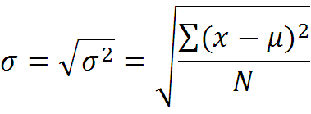
Population Variance and Standard Deviation
The variance is the average of the squares of the distance each value is from the mean.
The symbol for the population variance is
The formula for the population variance is
The standard deviation is the square root of the variance The symbol for the population standard deviation is
The formula for the population standard deviation is
Note: This PowerPoint is only a summary and your main source should be the book.

Slide 29
Example 3-21:
Find the variance and standard deviation for the data set for brand A paint in Example 3-18.
Step 1:Find the mean for the data .
Step 2: Subtract the mean from each data value.
10 – 35 = -25 | 50 – 35 = +15 | 40 – 35 = +5
60 – 35 = +25 | 30 – 35 = -5 | 20 – 35 = -15
Note: This PowerPoint is only a summary and your main source should be the book.

Slide 30
Step 3: Square each result.
Step 4: Find the sum of the squares.
Step 5: Divide the sum by N to get the variance
Variance = 1750 ÷ 6 = 291.7
625 + 625 + 225 + 25 + 25 +225 = 1750
Note: This PowerPoint is only a summary and your main source should be the book.

Slide 31
Step 6: Take the square root of the variance to get the
standard deviation .
standard deviation =
It is helpful to make a table.
A Values | B X- µ | C (x - µ)²
10 | -25 | 625
60 | +25 | 625
50 | -15 | 225
30 | -5 | 25
40 | +5 | 25
20 | -15 | 225
Note: This PowerPoint is only a summary and your main source should be the book.

Slide 32
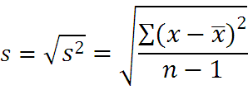
Sample Variance and Standard Deviation
The formula for the sample variance ,denoted by s² , is
Where x= individual
= sample mean
n = sample size
The standard deviation of a sample (denoted by s )is
Note: This PowerPoint is only a summary and your main source should be the book.

Slide 33
The shortcut or computational formulas for s² and s
variance
standard deviation
is not the same as .
T he notation means to square the values first then sum .
means to sum the values first then square the sum .
Note: This PowerPoint is only a summary and your main source should be the book.

Slide 34
Solution :
Example 3-23:
Find the sample variance and standard deviation for the amount of European auto sales for a sample of 6 years shown .The data are in million dollars.
11.2 , 11.9 , 12.0 , 12.8 , 13.4 , 14.3
Step 1: Find the sum of the values.
Step 2: Square the sum of the values.
Note: This PowerPoint is only a summary and your main source should be the book.

Slide 35
Step 3:Square each value and find the sum .
Step 4 :Substitute in the formulas and solve .
variance
standard deviation
Note: This PowerPoint is only a summary and your main source should be the book.

Slide 36
Coefficient of Variation
The coefficient of variation , denoted by Cvar is the standard deviation divided by the mean . The result is expressed as a percentage.
For sample For populations,
The coefficient of variation is used to compare standard deviations when the units are different for two variable being compared .
Note: This PowerPoint is only a summary and your main source should be the book.

Slide 37
Solution :
Example 3-25:
The mean of the number of sales of cars over a 3-month period is 87 and the standard deviation is 5. The mean commission is $5225 and standard deviation is $773. Compare the variations of the two.
The coefficients of variation are
Since the coefficients of variation is larger for commission.
The commission are more variable than the sales.
Note: This PowerPoint is only a summary and your main source should be the book.

Slide 38
Solution :
Example 3-25:
The mean for the number of pages of sample of women’s fitness magazines is 132 with a variance of 23.The mean for the number of advertisements of sample of women’s fitness magazines is 182 with a variance of 62. Compare the variations.
The coefficients of variation are
Since the coefficients of variation is larger for advertisements.
The number of advertisements are more variable than number of pages.
Note: This PowerPoint is only a summary and your main source should be the book.

Slide 39
Summary
 | Sample | populations
Variance
Standard Deviation
Cvar
Note: This PowerPoint is only a summary and your main source should be the book.

Slide 40
The empirical(Normal)Rule
For any bell shaped distribution.
Approximately 68% of the data values will fall within one standard deviation of the mean .
Approximately 95% of the data values will fall within two standard deviation of the mean .
Approximately 99.7% of the data values will fall within three standard deviation of the mean .
Note: This PowerPoint is only a summary and your main source should be the book.

Slide 41
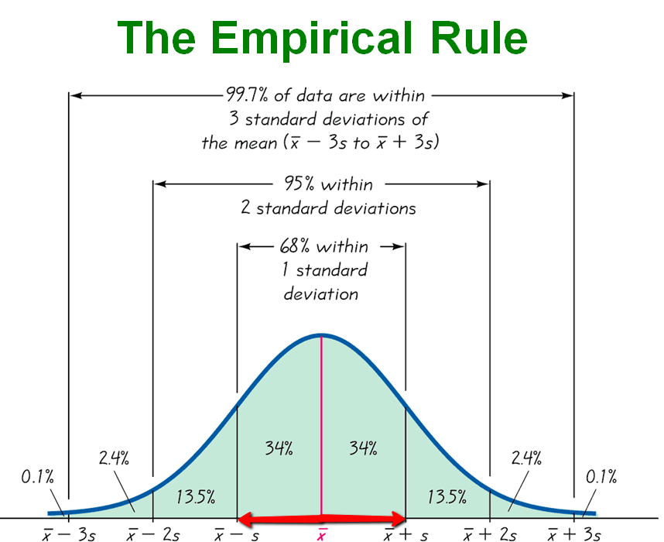
Note: This PowerPoint is only a summary and your main source should be the book.

Slide 42
For example :
= 480 , S = 90 , approximately 68%
= 480 –1(90)= 390
Then the data fall between 570 and 390
= 480 + 1(90)= 570
= 480 , S = 90 , approximately 95%
= 480 - 2(90) = 300
Then the data fall between 660 and 300
= 480 + 2(90) = 660
= 480 , S = 90 , approximately 99.7%
=480 + 3(90) = 750
Then the data fall between 750 and 210
=480 - 3(90) = 210
Note: This PowerPoint is only a summary and your main source should be the book.

Slide 43
Measures of Position
Lecturer : FATEN AL-HUSSAIN
Lecture (10)
Note: This PowerPoint is only a summary and your main source should be the book.

Slide 44
3-3 Measures of Position
Standard score or z score
Quartile
Note: This PowerPoint is only a summary and your main source should be the book.

Slide 45
Standard score or z score
A z score or standard score for a value is obtained by subtracting the mean from the value and dividing the result by the standard deviation . The symbol for a standard score is(z). The formula is
For samples , the formula is
For populations , the formula is
The z score represents the number of standard deviations
that a data value falls above or below the mean .
Note: This PowerPoint is only a summary and your main source should be the book.

Slide 46
Example 3-29 :
A student scored 65 on a calculus test that had a mean of 50 and a standard deviation of 10 ; she scored 30 on a history test with a mean of 25 and a standard deviation of 5 .
Compare her relative position on the two tests.
Solution:
The z scores. For calculus is
The z scores. For history is
Her relative position in the calculus class is higher than
her relative position in history class.
Note: This PowerPoint is only a summary and your main source should be the book.

Slide 47
Example 3-30 :
Find the z score for each test , and state which is higher .
Test A | X=38 | = 40 | S=5
Test B | X=94 | = 100 | S=10
Solution:
The z scores. For test A,
The z scores. For test B,
The score for test A is relatively higher than the score for test B.
Note: This PowerPoint is only a summary and your main source should be the book.

Slide 48
Quartiles
Quartiles divide the data set into 4 equal groups .
The median is the same as Q₂ .
Smallest
data value
largest
data value
Q₁
Q₂
Q₃
25%
25%
25%
25%
25%
50%
75%
Note: This PowerPoint is only a summary and your main source should be the book.

Slide 49
Procedure Table
Finding Data Values Corresponding to Q₁,Q₂and Q_{3 .}
Step 1: Arrange the data in order from lowest to highest .
Step 2: Find the median of the data values .This is the value
for Q₂ .
Step 3: Find the median of the data values that fall below Q₂.This is the value for Q₁ .
Step 4: Find the median of the data values that fall above Q₂.This is the value for Q₃.
Note: This PowerPoint is only a summary and your main source should be the book.

Slide 50
Example 3-36 :
Find Q₁ ,Q₂ and Q₃ for the data set
15 , 13 , 6 , 5 , 12 , 50 , 22 , 18 .
Solution:
Step 1: Arrange the data in order from lowest to highest .
5 , 6 , 12 , 13 , 15 , 18 , 22 , 50
Step 2: Find the median (Q₂).
5 , 6 , 12 , 13 , 15 , 18 , 22 , 50
MD
Q₂
Note: This PowerPoint is only a summary and your main source should be the book.

Slide 51
Step 3: Find the median of the data values less than 14 .
5 , 6 , 12 , 13
Q₁
Step 4: Find the median of the data values greater than 14 .
15 , 18 , 22 , 50
Q₃
Note: This PowerPoint is only a summary and your main source should be the book.

Slide 52
Step 3: Find the median of the data values less than 14 .
5 , 6 , 12 , 13
Q₁
Step 4: Find the median of the data values greater than 14 .
15 , 18 , 22 , 50
Q₃
Note: This PowerPoint is only a summary and your main source should be the book.

Slide 53
Procedure Table
Outliers
An outlier is an extremely high or an extremely low data value when compare with the rest of the data values .
Procedure for Identifying Outliers
Step 1: Arrange the data in order and find Q₁ and Q₃.
Step 2: Find the interquartile range IQR= Q₃ - Q₁
Step 3: Multiply the IQR by 1.5 .
Step 4: Subtract the value obtained in step 3 form Q₁ and add the value to Q₃.
Step 5: Check the data set for any data value that is smaller than Q₁-1.5(IQR) or larger than Q₃+1.5(IQR).
Note: This PowerPoint is only a summary and your main source should be the book.

Slide 54
Example 3-36 :
Check the following data set for outliers
15 , 13 , 6 , 5 , 12 , 50 , 22 , 18 .
Solution:
Step 1: Arrange the data in order and find Q₁ and Q₃.
This was done in example 3-36 ; Q₁= 9 and Q₃=20
Step 2: Find the interquartile range IQR= Q₃ - Q₁
IQR= Q₃ - Q₁ = 20 – 9 = 11
Note: This PowerPoint is only a summary and your main source should be the book.

Slide 55
Step 3: Multiply the IQR by 1.5 .
1.5(11) = 16.5
Step 4: Subtract the value obtained in step 3 form Q₁ and add the value to Q₃.
9-16.5 = -7.5
20 + 16.5 = 36.5
Step 5: Check the data set for any data value that fall outside the interval from -7.5 to 36.5 .
Such as the value 50 is outside this interval so it can be considered an outlier.
Note: This PowerPoint is only a summary and your main source should be the book.

Slide 56
Exploratory Data Analysis (EDA)
The five –Number Summary :
1-lowest value of the data set .
2-Q1.
3-the median(MD) Q2.
4-Q3.
5-the highest value of the data set .
A Box plot can be used to graphically represent the data set .
Note: This PowerPoint is only a summary and your main source should be the book.

Slide 57
Procedure for constructing a boxplot
Find five -Number summary .
Draw a horizontal axis with a scale such that it includes the maximum and minimum data value .
Draw a box whose vertical sides go through Q₁ and Q₃,and draw a vertical line though the median Q₂.
Draw a line from the minimum data value to the left side of the box and line from the maximum data value to the right side of the box.
Q₁
Q₂
Q₃
maximum
minimum
lowest value
highest value
0
20
40
60
80
100
Note: This PowerPoint is only a summary and your main source should be the book.

Slide 58
Example 3-39 :
Cheese substitute |  |  |  | Real cheese
290 | 250 | 180 | 270 | 40 | 45 | 420 | 310
310 | 340 | 260 | 130 | 90 | 180 | 240 | 220
Compare the distributions using Box Plot s?
Solution:
Step1: Find Q₁,MD,Q₃ for the Real cheese data
40 , 45 , 90 , 180 , 220 , 240 , 310 , 420
Q1 MD Q3
Note: This PowerPoint is only a summary and your main source should be the book.

Slide 59
,
,
Step2:Find Q₁ , MD and Q₃ for the cheese substitute data.
130 , 180 , 250 , 260 , 270 , 290 , 310 , 340
Q1 MD Q3
,
,
Note: This PowerPoint is only a summary and your main source should be the book.

Slide 60
67.5 200 275
40 420
215 265 300
130 340
0 100 200 300 400 500
Note: This PowerPoint is only a summary and your main source should be the book.

Slide 61
Information obtained from a Box plot
The median(MD) is near the center. | The distribution is symmetric.
The median falls to left of the center . | The distribution is positively skewed (Right skewed).
The median falls to right of the center . | The distribution is negatively skewed (Left skewed).
The lines are the same length. | The distribution is symmetric.
The right line is larger than the left line . | The distribution is positively skewed (Right skewed).
The left line is larger than the right line . | The distribution is negatively skewed (Left skewed).
Note: This PowerPoint is only a summary and your main source should be the book.

