Slide 2
Talk about one of these subjects
Sea , winter , cake

Slide 3
Unit 4
MYSTRIES

Slide 4
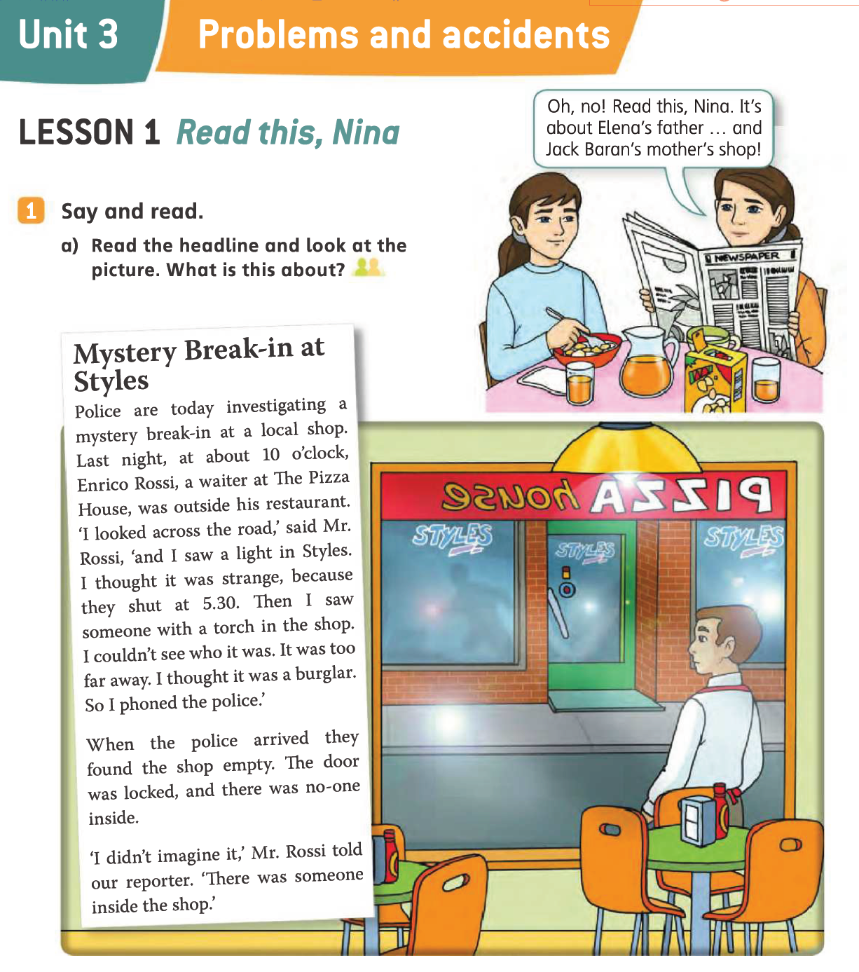

Slide 5
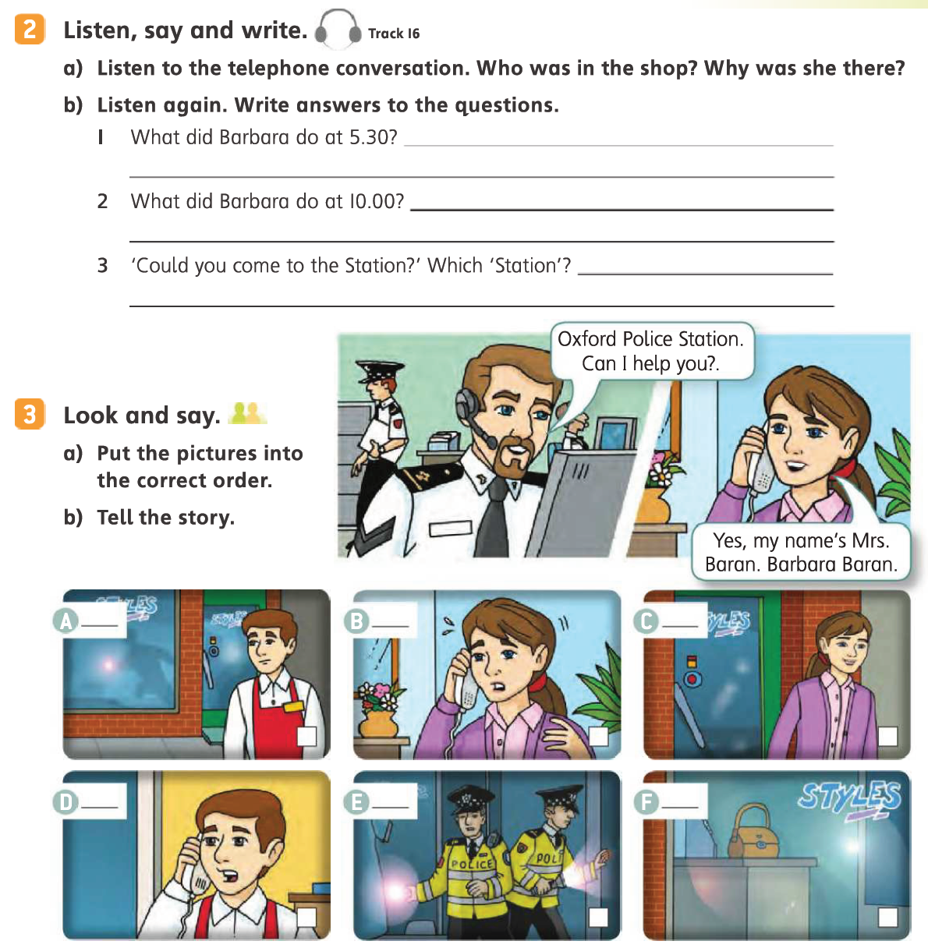
3
6
1
4
5
2

Slide 8
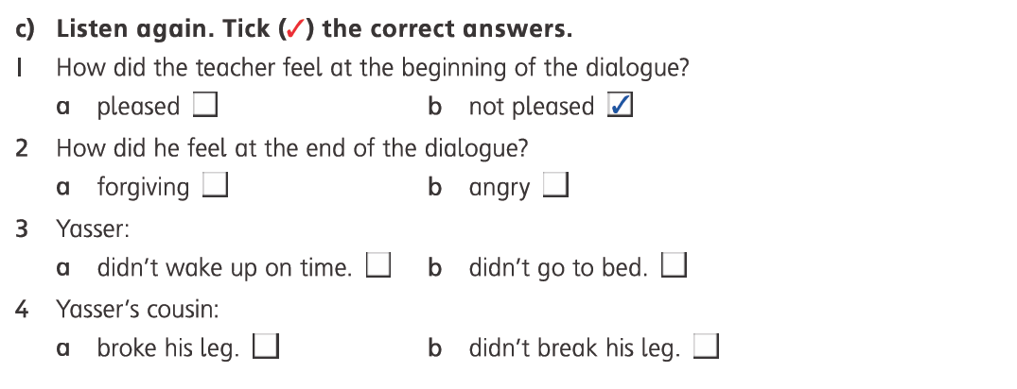

Slide 9
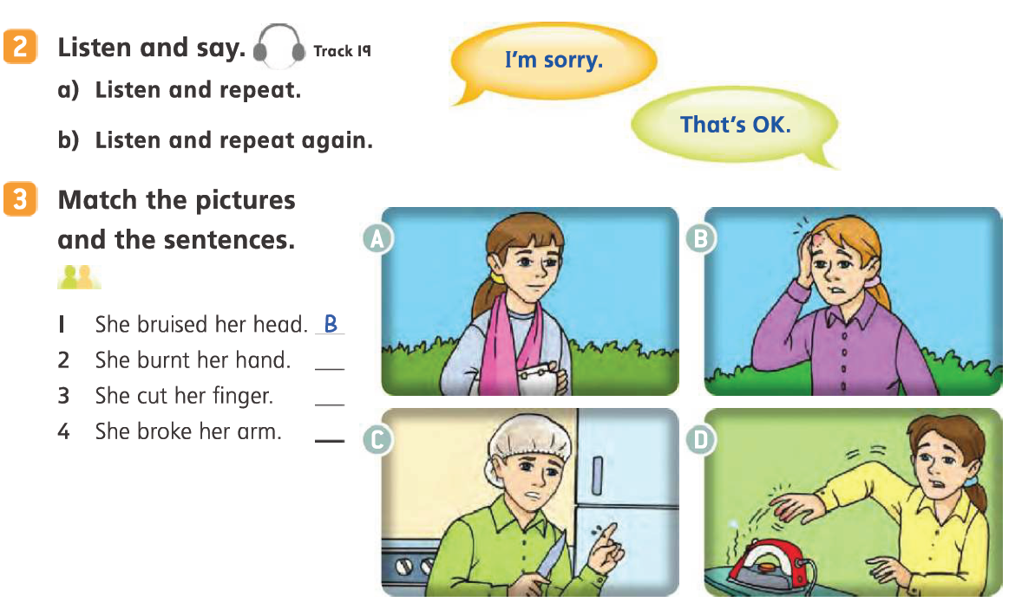
D
C
A

Slide 10
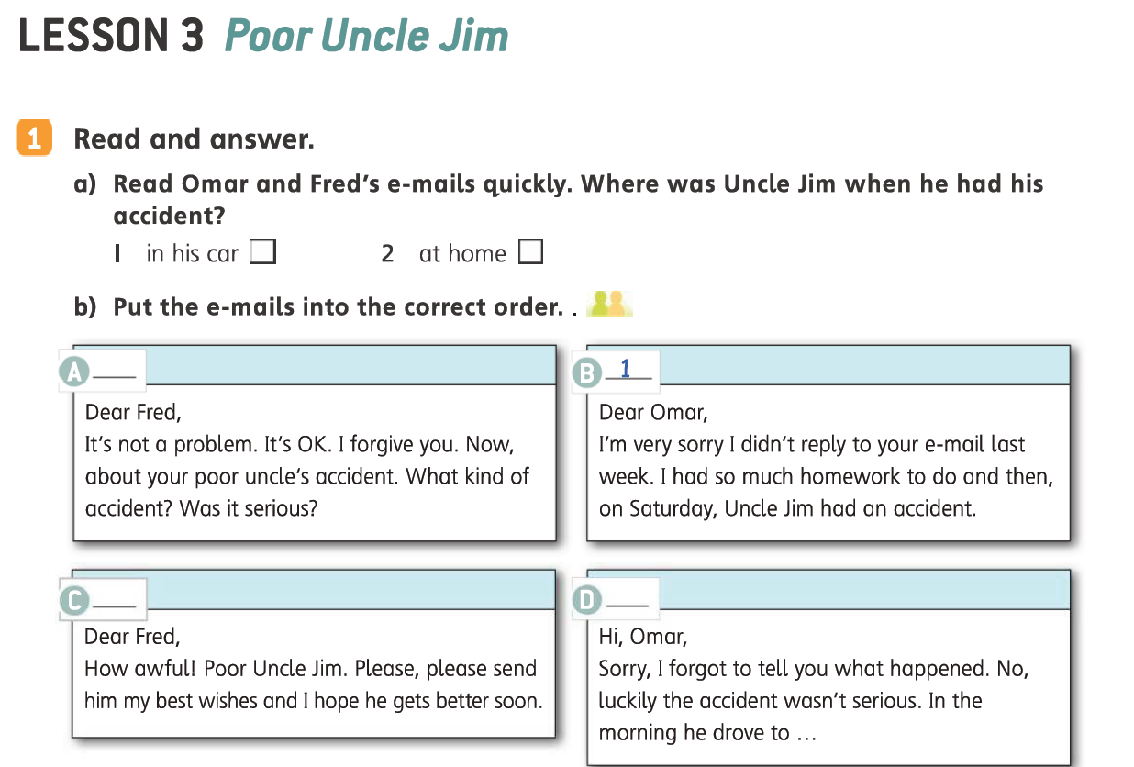
4
3
2

Slide 11
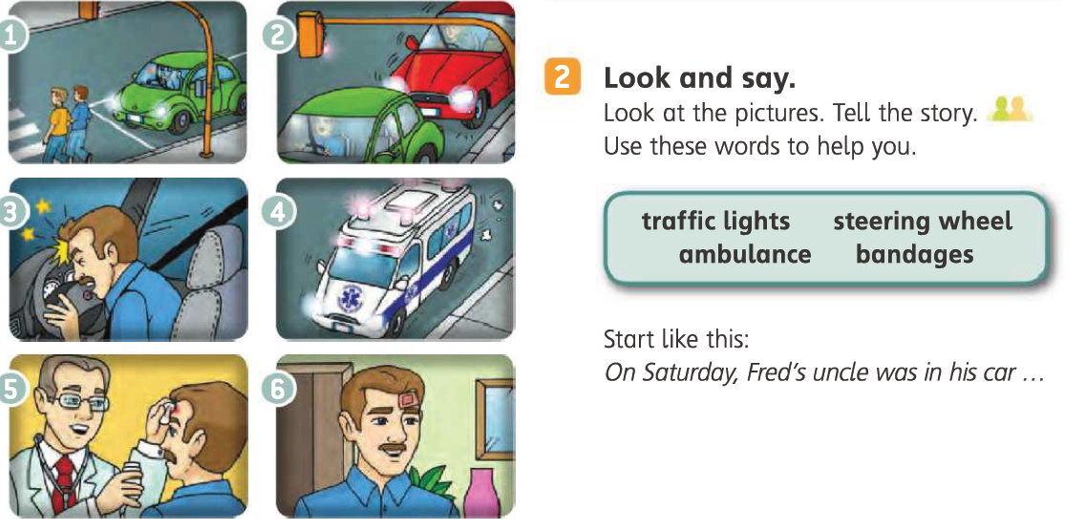
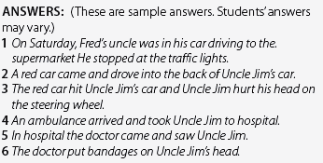

Slide 12
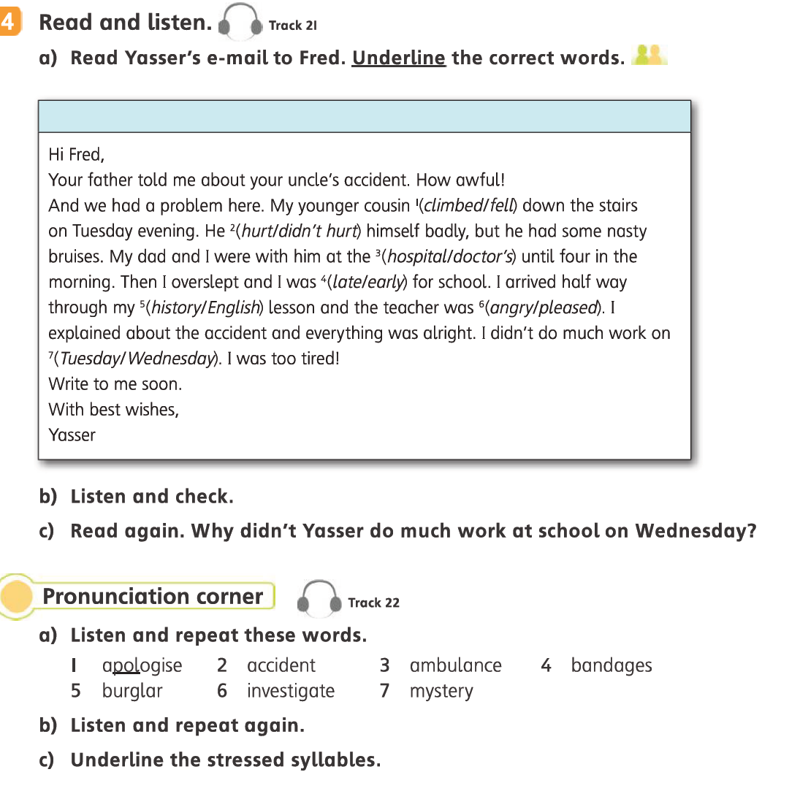

Slide 13
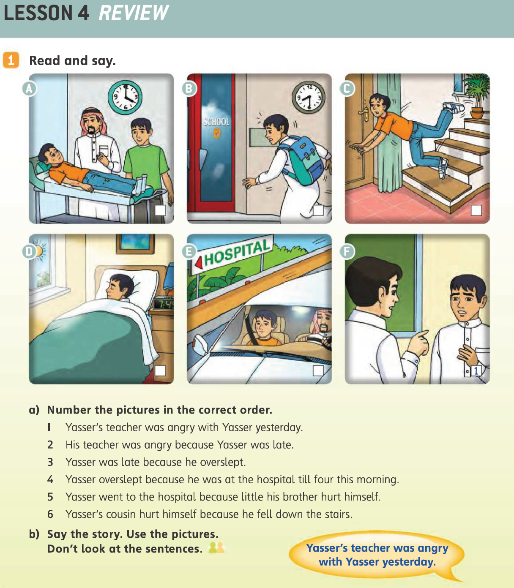
4
2
6
3
5

Slide 14
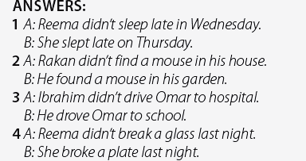

Slide 15
6
1
5
4
2
3

Slide 16
The End
والحمد الله والصلاة والسلام على رسول الله

