Slide 1
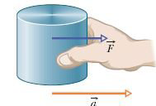
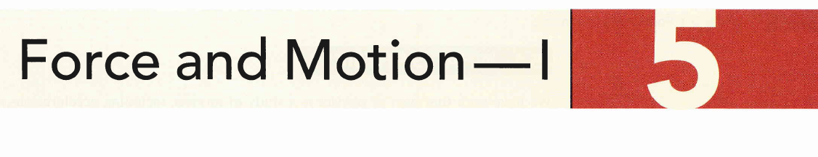
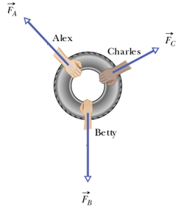
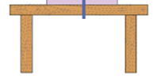
m
Friction

Slide 2

To study the motion of an object
We usually study the acceleration of this object
Acceleration is the changing in velocity
The cause of this changing is a Force

Slide 3
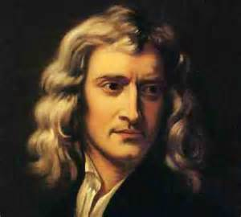
The scientist who first understood the relation between a force and the acceleration it causes was Isaac Newton

Slide 4

: Newtonian mechanics does not apply to
1- A very large speeds such as the speed of light, and instead it
replaced with Einstein's mechanics.
2- The scale of atomic structure, and instead it replaced with the Quantum mechanics.

Slide 5

If No Force acts on a body, the body’s velocity cannot change; that is, the body cannot Accelerate.
or
If there is No Force that acts on the body
if the body is at rest , it stays at rest
if the body is in motion, it stays in motion with the same velocity (same speed and direction)

Slide 6

The SI unit of force is Newton (N).
1Newton is the force that accelerates a body of 1kg with an acceleration of magnitude 1
Forces are vector quantities they combine according to the vector rules.
A force is represented with a symbol as

Slide 7
Forces follow the principle of superposition for forces.
If several forces act on a body

Slide 8


- Mass is an intrinsic characteristic of a body that relates a force F applied on the body and the resulting acceleration a.
SI Unit is Kg.
It is a scalar quantity.
F
F
m₀
m_{X}
a₀
a_{X}

Slide 9






Slide 10
From Newton’s second law the SI unit of force is

Slide 11

Free -body diagram
Draw x and y coordinates.
The body is represented by a dot at the origin.
Each Force on the body is drawn as a vector arrow
with its tail on the body.

Slide 12

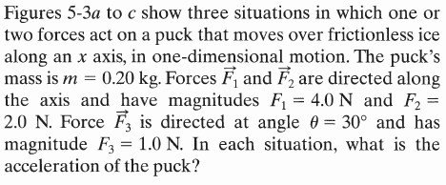
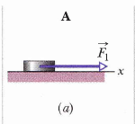
Free -body diagram

Slide 13
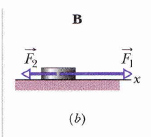
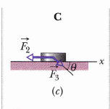

Slide 14

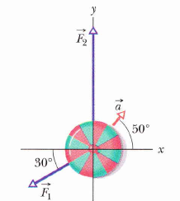
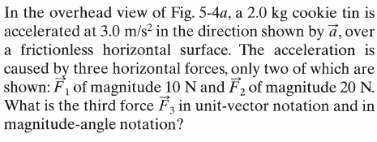

Slide 15

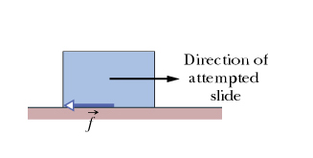
Some particular forces
Gravitational
force
Normal force
Friction
Tension
When a body presses against a surface, the surface deforms and
pushes on the body
with a normal force perpendicular to the contact surface.
This is the force
exerted by
a rope or a cable attached
to an object.
It is the force that the
Earth exerts on any object.
It is directed toward the center of the Earth.
The force that opposes
the motion.

Slide 16
Gravitational
force
Normal force
Friction
Tension
m
Friction

Slide 17
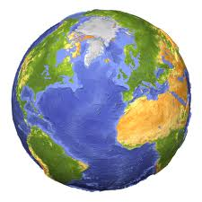
Gravitational force
It is the force that the Earth exerts on any object .It is directed toward the center of the Earth.
mass
weight
mass is constant.
weight is changeable, It depends
on g.
Unit: kg.
Unit: N.

Slide 18
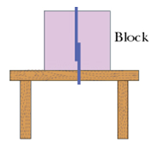
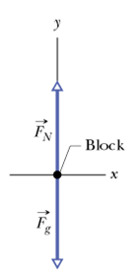
Normal force
The body at rest or moving
with constant velocity.
The body is moving
with acceleration
Direction
of motion
Direction
of motion

Slide 19
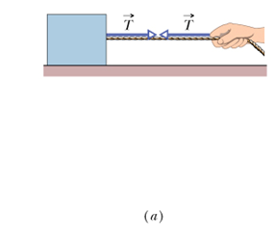
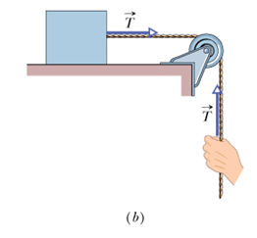
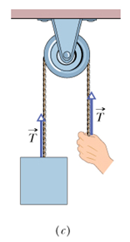
Tension
Tension has the following characteristics:
It is always directed along the rope.
It is always pulling the object.
3. It has the same value along the rope.

Slide 20

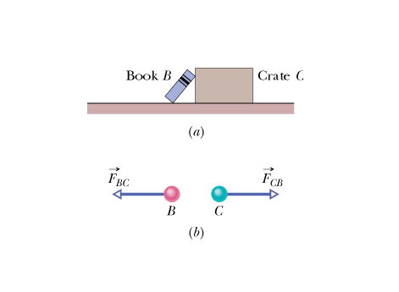

When two bodies interact by exerting forces on each other, the forces are equal in magnitude and opposite in direction.
The force on the book from the crate denoted by
and the force on the crate from the book denoted by
Why the action and reaction force do not cancel each other?
Action and reaction are called third-law force pair

Slide 21
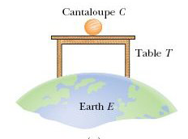
Fn
:force from table on the Cantaloupe(action)
Force from cantaloupe on the table (reaction)
Cantaloupe pulls on the earth.(Reaction)
earth pulls on Cantaloupe .(Action)

Slide 22





Free -body diagram

Slide 23
How to apply Newton’s Laws for a single particle?
Identify all the forces that act on the system. Label them on the diagram and the direction of motion of the object if it is moving.
Draw a free-body diagram for the object.
Check if there is any force needs to be resolved.
Write Newton’s Second law.
Decide how many equations do you need, if its one-dimension, need one equation, two-dimension ,you need two equations.
If the object stationary (at rest) or moving with constant velocity, then the acceleration is zero (a=0) along that axis, otherwise it a has a value.
Add all the components of the forces along the axis
solve the equation to find the unknown.

Slide 24
How to apply Newton’s Laws for a system of particles?
Identify all the forces that act on the system. Label them on the diagram and the direction of motion of each object if they are moving.
2. Remember that the system of two objects moves with the same acceleration.
3. Choose one object to start with and follow the steps below:
a) Draw a free-body diagram for the object.
b) Check if there is any force need to be resolved.
c) Write Newton 2ed law.
d) decide how many equations do you need, if its one-dimension, need one equation, two-dimension ,you need two equations.
e) If the object at rest or moving with constant velocity, then (a=0) the acceleration is zero along that axis, otherwise a has a value.
f) simplify the equation you get and label it (1)
4. Now Apply step( 3) to the other object till you get another equation and label (2).
5. Solve the two Equations to find the unknown.

Slide 25

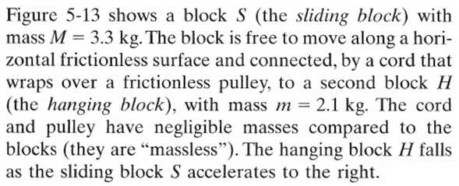
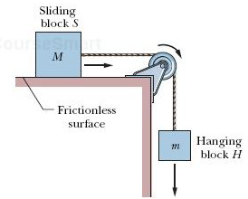

Free -body diagram

Slide 26
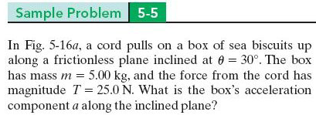
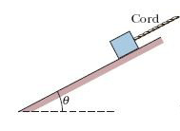
Free -body diagram

Slide 27
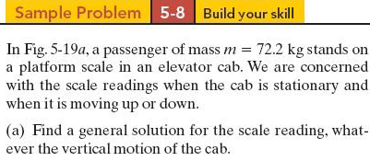
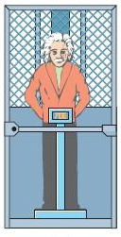


Slide 28


Slide 29
The End

