Slide 1
Unit 4
The body
Next
Main Page
Previous

Slide 2
4 The body
Reading
Vocabulary & Grammar
Listening
Vocabulary & Grammar
Speaking
Examination practice
Writing
Next
Main Page
Previous

Slide 3
4 The body
Reading
Next
Main Page
Previous

Slide 4
4 The body
Reading
Next
Main Page
Previous

Slide 5
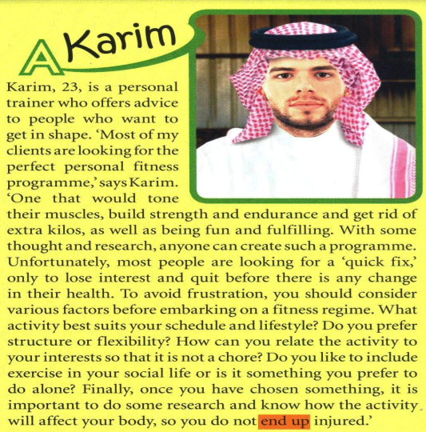
4 The body
Reading
Next
Main Page
Previous

Slide 6
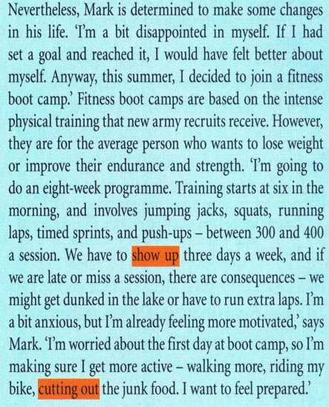
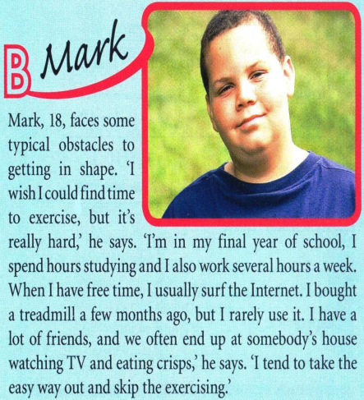
4 The body
Reading
Next
Main Page
Previous

Slide 7
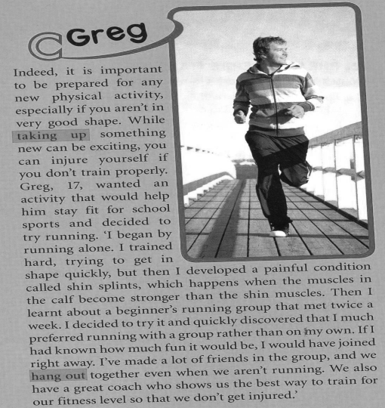
4 The body
Reading
Next
Main Page
Previous

Slide 8
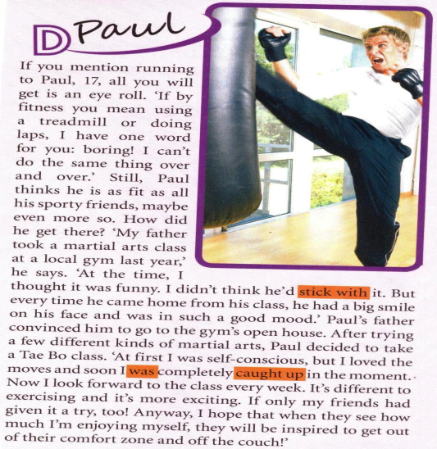
4 The body
Reading
Next
Main Page
Previous

Slide 9
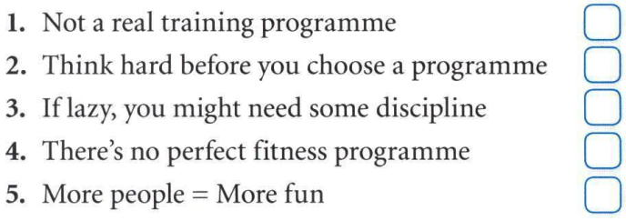
4 The body
4 The body
Reading
Next
Main Page
Previous

Slide 10
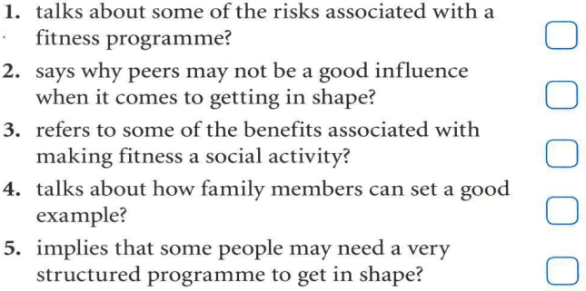
4 The body
Reading
Next
Main Page
Previous

Slide 11
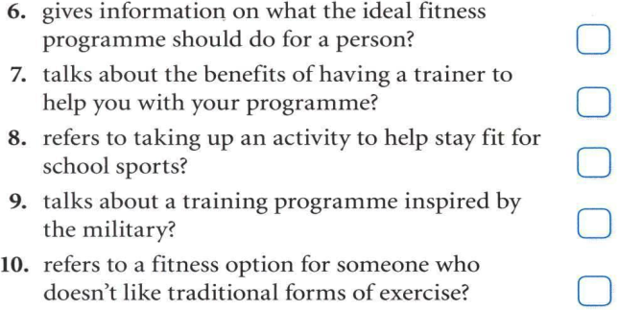
4 The body
Reading
Next
Main Page
Previous

Slide 12
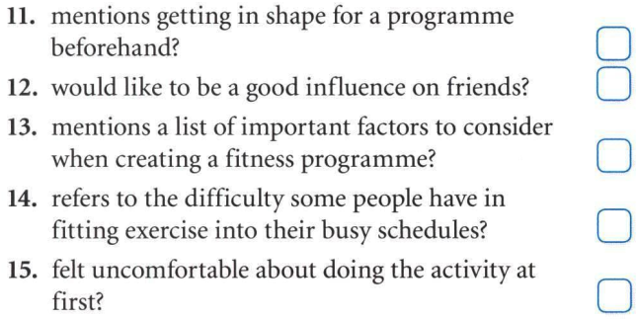
4 The body
Reading
Next
Main Page
Previous

Slide 13
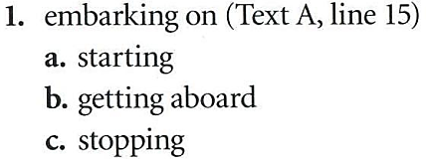
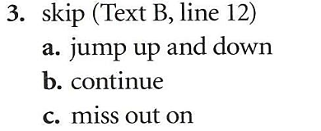
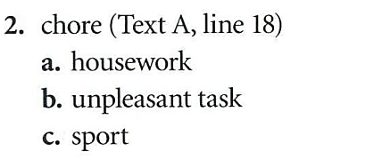
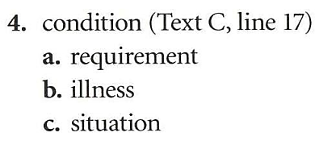
4 The body
Reading
Next
Main Page
Previous

Slide 14
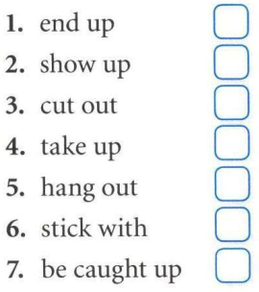
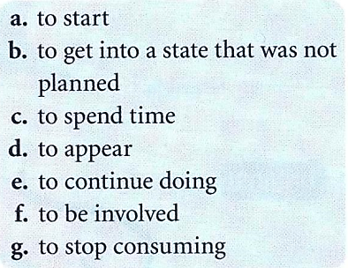
4 The body
Reading
Next
Main Page
Previous

Slide 15
4 The body
Reading
Next
Main Page
Previous

Slide 16
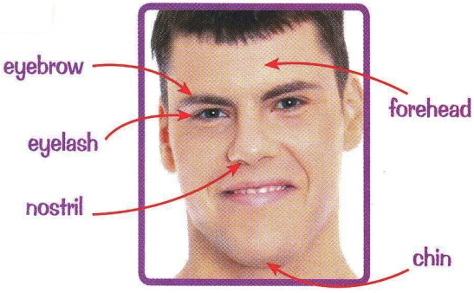
4 The body
Vocabulary & grammar
Vocabulary
Next
Main Page
Previous

Slide 17
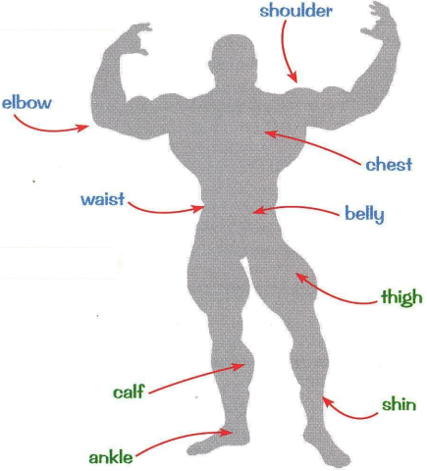
4 The body
Vocabulary & grammar
Vocabulary
Next
Main Page
Previous

Slide 18
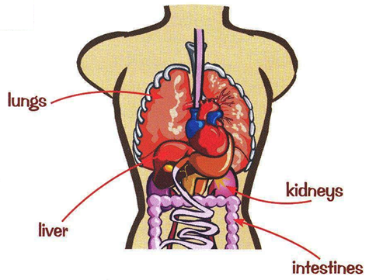
4 The body
Vocabulary & grammar
Vocabulary
Next
Main Page
Previous

Slide 19
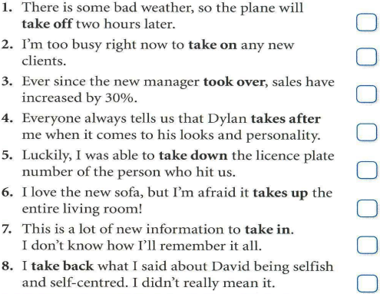
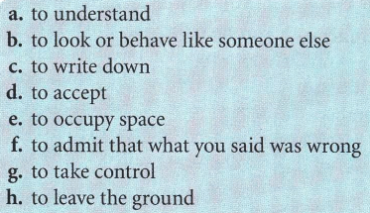
4 The body
Vocabulary & grammar
Vocabulary
Next
Main Page
Previous

Slide 20
4 The body
Vocabulary & grammar
Vocabulary
Next
Main Page
Previous

Slide 21
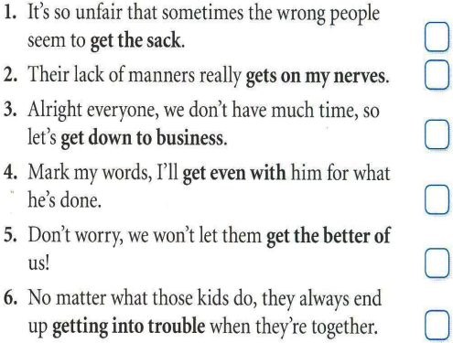
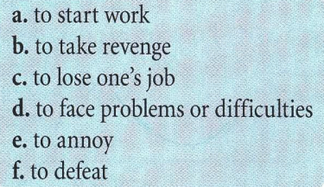
4 The body
Vocabulary & grammar
Vocabulary
Next
Main Page
Previous

Slide 22
4 The body
Vocabulary & grammar
Grammar
Next
Main Page
Previous

Slide 23
4 The body
Vocabulary & grammar
Grammar
Next
Main Page
Previous

Slide 24
4 The body
Vocabulary & grammar
Grammar
Next
Main Page
Previous

Slide 25
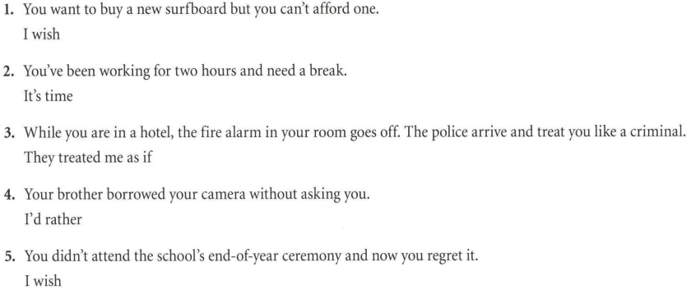
4 The body
Vocabulary & grammar
Grammar
Next
Main Page
Previous

Slide 26
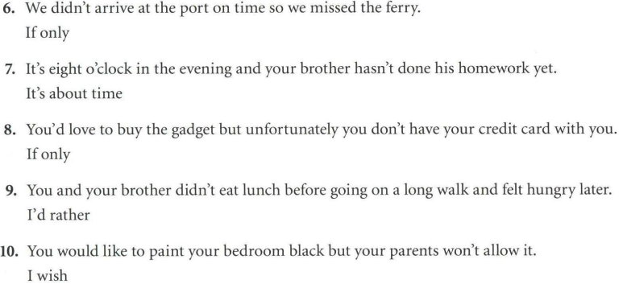
4 The body
Vocabulary & grammar
Grammar
Next
Main Page
Previous

Slide 27
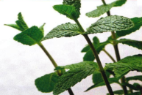
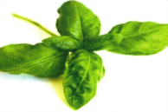
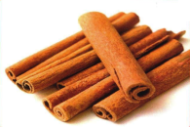
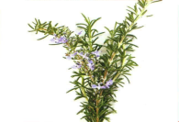
4 The body
Listening
Next
Main Page
Previous

Slide 28
4 The body
Listening
Next
Main Page
Previous

Slide 29
4 The body
Listening
Next
Main Page
Previous

Slide 30
4 The body
Listening
Next
Main Page
Previous

Slide 31
4 The body
Listening
Next
Main Page
Previous

Slide 32
4 The body
Vocabulary
Next
Main Page
Previous

Slide 33
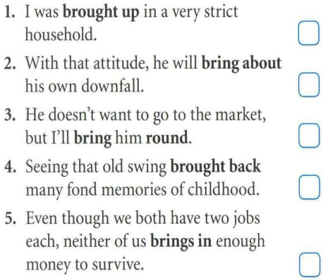
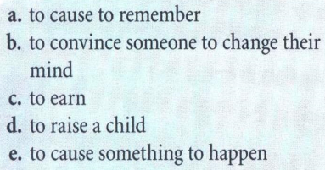
4 The body
Vocabulary
Vocabulary
Next
Main Page
Previous

Slide 34
4 The body
Vocabulary
Next
Main Page
Previous

Slide 35
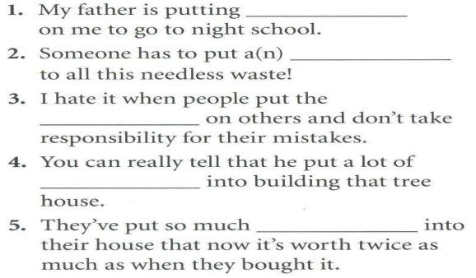
4 The body
Vocabulary
Next
Main Page
Previous

Slide 36
4 The body
Grammar
Next
Main Page
Previous

Slide 37
4 The body
Grammar
Next
Main Page
Previous

Slide 38
4 The body
Grammar
Next
Main Page
Previous

Slide 39
4 The body
Grammar
Next
Main Page
Previous

Slide 40
4 The body
Speaking
Next
Main Page
Previous

Slide 41
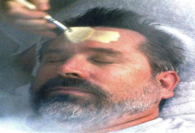
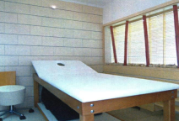
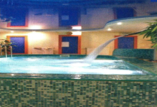
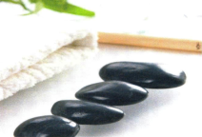
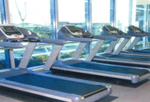
4 The body
Speaking
Next
Main Page
Previous

Slide 42
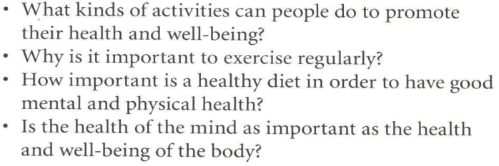
4 The body
Speaking
Next
Main Page
Previous

Slide 43
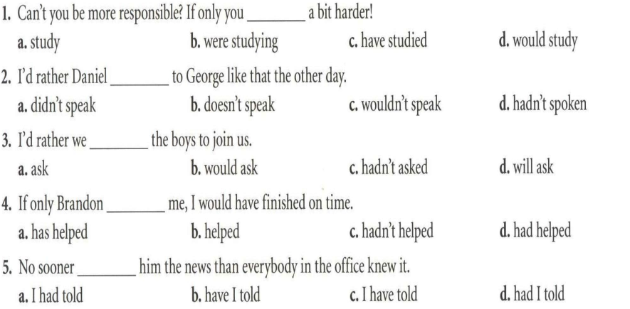
4 The body
Examination practice
Next
Main Page
Previous

Slide 44
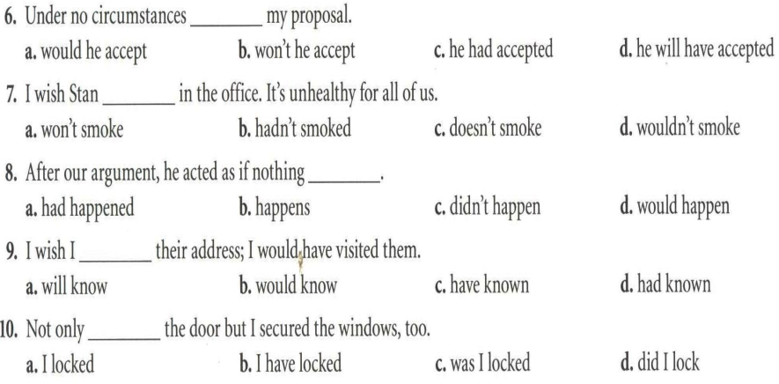
4 The body
Examination practice
Next
Main Page
Previous

Slide 45
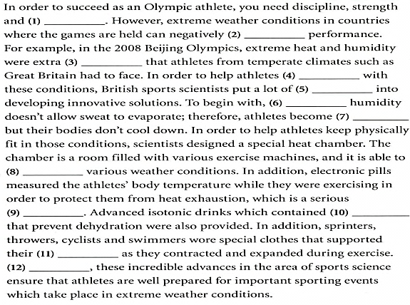
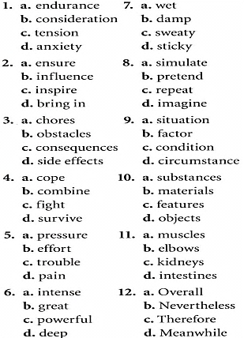
4 The body
Examination practice
Next
Main Page
Previous

Slide 46
4 The body
Writing
Next
Main Page
Previous

Slide 47
4 The body
Writing
Next
Main Page
Previous

Slide 48
4 The body
Writing
Next
Main Page
Previous

Slide 49
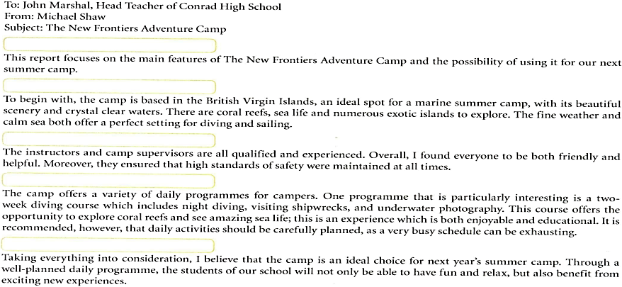
4 The body
Writing
Next
Main Page
Previous

Slide 50
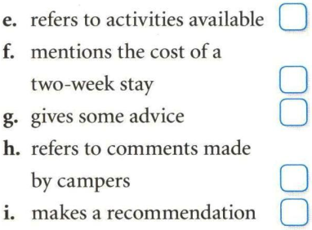
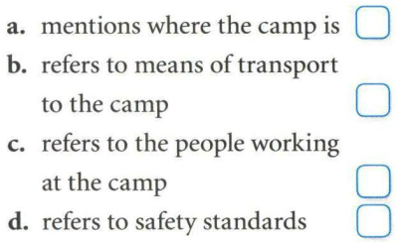
4 The body
Writing
Next
Main Page
Previous

Slide 51
4 The body
Writing
Next
Main Page
Previous

Slide 52
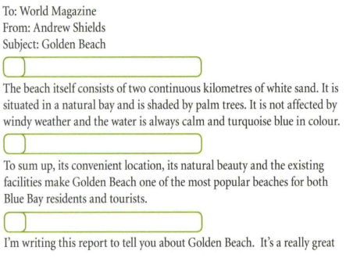
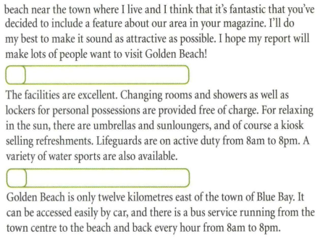
4 The body
Writing
Next
Main Page
Previous

Slide 53
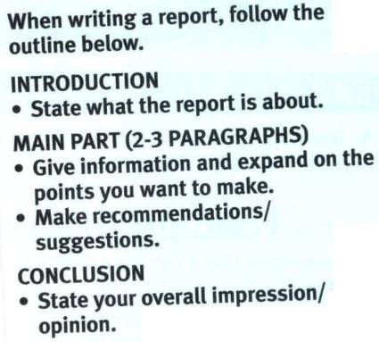
4 The body
Writing
Next
Main Page
Previous

Slide 54
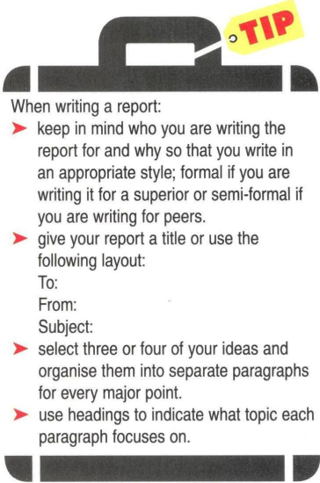
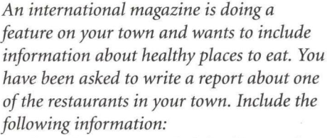
4 The body
Writing
Next
Main Page
Previous

