Slide 1
Principles of Microeconomics
Twelfth Edition, Global Edition (1 of 2)
PART I
INTRODUCTION TO ECONOMICS

Slide 2
Principles of Microeconomics
Twelfth Edition, Global Edition (2 of 2)
Chapter 1
The Scope and Method of Economics

Slide 3
Chapter Outline and Learning Objectives (1 of 2)
1.1 Why Study Economics?
Identify three key reasons to study economics. Think of an example from your life in which understanding opportunity costs or the principle of efficient markets could make a difference in your decision making.
(1.) Learn a way of thinking.
(2.) Understand society.
(3.) Be an informed citizen.
1.2 The Scope of Economics
Describe microeconomics, macroeconomics, and the diverse fields of economics.

Slide 4
Chapter Outline and Learning Objectives (2 of 2)
1.3 The Method of Economics
Think about an example of bad causal inference leading to erroneous decision making. Identify the four main goals of economic policy.
Appendix: How to Read and Understand Graphs
Understand how data can be graphically represented.

Slide 5
Chapter 1 The Scope and Method of Economics
economics The study of how individuals and societies choose to use the scarce resources that nature and previous generations have provided.
The key word in the definition is choose.
Economics is a behavioral, or social, science.
Economics is the study of how people make choices.

Slide 6
Why Study Economics?
To Learn a Way of Thinking
Economics has three fundamental concepts:
Opportunity cost
Marginalism
Efficient markets

Slide 7
To Learn a Way of Thinking (1 of 3)
Opportunity Cost
opportunity cost The best alternative that we forgo, or give up, when we make a choice or decision.
“He who has choice has pain” refers to the sad but unavoidable fact that whatever we decide to do is going to have a cost. If we decide to buy a hamburger it means we can’t buy a chicken sandwich. The sentence is primarily focused on the idea that all choices involve opportunity costs.

Slide 8
12. Explain why it is more likely that the opportunity cost of attending a 7:00 a.m. class is forgone sleep but that this is not reasonably likely to be the case for a class that meets at 12:00 noon.
At 7:00 a.m. there might not be too many other opportunity costs for your time. Forgone sleep might reasonably be an opportunity cost of your time. However, at 12:00 noon while it is possible that forgone sleep is your opportunity cost it is not likely since there are probably other things of higher value that you have given up by then unless you are a very late
scarce Limited.

Slide 9
To Learn a Way of Thinking (2 of 3)
Marginalism
marginalism The process of analyzing the additional or incremental costs or benefits arising from a choice or decision.

Slide 10
To Learn a Way of Thinking (3 of 3)
Efficient Markets—No Free Lunch
efficient market A market in which profit opportunities are eliminated almost instantaneously.
The study of economics teaches us a way of thinking and helps us make decisions.

Slide 11
FREE LUNCH
Assume that you have heard news that a local radio station is hosting a luncheon at your school by offering hot dogs, chips and cola at no expense to the student body. Why would economists say that this lunch is not truly free?
The lunch is not free for a couple of reasons. First, in order for the radio station to offer it they had to give up real resources in order to provide it. Secondly, it is likely that if the luncheon is offered at no expense to the students they will likely have to spend at least some amount of time waiting in line to get it. This time represents an opportunity cost which is not likely to be free.

Slide 12
20. Consider the following scenario. Assume the price of gold in London is selling for $1400 an ounce while in New York it is fetching a price of $1450 an ounce. What would an economist say about the efficiency of this market? What would an economist predict about what would happen next?
An economist would argue that this market is currently not efficient. The reason is that there are still profit opportunities to be had. Market participants could buy gold in London and sell it in New York until there is no more incentive to do so, i.e. (when there are no more profit opportunities).

Slide 13
To Understand Society
Industrial Revolution The period in England during the late eighteenth and early nineteenth centuries in which new manufacturing technologies and improved transportation gave rise to the modern factory system and a massive movement of the population from the countryside to the cities.
The study of economics is an essential part of the study of society.

Slide 14
To Be an Informed Citizen
To be an informed citizen requires a basic understanding of economics.

Slide 15
ECONOMICS IN PRACTICE iPod and the World
A sticker that says “Made in China” can often be misleading.
The iPod is composed of many small parts, and it is almost impossible to accurately tell exactly where each piece was produced without pulling it apart.
From an economics point of view, one often has to dig deep to see what is really going on.
THINKING PRACTICALLY
1. What do you think accounts for where components of the iPod and Barbie are made?

Slide 16
The Scope of Economics (1 of 2)
Microeconomics and Macroeconomics
microeconomics The branch of economics that examines the functioning of individual industries and the behavior of individual decision-making units—that is, firms and households.
macroeconomics The branch of economics that examines the economic behavior of aggregates—income, employment, output, and so on—on a national scale.
EXEMPLE IN WORD/ WHITE BOARD

Slide 17
The Scope of Economics (2 of 2)
Microeconomics and Macroeconomics
Microeconomics looks at the individual unit—the household, the firm, the industry. It sees and examines the “trees.”
Macroeconomics looks at the whole, the aggregate. It sees and analyzes the “forest.”

Slide 18
TABLE 1.1 Examples of Microeconomic and Macroeconomic Concerns
Division of Economics | Production | Prices | Income | Employment
Microeconomics | Production/output in individual industries and businesses How much steel How much office space How many cars | Prices of individual goods and services Price of medical care Price of gasoline Food prices Apartment rents | Distribution of income and wealth Wages in the auto industry Minimum wage Executive salaries Poverty | Employment by individual businesses and industries Jobs in the steel industry Number of employees in a firm Number of accountants
Macroeconomics | National production/output Total industrial output Gross domestic product Growth of output | Aggregate price level Consumer prices Producer prices Rate of inflation | National income Total wages and salaries Total corporate profits | Employment and unemployment in the economy Total number of jobs Unemployment rate

Slide 19
TABLE 1.2 The Fields of Economics ( 1 of 3)
Behavioral economics | Do aggregate household savings increase when we automatically enroll people in savings programs and let them opt out as opposed to requiring them to sign up?
Comparative economic systems | How does the resource allocation process differ in market versus command and control systems?
Econometrics | What inferences can we make based on conditional moment inequalities?
Economic development | Does increasing employment opportunities for girls in developing nations increase their educational achievements?
Economic history | How did the growth of railroads and improvement in transportation more generally change the U.S. banking systems in the nineteenth century?

Slide 20
TABLE 1.2 The Fields of Economics (cont’d 2 of 3)
Environmental economics | What effect would a tax on carbon have on emissions? Is a tax better or worse than rules?
Finance | Is high frequency trading socially beneficial?
Health economics | Do co-pays by patients change the choice and use of medicines by insured patients?
The history of economic thought | How did Aristotle think about just prices?
Industrial organization | How do we explain price wars in the airline industry

Slide 21
TABLE 1.2 The Fields of Economics (cont’d 3 of 3)
International economics | What are the benefits and costs of free trade? Does concern about the environment change our views of free trade?
Labor economics | Will increasing the minimum wage decrease employment opportunities?
Law and economics | Does the current U.S. patent law increase or decrease the rate of innovation?
Public economics | Why is corruption more widespread in some countries than in others?
Urban and regional economics | Do enterprise zones improve employment opportunities in central cities?

Slide 22
The Method of Economics
Economics deals with two kinds of questions: positive and normative.
positive economics An approach to economics that seeks to understand behavior and the operation of systems without making judgments. It describes what exists and how it works.
normative economics An approach to economics that analyzes outcomes of economic behavior, evaluates them as good or bad, and may prescribe courses of action. Also called policy economics. The normative statement should include some value judgment or "what should be".
EXAMPLE/ WORD- WHITE BOARD

Slide 23
Descriptive economics involves the compilation of data that describe economic phenomena and facts. Economic theory involves a statement or a set of related statements about cause and effect (action and reaction).

Slide 24
Theories and Models (1 of 5)
model A formal statement of a theory, usually a mathematical statement of a presumed relationship between two or more variables.
variable A measure that can change from time to time or from observation to observation.
Ockham’s razor The principle that irrelevant detail should be cut away. Assume that the research team of a major company is building a model of consumer demand that contains approximately 250 variables. Can you think of a principle that might be violated here that was discussed in chapter 1? Explain.The principle that is probably being violated is Ockham’s Razor. This is the idea that irrelevant data should be cut away. With 250 variables it is very likely that many of them are unnecessary and will only make the model more complicated.

Slide 25
Theories and Models ( 2 of 5)
All Else Equal
ceteris paribus, or all else equal A device used to analyze the relationship between two variables while the values of other variables are held unchanged.
Using the device of ceteris paribus is one part of the process of abstraction.
In formulating economic theory, the concept helps us simplify reality to focus on the relationships that interest us.

Slide 26
Theories and Models (3 of 5)
Expressing Models in Words, Graphs, and Equations
Graphs and equations capture the quantitative side of economic observations and predictions.

Slide 27
Theories and Models (4 of 5)
Cautions and Pitfalls
Economists are interested in cause and effect, but sorting out causality from correlation is not always easy.
post hoc, ergo propter hoc Literally, “after this (in time), therefore because of this.” A common error made in thinking about causation: If Event A happens before Event B, it is not necessarily true that A caused B.

Slide 28
Theories and Models (5 of 5)
Testing Theories and Models: Empirical Economics
empirical economics The collection and use of data to test economic theories.

Slide 29
ECONOMICS IN PRACTICE Does Your Part-time Job Matter for Your Academic Performance?
Several studies of the effect of part-time jobs on college grades help to sort out causality in part-time job effects.
One study used data on final-year journalism students’ academic achievements and well-being along with their employment reasons and working hours to test the part-time employment effects.
The overall results revealed strong negative employment effects.
THINKING PRACTICALLY
1. Would the academic outcomes of university juniors change as they become university seniors if they continuously pursue similar types of employment?

Slide 30
Economic Policy ( 1 of 3)
Four criteria are important in judging economic outcomes:
Efficiency
Equity
Growth
Stability

Slide 31
Economic Policy (2 of 3)
Efficiency
efficiency In economics, allocative efficiency. An efficient economy is one that produces what people want at the least possible cost.
Equity
equity Fairness.

Slide 32
Economic Policy ( 3 of 3)
Growth
economic growth An increase in the total output of an economy.
Stability
stability A condition in which national output is growing steadily, with low inflation and full employment of resources.

Slide 33
Explain the difference between economic growth and stability. Can a country experience both at the same time? Why or why not?
Economic growth refers to an increase in the total output of the economy. Stability occurs when output is steady or growing, with low inflation and full employment of resources. Yes, a country can experience both economic growth and stability at the same time, as long as the increase in output is not accompanied by a rising price level. The late 1990s were a period of growth for the U.S. economy with low inflation.

Slide 34
An Invitation
You cannot begin to understand how a society functions without knowing something about its economic history and its economic system.
Learning to think in this very powerful way will help you better understand the world.
This book proceeds step-by-step, each section building on the last.
Make sure you understand where it all fits in the big picture.

Slide 35
REVIEW TERMS AND CONCEPTS
ceteris paribus, or all else equal
economic growth
economics
efficiency
efficient market
empirical economics
equity
Industrial Revolution
macroeconomics
Marginalism
microeconomics
model
normative economics
Ockham’s razor
opportunity cost
positive economics
post hoc, ergo propter hoc
scarce
stability
variable
microeconomics
model
normative economics
Ockham’s razor
opportunity cost
positive economics
post hoc, ergo propter hoc
scarce
stability
variable

Slide 36
CHAPTER 1 APPENDIX: How to Read and Understand Graphs
graph A two-dimensional representation of a set of numbers or data.
Time Series Graphs
time series graph A graph illustrating how a variable changes over time.

Slide 37
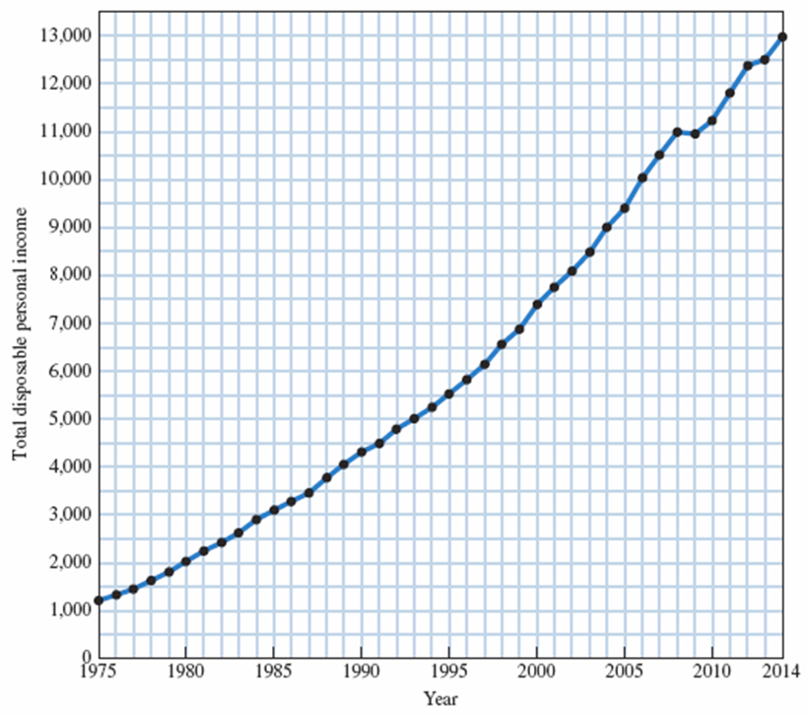
TABLE 1A.1 Total Disposable Personal Income in the United States, 1975–2014 (in Billions of Dollars)
FIGURE 1A.1 Total Disposable Personal Income in the United States: 1975–2014 (in Billions of Dollars)
Year | Total Disposable Personal Income | Year | Total Disposable Personal Income
1975 1976 1977 1978 1979 1980 1981 1982 1983 1984 1985 1986 1987 1988 1989 1990 1991 1992 1993 1994 | 1,219 1,326 1,457 1,630 1,809 2,018 2,251 2,425 2,617 2,904 3,099 3,288 3,466 3,770 4,052 4,312 4,485 4,800 5,000 5,244 | 1995 1996 1997 1998 1999 2000 2001 2002 2003 2004 2005 2006 2007 2008 2009 2010 2011 2012 2013 2014 | 5,533 5,830 6,149 6,561 6,876 7,401 7,752 8,099 8,466 9,002 9,401 10,037 10,507 10,994 10,943 11,238 11,801 12,384 12,508 12,981
Source: U.S. Department of Commerce, Bureau of Economic Analysis.
Source: See Table 1A.1.

Slide 38
Graphing Two Variables
X-axis The horizontal line against which a variable is plotted.
Y-axis The vertical line against which a variable is plotted.
origin The point at which the horizontal and vertical axes intersect.
Y-intercept The point at which a graph intersects the Y-axis.
X-intercept The point at which a graph intersects the X-axis.

Slide 39
Plotting Income and Consumption Data for Households
positive relationship A relationship between two variables, X and Y, in which a decrease in X is associated with a decrease in Y and an increase in X is associated with an increase in Y.
negative relationship A relationship between two variables, X and Y, in which a decrease in X is associated with an increase in Y and an increase in X is associated with a decrease in Y.

Slide 40
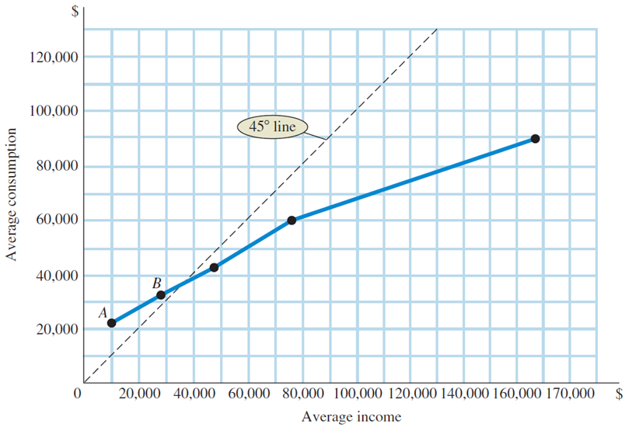
FIGURE 1A.2 Household Consumption and Income
TABLE 1A.2 Consumption Expenditures and Income, 2012
 | Average Income Before Taxes | Average Consumption Expenditures
Bottom fifth 2nd fifth 3rd fifth 4th fifth Top fifth | $ 9,988 27,585 47,265 75,952 167,010 | $ 22,154 32,632 43,004 59,980 99,368
Source: Consumer Expenditures in 2012, U.S. Bureau
of Labor Statistics.
Source: See Table 1A.2.
A graph is a simple two-dimensional geometric representation of data. The graph in Figure 1A.2 displays the data from Table 1A.2.
Along the horizontal scale (X-axis), we measure household income. Along the vertical scale (Y-axis), we measure household consumption.
Note: At point A, consumption equals $22,154 and income equals $9,988. At point B, consumption equals $32,632 and income equals $27,585.

Slide 41
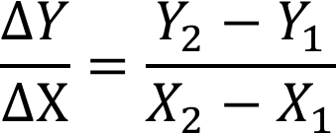
Slope
slope A measurement that indicates whether the relationship between variables is positive or negative and how much of a response there is in Y (the variable on the vertical axis) when X (the variable on the horizontal axis) changes.

Slide 42
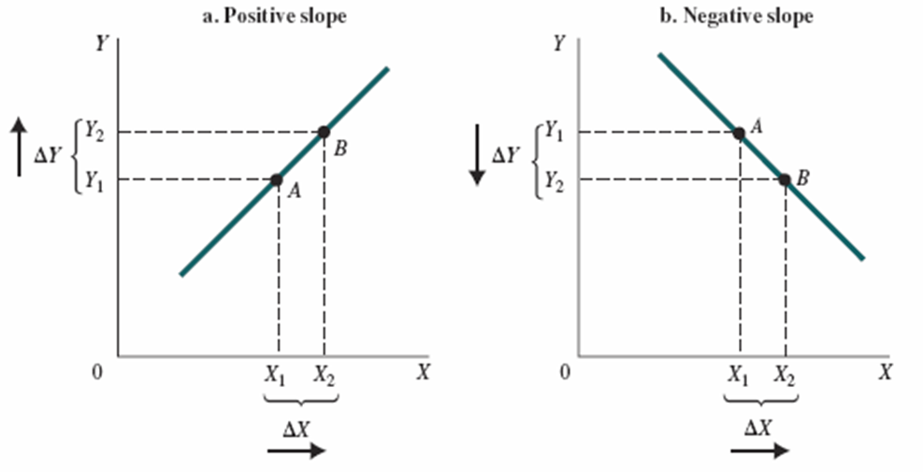
FIGURE 1A.3 A Curve with (a) Positive Slope and (b) Negative Slope
A positive slope indicates that increases in X are associated with increases in Y and that decreases in X are associated with decreases in Y.
A negative slope indicates the opposite—when X increases, Y decreases; and when X decreases, Y increases.

Slide 43
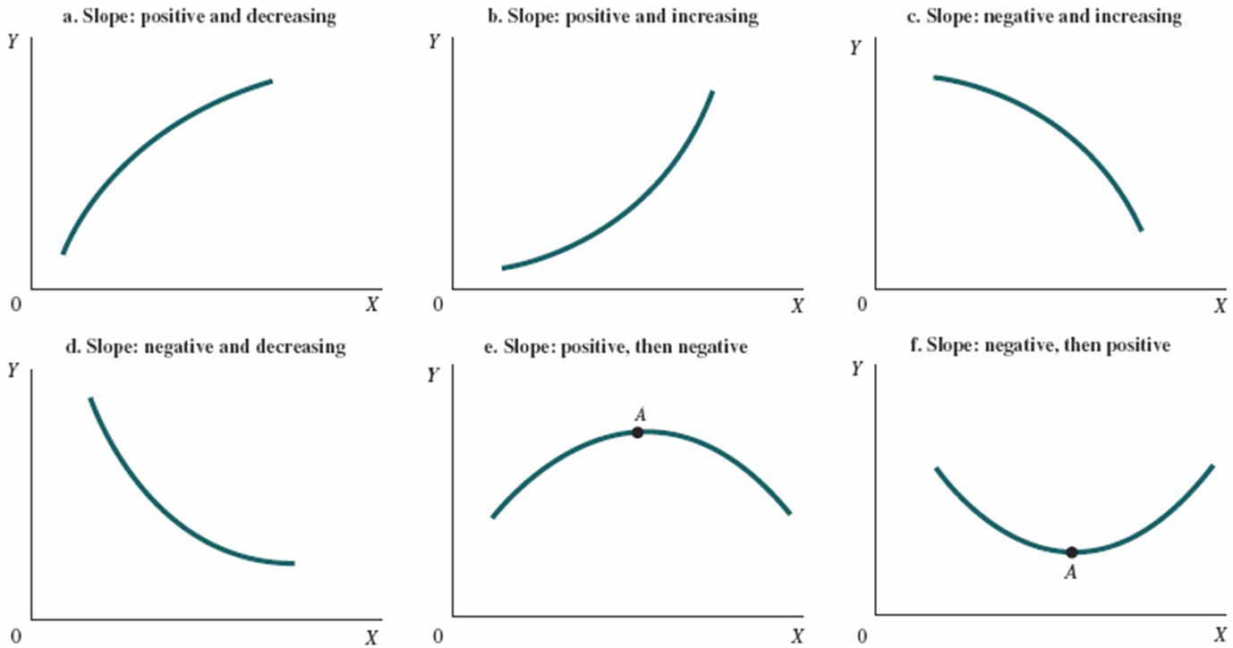
FIGURE 1A.4 Changing Slopes along Curves

Slide 44
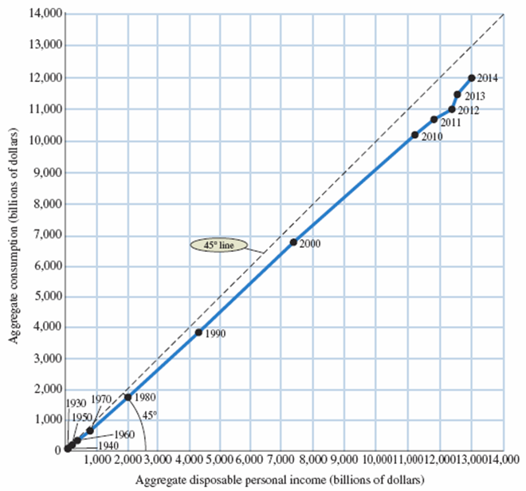
Some Precautions
FIGURE 1A.5 National Income and Consumption
TABLE 1A.3 Aggregate National Income and Consumption for the United States, 1930–2014 (in Billions of Dollars)
 | Aggregate National Income | Aggregate Consumption
1930 1940 1950 1960 1970 1980 1990 2000 2010 2011 2012 2013 2014 | 75 78 215 377 762 2,018 4,312 7,401 11,238 11,801 12,384 12,505 12,981 | 70 71 192 332 648 1,755 3,826 6,792 10,202 10,689 11,083 11,484 11,928
Source: See Table 1A.3.
Source: U.S. Department of Commerce, Bureau of Economic Analysis.
It is important to think carefully about what is represented by points in the space defined by the axes of a graph.
In Figure 1A.5 we have graphed income with consumption, as in Figure 1A.2, but here each observation point is national income and aggregate consumption in different years, measured in billions of dollars.

Slide 45
APPENDIX REVIEW TERMS AND CONCEPTS
graph
negative relationship
origin
positive relationship
Slope
time series graph
X-axis
X-intercept
Y-axis
Y-intercept

