Slide 1
Family and Friends 2-Grade 2
Unit 8
Tidy up!
Lesson 1
Page 72

Slide 2
Think !
How can we keep our room tidy?
_________________________________________________________________________________________________________________________________________________
Ministry of Education-2020

Slide 3
Objectives
1- Name six bedroom objects.
2- Recognise six bedroom objects.
3- Identify the use of on – in – under.
_________________________________________________________________________________________________________________________________________________
Ministry of Education-2020

Slide 4
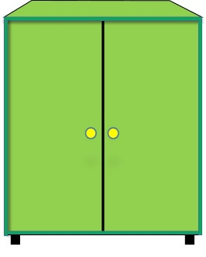
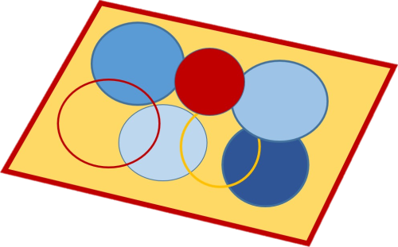
Listen, point and repeat
cupboard
rug
bed
pillow
blanket
shelf
_________________________________________________________________________________________________________________________________________________
Ministry of Education-2020

Slide 5
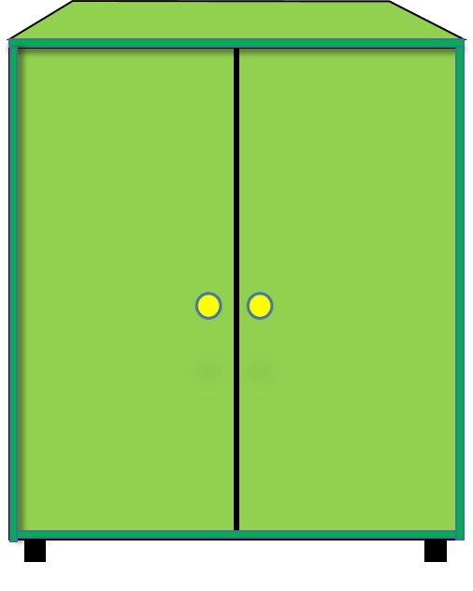
Read, point and repeat
cupboard
_________________________________________________________________________________________________________________________________________________
Ministry of Education-2020

Slide 6
Read, point and repeat
rug
_________________________________________________________________________________________________________________________________________________
Ministry of Education-2020
Notes:
If you have got short hair stand up.

Slide 7
Read, point and repeat
bed
_________________________________________________________________________________________________________________________________________________
Ministry of Education-2020

Slide 8
Read, point and repeat
shelf
_________________________________________________________________________________________________________________________________________________
Ministry of Education-2020

Slide 9
Read, point and repeat
pillow
_________________________________________________________________________________________________________________________________________________
Ministry of Education-2020
Notes:
If you have got curly hair stand up.

Slide 10
Read, point and repeat
blanket
_________________________________________________________________________________________________________________________________________________
Ministry of Education-2020

Slide 11
Bring out your white boards and markers!
Let’s practice!
____________________________________________________________________________________________________________________________________
Ministry of Education-2020

Slide 12
Let’s Play!
Look at the picture and write the correct word on your board
bed
cupboard
_________________________________________________________________________________________________________________________________________________
Ministry of Education-2020

Slide 13
Look at the picture and write the correct word on your board.
shelf
rug
_________________________________________________________________________________________________________________________________________________
Ministry of Education-2020

Slide 14
Look at the picture and write the correct word on your board.
pillow
rug
_________________________________________________________________________________________________________________________________________________
Ministry of Education-2020

Slide 15
Look at the picture and write the correct word on your board.
blanket
cupboard
_________________________________________________________________________________________________________________________________________________
Ministry of Education-2020

Slide 16
Look at the picture and write the correct word on your board.
pillow
shelf
_________________________________________________________________________________________________________________________________________________
Ministry of Education-2020

Slide 17
Look at the picture and write the correct word on your board.
bed
blanket
_________________________________________________________________________________________________________________________________________________
Ministry of Education-2020

Slide 18
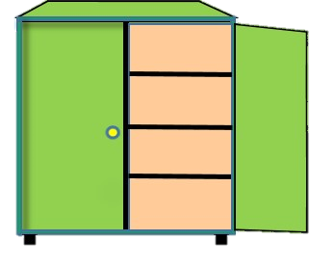
Listen then read
in
under
on
There is a ball in
the cupboard.
There is a ball
under the bed.
There is a ball on
the shelf.
_________________________________________________________________________________________________________________________________________________
Ministry of Education-2020

Slide 19
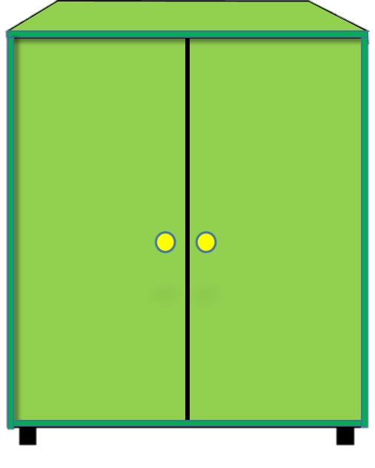
Listen then read
There is a book under the cupboard.
book
There is a box under the bed.
_________________________________________________________________________________________________________________________________________________
Ministry of Education-2020

Slide 20
Listen then read
There is a box on the shelf.
There is a book on the rug.
_________________________________________________________________________________________________________________________________________________
Ministry of Education-2020

Slide 21
Listen then read
There is a box in the cupboard.
There is a hat in the cupboard.
_________________________________________________________________________________________________________________________________________________
Ministry of Education-2020

Slide 22
Question 1
Let’s practice !
Open page 70 of your workbook. Answer the questions.
Question 2
_________________________________________________________________________________________________________________________________________________
Ministry of Education-2020

Slide 23
Write three sentences using the words you have learned today in your notebook.
Open the practice PPT and answer L 1.
_________________________________________________________________________________________________________________________________________________
Ministry of Education-2020

Slide 24
End of the
lesson!
_________________________________________________________________________________________________________________________________________________
Ministry of Education-2020

