Slide 1

Chapter 5
Aqueous Solutions and acids-base equilibria

Slide 2
Chapter 5
Aqueous Solutions and acids-base equilibria
Page:125-145
The Concept of dynamic Equilibrium
The Equilibrium Constant
Expressions Equilibrium Constant.
Heterogeneous Equilibrium.
Calculating Equilibrium constant.
Le Chatelier’s principle.
The natural of Acid and Base.
Acid strength - The pH scale (with all examples)
Base solutions
Lewis acids and bases

Slide 3
Chapter 5: Aqueous Solutions and acids-base equilibria
5.1. The Concept of dynamic Equilibrium
Few reaction are proceed in one direction.
Most reactions are reversible?
Chemical equilibrium: is achieved when
  1-the rates of the forward and reverse reactions are equal
  2- and the concentrations of the reactants and products remain constant

Slide 4
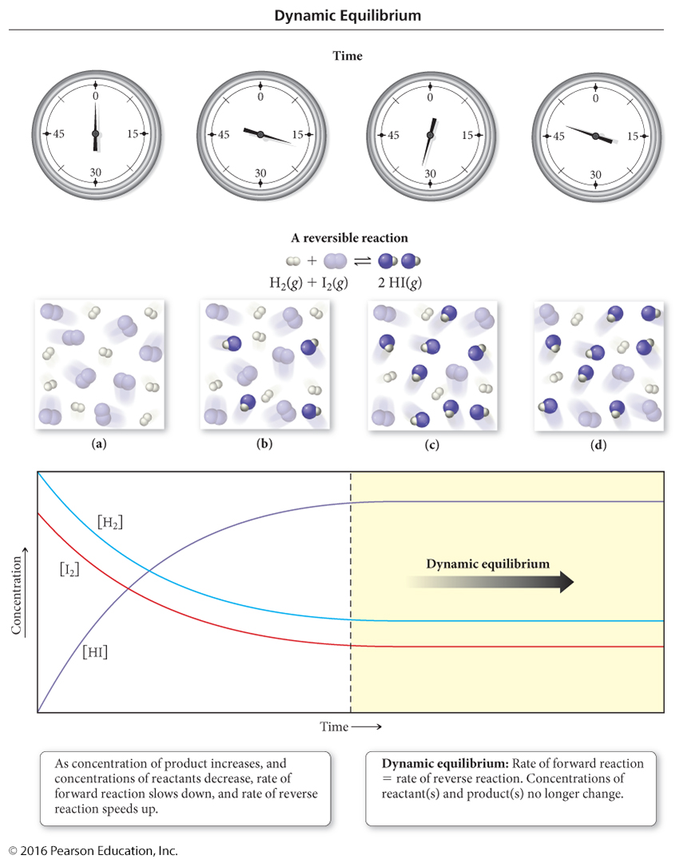
Chapter 5: Aqueous Solutions and acids-base equilibria
Note: [HI] at equilibrium is larger than [H₂] or [I₂]; this means the position of equilibrium favors products.

Slide 5
Chapter 5: Aqueous Solutions and acids-base equilibria
5.2. Equilibrium Constant (K) ثابت التوازن
even though the concentrations of reactants and products are not equal at equilibrium, there is a relationship between them.
the relationship between the chemical equation and the concentrations of reactants and products is called the Law of Mass Action
for the general equation: aA + bB ⇔ cC + dD,
the Law of Mass Action gives the relationship below:
K is called the equilibrium constant

Slide 6

Chapter 5: Aqueous Solutions and acids-base equilibria
5.2. Equilibrium Constant (K) ثابت التوازن
A, b, c, & d: are the stoichiometric coefficients for A, B, C , & D
The equilibrium constant: for a reversible reaction at equilibrium and a constant temperature, a certain ratio of reactant and product concentrations has a constant value, K, called the equilibrium constant.
The concentration of solids and pure liquids and solvents are not included in the expression for the equilibrium constant.
K has no unit.
تركيز النواتج مرفوعة لعدد مولاتها
ثابت الاتزان
تركيز المتفاعلات مرفوعة لعدد مولاتها
ثابت الاتزان = كسر البسط: هو ناتج ضرب تركيز النواتج كل مرفوع الى اس يساوي عدد مولاته في معادلة التفاعل الموزونه
والمقام: هو ناتج ضرب تركيز المتفاعلات كل مرفوع الى اس يساوي عدد مولاته في معادلة التفاعل الموزونه

Slide 7
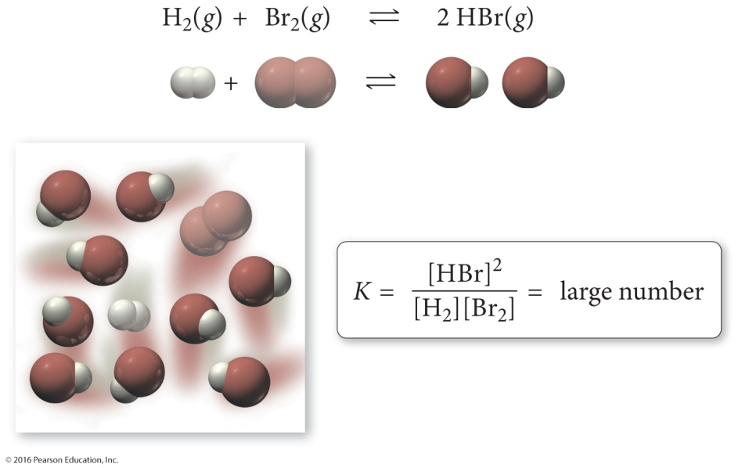
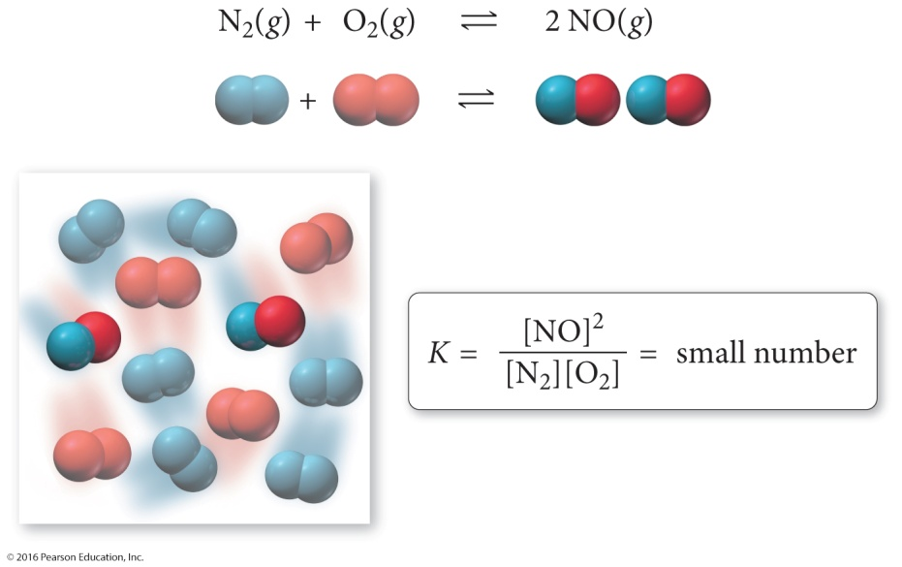
Chapter 5: Aqueous Solutions and acids-base equilibria
5.2. Equilibrium Constant (K) ثابت التوازن
What K tells US???
K_{c} > 1: Product favored
K_{c} < 1: Reactant favored
PRODUCTS → Larger product concentration
REACTANTS → Larger reactants concentration

Slide 8
Chapter 5: Aqueous Solutions and acids-base equilibria
5.2. Equilibrium Constant (K) ثابت التوازن
Writing Equilibrium Constant Expressions:
for the reaction:
aA_{(aq)} + bB_{(aq)} ⇔ cC_{(aq)} + dD_{(aq)}
the equilibrium constant expression is:
so for the reaction:
2 N₂O₅ ⇔ 4 NO₂ + O₂ the
equilibrium constant expression is:

Slide 9
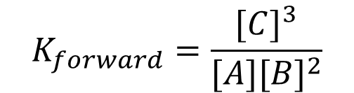
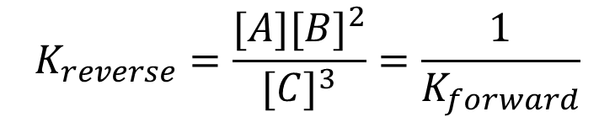
Chapter 5: Aqueous Solutions and acids-base equilibria
5.2. Equilibrium Constant (K) ثابت التوازن
Relationships between K and Chemical Equations
1-when the reaction is written backwards (reverse), the equilibrium constant is inverted
for the reaction:
A + 2B ⇔ 3C
the equilibrium constant expression is:
for the reaction:
3C ⇔ A + 2B
the equilibrium constant expression is:
$$K_{forward}=\frac{{[C]}^{3}}{{[A][B]}^{2}}$$
$$K_{reverse}=\frac{{[A][B]}^{2}}{{[C]}^{3}}=\frac{1}{K_{forward}}$$

Slide 10
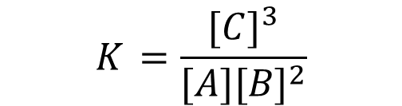
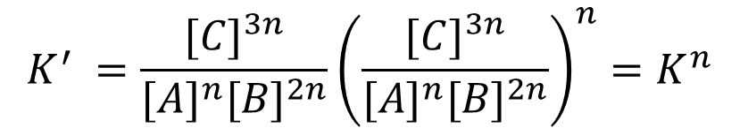
Chapter 5: Aqueous Solutions and acids-base equilibria
5.2. Equilibrium Constant (K) ثابت التوازن
Relationships between K and Chemical Equations
2-when the coefficients of an equation are multiplied by a factor, the equilibrium constant is raised to that factor.
for the reaction:
A + 2B ⇔ 3C
the equilibrium constant expression is:
for the reaction:
nA + n2B ⇔ 3nC
the equilibrium constant expression is:
$$K_{ }=\frac{{[C]}^{3}}{{[A][B]}^{2}}$$
$${K^{′}}_{ }=\frac{{[C]}^{3n}}{{{[A]}^{n}[B]}^{2n}}{\left(\frac{{[C]}^{3n}}{{{[A]}^{n}[B]}^{2n}}\right)}^{n}={K^{n}}_{ }$$

Slide 11

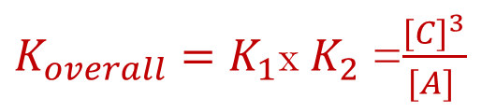

Chapter 5: Aqueous Solutions and acids-base equilibria
5.2. Equilibrium Constant (K) ثابت التوازن
Relationships between K and Chemical Equations
3-when you add equations to get a new equation, the equilibrium constant of the new equation is the product of the equilibrium constants of the old equations
for the reaction:
A ⇔ 2B
(2) 2B ⇔ 3C
$$K_{1}=\frac{{[B]}^{2}}{{[A]}^{ }}$$
$${K_{2}}_{ }=\frac{{[C]}^{3}}{{[B]}^{2}}$$
A ⇔ 3C
$K_{overall}=K_{1}$x${ K}_{2}$ =$\frac{{[C]}^{3}}{{[A]}^{ }}$

Slide 12
Example 5.1 P127: writing equilibrium expressions:
Chapter 5: Aqueous Solutions and acids-base equilibria
5.2. Equilibrium Constant (K) ثابت التوازن
CH₃OH(g) ⬄ CO(g) + 2H₂O(g)

Slide 13
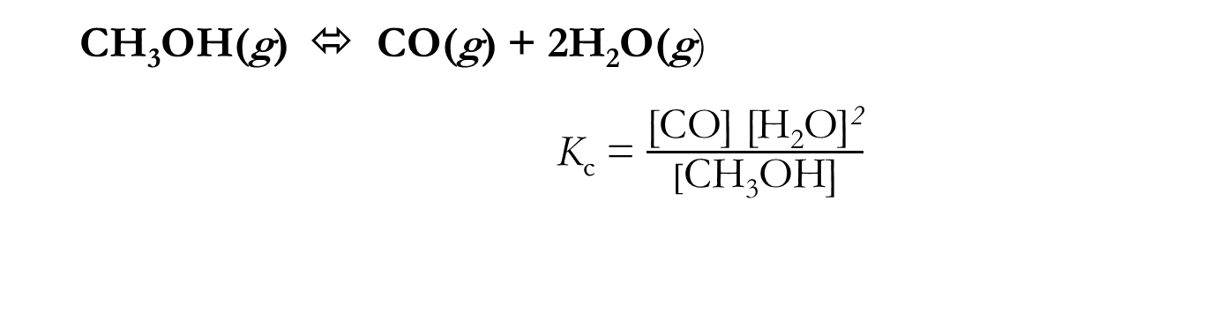
Example 5.1 P127: writing equilibrium expressions:
Chapter 5: Aqueous Solutions and acids-base equilibria
5.2. Equilibrium Constant (K) ثابت التوازن
CH₃OH(g) ⬄ CO(g) + 2H₂O(g)
  K_{c} = $\frac{\text{[}\text{CO}\text{] [}\text{H}\text{2}\text{O}\text{]}\text{2}}{[\text{CH}\text{3}\text{OH}\text{]}}$

Slide 14
Example: Writing Equilibrium Expressions
Chapter 5: Aqueous Solutions and acids-base equilibria
5.2. Equilibrium Constant (K) ثابت التوازن
2 COF₂(g) ⬄ CO₂(g) + CF₄(g)
C₃H₈(g) +5 O₂(g) ⬄ 3 CO₂(g) + 4H₂O(g)

Slide 15
Chapter 5: Aqueous Solutions and acids-base equilibria
5.3. Heterogeneous Equilibria
Because of concentration of solids and liquids don’t change, they not included in the equilibrium expression.
Example:
a A(s) + b B(aq) ⬄ c C(l) + d D(aq)
The equilibrium constant expression is:
Only equilibrium concentration (M) = K_{c}
or pressure (atm) = K_{p} values are used in an equilibrium expression.
K_{c} = [D]^{d}
[B]^{b}

Slide 16
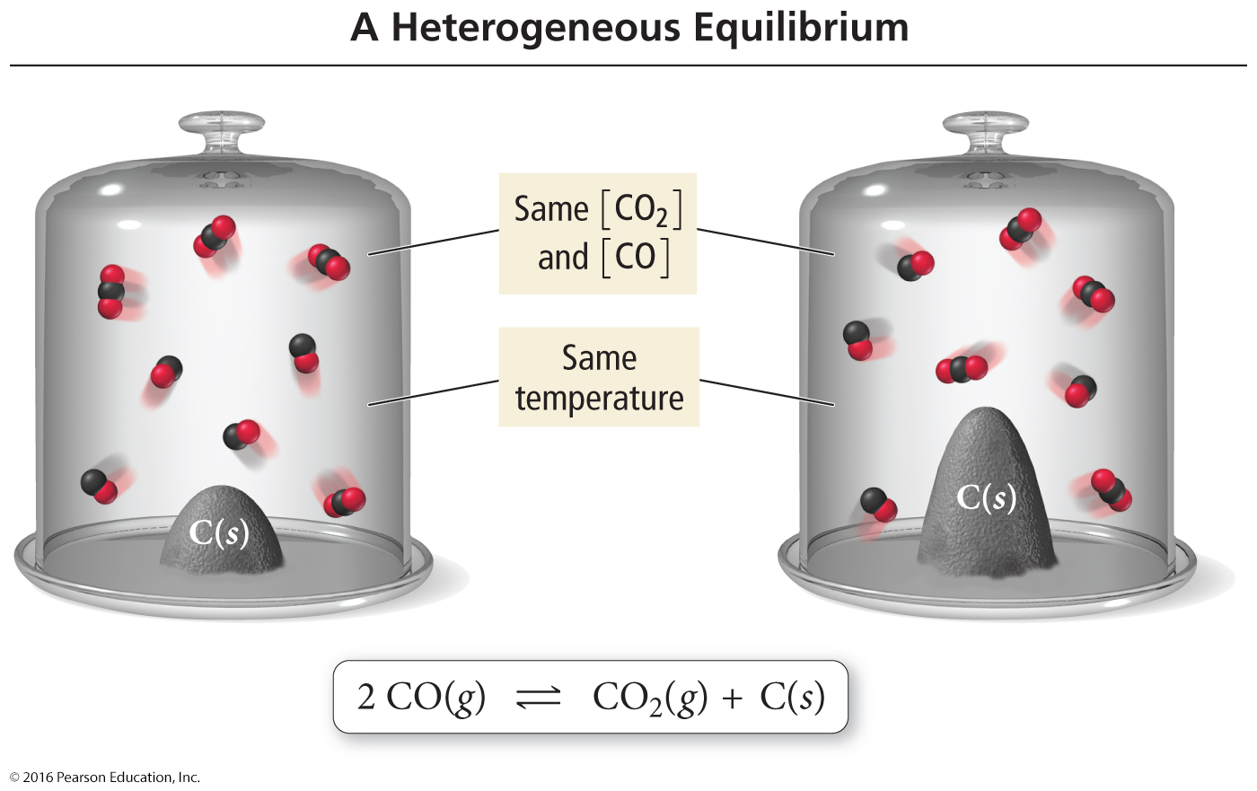
Chapter 5: Aqueous Solutions and acids-base equilibria
5.3. Heterogeneous Equilibria
K_{c} = [CO₂]/[CO]²

Slide 17
Example 5.2 p129 writing equilibrium expressions:
Chapter 5: Aqueous Solutions and acids-base equilibria
5.2. Equilibrium Constant (K) ثابت التوازن
CaCO₃(s) ⬄ CO₂(g) + CaO (s)

Slide 18
Example 5.2 p129 writing equilibrium expressions:
Chapter 5: Aqueous Solutions and acids-base equilibria
5.2. Equilibrium Constant (K) ثابت التوازن
CaCO₃(s) ⬄ CO₂(g) + CaO (s)
K_{c} = [CO₂]
CaCO₃ (s) and CaO (s)
لا تكتب في التعبير عن الاتزان لانهما صلبة

Slide 19

Chapter 5: Aqueous Solutions and acids-base equilibria
What Does the Equilibrium Constant Tell Us?
1. Predicting the Direction of a Reaction
K_{c} = 54.3 at 430 ºC.
Experiment: Inserting these initial concentration in the equilibrium constant expression!
Q_{c} > K_{c}
→ The concentration of the product should decreases
→ Reaction will proceed from right to left
Reaction Quotient Q_{c}
0.243 mol H₂ + 0.146 mol I₂ → 1.98 mol HI
Volume = 1 L

Slide 20
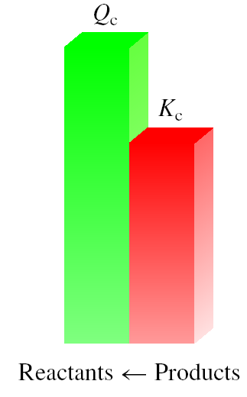
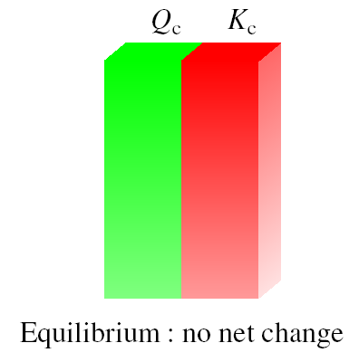
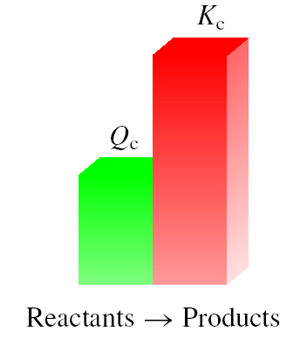
Chapter 5: Aqueous Solutions and acids-base equilibria
What Does the Equilibrium Constant Tell Us?
Reaction quotient (Q_{c}): is calculated by substituting the initial concentrations of the reactants and products into the equilibrium constant (K_{c}) expression.
IF
  Q_{c} > K_{c} system proceeds from right to left to reach equilibrium
  Q_{c} = K_{c} the system is at equilibrium
  Q_{c} < K_{c} system proceeds from left to right to reach equilibrium

Slide 21
Chapter 5: Aqueous Solutions and acids-base equilibria
What Does the Equilibrium Constant Tell Us?
2. Calculating Equilibrium Concentrations
Example:
Calculate the equilibrium constant K_{c} for the reaction:
If concentrations of [H₂]=0.11 M, I₂ [I₂]=0.11 M and [HI]=0.78M.

Slide 22
Chapter 5: Aqueous Solutions and acids-base equilibria
What Does the Equilibrium Constant Tell Us?
2. Calculating Equilibrium Concentrations
Example:
Calculate the equilibrium constant K_{c} for the reaction:
If concentrations of [H₂]=0.11 M, I₂ [I₂]=0.11 M and [HI]=0.78M.

Slide 23
Chapter 5: Aqueous Solutions and acids-base equilibria
5.6. Le Châtelier’s Principle:
A system at equilibrium can be altered by changes in:
temperature
concentration (M)
Volume (or pressure)
Change any factor may change the position or value of K, or it may has no effect.
Le Châtelier’s principle:
  If a system at equilibrium is then disturbed, the system will shift its equilibrium position to counter the effect of the disturbance.
  عندما نؤثر بمؤثر خارجي على نظام في حالة اتزان, فان النظام سوف يعدل من نفسه لكي يعوض التاثير الحاصل وبتالي يصل الى حالة الاتزان مره اخرى.

Slide 24


Chapter 5: Aqueous Solutions and acids-base equilibria
5.6. Le Châtelier’s Principle:
1- Concentration Effects
Equilibrium shifts left to offset stress
Add
NH₃
Change
Shifts the Equilibrium
Increase concentration of product(s)
left
Decrease concentration of product(s)
right
Increase concentration of reactant(s)
right
Decrease concentration of reactant(s)
left
THUS: Concentration effect the position and not the value of K

Slide 25
Chapter 5: Aqueous Solutions and acids-base equilibria
5.6. Le Châtelier’s Principle:
1- Concentration Effects
Summary
Factor |  | The direction of equilibrium | Note
The effect of Concentration | a) Increase of [reactant] | → | Change the position of K
 | b) Decrease of [reactant] | ←
 | C) Increase of [product] | ←
 | D) Decrease of [product] | →
 | E) Addition of external substance
 | (i) If it reacts with reactant | ←
 | (ii) If it reacts with product | →

Slide 26
Chapter 5: Aqueous Solutions and acids-base equilibria
5.6. Le Châtelier’s Principle:
1- Concentration Effects
Example: 5.3 p132
a)What is the effect of adding additional CO₂ to reaction?
b)What is the effect of adding additional CaCO₃
CaCO₃(s) ⬄ CO₂(g) + CaO (s)

Slide 27
Chapter 5: Aqueous Solutions and acids-base equilibria
5.6. Le Châtelier’s Principle:
1- Concentration Effects
Example: 5.3 p132
a)What is the effect of adding additional CO₂ to reaction?
b)What is the effect of adding additional CaCO₃
CaCO₃(s) ⬄ CO₂(g) + CaO (s)
adding additional CO₂ → Increase concentration of CO₂ → Shifts the Equilibrium to left
adding additional CaCO₃ → doesn’t Increase concentration of CaCO₃ → Equilibrium not change
لا يتغير لانه مادة صلبة CaCO₃تركيز

Slide 28
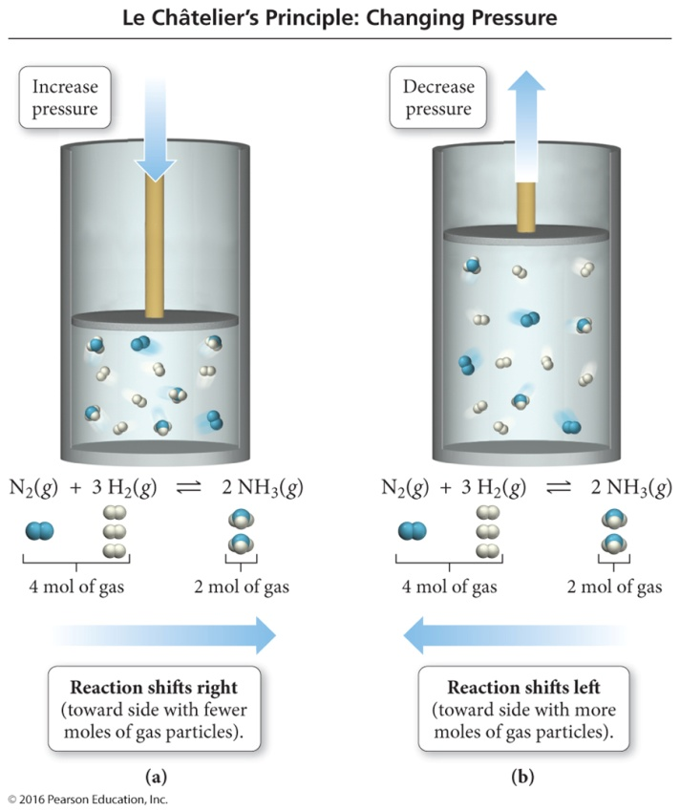
2- Pressure Effects
Chapter 5: Aqueous Solutions and acids-base equilibria
5.6. Le Châtelier’s Principle:
Change
Shifts the Equilibrium
Increase pressure
(decrease in volume)
Side with less moles of gas
Decrease pressure
(increase in volume)
Side with more moles of gas
Pressure α 1/volume
تناسب عكسي
THUS: Pressure effect the position and not the value of K
Volume has the opposite effect of pressure

Slide 29
2- Pressure Effects
Chapter 5: Aqueous Solutions and acids-base equilibria
5.6. Le Châtelier’s Principle:
Effect of Pressure (Only gases): summary*
Factor |  | The direction of equilibrium | Note
The effect of Pressure | 1. Δn > 0 |  | Change the position of K
 | (a) Increase of total pressure | ←
 | (b) Decrease of total pressure | →
 | 2. Δn < 0
 | (a) Increase of total pressure | →
 | (b) Decrease of total pressure | ←
* Volume effects reverse the impact of pressure

Slide 30
3- Temperature Effects
Chapter 5: Aqueous Solutions and acids-base equilibria
5.6. Le Châtelier’s Principle:
Temperature increase favour the endothermic reaction (ΔH = +ve)
Temperature decrease favours an exothermic reaction (ΔH = -ve)
Change
Exothermic Rx
Endothermic Rx
Increase temperature
K decreases
K increases
Decrease temperature
K increases
K decreases

Slide 31
3- Temperature Effects
Chapter 5: Aqueous Solutions and acids-base equilibria
5.6. Le Châtelier’s Principle:
SUMMARY
Factor |  | The direction of equilibrium | Note
The effect of Temperature | 1. Endothermic ΔH > 0 (+ve) |  | Change the position & value of K
 | (a) Increase of temp | →
 | (b) Decrease of temp | ←
 | 2. Exothermic ΔH < 0 (-ve)
 | (a) Increase of temp | ←
 | (b) Decrease of temp | →

Slide 32
H.W
7 P 147
17 P 148
Chapter 5: Aqueous Solutions and acids-base equilibria

Slide 33
Chapter 5: Aqueous Solutions and acids-base equilibria
5.7 The nature of Acids and bases
General
Acid Properties
General
Base Properties
Sour taste (ذات مذاق حامضي)
React with “active” metals
  Examples: Al, Zn, Fe, but not Cu, Ag, or Au
React with carbonates CO₃, producing CO₂
Blue litmus turns red.
React with bases to form ionic salts
Also known as alkalis
Taste bitter (ذات مذاق مر)
  Alkaloids: plant product that is alkaline
    Often poisonous (سامة)
Solutions feel slippery to touch.
Red litmus turns blue.
React with acids to form ionic salts

Slide 34
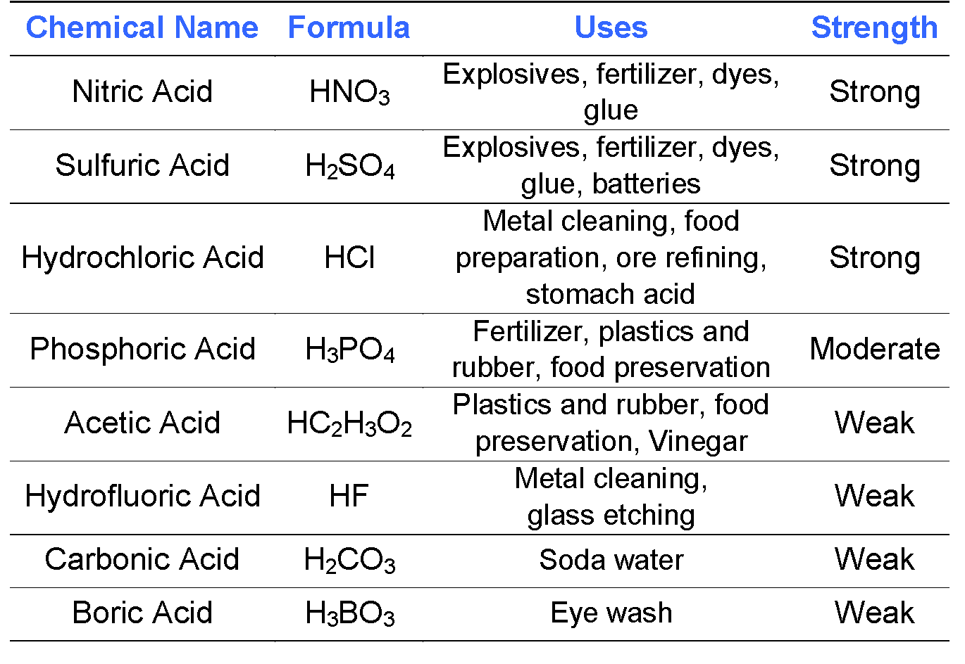
Common Acids
Chapter 5: Aqueous Solutions and acids-base equilibria
5.7 The nature of Acids and bases

Slide 35
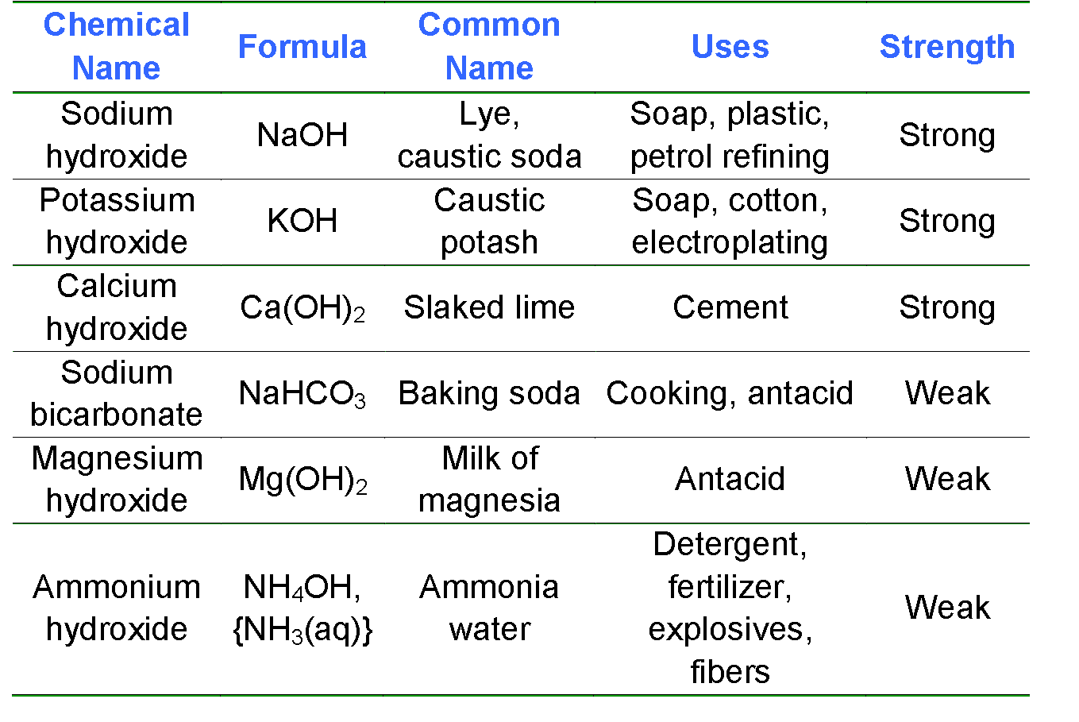
Common Bases
Chapter 5: Aqueous Solutions and acids-base equilibria
5.7 The nature of Acids and bases

Slide 36
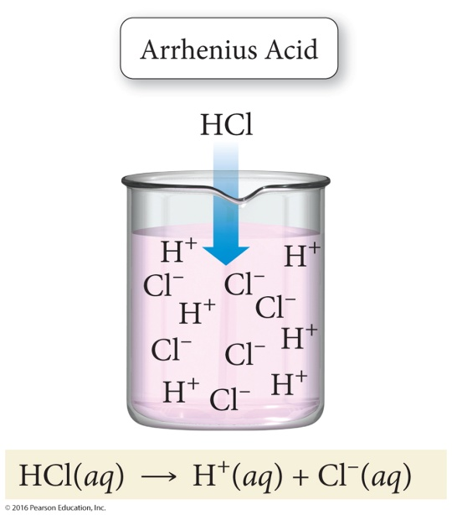
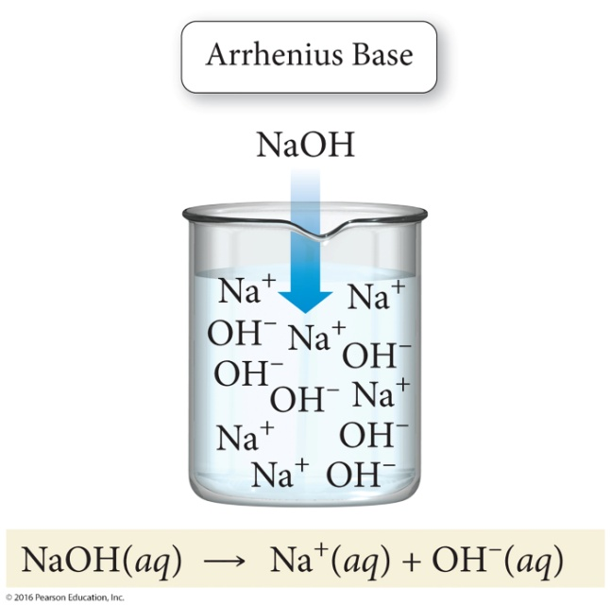
1-arrhenius Definition:
Chapter 5: Aqueous Solutions and acids-base equilibria
5.8 Definition of Acids and bases
What is an acid?
  Acids ionize in water to produce H⁺ ions and anions.
HCl(aq) → H⁺(aq) + Cl⁻(aq)
CH₃CO₂H(aq) → H⁺(aq) + CH₃CO₂⁻(aq)
What is a base?
  Bases dissociate in water to produce OH⁻ ions and cations.
NaOH(aq) → Na⁺(aq) + OH⁻(aq)

Slide 37
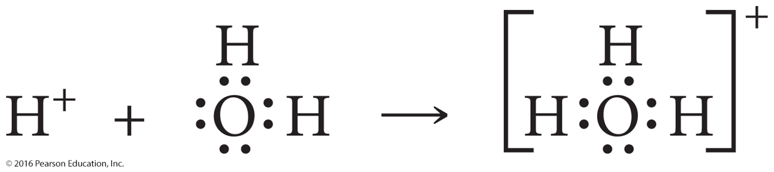
What Is a Hydronium Ion?
Chapter 5: Aqueous Solutions and acids-base equilibria
5.8 Definition of Acids and bases
Hydrogen ions, H⁺ (protons), when produced by an acid, are very reactive.
  Hydrogen ions do not exist in water as H⁺ ions but as H₃O⁺ (hydronium) ions.
H⁺ + H₂O(l) → H₃O⁺

Slide 38
2- Brønsted–lowry Definition
Chapter 5: Aqueous Solutions and acids-base equilibria
5.8 Definition of Acids and bases
The Brønsted–Lowry definition is the most general theory for common aqueous acids and bases.
What is an acid according to the Brønsted–Lowry definition?
  Acids are species that donate H⁺ ions.
    Similar to the definition presented in the Arrhenius theory
What is a base according to the Brønsted–Lowry definition?
  Bases are species that accept H⁺ ions.
    This broadens the Arrhenius definition for a base.
  The Brønsted–Lowry theory answers questions about nonhydroxide bases that the Arrhenius theory can not explain.

Slide 39
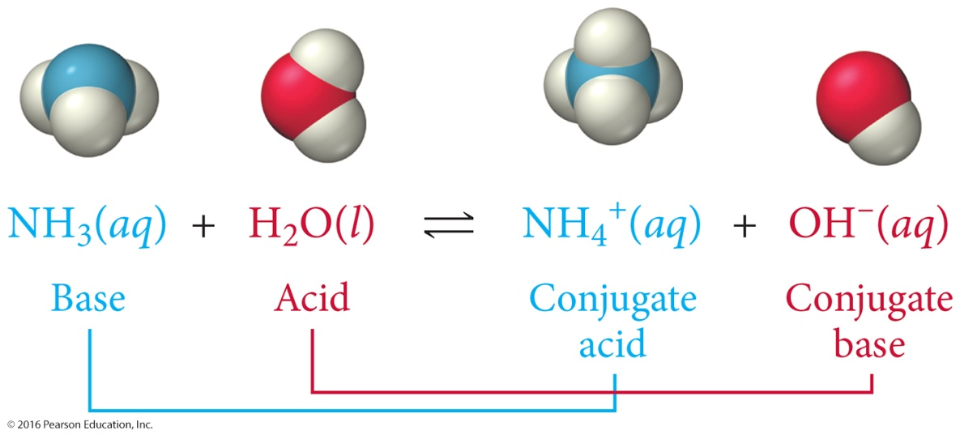
Chapter 5: Aqueous Solutions and acids-base equilibria
5.8 Definition of Acids and bases
2- Brønsted–lowry Definition
Ammonia, NH₃ is a base in water.
Water behaves as an acid species.
In an acid–base reaction,
  the original base picks up a hydrogen ion and becomes a conjugate acid in the reverse reaction,
  the original acid loses a hydrogen ion to form a conjugate base.

Slide 40
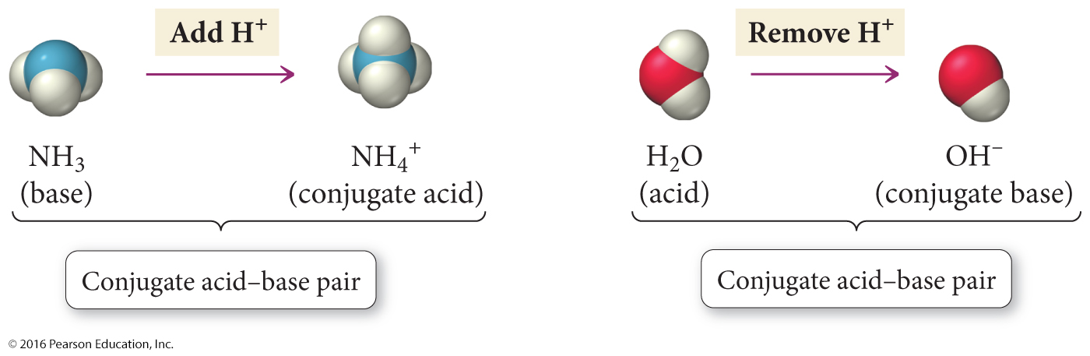
Chapter 5: Aqueous Solutions and acids-base equilibria
5.8 Definition of Acids and bases
2- Brønsted–lowry Definition
Conjugate pairs
  NH₃/NH₄⁺ is a weak base/conjugate acid pair.
  H₂O/OH⁻ is a weak acid/conjugate base pair.
  Conjugate acid–base pairs are related to each other by either the gain or the loss of an H⁺ ion.
  Every acid has a conjugate base and every base has a conjugate acid.

Slide 41
Example 5.4 p137: identify the brønsted-lowry acids and bases, and their conjugates, in the reaction
Chapter 5: Aqueous Solutions and acids-base equilibria
5.8 Definition of Acids and bases
2- Brønsted–lowry Definition
H₂SO₄ + H₂O ⇔ HSO₄– + H₃O⁺

Slide 42
Example 5.4 p137: identify the brønsted-lowry acids and bases, and their conjugates, in the reaction
Chapter 5: Aqueous Solutions and acids-base equilibria
5.8 Definition of Acids and bases
2- Brønsted–lowry Definition
H₂SO₄ + H₂O ⇔ HSO₄– + H₃O⁺
H₂SO₄ + H₂O ⇔ HSO₄– + H₃O⁺
acid base conjugate base conjugate acid
When the H₂SO₄ becomes HSO₄⁻, it loses an H⁺ so H₂SO₄ must be the acid and HSO₄⁻ its conjugate base.
When the H₂O becomes H₃O⁺, it accepts an H⁺ so H₂O must be the base and H₃O⁺ its conjugate acid.

Slide 43
Example 5.4 p137: identify the brønsted-lowry acids and bases, and their conjugates, in the reaction
Chapter 5: Aqueous Solutions and acids-base equilibria
5.8 Definition of Acids and bases
2- Brønsted–lowry Definition
HCO₃– + H₂O ⇔ H₂CO₃ + HO–

Slide 44
Example 5.4 p137: identify the brønsted-lowry acids and bases, and their conjugates, in the reaction
Chapter 5: Aqueous Solutions and acids-base equilibria
5.8 Definition of Acids and bases
2- Brønsted–lowry Definition
HCO₃– + H₂O ⇔ H₂CO₃ + HO–
HCO₃– + H₂O ⇔ H₂CO₃ + HO–
base acid conjugate acid conjugate base
When the HCO₃⁻ becomes H₂CO₃, it accepts an H⁺ so HCO₃⁻ must be the base and H₂CO₃ its conjugate acid
When the H₂O becomes OH⁻, it donats an H⁺ so H₂O must be the acid and OH⁻ its conjugate base

Slide 45
Problem:
Write the formulas for the conjugate acid for the following.
Chapter 5: Aqueous Solutions and acids-base equilibria
5.8 Definition of Acids and bases
النشاط 3
a. H₂O
b. NH₃
c. CO₃²⁻
d. H₂PO₄⁻
e. F⁻

Slide 46
Problem: write the formula for the conjugate base for each of the following.
Chapter 5: Aqueous Solutions and acids-base equilibria
5.8 Definition of Acids and bases
H₂O
NH₃
c. CO₃²⁻
d. H₂PO₄⁻
e. CH₃COOH

Slide 47
Problem: write the formula for the conjugate base for each of the following.
Chapter 5: Aqueous Solutions and acids-base equilibria
5.8 Definition of Acids and bases
a. H₂O OH⁻
b. NH₃ NH₂⁻
c. CO₃²⁻ Since CO₃²⁻ does not have an H, it cannot be an acid.
d. H₂PO₄⁻ HPO₄²⁻
e. CH₃COOH CH₃COO⁻

Slide 48
Acid and Base Strength
Chapter 5: Aqueous Solutions and acids-base equilibria
5.9 Acid strength
Acids and bases can be classified depending on their ability to dissociate in water:
strong
Weak
completely dissociate (ionize)in water.
تأين(تفكك) تام في الماء
partially dissociate (ionize) in water
تأين (تفكك) جزئي في الماء

Slide 49
Acid and Base Strength
Chapter 5: Aqueous Solutions and acids-base equilibria
5.9 Acid and base strength
1-Strong Acid and base
Complete (~100%) dissociation in water
  Strong electrolyte
Acid
HNO₃(aq) + H₂O(l) → H₃O⁺+ NO₃⁻
Base
NaOH(aq) → OH⁻ + Na⁺
Ca(OH)₂(aq) → 2 OH⁻ + Ca²⁺
Strong Acid
Strong base

Slide 50
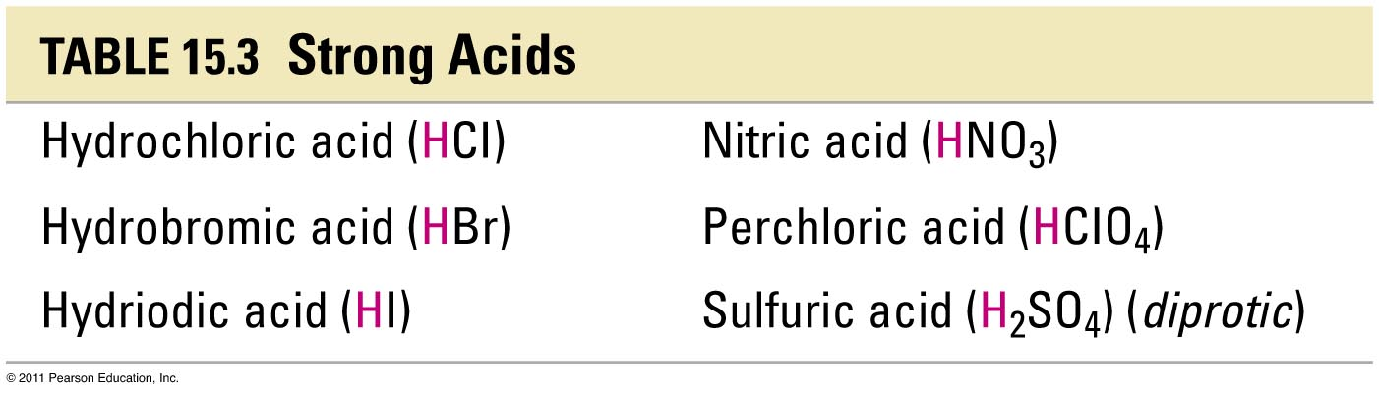
Acid and Base Strength
Chapter 5: Aqueous Solutions and acids-base equilibria
5.9 Acid strength

Slide 51
Acid and Base Strength
Chapter 5: Aqueous Solutions and acids-base equilibria
5.9 Acid and base strength
2-Weak Acid and base
Partial (≤ 5%) dissociation in water
  Weak electrolyte
Acid
Base
NH₃(aq) + H₂O(l) ⬄ NH₄⁺ + OH⁻
Weak Acid
Weak base

Slide 52
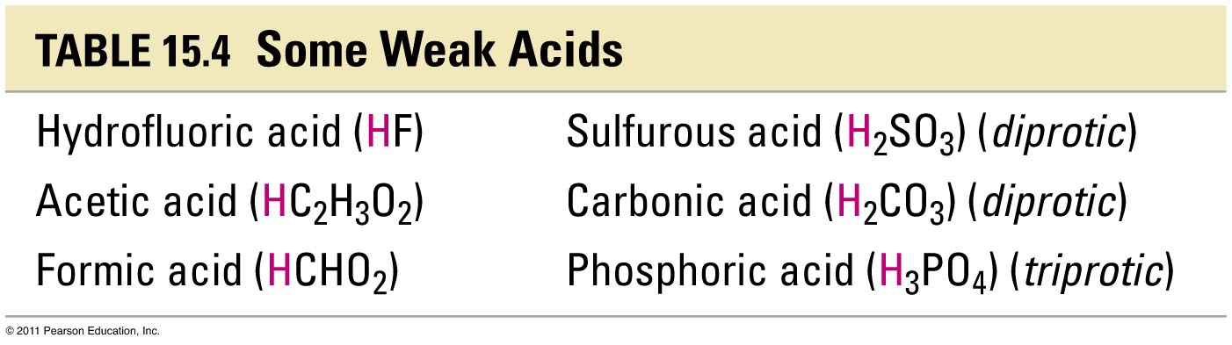
Acid and Base Strength
Chapter 5: Aqueous Solutions and acids-base equilibria
5.9 Acid strength

Slide 53
Acid and Base Strength
Chapter 5: Aqueous Solutions and acids-base equilibria
5.9 Acid strength-The pH scale –
pH of a solution: is the negative logarithm of the hydrogen ion concentration.
In the same manner
In the same manner

Slide 54
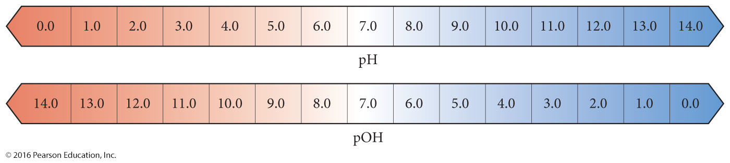
Acid and Base Strength
Chapter 5: Aqueous Solutions and acids-base equilibria
5.9 Acid strength-The pH scale -
Normal range is 0 to 14.
pH < 7
is acidic;
pH = 7
is neutral.
pH > 7
is basic;
Notes:
pH values can be negative (very acidic) or greater than 14 (very alkaline).

Slide 55
Acid and Base Strength
Chapter 5: Aqueous Solutions and acids-base equilibria
5.9 Acid strength-The pH scale -
Example 5.5 P141:
calculate pH of each solution at 25C and indicate whether the solution is acidic or basic.
[H₃O⁺]= 1.8 x 10⁻⁴ M
[OH⁻]= 1.3X10⁻²M
Solution:
(a)

Slide 56
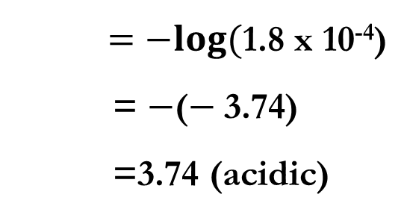
Acid and Base Strength
Chapter 5: Aqueous Solutions and acids-base equilibria
5.9 Acid strength-The pH scale -
Example 5.5 P141:
calculate pH of each solution at 25C and indicate whether the solution is acidic or basic.
[H₃O⁺]= 1.8 x 10⁻⁴ M
[OH⁻]= 1.3X10⁻²M
Solution:
(a)
$=−log(\text{1.8 }\text{x} \text{10}\text{−}\text{4}$)
= $−$($−$3.74)
=3.74 (acidic)

Slide 57
Acid and Base Strength
Chapter 5: Aqueous Solutions and acids-base equilibria
5.9 Acid strength-The pH scale -
Example 5.5 P141:
calculate pH of each solution at 25C and indicate whether the solution is acidic or basic.
[H₃O⁺]= 1.8 x 10⁻⁴ M
[OH⁻]= 1.3X10⁻²M
Solution:
(b)

Slide 58
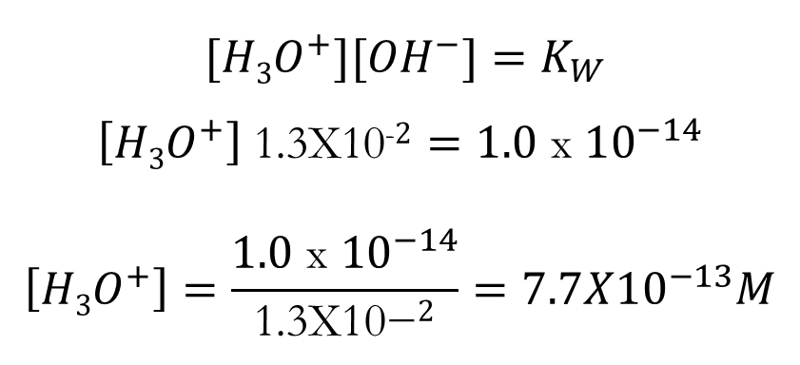
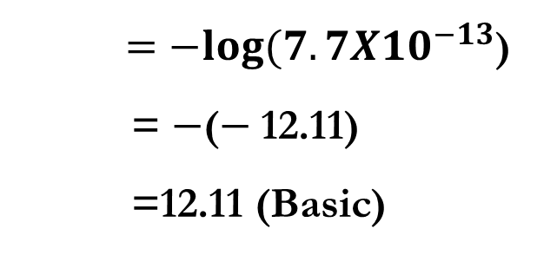
Acid and Base Strength
Chapter 5: Aqueous Solutions and acids-base equilibria
5.9 Acid strength-The pH scale -
Example 5.5 P141:
calculate pH of each solution at 25C and indicate whether the solution is acidic or basic.
[H₃O⁺]= 1.8 x 10⁻⁴ M
[OH⁻]= 1.3X10⁻²M
Solution:
(b)
$$[{H3O}^{+}]{[OH}^{−}]=K_{W}$$
$$\left[{H3O}^{+}\right] \text{1}\text{.}\text{3}\text{X}\text{10}\text{−}2=1.0 \text{x} {10}^{−14}$$
$$\left[{H3O}^{+}\right]=\frac{1.0 \text{x} {10}^{−14}}{\text{1}\text{.}\text{3}\text{X}\text{10}\text{−}2}=7.7X{10}^{−13}M$$
$=−log(7.7X{10}^{−13}$)
= $−$($−$12.11)
=12.11 (Basic)

Slide 59
Acid and Base Strength
Chapter 5: Aqueous Solutions and acids-base equilibria
5.9 Acid strength-The pH scale -
Example:
If the [H⁺] = 3.2 x 10^{–4} M. What is the pH ?.
Solution:

Slide 60
Acid and Base Strength
Chapter 5: Aqueous Solutions and acids-base equilibria
5.9 Acid strength-The pH scale -
Example:
If the [H⁺] = 3.2 x 10^{–4} M. What is the pH ?.
Solution:
THUS: pH is inversely proportional to [H⁺]

Slide 61
Acid and Base Strength
Chapter 5: Aqueous Solutions and acids-base equilibria
5.9 Acid strength-The pH scale -
Example 5.6 P141:
calculate H₃O⁺ concentration with pH 4.80
Solution:

Slide 62
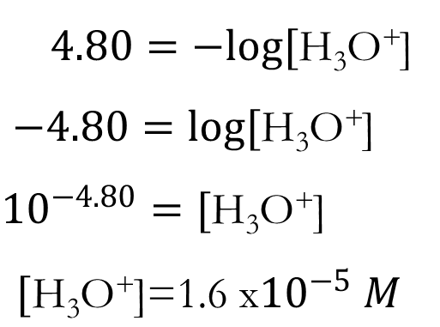
Acid and Base Strength
Chapter 5: Aqueous Solutions and acids-base equilibria
5.9 Acid strength-The pH scale -
Example 5.6 P141:
calculate H₃O⁺ concentration with pH 4.80
Solution:
In the calculator:
Press SHEFT + log button then (-ve ) value ( 4.80) then = button
$4.80=−log[\text{H}\text{3}\text{O}\text{+}$]
$−4.80=log[\text{H}\text{3}\text{O}\text{+}$]
$${10}^{−4.80}=[\text{H}\text{3}\text{O}\text{+}\text{]}$$
$$[\text{H}\text{3}\text{O}\text{+}\text{]}\text{=}\text{1}\text{.}\text{6 }\text{x}{10}^{−5} M$$
ضرب الطرفين في اشارة سالب ←
التخلص من اللوغريتم←
(Shift+log)

Slide 63
Acid and Base Strength
Chapter 5: Aqueous Solutions and acids-base equilibria
5.9 Acid strength-The pH scale -
Example:
The pH = 4.82 , What is the [H⁺] of the rain water.

Slide 64
Acid and Base Strength
Chapter 5: Aqueous Solutions and acids-base equilibria
5.9 Acid strength-The pH scale -
Example:
The pH = 4.82 , What is the [H⁺] of the rain water.
Solution:
In the calculator:
Press SHEFT + log button then (-ve ) value ( 4.82) then = button

Slide 65
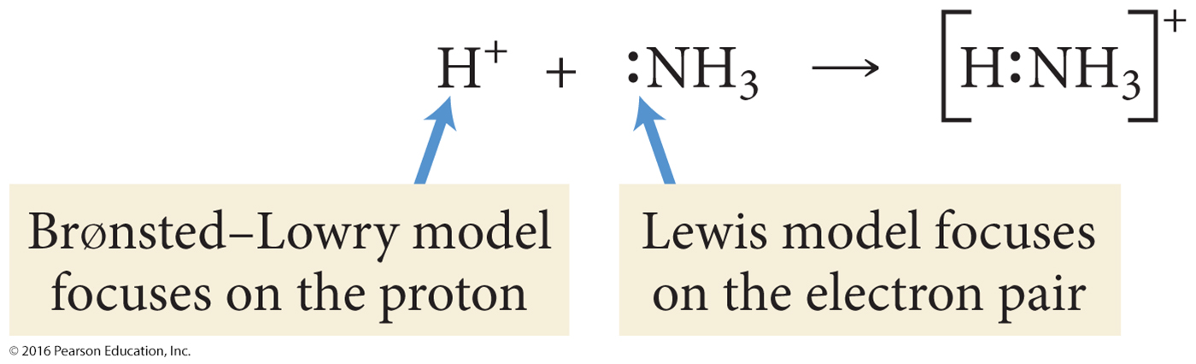
Lewis Acid And Bases: The Focus Is On The Electron Pair
Acid and Base Strength
Chapter 5: Aqueous Solutions and acids-base equilibria
5.12 Lewis acids and bases
Lewis acid–base theory focuses on transferring an electron pair and not a hydrogen atom.
A Lewis acid is a substance that accepts an electron pair.
A Lewis base is a substance that donates an electron pair.
A new bond formed using an electron pair from the Lewis base is referred to as a covalent bond.

Slide 66
Acid and Base Strength
Chapter 5: Aqueous Solutions and acids-base equilibria
5.12 Lewis acids and bases
Formation of hydronium ion is also an excellent example.
The electron pair of the new O—H bond originated on the Lewis base (water).

Slide 67
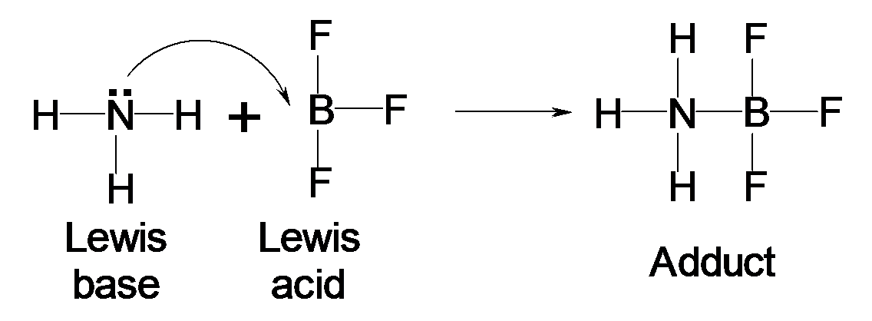
Acid and Base Strength
Chapter 5: Aqueous Solutions and acids-base equilibria
5.12 Lewis acids and bases
The Lewis base donates a pair of electrons to the Lewis acid.
Generally, this donation results in the formation of a covalent bond.
  H₃N: + BF₃ → H₃N─BF₃
  The product that forms is referred to as an adduct (H₃N─BF₃).

Slide 68
H.W
19, 24 P 148
39 P 149
Chapter 5: Aqueous Solutions and acids-base equilibria

Slide 69
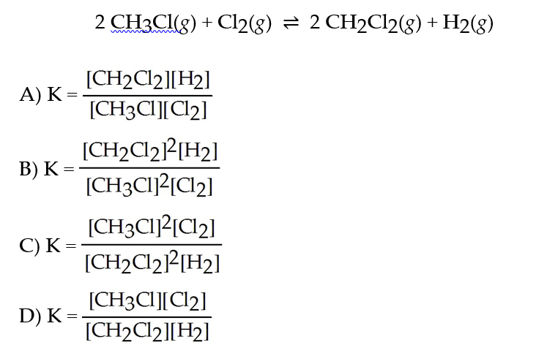
Acid and Base Strength
Chapter 5: Aqueous Solutions and acids-base equilibria
Review
1) Give the direction of the reaction, if K >> 1.
A) The forward reaction is favored.
B) The reverse reaction is favored.
C) Neither direction is favored.
D) If the temperature is raised, then the forward reaction is favored.
2) Express the equilibrium constant for the following reaction.

Slide 70
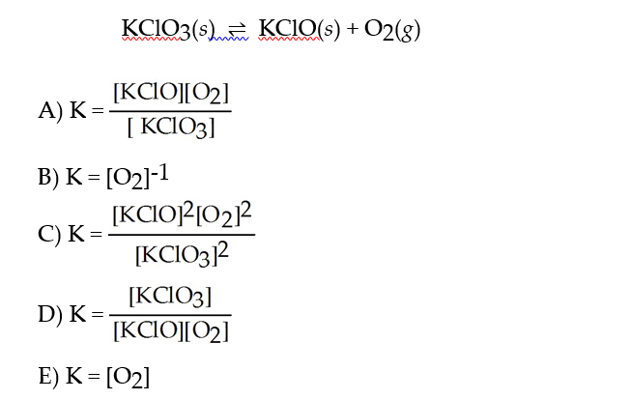
Acid and Base Strength
Chapter 5: Aqueous Solutions and acids-base equilibria
3) Express the equilibrium constant for the following reaction.

Slide 71
Acid and Base Strength
Chapter 5: Aqueous Solutions and acids-base equilibria
4) Which is the definition of Arrhenius acid?
A) a substance that produces H+ ions in aqueous solution
B) a substance that produces OH- ions in aqueous solution
C) a substance that is a proton donor
D) a substance that is a proton acceptor
5) Which is the definition of Lewis base? A Lewis acid is
A) an electron pair donor
B) an electron pair acceptor
C) a proton donor
D) proton acceptor
6) What is the pH of pure water at 40.0°C if the Kw at this temperature is 2.92 × 10-14?
A) 6.767
B) 0.465
C) 7.000
D) 7.233

