Slide 1
Printing Processes
Binder Printing
Direct Printing

Slide 2
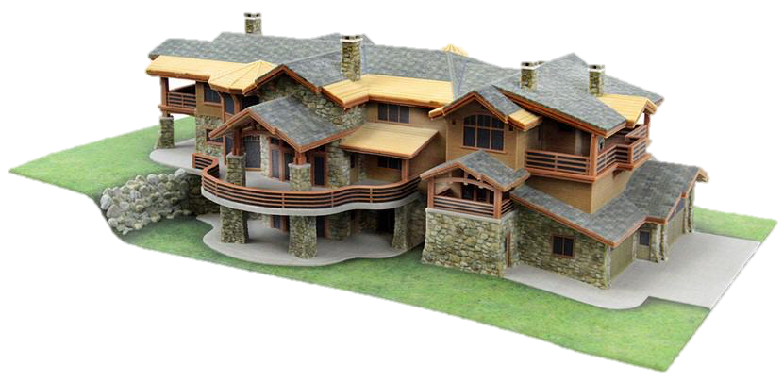
Binder Printing (Binder Jetting Technology)
Binder printing refers to a broad class of processes where binder or other additive is printed onto a powder bed which forms the bulk of the part.
Aqueous Solution
Excess of powder
Binder print head
roller
Building Platform
Powder Supply
Plan view

Slide 3
Binder Printing
(Binder Jetting Technology)
Nature of the raw material | Powder
Final Product | Metal, Ceramics, plaster , Plastic, food like powder.
Advantages | Disadvantages
The variety of materials can be printed with this technology | Compared to FDM technology, this technique is expensive.
A full color model can be printed with this technology | This technique require a qualified technician to operate it.

Slide 4
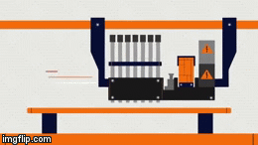
Direct Printing (PolyJet Technology)
Direct printing refers to processes where all of the part material is dispensed from a print head.
Nature of the raw material | Liquid (Resin)
Final Product | Plastic

Slide 5
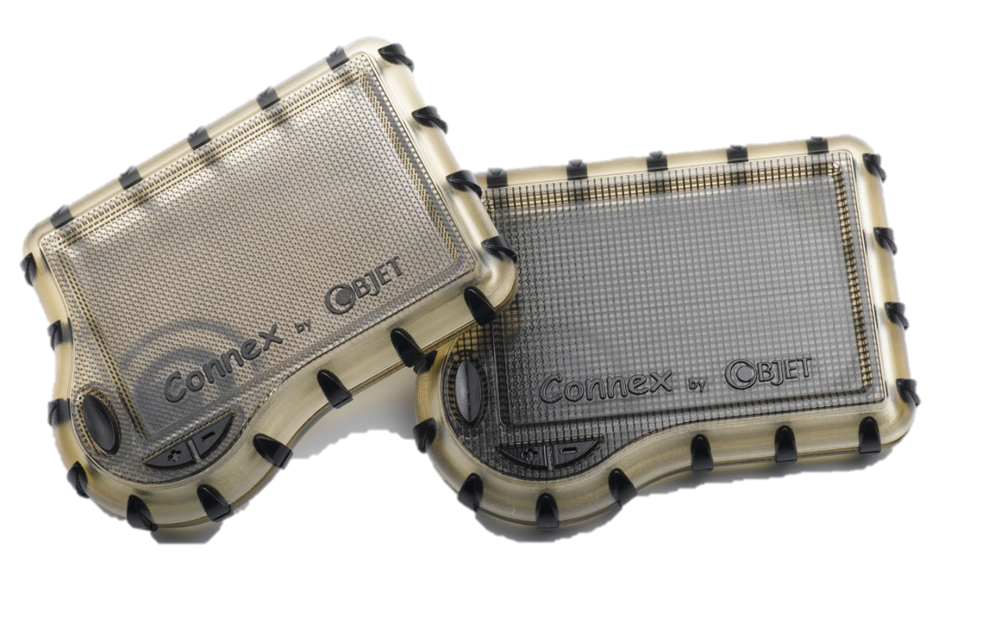
Direct Printing (PolyJet Technology)
Advantages | Disadvantages
High precision products | The required post-processing steps are not simple.
It can print a product including different materials with varied textures and colors. | High cost of printing

Slide 6
Droplet Formation Technologies
Drop-on-Demand Mode
Continuous Mode

Slide 7
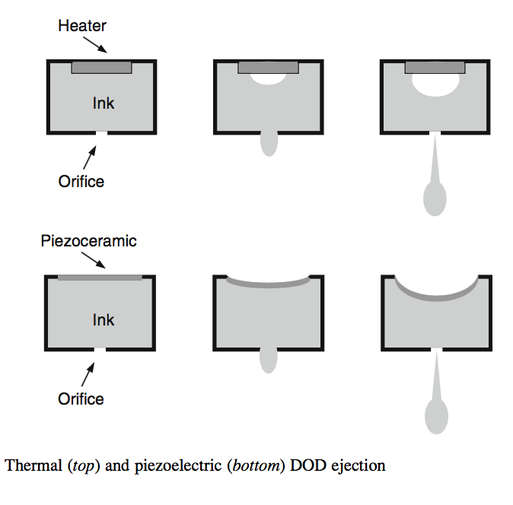
Drop-on-Demand Mode
In DOD mode, individual droplets are produced directly from the nozzle.
Droplets are formed only when individual pressure pulses in the nozzle cause the fluid to be expelled.
These pressure pulses are created at specific times by thermal or piezoelectric.

Slide 8
Continuous Mode
In Continuous Mode, a steady pressure is applied to the fluid reservoir, causing a pressurized column of fluid to be ejected from the nozzle.

Slide 9
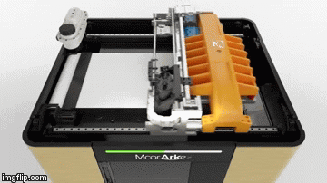
Selective Deposition Lamination (SDL)&LAMINATED OBJECT MANUFACTURING(LOM)
Nature of the raw material | Paper, Metal sheets
Final Product | Metal, Paper.

Slide 10
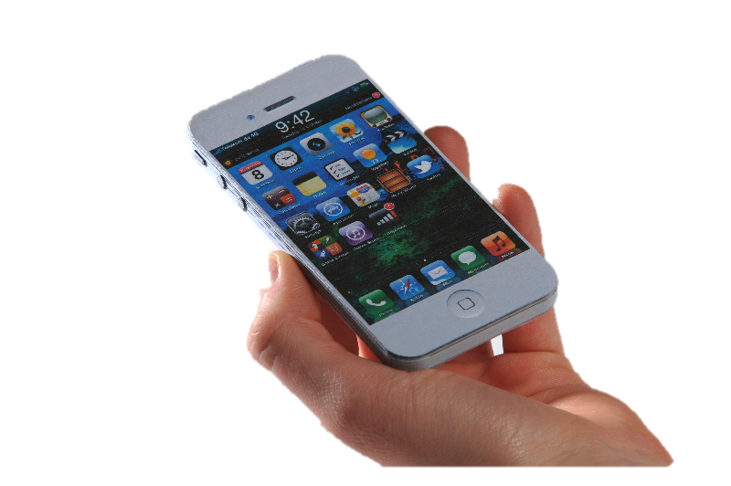
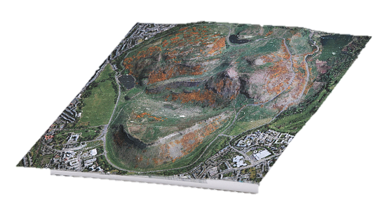
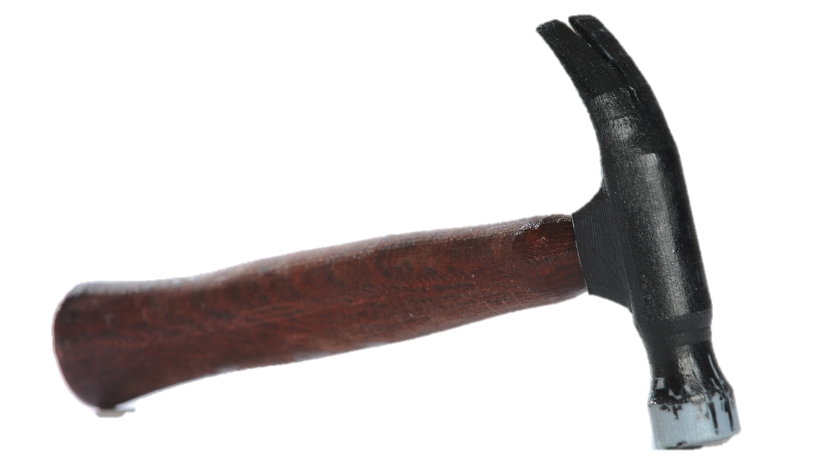
Selective Deposition Lamination (SDL)
Advantages | Disadvantages
Eco-friendly | Produced Models are not strong and mostly use for display.
Full color model | Cleaning the support material is difficult job.

