Slide 1
Lab Exercise # 10
Zoo- 145
Anatomy of Rat
External Morphological Features and the Digestive System of the rat, Rattus norvegicus

Slide 2
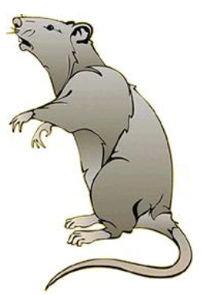
Lab Exercise # 10
Zoo- 145
The classification of the Rat (Rattus norvegicus)
Phylum: Chordata
Subphylum: Vertebrata
Class: Mammalia
Order: Rodentia
Family: Muridae
Genus: Rattus
Species: norvegicus

Slide 3
BODY
Head Neck Trunk Tail
Mouth
External nares
Semicircular movement of head
A pair of eyes, Each eye is covered with two eye lids
A pair of External Ears (Pinnae)
Few Extra sensitive hair on upper lip are named as vibrissae.
Thorax Abdomen
A pair of fore arms
A pair of hind arms
External genitalia penis and scrotum in males and vulva in females

Slide 4
Lab Exercise # 10
Zoo- 145
The body of the rat is covered with a thick sheath of hair and mouth of the rat is bound by two mobile lips whilst lower lip bifurcated or is cut in two halves.
The external ears are called pinnae.
On the ventral side of female rat, the trunk or abdomen the teats are protruded out of the mammary glands and used to nurse the new born babies
The different parts with their respective locations are listed blow:

Slide 5
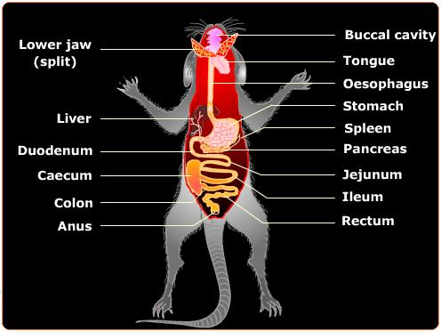

Slide 6
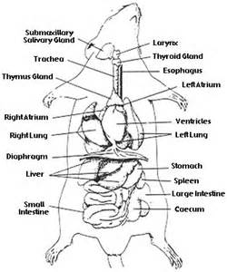

Slide 7
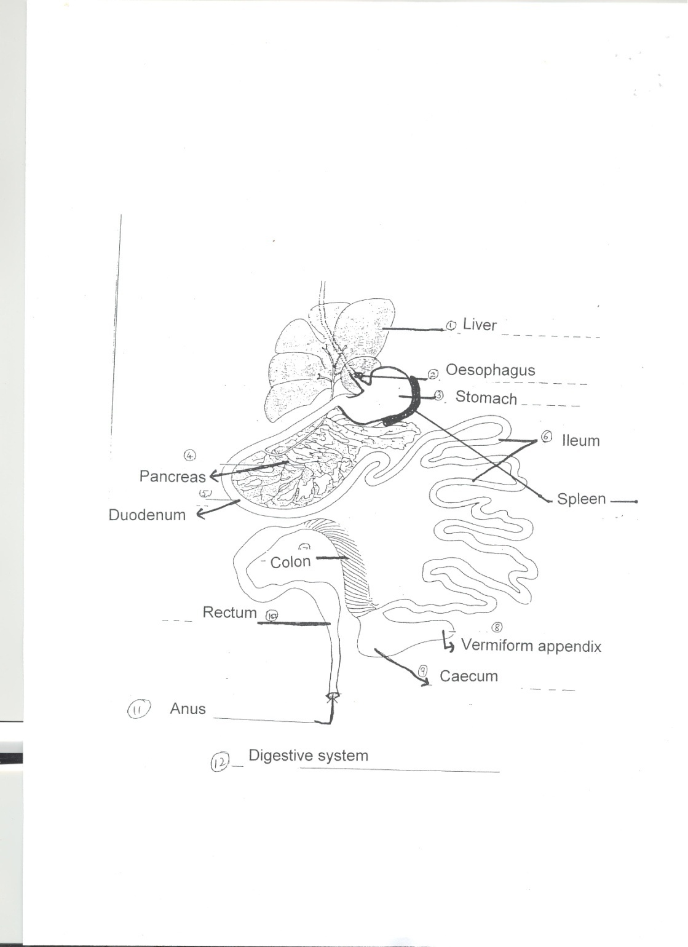

Slide 8
Incision lines for dissection of the rat.

