Slide 1


Slide 2
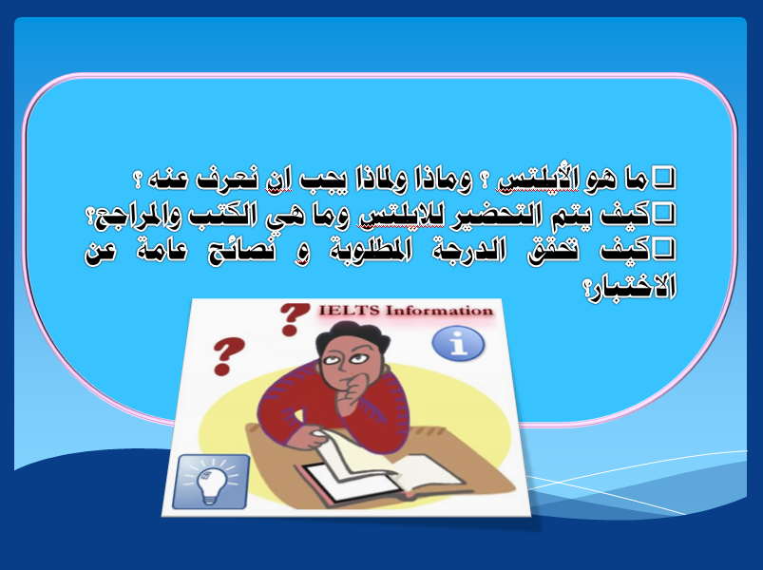

Slide 3
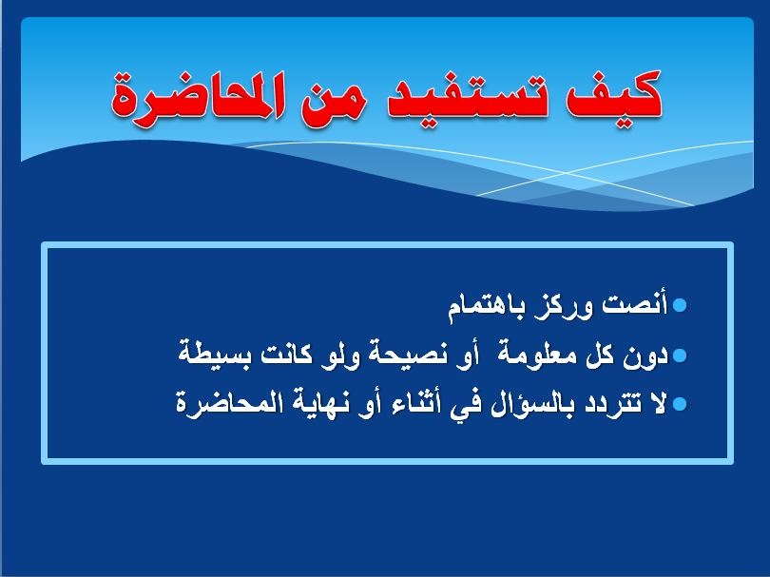

Slide 4


IELTS :International English Language Testing System
IELTS is a test of your language skills in Listening, Reading, Writing and Speaking.
800 centers with tests up to four times a month - 9000 Organisations
British Council, IDP: IELTS Australia and the University of Cambridge ESOL Examinations (Cambridge ESOL)
Developed as a test of English for:
    Immigration
    Work
    Academic Study

Slide 5
What does the whole test look like?
IELTS is available in two formats – Academic and General Training.
IELTS is a test of all four language skills: Listening, Reading, Writing and Speaking
All test takers (in both the Academic and General Training tests) take the same Listening and Speaking tests. The Writing and Reading tests are different.

Slide 6
The first 3 tests (Listening, Reading, and Writing) must be taken the same day.
The Speaking test can be taken 7 days before or after (depending on the testing center).
There is no break between the tests.

Slide 7
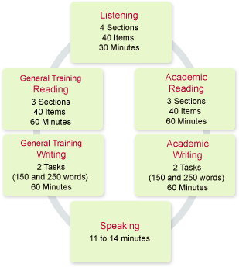

Slide 8
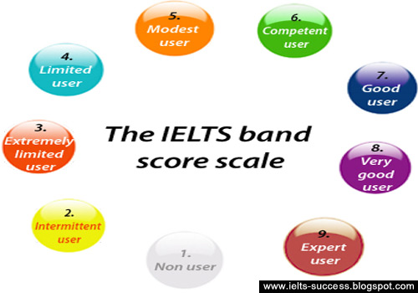
Scores on the IELTS test are graded into nine bands as follows:

Slide 9
How your overall band score is calculated
Your overall band score is calculated by taking the mean score of the four test components (Listening, Reading, Writing and Speaking). The score for each component is equally weighted. Your overall band score is rounded to the
nearest whole or half band
For example:
If you achieve 6.5 for Listening, 6.5 for Reading, 5.0 for Writing and 7.0 for
Speaking, you will be awarded an Overall Band Score of 6.5
Total score of 25 ÷ 4 = 6.25 which is a band score of 6.5
If you achieve 4.0 for Listening, 3.5 for Reading, 4.0 for Writing and 4.0 for Speaking, you would be awarded an Overall Band Score of 4.0.
Total score of 15.5 ÷ 4 = 3.875 which is a band score of 4.0.

Slide 10

What does each test look like?

Slide 11

1st Test
(30- 40 minutes)
Listening

Slide 12
Listening
Candidates listen to 4 recorded texts.
These feature a variety of English accents.
The recording is heard only once.
Candidates are given time to read the questions before each text starts.

Slide 13
Listening cont.
Section 1
A conversation between two people set in an everyday social context, e.g. a conversation in an accommodation agency.
Section 2
A monologue set in an everyday social context, e.g. a speech about local facilities.
Section 3
A conversation between a maximum of four people set in an educational or training context, e.g. a university tutor and a student discussing an assignment.
Section 4
A monologue on an academic subject, e.g. a university lecture.

Slide 14
Listening cont.
They write down their answers in the test booklet while they are listening.
At the end of each section, they have 30 seconds to check their answers.
At the end of the test, they are given 10 minutes to transfer their answers to the official answer sheet.
Poor spelling and grammar are penalized.
Writing more than is necessary is penalized.

Slide 15
Listening Test
Question types:
multiple choice
short-answer questions
sentence completion
note/summary/flow-chart/table completion
labeling a diagram
classification
matching

Slide 16
Listening – Common Challenges
Each recording played only once.
Must write and listen simultaneously.
Range of accents used.
Must follow line of argument or thought.
Unfamiliar vocabulary.
Correct spelling required.

Slide 17
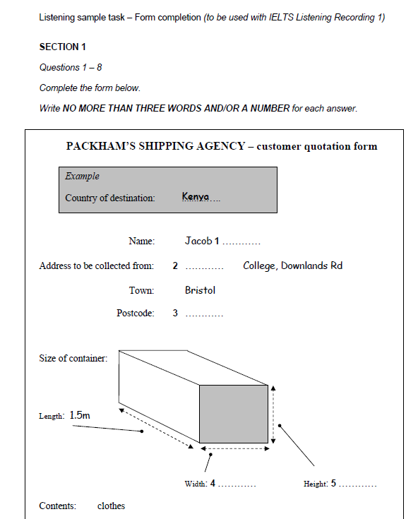

Slide 18
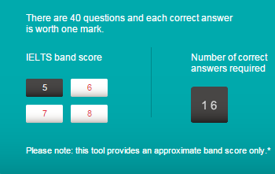
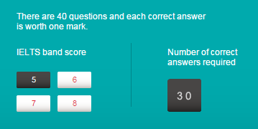

5
7
6

Slide 19

2nd Test
(60 minutes)
Reading

Slide 20
Academic Reading
There are three reading passages with a total of 2000 – 2750 words.
Texts are taken from books, magazines, journals and newspapers, all written for a non-specialist audience.
At least one of the texts contains a detailed argument.

Slide 21
Academic Reading cont.
Total of 40 questions
3 Categories of 10 Question Types:
Matching
Gap fill
Selection

Slide 22
Reading Common Challenges
Time is short!
Unfamiliar topics
Unusual question types, such as labeling a flowchart
Incorrect spelling and grammar are penalized.
Writing more than is necessary is penalized.

Slide 23
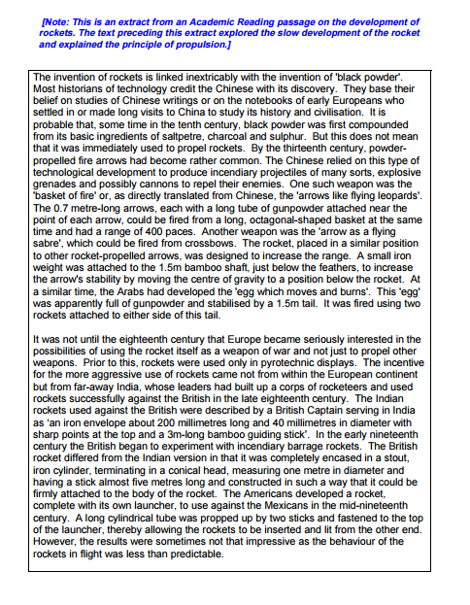
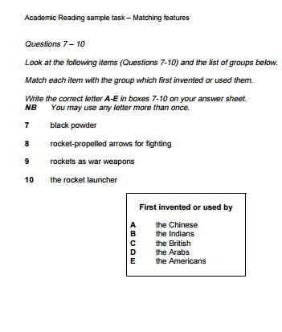

Slide 24
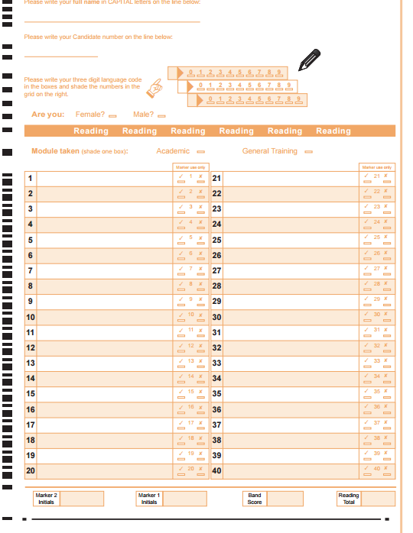

Slide 25
5
7
6

Slide 26

3rd Test
(60 mins)
Writing

Slide 27
Academic Writing
2 Tasks
Candidates ADVISED 20 mins for 1st task, 40 mins for 2nd task
Score based on:
  Task achievement
  Coherence and cohesion
  Lexical resource
  Grammatical range and accuracy

Slide 28
Writing – 1st task
Write a description of at least 150 words.
Based on material found in a chart, table, graph or diagram
Demonstrates ability to present information and to summarize the main features of the input.

Slide 29
Writing Task 1 Organization
Introductory Sentence(s) – describe the information presented in the graph….
General Observations
Specific Observations
Concluding Statement – analysis of information garnered from the visual

Slide 30
Writing – 2nd task
Write a short essay of at least 250 words in response to a statement or question.
Demonstrate an ability to present a position, construct an argument and discuss abstract issues.

Slide 31
Writing – Common Challenges
Task 1
  Analyze, select, and order data
  See general trends
  Identify key chunks of information and exceptions to general trends
  Use complex sentence structure
Task 2
  Unfamiliar topic
  Take a stand and argue it effectively

Slide 32
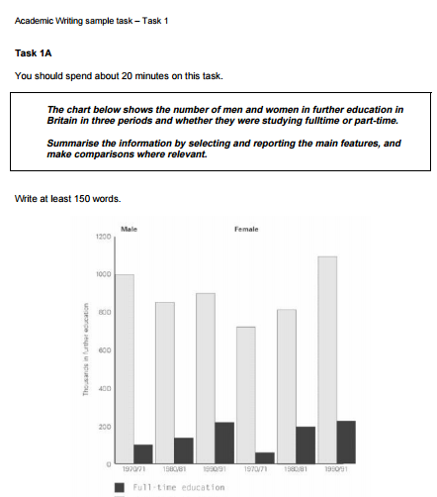
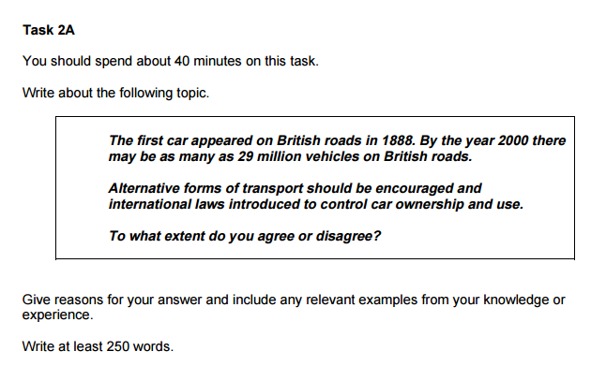

Slide 33
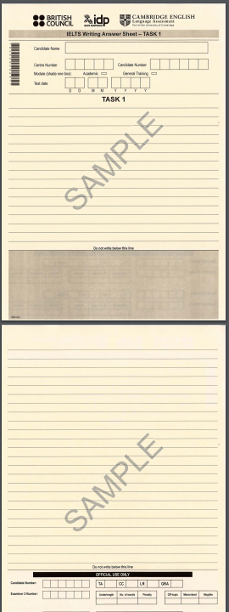
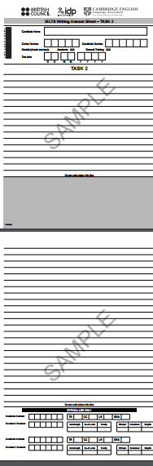

Slide 34
4th (and final) Test
(11-14 minutes)
Speaking

Slide 35
Speaking
The test is a face-to-face interview.
Candidates are assessed on their use of spoken English to
  answer short questions
  speak at length on a familiar topic
  interact with the examiner

Slide 36
Speaking
Speaking: Examiners award a band score for each of four criterion areas:
Fluency and Coherence
Lexical Resource
Grammatical Range
Accuracy and Pronunciation.

Slide 37
Speaking Test Sections
Introduction and interview (4-5 mins)
  Give name and talk about self, family, and own life.
Individual long turn (3-4 mins)
  Given a card prompt.
  1 min to prepare
  1-2 mins talk
  1 min answer related question from examiner
Two-way discussion (4-5 mins)
  Related to topic on the card
  Less personal

Slide 38
Speaking – Common Challenges
Talking extensively
Vocabulary
Abstract topics in 3rd section

Slide 39



Slide 40
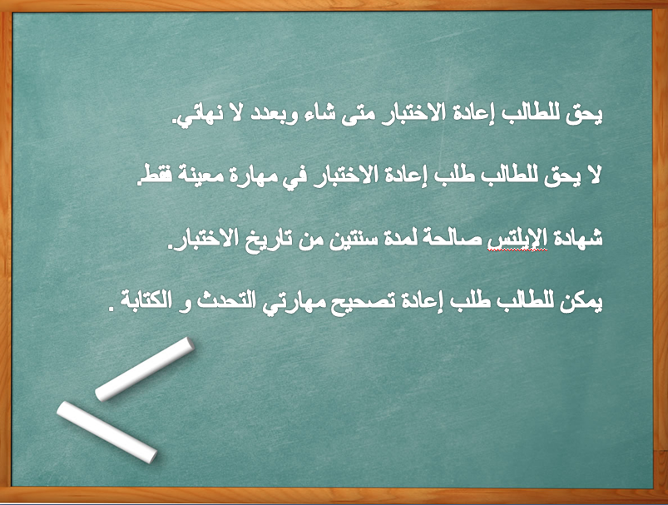

Slide 41
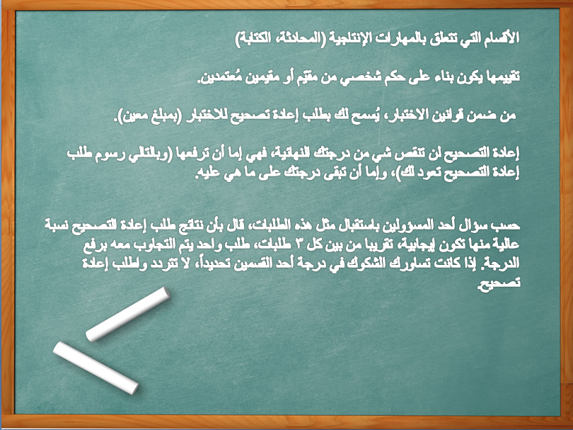

Slide 42
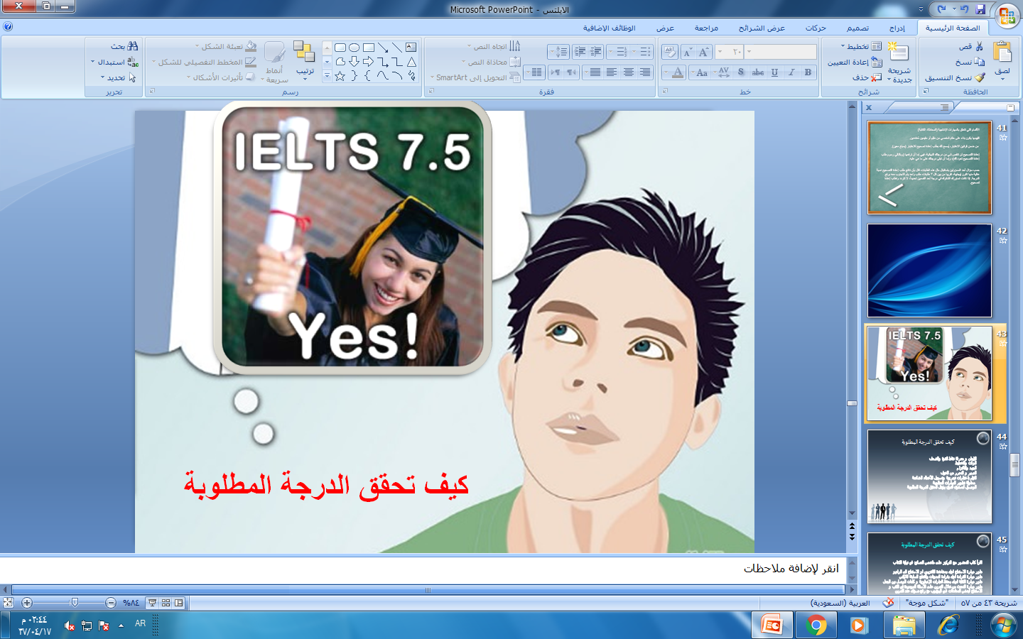

Slide 43


Slide 44
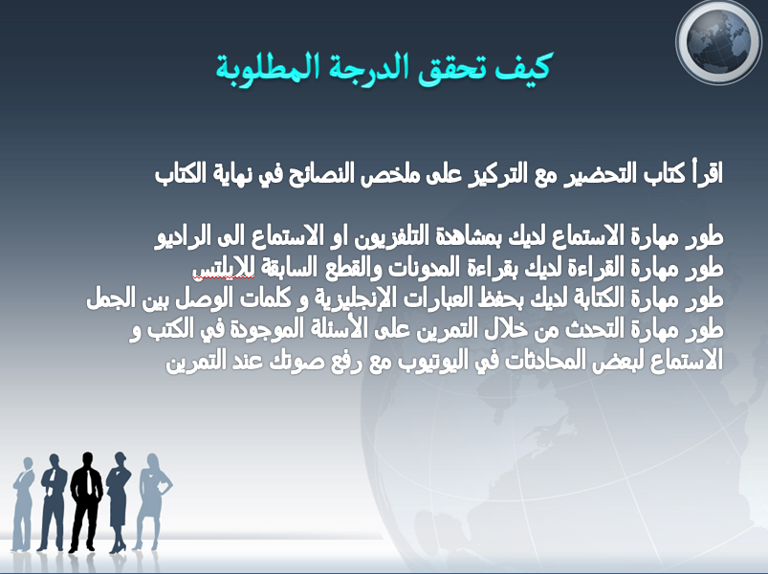

Slide 45


Slide 46
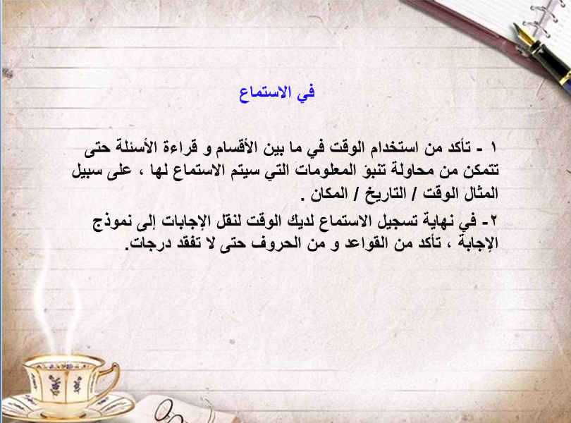


Slide 47
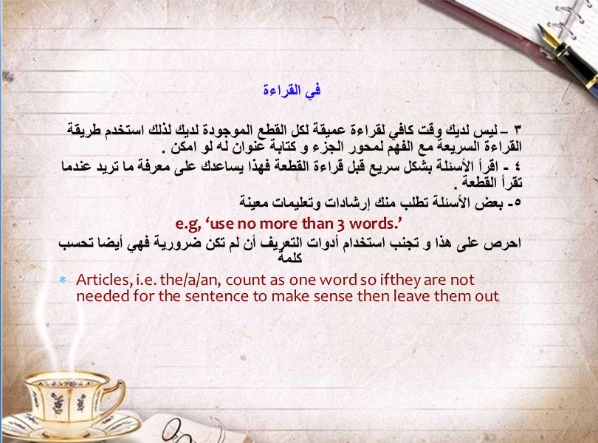

Slide 48
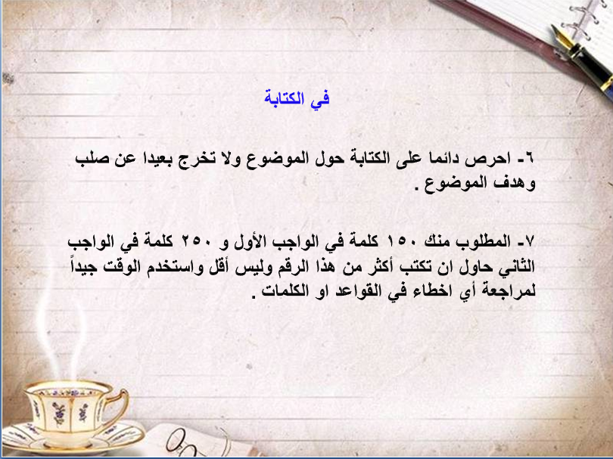

Slide 49
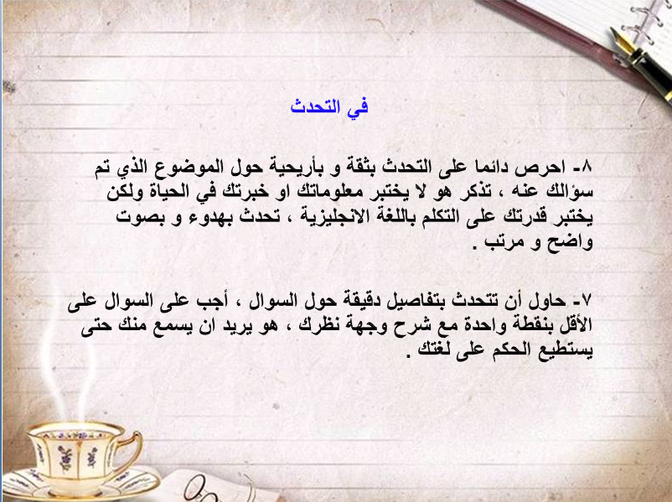

Slide 50
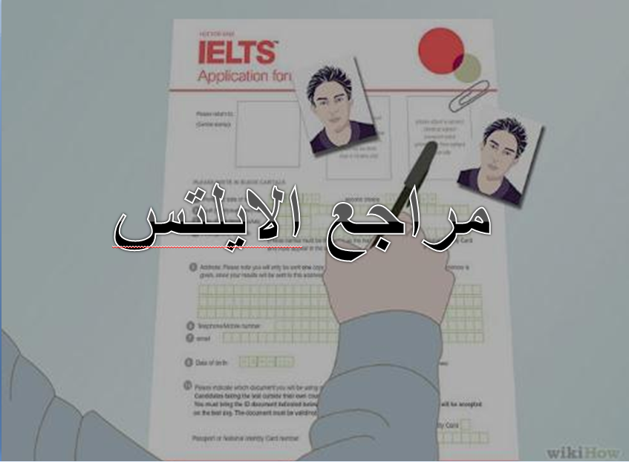

Slide 51
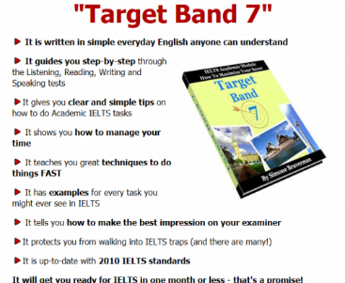

Slide 52


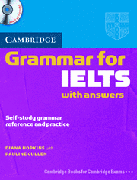

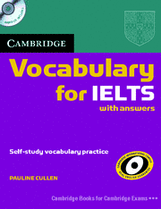
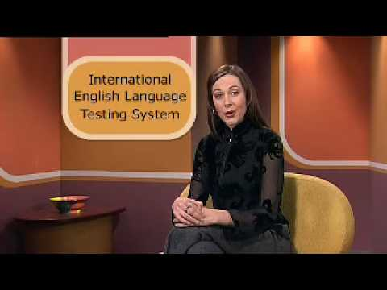

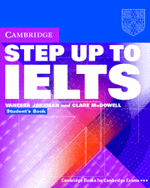
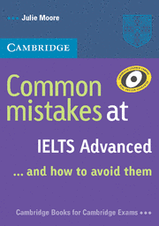
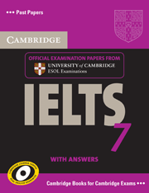
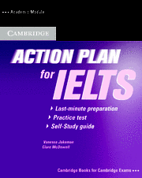

Slide 53
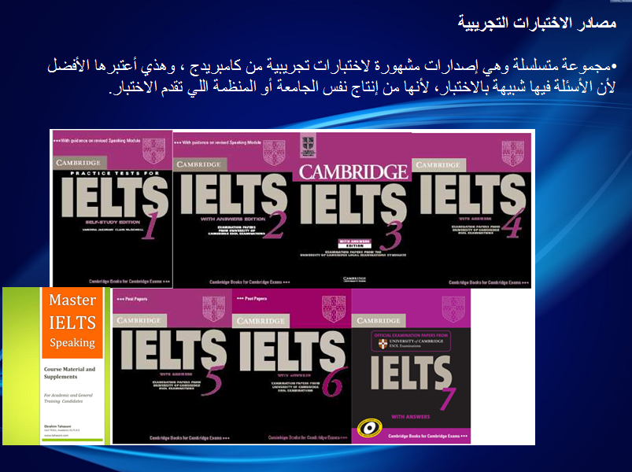

Slide 54
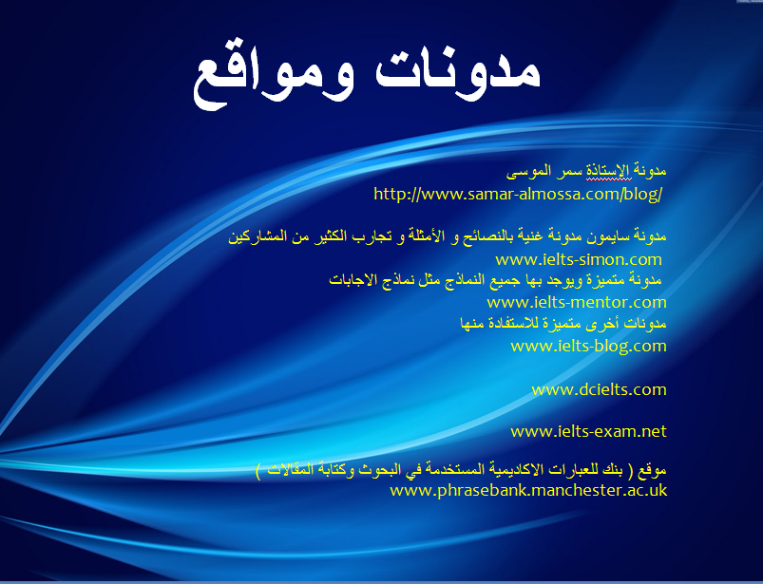

Slide 55
Conclusion
Practice makes perfect
Be effective
Use your time well
Most importantly, be yourself!

Slide 56
