Slide 1
Unit 2
Communication
Next
Main Page
Previous

Slide 2
2 Communication
Reading
Vocabulary & Grammar
Listening
Vocabulary & Grammar
Speaking
Examination practice
Writing
Next
Main Page
Previous

Slide 3
2 Communication
Reading
Next
Main Page
Previous

Slide 4
2 Communication
Reading
Next
Main Page
Previous

Slide 5
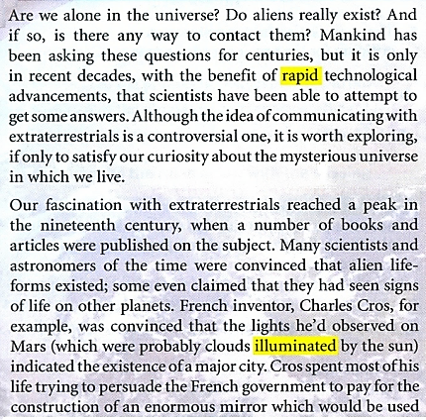
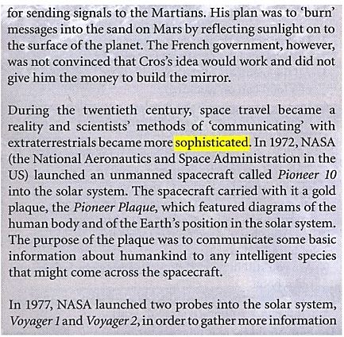
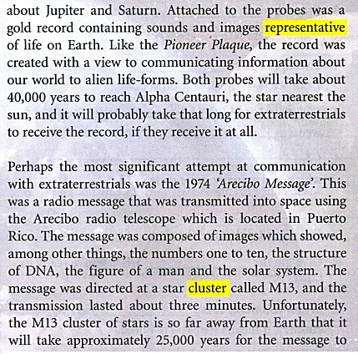
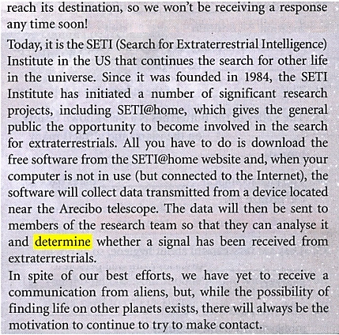
2 Communication
Reading
Next
Main Page
Previous

Slide 6
2 Communication
Reading
Next
Main Page
Previous

Slide 7
2 Communication
Reading
Next
Main Page
Previous

Slide 8
2 Communication
Reading
Next
Main Page
Previous

Slide 9
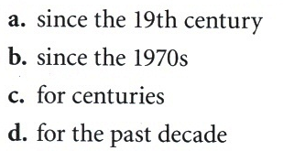
2 Communication
Reading
Next
Main Page
Previous

Slide 10
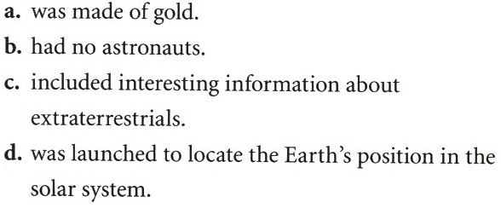
2 Communication
Reading
Next
Main Page
Previous

Slide 11
2 Communication
Reading
Next
Main Page
Previous

Slide 12
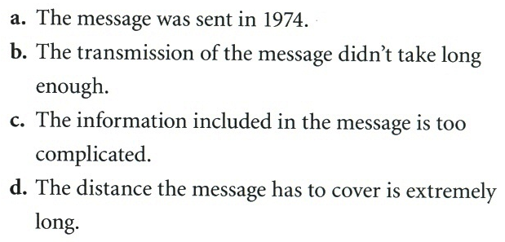
2 Communication
Reading
Next
Main Page
Previous

Slide 13
2 Communication
Reading
Next
Main Page
Previous

Slide 14
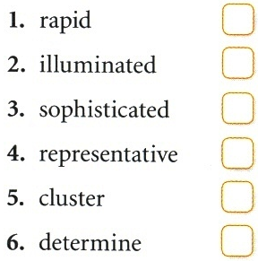
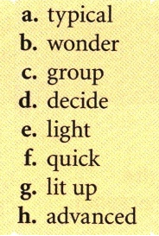
2 Communication
Reading
Next
Main Page
Previous

Slide 15
2 Communication
Reading
Next
Main Page
Previous

Slide 16
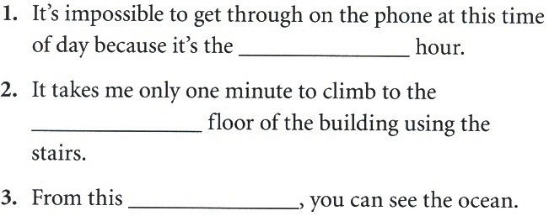
2 Communication
Vocabulary & grammar
Vocabulary
Next
Main Page
Previous

Slide 17
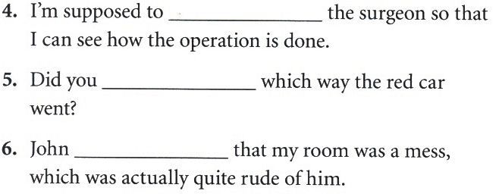
2 Communication
Vocabulary & grammar
Vocabulary
Next
Main Page
Previous

Slide 18
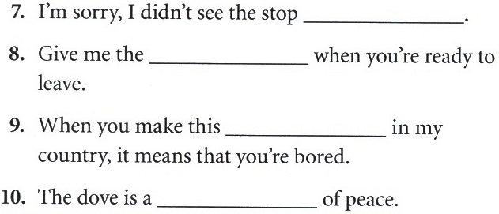
2 Communication
Vocabulary & grammar
Vocabulary
Next
Main Page
Previous

Slide 19
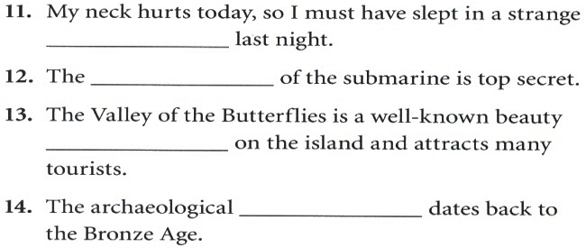
2 Communication
Vocabulary & grammar
Vocabulary
Next
Main Page
Previous

Slide 20
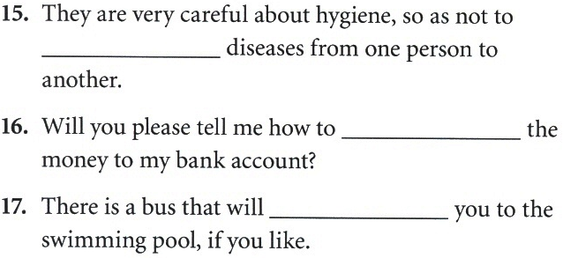
2 Communication
Vocabulary & grammar
Vocabulary
Next
Main Page
Previous

Slide 21
2 Communication
Vocabulary & grammar
Vocabulary
Next
Main Page
Previous

Slide 22
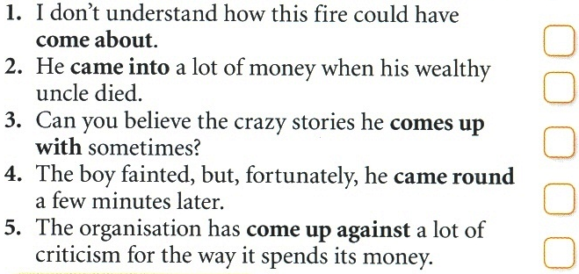
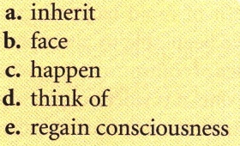
2 Communication
Vocabulary & grammar
Vocabulary
Next
Main Page
Previous

Slide 23
2 Communication
Vocabulary & grammar
Vocabulary
Next
Main Page
Previous

Slide 24
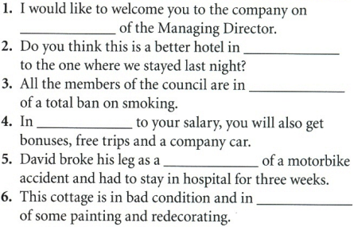
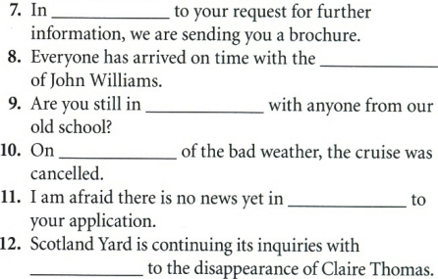
2 Communication
Vocabulary & grammar
Vocabulary
Next
Main Page
Previous

Slide 25
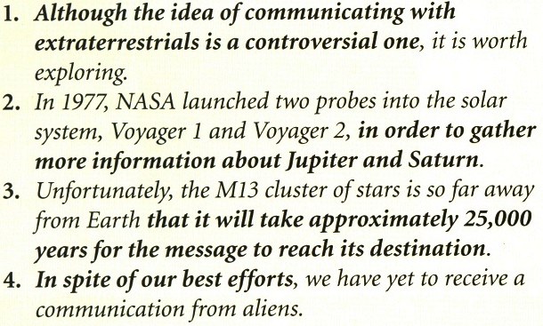
2 Communication
Vocabulary & grammar
Grammar
Next
Main Page
Previous

Slide 26
2 Communication
Vocabulary & grammar
Grammar
Next
Main Page
Previous

Slide 27
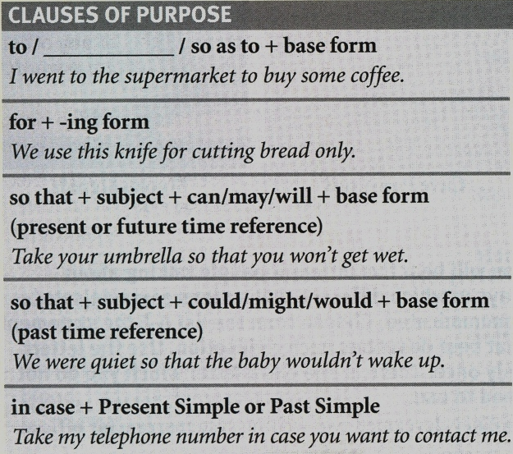
2 Communication
Vocabulary & grammar
Grammar
Next
Main Page
Previous

Slide 28
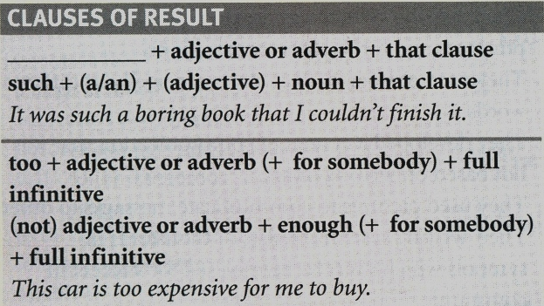
2 Communication
Vocabulary & grammar
Grammar
Next
Main Page
Previous

Slide 29
2 Communication
Vocabulary & grammar
Grammar
Next
Main Page
Previous

Slide 30
2 Communication
Vocabulary & grammar
Grammar
Next
Main Page
Previous

Slide 31
2 Communication
Vocabulary & grammar
Grammar
Next
Main Page
Previous

Slide 32
2 Communication
Vocabulary & grammar
Grammar
Next
Main Page
Previous

Slide 33
2 Communication
Listening
Next
Main Page
Previous

Slide 34
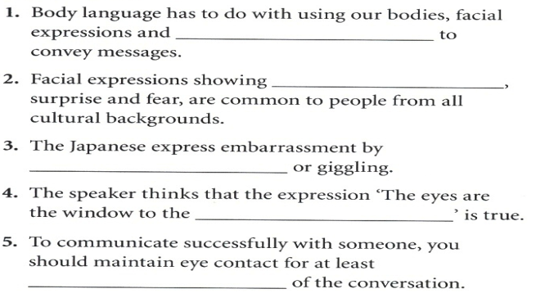
2 Communication
Listening
Next
Main Page
Previous

Slide 35
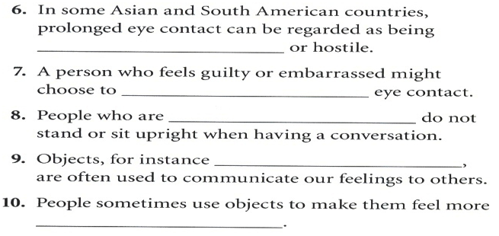
2 Communication
Listening
Next
Main Page
Previous

Slide 36
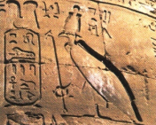
2 Communication
Listening
Next
Main Page
Previous

Slide 37
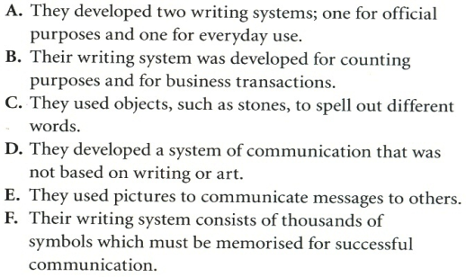
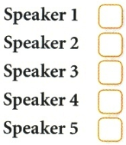
2 Communication
Listening
Next
Main Page
Previous

Slide 38
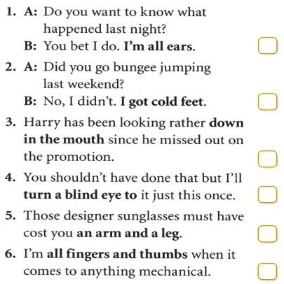
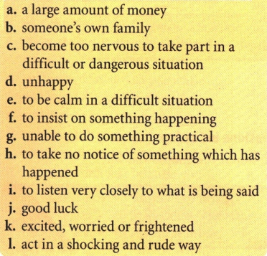
2 Communication
Vocabulary
Next
Main Page
Previous

Slide 39
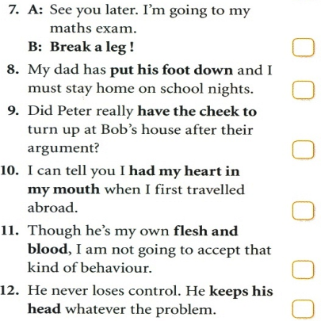
2 Communication
Vocabulary
Next
Main Page
Previous

Slide 40
2 Communication
Grammar
Next
Main Page
Previous

Slide 41
2 Communication
Grammar
Next
Main Page
Previous

Slide 42
2 Communication
Grammar
Next
Main Page
Previous

Slide 43
2 Communication
Grammar
Next
Main Page
Previous

Slide 44
2 Communication
Grammar
Next
Main Page
Previous

Slide 45
2 Communication
Speaking
Next
Main Page
Previous

Slide 46
2 Communication
Speaking
Next
Main Page
Previous

Slide 47
2 Communication
Speaking
Next
Main Page
Previous

Slide 48
2 Communication
Speaking
Next
Main Page
Previous

Slide 49
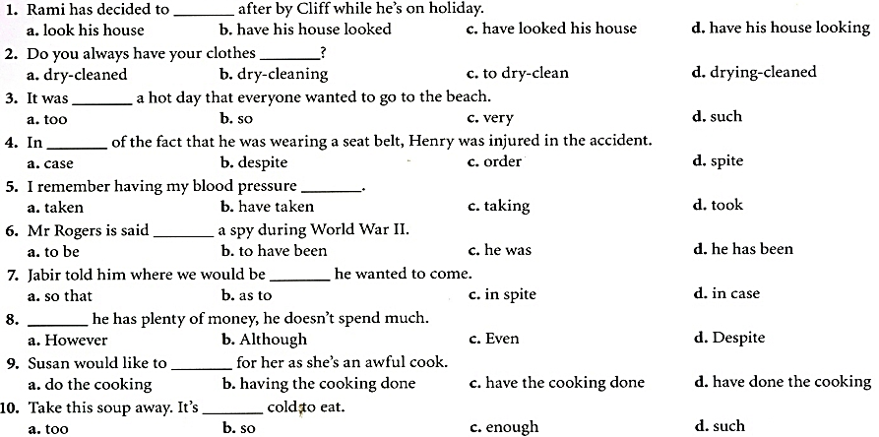
2 Communication
Examination practice
Next
Main Page
Previous

Slide 50
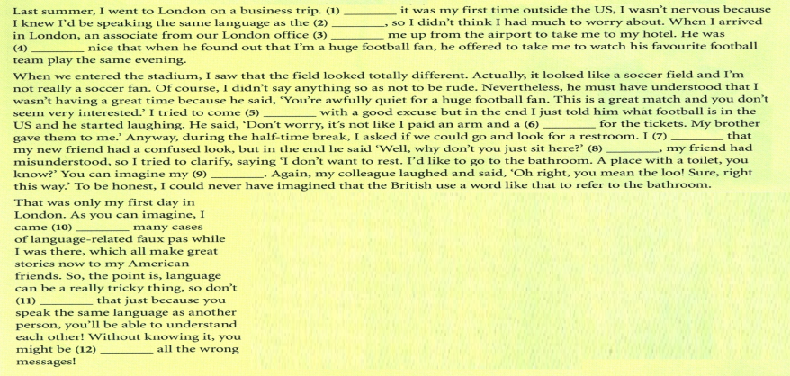
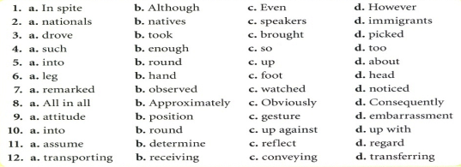
2 Communication
Examination practice
Next
Main Page
Previous

Slide 51
2 Communication
Writing
Next
Main Page
Previous

Slide 52
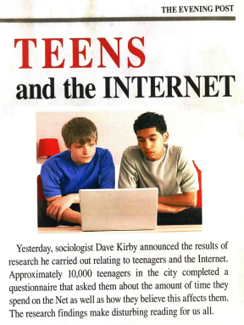
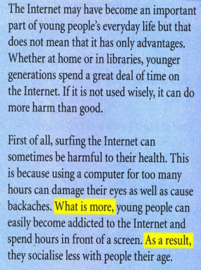
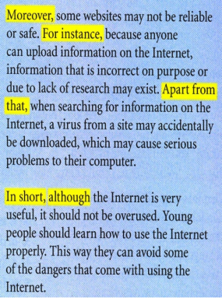
2 Communication
Writing
Next
Main Page
Previous

Slide 53
2 Communication
Writing
Next
Main Page
Previous

Slide 54
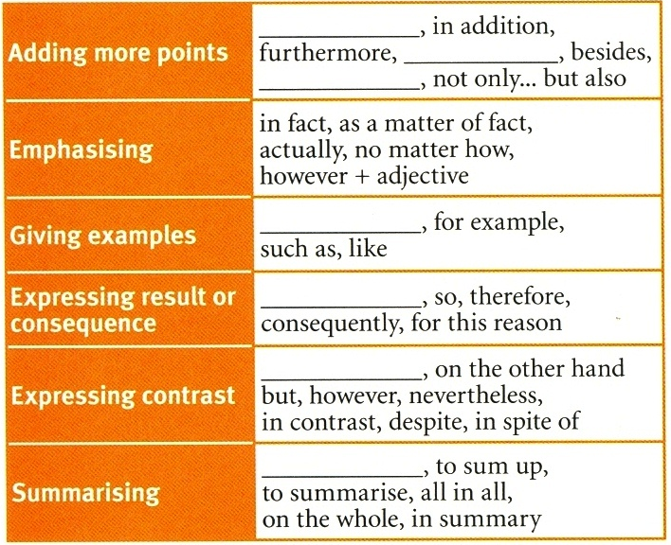
2 Communication
Writing
Next
Main Page
Previous

Slide 55
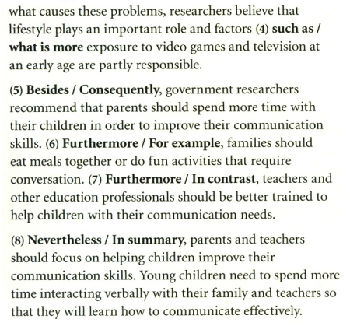
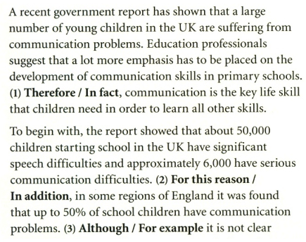
2 Communication
Writing
Next
Main Page
Previous

Slide 56
2 Communication
Writing
Next
Main Page
Previous

Slide 57
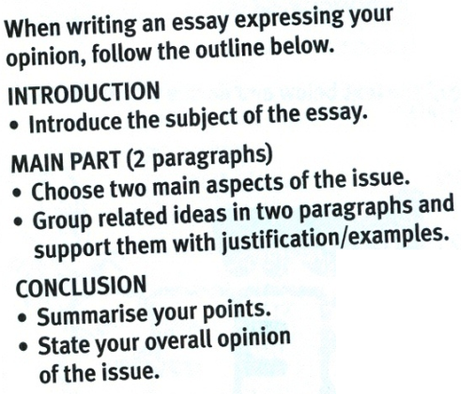
2 Communication
Writing
Next
Main Page
Previous

Slide 58
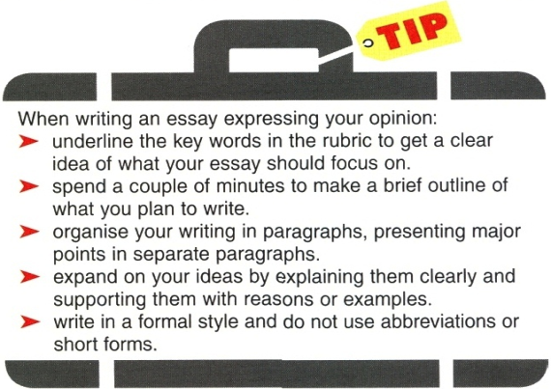
2 Communication
Writing
Next
Main Page
Previous

