Slide 1
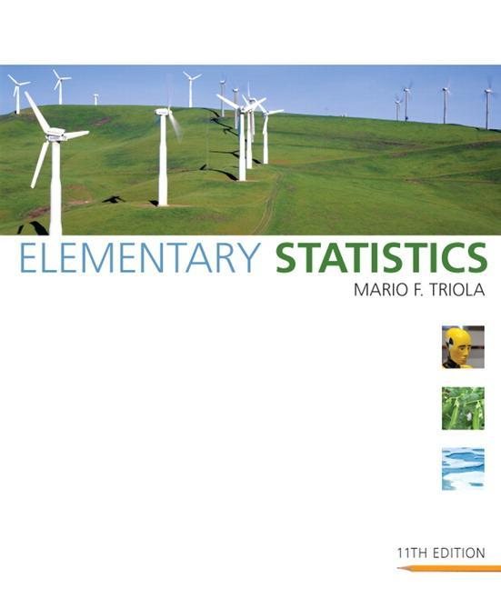
Lecture Slides
Elementary Statistics Eleventh Edition
and the Triola Statistics Series
by Mario F. Triola

Slide 2
Chapter 2 Summarizing and Graphing Data
2-1 Review and Preview
2-2 Frequency Distributions
2-3 Histograms
2-4 Statistical Graphics
2-5 Critical Thinking: Bad Graphs

Slide 3
Section 2-1
Review and Preview

Slide 4
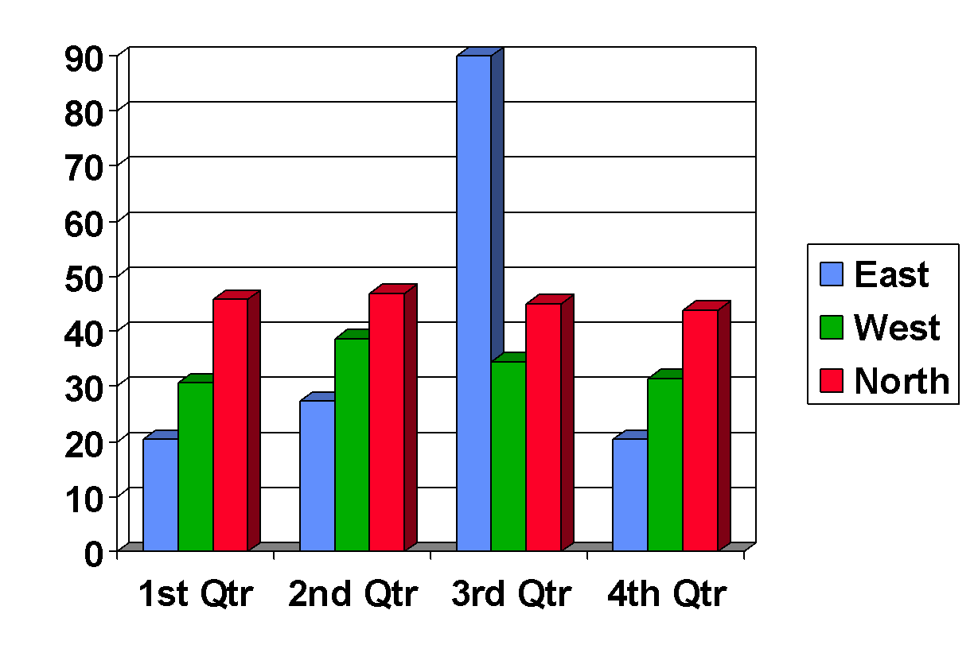
Preview
Important Characteristics of Data
1. Center: A representative or average value that indicates where the middle of the data set is located.
2. Variation: A measure of the amount that the data values vary.
3. Distribution: The nature or shape of the spread of data over the range of values (such as bell-shaped, uniform, or skewed).
4. Outliers: Sample values that lie very far away from the vast majority of other sample values.
5. Time: Changing characteristics of the data over time.

Slide 5
Section 2-2
Frequency Distributions
Copyright © 2010 Pearson Education
Copyright © 2010 Pearson Education

Slide 6
Key Concept
When working with large data sets, it is often helpful to organize and summarize data by constructing a table called a frequency distribution, defined later. Because computer software and calculators can generate frequency distributions, the details of constructing them are not as important as what they tell us about data sets. It helps us understand the nature of the distribution of a data set.
Copyright © 2010 Pearson Education

Slide 7
Definition
Frequency Distribution (or Frequency Table)
shows how a data set is partitioned among all of several categories (or classes) by listing all of the categories along with the number of data values in each of the categories.
Copyright © 2010 Pearson Education

Slide 8
Pulse Rates of Females and Males
Original Data
Copyright © 2010 Pearson Education

Slide 9
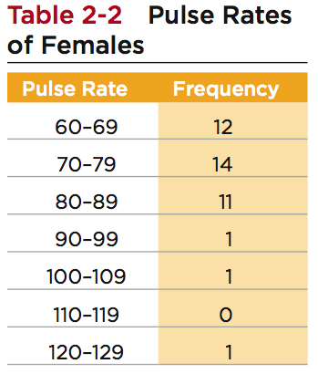
Frequency Distribution Pulse Rates of Females
The frequency for a particular class is the number of original values that fall into that class.
Copyright © 2010 Pearson Education

Slide 10
Frequency Distributions
Definitions
Copyright © 2010 Pearson Education

Slide 11
Lower Class Limits
are the smallest numbers that can actually belong to different classes
Lower Class
Limits
Copyright © 2010 Pearson Education
Notes:
Available in a Dezel form not in fracture form

Slide 12
Upper Class Limits
are the largest numbers that can actually belong to different classes
Upper Class
Limits
Copyright © 2010 Pearson Education

Slide 13
Class Boundaries
are the numbers used to separate classes, but without the gaps created by class limits
59.5
69.5
79.5
89.5
99.5
109.5
119.5
129.5
Class
Boundaries
Copyright © 2010 Pearson Education
Notes:
59.5-69.5
69.5-79.5
If we have 69.5 it will be in the second pulse rate

Slide 14
Class Midpoints
are the values in the middle of the classes and can be found by adding the lower class limit to the upper class
limit and dividing the sum by two
64.5
74.5
84.5
94.5
104.5
114.5
124.5
Class
Midpoints
Copyright © 2010 Pearson Education

Slide 15
Class Width
is the difference between two consecutive lower class limits or two consecutive lower class boundaries
10
10
10
10
10
10
Class
Width
Copyright © 2010 Pearson Education
Notes:
Class width is the difference between the first raw and sacund raw

Slide 16
Reasons for Constructing
Frequency Distributions
1. Large data sets can be summarized.
2. We can analyze the nature of data.
3. We have a basis for constructing important graphs.
Copyright © 2010 Pearson Education

Slide 17
Constructing A Frequency Distribution
1. Determine the number of classes (should be between 5 and 20).
2. Calculate the class width (round up).
class width ≈
(maximum value) – (minimum value)
number of classes
3. Starting point: Choose the minimum data value or a convenient value below it as the first lower class limit.
Using the first lower class limit and class width, proceed to list the other lower class limits.
5. List the lower class limits in a vertical column and proceed to enter the upper class limits.
6. Take each individual data value and put a tally mark in the appropriate class. Add the tally marks to get the frequency.
Copyright © 2010 Pearson Education

Slide 18
Relative Frequency Distribution
includes the same class limits as a frequency distribution, but the frequency of a class is replaced with a relative frequencies (a proportion) or a percentage frequency ( a percent)
class frequency
relative frequency =
sum of all frequencies
percentage
frequency
class frequency
=
× 100%
sum of all frequencies
Copyright © 2010 Pearson Education

Slide 19
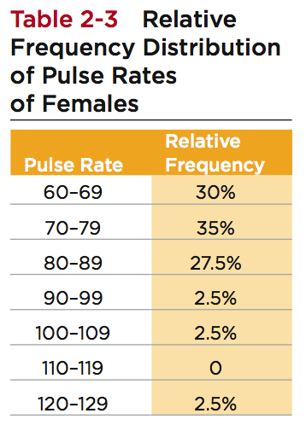
Relative Frequency Distribution
*
Total Frequency = 40
* 12/40 × 100 = 30%
Copyright © 2010 Pearson Education

Slide 20
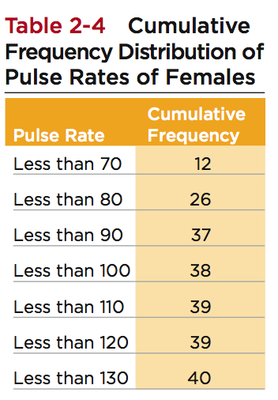
Cumulative Frequency Distribution
Cumulative Frequencies
Copyright © 2010 Pearson Education

Slide 21
Frequency Tables
Copyright © 2010 Pearson Education

Slide 22
Critical Thinking Interpreting Frequency Distributions
In later chapters, there will be frequent reference to data with a normal distribution. One key characteristic of a normal distribution is that it has a “bell” shape.
The frequencies start low, then increase to one or two high frequencies, then decrease to a low frequency.
The distribution is approximately symmetric, with frequencies preceding the maximum being roughly a mirror image of those that follow the maximum.
Copyright © 2010 Pearson Education

Slide 23
Gaps
Gaps The presence of gaps can show that we have data from two or more different populations. However, the converse is not true, because data from different populations do not necessarily result in gaps.
Copyright © 2010 Pearson Education

Slide 24
Recap
In this Section we have discussed
Important characteristics of data
Frequency distributions
Procedures for constructing frequency distributions
Relative frequency distributions
Cumulative frequency distributions
Copyright © 2010 Pearson Education

Slide 25
Section 2-3
Histograms
Copyright © 2010 Pearson Education

Slide 26
Key Concept
We use a visual tool called a histogram to analyze the shape of the distribution of the data.
Copyright © 2010 Pearson Education

Slide 27
Histogram
A graph consisting of bars of equal width drawn adjacent to each other (without gaps). The horizontal scale represents the classes of quantitative data values and the vertical scale represents the frequencies. The heights of the bars correspond to the frequency values.
Copyright © 2010 Pearson Education

Slide 28
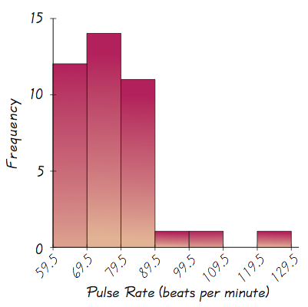
Histogram
Basically a graphic version of a frequency distribution.
Copyright © 2010 Pearson Education

Slide 29
Histogram
The bars on the horizontal scale are labeled with one of the following:
Class boundaries
Class midpoints
Lower class limits (introduces a small error)
Horizontal Scale for Histogram: Use class boundaries or class midpoints.
Vertical Scale for Histogram: Use the class frequencies.
Copyright © 2010 Pearson Education

Slide 30
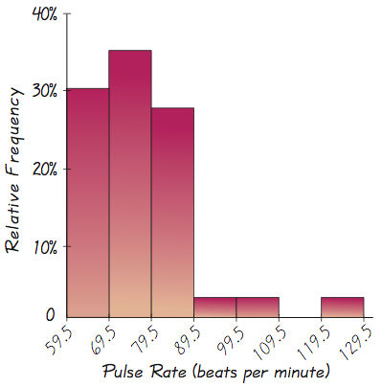
Relative Frequency Histogram
Has the same shape and horizontal scale as a histogram, but the vertical scale is marked with relative frequencies instead of actual frequencies
Copyright © 2010 Pearson Education

Slide 31
Critical Thinking Interpreting Histograms
Objective is not simply to construct a histogram, but rather to understand something about the data.
When graphed, a normal distribution has a “bell” shape. Characteristic of the bell shape are
(1) The frequencies increase to a maximum, and then decrease, and
(2) symmetry, with the left half of the graph roughly a mirror image of the right half.
The histogram on the next slide illustrates this.
Copyright © 2010 Pearson Education

Slide 32
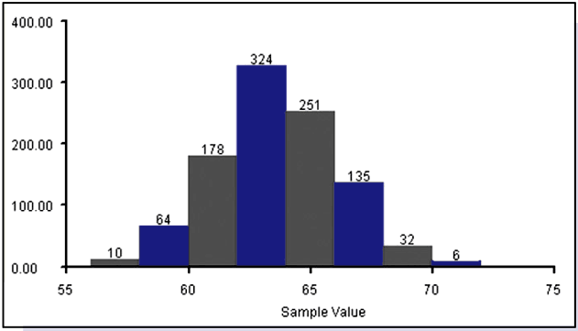
Critical Thinking Interpreting Histograms
Copyright © 2010 Pearson Education

Slide 33
Recap
In this Section we have discussed
Histograms
Relative Frequency Histograms
Copyright © 2010 Pearson Education

Slide 34
Section 2-4
Statistical Graphics

Slide 35
Key Concept
This section discusses other types of statistical graphs.
Our objective is to identify a suitable graph for representing the data set. The graph should be effective in revealing the important characteristics of the data.

Slide 36
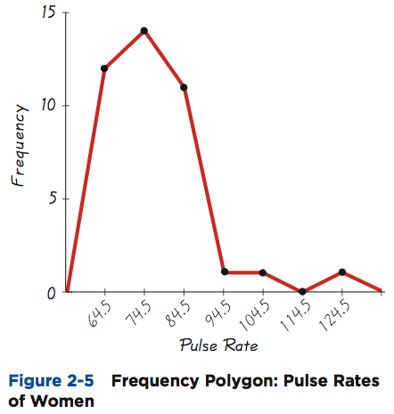
Frequency Polygon
Uses line segments connected to points directly above class midpoint values

Slide 37
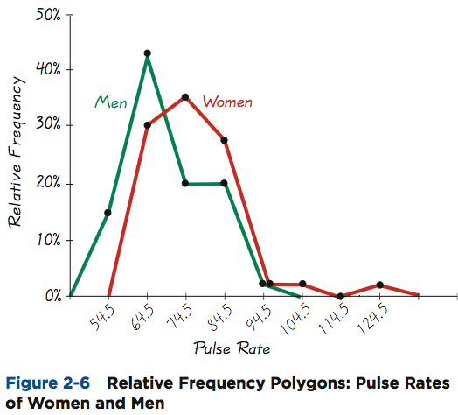
Relative Frequency Polygon
Uses relative frequencies (proportions or percentages) for the vertical scale.

Slide 38
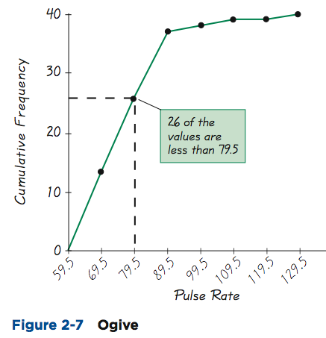
Ogive
A line graph that depicts cumulative frequencies

Slide 39
Dot Plot
Consists of a graph in which each data value is plotted as a point (or dot) along a scale of values. Dots representing equal values are stacked.

Slide 40
Stemplot (or Stem-and-Leaf Plot)
Represents quantitative data by separating each value into two parts: the stem (such as the leftmost digit) and the leaf (such as the rightmost digit)
Pulse Rates of Females

Slide 41
Bar Graph
Uses bars of equal width to show frequencies of categories of qualitative data. Vertical scale represents frequencies or relative frequencies. Horizontal scale identifies the different categories of qualitative data.
A multiple bar graph has two or more sets of bars, and is used to compare two or more data sets.

Slide 42
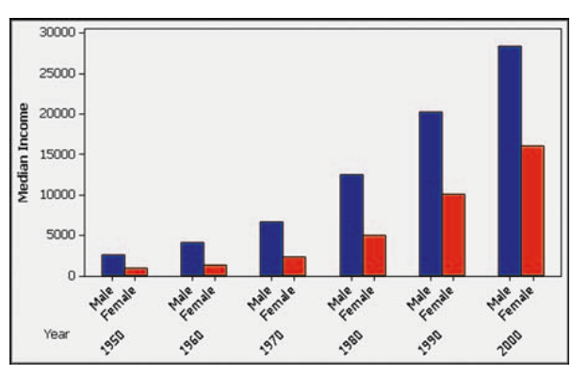
Multiple Bar Graph
Median Income of Males and Females

Slide 43
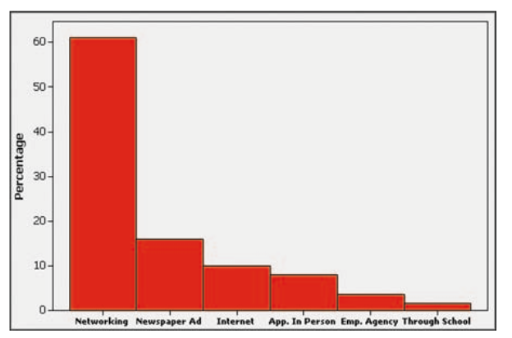
Pareto Chart
A bar graph for qualitative data, with the bars arranged in descending order according to frequencies

Slide 44
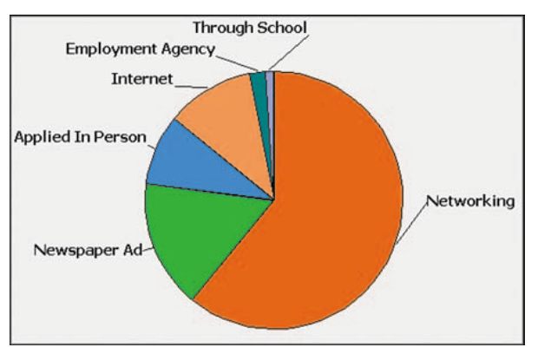
Pie Chart
A graph depicting qualitative data as slices of a circle, size of slice is proportional to frequency count

Slide 45
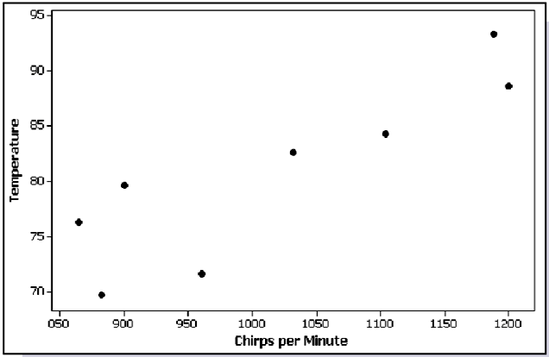
Scatter Plot (or Scatter Diagram)
A plot of paired (x,y) data with a horizontal x-axis and a vertical y-axis. Used to determine whether there is a relationship between the two variables

Slide 46
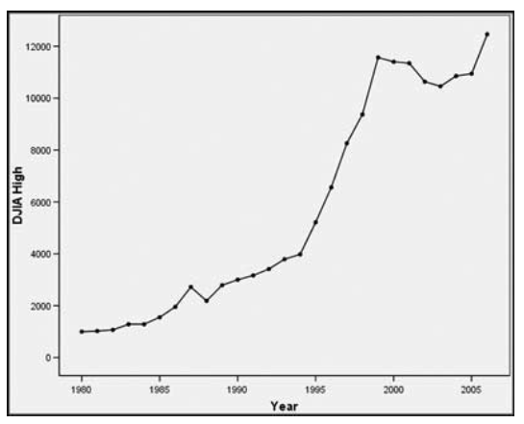
Time-Series Graph
Data that have been collected at different points in time: time-series data

Slide 47
Important Principles Suggested by Edward Tufte
For small data sets of 20 values or fewer, use a table instead of a graph.
A graph of data should make the viewer focus on the true nature of the data, not on other elements, such as eye-catching but distracting design features.
Do not distort data, construct a graph to reveal the true nature of the data.
Almost all of the ink in a graph should be used for the data, not the other design elements.

Slide 48
Important Principles Suggested by Edward Tufte
Don’t use screening consisting of features such as slanted lines, dots, cross-hatching, because they create the uncomfortable illusion of movement.
Don’t use area or volumes for data that are actually one-dimensional in nature. (Don’t use drawings of dollar bills to represent budget amounts for different years.)
Never publish pie charts, because they waste ink on nondata components, and they lack appropriate scale.

Slide 49
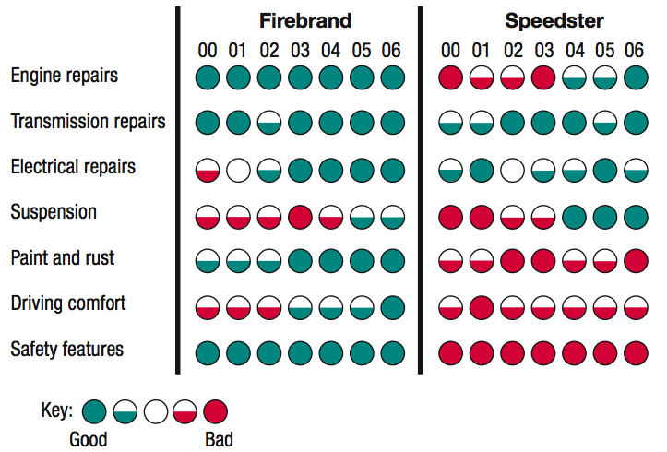
Car Reliability Data

Slide 50
Recap
In this section we saw that graphs are excellent tools for describing, exploring and comparing data.
Describing data: Histogram - consider distribution, center, variation, and outliers.
Exploring data: features that reveal some useful and/or interesting characteristic of the data set.
Comparing data: Construct similar graphs to compare data sets.

Slide 51
Section 2-5
Critical Thinking: Bad Graphs

Slide 52
Key Concept
Some graphs are bad in the sense that they contain errors.
Some are bad because they are technically correct, but misleading.
It is important to develop the ability to recognize bad graphs and identify exactly how they are misleading.

Slide 53
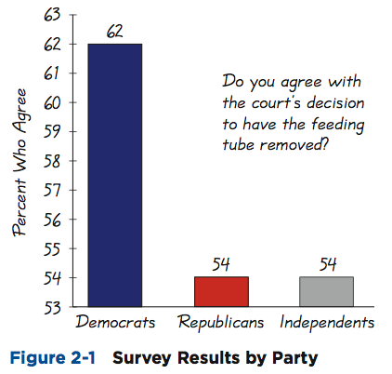
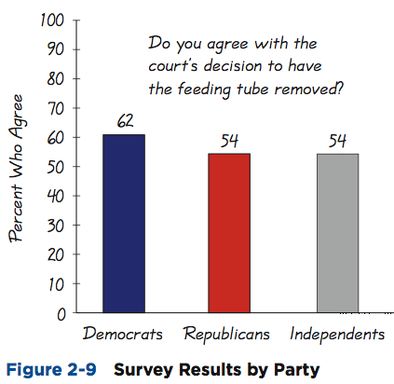
Nonzero Axis
Are misleading because one or both of the axes begin at some value other than zero, so that differences are exaggerated.

Slide 54
Pictographs
are drawings of objects. Three-dimensional objects - money bags, stacks of coins, army tanks (for army expenditures), people (for population sizes), barrels (for oil production), and houses (for home construction) are commonly used to depict data.
These drawings can create false impressions that distort the data.
If you double each side of a square, the area does not merely double; it increases by a factor of four;if you double each side of a cube, the volume does not merely double; it increases by a factor of eight.
Pictographs using areas and volumes can therefore be very misleading.

Slide 55
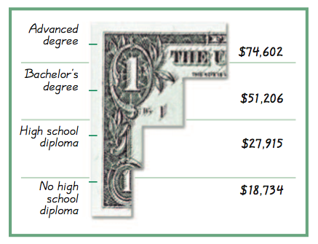
Annual Incomes of Groups with Different Education Levels
Bars have same width, too busy, too difficult to understand.

Slide 56
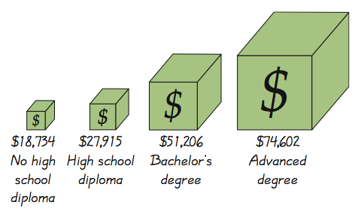
Annual Incomes of Groups with Different Education Levels
Misleading. Depicts one-dimensional data with three-dimensional boxes. Last box is 64 times as large as first box, but income is only 4 times as large.

Slide 57
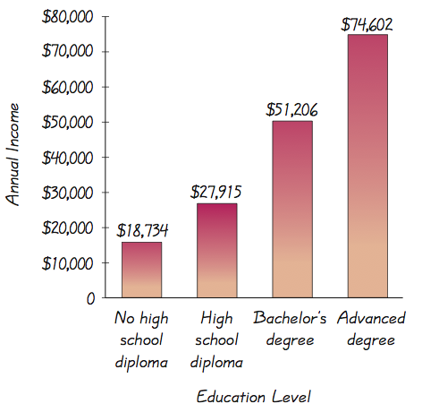
Annual Incomes of Groups with Different Education Levels
Fair, objective, unencumbered by distracting features.

