Slide 1
University of Hail
Preparatory Year College
Medical Physics
PHYS121
Introduction to
Biological Physics
For The Health Life Science
Kirsten Franklin and others

Slide 2
V- Radiation and Health
Ch. 33-34-35-36-37

Slide 3
Objectives
In this chapters we will extend our knowledge about the following
Structure of the atom
Isotopes
Radioactivity
X-ray and Gamma Radiation, Particles
Mechanisms of Cell Damage, Dose and Dose Equivalent, Types of Effects, radiation in medicine

Slide 4
Topics to be covered
Ch. 33
Atoms , structure of the atoms
Ch. 34
2. Nuclei and Isotopes, Energy and Mass Units,
Ch. 35
3. Radioactivity Processes, Activity and Half- Life, transformation processes
Ch. 36
4. X-ray and Gamma Radiation, Particles
Ch. 37
5. Mechanisms of Cell Damage, Dose and Dose Equivalent, Types of Effect,

Slide 5
Ch.33 - INTRODUCTION
*All matter is composed of atoms
*Atoms cannot be subdivided, created or destroyed in ordinary chemical reactions, however these changes can occur in nuclear reactions!
*Atoms of any one element differ in properties from atoms of another element

Slide 6
ATOMS
An atom is defined as the smallest part of an element which retains the chemical properties of the element. Atoms are incredibly small about one ten-millionth of a millimeter across (10⁻¹⁰ m )

Slide 7
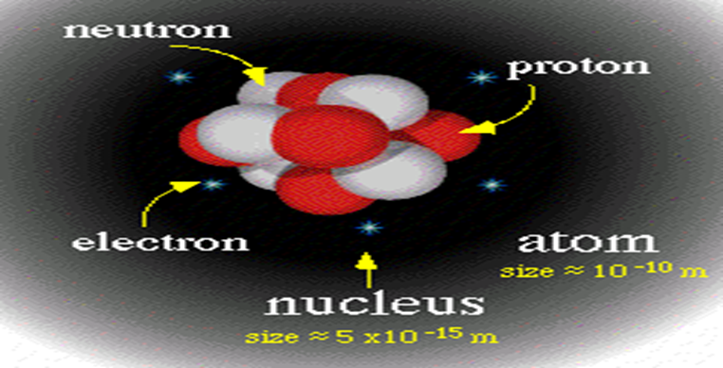
THE STRUCTURE OF THE ATOM
Atoms consists of a central nucleus surrounded by one or more electrons.

Slide 8
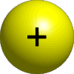
Ch.34- WHAT IS THE NUCLEUS?
It is the central part of an atom.
It is composed of protons and neutrons.
It is contains most of an atom's mass.
What is a Proton?
Positively charged particle = 1.6 X 10⁻¹⁹ C
Found within an atomic nucleus.
What is a Neutron?
Uncharged particle.
Found within an atomic nucleus.

Slide 9
What is an Electron?
Negatively charged particle =1.6 X 10⁻¹⁹ C
Located in shells that surround an atom's nucleus.
summarized
Particle Symbol Charge Mass
Electron e⁻ - 9.11 X 10⁻³¹ Kg
Proton p⁺ + 1.66 X 10⁻²⁷ Kg
Neutron n 0 1.66 X 10⁻²⁷ Kg

Slide 10
Atomic nomenclature
Atomic number (Z) : It is the number of protons(p) in the atom
Atomic mass or Mass number (A) It is the total number of protons and neutrons. → A = p + n

Slide 11
Ch.34- Isotopes
Two or more varieties of an element having the same number of protons but different number of neutrons. These elements call isotopes are “unstable” and decay to lighter isotopes or elements.
Therefore:
Isotopes agree in atomic number and differ in atomic mass number.
An unstable nucleus releases energy to become more stable

Slide 12
Example of Isotope
Neutron
+
+
+
Carbon-14
Neutrons 8
Protons 6
Electrons 6
Electrons
Nucleus
+
+
+
Proton
Nucleus
Nucleus
Proton
+
+
+
Neutron
+
+
Electrons
+
Carbon-12
Neutrons 6
Protons 6
Electrons 6
Nucleus
Notes:
The chemistry of each element is determined by its number of protons and electrons.
In a neutral atom, the number of electrons equals the number of protons.
Symbols for elements are derived directly from the element’s name.
Nuclei of atoms contain neutrons as well as protons.
The number of neutrons is not fixed for most elements, unlike protons.
Atoms that have the same number of protons, and hence the same atomic number, but different numbers of neutrons are called isotopes.

Slide 13
Energy and mass units
Equivalence of mass and energy
In 1905, Einstein was able to show that energy and mass are related by the expression, E=mc².
Using this relationship, we can specify masses in terms of their energy equivalent.
Electron Volt
An electron volt is the change in the electrostatic potential energy of an electron when it is moved through a potential difference of 1 V
1eV= 1.602X10⁻¹⁹ J
Atomic Mass Unit (amu)
unit of mass equal to ¹/₁₂ the mass of an atom of the most common
isotope of carbon (carbon 12), which is assigned a mass of 12 and has a value of 1.660 × 10 ⁻²⁴grams

Slide 14
Ch. 35- Introduction
In this chapter we will talk about the radioactivity and the three main types of radiation alpha, beta and gamma radiation and the decay processes which produce them.

Slide 15
radioactivity
Radioactivity, or radioactive decay, is defined as a process whereby some nuclides undergo spontaneous changes in the structure of their nuclei, accompanied by the emission of particles and radiation.
Radioactive decay occurs in an unstable atoms which differ from stable atoms because they have an excess of energy or mass or both.
Unstable atoms are said to be radioactive. In order to reach stability, these atoms give off, or emit, the excess energy or mass. These emissions are called radiation.
after
the same but stable nucleus
 or new nucleus
Unstable
Nucleus
decay

Slide 16
ACTIVITY

Slide 17
The SI unit of activity is the becquerel (Bq). A becquerel is equivalent to one disintegration per second.
Another unit still in use, particularly in US, is curie(Ci)
1 Ci = 3.7 x 10¹⁰ Bq
Half-life

Slide 18
Type of Half-life
Physical Half-Life (T_{p})
It is the time (in minutes, hours, days, or years) required for the activity of a radioactive material to decrease by one half due to radioactive decay
Biological Half-Life (T_{b})
It is the time required for the body to eliminate half of the radioactive material (depends on the chemical form) taken into it.
Effective Half-Life (T_{eff})
The net effect of the combination of the physical and biological half-lives in removing the radioactive material from the body
(4)

Slide 19
TRANSFORMATION PROCESSES
When radionuclides break down, several different types of emissions may be produced, depending on which particular process of decay has occurred.
The nucleus emits α particles, ß⁺ particles, ß⁻ particles, γ rays or Neutron during this process.

Slide 20
What happens during alpha decay?
Alpha particle consists of two protons and two neutrons. It is the same as a helium nucleus.
When an atom’s nucleus decays and releases an alpha particle, it loses two protons and two neutrons.
mass number decreases by 4
238
234
4
U
➔
Th
+
α
92
90
2
atomic number
decreases by 2
The number of protons has changed, so the decayed atom has changed into a new element.

Slide 21
What happens during beta negative decay?
Negative Beta particle consists of a high energy electron, The emission of a negatively charged beta particle is associated with the decay of nuclides which have too many neutrons .
The decayed atom has gained a proton and so has changed into a new element.

Slide 22
What happens during beta positive decay?
The emission of a positively charged beta particle(positron –electron with positive charge or antielectron) is associated with the decay of nuclides which have too many protons .
The decayed atom has gained a proton and so has changed into a new element.

Slide 23
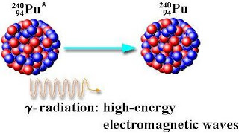
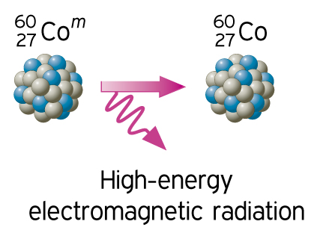
What happens during Gamma-rays (g) decay?
After a decay reaction, the nucleus is often in an “excited” state. This means that the nucleus still has excess energy to get rid of. So, the emission of gamma rays is a way for a high energy nucleus to reduce its energy and become more stable.

Slide 24
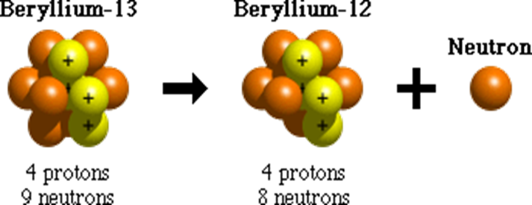
Neutron Emission
Neutron emission is one process that unstable atoms can use to become more stable. During neutron emission, a neutron is ejected from an atom's nucleus.
Since the number of protons within an atom doesn't change during neutron emission, it doesn't change from one element to another. It does, however, become a different isotope of that element.

Slide 25
Types of Radiation
radiation is the emission or transmission of energy in the form of waves or particles through space or through a material medium. This includes
Ionizing Radiation
Higher energy electromagnetic waves (gamma) or heavy particles (beta and alpha).
High enough energy to pull electron from orbit.
Non-ionizing Radiation
Lower energy electromagnetic waves.
Not enough energy to pull electron from orbit, but can excite the electron.

Slide 26
Ionizing radiation
Particulate
Electromagnetic wave
Transfer of energy
By high velocity
subatomic particles
( α and β particles,
protons and neutrons )
Transfer of energy
in the form of waves
at the speed of light
and as a combination of electric and magnetic fields (γ and X-rays)

Slide 27
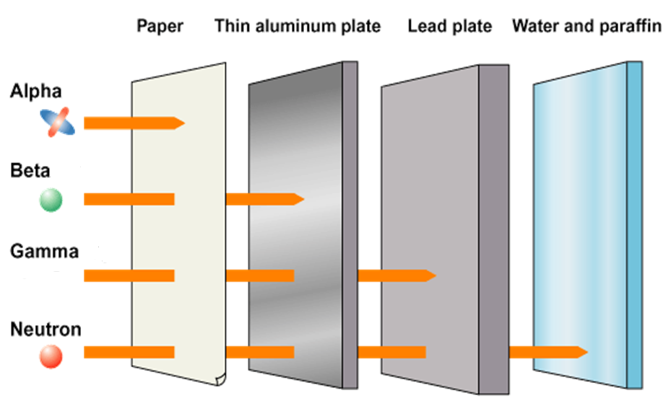
Ability of nuclear radiation to penetration

Slide 28
CH.36 Interaction of ionizing radiation with matter
The way in which ionizing radiation interact with matter depend on the types of radiation (particles or electromagnetic waves) and its energy.

Slide 29
Particles
Particulates radiation (Alpha ,Beta and neutron radiation) have high enough energy to pull electron from orbit.
Particulates interacts with matter by colliding with the atoms or molecules and ionizing them.

Slide 30
Electromagnetic waves
X and Gamma rays
X-RAY
Most X-rays have a wavelength ranging from 0.01 to 10 nanometres.
X-rays travel in straight lines such as light.
X-rays travel at the same speed of light (300,000 Km/s)
X-ray have no charge so it cannot be deviated with a magnetic or electric fields
X-rays have an effect on photographic films like the effect of light, hence it can produce a latent image on the film that is invisible, but can be seen by chemical processing of the film.

Slide 31
Gamma ray
The properties of γ-rays resembles that of x-rays except that the energy of the former is higher than that of the latter. γ Rays is used usually in treatment and diagnosis as well as sterilization
Gamma and X-rays are both electromagnetic photons. Photons transfer energy to electrons by three processes
 Compton scattering
❖ Photoelectric effect
⬥ Pair production

Slide 32
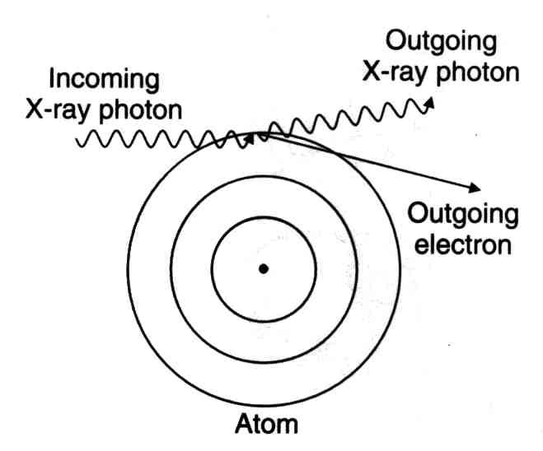
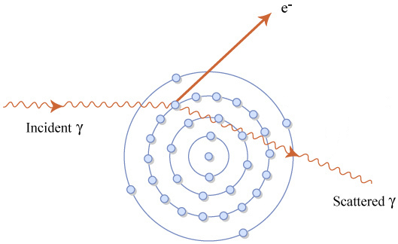
Compton scattering
Takes place for outer electrons, where the electron absorb some energy from the original photon gives rise to another photon with low energy.

Slide 33
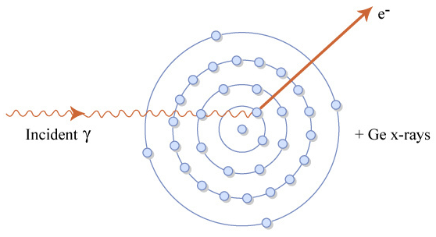
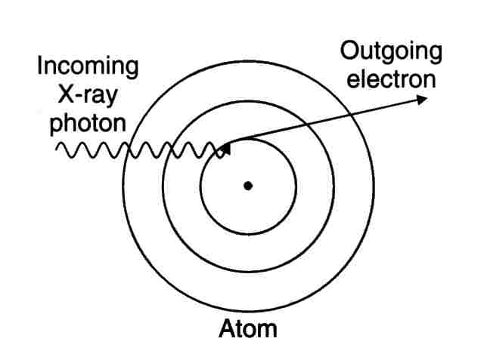
Photoelectric effect
Takes place for inner electrons, where the electron absorb all the energy from the original photon and escape from the atom.

Slide 34
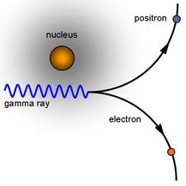
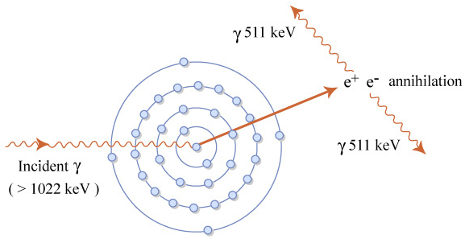
Pair production
Takes place when gamma photons of enough energy is incident in the vicinity of the nucleus. The photon can annihilate and create an electron and its antiparticle (positron). The photon's energy is converted into the mass of the two particles according to E=mc², and whatever energy is left over goes into their speed. After traveling a short distance (3-5mm), the positron emitted encounters an electron from the surrounding environment. The two particles combine and "annihilate" each other, resulting in the emission of two gamma rays in opposite directions

Slide 35
Ch.37
Biological Effects Of Ionizing Radiation
In this chapter we will investigate the interaction of ionizing radiation with biological tissue. The specific effects produced by this interaction depend on the type of radiation and how the exposure occurs.

Slide 36
PENETRATING RADIATION OF THE HUMAN BODY
Alpha
Alpha absorbed at the outer layer of the skin
Beta penetrate the body and absorbed inside
Penetrate the body and transmitted
Beta
Gamma, X-Ray and Neutrons

Slide 37
Mechanisms Of Cell Damage
A typical tissue cell has a very complex structure. However, one of the most important components is DNA.The chromosomes within the nucleus are made of DNA and they are responsible, via the activation of genes, for the functioning of the cell. Any radiation damage to the DNA can result in significant biological damage to the cell.
The damage of the DNA can be caused in one of two ways (Direct and Indirect effect)

Slide 38
Direct effect
In this state the radiation interacts directly with DNA and cause damage .
Indirect effect
Here the radiation interact with a molecule of water in the human body to produce free radicals.
Free radicals are a group of highly reactive chemicals that can have a damage effect on the DNA structure

Slide 39
Types of the biological Effect
The biological effects of radiation can classified as somatic and genetic effects, which related to body area, or as deterministic and stochastic, which related to the type of damage that may be caused.

Slide 40
SOMATIC EFFECTS
These effects are the results of irradiation of the body tissues. The major feature of somatic effects is that they are restricted to the individual irradiated.
They are not passed on the future generations
Examples of somatic effects are radiation induced cancers or radiation cataracts.

Slide 41
Genetic effects
Genetic effects are caused by irradiation of the gonads and may be passed on an individual's off spring. The effect do not appear in the person receiving the exposure but in their descendants as they are caused by damage to the DNA of the sperm or ovum
Example of genetic effects are leukemia and mental retardation

Slide 42
Deterministic effects
Deterministic effects are always somatic effects. As the name implies, deterministic effects are determined by the dose received by an individual.
The main features of a deterministic effect are:-
* There is a threshold dose below which the effect will not occur.
* The severity of the effect increases with the dose received
The most common deterministic effects are impaired fertility and cataracts.

Slide 43
Stochastic effects
Stochastic is a statistical term relating to probability.
Stochastic effects can be either somatic or genetic
The main features of stochastic effects are:-
* There is no threshold dose , this means that for any exposure there is always a risk of developing cancer
* The probability of an effect occurring increases with the dose received.
The main stochastic effect is cancer.

Slide 44
Radiation units of measurements
1. Absorbed Dose
Absorbed dose is one of the fundamental dosimetric quantities in radiation protection. It is a physical quantity to measure radiation energy absorbed by unit mass of materials.
The SI unit of absorbed dose is the gray, symbol Gy
1Gy = 1 Joule per Kilogram
1Gy = 100 rad

Slide 45
2. Equivalent Dose
Equivalent dose is a physical quantity to measure the effect to a tissue or organ by different types and energies of
radiation.
The SI unit of dose equivalent is Sievert (Sv)
1 Sv= 1 Gy x QF
Dose equivalent (Sv)= Absorbed dose x quality factor
Where QF is given in table below which related to the type of radiation
1 Sv = 100 rem
Type of radiation | QF
X-rays and gamma rays | 1
Electrons | 1
Neutrons | 10
Alpha particles | 2

Slide 46
RADIATION IN MEDICINE
There are 3 main uses of ionizing radiation in medicine:
Treatment: used to treat cancers by irradiating them with ionising radiation.
Diagnosis: used to diagnose and investigate several medical conditions.
Sterilization: Radiation not only kills cells, it can also kill germs or bacteria

Slide 47
Thanks for your listening

