Slide 1
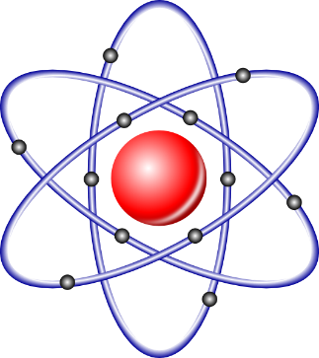
Chapter 2
Atoms, Molecules, Ions and Periodicity

Slide 2
Chapter 2
Atoms, Molecules, and Ions
Page:23-41
2.5. Subatomic particles: proton, neutrons and electrons in atom.
2.6. Finding patterns: The periodic law and periodic table.
2.7. Atomic Mass: Avogadro’s Mass of an element’s atoms.
2.8. Molar mass.
2.10. Electron Configuration.
2.11. Electron Configuration and valence electron
2.13. Periodic trends in the size of atoms.
2.14. Electron affinities and metallic character.

Slide 3
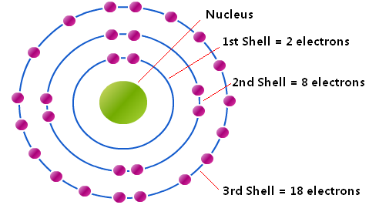
Chapter 2/Atoms, Molecules, and Ions
2.10. Electron Configuration:
Electron configuration: is how the electrons are distributed among the various atomic orbitals in an atom.

Slide 4
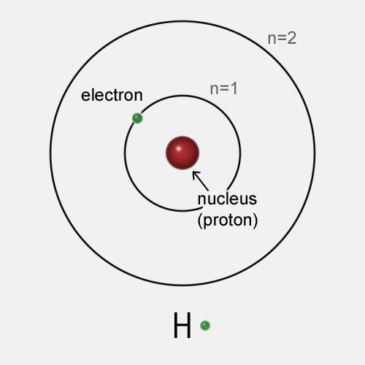
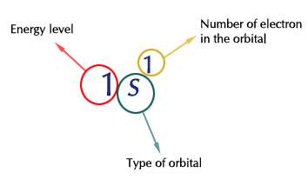
Chapter 2/Atoms, Molecules, and Ions
2.10. Electron Configuration:
Electron configuration: is how the electrons are distributed among the various atomic orbitals in an atom.
Example:
H= 1s¹

Slide 5
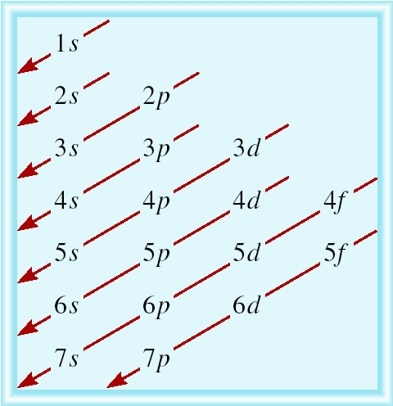
Chapter 2/Atoms, Molecules, and Ions
2.10. Electron Configuration:
Order of orbitals (filling) in multi-electron atom
The s sublevel has just 1 orbital, so can contain 2 electrons.
The p sublevel has 3 orbitals, so can contain 6 electrons.
The d sublevel has 5 orbitals, so can contain 10 electrons.
The f sublevel has 7 orbitals, so can contain 14 electrons.
اما ان يحفظ هذا
(أو)
هذا
1s < 2s < 2p < 3s < 3p < 4s < 3d < 4p < 5s < 4d < 5p < 6s

Slide 6
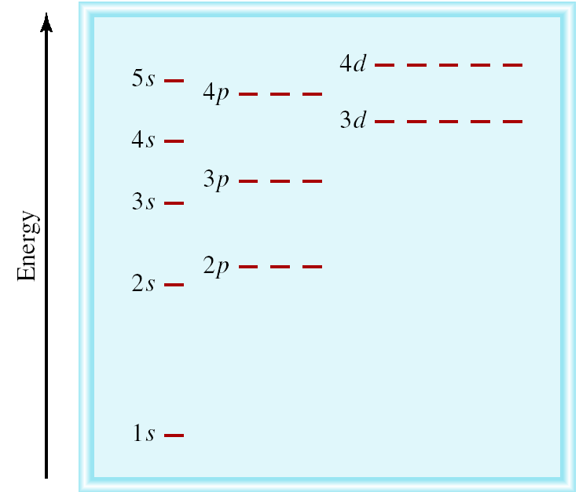
Chapter 2/Atoms, Molecules, and Ions
2.10. Electron Configuration:
Energy of orbitals:
1s < 2s < 2p < 3s < 3p < 4s < 3d < 4p < 5s < 4d < 5p < 6s

Slide 7
Chapter 2/Atoms, Molecules, and Ions
2.10. Electron Configuration:
1-Aufbau Principle (“Fill up” electrons): the electrons are added one by one to the atomic orbitals in lowest energy orbitals. 2-The Pauli Exclusion Principal: NO two electrons in an atom can have the same set of four quantum numbers. 3-Hund’s Rule: The most stable arrangement of electrons in subshells is the one with the greatest number of parallel spins.
Quantum numbers?
The principal quantum number (n) (1,2,3..)
The angular momentum quantum number (l) (s,p,d..)
The magnetic quantum number (m_{l}) (px, py, pz..)
The spin quantum number (m_{s}) (+½ , -½)

Slide 8
Chapter 2/Atoms, Molecules, and Ions
2.10. Electron Configuration:
1-“Fill up” electrons in lowest energy orbitals (Aufbau principle): the electrons are added one by one to the atomic orbitals
H 1 electron
H= 1s¹

Slide 9
Chapter 2/Atoms, Molecules, and Ions
2.10. Electron Configuration:
2-Pauli Exclusion Principal: No two electrons in an atom can have the same set of four quantum numbers
He 2 electrons
He= 1s²

Slide 10
Chapter 2/Atoms, Molecules, and Ions
2.10. Electron Configuration:
2-Pauli Exclusion Principal: No two electrons in an atom can have the same set of four quantum numbers
He 2 electrons
He= 1s²

Slide 11
Chapter 2/Atoms, Molecules, and Ions
2.10. Electron Configuration:
1-“Fill up” electrons in lowest energy orbitals (Aufbau principle): the electrons are added one by one to the atomic orbitals
Li 3 electrons
Li= 1s²2s¹

Slide 12
Chapter 2/Atoms, Molecules, and Ions
2.10. Electron Configuration:
1-“Fill up” electrons in lowest energy orbitals (Aufbau principle): the electrons are added one by one to the atomic orbitals
Be 4 electrons
Be= 1s²2s²

Slide 13
Chapter 2/Atoms, Molecules, and Ions
2.10. Electron Configuration:
1-“Fill up” electrons in lowest energy orbitals (Aufbau principle): the electrons are added one by one to the atomic orbitals
B 5 electrons
B= 1s²2s²2p¹

Slide 14
Chapter 2/Atoms, Molecules, and Ions
2.10. Electron Configuration:
3-The most stable arrangement of electrons in subshells is the one with the greatest number of parallel spins (Hund’s rule).
C 6 electrons
C= 1s²2s²2p²

Slide 15
Chapter 2/Atoms, Molecules, and Ions
2.10. Electron Configuration:
3-The most stable arrangement of electrons in subshells is the one with the greatest number of parallel spins (Hund’s rule).
C 6 electrons
C= 1s²2s²2p²

Slide 16
Chapter 2/Atoms, Molecules, and Ions
2.10. Electron Configuration:
3-The most stable arrangement of electrons in subshells is the one with the greatest number of parallel spins (Hund’s rule).
N 7 electrons
N= 1s²2s²2p³

Slide 17
Chapter 2/Atoms, Molecules, and Ions
2.10. Electron Configuration:
1-“Fill up” electrons in lowest energy orbitals (Aufbau principle): the electrons are added one by one to the atomic orbitals
O 8 electrons
O= 1s²2s²2p⁴

Slide 18
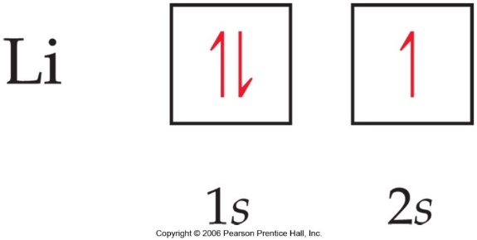
Chapter 2/Atoms, Molecules, and Ions
2.10. Electron Configuration:
Orbital Diagram: the electron configuration can also represented by the orbital diagram
In the Orbital Diagram:
Each box represents one orbital.
Half-arrows represent the electrons.
The direction of the arrow represents the spin of the electron.

Slide 19
Chapter 2/Atoms, Molecules, and Ions
2.10. Electron Configuration:
Example 2.5: (a)What is the electron configuration of Mg?
Mg atom has 12 electrons (from: Periodic table (atomic number))
The Electron Configuration: 1s²2s²2p⁶3s²
2 + 2 + 6 + 2 = 12 electrons
Orbital Diagram:
Short notation: [Ne] 3s²;
Since: [Ne] 1s²2s²2p⁶
Short Notation: we write in the electron configuration of any element, the symbol of the Noble gas element in the previous period in brackets followed by the symbol of highest filled subshells in the outermost shells.
1s² 2s² 2p⁶ 3s²
See example: 2.5 p33

Slide 20
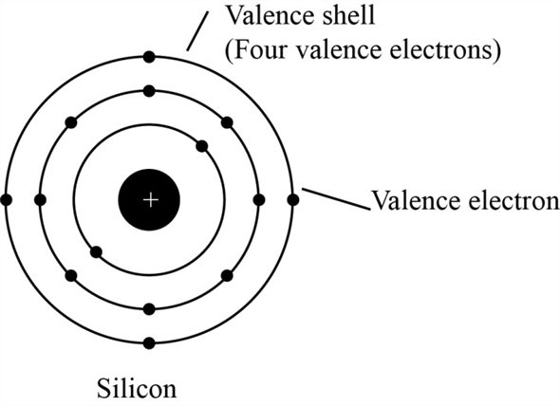
Chapter 2/Atoms, Molecules, and Ions
2.11. Electron Configuration and valence electron:
Valence electron :(الالكترونات الداخلية) those electron that are important in chemical bonding.
For main group element, the valance electrons are those in outermost principal energy level.
Core electron (إلكترونات التكافؤ) : those electrons in a complete principal energy level and those in complete d and f sublevels.
Example: Silicon (Si) has 4 valance electrons and has 10 core electrons.
Si

Slide 21
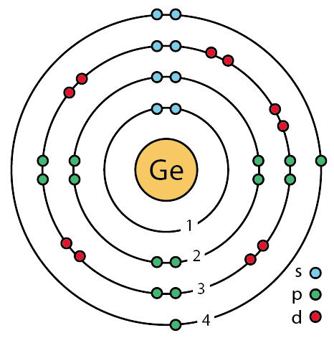
Chapter 2/Atoms, Molecules, and Ions
2.11. Electron Configuration and valence electron:
Example 2.7: Write the electron configuration of Ge and identify valance and core electrons?
Atomic number of Ge= 32
Ge: 1s² 2s² 2p⁶ 3s² 3p⁶ 4s² 3d¹⁰ 4p²

Slide 22
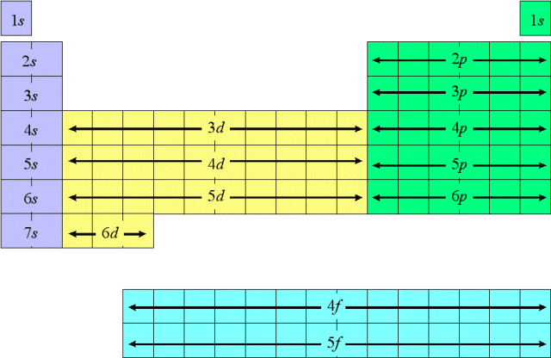
Chapter 2/Atoms, Molecules, and Ions
2.10. Electron Configuration:
Periodic table are divisible into 4 blocks corresponding to filling of 4 quantum sublevels (s,p,d,f )

Slide 23
Chapter 2/Atoms, Molecules, and Ions
2.11. Electron Configuration and valence electron:
The group number is equal to the number of valance electron
The row number is equal to the highest principle quantum number (n).
principle quantum number
number of valance electron
Cl is in column 7A thus it has 7 valence electrons
Also is in row 3 thus it has 3n (principle quantum number )

Slide 24
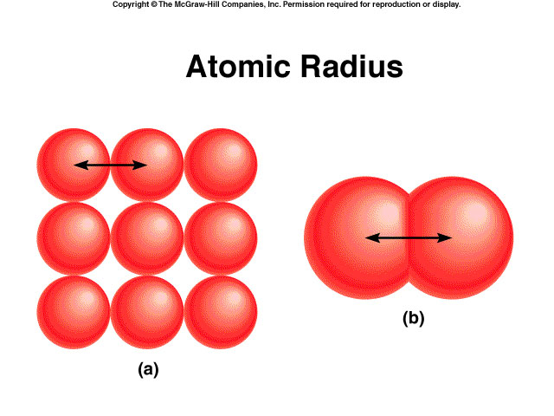
Chapter 2/Atoms, Molecules, and Ions
2.13. Periodic trends in the size of atoms
Atomic Radius: (نصف القطر الذري)
is a term used to describe the size of the atom,
نصف قطر التشارك
and it is one-half (½) the distance between the two nuclei in two adjacent metal atoms (a) or in a diatomic molecule (b).

Slide 25
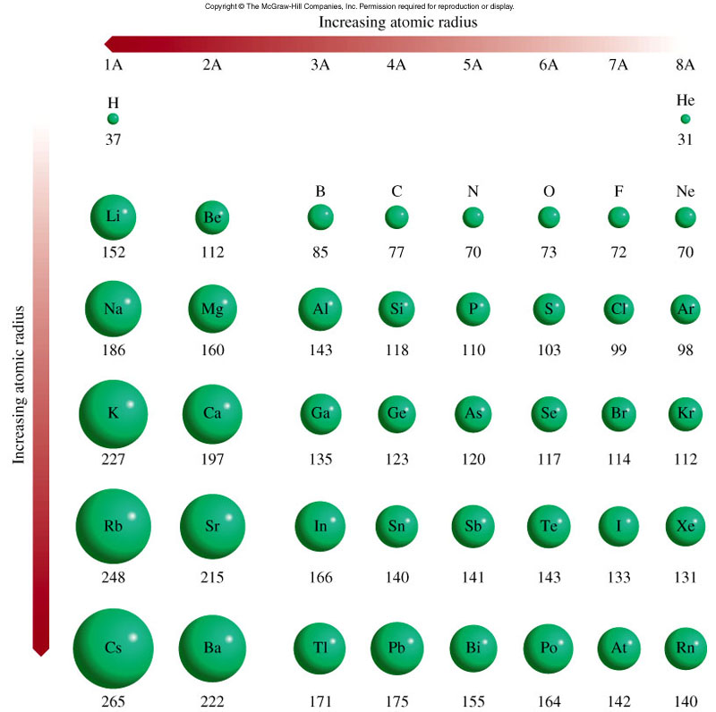
Chapter 2/Atoms, Molecules, and Ions
2.13. Periodic trends in the size of atoms
1.Atomic Radius
In the same period: the effective nuclear charge increases from left to right → n is the same → the added valence electron is more strongly attracted by the nucleus → the atomic radius decreases from left to right in the period.
In the same group: n increases → atomic radius increases from top to bottom in the group.
Decreasing atomic radius
Increasing atomic radius

Slide 26
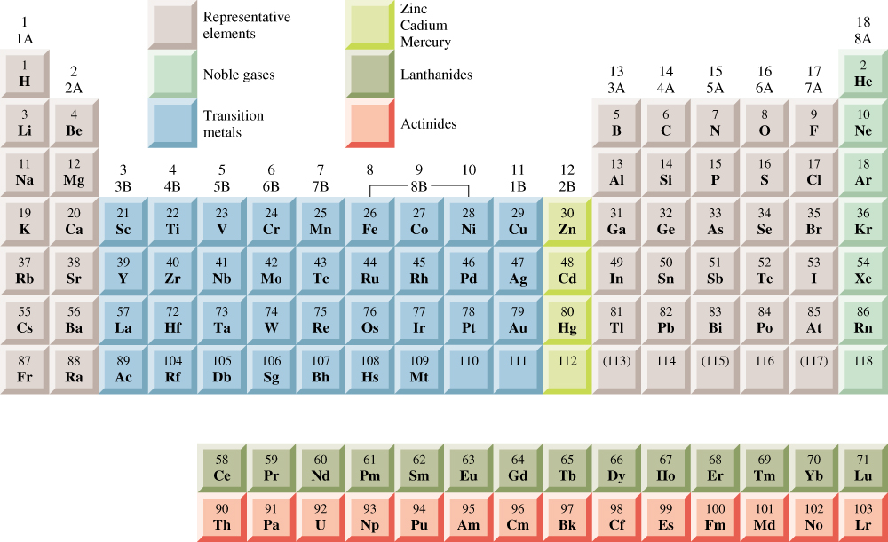
Chapter 2/Atoms, Molecules, and Ions
2.13. Periodic trends in the size of atoms
1.Atomic Radius
General Trend in Atomic radius:
Decreasing atomic radius
Increasing atomic radius

Slide 27
Chapter 2/Atoms, Molecules, and Ions
2.13. Periodic trends in the size of atoms
1.Atomic Radius
Example: Referring to a periodic table, arrange the following atoms in order of increasing atomic radius: P, Si, N.
Solution:
N & P are in the same group → N is smaller than P
2. P & Si are in the same period → P is smaller than Si
The arrangement of increasing atomic radius is:
N < P < Si

Slide 28
Chapter 2/Atoms, Molecules, and Ions
2.13. Periodic trends in the size of atoms
2- Ionization Energy (طاقة التأين) : is the minimum energy (kJ/mol) required to remove an electron from a gases atom in its ground state.
Atom → cation
I₁ + X _{(g)} X⁺_{(g)} + e⁻
I₁ first ionization energy
I₂ + X⁺_{(g)} X²⁺_{(g)} + e⁻
I₂ second ionization energy
I₃ + X²⁺_{(g)} X³⁺_{(g)} + e⁻
I₃ third ionization energy
The higher ionization energy, the more difficult is to remove the electrons.

Slide 29
Chapter 2/Atoms, Molecules, and Ions
2.13. Periodic trends in the size of atoms
2. Ionization Energy
General Trend in Ionization Energy:
Increasing First Ionization Energy
Decreasing First Ionization Energy

Slide 30
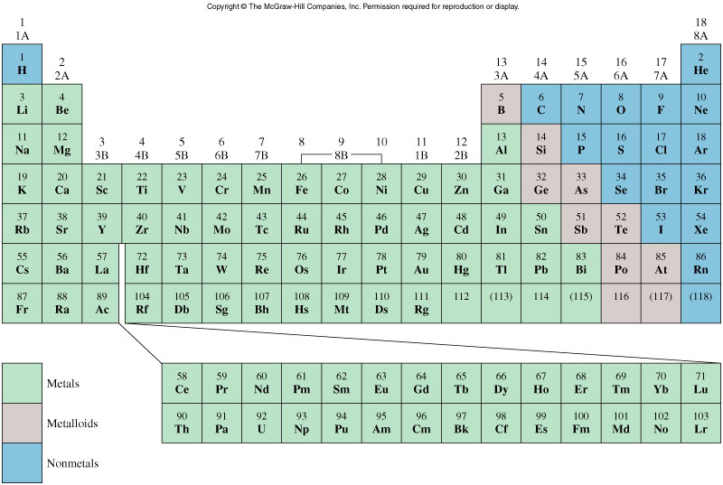
Chapter 2/Atoms, Molecules, and Ions
2.13. Periodic trends in the size of atoms
Example : Which atom should have a smaller first ionization energy: oxygen (O) or sulphur (S)?
Solution:
O & S are in group 6A
O: [He] 2s² 2p⁴
S: [Ne] 3s² 3p⁴
The valence electrons in S are farther from the nucleus → removing of them is easier
Thus: I₁ (S) < I₁ (O)
Increasing First Ionization Energy
Decreasing First Ionization Energy

Slide 31
Chapter 2/Atoms, Molecules, and Ions
2.13. Periodic trends in the size of atoms
3- Electron Affinity :(الألفة الالكترونية) is the negative of the energy change that occurs when an electron is accepted by an atom in the gases state to form an anion.
X _{(g)} + e⁻ X⁻_{(g)}
F _{(g)} + e⁻ F⁻_{(g)}
ΔH = -328 kJ/mol
EA = +328 kJ/mol
O _{(g)} + e⁻ O⁻_{(g)}
ΔH = -141 kJ/mol
EA = +141 kJ/mol
The higher electron affinity, the greater affinity to accept the electron.
Notes:
هي كمية الطاقة الممتصة عند إضافة إلكترون لذرة غازية متعادلة لتكوين أيون غازي بشحنة مقدارها -1. وتصبح شحنتها سالبة عند انطلاق الطاقة.

Slide 32
Chapter 2/Atoms, Molecules, and Ions
2.13. Periodic trends in the size of atoms
3. Electron affinity
General Trend in Electron affinity :
Increasing Electron affinity
Decreasing Electron affinity

Slide 33
Chapter 2/Atoms, Molecules, and Ions
2.13. Periodic trends in the size of atoms
3. Electron affinity
Increasing Electron affinity
Which choice correctly lists the elements in order of decreasing electron affinity?
O, Cl, B, C
O, Cl, C, B
Cl, O, C, B
Cl, O, B, C
Decreasing Electron affinity
من الأكبر إلى الأصغر

Slide 34
Chapter 2/Atoms, Molecules, and Ions
2.13. Periodic trends in the size of atoms
4. Metallic Character
Metal: large class of element that are generally good conductor of heat and electricity, malleable (قابلة للطرق), ductile (قابلة لسحب), lustrous (لامعة), and tend to lose electrons during chemical change.
General Trend:
decreasing Metallic Character
Increasing Metallic Character

Slide 35
Chapter 2/Atoms, Molecules, and Ions
2.13. Periodic trends in the size of atoms
4. Metallic Character
decreasing Electron affinity
Example 2.9 (p43):
choose the more metallic element from following:
Sn or Te
Sn>Te
(b) P or Sb
Sb > P
increasing Electron affinity

Slide 36
Chapter 2/Atoms, Molecules, and Ions
H.W
23, 24 (a and b) 25, 29, p45
38, 43 p46

Slide 37
Chapter 2/Atoms, Molecules, and Ions
Reviewمراجعة
(1) The element that has the valance electron configuration 3s² 3p³ is:
Carbon
Nitrogen
Phosphorus
Neon
(2) Titanium (Ti) element is found in the periodic table in
s-block
P-block
d-block
f-block

Slide 38
Chapter 2/Atoms, Molecules, and Ions
Reviewمراجعة
(3) What the electronic configuration for Co
[Ar] 4s² 3d⁵
[Ar] 4s² 3d⁷
[Ar] 4s¹ 3d⁶
[Ar] 4s² 3d⁴
(4) Arrange the following in order of increasing first ionization energy: F, K, P, Ca, and Ne.
K < Ca < P < F < Ne
Ne < F < Ca < K < P
P < F < Ne < K < Ca
K < F < P < Ne < Ca
Notes:
Co: [Ar] 4s² 3d⁷ (transition metal)
→ Co²⁺: [Ar] 3d⁷

Slide 39
Chapter 2/Atoms, Molecules, and Ions
Reviewمراجعة
(5) Which of these elements is most likely to be a good
conductor of electricity?
N
S
He
Fe
(6) magnesium ion, ₁₂Mg²⁺ , has
12 protons and 13 electrons.
24 protons and 26 electrons.
12 protons and 10 electrons.
24 protons and 22 electrons.
Notes:
Co: [Ar] 4s² 3d⁷ (transition metal)
→ Co²⁺: [Ar] 3d⁷

