Slide 1
Unit 3 My house
Lesson 1

Slide 3
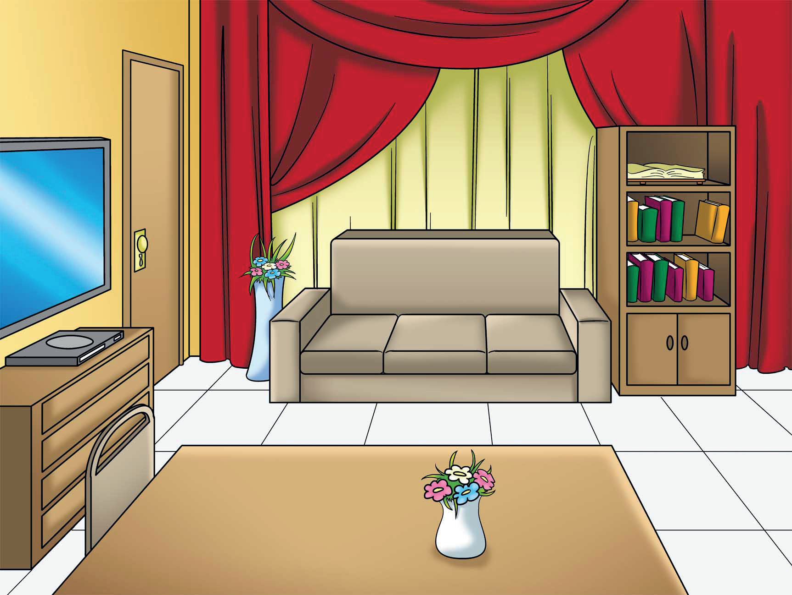
living room

Slide 4
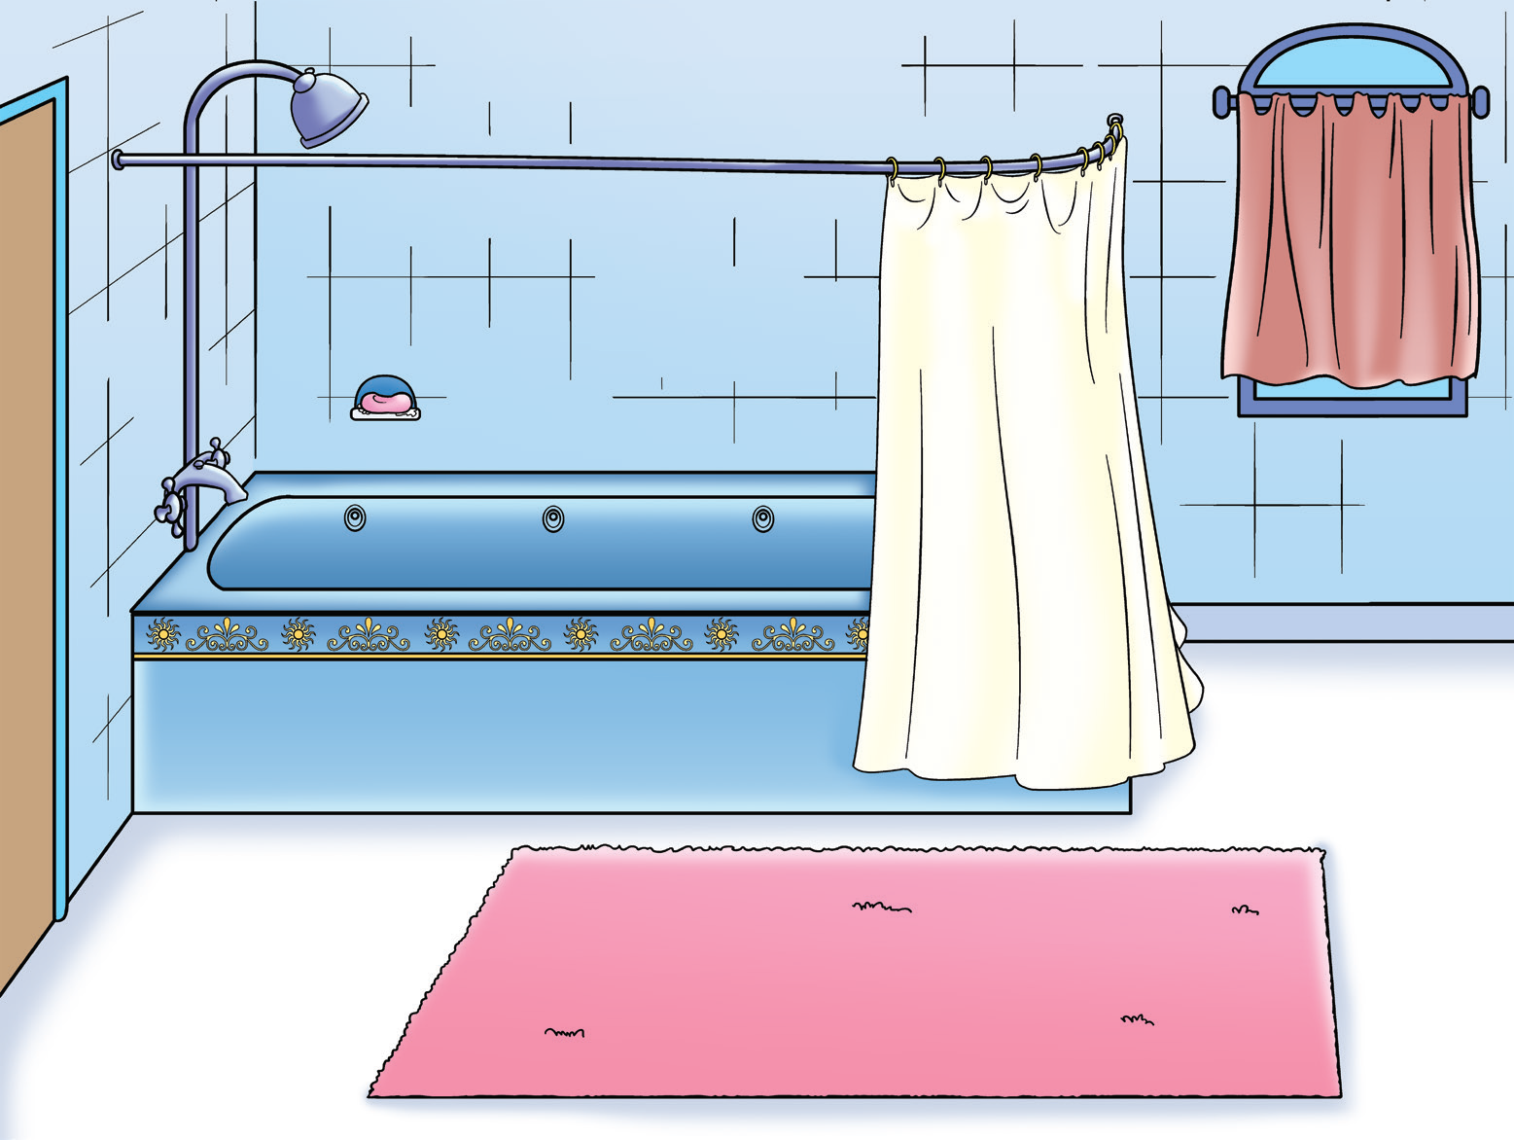
bathroom

Slide 5
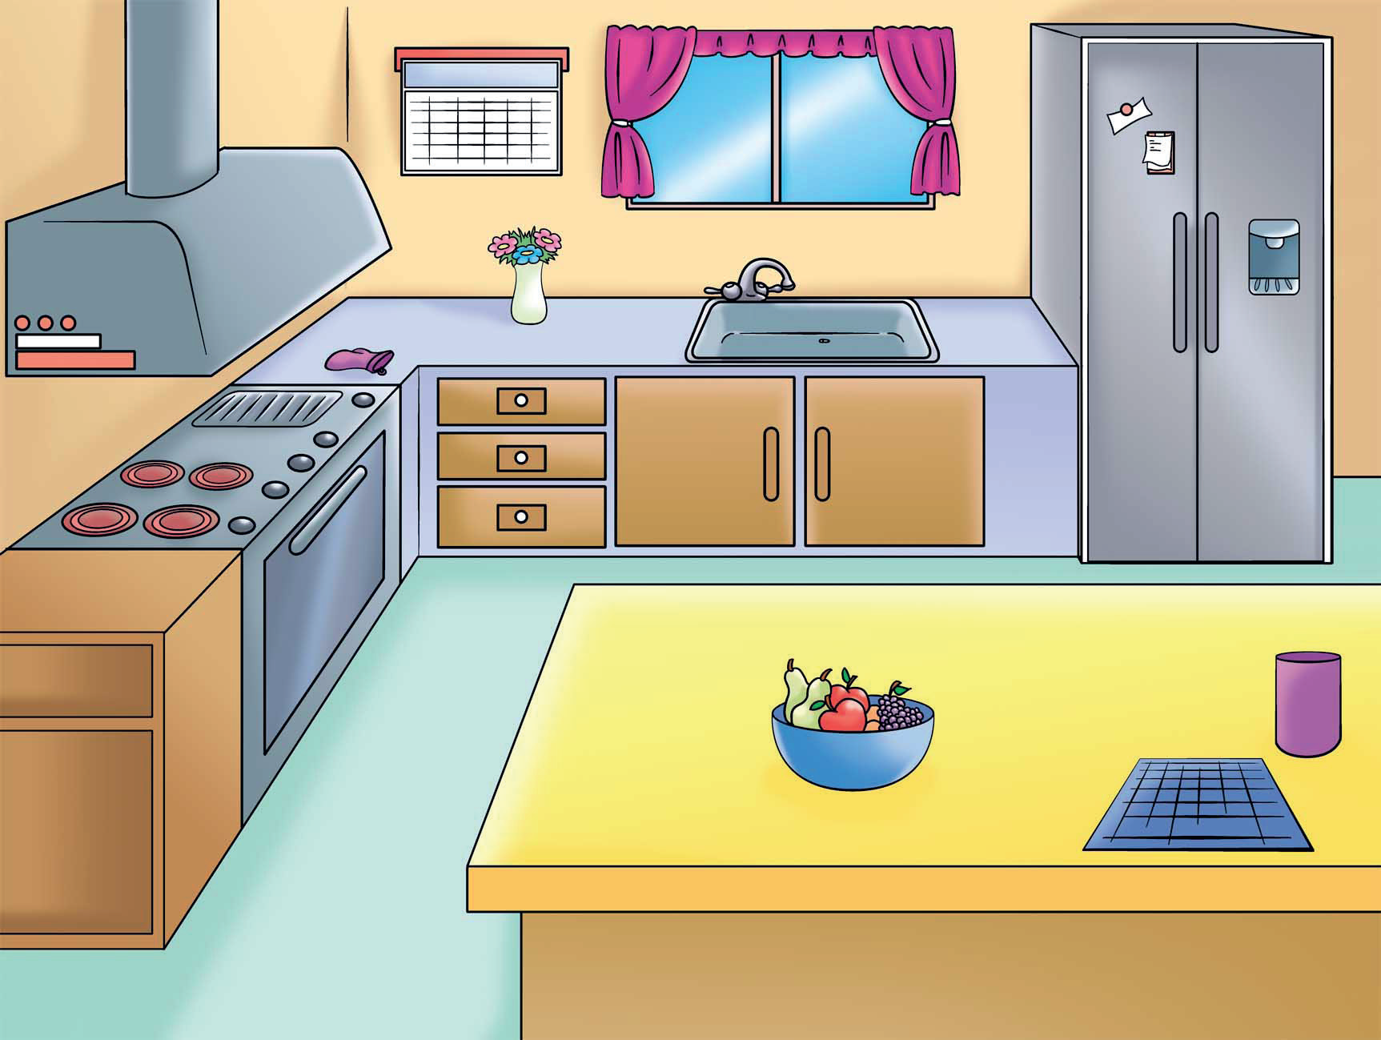
kitchen

Slide 6
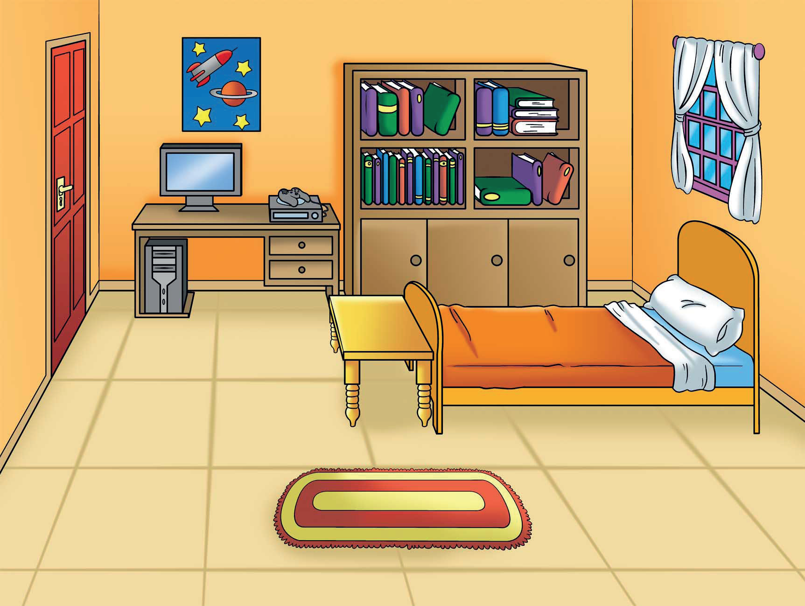
bedroom

Slide 7
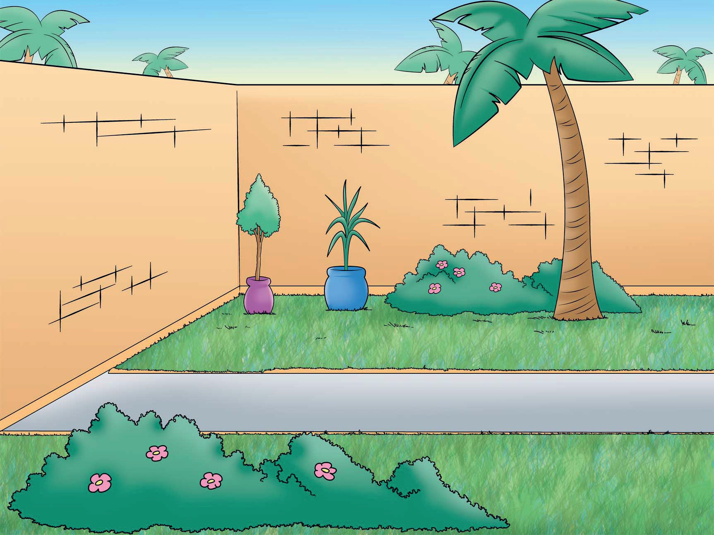
garden

Slide 8
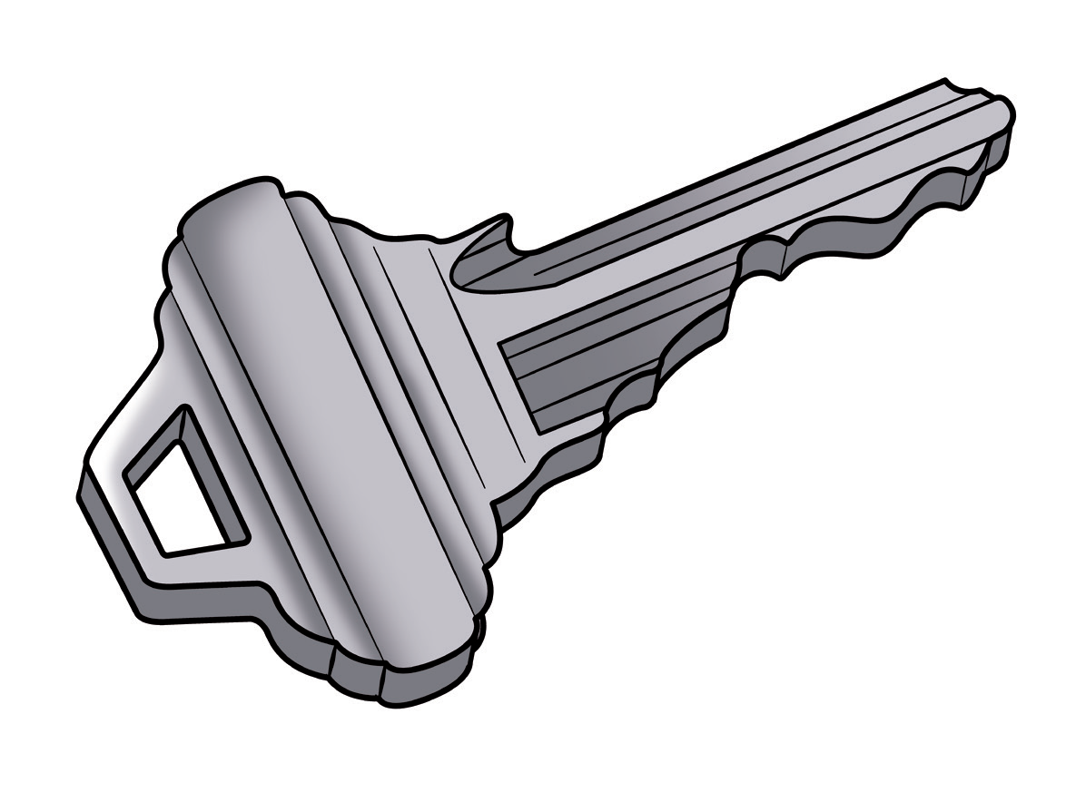
key

Slide 9
J j
juice

Slide 10
U u
umbrella

Slide 11
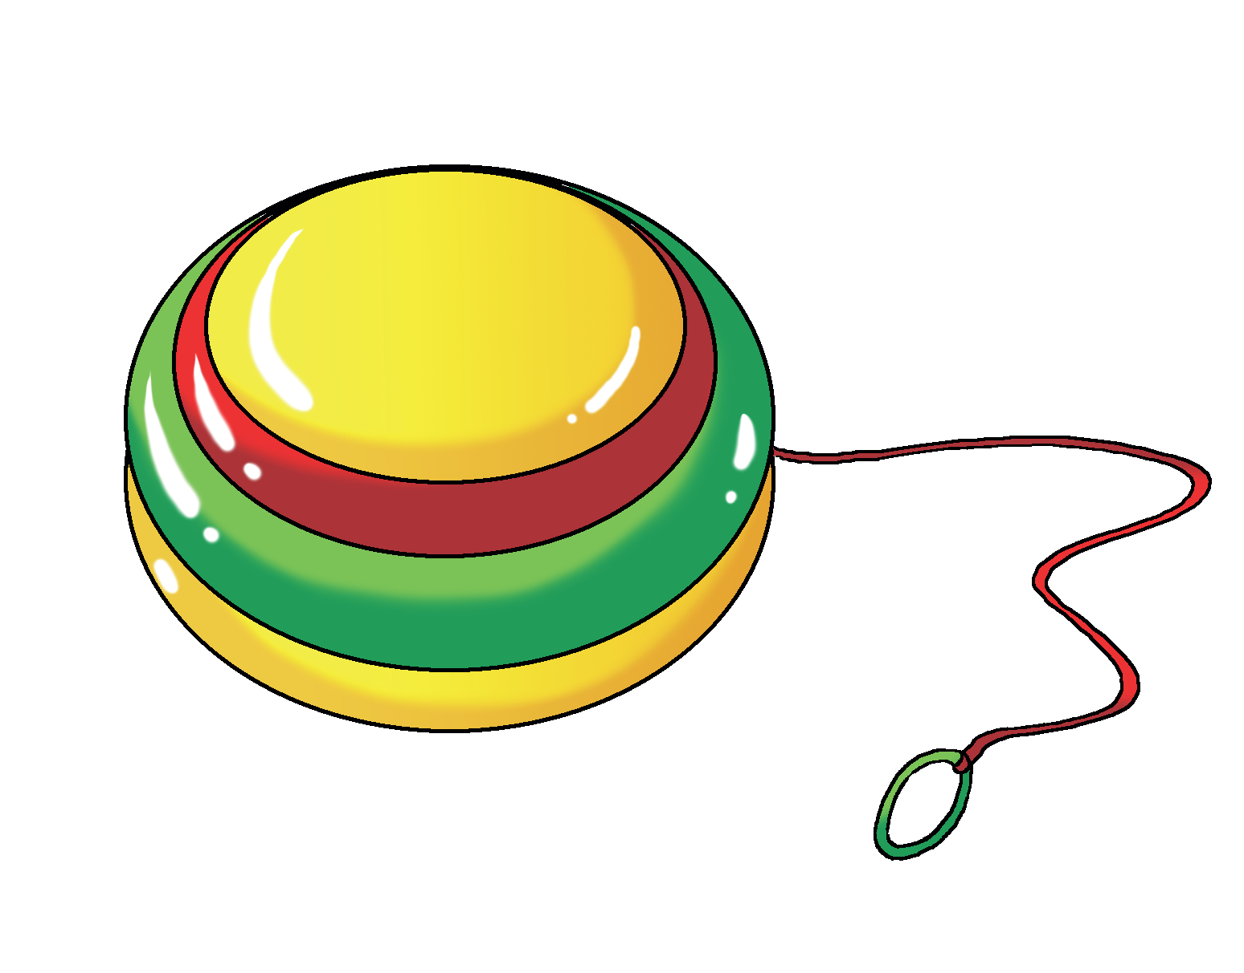
Y y
yo – yo

Slide 12
Write the new words & letters on B.B my house – living room – bathroom – bedroom – kitchen – garden – key J j – U u – Y y

Slide 13
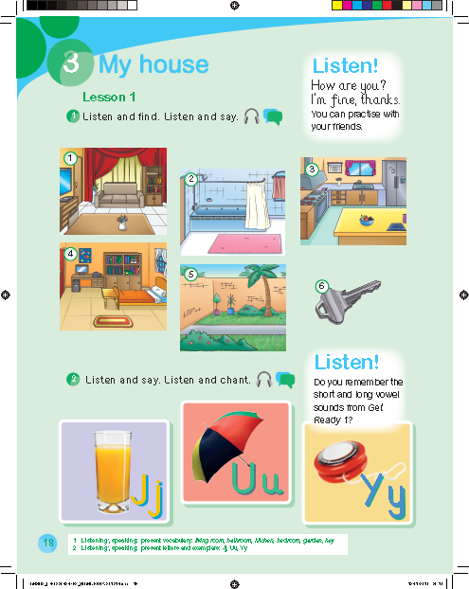

Slide 15
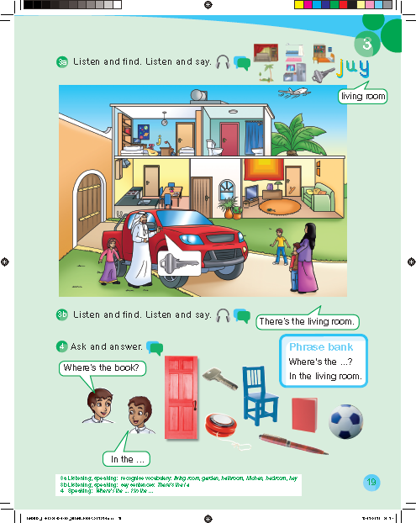

Slide 17
Work book p. 67

Slide 18
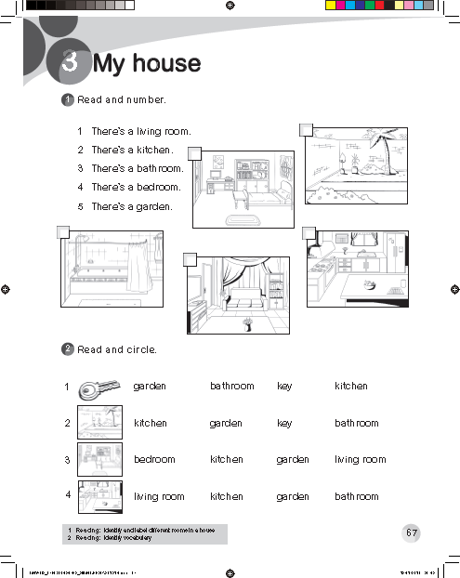
5
4
3
2
1

