Slide 1
The Muscular Tissues

Slide 2
The Muscular Tissues
General characteristics of the muscular tissues:
The cells of the muscular tissues are elongated elements, named muscle fibers.
The cytoplasm of the muscle fiber, the sarcoplasm, contains myofibrils. These fibrils are made up of the proteins actin and myosin.
The plasma membrane of the muscle fiber is called the sarcolemma.
There are three types of muscle fiber:
Skeletal muscles, which are voluntary and striated.
Smooth muscle, which are involuntary and non- striated.
Cardiac muscles, which are involuntary and striated.

Slide 3
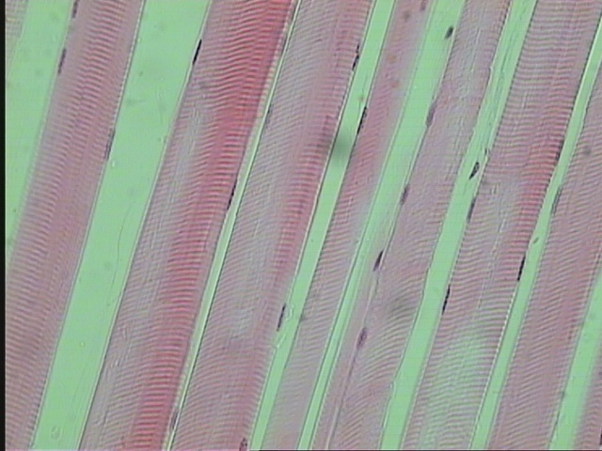
The skeletal or striated muscles L.S of skeletal muscles
the muscle attached to the skeleton.
muscle fibers are transversely striated and are voluntary
Each muscle fiber is elongated, unbranched, cylindrical cell, with numerous peripheral flatten nuclei
sarcolemma
nuclei
Connective
tissue
Dark and light bands
Muscle fiber

Slide 4
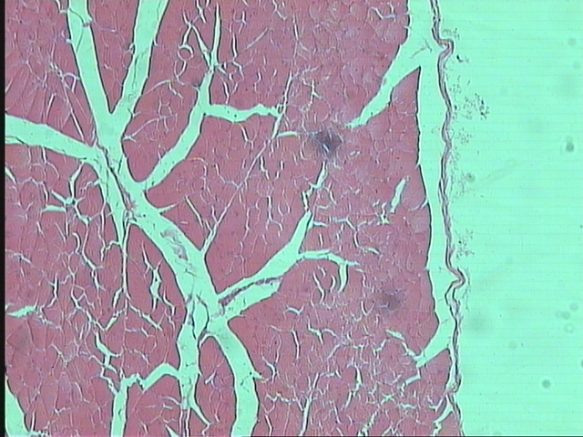
T.S of skeletal muscles
Each individual muscle fiber is surrounded by a delicate connective tissue, the endomysium
Bundles or groups of fibers are wrapped by a dense connective tissue called the perimysium
The whole muscle (formed of several bundles) is covered by a dense connective tissue sheath, the epimysium
1
2
3
T.S. of Striated Muscles Fibers (Skeletal Muscles Fibers)
Endomysium 2-Perimysium -3- Epimysium

Slide 5
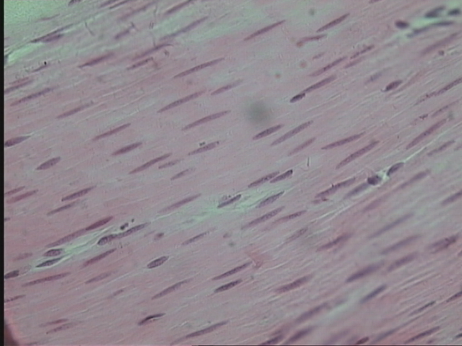
The Smooth Unstriated Muscle
These muscles are present in the wall of blood vessels, and digestive, respiratory, urinary and reproduction systems
The smooth muscle fibers are Unstriated and involuntary
The smooth muscle fibers are elongated, spindle- shaped cells with pointed ends.
The nucleus is elongated or rod-shaped and centrally located in the cytoplasm at the widest part of the cell.
nuclei
Muscle fiber
Connective
tissue

Slide 6
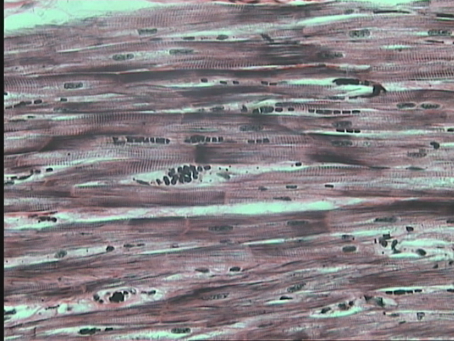
The Cardiac Muscles
These muscles are present in the heart
The cardiac muscle fibers are striated but are involuntary.
cardiac muscle fibers are elongated, branched, mononucleate or binucleate cells.
The nuclei are oval and centrally located.
At the end to end junction of the cells there are intercalated discs.
nuclei
Connective tissue
Dark and light bands
intercalated disc
Muscle fiber

Slide 7
The Nervous Tissues

Slide 8
The nervous system is divided anatomically into:-

Slide 9
Structure of the Neuron
The cell body
it is also called the perikaryon or soma. It contains the nucleus and much of the metabolic machinery of the cell
The axon
a single, usually long process specialized in conducting nerve impulses to other cells
The dendrites
they are multiple cytoplasmic processes specialized in receiving stimuli and transmitting them to the cell body.

Slide 10
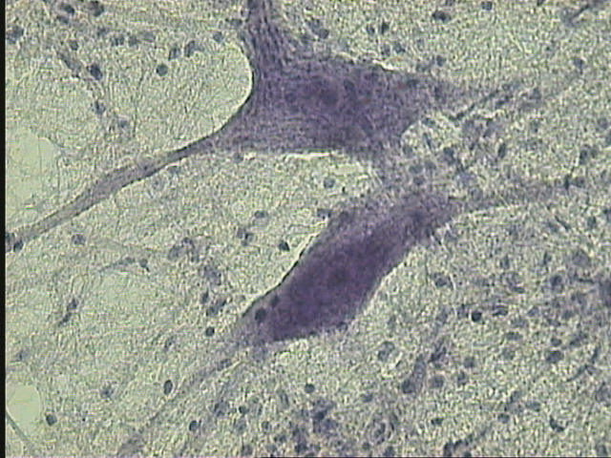
Neurons
Glial cell nucleus
The nervous Tissue
Neurons – Glial cell nucleus

Slide 11
Thank you
for your attention

