Slide 1


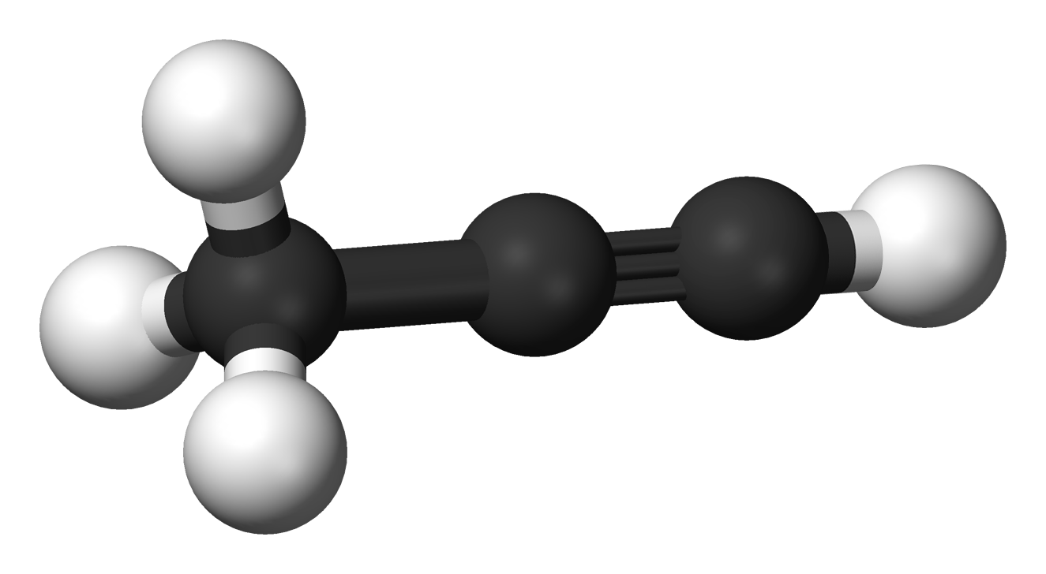
Unsaturated Hydrocarbons
Alkynes
1435-1436
2014-2015
1

Slide 2


Learning Objectives
Alkynes
Chapter three discusses the following topics which have to be understood and memorized :
The structure, hybridization and Bonding in alkynes
Common and IUPAC naming of alkynes
Physical properties of alkynes
Preparation of alkynes
Reactions of alkynes: addition reactions and acidity

Slide 3
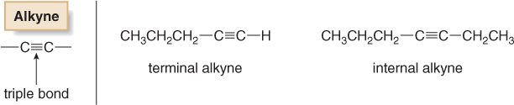
Alkynes: Molecular And Structural Formulae
Alkynes
The alkynes comprise a series of carbon- and hydrogen- based compounds that contain at least one triple bond. This group of compounds is a homologous series with the general molecular formula of C_{n} H_{2n—2}
The alkyne triple bond is composed of one σ and two 2 π covalent bonds, the triple bond can be terminal or internal.
The simplest alkyne, ethyne (also known as acetylene), has two carbon atoms and the molecular formula of C₂H₂. The structural formula for ethyne is:
3

Slide 4
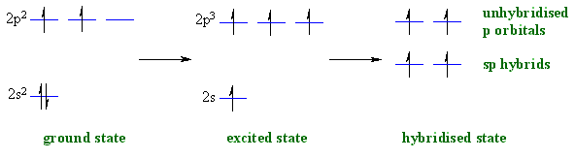

sp Hybridization Of Alkynes
Alkynes
This involves the mixing of one s- and one p-orbital forming two sp-hybrid orbitals of equivalent energy. The two sp-hybrid orbitals are oriented in a linear arrangement and bond angle is 180° to minimize the repulsion between them.
The remaining two p orbitals (py and Pz) are unaltered
4

Slide 5
Alkynes
Orbital Overlap IN Ethyne
Molecular formula of ethyne is C₂H₂.
In ethyne, each carbon atom is sp-hybridized.
In this way, four sp-orbital are generated.
One sp- orbital of each carbon atom by overlapping forms a sigma bond between carbon atoms.
Remaining one sp-orbital of each carbon atom overlap with 1s-orbital of a hydrogen atom to produce two sigma bonds.
P_{y}-orbital and P_{z}-orbitals of each carbon by parallel overlapping form two pi-bonds between the two carbon atoms.
Geometry (shape) of ethyne molecule is linear in which bond angles are 180º and C=C bond length is 1.20 Å
5

Slide 6

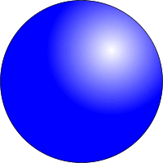
Alkynes
sp HYBRIDISATION OF ORBITALS in ALKYNES
The electronic configuration of a carbon atom is 1s²2s²2p²
2s²2p²
2s¹2p³
2 x sp
2p
promotion
hybridization

Slide 7

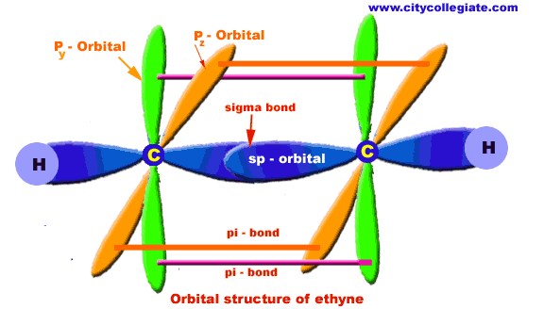
Alkynes
7

Slide 8
Alkynes
Summary
sp hybridization occurs when a C has 2 sigma bonds only
sp hybridized orbital has 50% s and 50% p character
The 2 sp hybrids point in opposite directions at 180º to each other
Each sp hybrid is involved in a(σ)sigma bond
The remaining p orbitals form the 2pi bonds
The triple bond is one (σ)bond and two pi (∏) bonds.
8

Slide 9
IUPAC Nomenclature of Alkynes
Alkynes
Find the longest chain containing both atoms of the triple bond; this gives the root name.
Add the ending –yne to the root name.
Number the chain, starting at the end closest to the triple bond.
Give branches or other substituents names and numbers to locate their positions.
Indicate the number of identical groups by prefixes di, tri, tetra, etc.
Place the position numbers and names of the substituent groups in alphabetical order, before the root name. In alphabetizing ignore prefixes like tert., di, tri, etc. but include iso and cyclo.
Double and triple bonds are considered to have equal priority: thus in a molecule with both a double and triple bond, whichever is close to the end of the chain determines the direction of numbering.
In case where double and triple bonds would have the same position number, the double bond takes the lower number.
In writing the final name ‘’ene’’ comes before ‘’yne’’ regardless which takes the lower number (i.e. alphabetical order).
9

Slide 10
Examples
IUPAC Names Of Alkynes
Alkynes

Slide 11
Common Nomenclature Of Alkynes
Alkynes
The simplest alkyne its common name is acetylene
Therefore the common names of alkynes are derived from acetylene
( e.g. Methyl acetylene)
Examples:
HC ≡CH
Common : Methyl acetylene
Common : Isobutyisopropylacetylene
Common: Isopropylmethylacetylene

Slide 12
Exercise
Alkynes
Give the IUPAC and common names of the following compounds
12

Slide 13
Physical Properties
Alkynes
Nonpolar, insoluble in water.
Soluble in most organic solvents.
The boiling points and melting points of alkynes increase with molecular weight.
Branching reduces the boiling point of alkynes
Terminal alkynes, R-C≡C-H, are more acidic than other hydrocarbons.
13

Slide 14
Preparation of alkynes
Alkynes
By dehydrohalogenation of geminal or vicinal dihaloalkanes
(-2HX):
14

Slide 15
Alkynes
From reaction of sodium Acetylide with Primary Alkyl Halides (Alkylationof acetylide with primary alkyl halid)
For Terminal C≡C (use only Acetylene H-C≡C-H)
For Non Terminal C≡C (use Monosub. R-C≡C-H)

Slide 16
Alkynes

Slide 17
Reactions of alkynes
Alkynes
Electrophilic Addition Reaction
1. Addition of hydrogen ( Hydrogenation)
Alkynes can be partially reduced to cis-alkenes with H₂ in the presence of poisoned catalysts.
or (Z)
Alkynes can be reduced to trans-alkenes using Na or Li in liquid NH₃
or (E)
17

Slide 18
2. Addition of halogen (Halogenation)
Alkynes
HC≡CH + X₂ HXC=CXH + X₂ H XX C–CXXH
Trans
If we used one mole ……(alkene) two mole …….alkane
18

Slide 19
Alkynes
3. Addition of hydrogen halide
HC ≡ CR + HX HHC=CX R + HX HHHC – CXXR

Slide 20
Alkynes
4. Addition of water: Hydration

Slide 21
Alkynes
1. An alkyne’s name ends with
(a) –ane (b) -ene
(c) –yne (d) diene
2. An alkyne function has …….. pi bond(s).
(a) one (b) two
(c) three (d) four
3. Alkynes react with HCl by a mechanism called
(a) elimination (b) Markovnikov addition
(c) (d) substitution
4. Alkynes react with water in the presence of a catalyst to give
(a) a dialcohol (diol) (b) an alkane
(c) an enol (d) a dibromide
5. The conversion of alkynes to alkanes is an example of
(a) oxidation (b) reduction
(c) chlorination (d) dehydration

Slide 22
Thank You for your kind attention !
Alkynes
Questions?
Comments

