Slide 1
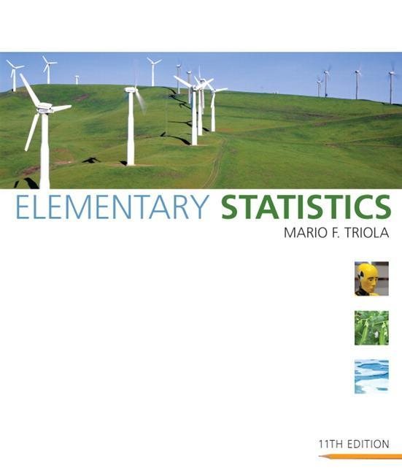
Lecture Slides
Elementary Statistics Eleventh Edition
and the Triola Statistics Series
by Mario F. Triola

Slide 2
Chapter 1 Introduction to Statistics
1-1 Review and Preview
1-2 Statistical Thinking
1-3 Types of Data
1-4 Critical Thinking
1-5 Collecting Sample Data

Slide 3
Section 1-1
Review and Preview

Slide 4
Preview
Polls, studies, surveys and other data collecting tools collect data from a small part of a larger group so that we can learn something about the larger group. This is a common and important goal of statistics: Learn about a large group by examining data from some of its members.

Slide 5
Preview
In this context, the terms sample and population have special meaning. Formal definitions for these and other basic terms will be given here.
In this section we will look at some of the ways to describe data.

Slide 6
Data
Data
collections of observations (such as measurements, genders, survey responses)

Slide 7
Statistics
Statistics
is the science of planning studies and experiments, obtaining data, and then organizing, summarizing, presenting, analyzing, interpreting, and drawing conclusions based on the data

Slide 8
Population
Population
the complete collection of all individuals (scores, people, measurements, and so on) to be studied; the collection is complete in the sense that it includes all of the individuals to be studied

Slide 9
Census versus Sample
Census
Collection of data from every member of a population
Sample
Subcollection of members selected from a population

Slide 10
Chapter Key Concepts
Sample data must be collected in an appropriate way, such as through a process of random selection.
If sample data are not collected in an appropriate way, the data may be so completely useless that no amount of statistical torturing can salvage them.

Slide 11
Section 1-2
Statistical Thinking

Slide 12
Key Concept
This section introduces basic principles of statistical thinking used throughout this book. Whether conducting statistical analysis of data that we have collected, or analyzing a statistical analysis done by someone else, we should not rely on blind acceptance of mathematical calculation. We should consider these factors:

Slide 13
Key Concept (continued)
Context of the data
Source of the data
Sampling method
Conclusions
Practical implications

Slide 14
Context
What do the values represent?
Where did the data come from?
Why were they collected?
An understanding of the context will directly affect the statistical procedure used.

Slide 15
Source of data
Is the source objective?
Is the source biased?
Is there some incentive to distort or spin results to support some self-serving position?
Is there something to gain or lose by distorting results?
Be vigilant and skeptical of studies from sources that may be biased.

Slide 16
Sampling Method
Does the method chosen greatly influence the validity of the conclusion?
Voluntary response (or self-selected) samples often have bias (those with special interest are more likely to participate). These samples’ results are not necessarily valid.
Other methods are more likely to produce good results.

Slide 17
Conclusions
Make statements that are clear to those without an understanding of statistics and its terminology.
Avoid making statements not justified by the statistical analysis.

Slide 18
Practical Implications
State practical implications of the results.
There may exist some statistical significance yet there may be NO practical significance.
Common sense might suggest that the finding does not make enough of a difference to justify its use or to be practical.

Slide 19
Statistical Significance
Consider the likelihood of getting the results by chance.
If results could easily occur by chance, then they are not statistically significant.
If the likelihood of getting the results is so small, then the results are statistically significant.

Slide 20
Section 1-3
Types of Data

Slide 21
Key Concept
The subject of statistics is largely about using sample data to make inferences (or generalizations) about an entire population. It is essential to know and understand the definitions that follow.

Slide 22
Parameter
Parameter
a numerical measurement describing some characteristic of a population.
population
parameter

Slide 23
Statistic
Statistic
a numerical measurement describing some characteristic of a sample.
sample
statistic

Slide 24
Quantitative Data
Quantitative (or numerical) data
consists of numbers representing counts or measurements.
Example: The weights of supermodels
Example: The ages of respondents

Slide 25
Categorical Data
Categorical (or qualitative or attribute) data
consists of names or labels (representing categories)
Example: The genders (male/female) of professional athletes
Example: Shirt numbers on professional athletes uniforms - substitutes for names.

Slide 26
Working with Quantitative Data
Quantitative data can further be described by distinguishing between discrete and continuous types.

Slide 27
Discrete Data
Discrete data
result when the number of possible values is either a finite number or a ‘countable’ number
(i.e. the number of possible values is
0, 1, 2, 3, . . .)
Example: The number of eggs that a hen lays

Slide 28
Continuous Data
Continuous (numerical) data
result from infinitely many possible values that correspond to some continuous scale that covers a range of values without gaps, interruptions, or jumps
Example: The amount of milk that a cow produces; e.g. 2.343115 gallons per day

Slide 29
Levels of Measurement
Another way to classify data is to use levels of measurement. Four of these levels are discussed in the following slides.

Slide 30
Nominal Level
Nominal level of measurement
characterized by data that consist of names, labels, or categories only, and the data cannot be arranged in an ordering scheme (such as low to high)
Example: Survey responses yes, no, undecided

Slide 31
Ordinal Level
Ordinal level of measurement
involves data that can be arranged in some order, but differences between data values either cannot be determined or are meaningless
Example: Course grades A, B, C, D, or F

Slide 32
Interval Level
Interval level of measurement
like the ordinal level, with the additional property that the difference between any two data values is meaningful, however, there is no natural zero starting point (where none of the quantity is present)
Example: Years 1000, 2000, 1776, and 1492

Slide 33
Ratio Level
Ratio level of measurement
the interval level with the additional property that there is also a natural zero starting point (where zero indicates that none of the quantity is present); for values at this level, differences and ratios are meaningful
Example: Prices of college textbooks ($0 represents no cost, a $100 book costs twice as much as a $50 book)

Slide 34
Summary - Levels of Measurement
Nominal - categories only
Ordinal - categories with some order
Interval - differences but no natural starting point
Ratio - differences and a natural starting point

Slide 35
Recap
In this section we have looked at:
Basic definitions and terms describing data
Parameters versus statistics
Types of data (quantitative and qualitative)
Levels of measurement

Slide 36
Section 1-4
Critical Thinking

Slide 37
Key Concepts
Success in the introductory statistics course typically requires more common sense than mathematical expertise.
Improve skills in interpreting information based on data.
This section is designed to illustrate how common sense is used when we think critically about data and statistics.
Think carefully about the context, source, method, conclusions and practical implications.

Slide 38
Misuses of Statistics
1. Evil intent on the part of dishonest people.
2. Unintentional errors on the part of people who don’t know any better.
We should learn to distinguish between statistical conclusions that are likely to be valid and those that are seriously flawed.

Slide 39
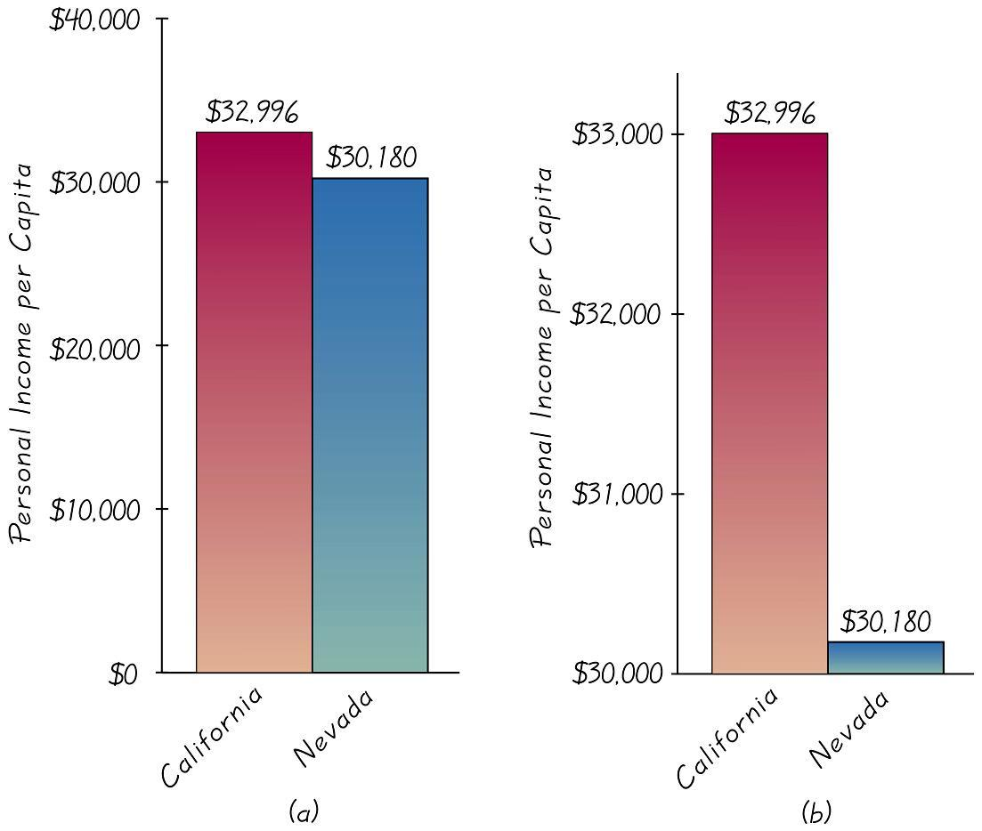
Graphs
To correctly interpret a graph, you must analyze the numerical information given in the graph, so as not to be misled by the graph’s shape. READ labels and units on the axes!

Slide 40
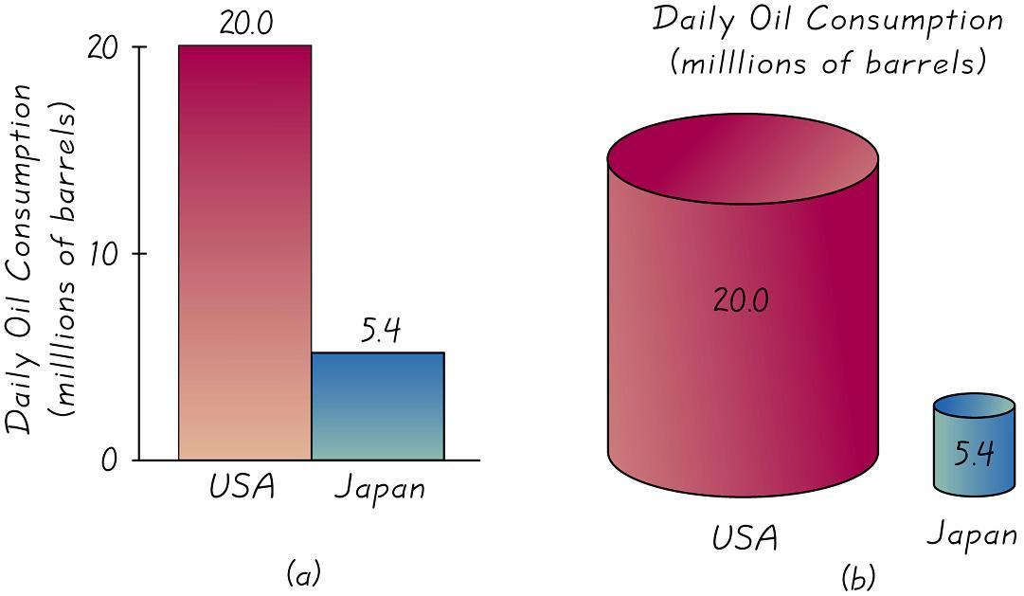
Pictographs
Part (b) is designed to exaggerate the difference by increasing each dimension in proportion to the actual amounts of oil consumption.

Slide 41
Bad Samples
Voluntary response sample
(or self-selected sample)
one in which the respondents themselves decide whether to be included
In this case, valid conclusions can be made only about the specific group of people who agree to participate and not about the population.

Slide 42
Correlation and Causality
Concluding that one variable causes the other variable when in fact the variables are linked
Two variables may seemed linked, smoking and pulse rate, this relationship is called correlation. Cannot conclude the one causes the other. Correlation does not imply causality.

Slide 43
Small Samples
Conclusions should not be based on samples that are far too small.
Example: Basing a school suspension rate on a sample of only three students

Slide 44
Percentages
Misleading or unclear percentages are sometimes used. For example, if you take 100% of a quantity, you take it all. If you have improved 100%, then are you perfect?! 110% of an effort does not make sense.

Slide 45
Loaded Questions
If survey questions are not worded carefully, the results of a study can be misleading. Survey questions can be “loaded” or intentionally worded to elicit a desired response.
Too little money is being spent on “welfare” versus too little money is being spent on “assistance to the poor.” Results: 19% versus 63%

Slide 46
Order of Questions
Questions are unintentionally loaded by such factors as the order of the items being considered.
Would you say traffic contributes more or less to air pollution than industry? Results: traffic - 45%; industry - 27%
When order reversed. Results: industry - 57%; traffic - 24%

Slide 47
Nonresponse
Occurs when someone either refuses to respond to a survey question or is unavailable.
People who refuse to talk to pollsters have a view of the world around them that is markedly different than those who will let poll-takers into their homes.

Slide 48
Missing Data
Can dramatically affect results.
Subjects may drop out for reasons unrelated to the study.
People with low incomes are less likely to report their incomes.
US Census suffers from missing people (tend to be homeless or low income).

Slide 49
Self-Interest Study
Some parties with interest to promote will sponsor studies.
Be wary of a survey in which the sponsor can enjoy monetary gain from the results.
When assessing validity of a study, always consider whether the sponsor might influence the results.

Slide 50
Precise Numbers
Because as a figure is precise, many people incorrectly assume that it is also accurate.
A precise number can be an estimate, and it should be referred to that way.

Slide 51
Deliberate Distortion
Some studies or surveys are distorted on purpose. The distortion can occur within the context of the data, the source of the data, the sampling method, or the conclusions.

Slide 52
Recap
In this section we have:
Reviewed misuses of statistics
Illustrated how common sense can play a big role in interpreting data and statistics

Slide 53
Section 1-5
Collecting Sample Data

Slide 54
Key Concept
If sample data are not collected in an appropriate way, the data may be so completely useless that no amount of statistical torturing can salvage them.
Method used to collect sample data influences the quality of the statistical analysis.
Of particular importance is simple random sample.

Slide 55
Basics of Collecting Data
Statistical methods are driven by the data that we collect. We typically obtain data from two distinct sources: observational studies and experiment.

Slide 56
Observational Study
Observational study
observing and measuring specific characteristics without attempting to modify the subjects being studied

Slide 57
Experiment
Experiment
apply some treatment and then observe its effects on the subjects; (subjects in experiments are called experimental units)

Slide 58
Simple Random Sample
Simple Random Sample
of n subjects selected in such a way that every possible sample of the same size n has the same chance of being chosen

Slide 59
Random & Probability Samples
Random Sample
members from the population are selected in such a way that each individual member in the population has an equal chance of being selected
Probability Sample
selecting members from a population in such a way that each member of the population has a known (but not necessarily the same) chance of being selected

Slide 60
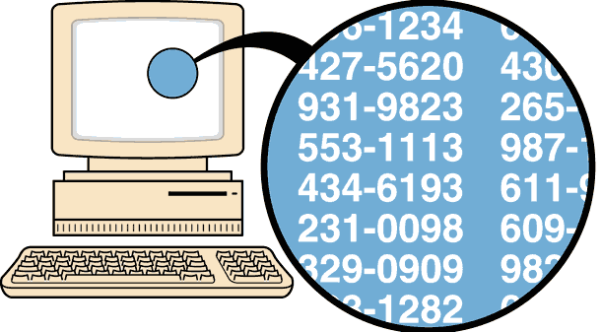
Random Sampling
selection so that each
individual member has an
equal chance of being selected

Slide 61
Systematic Sampling
Select some starting point and then
select every kth element in the population

Slide 62
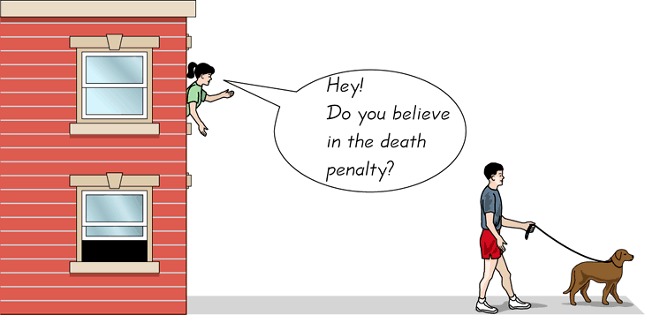
Convenience Sampling
use results that are easy to get

Slide 63
Stratified Sampling
subdivide the population into at
least two different subgroups that share the same characteristics, then draw a sample from each subgroup (or stratum)

Slide 64
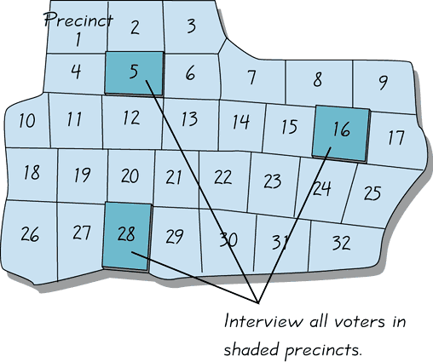
Cluster Sampling
divide the population area into sections
(or clusters); randomly select some of those clusters; choose all members from selected clusters

Slide 65
Multistage Sampling
Collect data by using some combination of the basic sampling methods
In a multistage sample design, pollsters select a sample in different stages, and each stage might use different methods of sampling

Slide 66
Methods of Sampling - Summary
Random
Systematic
Convenience
Stratified
Cluster
Multistage

Slide 67
Beyond the Basics of Collecting Data
Different types of observational studies and experiment design

Slide 68
Types of Studies
Cross sectional study
data are observed, measured, and collected at one point in time
Retrospective (or case control) study
data are collected from the past by going back in time (examine records, interviews, …)
Prospective (or longitudinal or cohort) study
data are collected in the future from groups sharing common factors (called cohorts)

Slide 69
Randomization
Randomization
is used when subjects are assigned to different groups through a process of random selection. The logic is to use chance as a way to create two groups that are similar.

Slide 70
Replication
Replication is the repetition of an experiment on more than one subject. Samples should be large enough so that the erratic behavior that is characteristic of very small samples will not disguise the true effects of different treatments. It is used effectively when there are enough subjects to recognize the differences from different treatments.
Use a sample size that is large enough to let us see the true nature of any effects, and obtain the sample using an appropriate method, such as one based on randomness.

Slide 71
Blinding
Blinding
is a technique in which the subject doesn’t know whether he or she is receiving a treatment or a placebo. Blinding allows us to determine whether the treatment effect is significantly different from a placebo effect, which occurs when an untreated subject reports improvement in symptoms.

Slide 72
Double Blind
Double-Blind
Blinding occurs at two levels:
(1) The subject doesn’t know whether he or she is receiving the treatment or a placebo
(2) The experimenter does not know whether he or she is administering the treatment or placebo

Slide 73
Confounding
Confounding
occurs in an experiment when the experimenter is not able to distinguish between the effects of different factors.
Try to plan the experiment so that confounding does not occur.

Slide 74
Controlling Effects of Variables
Completely Randomized Experimental Design assign subjects to different treatment groups through a process of random selection
Randomized Block Design a block is a group of subjects that are similar, but blocks differ in ways that might affect the outcome of the experiment
Rigorously Controlled Design carefully assign subjects to different treatment groups, so that those given each treatment are similar in ways that are important to the experiment
Matched Pairs Design compare exactly two treatment groups using subjects matched in pairs that are somehow related or have similar characteristics

Slide 75
Summary
Three very important considerations in the design of experiments are the following:
1. Use randomization to assign subjects to different groups
2. Use replication by repeating the experiment on enough subjects so that effects of treatment or other factors can be clearly seen.
3. Control the effects of variables by using such techniques as blinding and a completely randomized experimental design

Slide 76
Errors
No matter how well you plan and execute the sample collection process, there is likely to be some error in the results.
Sampling error
the difference between a sample result and the true population result; such an error results from chance sample fluctuations
Nonsampling error
sample data incorrectly collected, recorded, or analyzed (such as by selecting a biased sample, using a defective instrument, or copying the data incorrectly)

Slide 77
Recap
In this section we have looked at:
Types of studies and experiments
Controlling the effects of variables
Randomization
Types of sampling
Sampling errors

