Slide 1
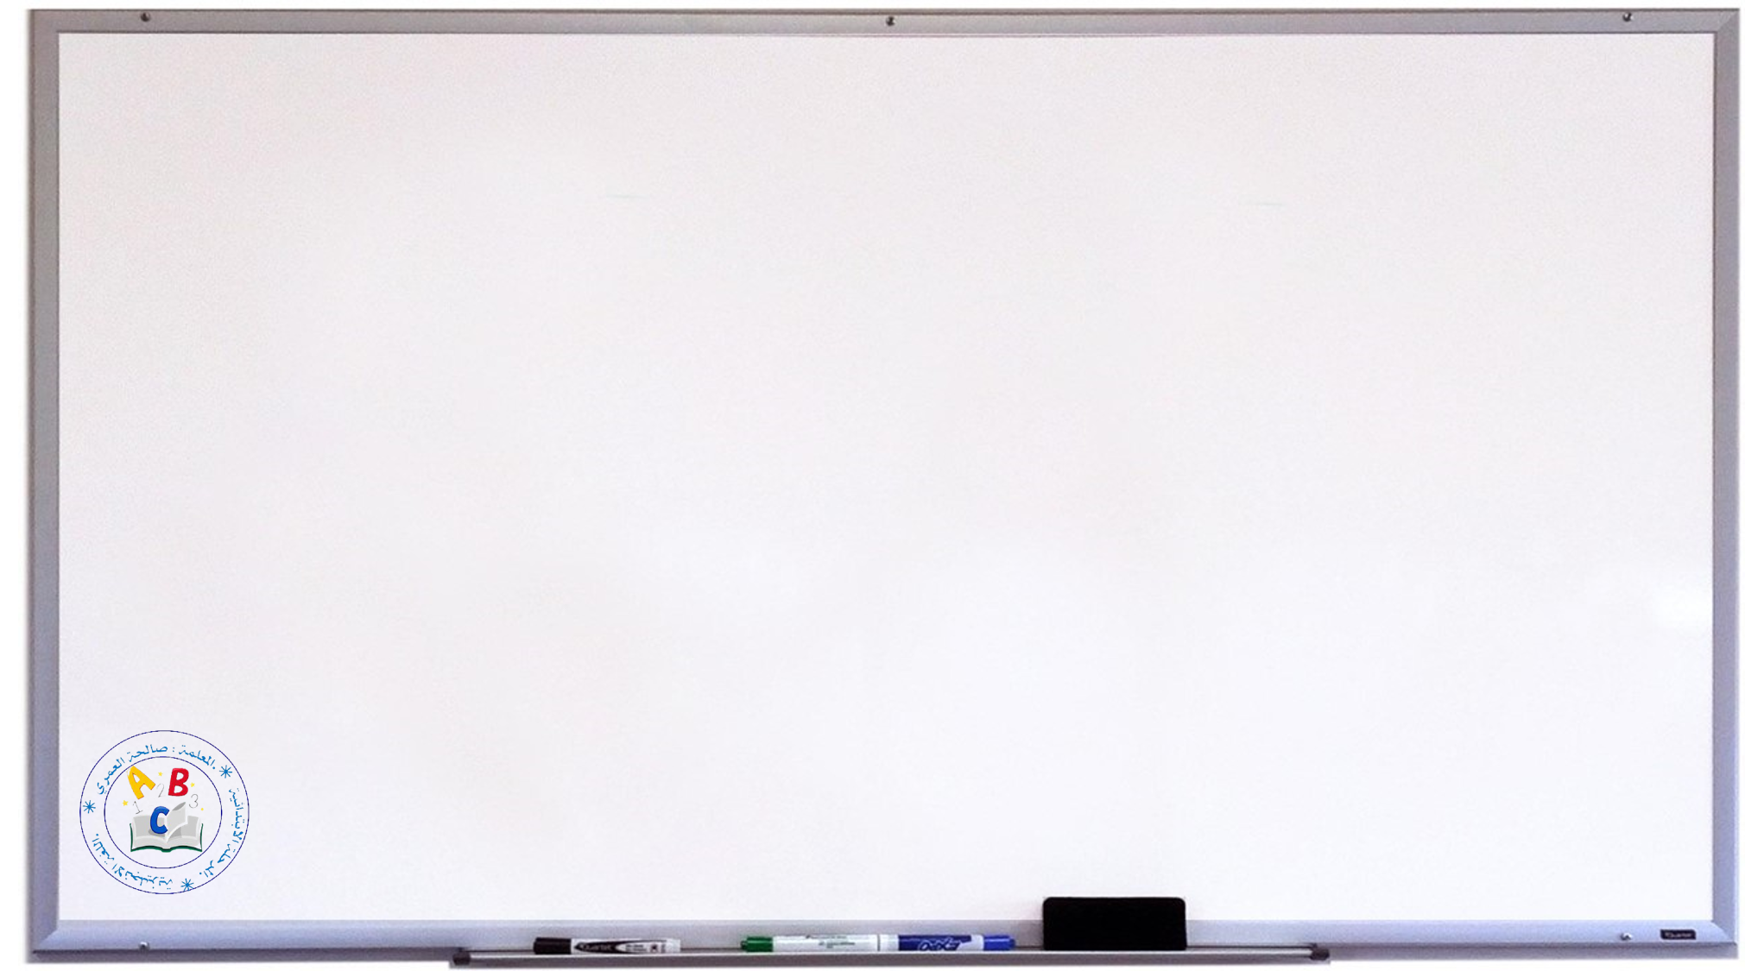

Revision
General Questions :
1- What is your name?
2- How are you?
3- How old are you?
What is this?
What shape is it?
What color is it?

Slide 2


Put in the correct order:
G | B | A | E | D | H | F | C
P | M | O | N | L | J | I | K
6 | 2 | 1 | 4 | 8 | 7 | 3 | 5

Slide 3
Write the uppercase of the following letters:
b | g | q | e | d | h | r | a
f | l | n | y | n | i | j | m

Slide 4
Write the lowercase of the following letters:
I | L | R | F | G | Q | N | A
K | O | S | Y | M | H | D | B

Slide 5
Match:
A
B
R
Q
G
D
H
E
d
h
g
a
e
b
q
r

Slide 6
Write a / an :
1- This is ………… apple.
2-This is ……… duck.
3-It is ………. Egg.
4- T hat is ………. Notebook.
5- It is …………orange.

Slide 7




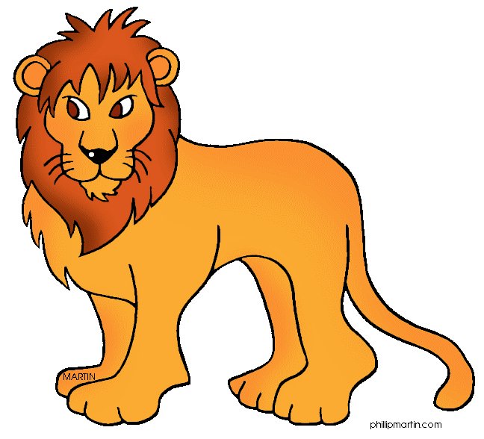

Use This / That:
1- ………….. a banana.
2-…………… an apple.
3- ……….. a bicycle.
4-………….. a lion.
5- ........ a book.

Slide 8

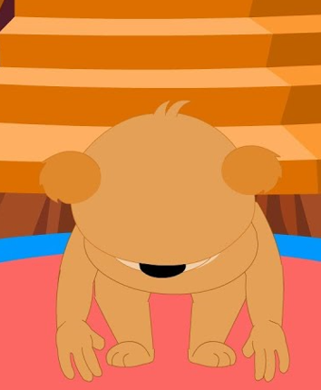
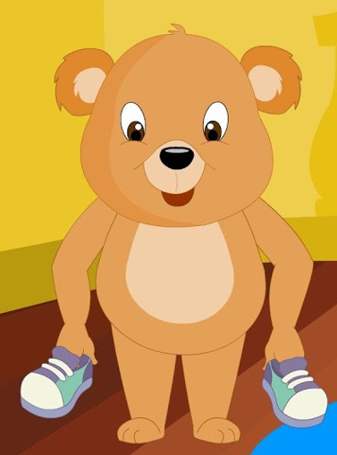
:
B)- Write True= False=
3-This is star. ( )
1-Turn around. ( )
2- Show your shoe. ( )

Slide 9

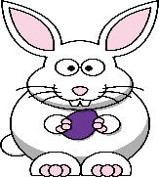




Read and write the matching number:

Slide 10
Rearrange :
Pizza / I / like
pink / are / They
You / salad/ like
red / is / It

Slide 11

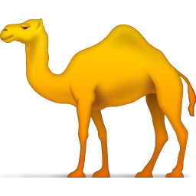
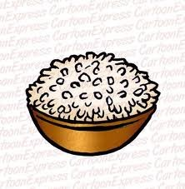
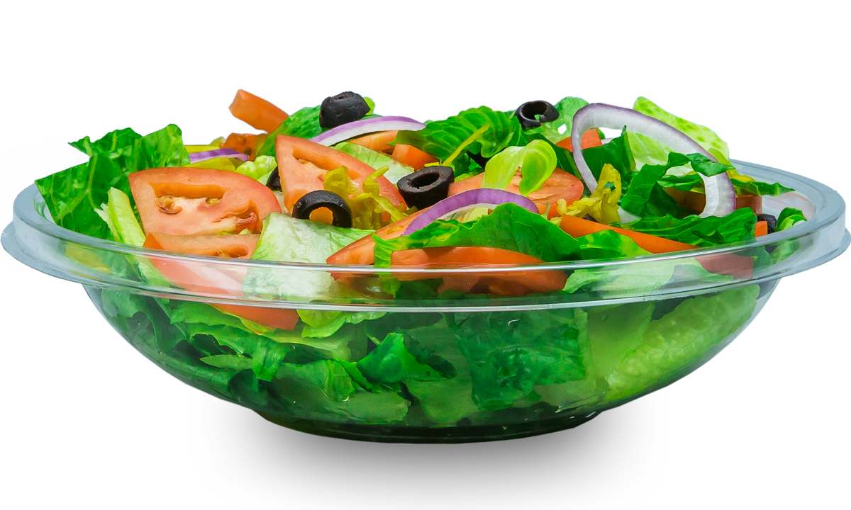

Circle the odd word:
1- star - circle - camel – triangle.
2- rice – salad – pizza – book.
3- bear – yellow – red – black
4- bear – pencil- duck - fish.

Slide 12
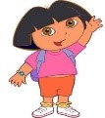

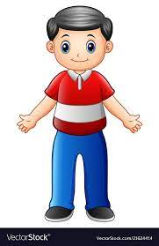
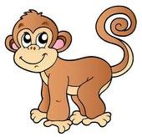


B)- Match :
C)-Choose the correct answer:
1- How many kites do you have ( ./ ? ).
2- Do you like kabsa? ( Yes, I do / No , I don’t)
3- They are three ( robot – robots )
He
She
It
We

Slide 13
Orthography:
A)-Fill in the missing letters with:
{ F / B / G / P }
B)-Rearrange the letters :
……OAT
……ARROT
……EAR
……ISH
woc
……………
aht
……………
kin
……………
gge
……………

