Slide 1
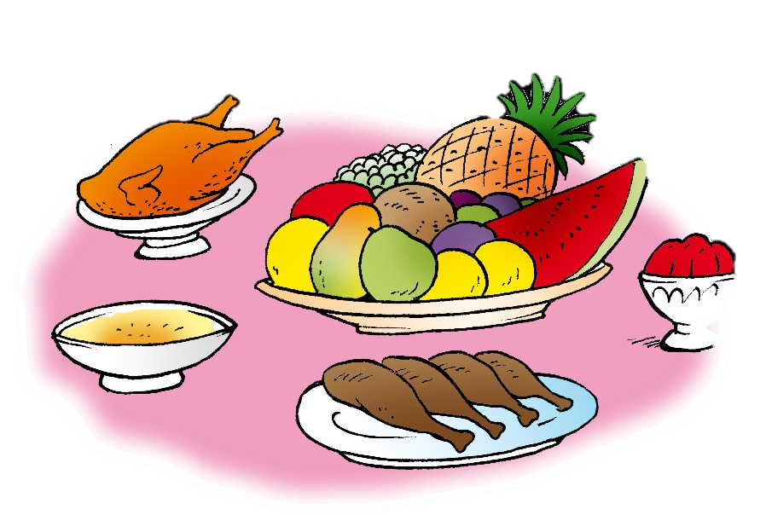
Unit 7- Lesson 5 P 68
Dinnertime!
Family and Friend 2
Grade 2

Slide 2
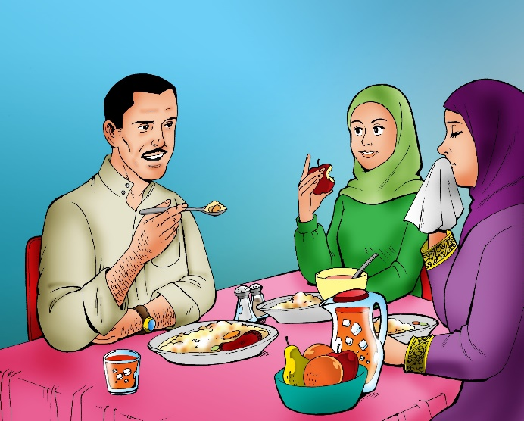
Think
1. What’s your favourite food?
2. What are your favourite restaurants?
____________________________________________________________________________________________________________________________________
Ministry of Education-2020

Slide 3
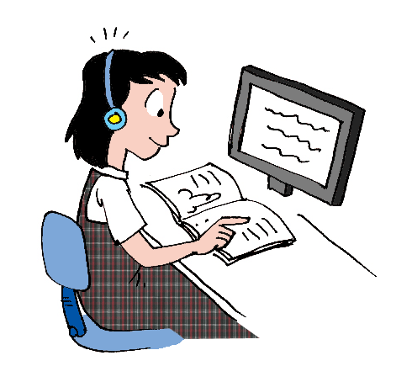
Objectives
1) Read the text.
2) Answer the questions.
____________________________________________________________________________________________________________________________________
Ministry of Education-2020

Slide 4
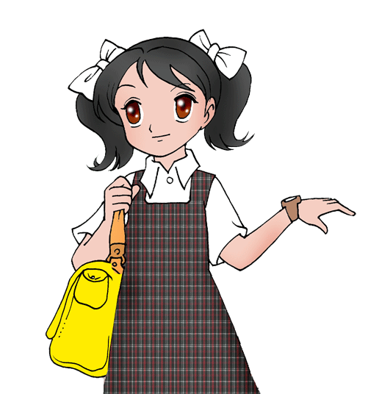
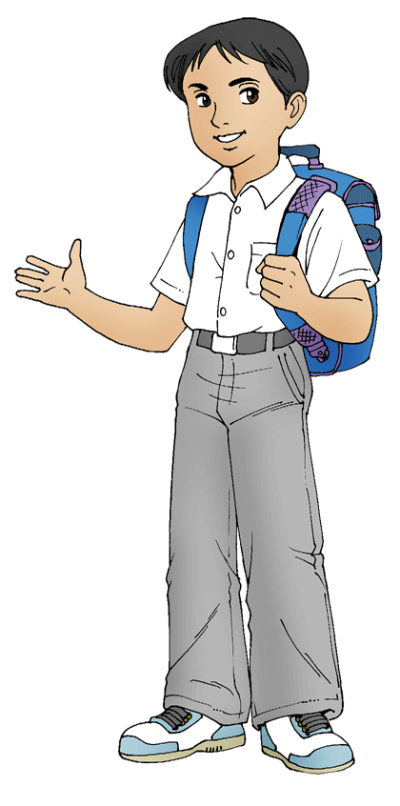
Listen then read
Hi! I’m Sara. I like to have lunch with my family everyday.
I like fish, meat and rice. I don’t like yogurt or bread.
Hi! I’m Tom. I like bread and yogurt. I eat it everyday. I don’t like fish or meat.
____________________________________________________________________________________________________________________________________
Ministry of Education-2020

Slide 5
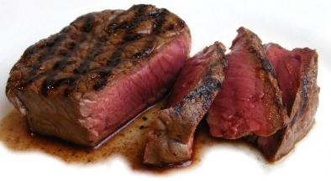
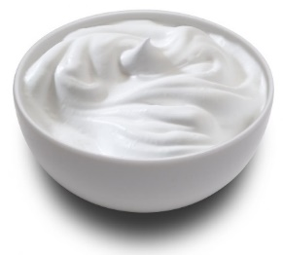
After reading, answer the questions
Look at the pictures and match. What they like:
____________________________________________________________________________________________________________________________________
Ministry of Education-2020

Slide 6
After reading, answer the questions
Look at the pictures and match. What they like:
____________________________________________________________________________________________________________________________________
Ministry of Education-2020

Slide 7
After reading, answer the questions
Look at the pictures and match. What they don’t like:
____________________________________________________________________________________________________________________________________
Ministry of Education-2020

Slide 8
After reading, answer the questions
Look at the pictures and match. What they don’t like:
____________________________________________________________________________________________________________________________________
Ministry of Education-2020

Slide 9
After reading, answer the questions
Read and put tick for the correct answers:
Sara likes yogurt.
Tom likes yogurt.
Sara doesn’t like to have lunch with her family.
Tom doesn’t like fish.
Sara likes fish and meat.
Tom likes bread very much.
____________________________________________________________________________________________________________________________________
Ministry of Education-2020

Slide 10
After reading, answer the questions
Read and put tick for the correct answers:
Sara likes yogurt.
Tom likes yogurt.
Sara doesn’t like to have lunch with her family.
Tom doesn’t like fish.
Sara likes fish and meat.
Tom likes bread very much.
____________________________________________________________________________________________________________________________________
Ministry of Education-2020

Slide 11
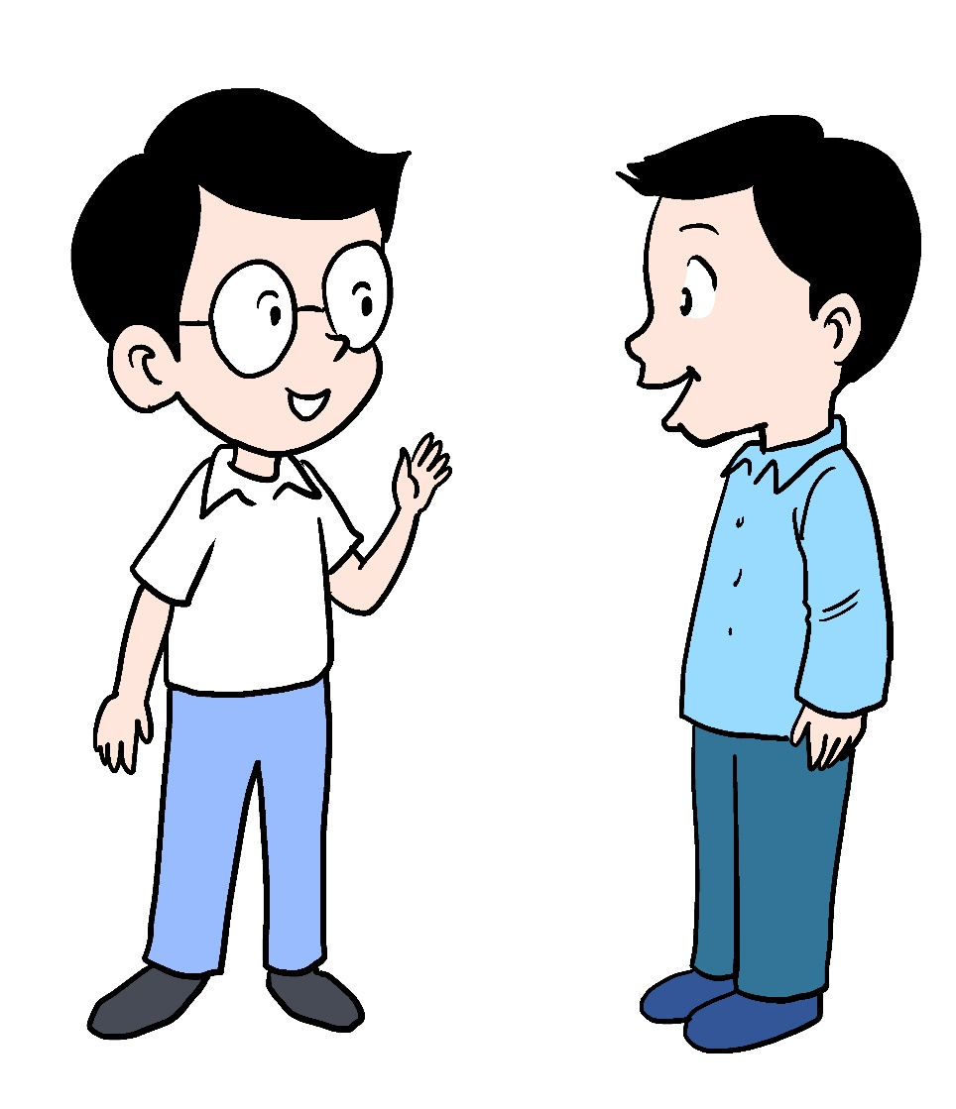
Read and talk about what you like.
Open your Class book page 68
____________________________________________________________________________________________________________________________________
Ministry of Education-2020

Slide 12
Open your Workbook page 66.
Answer the questions.
Question 1
1) orange juice
2) milk
click and check your answer
____________________________________________________________________________________________________________________________________
Ministry of Education-2020

Slide 13
Open your Workbook page 66.
Answer the questions.
Question 2
a) Amira b) Amira
c) Farhan d) Rashid
e) Amira f) Amira
g) Amira h) Rashid
click and check your answer
____________________________________________________________________________________________________________________________________
Ministry of Education-2020

Slide 14
Don’t forget to answer the questions
in the practice PPT for L5.
____________________________________________________________________________________________________________________________________
Ministry of Education-2020

Slide 15
Well Done Kids !
End of lesson 5
____________________________________________________________________________________________________________________________________
Ministry of Education-2020

