Slide 1
Unit 4 food
Lesson 2

Slide 3
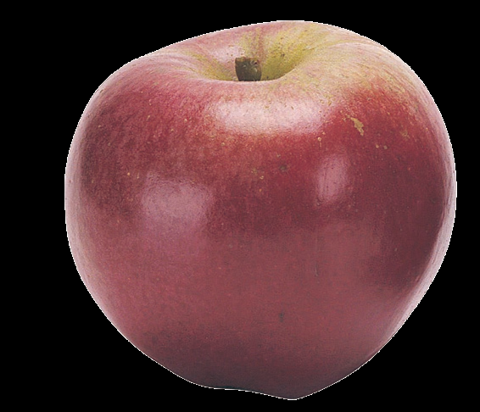
apple

Slide 4
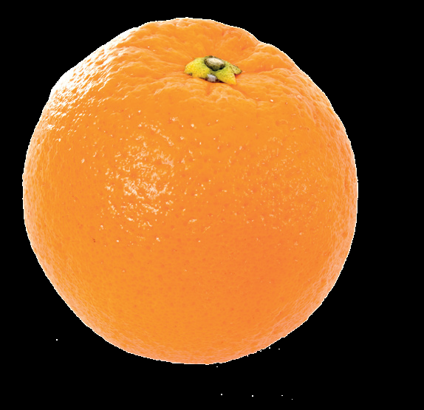
orange

Slide 5
egg

Slide 6
juice

Slide 7
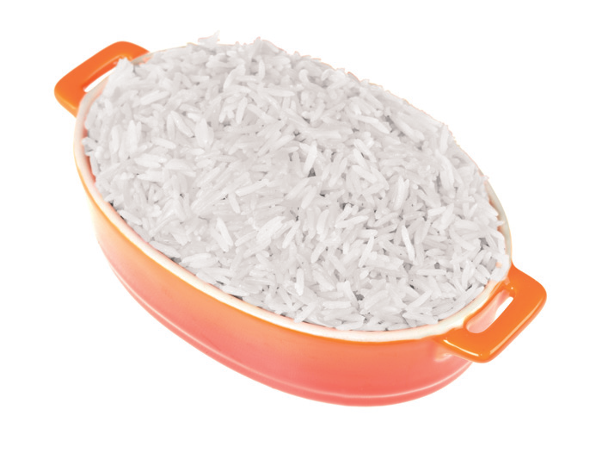
rice

Slide 8
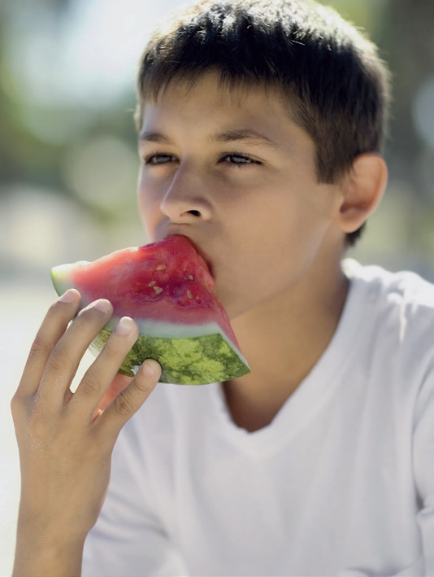
eat

Slide 9
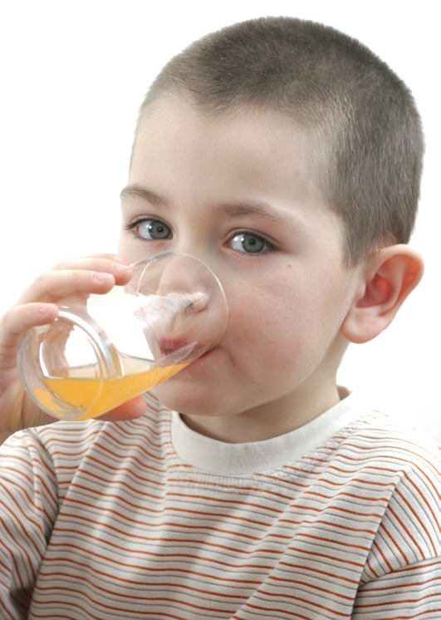
drink

Slide 10
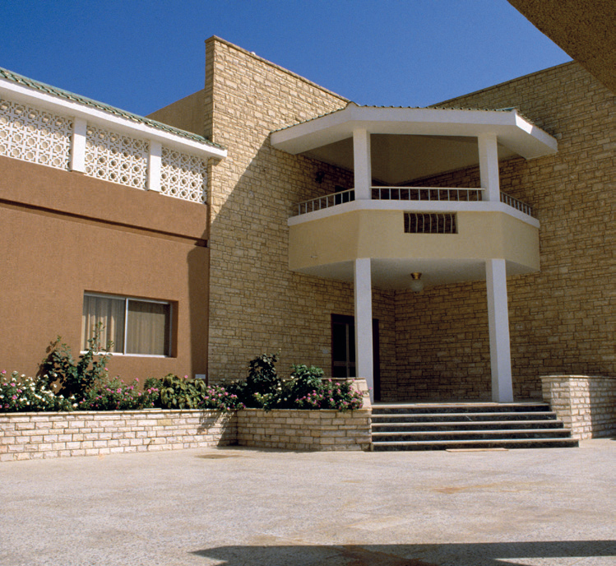
V v
villa

Slide 11
W w
window

Slide 12
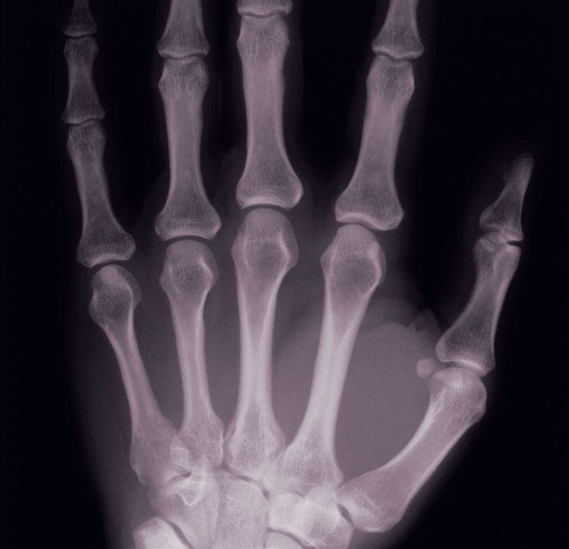
X x
x-ray

Slide 13
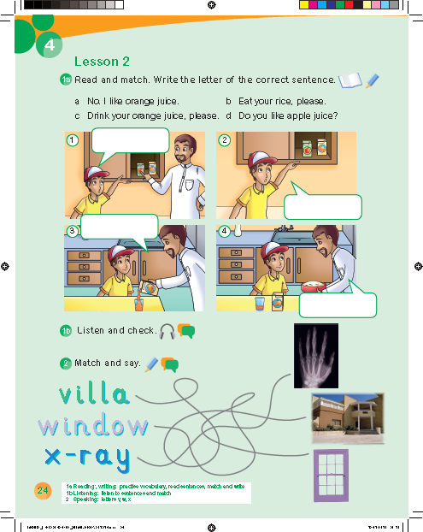
d
a
c
b

Slide 16
2
1
3
7
6
5
4

Slide 17
Work book p. 70

Slide 18
i
a
o
j
e

Slide 19
orange
egg
apple
juice

Slide 22
v
w
x

