Slide 1
Review chapter 5+6+7

Slide 2
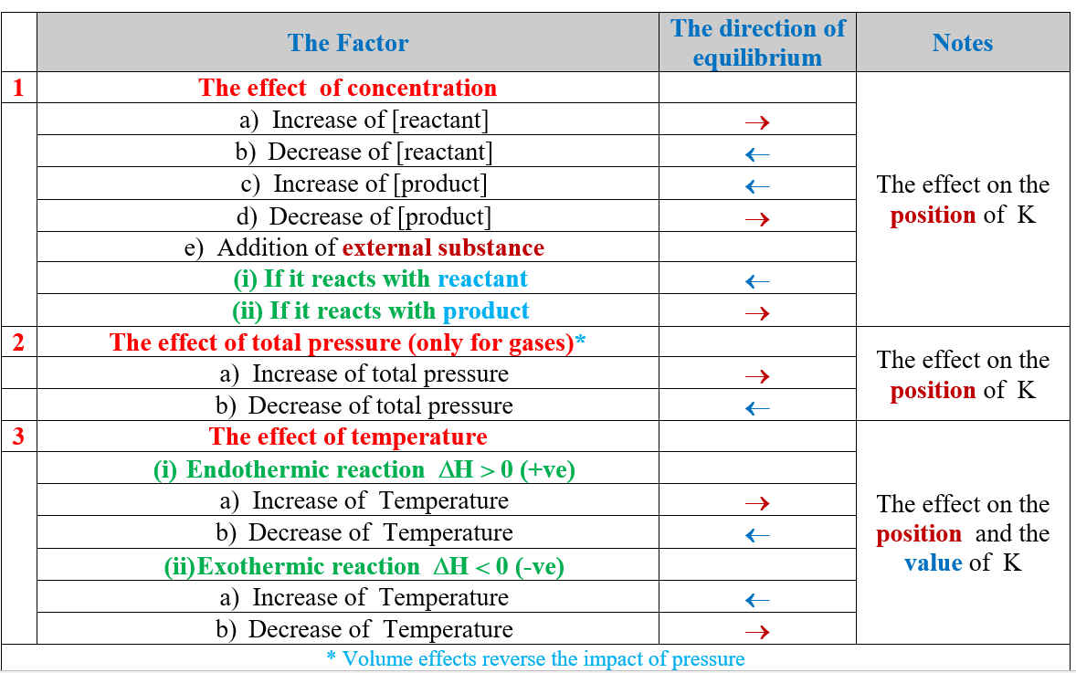

Slide 3

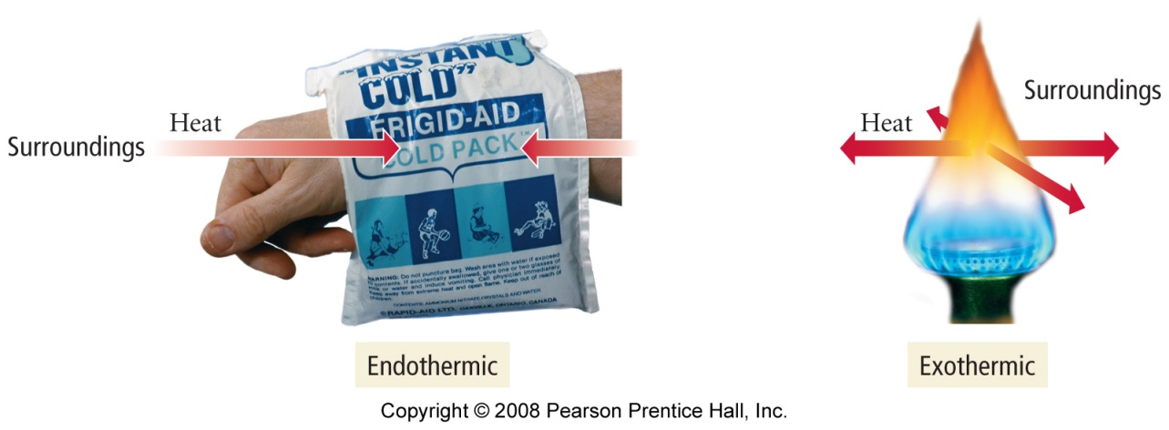
Endothermic and Exothermic Reactions
Review ch5+6+7
when ΔH is ─, heat is being released by the system
reactions that release heat are called exothermic reactions
when ΔH is +, heat is being absorbed by the system
reactions that release heat are called endothermic reactions

Slide 4

Review ch5+6+7
For the following equilibrium: 2KClO_{3(s)} ⇌ 2KCl_{(s)} + 3O_{2(g)}
When KClO₃ is added to the reaction mixture, the reaction will
(A) Shift to right (B) Shift to left (C) remain unaffected (D) none
2. For the following equilibrium: C_{(s)} ⇌ 2H_{2(g)} + CH_{4(g)}
When CH₄ is added to the reaction mixture, the reaction will
(A) Shift to right (B) Shift to left (C) remain unaffected (D) none
3. The following reaction is endothermic: C_{(s)} + CO_{2(g)} ⇌ 2CO_{(g)}
When the reaction temperature is increased, the reaction will
(A) Shift to right (B) Shift to left (C) remain unaffected (D) none
4. Which of the following is a heterogeneous equilibrium?
(A) NH_{3(aq)} + H₂O _{(l)} ⇌ NH₄⁺ _{(aq)} + OH⁻_{(aq)}
(B) HF_{(aq)} + H₂O _{(l)} ⇌ H₃O⁺ _{(aq)} + F⁻_{(aq)}
(C) 2KClO_{3(s)} ⇌ 2KCl_{(s)} + 3O_{2(g)}
(D) CO₃²⁻_{(aq)} + H₂O _{(l)} ⇌ HCO₃⁻ _{(aq)} + OH⁻_{(aq)}
KClO₃تركيز
لا يتغير لانه مادة صلبة

Slide 5
Review ch5+6+7
For the following equilibrium: 2KClO_{3(s)} ⇌ 2KCl_{(s)} + 3O_{2(g)}
When KClO₃ is added to the reaction mixture, the reaction will
(A) Shift to right (B) Shift to left (C) remain unaffected (D) none
2. For the following equilibrium: C_{(s)} ⇌ 2H_{2(g)} + CH_{4(g)}
When CH₄ is added to the reaction mixture, the reaction will
(A) Shift to right (B) Shift to left (C) remain unaffected (D) none
3. The following reaction is endothermic: C_{(s)} + CO_{2(g)} ⇌ 2CO_{(g)}
When the reaction temperature is increased, the reaction will
(A) Shift to right (B) Shift to left (C) remain unaffected (D) none
4. Which of the following is a heterogeneous equilibrium?
(A) NH_{3(aq)} + H₂O _{(l)} ⇌ NH₄⁺ _{(aq)} + OH⁻_{(aq)}
(B) HF_{(aq)} + H₂O _{(l)} ⇌ H₃O⁺ _{(aq)} + F⁻_{(aq)}
(C) 2KClO_{3(s)} ⇌ 2KCl_{(s)} + 3O_{2(g)}
(D) CO₃²⁻_{(aq)} + H₂O _{(l)} ⇌ HCO₃⁻ _{(aq)} + OH⁻_{(aq)}
KClO₃تركيز
لا يتغير لانه مادة صلبة

Slide 6
Review ch5+6+7
5. Which of the following is a weak acid?
(A) HCl (B) HNO₃ (C) HBr (D) H₂SO₃
6. Which of the following is a weak base?
(A) NaOH (B) NH₃ (C) HC₂H₃O₂ (D) HN₃
7. Which of the following anions is a weak base?
(A) Cl⁻ (B) NH₃ (C) CHO₂⁻ (D) ClO₄⁻
8. The hydronium ion concentration of a solution of pH 7.8 is ……….
(A) 1.6 ×10⁸ (B) 6.2 (C) 1.6 ×10⁻⁸ (D) 6.3×10⁷
9. Which of the following anions has a neutral pH?
CHO₂⁻ (B) NO₃⁻ (C) C₂H₃O₂⁻ (D) F⁻
10. Which of the following is a Lewis acid?
HCl (B) NH₃ (C) HNO₃ (D) BF₃
An anion that is the conjugate base of a strong acid is pH neutral.
An anion that is the conjugate base of a weak acid is weak base.

Slide 7
Review ch5+6+7
5. Which of the following is a weak acid?
(A) HCl (B) HNO₃ (C) HBr (D) H₂SO₃
6. Which of the following is a weak base?
(A) NaOH (B) NH₃ (C) HC₂H₃O₂ (D) HN₃
7. Which of the following anions is a weak base?
(A) Cl⁻ (B) NH₃ (C) CHO₂⁻ (D) ClO₄⁻
8. The hydronium ion concentration of a solution of pH 7.8 is ……….
(A) 1.6 ×10⁸ (B) 6.2 (C) 1.6 ×10⁻⁸ (D) 6.3×10⁷
9. Which of the following anions has a neutral pH?
CHO₂⁻ (B) NO₃⁻ (C) C₂H₃O₂⁻ (D) F⁻
10. Which of the following is a Lewis acid?
HCl (B) NH₃ (C) HNO₃ (D) BF₃
An anion that is the conjugate base of a strong acid is pH neutral.
An anion that is the conjugate base of a weak acid is weak base.

Slide 8
Review ch5+6+7
11. For the following equilibrium reaction A ⇌ 3C K₁
The overall equilibrium constant K₁ in terms of the given two equilibria
A ⇌ 2B K₂
2B ⇌ 3C K₃
K₁=K₂+K₃ (B) K₁=K₂. K₃ (C) K₁=K₂/K₃ (D) K₁=K₃/K₃
12. The household ammonia has a ………….
(A) pH =7 (B) pH <7 (C) pH >7 (D) pH ≤ 7
13. The equilibrium constant K, for the reaction
2KClO_{3(s)} ⇌ 2KCl_{(s)} + 3O_{2(g)} is given by
K = [KCl]² [O₂]³/ [KClO_{3(s)}]²
K = [O₂]³
K = [KClO_{3(s)}]² / [KCl]² [O₂]³
K = 1/ [O₂]³
14. The following reaction: N₂O₄(g) ⇌ 2 NO₂(g) represents
(A) irreversible (B) reversible (C) acidic (D) neutral

Slide 9
Review ch5+6+7
11. For the following equilibrium reaction A ⇌ 3C K₁
The overall equilibrium constant K₁ in terms of the given two equilibria
A ⇌ 2B K₂
2B ⇌ 3C K₃
K₁=K₂+K₃ (B) K₁=K₂. K₃ (C) K₁=K₂/K₃ (D) K₁=K₃/K₃
12. The household ammonia has a ………….
(A) pH =7 (B) pH <7 (C) pH >7 (D) pH ≤ 7
13. The equilibrium constant K, for the reaction
2KClO_{3(s)} ⇌ 2KCl_{(s)} + 3O_{2(g)} is given by
K = [KCl]² [O₂]³/ [KClO_{3(s)}]²
K = [O₂]³
K = [KClO_{3(s)}]² / [KCl]² [O₂]³
K = 1/ [O₂]³
14. The following reaction: N₂O₄(g) ⇌ 2 NO₂(g) represents
(A) irreversible (B) reversible (C) acidic (D) neutral

Slide 10
Review ch5+6+7
15. The soft drinks (e.g. Pepsi) has a ………….
(A) pH =7 (B) pH <7 (C) pH >7 (D) pH ≤ 7
16. The statement “The total energy of the universe is constant” is related to
(A) Internal energy (B) The first law of thermodynamics (C ) Enthalpy (D) The heat capacity
17. The statement “A state function that equals to the sum of kinetic and potential energies of all particles in the system” is related to
(A) Hess’s law (B) The first law of thermodynamics (C ) bomb calorimeter (D) Coffee-cup calorimeter
18. ……………….. is used to measure the heat evolved from combustion reactions at constant volume.
(A) Coffee-cup calorimeter (B) The first law of thermodynamics
(C ) bomb calorimeter (D) Hess’s law
19. ………………….. is used to measure the heat changes in different reactions at constant pressure.
(A) Hess’s law (B) The first law of thermodynamics
(C ) bomb calorimeter (D) Coffee-cup calorimeter

Slide 11
Review ch5+6+7
15. The soft drinks (e.g. Pepsi) has a ………….
(A) pH =7 (B) pH <7 (C) pH >7 (D) pH ≤ 7
16. The statement “The total energy of the universe is constant” is related to
(A) Internal energy (B) The first law of thermodynamics (C ) Enthalpy (D) The heat capacity
17. The statement “A state function that equals to the sum of kinetic and potential energies of all particles in the system” is related to
(A) Hess’s law (B) The first law of thermodynamics (C ) bomb calorimeter (D) Coffee-cup calorimeter
18. ……………….. is used to measure the heat evolved from combustion reactions at constant volume.
(A) Coffee-cup calorimeter (B) The first law of thermodynamics
(C ) bomb calorimeter (D) Hess’s law
19. ………………….. is used to measure the heat changes in different reactions at constant pressure.
(A) Hess’s law (B) The first law of thermodynamics
(C ) bomb calorimeter (D) Coffee-cup calorimeter

Slide 12
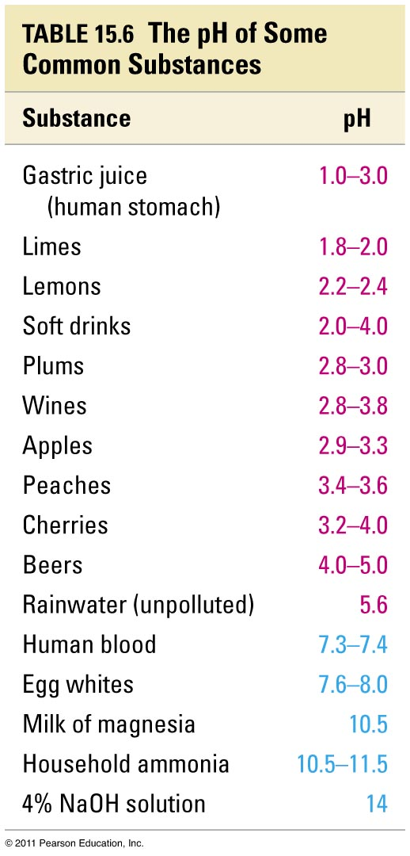
Review ch5+6+7

Slide 13
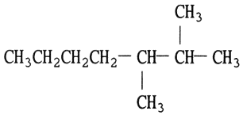
Review ch5+6+7
20. What is the work exerted by a gas that expanded from 0.10 L to 0.75 L against a constant pressure of 1.2 atm?
(A) 0.78 L. atm (B) -79.1 J
(C ) – 0.78 L atm ⁻¹ (D) 79.0 J
21. The endothermic reaction is the one whose…………
(A) ∆H< 0 (B) ∆H = 0
(C ) ∆H > 0 (D) None of them
22. The relation between the energy and enthalpy is ………………
(A) E = H + PV (B) H = E - PV
(C ) H = E + PV (D) none of them
23. The correct name of the following structure
2,3-dimethylheptane B) 2-methylheptane C) 2,3-dimethylhexane D) 2,3-dimethylpentane
24. ……….. is the general formula of an alcohol.
A) R—O—R B) R—CO—R C) R—CO—OH D) R—OH
25. Which one of the following is not an alcohol?
A) acetone B) methanol C) ethanol D) propanol

Slide 14
Review ch5+6+7
20. What is the work exerted by a gas that expanded from 0.10 L to 0.75 L against a constant pressure of 1.2 atm?
(A) 0.78 L. atm (B) -79.1 J
(C ) – 0.78 L atm ⁻¹ (D) 79.0 J
21. The endothermic reaction is the one whose…………
(A) ∆H< 0 (B) ∆H = 0
(C ) ∆H > 0 (D) None of them
22. The relation between the energy and enthalpy is ………………
(A) E = H + PV (B) H = E - PV
(C ) H = E + PV (D) none of them
23. The correct name of the following structure
2,3-dimethylheptane B) 2-methylheptane C) 2,3-dimethylhexane D) 2,3-dimethylpentane
24. ……….. is the general formula of an alcohol.
A) R—O—R B) R—CO—R C) R—CO—OH D) R—OH
25. Which one of the following is not an alcohol?
A) acetone B) methanol C) ethanol D) propanol

Slide 15
Review ch5+6+7
26.
27.

Slide 16
Review ch5+6+7
26.
27.

Slide 17
Review ch5+6+7
28.
29.

Slide 18
Review ch5+6+7
28.
29.

Slide 19
Review ch5+6+7
30.
31. Hybridization of the carbon atom indicated by (*) in
CH₃-*CH₂-CH₃,*CH₂=CH₂, and CH₃-*C≡CH is
________, ________, and ________, respectively.
A) sp3, sp2, sp B) sp3, sp, sp2
C) sp, sp2, sp3 D) sp, sp3, sp2
32. Hydrocarbons containing only single bonds between
the carbon atoms are called…..
alkenes B) alkynes C) aromatics D) alkanes
33. Which of the following are known as olefins?
A) alkenes B) alkynes C) aromatics D) alkanes
34. The simplest alkyne is ________.
A) ethylene B) ethane C) acetylene D) benzene

Slide 20
Review ch5+6+7
30.
31. Hybridization of the carbon atom indicated by (*) in
CH₃-*CH₂-CH₃,*CH₂=CH₂, and CH₃-*C≡CH is
________, ________, and ________, respectively.
A) sp3, sp2, sp B) sp3, sp, sp2
C) sp, sp2, sp3 D) sp, sp3, sp2
32. Hydrocarbons containing only single bonds between
the carbon atoms are called…..
alkenes B) alkynes C) aromatics D) alkanes
33. Which of the following are known as olefins?
A) alkenes B) alkynes C) aromatics D) alkanes
34. The simplest alkyne is ________.
A) ethylene B) ethane C) acetylene D) benzene

Slide 21
Review ch5+6+7
35. Hydrocarbons containing carbon-carbon triple bonds are called………
A) alkanes B) aromatic hydrocarbons C) alkynes D) alkenes
36. Alkynes always contain a ________.
A) C=C bond B) C≡C bond C) C—C bond D) C=H
37. Alkenes always contain a ________.
A) C=C bond B) C≡C bond C) C—C bond D) C=H
38. The general formula of alkenes is ________.
A) C_{n}H_{2n} B) C_{n}H_{2n-2} C) C_{n}H_{2n+2} D) C_{n}H_{n}
39. The general formula of alkanes is ________.
C_{n}H_{2n} B) C_{n}H_{2n-2} C) C_{n}H_{2n+2} D) C_{n}H_{n}
40. The general formula of alkynes is ________.
C_{n}H_{2n} B) C_{n}H_{2n-2} C) C_{n}H_{2n+2} D) C_{n}H_{n}

Slide 22
Review ch5+6+7
35. Hydrocarbons containing carbon-carbon triple bonds are called………
A) alkanes B) aromatic hydrocarbons C) alkynes D) alkenes
36. Alkynes always contain a ________.
A) C=C bond B) C≡C bond C) C—C bond D) C=H
37. Alkenes always contain a ________.
A) C=C bond B) C≡C bond C) C—C bond D) C=H
38. The general formula of alkenes is ________.
A) C_{n}H_{2n} B) C_{n}H_{2n-2} C) C_{n}H_{2n+2} D) C_{n}H_{n}
39. The general formula of alkanes is ________.
C_{n}H_{2n} B) C_{n}H_{2n-2} C) C_{n}H_{2n+2} D) C_{n}H_{n}
40. The general formula of alkynes is ________.
C_{n}H_{2n} B) C_{n}H_{2n-2} C) C_{n}H_{2n+2} D) C_{n}H_{n}

Slide 23
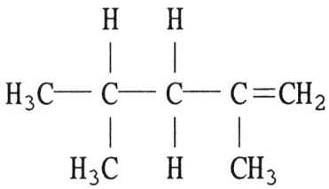
Review ch5+6+7
41. What is the name of the compound below?
A) 2,4-methylbutene B) 2,5-dimethylpentane
C) 2,4-ethylbutene D) 2,4-dimethyl-1-pentene
42.What is the number of π bond in the following compound?
A) 1 B) 2 C) 4 D) 3
43.The number of π bonds in CH₃-CH=C=CH-CH-CH=CH-CH₃ is
1 B) 2 C) 4 D) 3
44. ________ could be alkene.
A) C₃H₈ B) C₃H₆ C) C₆H₆ D) C₁₇H₃₆

Slide 24
Review ch5+6+7
41. What is the name of the compound below?
A) 2,4-methylbutene B) 2,5-dimethylpentane
C) 2,4-ethylbutene D) 2,4-dimethyl-1-pentene
42.What is the number of π bond in the following compound?
A) 1 B) 2 C) 4 D) 3
43.The number of π bonds in CH₃-CH=C=CH-CH-CH=CH-CH₃ is
1 B) 2 C) 4 D) 3
44. ________ could be alkene.
A) C₃H₈ B) C₃H₆ C) C₆H₆ D) C₁₇H₃₆

Slide 25



Review ch5+6+7
45. The addition of HBr to 2-butene produces ________.
1-bromobutane B) 2-bromobutane C) 1,2-dibromobutane D) 2,3-dibromobutan
46. The following structure represents ________.
A) Ether B) ester C) ketone D) aldehyde
47. The following structure represents ________.
_______.
A) Ether B) ester C) ketone D) aldehyde
48. The following structure represents________.
_______.
A) carboxylic acid B) ester C) ketone D) aldehyde
49. The following structure represents________.
______.
A) carboxylic acid B) ester C) ketone D) aldehyde

Slide 26
Review ch5+6+7
45. The addition of HBr to 2-butene produces ________.
1-bromobutane B) 2-bromobutane C) 1,2-dibromobutane D) 2,3-dibromobutan
46. The following structure represents ________.
A) Ether B) ester C) ketone D) aldehyde
47. The following structure represents ________.
_______.
A) Ether B) ester C) ketone D) aldehyde
48. The following structure represents________.
_______.
A) carboxylic acid B) ester C) ketone D) aldehyde
49. The following structure represents________.
______.
A) carboxylic acid B) ester C) ketone D) aldehyde

Slide 27

Review ch5+6+7
50. is called ________.
A) amine B) amide C) ketone D) aldehyde
51. Starch, glycogen, and cellulose are made of repeating units of ________.
(A) lactose B) glucose C) fructose D) sucrose
52 The correct name of CH₃-CH₃ is ________.
A) ethane B) propane C) ethyl D) propyne
53. The product of the addition of H₂ to 1-propene in the presence of a nickel catalyst is ________.
A) propane B) propyne C) propanol D) 2-butene
54. ________ is a monosaccharide.
(A) Fructose B) Lactose C) Guanine D) Glycogen
55. ________ is a polysaccharide.
A) Cellulose B) Galactose C) Ribose D) Sucrose

Slide 28
Review ch5+6+7
50. is called ________.
A) amine B) amide C) ketone D) aldehyde
51. Starch, glycogen, and cellulose are made of repeating units of ________.
(A) lactose B) glucose C) fructose D) sucrose
52 The correct name of CH₃-CH₃ is ________.
A) ethane B) propane C) ethyl D) propyne
53. The product of the addition of H₂ to 1-propene in the presence of a nickel catalyst is ________.
A) propane B) propyne C) propanol D) 2-butene
54. ________ is a monosaccharide.
(A) Fructose B) Lactose C) Guanine D) Glycogen
55. ________ is a polysaccharide.
A) Cellulose B) Galactose C) Ribose D) Sucrose

