Slide 1
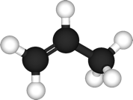
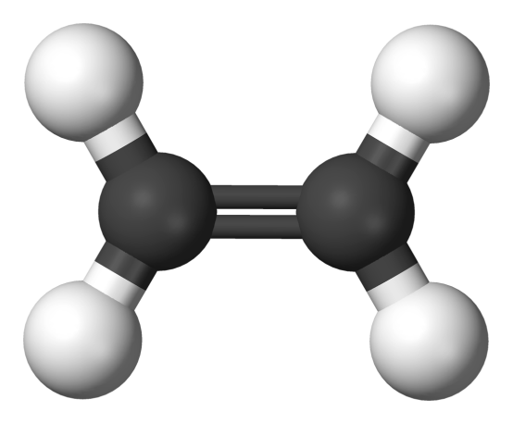
Unsaturated Hydrocarbons
Alkenes
1435-1436
2014-2015

Slide 2
Learning Objectives
Alkenes
Chapter two discusses the following topics and the student by the end of this chapter will:
Know the structure, hybridization and bonding of alkenes
Know the common and IUPAC naming of alkenes
Know the geometry of the double bond i.e. cis/trans isomerization
Know the physical properties of alkenes
Know the different methods used for preparation of alkenes (elimination reactions ; dehydrogenation, dehydration and alkenes stability (Zaitsev’s rule) play an important role in understanding these reactions
Know the addition reactions of alkenes and the effect of Markovnikov’s rule in determining the regioselectivity of this reaction.

Slide 3
Alkenes
Structure Of Alkenes
They are unsaturated hydrocarbons – made up of C and H atoms and contain one or more C=C double bond somewhere in their structures.
Their general formula is C_{n}H_{2n} - for non-cyclic alkenes
Their general formula is CnH₂n-2 - for cyclic alkenes
3

Slide 4
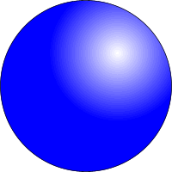
Alkenes
sp² Hybridization Of Orbitals In Alkenes
The electronic configuration of a carbon atom is 1s²2s²2p²
Thus
2s²
2s¹
2p³
3 x sp²
2p
2p²
promotion
hybridization
Trigonal planar

Slide 5
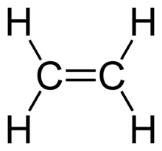
Alkenes
Orbital Overlap In Ethene
In ethylene (ethene), each carbon atom use an sp² orbital to form a single
C-C bond. Because of the two sp² orbitals overlap by end- to- end the resulting bond is called σ bond. The pi (π) bond between the two carbon atoms is formed by side- by-side overlap of the two unhybridized p- orbitals (2p–2p ) for maximum overlap and hence the strongest bond, the 2p orbitals are in line and perpendicular to the molecular plane.
This gives rise to the planar arrangement around C=C bonds. Also s orbitals of hydrogen atoms overlap with the sp² orbitals in carbon atoms to form two
C-H bonds with each carbon atom.
The resulting shape of ethene molecule is planar with bond angles of 120º and C=C bond length is 1.34 Å
5

Slide 6
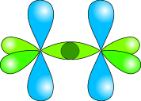
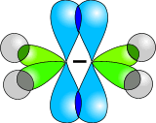
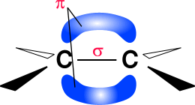
Alkenes
Orbital Overlap In Ethene
sp² hybridized carbon atoms
two sp² orbitals overlap to form a sigma bond between the two carbon atoms
two 2p orbitals overlap to form a pi bond between the two carbon atoms
s orbitals in hydrogen atoms overlap with the sp² orbitals in carbon atoms to form C-H bonds
the resulting shape is planar with bond angles of 120º and C=C (1.34 Å)
6

Slide 7
Nomencalture Of Alkenes And Cycloalkenes
Alkenes
1. Alkene common names:
Substituent groups containing double bonds are:
H₂C=CH– Vinyl group
H₂C=CH–CH₂– Allyl group
7

Slide 8
2. IUPAC Nomenclature Of Alkenes
Alkenes
Find the longest continuous Carbon chain containing the double bond this determines the root name then add the suffix -ene.
Number the C- chain from the end that is nearer to the double bond. Indicate the location of the double bond by using the number of the first atom of the double bond just before the suffix ene or as a prefix.
Indicate the positions of the substituents using numbers of carbon atoms to which they are bonded and write their names in alphabetical order (N.B. discard the suffixes tert-, di, tri,---when alphabetize the substituents) and if more than one substituent of the same type are present use the prefixes di- or tri or tetra or penta,--- to indicate their numbers.
8

Slide 9
Alkenes

Slide 10
Alkenes
In cycloalkenes the double bond carbons are assigned ring locations #1 and #2. Which of the two is #1 may be determined by the nearest substituent rule.
If the substituents on both sides of the = bond are at the same distance, the numbering should start from the side that gives the substituents with lower alphabet the lower number.
10

Slide 11
Alkenes
When the longer chain cannot include the C=C, a substituent name is used.

Slide 12
Geometrical Isomerism In Alkenes
Alkenes
G. I. found in some, but not all, alkenes
It occurs in alkenes having two different groups / atoms attached to each carbon atom of the = bond
G. I. x G. I. X G. I.  G. I. 
A=C or B=D
No Cis or transe
(G. I. X)
A≠C B≠D,
A =B or C=D Cis / A =D or C= B transe
G. I. 
12

Slide 13
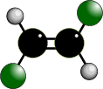
Alkenes
Geometrical Isomerism In Alkenes
It occurs due to the Restricted Rotation of C=C bonds so the groups on either end of the bond are ‘fixed’ in one position in space; to flip between the two groups a bond must be broken.
Geometrical isomers can not convert to each at room temperature.

Slide 14
Alkenes
Types Of Geometric Isomerism
A) Cis / trans isomerism in alkenes
Exhibited by alkenes having two H’s and two other similar groups or atoms attached to each carbon atom of the = bond (or generally the alkene have only two types of atom or groups i.e. ABC=CAB)
Cis prefix used when hydrogen atoms on both carbon atoms are on the SAME side of C=C bond
Trans prefix used when non-hydrogen groups / atoms are on the opposite sides of C=C bond
14

Slide 15
Alkenes
Cis
Groups / atoms are on the
Same Side of the double bond
Trans
Groups / atoms are on Opposite Sides across the double bond
15

Slide 16
Alkenes
B) Z/ E isomerism in alkenes
If the groups attached to the C=C are different, we distinguish the two isomers by adding the prefix Z (from German word Zusammen) if the higher-priority groups are together in the same side or E (from German word Entgegen) if the higher-priority groups are opposite sides depending on the atomic number of the atoms attached to each end of the C=C.
Atoms with higher atomic numbers receive higher priority
I> Br > Cl > F > O > N > C > H

Slide 17
Alkenes

Slide 18
Exercise
Alkenes
Q1-Which of the following compounds can exhibit cis / trans isomerism
2-Methylpropene
1-Butene
2-Methyl-2-pentene
2-Butene
3-Methyl-2-hexene
Q2- Name the following compounds according to IUPAC system
18

Slide 19
Alkenes
E-3-Methyl-2-pentene

Slide 20
Physical Properties of Alkenes
Alkenes
Alkenes are nonpolar compounds thus:
Insoluble in water
Soluble in nonpolar solvents ( hexane, benzene,…)
The boiling point of alkenes increase as the number of carbons increase.
20

Slide 21
Preparation Of Aalkenes
Alkenes
1- Dehydration of alcohols ( removal of OH group and a proton from two adjacent carbon atoms ) using mineral acids such as H₂SO₄ or H₃PO₄
21

Slide 22
Alkenes
Zaitsev’sRule
If there are different protons can be eliminated with the hydroxyl group or with halogen atom, in this case more than one alkene can be formed, the major product will be the alkene with the most alkyl substituents attached to the double bonded carbon.
Zaitsev rule: an elimination occurs to give the most stable, more highly substituted alkene
22

Slide 23
Alkenes
2- Dehydrohalogenation of alkyl halides using a base
or NaOH
23

Slide 24
Alkenes
3. Dehalogenation of vicinal dihalides
For example: Dehalogenation of 1,2-Dibromobutane leads to the formation of 1-Butene. In the presence of catalyst.

Slide 25
Reactions Of Alkenes
Alkenes
25

Slide 26
Alkenes
An electrophile, an electron-poor species,(from the Greek words meaning electron loving). It is a species (any molecule, ion or atom) that accept a pair of electrons to form a new covalent bond.
A nucleophile, an electron-rich species, ,(from the Greek words meaning nucleus loving). It is a species (any molecule, ion or atom) that donate an electron pair to form a new covalent bond.

Slide 27
Alkenes
Electrophilic Addition Reaction
1- Additions To The Carbon-Carbon Double Bond
1.1 Addition Of Hydrogen: Hydrogenation
Cis-1,2-Dimethyl cyclohexane

Slide 28
Alkenes
1.2.Addition of Halogens( Halogenation)
28
Trans-1,2- Dibromo-1,2-Dimethyl cyclohexane

Slide 29
Alkenes
1.3. Addition of Hydrogen Halides
Only one product is possible from the addition of these strong acids to symmetrical alkenes such as ethene, 2-butene and cyclohexene.
However, if the double bond carbon atoms are not structurally equivalent, i.e. unsymmetrical alkenes as in molecules of 1- propene, 1-butene, 2-methyl-2-butene and 1-methylcyclohexene, the reagent may add in two different ways to give two isomeric products. This is shown for 1-propene in the following equation.
29

Slide 30
Alkenes
Stability of carbocation
30

Slide 31
Alkenes
However when the addition reactions to such unsymmetrical alkenes are carried out, it was found that 2-bromopropane is nearly the exclusive product. Thus it said the reaction proceeded according to Markovnikov’s rule
Markovnikov’s rule stats that : In addition of unsymmetrical reagent to unsymmetrical alkenes the positive ion adds to the carbon of the alkene that bears the greater number of hydrogen atoms and the negative ion adds to the other carbon of the alkene.

Slide 32
1.4. Addition of HOX halogen in aqueous solution ( ⁻OH, X⁺): Halohydrin formation
Alkenes
Only one product is possible from the addition of HOX acids (formed from mixture of H2O and X2) to symmetrical alkenes such as ethene and cyclohexene.
32

Slide 33
Alkenes
However, addition reactions to unsymmetrical alkenes will result in the formation of Markovonikov’s product preferentially.

Slide 34
Alkenes
1.5. Addition of H₂O: Hydration
Only one product is possible from the addition of H₂O in presence of acids as catalysts to symmetrical alkenes such as ethene and cyclohexene.
However, addition reactions to unsymmetrical alkenes will result in the formation of Markovonikov’s product preferentially.
34

Slide 35
Alkenes
Oxidation Reaction:
1- Ozonolysis (Oxidative cleavage):
This reaction involves rupture of the C=C to give aldehydes or ketones according to the structure of the original alkene.
35

Slide 36
Alkenes
2- Oxidation with KMnO₄ (Oxidative addition):
Cis- doil
36

Slide 37
Thank You for your kind attention !
Alkenes
Questions?
Comments

