Slide 1
Practice Review Family and Friends 2 Grade 2 Unit 7 Dinnertime!

Slide 2
Lesson 1 Exercise 1
Hi, my name is Khalid. I have got meat, carrots and rice.
Hi, my name is Mariam. I have got fish, yogurt, carrots and bread.
Read and tick (√) or cross ( X)
meat | yogurt | fish | carrots | rice | bread
√

Slide 3
Lesson 1 Now check your answers Exercise 1
Hi, my name is Khalid. I have got meat, carrots and rice.
Hi, my name is Mariam. I have got fish, yogurt, carrots and bread.
Read and tick (√) or cross ( X)
Meat | Yogurt | Fish | Carrots | Rice | bread
√ |  |  | √ | √
 | √ | √ | √ |  | √

Slide 4
Ex. 2 Read and write the correct answer.
Hi, my name is Khalid. I like meat and rice.
I don’t like yogurt.
Hi, my name is Mariam. I like fish and carrots.
I don’t like meat.
I like meat and ______ .
I don’t like _________.
I like fish and ______ .
I don’t like _________.

Slide 5
Now check your answers Ex. 2 Read and write the correct answer.
Hi, my name is Khalid. I like meat and rice.
I don’t like yogurt.
Hi, my name is Mariam. I like fish and carrots.
I don’t like meat.
I like meat and rice.
I don’t like yogurt.
I like fish and carrots.
I don’t like meat.

Slide 6
Lesson 2
Ex.1 Rearrange the sentences correctly.
1. like | Do | ? | apples| you
Do you like apples?
do. | I | Yes,
--------------------------------------------------------
3. bread? | you | like| Do
--------------------------------------------------------
4. don’t. | I | No,
--------------------------------------------------------

Slide 7
Lesson 2 Now check your answers
Ex.1 Rearrange the sentences correctly.
1. like | Do | ? | apples| you
Do you like apples?
do. | I | Yes,
Yes, I do.
3. bread? | you | like| Do Do you like bread?
4. don’t. | I | No,
No, I don’t.

Slide 8
Ex.2 Complete the sentences.
do like don’t Do
1. Do you like carrots?
Yes, I _______ .
2. _______ you ________ meat and rice ?
Yes, I ______ .
3. _______ you _______ meat?
No , I ______ .

Slide 9
Now check your answers Ex.2 Complete the sentences.
do like don’t Do
1. Do you like carrots?
Yes, I do.
2. Do you like meat and rice?
Yes, I do.
3. Do you like meat?
No , I don’t .

Slide 10
Lesson 3
Look at the picture and write the correct word.
Milk water juice tea hot chocolate
Do you like___________ ?
Do you like___________ ?
Do you like___________ ?
Do you like___________ ?
Do you like___________ ?

Slide 11
Lesson 3
Now check your answers 1. Look at the picture and write the correct word.
Milk water juice tea hot chocolate
Do you like milk?
Do you like tea?
Do you like juice?
Do you like water?
Do you like hot chocolate?

Slide 12
2.Look at the picture and write the correct word.
Milk water juice tea hot chocolate
Do you like___________ or___________ ?
Do you like___________ or___________ ?
Do you like___________ or___________ ?

Slide 13
Now check your answers 2.Look at the picture and write the correct word.
Milk water juice tea hot chocolate
Do you like milk or tea?
Do you like juice or water?
Do you like tea or hot chocolate?

Slide 14
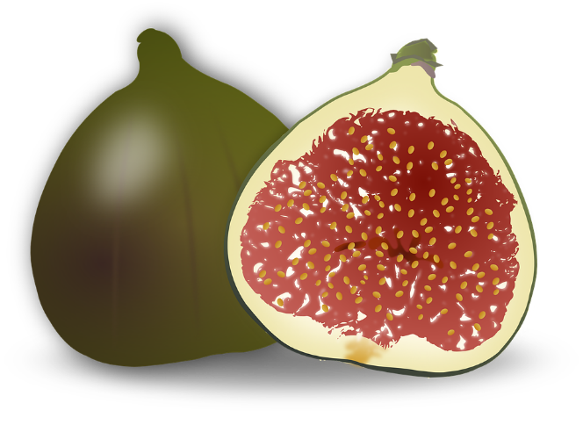
Lesson 4
1.Order the letters to form the word.
int
ibn
__________
__________
gif
sxi
__________
__________

Slide 15
Lesson 4
Now check your answers 1.Order the letters to form the word.
int
ibn
tin
bin
gif
sxi
fig
six

Slide 16
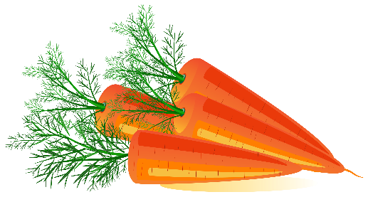
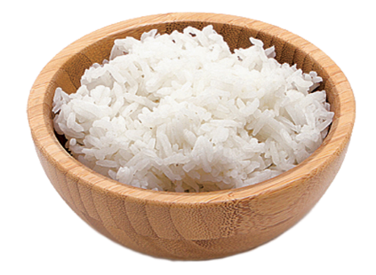
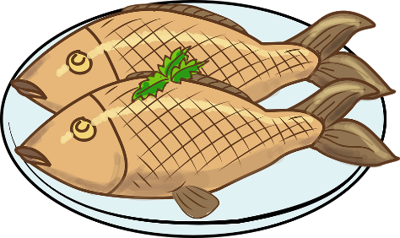
Lesson 5
Complete the questions and write yes, I do Or No, I don’t.
1
2
3
4
Do you like _____________ ? ________________.
Do you like _____________ ? ________________.
Do you like _____________?_________________.
Do you like _____________?_________________.

Slide 17
Lesson 5 Now check your answers
Complete the questions and write yes, I do Or No, I don’t.
1
2
3
4
Do you like milk? Yes, I do.
Do you like rice? No, I don’t.
Do you like carrots? Yes, I do.
Do you like fish? No, I don’t.

Slide 18
Skills Time
7
Lesson six
Writing
Write the short form.
I do not like rice.
Her hair is not long.
They are not circles.
This is not tea.
It is not his car.
_________________________________________________________________________________________________________________________________________________
Ministry of Education-2020

Slide 19
Skills Time
7
Lesson six
Writing
Write the short form.
I do not like rice. I don’t like rice.
Her hair is not long. Her hair isn’t long.
They are not circles. They aren’t circles.
This is not tea. This isn’t tea.
It is not his car. It isn’t his car.
_________________________________________________________________________________________________________________________________________________
Ministry of Education-2020

Slide 20
Skills Time
7
Lesson six
Writing
2- What do you like? What don’t you like? Read and tick (√ ) or cross (×)
bananas
yogurt
rice
egg
carrots
pears
cherries
bread
fish
tomatoes
apples
meat
I like …………….
I don’t …………….
_________________________________________________________________________________________________________________________________________________
Ministry of Education-2020

Slide 21
7
Review
2 Find and circle the words. Then write
1
8
s | t | o | r | r | a | c
y | e | h | s | i | f | b
o | a | b | b | v | w | r
g | w | t | a | e | m | e
u | r | e | t | a | w | a
r | e | c | i | u | j | d
t | k | l | i | m | r | s
Carrots
2
7
2
6
4
5
_________________________________________________________________________________________________________________________________________________
Ministry of Education-2020

Slide 22
7
Review
2 Find and circle the words. Then write
1
s | t | o | r | r | a | c
y | e | h | s | i | f | b
o | a | b | b | v | w | r
g | w | t | a | e | m | e
u | r | e | t | a | w | a
r | e | c | i | u | j | d
t | k | l | i | m | r | s
8
Carrots
water
2
7
milk
juice
2
6
meat
bread
4
5
yogurt
fish
_________________________________________________________________________________________________________________________________________________
Ministry of Education-2020

Slide 23
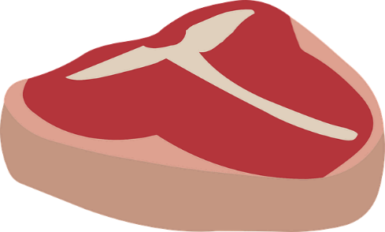
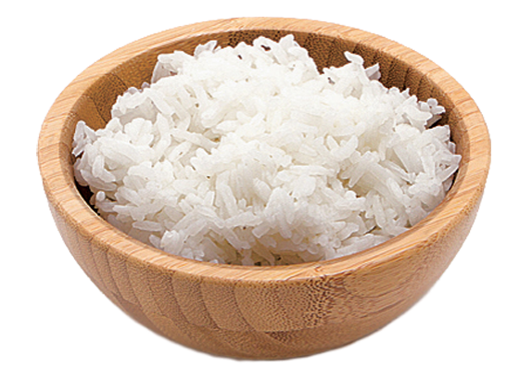
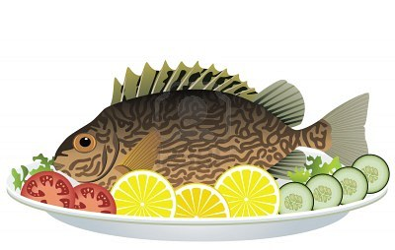
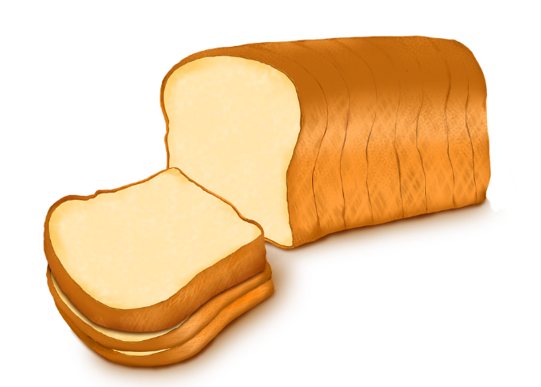
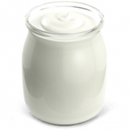
Review
7
Name the pictures:
_________________________________________________________________________________________________________________________________________________
Ministry of Education-2020

Slide 24
Review
7
Name the pictures:
rice
meat
carrots
yogurt
fish
bread
_________________________________________________________________________________________________________________________________________________
Ministry of Education-2020

Slide 25
Review
7
1- Write about you
Do you like rice? | I like rice. | I don’t like rice
Do you like yogurt?
Do you like fish?
Do you like carrots?
Do you like milk?
Do you like juice?
_________________________________________________________________________________________________________________________________________________
Ministry of Education-2020

