Slide 1
Family and Friends 2 Grade 2 Fluency Time & Fluency craft
P 62 - 63

Slide 2
Objectives
1- Read for comprehension.
2- Practice ordering food.
_________________________________________________________________________________________________________________________________________________
Ministry of Education-2020

Slide 3
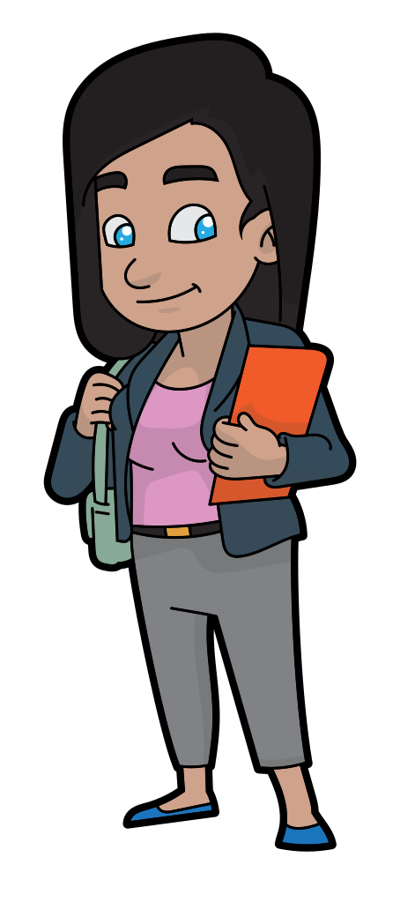
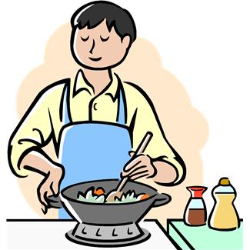
Look at the pictures and read.
2. I’d like rice and meat, please.
1. Can I help you?
3. Any thing else?
4. No, thanks. How much is it?
6. Thank you.
5. 1 dinnar, please
_________________________________________________________________________________________________________________________________________________
Ministry of Education-2020

Slide 4
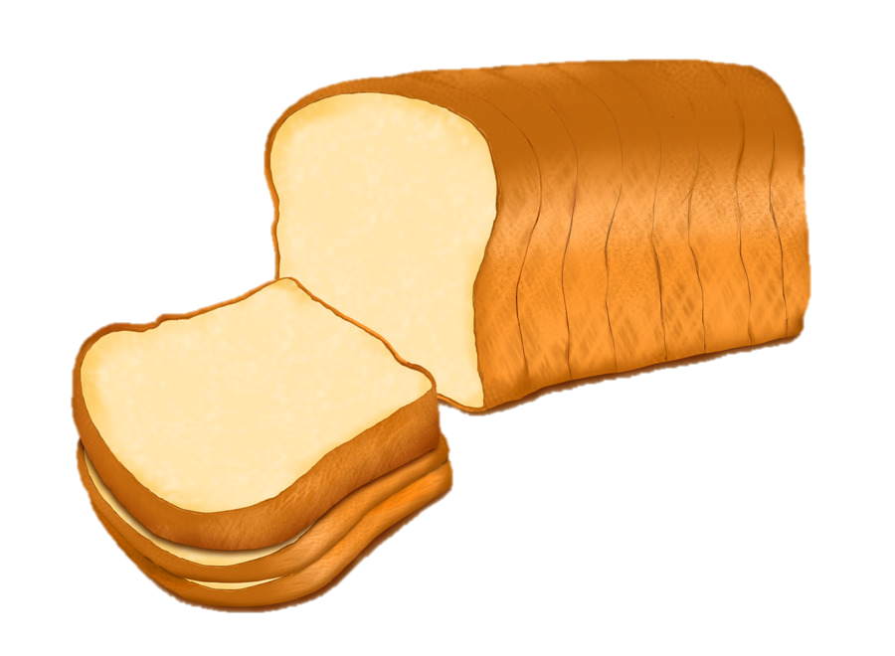
Look at the pictures and write.
rice and meat.
1- She would like ……………………
2- She wouldn’t like ………………..
fish and bread.
_________________________________________________________________________________________________________________________________________________
Ministry of Education-2020

Slide 5
Open your Class book
Page 62
Look at the pictures and read.
_________________________________________________________________________________________________________________________________________________
Ministry of Education-2020

Slide 6
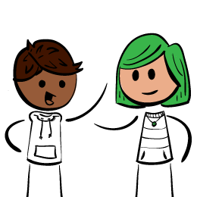
With your family or friends, ask and answer.
-Can I help you?
-I’d like three oranges, please.
-Anything else?
-No, thanks. How much is it?
_________________________________________________________________________________________________________________________________________________
Ministry of Education-2020

Slide 7
Fun Crafts !
Open your Class Book page 63.
Make a market stall.
Follow the instructions in the pictures.
_________________________________________________________________________________________________________________________________________________
Ministry of Education-2020

Slide 8
End of the Fluency lesson
_________________________________________________________________________________________________________________________________________________
Ministry of Education-2020

