Slide 1


University of Hail
Preparatory Year College
Medical Physics
PHYS121
Introduction to
Biological Physics
For The Health Life Science
Kirsten Franklin and others

Slide 2
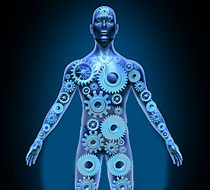
Mechanics
Part 1 - Ch. 4
statics

Slide 3
Objectives
To understand the concepts of static, dynamic, stable and unstable equilibrium.
To understand the concepts of torque.
To be able to solve lever problem using the concept of torque.

Slide 4
Topics to be covered
Introduction
Equilibrium
Torque
The principle of Moments
Center of Gravity/ Center of Mass, Stability
Stability

Slide 5
1- Introduction
Statics is the study of stability in systems.
Generally, we are primarily interested in the stability of an object or objects under the influence of gravity.
Statics is of center importance in biomechanics.
Statics also provides the basis for understanding the body shapes necessary to allow fish and other aquatic animals to remain upright while swimming.

Slide 6
2. Equilibrium
A system is said to be in equilibrium when the net force on that system is zero and the net torque on the system is also zero.
A system is in static equilibrium when it is in equilibrium and stationary.
A system is in dynamic equilibrium when it is in equilibrium and also in motion, which implies that the system is travelling at constant velocity and or rotating at a constant rate.

Slide 7
Equilibrium
A system is said to be in equilibrium when
Translational
Equilibrium
Rotational Equilibrium
Dynamic equilibrium
Static equilibrium
Net Force
(ΣF) = 0
Net Torque
(Σ τ) = 0

Slide 8
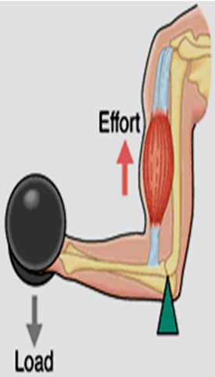
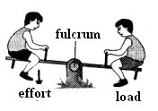
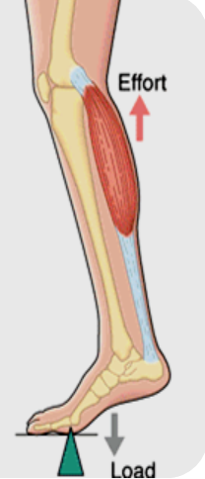
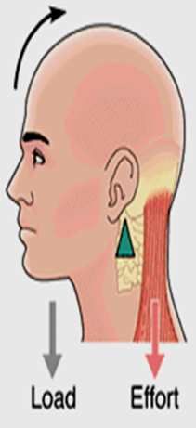
Static equilibrium occurs when
When seesaw is perfectly balanced
When you are
lifting something
Stands on tip toes
When lifting your head

Slide 9
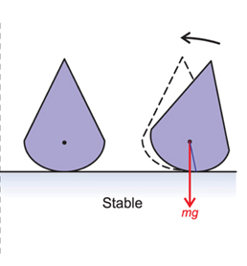
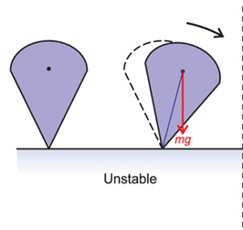
A system is in stable equilibrium if it will return to equilibrium after it has been small displacement.
A system is in an unstable equilibrium if it will not return to this equilibrium having been subject to a small displacement.

Slide 10
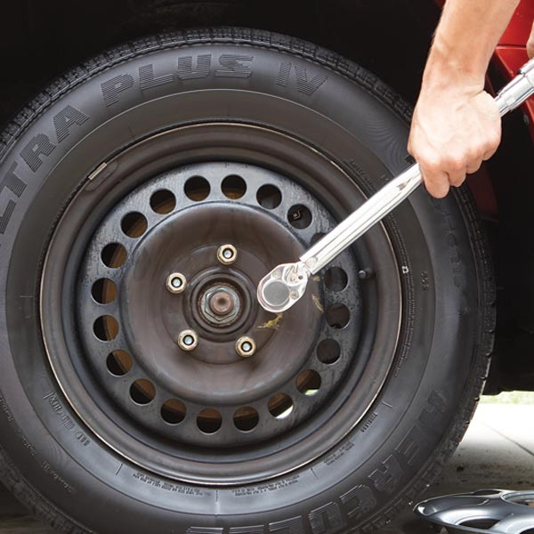
3. Torque
The physical quantity which causes an objects to begin rotate or move in a circle or (more generally) to change its rate of rotation, is a Torque (moment).
Note: Torque (moment) is not force.

Slide 11
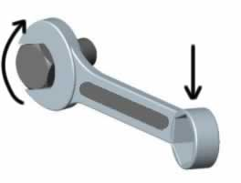
Torque depends on :
The applied force (F).
The force arm length (r).
The angle (θ) between force and force arm (usually = 90°).
F
θ
r
The force arm (r) is the distance between the axis of rotation (fulcrum) to the point of force application.
τ = F d sinθ
τ = F d only when angle is 90º
The units for torque is (Newton × meter) Nm

Slide 12
Torque is a measure of the force that can cause an object to rotate about an axis. Just as force is what causes an object to accelerate in linear kinematics, torque is what causes an object to acquire angular acceleration.
Torque is a vector quantity. The direction of the torque vector depends on the direction of the force on the axis (Right Hand Rule).

Slide 13
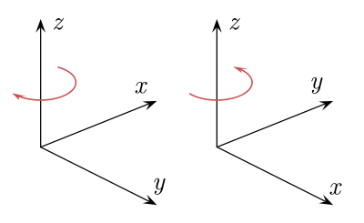
Right Hand Rule
When the rotation is counterclockwise; the torque is positive (according to the value of angle).
When the rotation is clockwise then the torque is negative (according to the value of angle).
-ve⬇
+ve ⬆

Slide 14
4. The Principle of moments
The principle of moments states that when in equilibrium the total sum of the anti clockwise moment is equal to the total sum of the clockwise moment.
When a system is stable or balance it is said to be in equilibrium as all the forces acting on the system cancel each other out.
In equilibrium
Total Anticlockwise Moment = Total Clockwise Moment

Slide 15
The direction of the rotation is depending on the applied force in clockwise (cw) or counterclockwise (ccw). At equilibrium all torques are balanced so that net torque equal zero i.e.
Σ τ_{(cw)} = Σ τ_{(ccw)}
or Σ F_{cw} d_{cw} = Σ F_{ccw} d_{ccw}
or shortly F₁d₁=F₂d₂
This condition is called the principal of moments

Slide 16
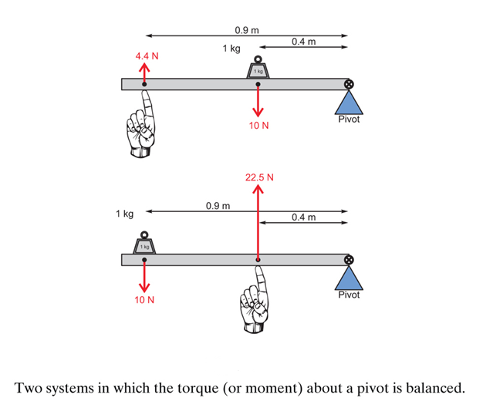
the principal of moments
Σ F_{cw} d_{cw} = Σ F_{ccw} d_{ccw}

Slide 17
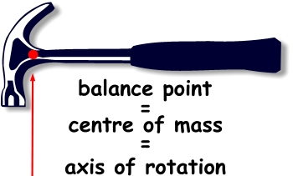
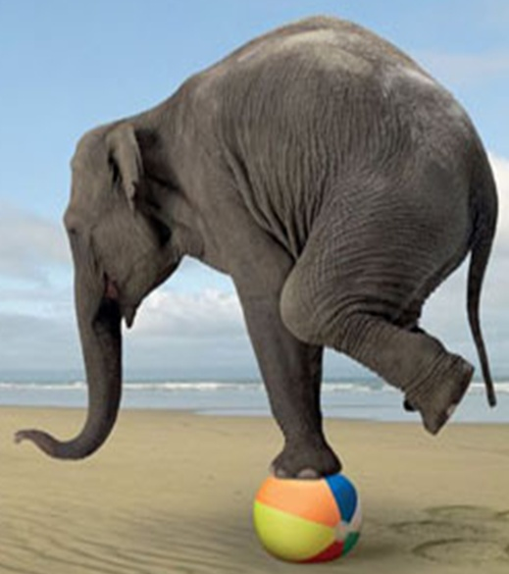
5. The center of gravity (C.G)
C.G

Slide 18
In the previous condition we ignore the mass body. But the force will produce a torque not ignore, at equilibrium, this force will be the gravitational force (weight), so the mass must be known.
For the purpose of calculations we can deal with the body of mass (w) as a point with mass w concentrated at point.
This point called center of mass or center of gravity; is the point at which the object's whole mass can be considered to be concentrated.

Slide 19
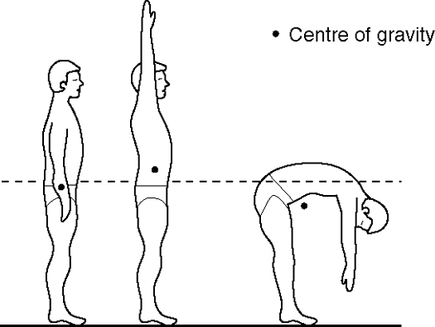
symmetric objects
The centers of gravity of symmetric objects are their geometrical centers

Slide 20
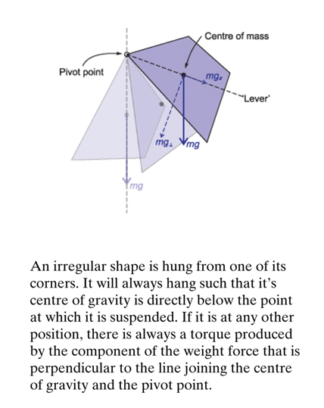
Asymmetric objects

Slide 21
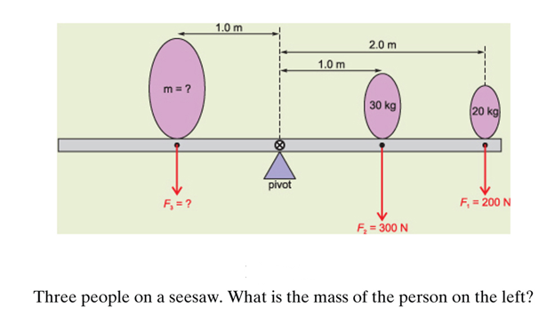
1- Example (the principal of moments)

Slide 22
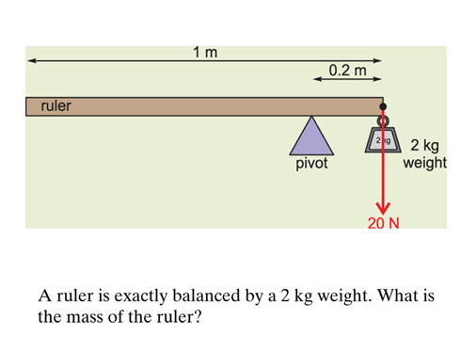
2- Example (the principal of moments)
Solve by yourself

Slide 23
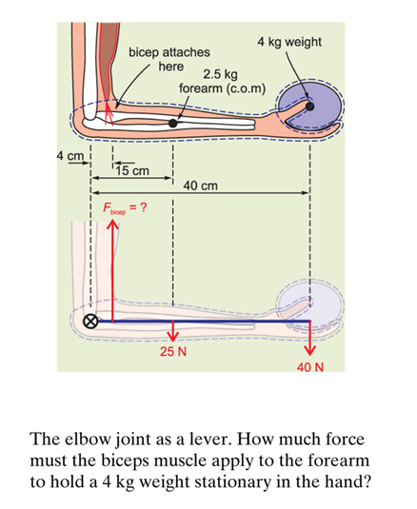
3- Example (the principal of moments)

Slide 24
The bar is in equilibrium
Net Torque (Σ τ) = 0

Slide 25
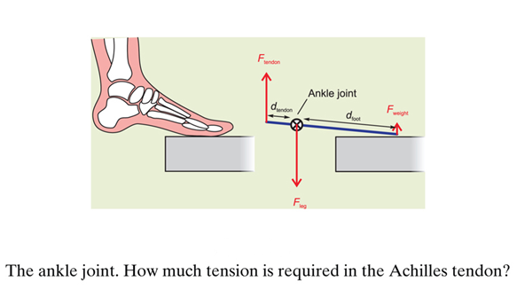
4- Example (the principal of moments)
A diver weighing 80 kg stands on the very edge of a diving board. The diver’s foot is 20 cm. The articulates about the joint located 4 cm from the heel. Assume that the only contact between the foot and the diving board occurs at the very end of the foot 16 cm from the ankle joint.

Slide 26
The total upward force is therefore 4000N. Since the ankle is stationary, this must be equal to the downward force exerted on the ankle joint. Note that this is equivalent to the weight of a 400 kg mass!!!!
It is surprising, these joints are often injured and have a tendency to wear out over time.

Slide 27
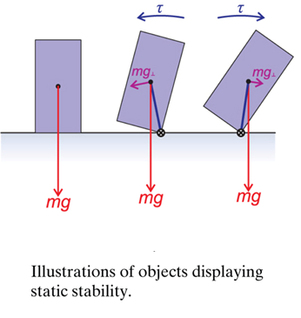
6. Stability
We now consider one final important application of the principle of moments and the center of gravity.
An object is STABLE if it will either remain in stable equilibrium indefinitely or will tend to move back to stable equilibrium when displaced, otherwise the object is called INSTABLE.
In general, static stability occurs when the vertical line through the object’s center of gravity passes through its base of support.

Slide 28
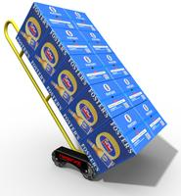
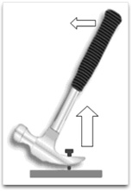
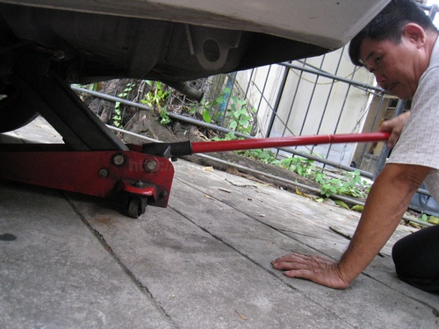
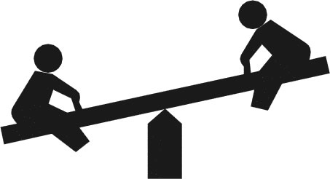
4-Levers and Mechanical advantage
What is a lever?
A lever is a device that applies force or transfers it.
A lever is a rigid bar that rotates about a fixed point enabling it to exert a force to move a load.
The use of levers create a mechanical advantage of strength & speed

Slide 29
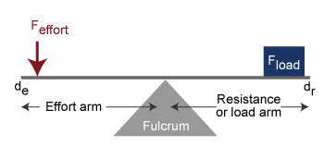
Levers
A lever is characterized by a fulcrum (F) , Load (L) and effort (E)
    Fulcrum = point of rotation
    Load = The force to overcome (resistance)
    Effort = Force exerted

Slide 30
Levers of the human body
Muscles move bones through mechanical leverage
As a muscle contracts, it causes the bone to act like a lever …..
How?
Bones serve as levers
Joints act as fulcrums
the contraction of the muscles are the effort
the body part concerned is the load or resistance which resists the pull of the muscle

Slide 31
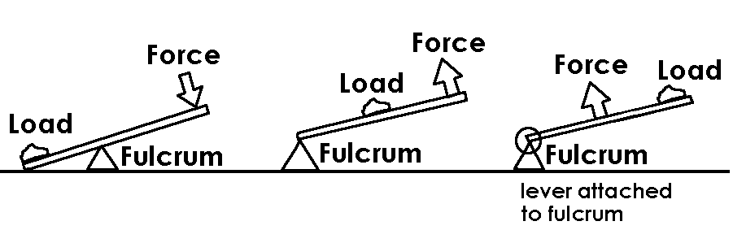
Types of levers
There are 3 types of levers; First, Second and Third class levers
Levers are classified according to the positions of the fulcrum, effort & load
The arrangement of these determines the mechanical advantage of strength & speed

Slide 32
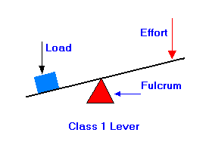
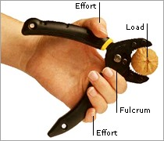
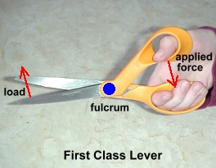
First class levers
The fulcrum is between the effort and the load

Slide 33
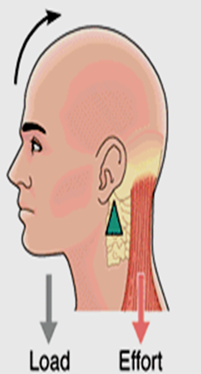
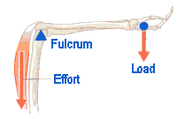
First class levers in the human body
Triceps extension
A small force can be used to advantage over a heavy weight if a long force arm is used.

Slide 34
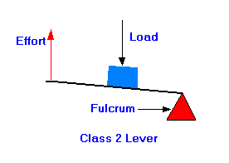
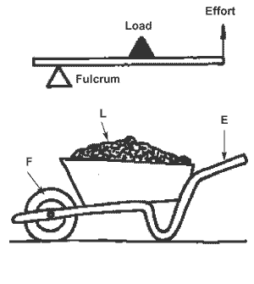
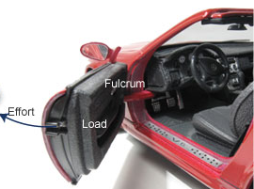
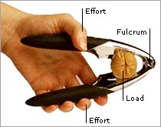
Second class levers
Load between fulcrum & effort

Slide 35


Second class levers in the human body
Push up
L
E
Calf raise
F
A smaller effort can be used to advantage over a larger weight. E.g. wheel barrow
Give advantage of strength

Slide 36
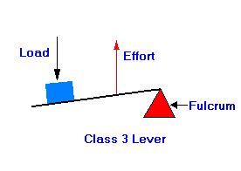
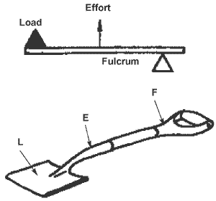
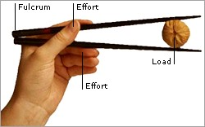
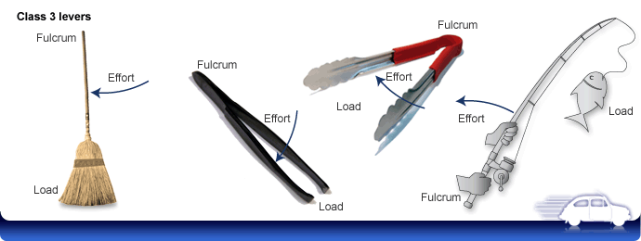
Third class levers
The force is between the fulcrum and the load

Slide 37
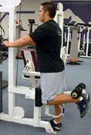
Third class levers in the human body
Bicep curl
Load
Effort
Fulcrum
Standing leg curl

Slide 38
Third class levers
Produce speed & range of motion movements
No force advantage
Requires a great deal of force to move even a small resistance
Most common in human body – most movements produced by third class levers
  therefore movements adapted more to speed

Slide 39
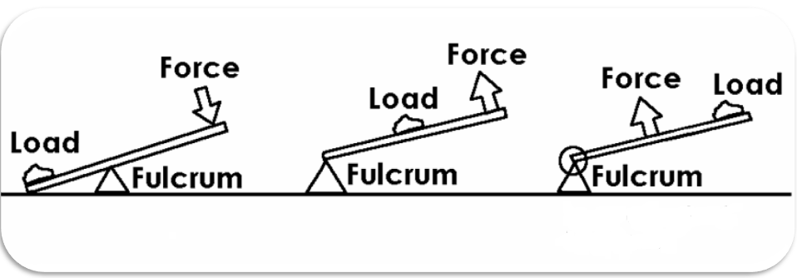
Mechanical Advantage (M A)
It is the ratio of force (effort) arm to resistance (load) arm
1st class: M.A can be >,<, or = 1
2nd class: M.A>1
3rd class: M.A<1

Slide 40
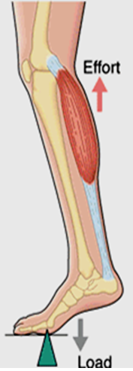
Summary of levers in the human body
In the human body, all bones act as levers and each joint can serve as a fulcrum.
  When lifting your head, your neck works as a first-class lever.
  When you stand on your toes, the foot acts as second-class lever.
  When you are lifting something, your arm works as a third-class lever.

Slide 41

Thank You
Questions?

