Slide 1
Super goal 3

Slide 2
Unit 4

Slide 3
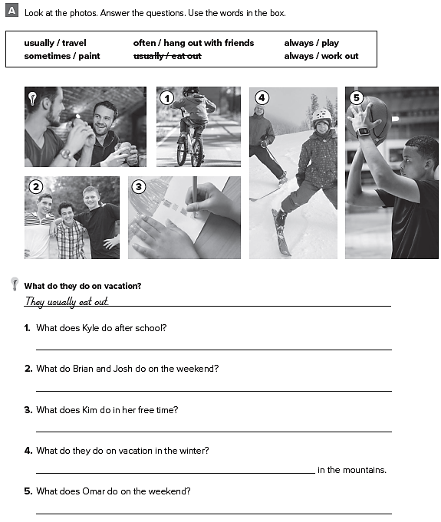
He always work out on his bike
They often hang out with friends
She sometimes paint
They usually travel and ski
He always play basketball

Slide 4
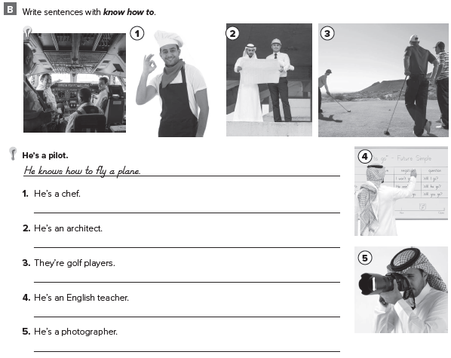
He knows how to cook
He knows how to design houses
They know how to play golf
He knows how to teach
He knows how to take photos

Slide 5
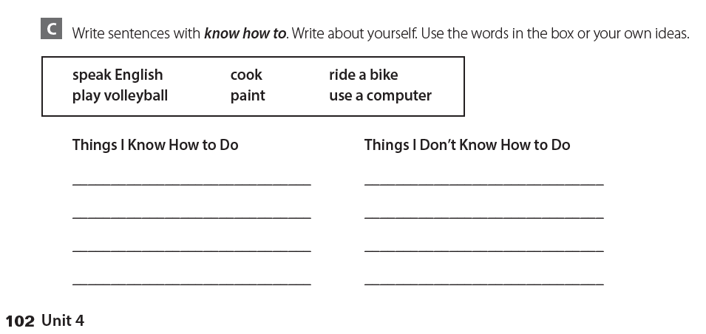
كل طالب يجيب عن نفسه

Slide 6
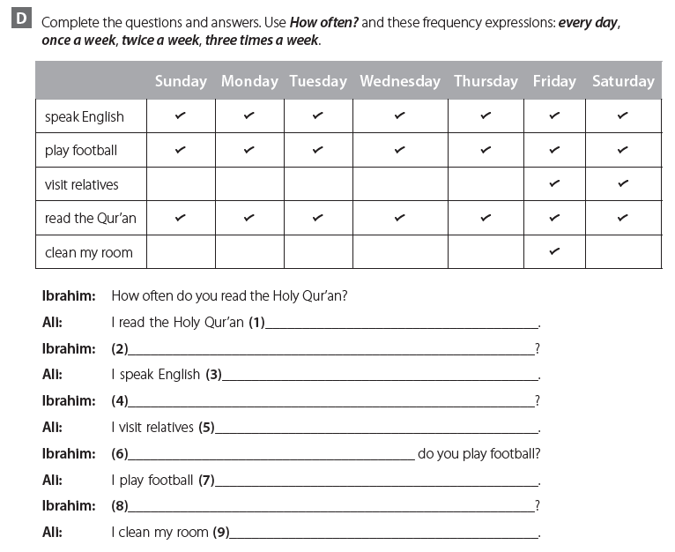
everyday
How often do you speak English
everyday
How often do you visit your relatives
twice a week
How often
everyday
How often do you clean your room
once a week

Slide 7
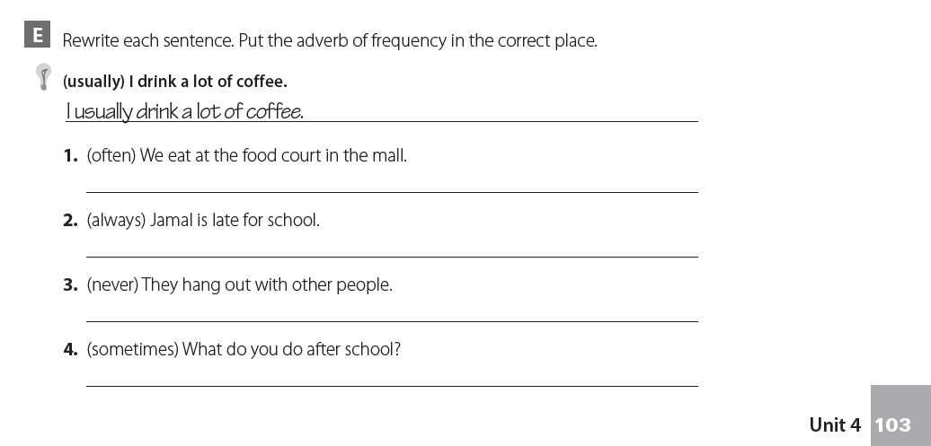
We often eat at the food court in the mall
Jamal is always late for school
They never hang out with other people
What do you sometimes do after school ?

Slide 8
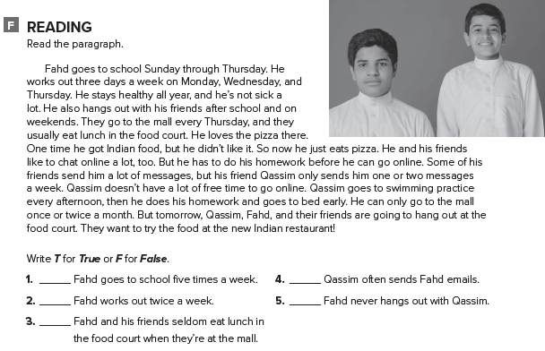
T
F
F
F
F

Slide 9
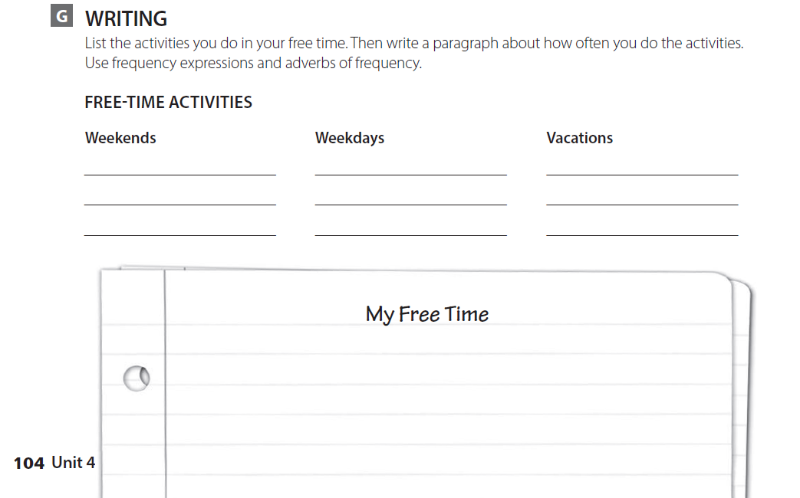
قم بكتابة مقال بسيط عن ما تفعله خلال وقت فراغك مع استعمال أدوات التكرار

Slide 10
expansion 1

Slide 11
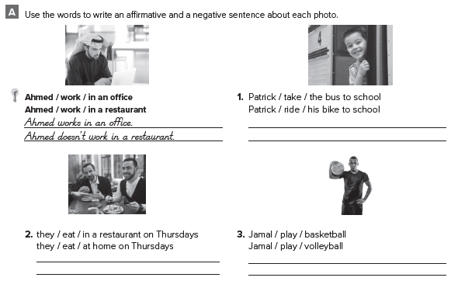
Patrick takes the bus to school
Patrick doesn’t ride his bike to school
They eat in the restaurant on Thursdays
They don’t eat at home on Thursdays
Jamal plays basketball
Jamal doesn’t play volleyball

Slide 12
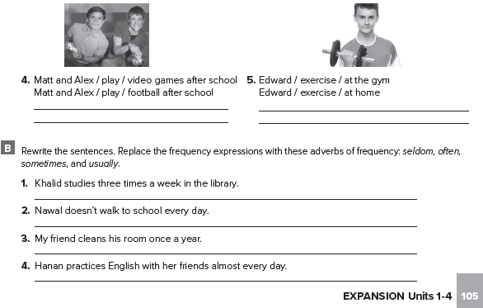
They play videogames after school
They don’t play football after school
Edward exercise at the gym
Edward doesn’t exercise at home
Khalid often studies in the library
Nawal never walks to school
My friend seldom cleans his room
Hanan always practices English with he friends

Slide 13
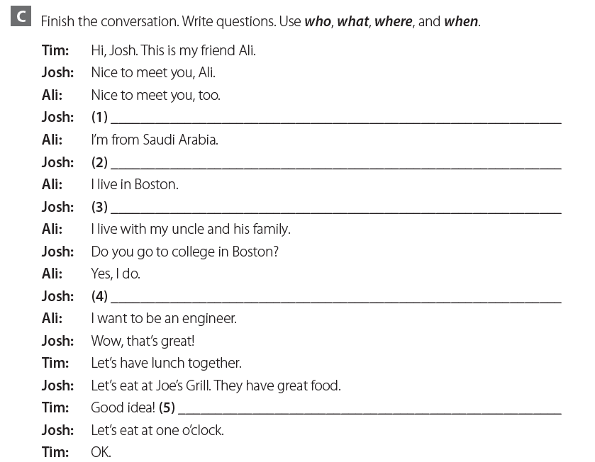
Where are you from ?
And where do you live ?
Who do you live with ?
What do you want to be ?
When ?

Slide 14
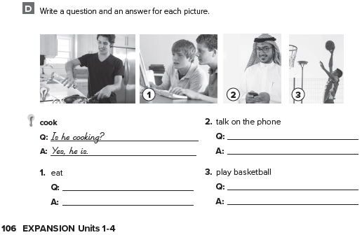
Is he talking on his phone ?
No , he is not
Are they eating ?
No , they are not
Are they playing basketball ?
Yes , they are

Slide 15
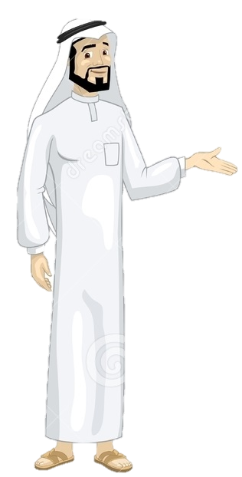
See you later
Take care
Teacher :
Badr Sayid Al-Shehri

