Slide 1
Family and Friends 2-Grade 2
Unit 8
Tidy up!
Lesson 2
Page 73

Slide 2
Objectives
1- Recall six bedroom objects.
2- Use there’s and there are in sentences.

Slide 3
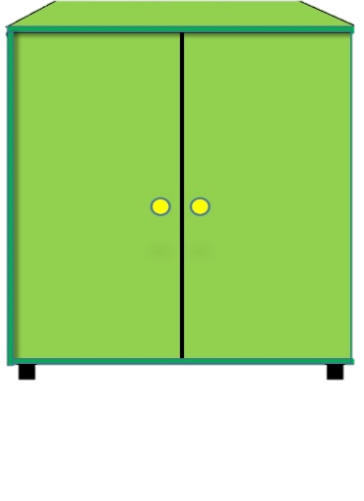
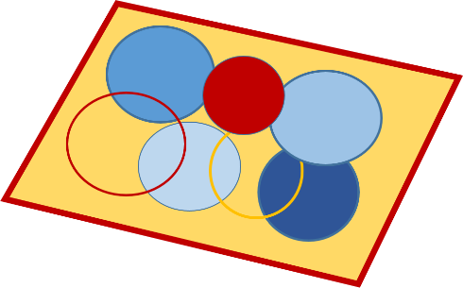
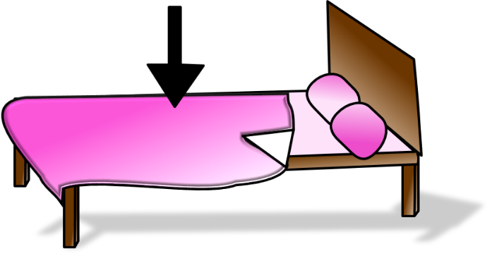
Let’s remember!
1
2
3
4
5
6

Slide 4
Let’s remember!
1
2
3
rug
bed
cupboard
4
5
6
shelf
pillow
blanket

Slide 5
Listen
If you have one item use ‘There’s’.
If you have more than one item use ‘There are’.

Slide 6
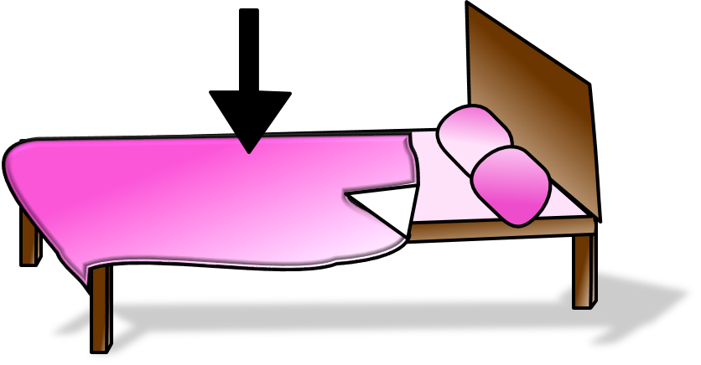
Listen and repeat
There’s a blanket.

Slide 7
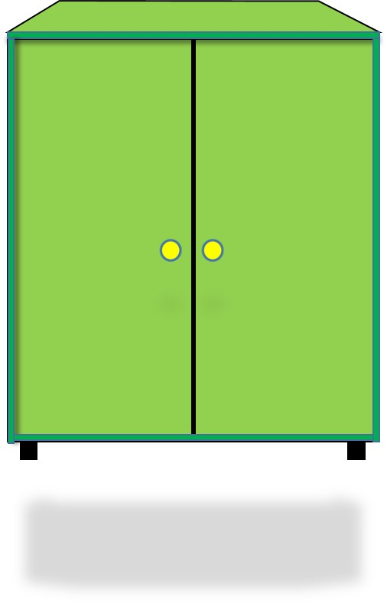
Listen and repeat
There’s a cupboard.

Slide 8
Listen and repeat
There’s a shelf.

Slide 9
Listen and repeat
There are three pillows.

Slide 10
Listen and repeat
There are two rugs.

Slide 11
Listen and repeat
There are three books.

Slide 12
Bring out your white boards and markers!
Let’s practice!
____________________________________________________________________________________________________________________________________
Ministry of Education-2020

Slide 13
Look at the picture and write on your mini-board (There’s) or (There are).
There’s
There are
a rug

Slide 14
Look at the picture and write on your mini-board (There’s) or (There are).
There’s
There are
three books

Slide 15
Look at the picture and write on your mini-board (There’s) or (There are).
There’s
two beds
There are

Slide 16
Look at the picture and write on your mini-board (There’s) or (There are).
There’s
a pillow
There are

Slide 17
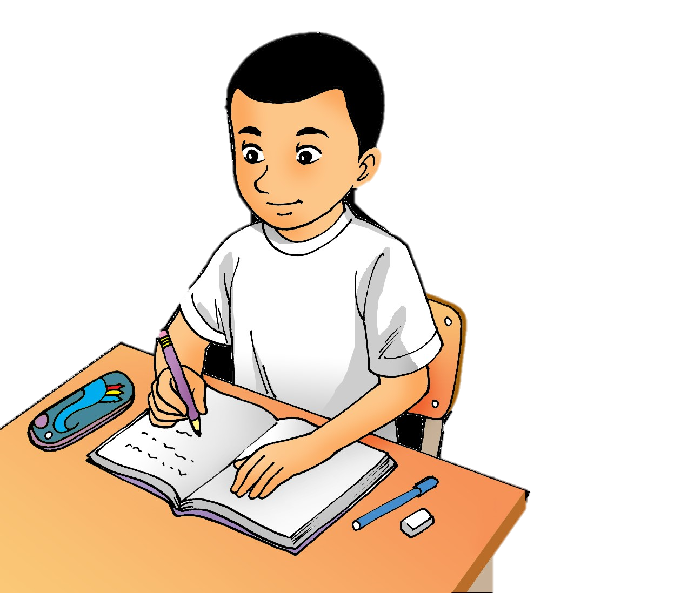
Write four sentences about what you have in your bedroom using ( there’s) and (there are).

Slide 18
Open Page 71 of your Workbook. Answer questions 1 and 2.
Question 1
Order the words.
1- There’s
2- There are
3- there are
4- there’s
click and check your answer

Slide 19
Open Page 71 of your Workbook. Answer questions 1 and 2.
Question 2
Write.
click and check your answer
1- There’s 2- There are
3- There are 4- There are
5- There are 6- There’s

Slide 20
Don’t forget to answer the questions
in the practice PPT for L2.

Slide 21
End of the
lesson!

